Slide 1
Honeywell PM8088 performance tuning
Jun 25, 2014
Proprietary and Confidential – Disclosed under NDA

Slide 2
Content
Observation
Question
Next step

Slide 3
Observation
Summary
The libc library is heavily called, need deeper analyze
Some new image file been found in log, need to understand the new work flow
Need system log for the “receive and forward without saving” mode
The functionality for known processes are mostly changed
Need to read the source relating to heavily used functions
Need to review the modification for all released patches

Slide 4
Observation
Points
The libc-2.11.3.so used most CPU power, need to get deep into the symbol detail
Some new modules can have potential to be optimized
samples | % | image_name | app_name | symbol_name
72025 | 44.3239 | vmlinux | vmlinux | r4k_wait_irqoff
19074 | 11.7381 | vmlinux | vmlinux | __pastwait
17314 | 10.655 | libc-2.11.3.so | libc-2.11.3.so | /lib/libc-2.11.3.so
5506 | 3.3884 | vmlinux | vmlinux | __copy_user
2913 | 1.7926 | vmlinux | vmlinux | _raw_spin_unlock_irqrestore
2283 | 1.4049 | vmlinux | vmlinux | __do_softirq
1896 | 1.1668 | vmlinux | vmlinux | finish_task_switch
920 | 0.5662 | vmlinux | vmlinux | bnx2_poll_work
samples | % | image_name
129198 | 79.5079 | vmlinux
17314 | 10.655 | libc-2.11.3.so
4413 | 2.7157 | ONVIFAdaptor
2792 | 1.7182 | libpthread-2.11.3.so
2442 | 1.5028 | CPSModule
2411 | 1.4837 | StreamingServer
1336 | 0.8222 | rpc
1144 | 0.704 | libsys_api.so
695 | 0.4277 | oprofiled
370 | 0.2277 | libgcc_s.so.1

Slide 5
Observation
Points (continued)
Most used functions from ONVIFAdaptor
samples | % | image_name | app_name | symbol_name
328 | 0.2018 | ONVIFAdaptor | ONVIFAdaptor | __udivdi3
315 | 0.1938 | ONVIFAdaptor | ONVIFAdaptor | RTPReceptionStats::noteIncomingPacket()
287 | 0.1766 | ONVIFAdaptor | ONVIFAdaptor | BasicTaskSchedulerEpoll::SingleStep()
278 | 0.1711 | ONVIFAdaptor | ONVIFAdaptor | MultiFramedRTPSource::networkReadHandler1()
226 | 0.1391 | ONVIFAdaptor | ONVIFAdaptor | NVRH264Sink::addData()
186 | 0.1145 | ONVIFAdaptor | ONVIFAdaptor | __moddi3
178 | 0.1095 | ONVIFAdaptor | ONVIFAdaptor | MultiFramedRTPSource::doGetNextFrame1()
153 | 0.0942 | ONVIFAdaptor | ONVIFAdaptor | Groupsock::handleRead()
149 | 0.0917 | ONVIFAdaptor | ONVIFAdaptor | __divdi3
132 | 0.0812 | ONVIFAdaptor | ONVIFAdaptor | BufferedPacket::use()
112 | 0.0689 | ONVIFAdaptor | ONVIFAdaptor | ReorderingPacketBuffer::storePacket()
107 | 0.0658 | ONVIFAdaptor | ONVIFAdaptor | Groupsock::outputToAllMembersExcept()
105 | 0.0646 | ONVIFAdaptor | ONVIFAdaptor | RTPInterface::handleRead()
103 | 0.0634 | ONVIFAdaptor | ONVIFAdaptor | BasicHashTable::Iterator::next()
95 | 0.0585 | ONVIFAdaptor | ONVIFAdaptor | BufferedPacket::fillInData()
91 | 0.056 | ONVIFAdaptor | ONVIFAdaptor | RTPReceptionStatsDB::noteIncomingPacket()

Slide 6
Observation
Points (continued)
Most used functions from CPSModule
samples | % | image_name | app_name | symbol_name
389 | 0.2394 | CPSModule | CPSModule | StdPacketizer::SendH264Frame()
311 | 0.1914 | CPSModule | CPSModule | find_fit
131 | 0.0806 | CPSModule | CPSModule | coalesce
131 | 0.0806 | CPSModule | CPSModule | msb_adjust_headers_live
127 | 0.0782 | CPSModule | CPSModule | msb_put_one_frame_by_index
126 | 0.0775 | CPSModule | CPSModule | Streamer::HandleData1()
121 | 0.0745 | CPSModule | CPSModule | NetworkTask::ProcessData()
94 | 0.0578 | CPSModule | CPSModule | StdRelayConnector::WriteStream()
82 | 0.0505 | CPSModule | CPSModule | msb_bfree_new

Slide 7
Observation
Points (continued)
Most used functions from StreamServer
samples | % | image_name | app_name | symbol_name
629 | 0.3871 | StreamingServer | StreamingServer | RTPStream::Write()
239 | 0.1471 | StreamingServer | StreamingServer | OSMutex::RecursiveLock()
190 | 0.1169 | StreamingServer | StreamingServer | OSMutex::RecursiveUnlock()
147 | 0.0905 | StreamingServer | StreamingServer | RTPOverbufferWindow::CheckTransmitTime()
142 | 0.0874 | StreamingServer | StreamingServer | LogError()
131 | 0.0806 | StreamingServer | StreamingServer | RTPStream::UpdateQualityLevel()
128 | 0.0788 | StreamingServer | StreamingServer | OS::Milliseconds()
88 | 0.0542 | StreamingServer | StreamingServer | QTSServerInterface::LogError()
83 | 0.0511 | StreamingServer | StreamingServer | OSMutex::RecursiveTryLock()
77 | 0.0474 | StreamingServer | StreamingServer | UDPSocket::SendTo()
75 | 0.0462 | StreamingServer | StreamingServer | QTSSCallbacks::QTSS_Write()
71 | 0.0437 | StreamingServer | StreamingServer | atomic_add
65 | 0.04 | StreamingServer | StreamingServer | qtss_snprintf
54 | 0.0332 | StreamingServer | StreamingServer | RTPStream3GPP::AddSeqNumTimeMapping()

Slide 8
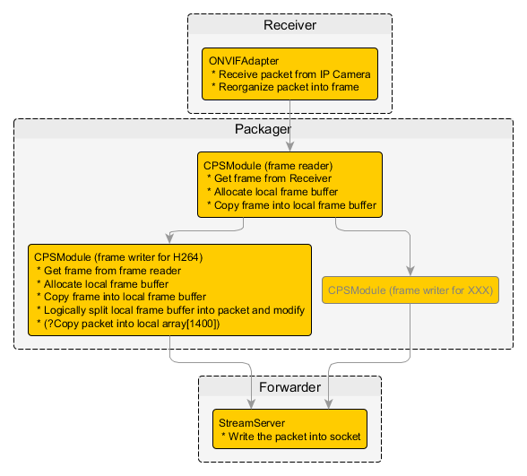
Question
Please confirm if the flow below is consistent with Honeywell’s latest code
Especially on the “Copy” related description

Slide 9
Next step
HON
Install "libc6-dev“ into system for analyzing the /lib/libc-2.11.3.so
Confirm the work flow mentioned in question and possibly add more detail
Gather oprofile data according to reviewed code
Gather system log according to reviewed code
onsite
Read the source relating to heavy used functions
Review the modifications according to all released patches
Discuss the optimize proposal for “Packager” memcpy flow

