Slide 1


Why Microservices Architecture for NearNook?
o
Building a Scalable, Flexible, and Future-Proof E-Commerce Platform
by Md Joynal

Slide 2
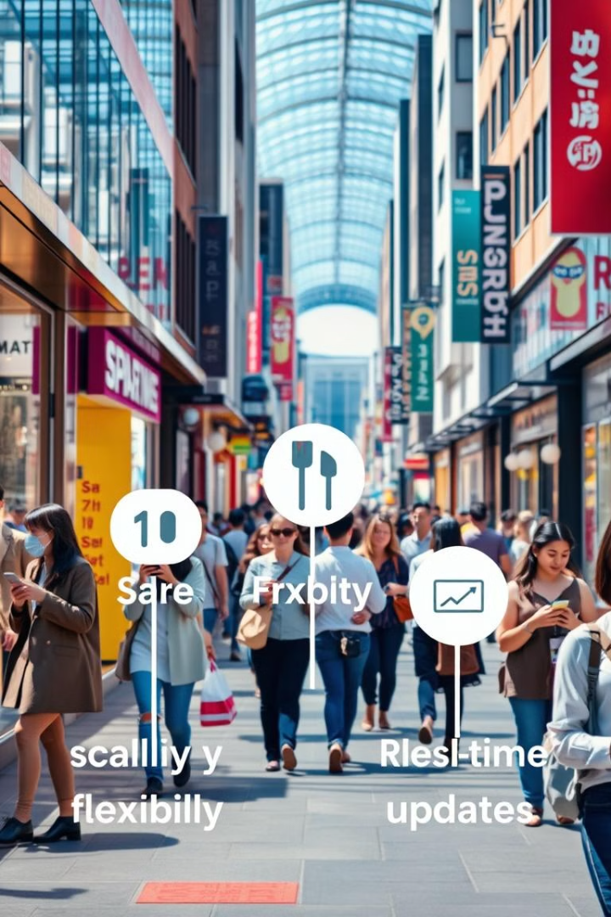
The Need for the Right Architecture
NearNook connects consumers with local shops
Manage high traffic and diverse features

Slide 3
Microservices Architecture Explained
Loosely coupled, independent services
Flexible Scaling , Technology Flexibility
Services communicate via APIs or message brokers

Slide 4
Scalability for Growing Demand
NearNook handles high traffic during peak seasons
Independent scaling of services
Ensures smooth performance during traffic spikes

Slide 5
Flexibility to Innovate
Use different technologies for different services
Node.js for real-time updates, Python for analytics
Easily add new features or update existing ones

Slide 6
Fault Isolation for Reliability
One service failure doesn’t affect others
If the payment service fails, users can still browse
Improves system reliability and user experience

Slide 7
Real-Time Updates with Event-Driven Communication
NearNook requires real-time updates for order tracking
Integrate with message brokers like Apache Kafka
Ensures users and merchants get real-time information

Slide 8
Faster Development and Deployment
Microservices allow independent deployment of services
Teams can work on different services simultaneously
Enables continuous integration and delivery (CI/CD)

Slide 9
Tech Stack for NearNook
Frontend: React.js (dynamic and responsive UI)
Backend: Node.js with Express (scalable APIs)
Database: MongoDB (flexible and scalable data storage)
Message Broker: Apache Kafka (event-driven communication)

