Slide 1

Customer Shopping Behavior Analysis
Analyzing 3,900 transactions across product categories to uncover spending patterns, customer segments, and strategic insights.

Slide 2
Dataset at a Glance
3,900
18
37
Purchases
Columns
Missing Values
Transactional records analyzed
Features per transaction
In Review Rating only
Customer Demographics
Purchase & Behavior
Age, Gender, Location, Subscription Status
Item, Category, Amount, Season, Size, Color, Discount, Shipping, Frequency, Review Rating

Slide 3

Data Preparation in Python
01
Load & Explore
Imported via Pandas; used df.info() and .describe() for structure and summary stats.
02
Clean Missing Data
Imputed missing Review_Rating values using median rating per product category.
03
Feature Engineering
Created age_group bins and purchase_frequency_days; dropped redundant promo_code_used.
04
Database Integration
Loaded cleaned DataFrame into SQL Server for structured analysis.

Slide 4
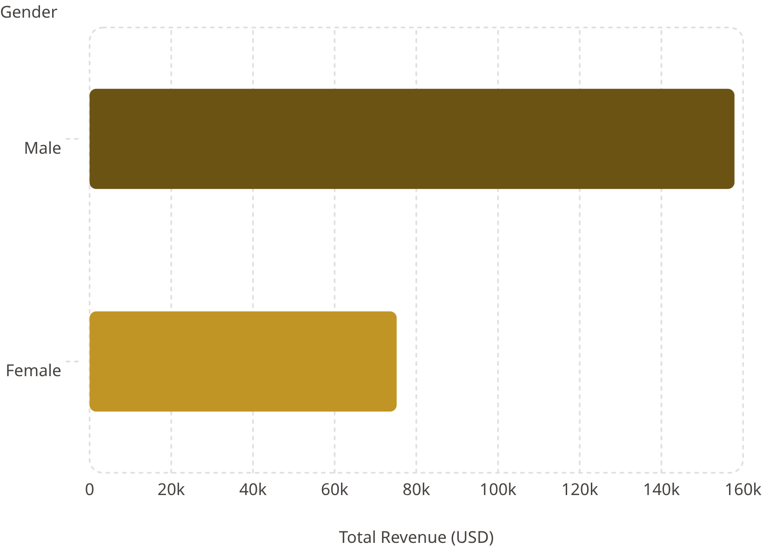
Revenue by Gender
Key Finding
Male customers generated $157,890 in total revenue — more than double female customers' $75,191. Males also represent the dominant gender in the dataset (2,652 of 3,900 customers).

Slide 5
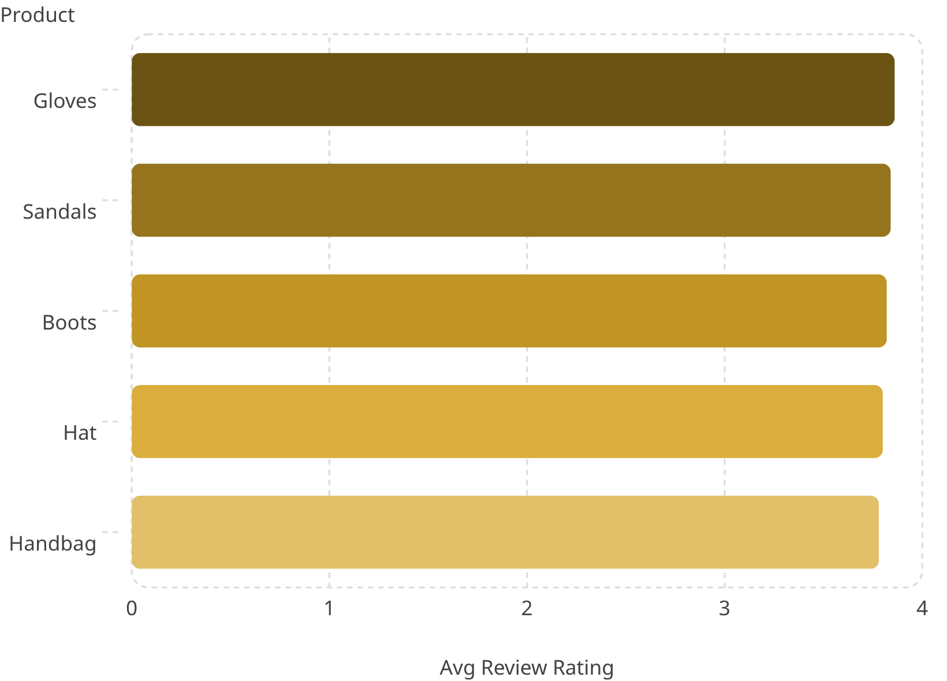

Product Ratings & Discount Dependence
Top 5 Products by Avg Rating
Most Discount-Dependent Products
Products with the highest percentage of discounted purchases:
Hat — 50%
Coat — 49%
Sneakers — 49%
Sweater — 48%
Pants — 47%
Hats lead both rating and discount dependence — a key campaign opportunity.

Slide 6
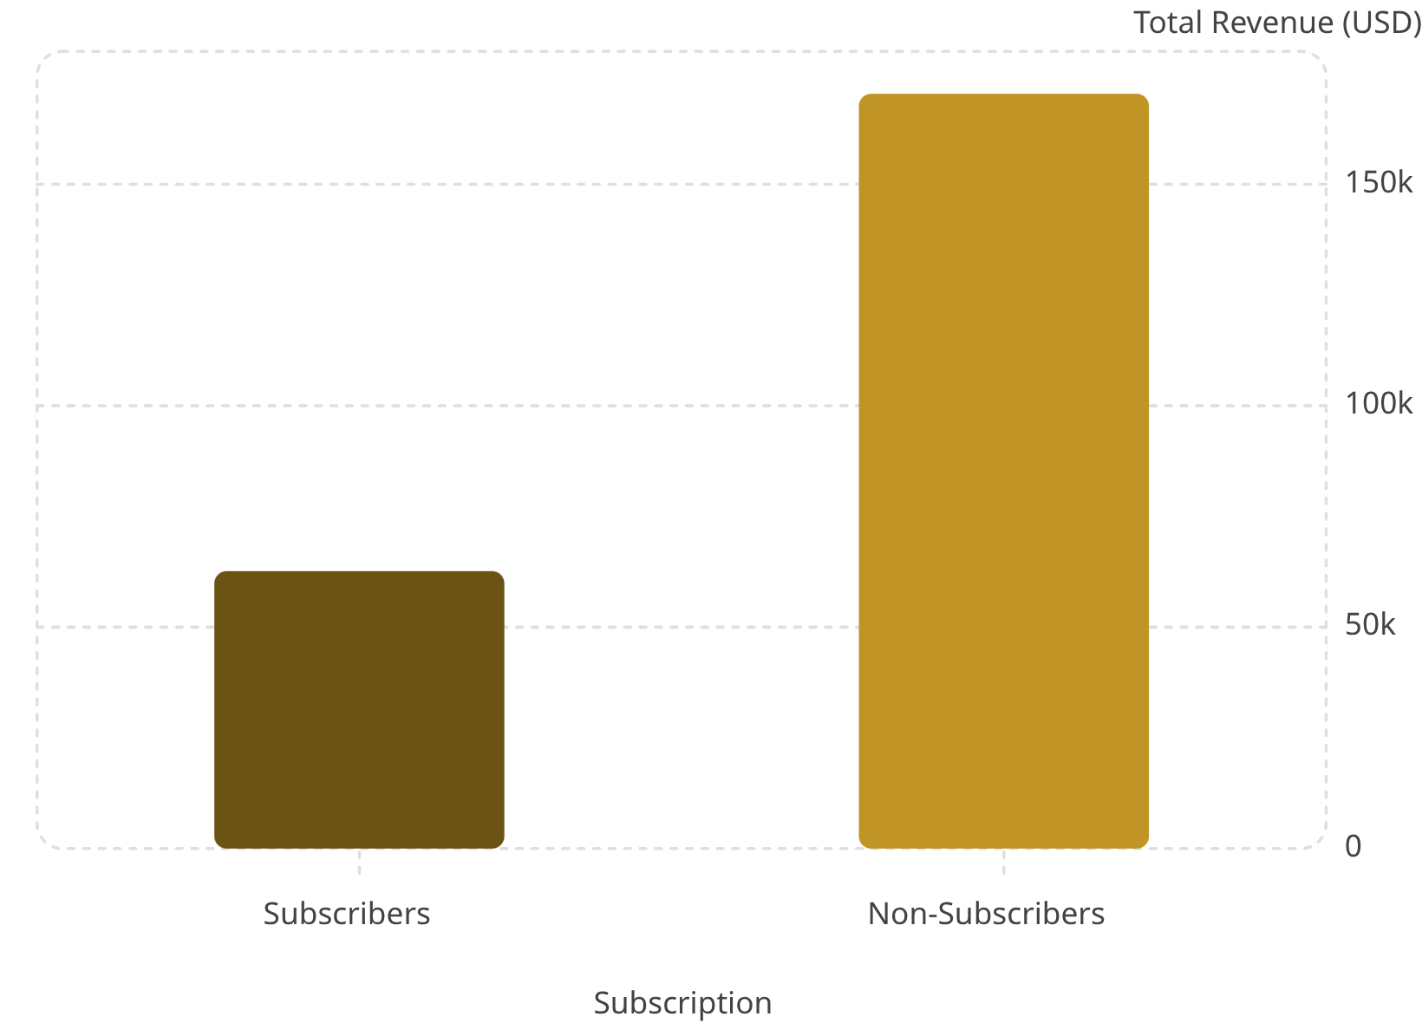
Subscription Behavior Insights
What the Data Shows
Subscribers make up only 27% of customers (1,053) vs. 73% non-subscribers (2,847), yet both groups share the same average spend of $59.
Among customers with more than 5 purchases: 958 are subscribers vs. 2,518 non-subscribers — indicating significant untapped subscription potential among repeat buyers.

Slide 7

Customer Segmentation
🆕 New
🔁 Returning
83 customers — First-time or low-frequency buyers with minimal purchase history.
701 customers — Repeat buyers showing growing engagement and purchase frequency.
⭐ Loyal
3,116 customers — The dominant segment; high-frequency buyers driving the majority of revenue.

Slide 8
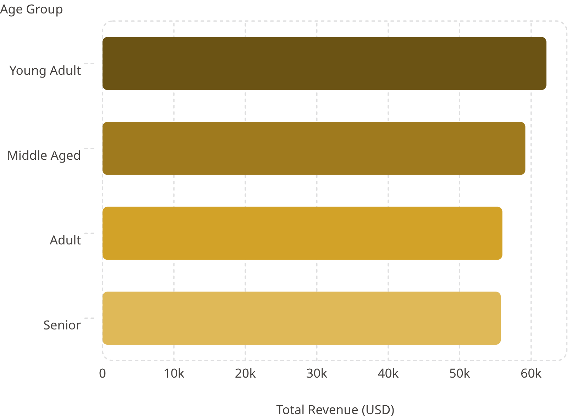
Revenue by Age Group
Age Group Breakdown
Young Adults lead revenue contribution at $62,143, followed by Middle Aged ($59,197), Adult ($55,978), and Senior ($55,763).
Revenue distribution is relatively balanced across age groups, suggesting broad product appeal across demographics.

Slide 9
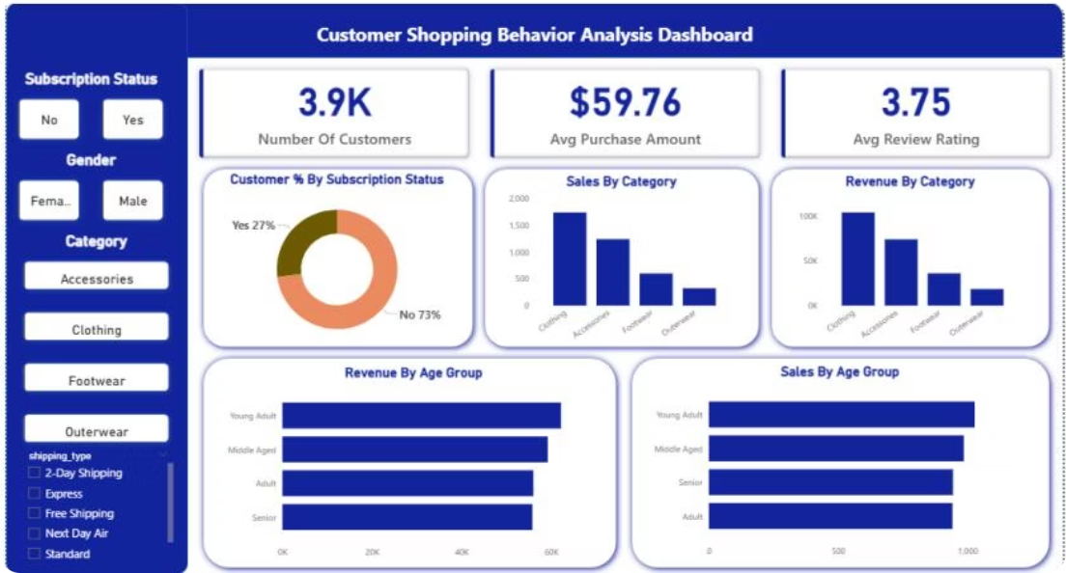
Power BI Dashboard
Interactive Dashboard Highlights
3.9K Customers
Filters
Visuals
Subscription, Gender, Category, Shipping Type
Sales & Revenue by Category and Age Group
Avg Purchase: $59.76 | Avg Rating: 3.75

Slide 10

Business Recommendations
Boost Subscriptions
Promote exclusive benefits to convert the 73% non-subscriber base.
Customer Loyalty Programs
Reward repeat buyers to move them into the "Loyal" segment.
Review Discount Policy
Balance sales boosts with margin control, especially for discount-dependent products.
Product Positioning
Highlight top-rated and best-selling products in campaigns.
Targeted Marketing
Focus on high-revenue age groups and express-shipping users.

