Slide 1
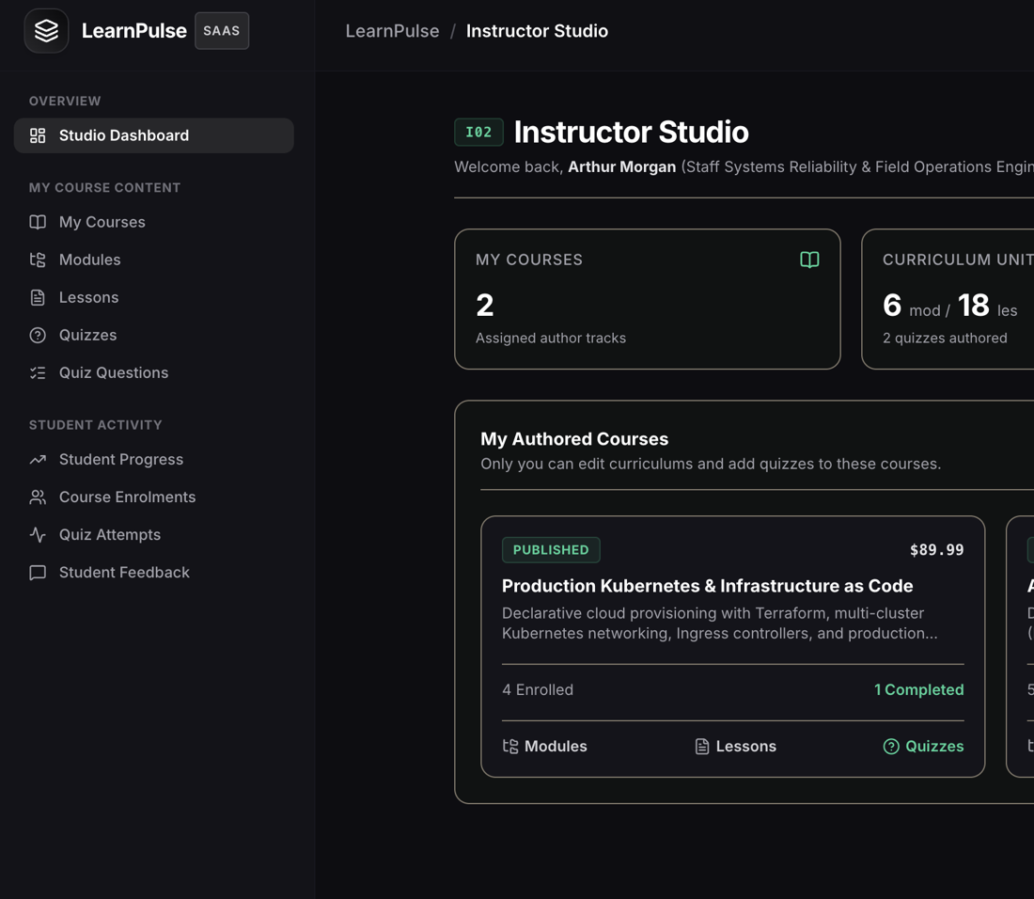
REVIEW - 2
Project 34:
Online Course Database Management System
By Joy Peswani
25WU0102110
Notes:
Review 2: normalized design, DDL, sample data and queries, plus a working prototype with Learner and Instructor modes.

Slide 2
Where we are
REVIEW 1
REVIEW 2
REVIEW 3
Done
This review
Next
Problem, scope, users
ER diagram
Initial schema (8 tables)
3NF schema, 13 tables
DDL, triggers, procedures
Sample data and SQL queries
Learner mode + Instructor mode
Admin mode (password protected)
Full CRUD on every table
Reports and SQL console
Final demo and testing
Notes:
Review 1 was design. Review 2 is the working database plus two of the three user modes. Admin mode comes in Review 3.

Slide 3
Relational schema (3NF)
People
Content
Assessment
Tracking
instructors
courses
quizzes
enrolments
instructor_id PK
course_id PK, instructor_id FK
quiz_id PK, course_id FK
enrolment_id PK, learner_id FK, course_id FK
learners
modules
questions
lesson_progress
learner_id PK
module_id PK, course_id FK
question_id PK, quiz_id FK
progress_id PK, enrolment_id FK, lesson_id FK
lessons
attempts
certificates
lesson_id PK, module_id FK
attempt_id PK, quiz_id FK, enrolment_id FK
certificate_id PK, enrolment_id FK
responses
feedback
response_id PK, attempt_id FK, question_id FK
feedback_id PK, enrolment_id FK
Notes:
Review 1 had 8 tables. To reach 3NF and cover the full brief, the design now has 13 tables in four groups.

Slide 4
Normalization: 1NF to 3NF
1NF
2NF
3NF
Atomic values
No partial dependency
No transitive dependency
Every column holds one value. Quiz options are stored as option_a to option_d, and each response is its own row in responses.
Non-key columns depend on the whole key. Enrolment details sit in enrolments, not repeated in lesson_progress or attempts.
Instructor details live only in instructors, referenced by instructor_id from courses. Course progress is calculated by views, not stored twice.
Notes:
Each step in plain words, with a concrete example from this schema.

Slide 5
Functional dependencies
Table | Functional dependency | Candidate keys
enrolments | enrolment_id -> learner_id, course_id, enrol_date, status | enrolment_id; (learner_id, course_id)
lessons | lesson_id -> module_id, title, duration, lesson_order | lesson_id; (module_id, lesson_order)
courses | course_id -> title, category, level, price, status, instructor_id | course_id
attempts | attempt_id -> enrolment_id, quiz_id, attempt_no, score | attempt_id; (enrolment_id, quiz_id, attempt_no)
lesson_progress | progress_id -> enrolment_id, lesson_id, progress_pct | progress_id; (enrolment_id, lesson_id)
certificates | certificate_id -> enrolment_id, certificate_code, issued_on | certificate_id; enrolment_id; certificate_code
Notes:
Every determinant is a candidate key, so each table meets 3NF (and BCNF).

Slide 6
Data dictionary (key columns)
Table.column | Type | Constraint | Description
learners.email | VARCHAR(100) | UNIQUE, NOT NULL, CHECK format | Login and contact address
courses.status | ENUM | DEFAULT 'draft' | draft, published or archived
enrolments.status | ENUM | DEFAULT 'Active' | Active, Completed or Dropped
enrolments (learner, course) | INT, INT | UNIQUE pair, both FK | One enrolment per course
lesson_progress.progress_pct | TINYINT | CHECK 0 to 100, DEFAULT 0 | Completion of one lesson
quizzes.max_attempts | INT | CHECK > 0, DEFAULT 3 | Attempt cap per quiz
attempts.score | INT | CHECK >= 0, trigger <= total | Marks earned in an attempt
questions.correct_option | ENUM('A'..'D') | NOT NULL | Answer key
feedback.rating | TINYINT | CHECK 1 to 5 | Learner rating
Notes:
A concise dictionary of the columns that carry business rules.

Slide 7
Business rules enforced in the database
One enrolment per course
CREATE TABLE enrolments (
enrolment_id INT AUTO_INCREMENT PRIMARY KEY,
learner_id INT NOT NULL,
course_id INT NOT NULL,
enrol_date DATE DEFAULT (CURRENT_DATE),
status ENUM('Active','Completed','Dropped')
NOT NULL DEFAULT 'Active',
UNIQUE (learner_id, course_id),
FOREIGN KEY (learner_id)
REFERENCES learners(learner_id),
FOREIGN KEY (course_id)
REFERENCES courses(course_id)
);
CREATE TABLE lesson_progress (
...
progress_pct TINYINT NOT NULL DEFAULT 0
CHECK (progress_pct BETWEEN 0 AND 100)
);
UNIQUE (learner_id, course_id)
Progress within 0 to 100
CHECK (progress_pct BETWEEN 0 AND 100)
Attempt limits
Trigger on attempts vs quizzes.max_attempts
Valid scores
CHECK (score >= 0) + trigger vs total marks
Completion criteria
Certificate trigger checks lessons and quizzes
Notes:
Rules live in the database, so no application bug can break them.

Slide 8
Triggers, procedures, views, indexes
Triggers
Stored procedures
Block extra quiz attempts. Block certificates unless the course is completed and quizzes passed.
enroll_learner, submit_quiz_attempt, complete_lesson, issue_certificate. Each runs in a transaction with rollback on error.
Views
Indexes
learner progress, course completion, dropout, quiz performance, certificate eligibility, instructor summary.
On email, course title and status, enrolment learner and course, attempt enrolment and quiz.
Notes:
Transactions use START TRANSACTION, COMMIT and ROLLBACK with error handlers.

Slide 9
Sample data
9
5
9
5
published courses
instructors
lessons in a full course (3 modules x 3)
questions per quiz, 20 marks each
Enrolments cover every status so the reports have something to show
Active
Completed
Dropped
Learners, lesson progress, quiz attempts with responses, certificates and feedback are spread over several months. Constraints reject duplicate enrolments, progress above 100 and extra quiz attempts.
Notes:
Seed data uses realistic names, courses and quizzes so every report returns meaningful rows.

Slide 10
SQL queries: joins and aggregation
1. Learner progress [JOIN]
2. Course completion rate [GROUP BY]
SELECT l.name, c.title, e.status,
COUNT(lp.lesson_id) AS lessons_done
FROM enrolments e
JOIN learners l ON l.learner_id = e.learner_id
JOIN courses c ON c.course_id = e.course_id
LEFT JOIN lesson_progress lp
ON lp.enrolment_id = e.enrolment_id
AND lp.progress_pct = 100
GROUP BY e.enrolment_id, l.name,
c.title, e.status;
SELECT c.title,
COUNT(*) AS enrolled,
SUM(e.status = 'Completed') AS completed,
ROUND(100 * SUM(e.status = 'Completed')
/ COUNT(*), 1) AS completion_pct
FROM courses c
JOIN enrolments e
ON e.course_id = c.course_id
GROUP BY c.course_id, c.title
HAVING COUNT(*) > 0;
Shows how many lessons each learner has finished in each course.
Shows enrolled, completed and completion percentage for every course.
Notes:
Query 1 is the learner progress report. Query 2 is completion rate per course.

Slide 11
SQL queries: subqueries and views
3. Certificate eligibility [nested subquery]
Views created
SELECT e.enrolment_id, l.name, c.title
FROM enrolments e
JOIN learners l ON l.learner_id = e.learner_id
JOIN courses c ON c.course_id = e.course_id
WHERE e.status = 'Completed'
AND e.enrolment_id NOT IN
(SELECT enrolment_id FROM certificates)
AND NOT EXISTS (
SELECT 1 FROM quizzes q
WHERE q.course_id = e.course_id
AND NOT EXISTS (
SELECT 1 FROM attempts a
WHERE a.enrolment_id = e.enrolment_id
AND a.quiz_id = q.quiz_id
AND a.score >= q.pass_marks));
vw_learner_progress
vw_course_completion
vw_dropout_report
vw_quiz_performance
vw_certificate_eligibility
vw_instructor_summary
Notes:
Certificate eligibility uses nested subqueries. The view packages it for reuse.

Slide 12
Prototype: three modes, one database
Learner mode
Instructor mode
Admin mode
Available
Available
Review 3
Browse course catalog and enrol
Track lessons and progress
Take quizzes within attempt limits
View and print certificates
Password-protected studio
Courses, modules, lessons, quizzes
Add, edit and delete content
Student progress and feedback
Password-protected
Every table, full CRUD
Reports and CSV export
SQL console
Notes:
Learner and Instructor modes are working now. Admin mode is added in Review 3.

Slide 13
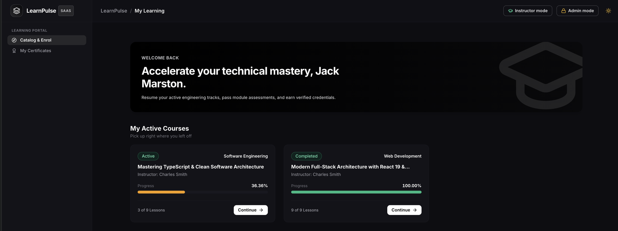
Learner mode: my learning
Progress bars and lesson counts come from the learner progress view. Completed and Active states match the enrolment status in the database.
Notes:
The learner sees active and completed courses with live progress from the database.

Slide 14
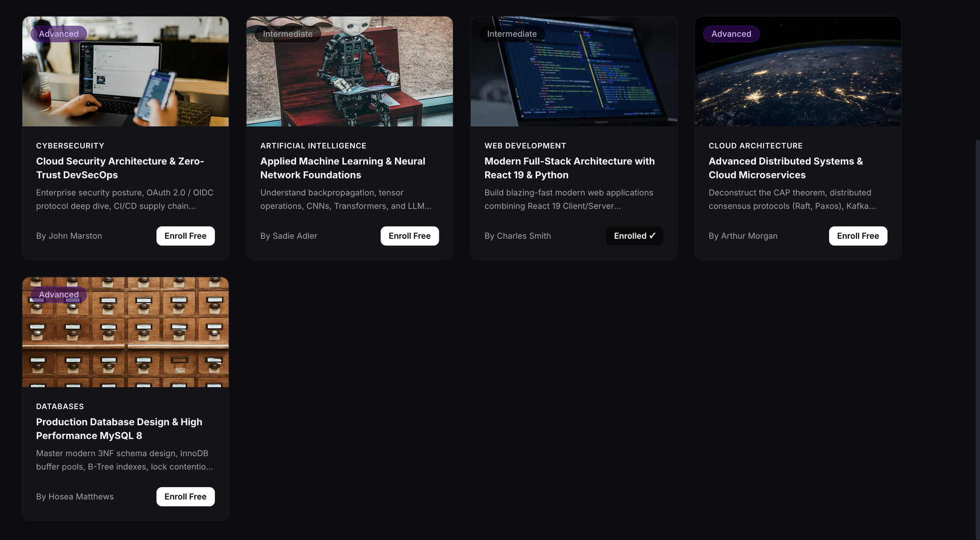
Learner mode: catalog and enrolment
Search and browse published courses
Enrol Free calls the enroll_learner procedure
Enrolled courses cannot be enrolled twice
Level and category come from the courses table
Notes:
The Enrolled button reflects the unique enrolment rule. A second enrolment is rejected.

Slide 15
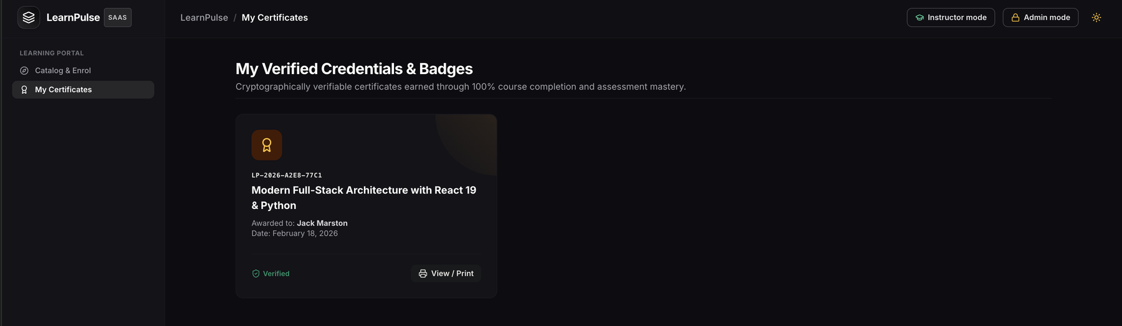
Learner mode: certificates
Unique certificate code for every issue
Issued only when lessons and quizzes are complete
View or print from the learner portal
Notes:
A certificate is only created after completion rules are met.

Slide 16
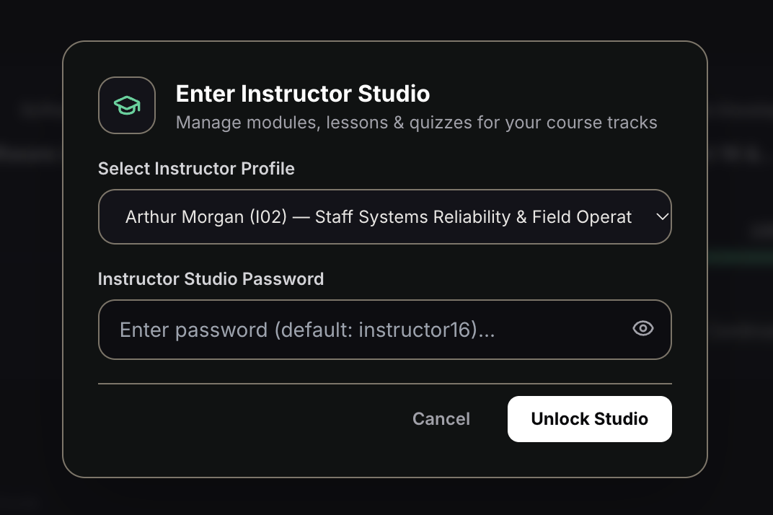
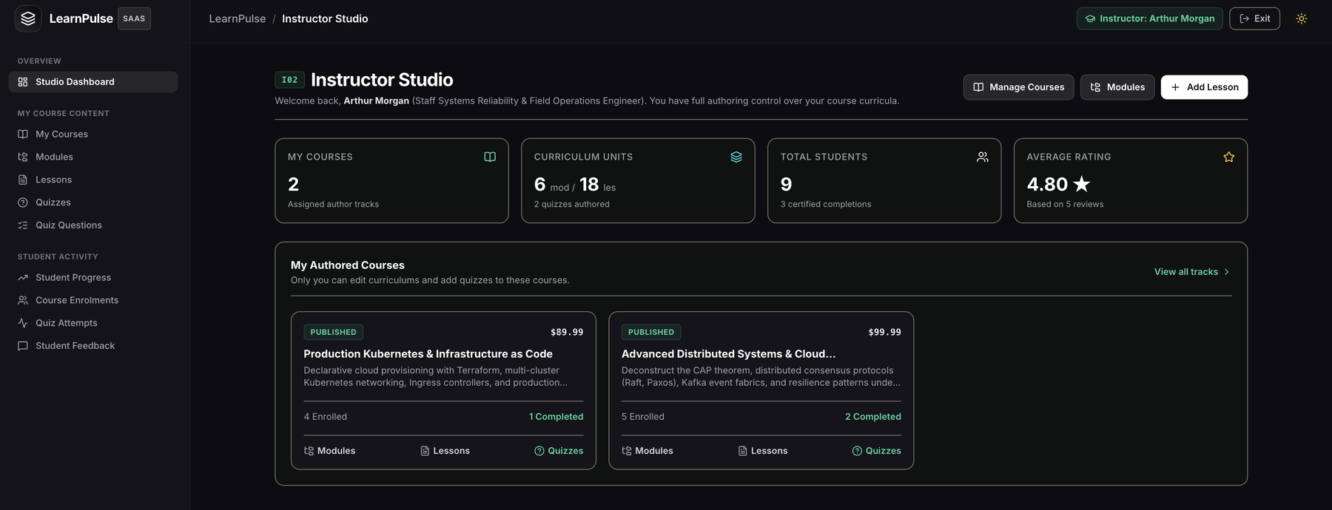
Instructor mode: studio
Pick an instructor profile and unlock the studio
Dashboard shows courses, modules, lessons, students and average rating
Instructors only see and edit their own courses
Notes:
Instructor mode opens with a profile and password check, then shows that instructor's own courses.

Slide 17
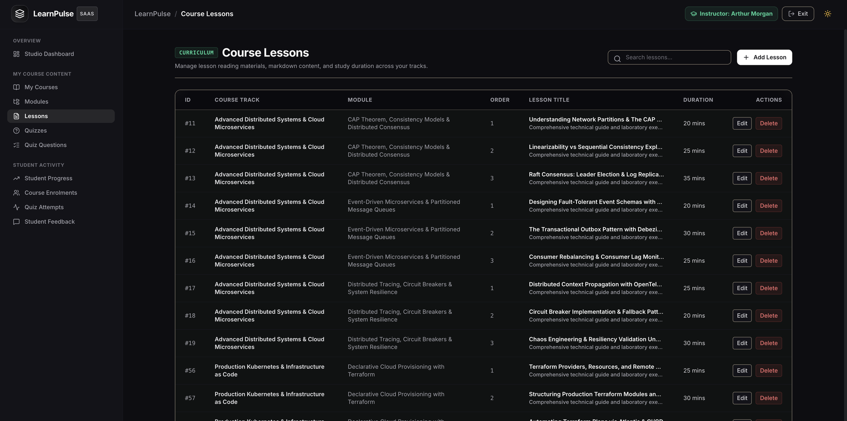
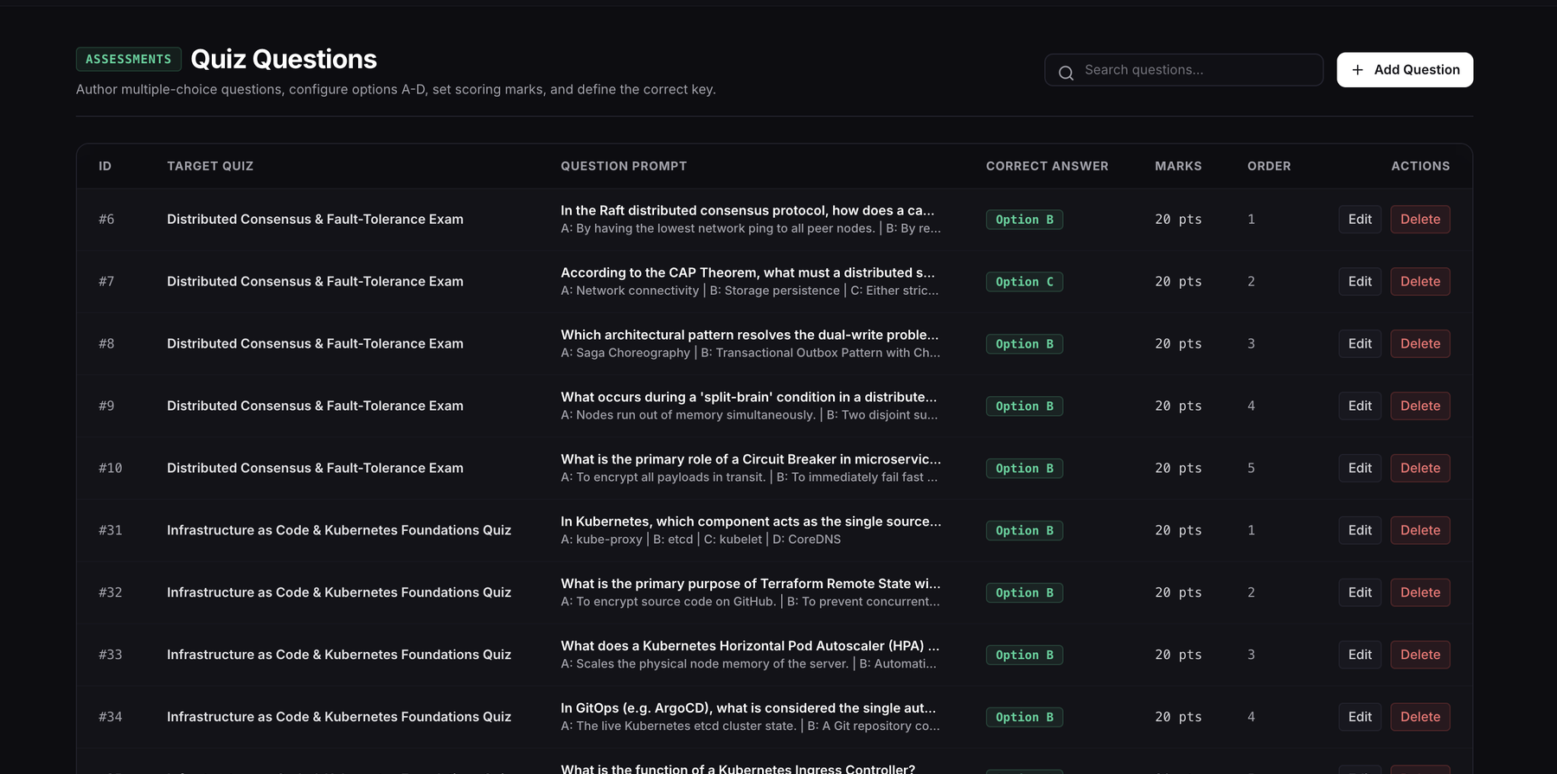
Instructor mode: lessons and quizzes
Lessons grouped by course and module
Order and duration for each lesson
Options A to D with the correct key
Marks and order for each question
Notes:
Full create, edit and delete for lessons and quiz questions.

Slide 18
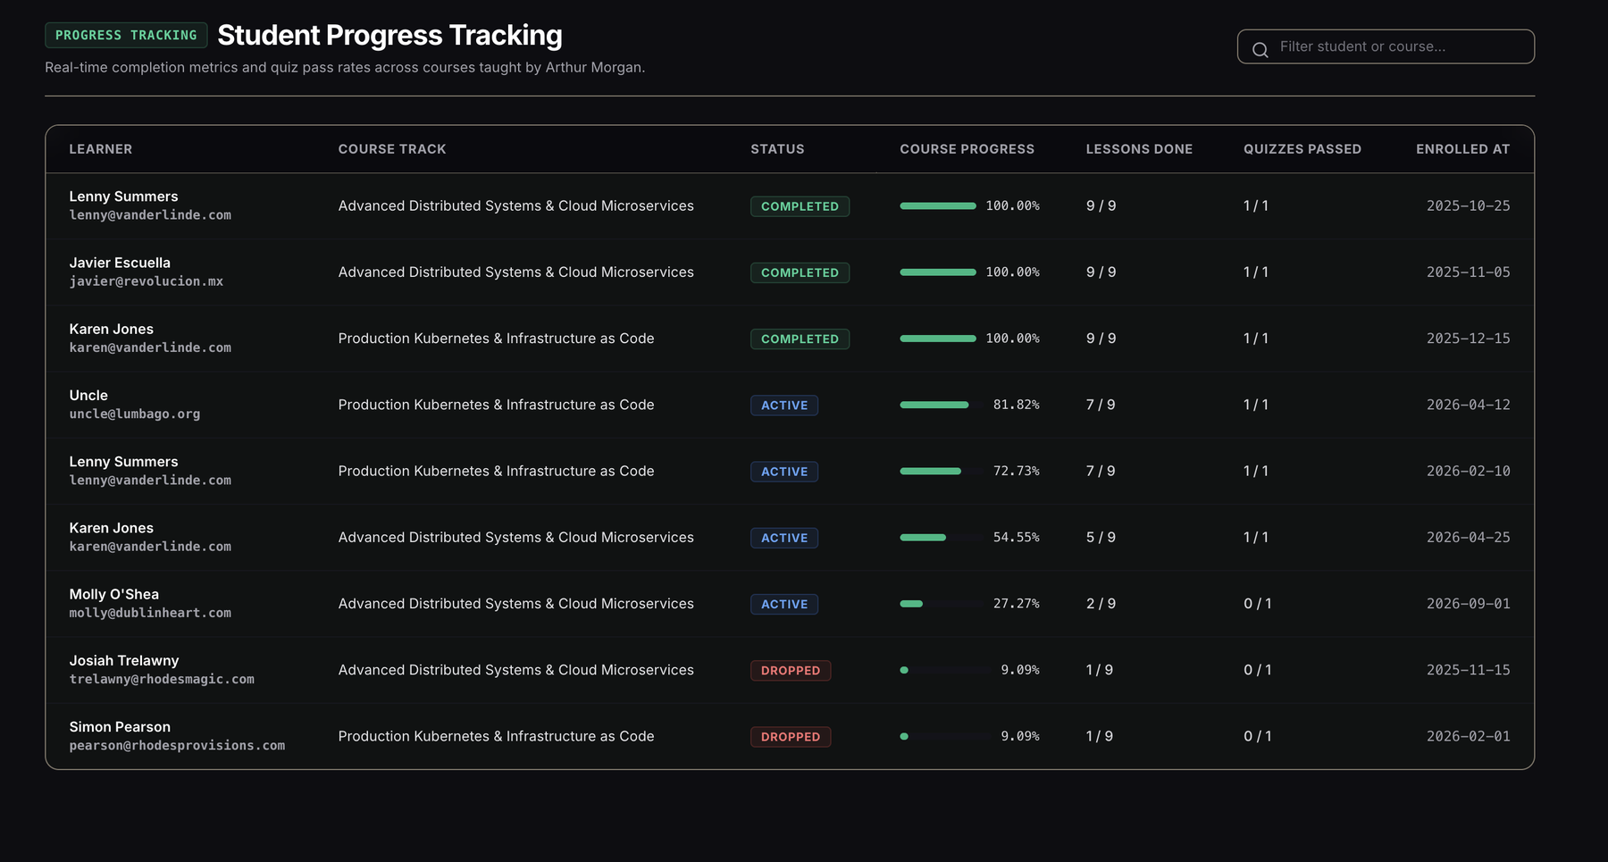
Instructor mode: student progress
Built on the learner progress view
Status pills: Active, Completed, Dropped
Lessons done and quizzes passed per learner
Filter by student or course
Notes:
This page is the learner progress query from the SQL slides, shown in the app.

Slide 19
Progress and next steps
Completed in Review 2
Planned for Review 3
3NF schema with 13 tables
DDL with constraints and triggers
Procedures and views
Sample data and SQL queries
Learner mode
Instructor mode
Admin mode with password
Table browser with CRUD on all tables
Reports with CSV export
SQL console for read-only queries
Testing and error handling
Final demonstration
Notes:
Everything for Review 2 is done. Review 3 adds admin mode and the final demo.

