Slide 1
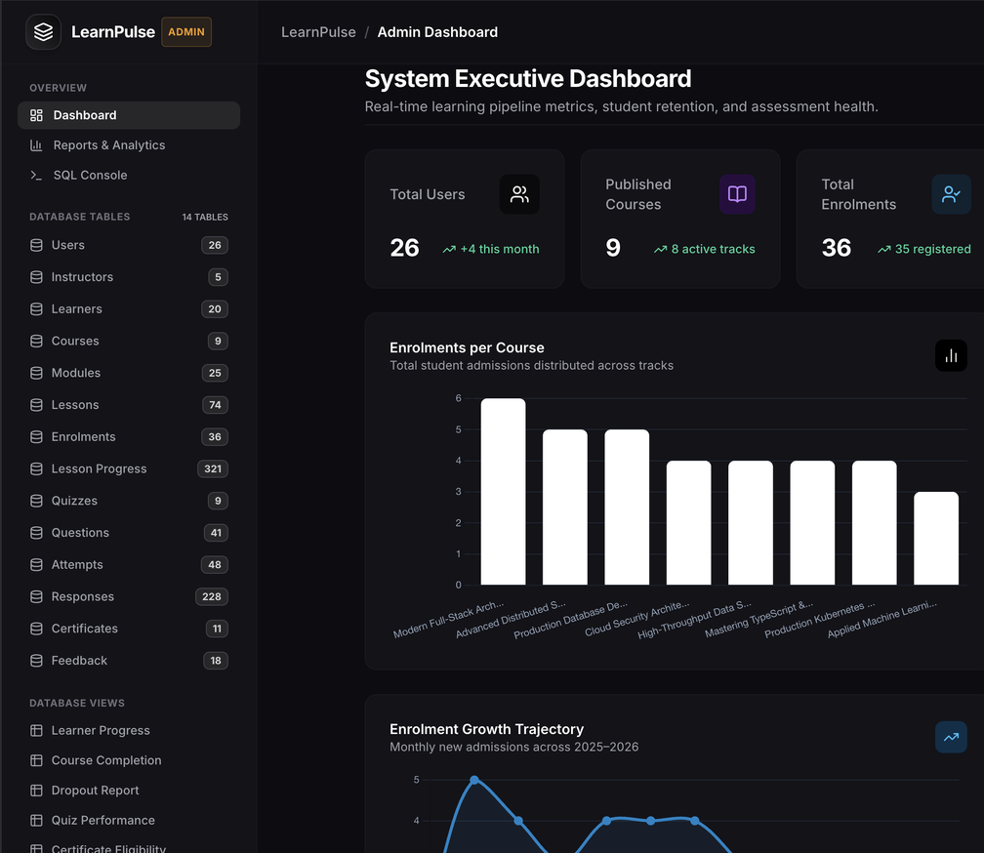
REVIEW - 3
Project 34:
Online Course Database Management System
By Joy Peswani
25WU0102110
Notes:
Final review: the complete system with Learner, Instructor and Admin modes on one MySQL database.

Slide 2
The complete system
REVIEW 1
REVIEW 2
REVIEW 3
Done
Done
This review
Problem, scope, users
ER diagram
Initial schema
3NF schema, DDL, data
SQL queries and views
Learner mode
Instructor mode
Admin mode with password
CRUD on all 14 tables
Reports, SQL console, certificates
Testing and final demo
Notes:
Review 1 was design, Review 2 was database plus two modes, Review 3 completes the system with admin mode.

Slide 3
System architecture
Browser
Python Flask app
MySQL 8
Learner mode
Instructor mode
Admin mode
Routes for each mode
Form validation
Session and passwords
14 tables, 6 views
Constraints and triggers
course_progress_db
Local app
Settings in .env
One database
Runs on port 5001 and opens in the browser from a start script.
Database login and mode passwords stay out of the page code.
All three modes read and write the same tables.
Notes:
A browser front end, a Flask application, and the MySQL database that enforces the rules.

Slide 4
The final database in numbers
26
5
20
9
25
74
36
Users
Instructors
Learners
Courses
Modules
Lessons
Enrolments
321
9
41
48
228
11
18
Lesson progress
Quizzes
Questions
Attempts
Responses
Certificates
Feedback
871
rows across 14 tables
6
SQL views feed the reports
26
users: 1 admin, 5 instructors, 20 learners
Notes:
Row counts are read from the admin sidebar. Users holds one admin, five instructors and twenty learners.

Slide 5
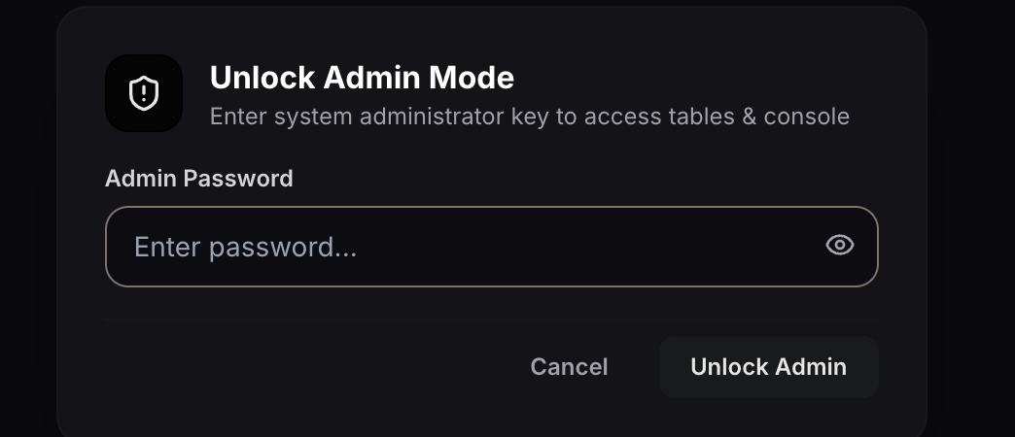
Admin mode: password access
Admin mode button in the top bar
Password is checked by the server and kept in .env
Admin sidebar lists every table, view and action
Exit button returns to learner mode
Learner mode
Instructor mode
Admin mode
Open to everyone
Profile and password
Password
Notes:
Admin mode is opened from the top bar and needs a password.

Slide 6
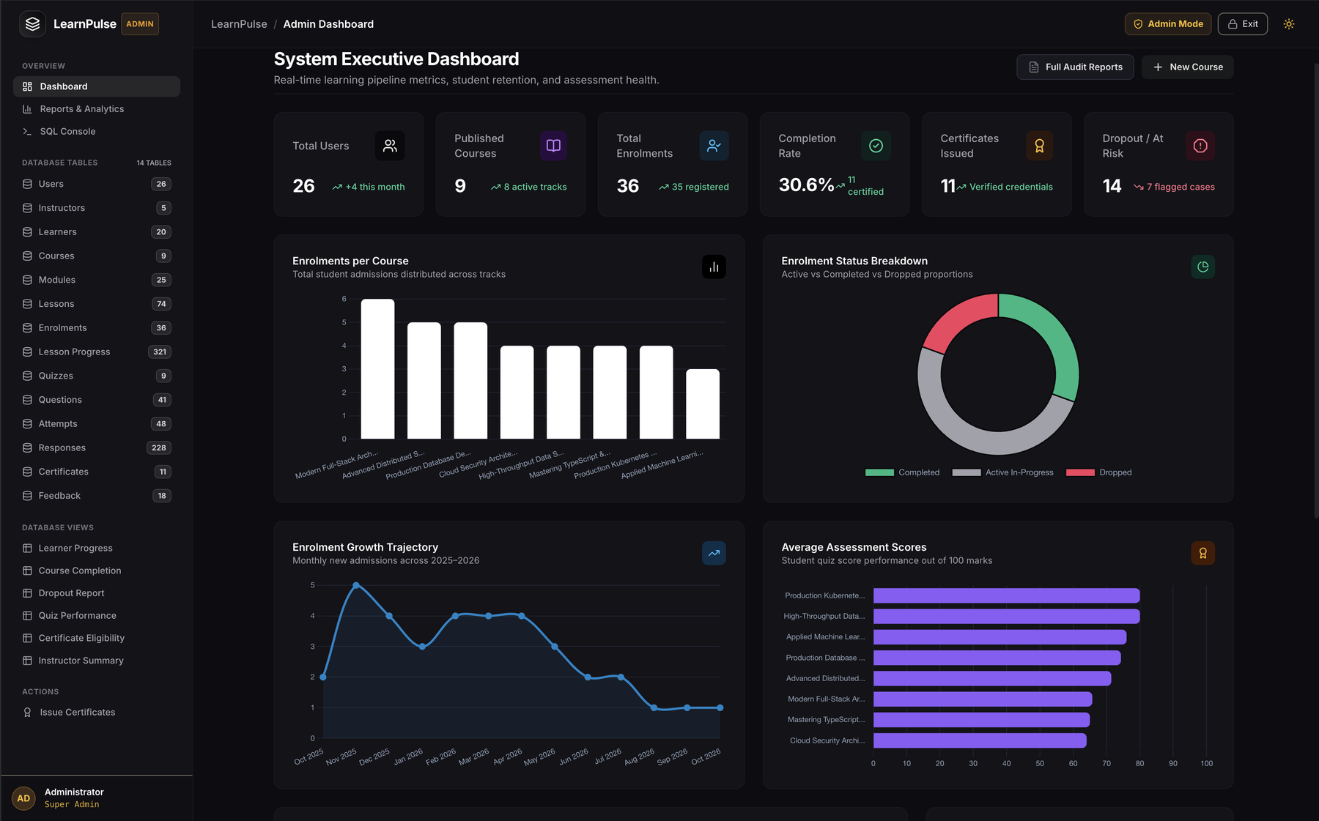
Admin dashboard
Six KPI cards: users, courses, enrolments, completion rate, certificates, dropouts
Charts: enrolments per course, status breakdown, growth over time, average quiz scores
Sidebar shows all 14 tables with row counts and the 6 views
Notes:
Six KPI cards and four charts, all calculated from the database.

Slide 7
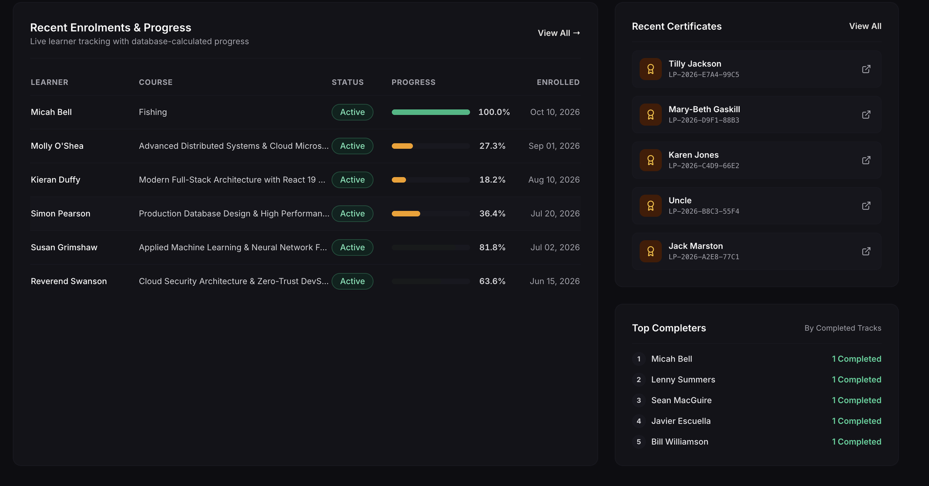
Live learner tracking
Recent enrolments with status and progress
Recent certificates with verification codes
Top completers by finished courses
Progress is calculated in the database
Notes:
Progress percentages are calculated by the database, not typed in.

Slide 8
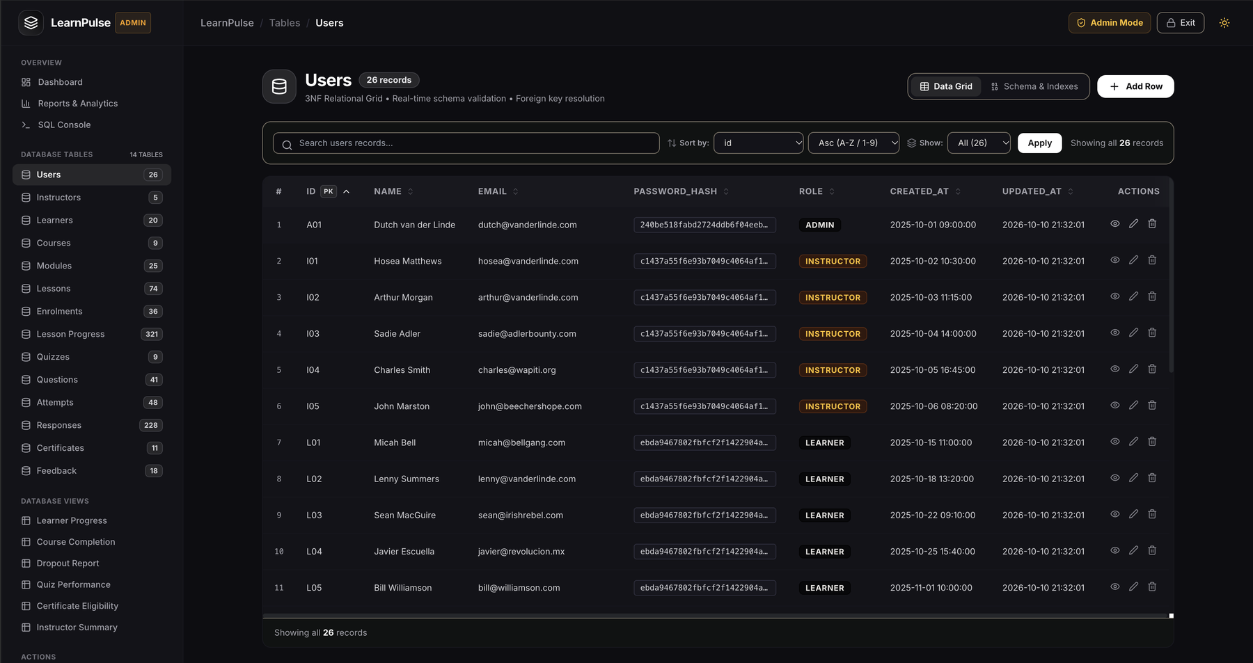
Every table with full CRUD
Search, sort and filter rows
Add, view, edit and delete from any table
Schema and Indexes tab for each table
Primary keys marked, foreign keys resolved
Notes:
One table browser covers all 14 tables: create, read, update and delete.

Slide 9
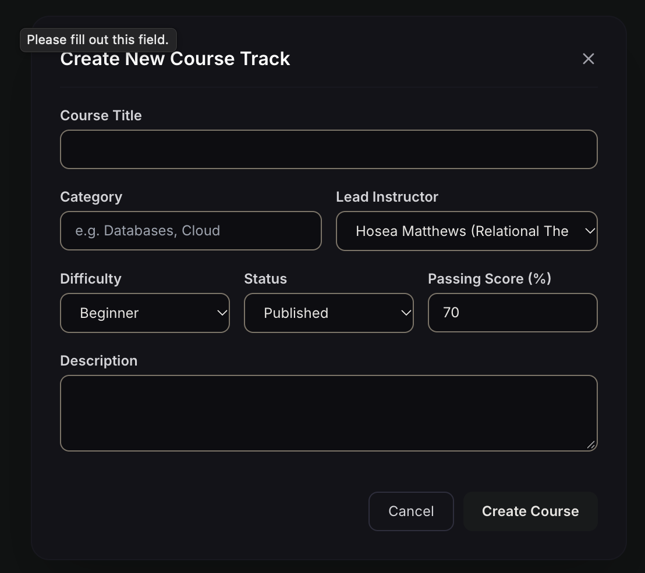
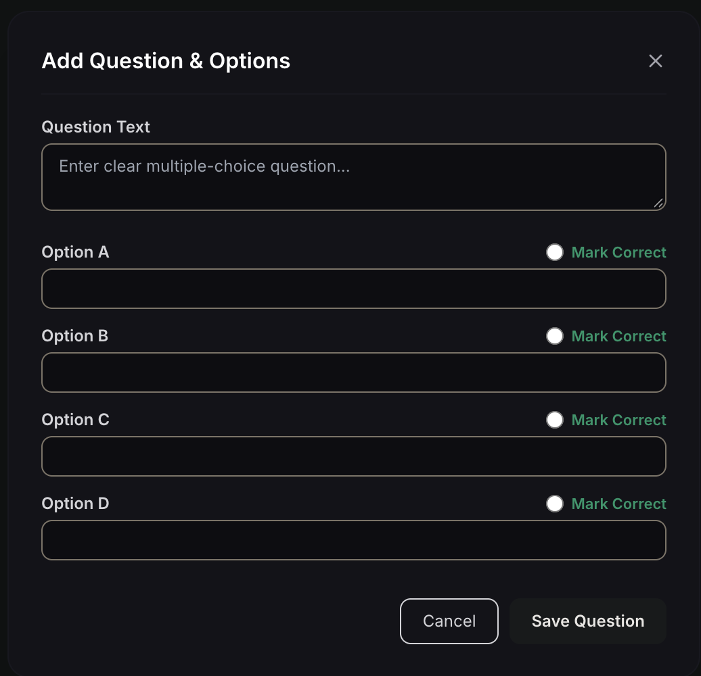
Course publishing and validation
Course form: title, category, instructor, difficulty, status and pass score
Empty required fields are blocked with a message
Question form: four options, one marked correct
Notes:
Required fields are checked before anything reaches the database.

Slide 10
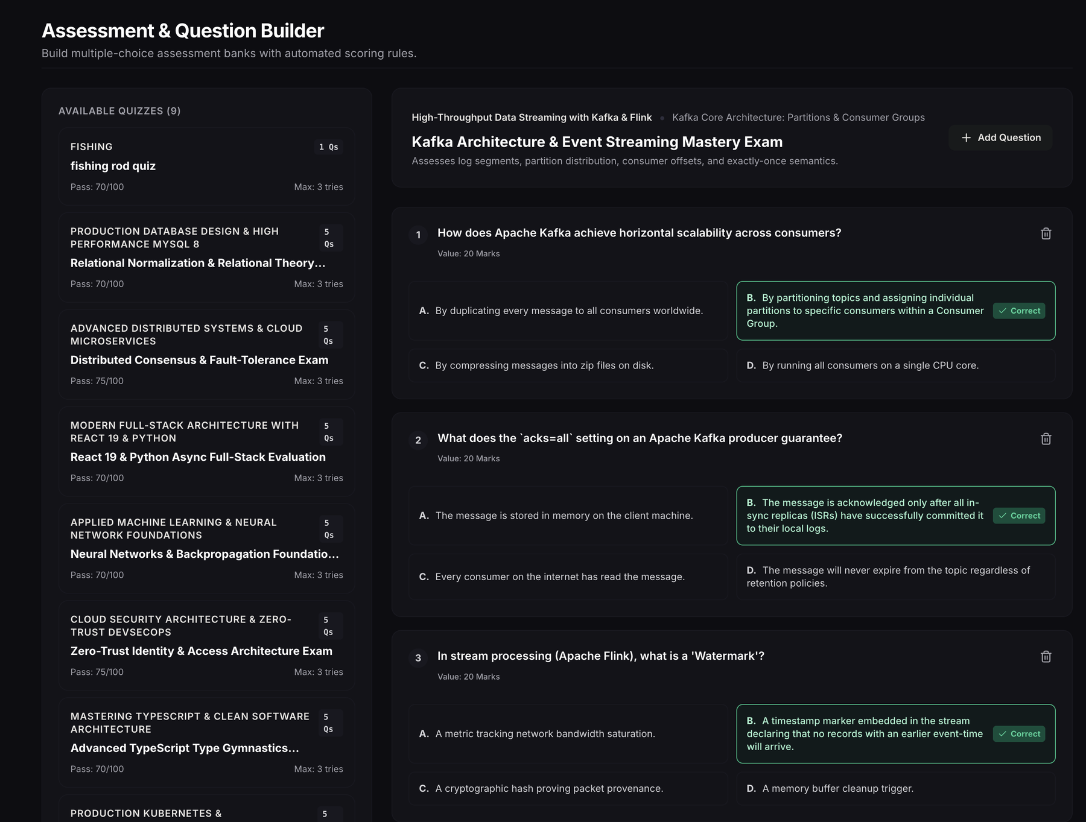
Assessment and question builder
Nine quizzes listed with pass mark and max tries
Each question has options A to D with the correct key highlighted
Every question carries 20 marks
Add or delete questions from the builder
Notes:
Nine quizzes. Each shows pass mark, max tries and its questions.

Slide 11
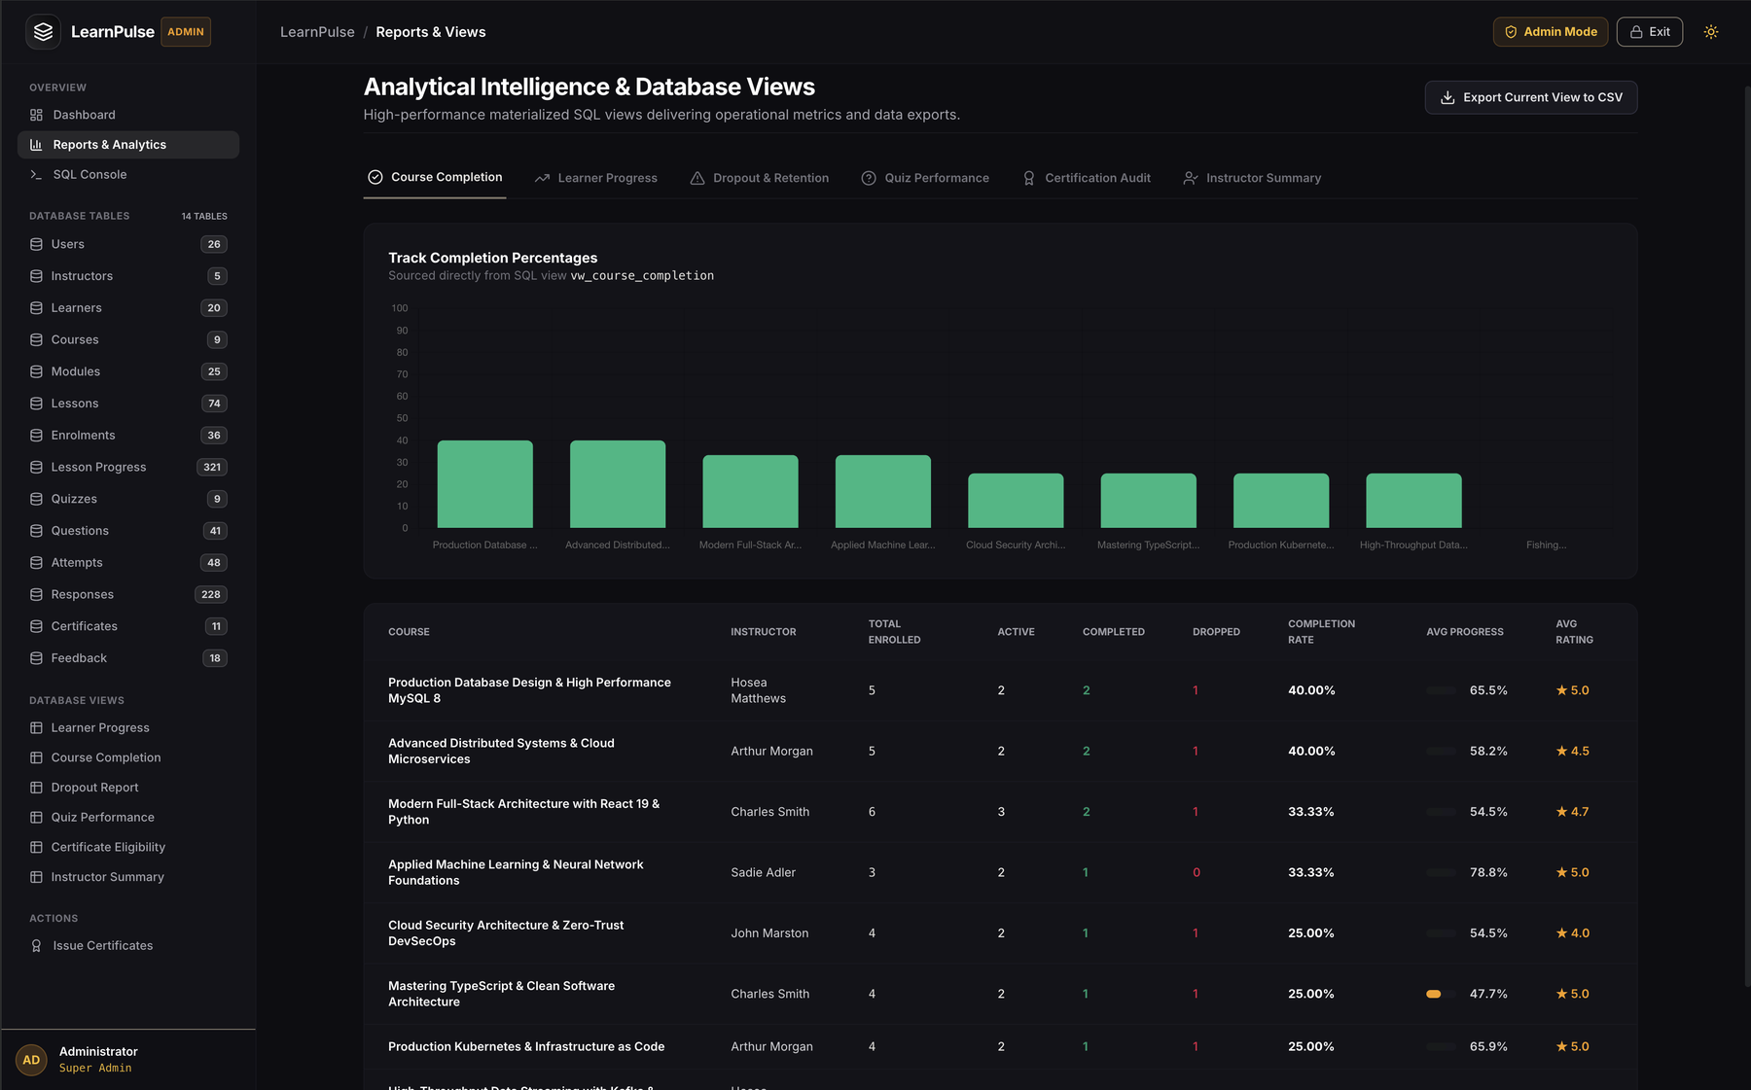
Reports and analytics
Six tabs: course completion, learner progress, dropout, quiz performance, certification audit, instructor summary
Each tab reads a SQL view
Export current view to CSV
Notes:
Each report tab reads one SQL view and can be exported to CSV.

Slide 12
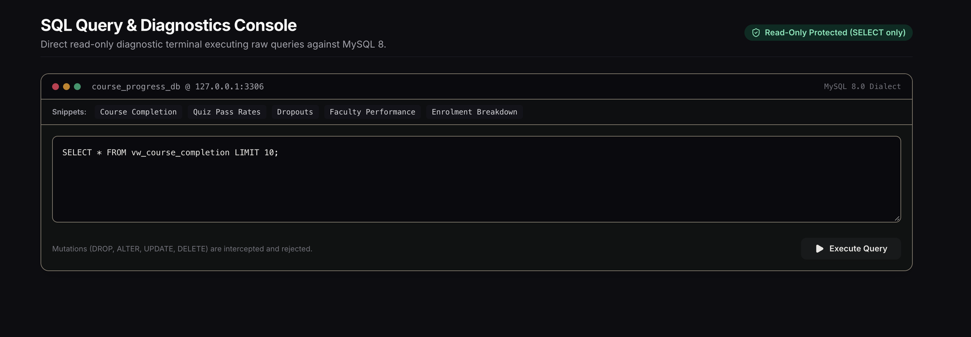
SQL console
Read-only: only SELECT runs. DROP, ALTER, UPDATE and DELETE are rejected.
Ready-made snippets: course completion, quiz pass rates, dropouts, faculty performance, enrolment breakdown.
Notes:
A read-only console for live queries during the demo.

Slide 13
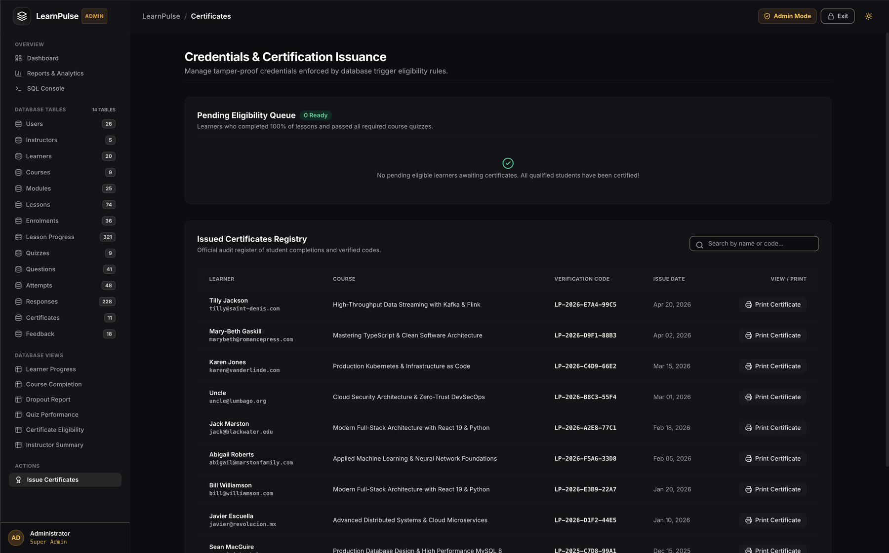
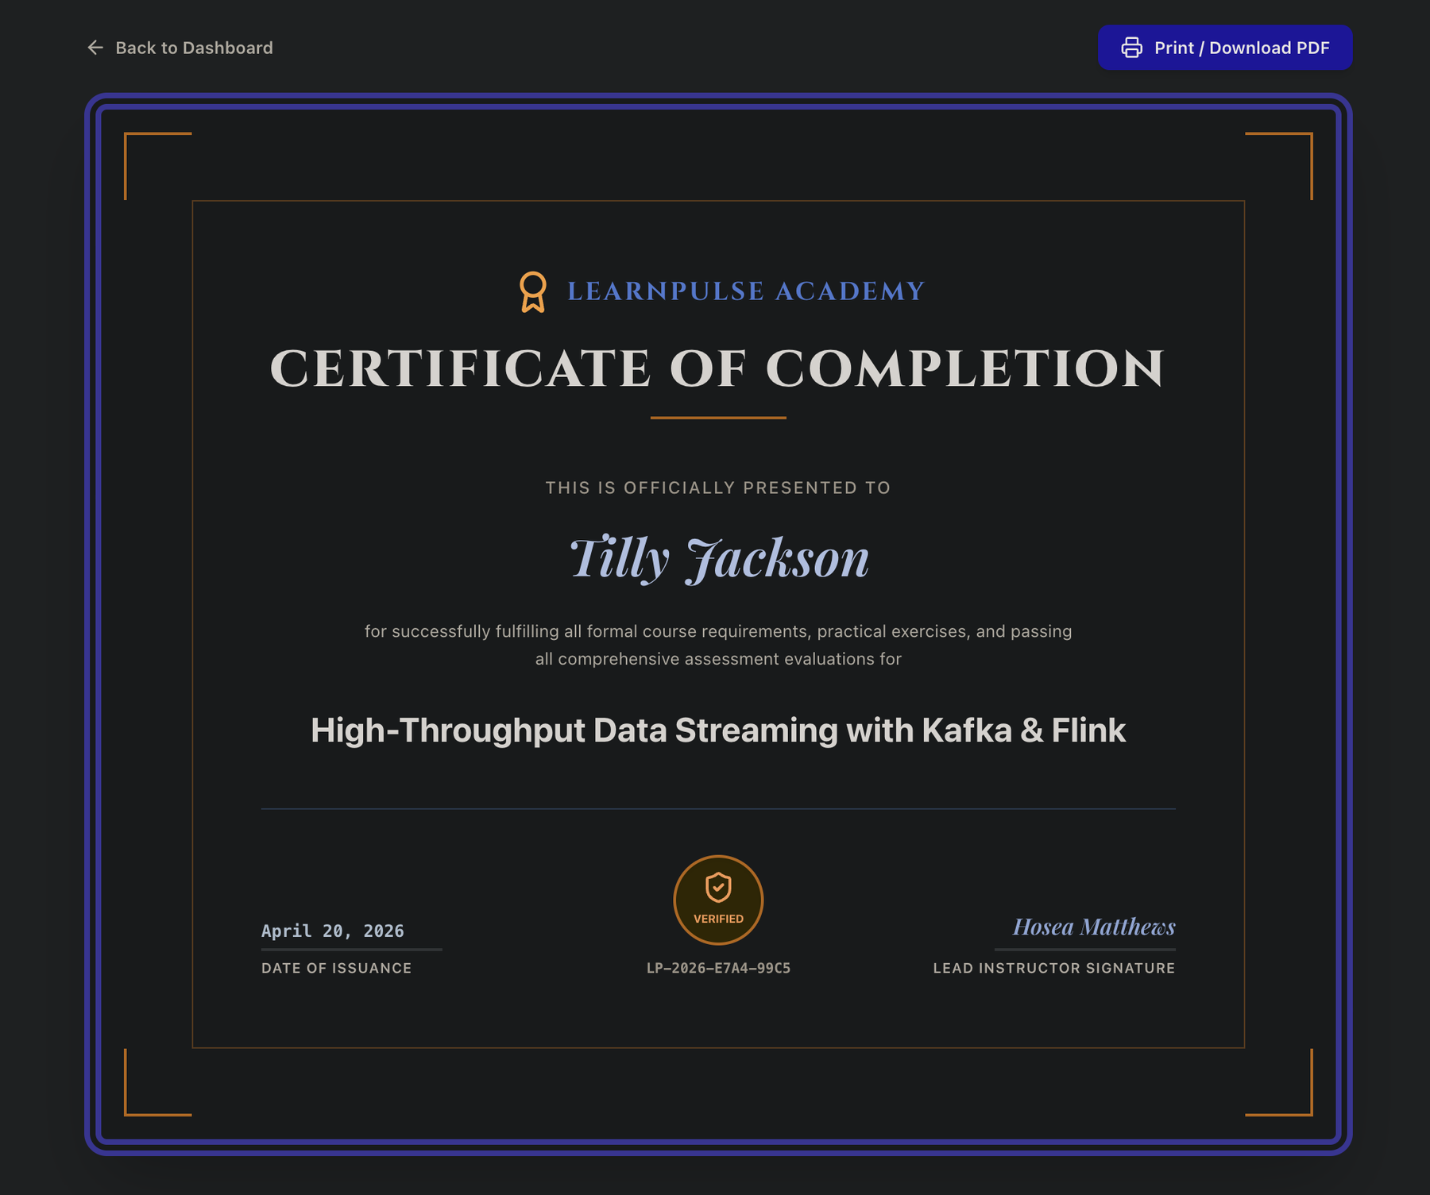
Certificates
Registry with search and a print button for every certificate.
Printable certificate with a unique verification code. Only learners who finished all lessons and passed the quizzes are eligible.
Notes:
Eligibility is enforced by a database trigger, so a certificate cannot be issued early.

Slide 14
Business rules in action
Rule | Enforced by | Where you can see it
One enrolment per course | UNIQUE (learner, course) | Catalog shows Enrolled
Progress from 0 to 100 | CHECK constraint | Progress bars and lesson progress table
Attempt limit | Trigger against max tries | Max: 3 tries on every quiz
Valid scores | CHECK on score and marks | 20 marks per question in the builder
Certificate only when complete | Database trigger | Pending eligibility queue
Safe SQL console | SELECT-only filter | DROP, ALTER, UPDATE, DELETE rejected
Notes:
Each rule is enforced by the database, so the application cannot bypass it.

Slide 15
Test cases
ID | Test | Input | Expected result
T1 | Duplicate enrolment | Enrol the same learner in the same course | Rejected with a clear message
T2 | Progress out of range | Set lesson progress to 101 | Rejected by the CHECK constraint
T3 | Attempt limit | Make a 4th attempt on a quiz with 3 tries | Blocked by the trigger
T4 | Early certificate | Issue a certificate before completion | Blocked by the trigger
T5 | Empty required field | Create a course with no title | Form asks to fill the field
T6 | Unsafe SQL | Run DROP TABLE in the console | Rejected, data unchanged
T7 | Wrong admin password | Enter an incorrect password | Access denied
Notes:
Run each case in the live demo and record the actual result in the report.

Slide 16
Final submission package
1
Source code
2
Database script
3
Test data
Flask app with all three modes
Schema, views, triggers and procedures
871 rows across 14 tables
4
Output screens
5
Project report
6
Viva notes
Learner, instructor and admin pages
Design, implementation and testing
Normalization, keys, triggers, ACID
Notes:
The full package for the final review and viva.

Slide 17
Conclusion and future scope
Conclusion
Future scope
The project delivers a normalized 3NF MySQL database and a working web application. Learners enrol and track progress, instructors publish content and quizzes, and admins manage every table, run reports and issue certificates. The database itself enforces the key business rules.
Individual logins with hashed passwords
Production web server instead of the development server
Quiz timers and question randomization
Export reports to PDF
Email alerts for certificates and dropouts
Notes:
The system covers the whole learning lifecycle. Future work moves it from a demo to a production service.

