Slide 1

Virtualization

Slide 2
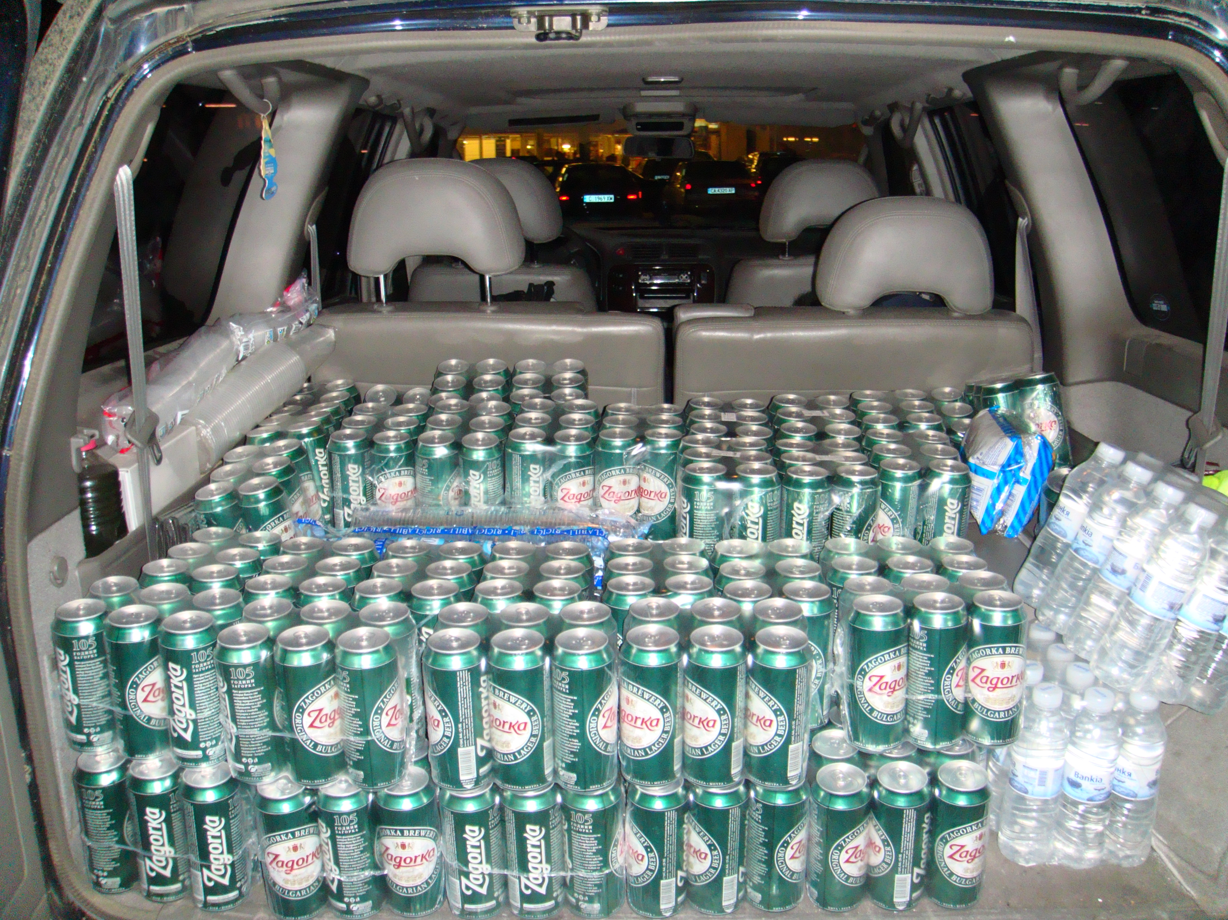
What is virtualization?

Slide 3
What is virtualization?
mov
cmp
jmp
call
push
pop
int
nop
Full virtualization
Para virtualization
Partial virtualization
RAM
CPU
MMU

Slide 4
What is virtualization?
mov
cmp
jmp
call
push
pop
int
nop
Full virtualization
Para virtualization
Partial virtualization
RAM
CPU
MMU

Slide 5

Find out if your CPU is virtualization enabled
For Intel VT-x
$ grep –color vmx /proc/cpuinfo
For AMD V
$ grep –color svm /proc/cpuinfo
flags : fpu vme de pse tsc msr pae mce cx8 apic sep mtrr pge mca cmov pat pse36 clflush dts acpi mmx fxsr sse sse2 ss ht tm pbe nx rdtscp lm constant_tsc arch_perfmon pebs bts xtopology nonstop_tsc aperfmperf eagerfpu pni pclmulqdq dtes64 monitor ds_cpl vmx est tm2 ssse3 cx16 xtpr pdcm pcid sse4_1 sse4_2 x2apic popcnt tsc_deadline_timer xsave avx lahf_lm ida arat epb xsaveopt pln pts dtherm tpr_shadow vnmi flexpriority ept vpid

Slide 6

Organization
Host kernel
KVM - in the kernel
QEMU - System virtualization
Libvirt - management simplification
KVM
VM
Kernel
VM
Kernel
VM
Kernel
VM
Kernel
VM
Kernel
VM
Kernel

Slide 7
KVM Kernel configuration
CONFIG_KVM_GUEST=y
# CONFIG_KVM_DEBUG_FS is not set
CONFIG_HAVE_KVM=y
CONFIG_HAVE_KVM_IRQCHIP=y
CONFIG_HAVE_KVM_IRQ_ROUTING=y
CONFIG_HAVE_KVM_EVENTFD=y
CONFIG_KVM_APIC_ARCHITECTURE=y
CONFIG_KVM_MMIO=y
CONFIG_KVM_ASYNC_PF=y
CONFIG_HAVE_KVM_MSI=y
CONFIG_HAVE_KVM_CPU_RELAX_INTERCEPT=y
CONFIG_KVM=y
CONFIG_KVM_INTEL=y
# CONFIG_KVM_AMD is not set
# CONFIG_KVM_MMU_AUDIT is not set
CONFIG_KVM_DEVICE_ASSIGNMENT=y
CONFIG_PARAVIRT=y
# CONFIG_PARAVIRT_DEBUG is not set
CONFIG_PARAVIRT_SPINLOCKS=y
CONFIG_PARAVIRT_TIME_ACCOUNTING=y
CONFIG_PARAVIRT_CLOCK=y
CONFIG_VIRT_TO_BUS=y
CONFIG_VIRTIO_BLK=m
CONFIG_SCSI_VIRTIO=m
CONFIG_VIRTIO_NET=m
CONFIG_VIRTIO_CONSOLE=y
CONFIG_HW_RANDOM_VIRTIO=m
CONFIG_VIRT_DRIVERS=y
CONFIG_VIRTIO=y
# Virtio drivers
CONFIG_VIRTIO_PCI=y
CONFIG_VIRTIO_BALLOON=m
CONFIG_VIRTIO_MMIO=m
CONFIG_VIRTIO_MMIO_CMDLINE_DEVICES=y
# CONFIG_DEBUG_VIRTUAL is not set
CONFIG_VIRTUALIZATION=y

Slide 8

KVM Kernel configuration
Processor type and features ->
Linux guest support -> *
BUS options -> PCI IOV
Device Drivers ->
Block devices -> Virtio block driver
SCSI device support -> SCSI low-level drivers -> virtio-scsi
Network device support -> Virtio network driver
Character devices ->
* HW Random Number Generator
Virtio console
Virtio drivers -> *
Virtualization -> *

Slide 9

Create
Start
Talk to QEMU

Slide 10

KVM tools
virsh
virt-manager

Slide 11
KVM information
List VMs
  virsh list
  virsh list – all (including the suspended and stopped)
Node Information
  virsh nodeinfo – information about the host node
  virsh dominfo vm_name - information about the VM
  virsh vcpuinfo vm_name - CPU info about the VM

Slide 12
VM Management :)
Start
  virsh start vm_name
Stop
  virsh shutdown vm_name - soft shutdown
  virsh destroy vm_name - power down
Restart
  virsh reboot vm_name
  virsh shutdown vm_name
  virsh destroy vm_name - power cycle
  virsh start vm_name
Suspend
  virsh suspend vm_name - to RAM

Slide 13

Hibernate
Save - save the VM state to a file
  virsh save vm_name
  virsh save-image-define save-file.img
Restore
  virsh restore save-file.img
File location
  /var/lib/libvirt/qemu/

Slide 14
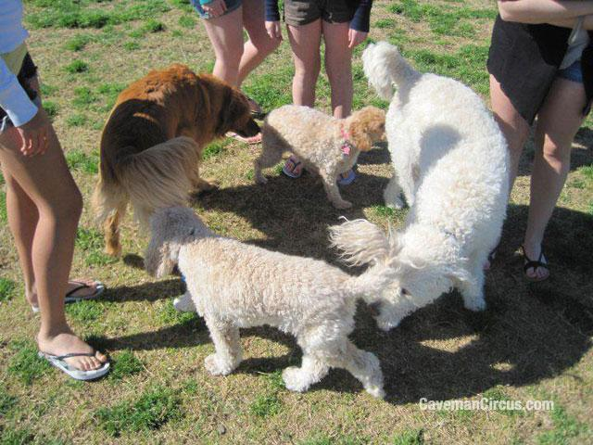
Network
List all defined networks
  virsh net-list
Get information for predefined network
  virsh net-info net_name
Activate a network on Host boot
  virsh net-autostart net_name
Start/Stop/Remove network
  virsh net-start net_name
  virsh net-destroy net_name
  virsh net-undefine net_name

Slide 15

Storage pools
List all defined storage pools
  virsh pool-list
Get information for predefined pool
  virsh pool-info pool_name
Activate a storage pool on Host boot
  virsh pool-autostart pool_name
Start/Stop/Remove network
  virsh pool-start net_name
  virsh pool-destroy net_name
  virsh pool-undefine net_name

Slide 16


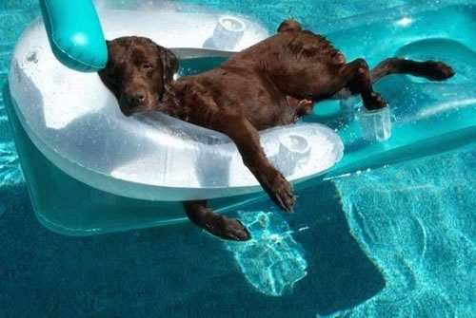
Storage pools
Create a pool
  # virsh pool-create pool.xml
  # virsh pool-create-as --name pesho \
  --type [dir,disk,fs,logical,netfs...] \
  --target (depending on the type) \
Refresh the files/volume in a pool
  # virsh pool-refresh pool_name

Slide 17

Volumes
Create
  # virsh vol-create volume.xml
  # virsh vol-create-as --pool=pool_name \
  --name pesho_be \
  --capacity (int in Bytes) \
  --format [raw,bochs,qcow,qcow2,qed,vmdk]
Clone
  # virsh vol-clone vol_name new_name --pool pool_name
Delete
  # virsh vol-delete vol_name --pool pool_name

Slide 18

Snapshots
# virsh snapshot-create-as vm_name snapshot1 "backup1" --disk-only --atomic
# virsh snapshot-list vm_name
# virsh snapshot-info vm_name \
--snapshotname snapshot1

Slide 19

Migration
Migration with shared storage
  virsh migrate --live Jab2 qemu+ssh://192.168.0.5/system
Migration with local storage
  # qemu-img info /vm/vm-test.img
  image: /vm/jivko-test.img
  file format: raw
  virtual size: 8.0G (8589934592 bytes)
  disk size: 8.0G
  # qemu-img create -f raw /vm/vm-test.img 8G Formatting '/vm/jivko-test.img', fmt=raw size=8589934592
  # virsh migrate --persistent --live --copy-storage-all Jab2 qemu+ssh://192.168.0.5/system

Slide 20

Create a new VM
Installation image
Command
  qemu -drive file=ubuntu-lucid.img,if=virtio \ -kernel /path/to/kernel/bzImage \
  -append "console=ttyS0 root=/dev/vda" \
  -m 512 -smp 1 -fsdev local,id=test_dev,path=shared,security_model=none
  -enable-kvm

Slide 21

Backups

Slide 22

Configuration
Fuck... it's XML based...
/etc/libvirt/qemu/vm_name.xml
/etc/libvirt/qemu/autostart
/etc/libvirt/qemu/networks
/var/lib/libvirt/images

Slide 23
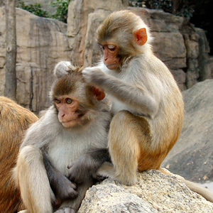
Console &
Debugging
Console
  virsh console vm_name
  /usr/bin/virsh -c \
  'qemu+ssh://root@IP:22/system' console vm_name
  Install virt-manager and setup connection to the host node, then connect to the vm with double click :)
Debugging
# qemu -gdb tcp:127.0.0.1:1212 [...]
# gdb vmlinux-of-guest
(gdb) target remote tcp:127.0.0.1:1212

Slide 24

Common issues
Sometimes libvirt can't start some VMs
  check if they have .save files in
    /var/lib/libvirt/qemu/images
  check if there are files with the VM name in
    /var/lib/libvirt/qemu/save
  If there are any files for that VM in either of these dirs, remove them and the VM should start

