Slide 1
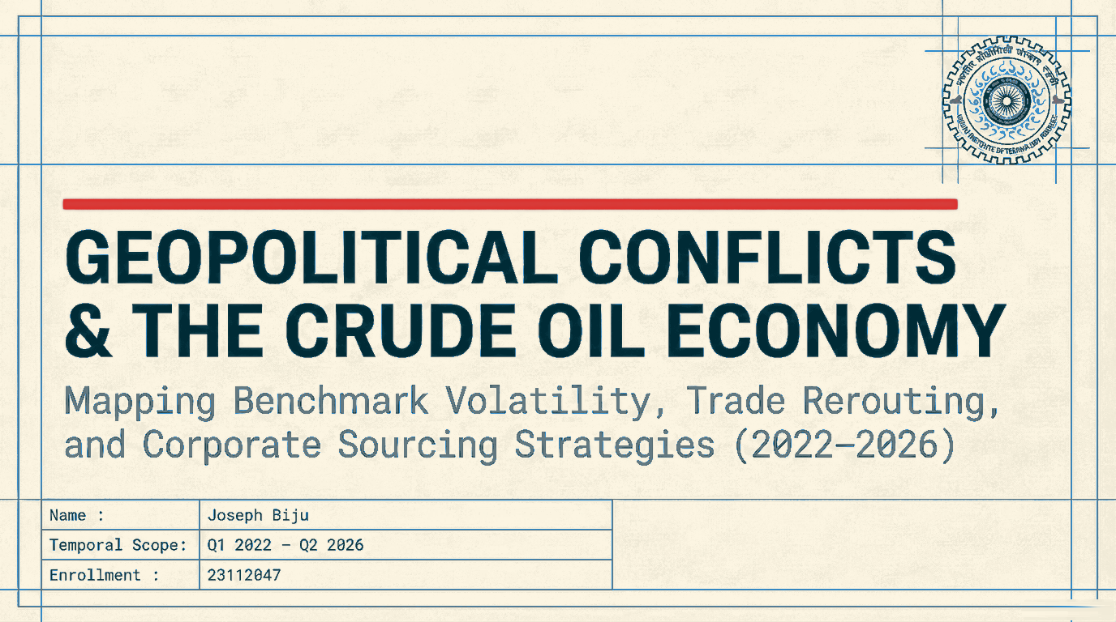

Slide 2
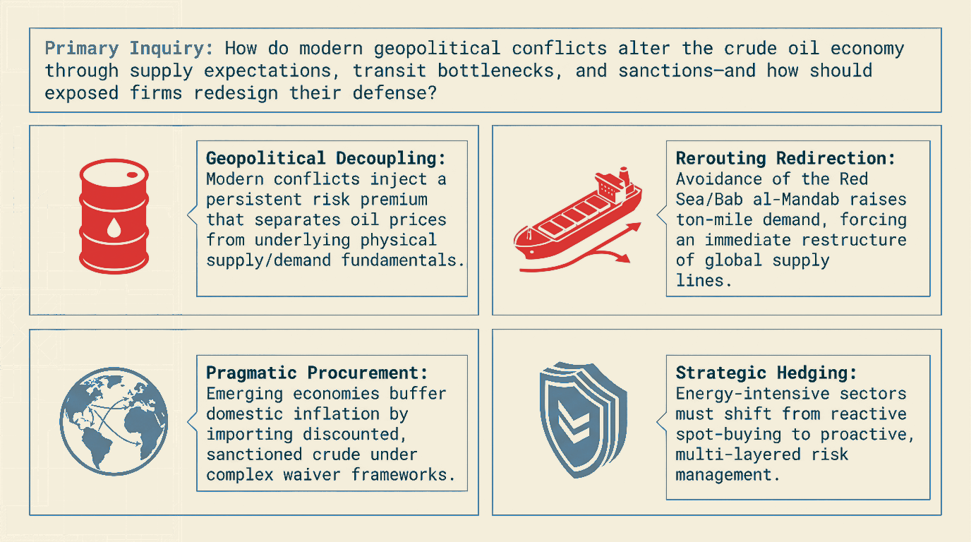

Slide 3
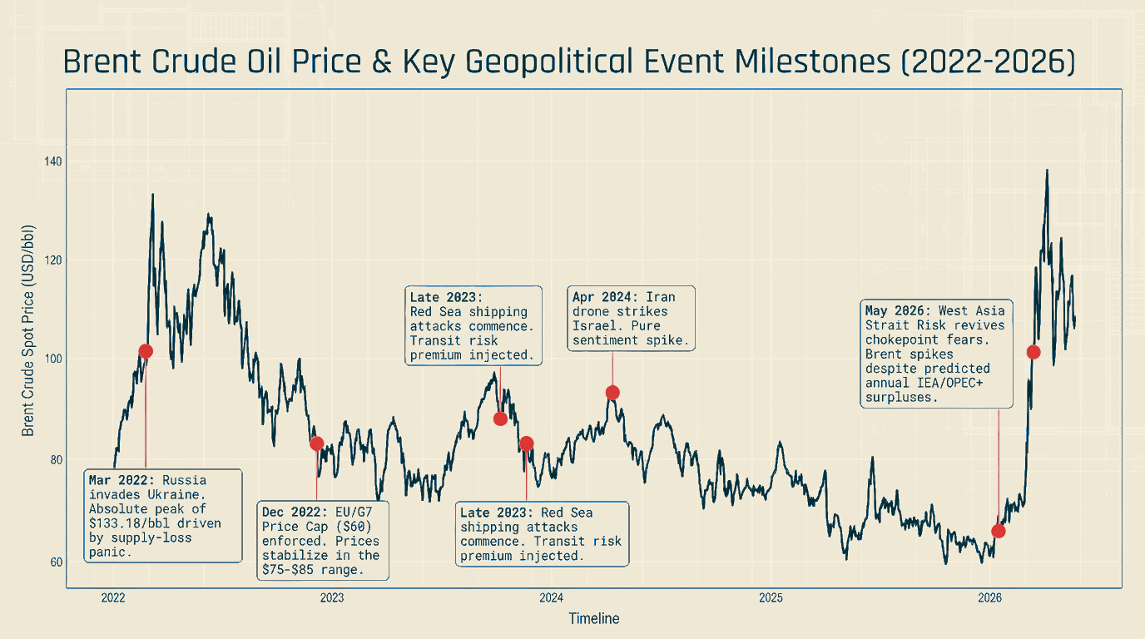

Slide 4
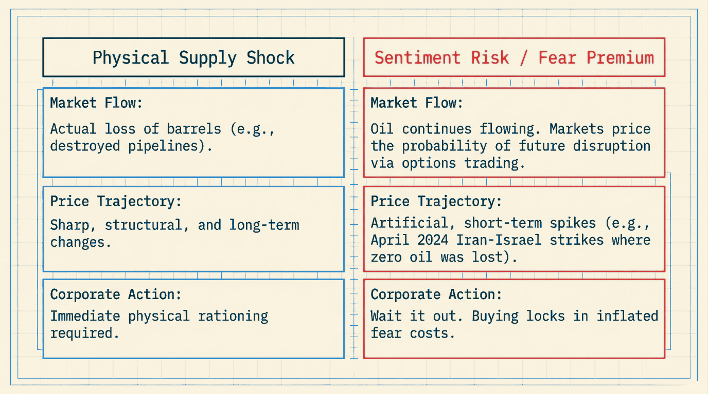

Slide 5
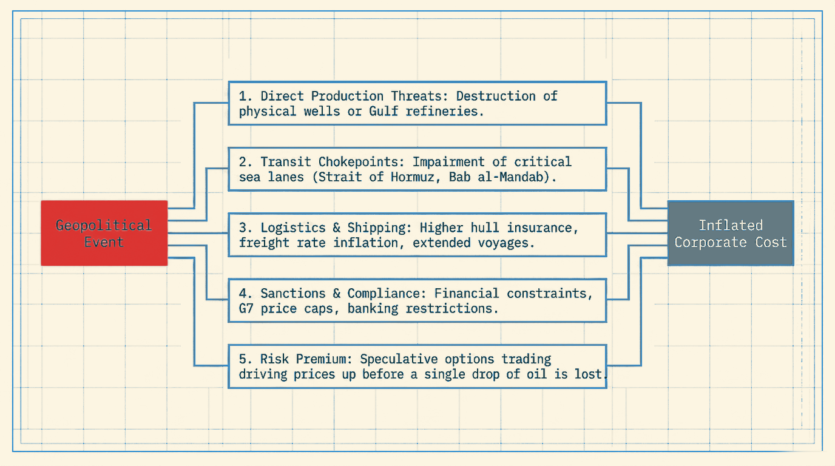

Slide 6
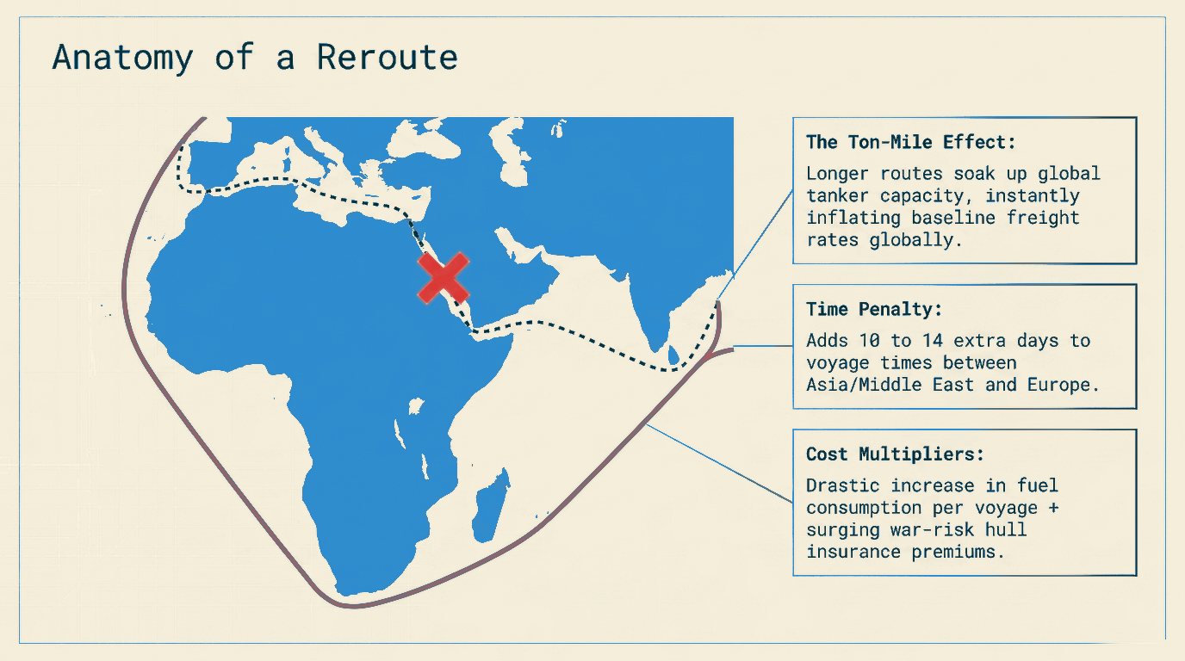

Slide 7
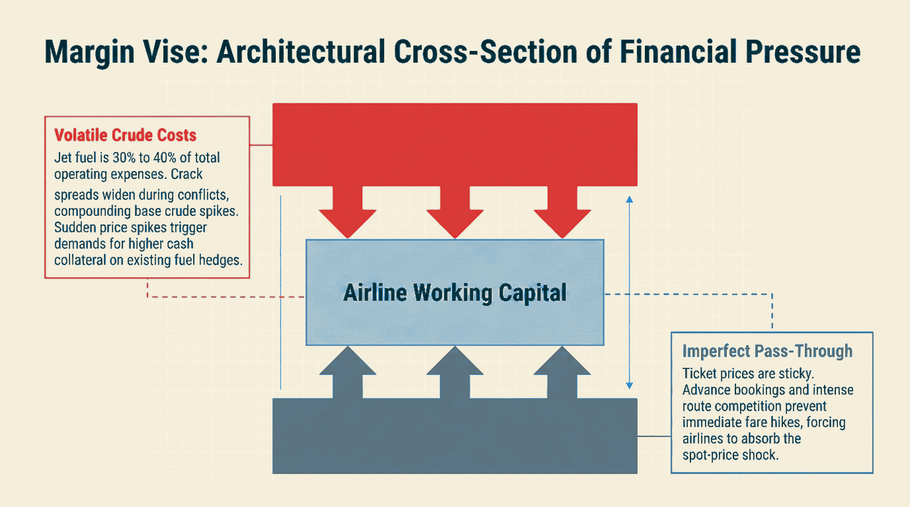

Slide 8
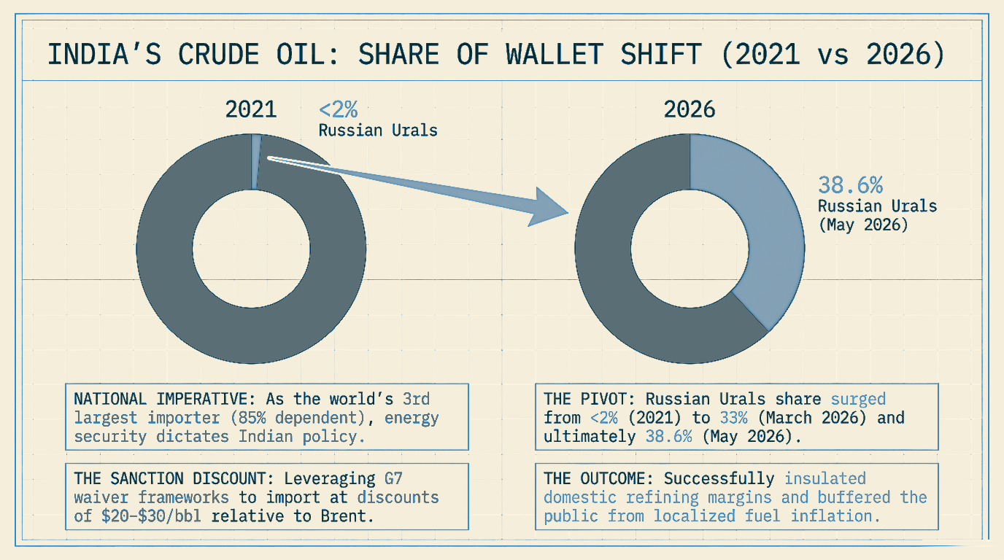

Slide 9
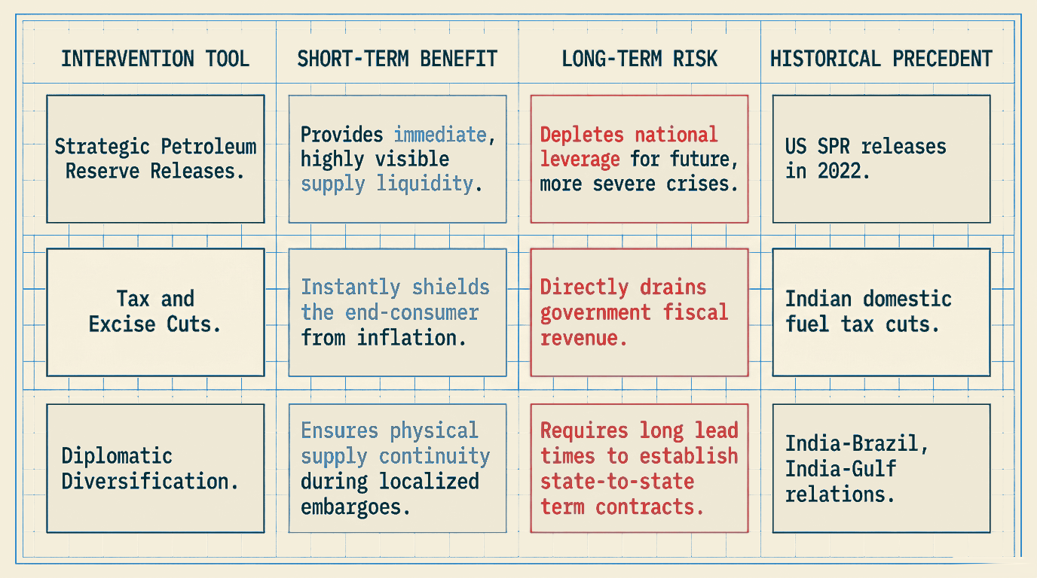

Slide 10
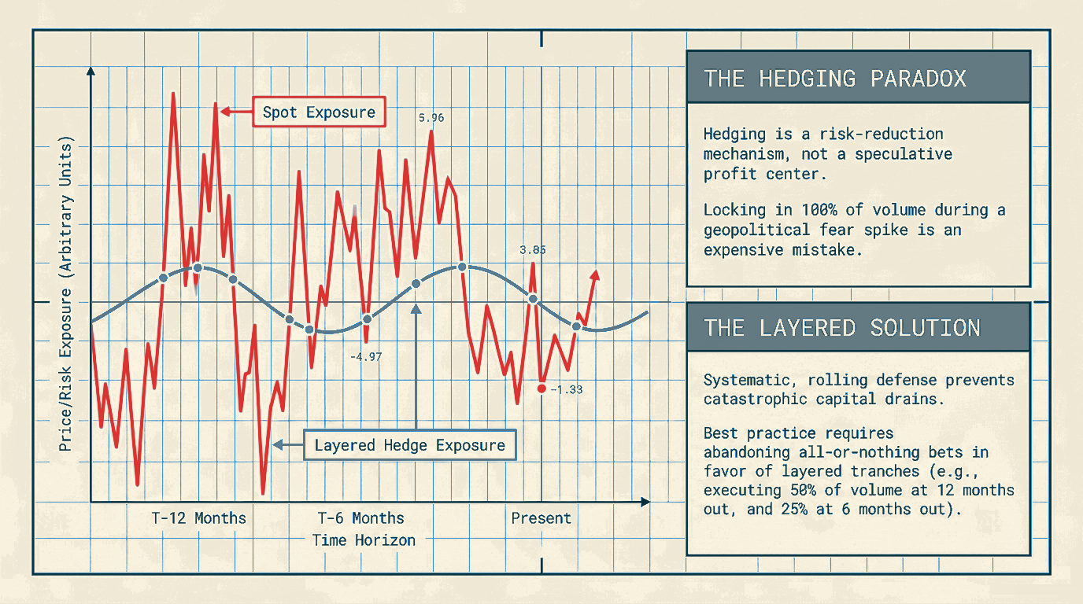

Slide 11
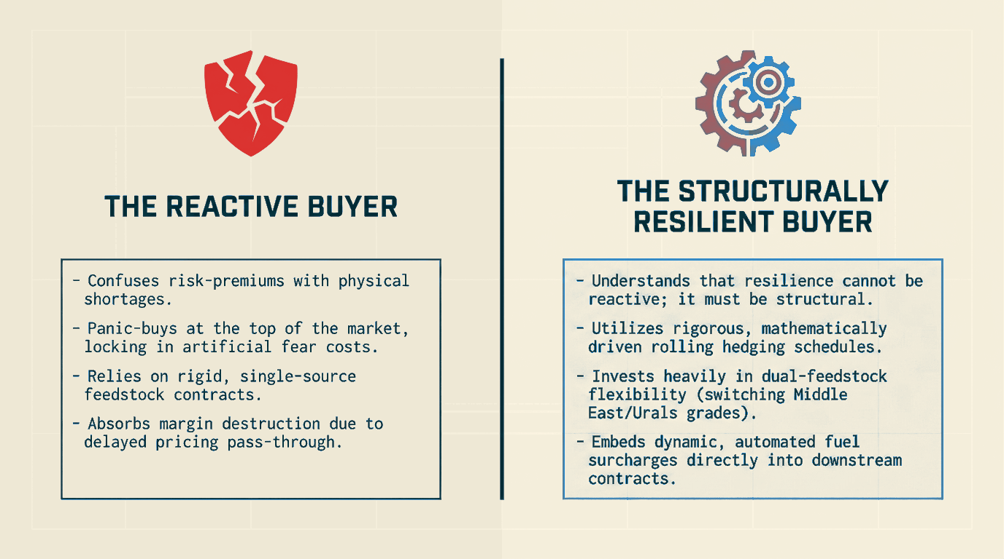

Slide 12
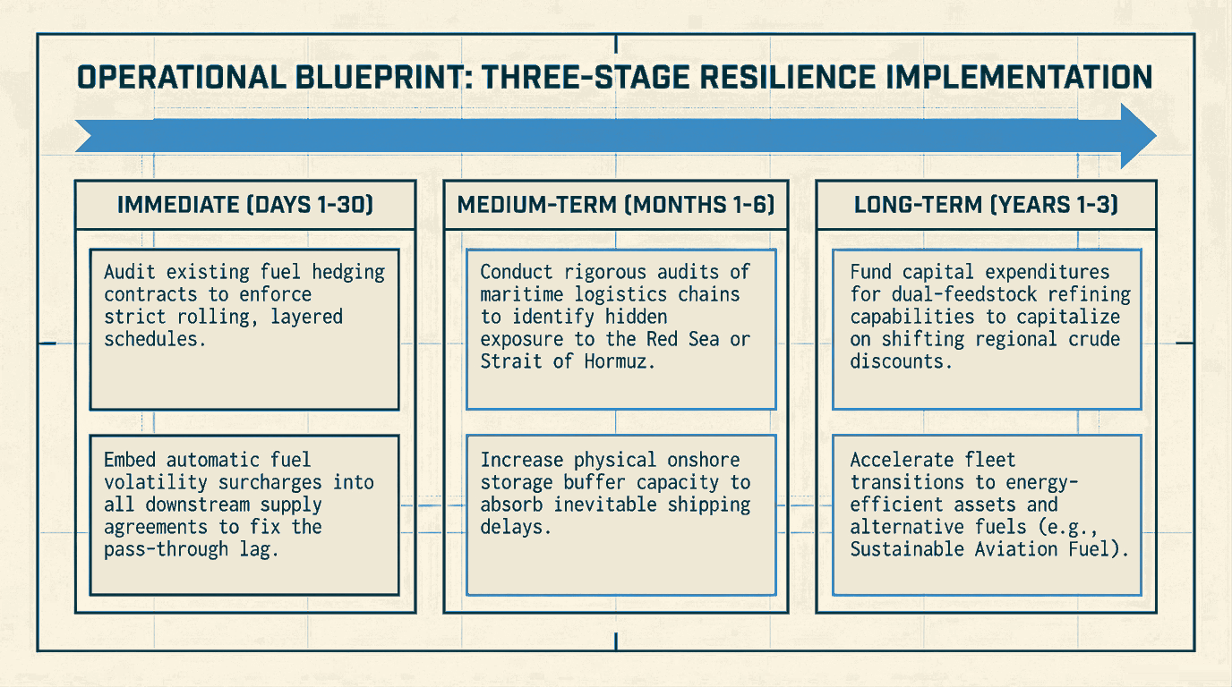

Slide 13
Key Data Sources & References
Brent Crude Spot Prices & Historical Volatility
• U.S. Energy Information Administration (EIA) Spot Prices (eia.gov)
• St. Louis Fed (FRED) Economic Database - Series DCOILBRENTEU (fred.stlouisfed.org)
Indian Crude Sourcing & Import Statistics
• Ministry of Petroleum & Natural Gas, India - PPAC (ppac.gov.in)
• Ministry of Commerce & Industry, India - Import Export Data Bank (commerce.gov.in)
• Shipment Tracking: Vortexa Analytics & Kpler Tanker Flow Databases
Maritime Chokepoints & Logistics Economics
• EIA World Oil Transit Chokepoints Brief (Strait of Hormuz & Bab al-Mandab)
• UNCTAD Reports on Red Sea Navigation Disruptions (2024–2026)
• Freight Rate & Insurance Indices: Clarksons Research & Drewry
Sanctions & Price Cap Compliance Frameworks
• G7 Price Cap Coalition Compliance Advisories (OFAC & EU DG FISMA)
• International Energy Agency (IEA) Monthly Oil Market Reports
Aviation Industry Transmission & Hedging Strategy
• IATA Jet Fuel Price Monitor & Refined Kerosene Crack Spreads (iata.org)
• Corporate Disclosures: InterGlobe Aviation (IndiGo) & Delta Air Lines Annual 10-K Filings
Playbook Code & Data Repository
• GitHub Repository: github.com/jozee-io/oil-geopolitics-2022-2026

