Slide 1

MS Synthetic Library
Bc. Petronela belková
Bc. Jozef vargan
Bc. Michal holub
2022/2023
Notes:
Michal

Slide 2
Problem Definition
Mass spectrometry:
Analytical method
Unrivaled sensitivity
Low detection limits
Huge amount of data
Synthetic spectral libraries:
Cover blank spaces in database
Better availability and retreivability of compounds
Notes:
Michal

Slide 3
Aims of the Project
Load mass spectrometry data from two different in-silico spectral libraries
Evaluate defined criteria on both libraries
Compare performance of both libraries
Notes:
Michal

Slide 4
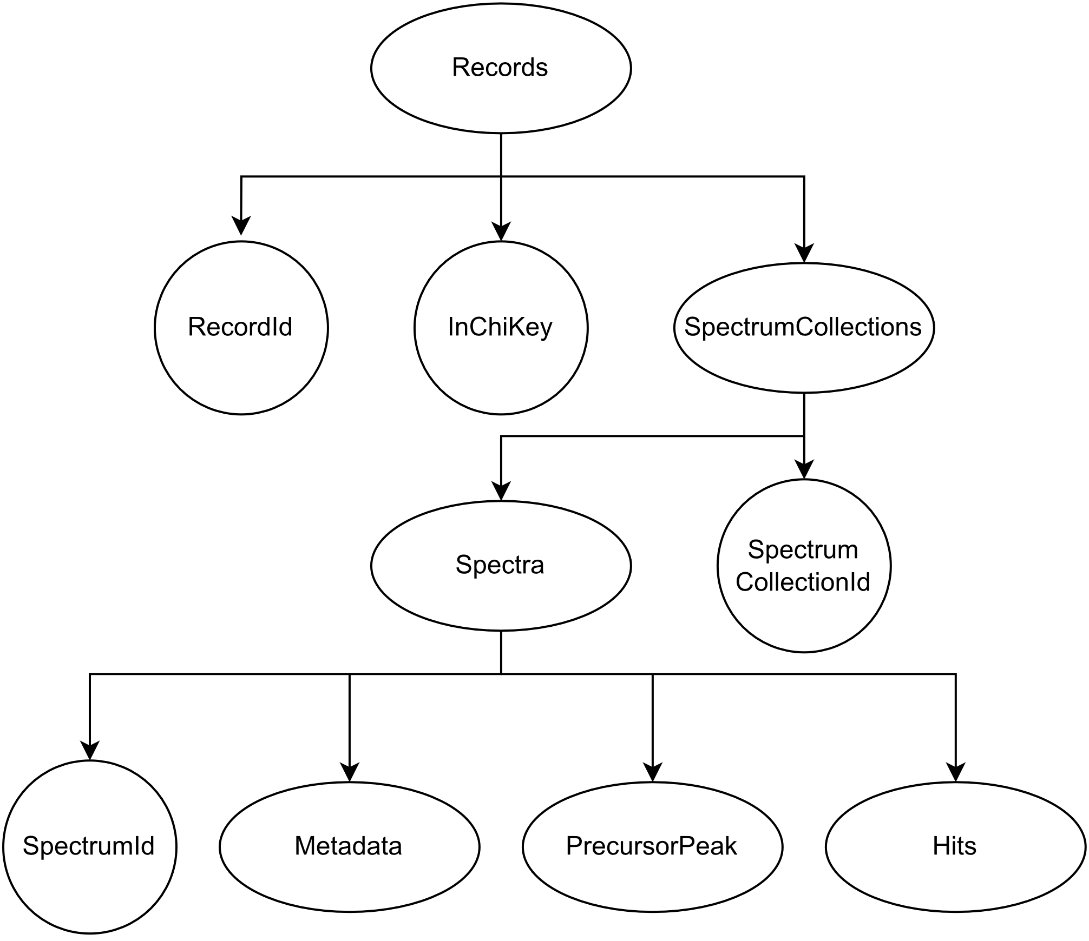
Results
Data Extraction
Format: JSON
More than 90 records for each library
Each record has metadata
Each record can have multiple hits
Notes:
Michal

Slide 5
Results
Create a binary column of whether the hit is true-positive or false-positive
Synthetic search
Barcode search
Hit | InChIKey | InChIKey_hits | Positivity
0 | 33 | 33 | True
1 | 33 | 27 | False
2 | 33 | 27 | False
... | ... | ... | ...
299 | 34 | 34 | True
Hit | InChIKey | InChIKey_hits | Positivity
0 | 33 | 33 | True
1 | 33 | 27 | False
2 | 24 | 24 | True
... | ... | ... | ...
266 | 34 | 69 | False
Notes:
Jozef

Slide 6
Results
Compute the difference between experimental conditions
Synthetic search
Barcode search
Hit | Polarity | ScanRange Max | ScanRange Min | NCE | Ion Activation
0 | 1.0 | 0.194655 | 0.0 | 0.15790 | 1.0
1 | 1.0 | 0.194655 | 0.0 | 0.15790 | 1.0
2 | 1.0 | 0.194655 | 0.0 | 0.02632 | 1.0
... | ... | ... | ... | ... | ...
299 | 1.0 | 0.113322 | 0.0 | 0.10526 | 0.0
Hit | Polarity | ScanRange Max | ScanRange Min | NCE | Ion Activation
0 | 0.0 | 0.194655 | 0.0 | 0.05263 | 1.0
1 | 0.0 | 0.194655 | 0.0 | 0.05263 | 1.0
2 | 0.0 | 0.194821 | 0.0 | 0.05263 | 0.0
... | ... | ... | ... | ... | ...
266 | 0.0 | 0.113322 | 0.0 | 0.05263 | 0.0
Notes:
Jozef

Slide 7
Results
For each compound compute the number of correct hits and incorrect hits
Synthetic search
Barcode search
recordId | InChIKey | Correct hits | Incorrect hits
0 | 33 | 1 | 2
1 | 24 | 1 | 0
2 | 44 | 2 | 1
... | ... | ... | ...
94 | 34 | 2 | 0
recordId | InChIKey | Correct hits | Incorrect hits
0 | 33 | 1 | 1
1 | 24 | 1 | 0
2 | 44 | 1 | 1
... | ... | ... | ...
93 | 34 | 1 | 1
Notes:
Jozef

Slide 8
Results
Relate the ranking of candidates based on their score to the number of potential hits
Synthetic search
Barcode search
Hit | Cosine relative rank | Denver relative rank | NIST relative rank
0 | 0.0 | 0.0 | 0.0
1 | 0.5 | 0.5 | 0.5
2 | 1.0 | 1.0 | 1.0
... | ... | ... | ...
299 | 0.0 | 1.0 | 0.0
Hit | Cosine relative rank | Denver relative rank | NIST relative rank
0 | 0.0 | 0.0 | 0.0
1 | 1.0 | 1.0 | 1.0
2 | 0.0 | 0.0 | 0.0
... | ... | ... | ...
266 | 1.0 | 1.0 | 1.0
Notes:
Peťa

Slide 9
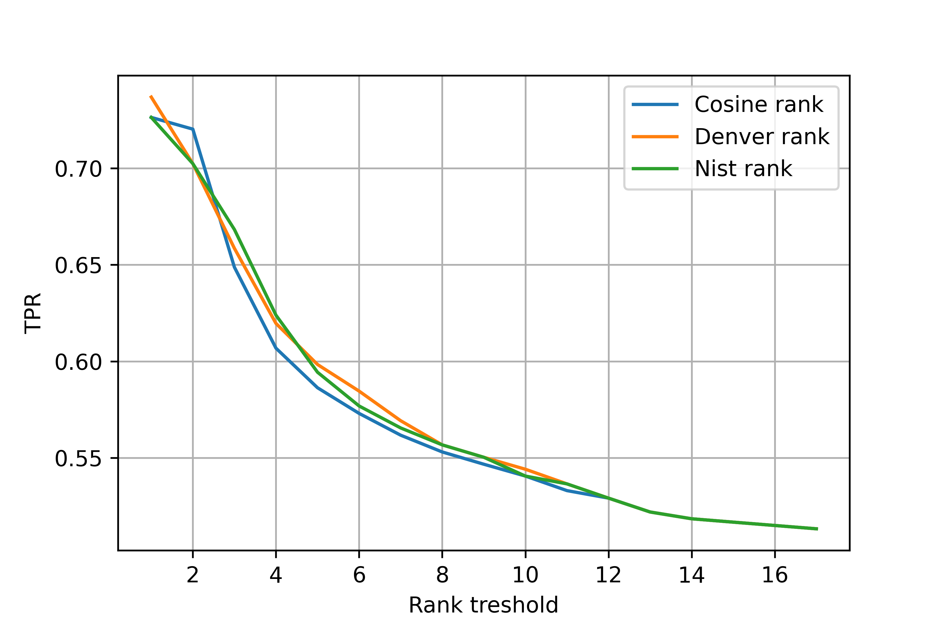
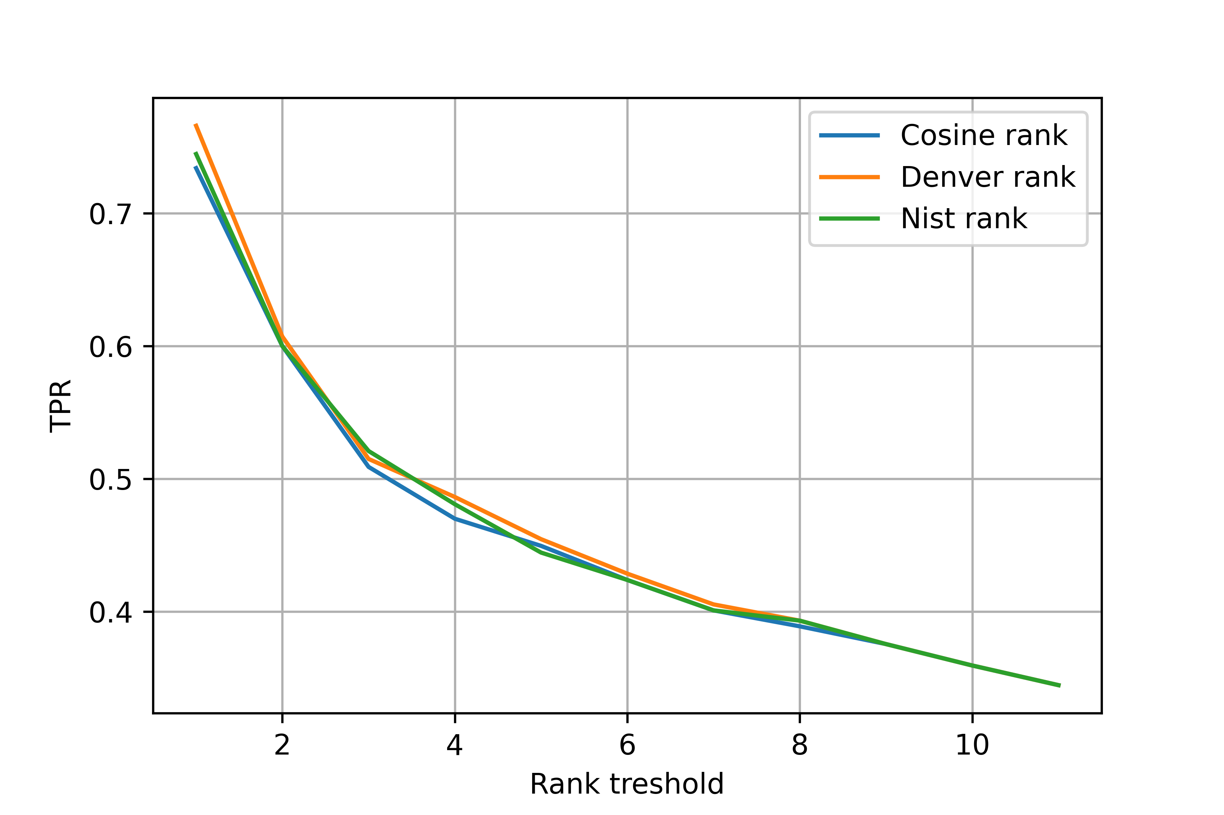
Results
Plot true-positive rate vs. rank threshold
Synthetic search
Barcode search
Notes:
Peťa

Slide 10
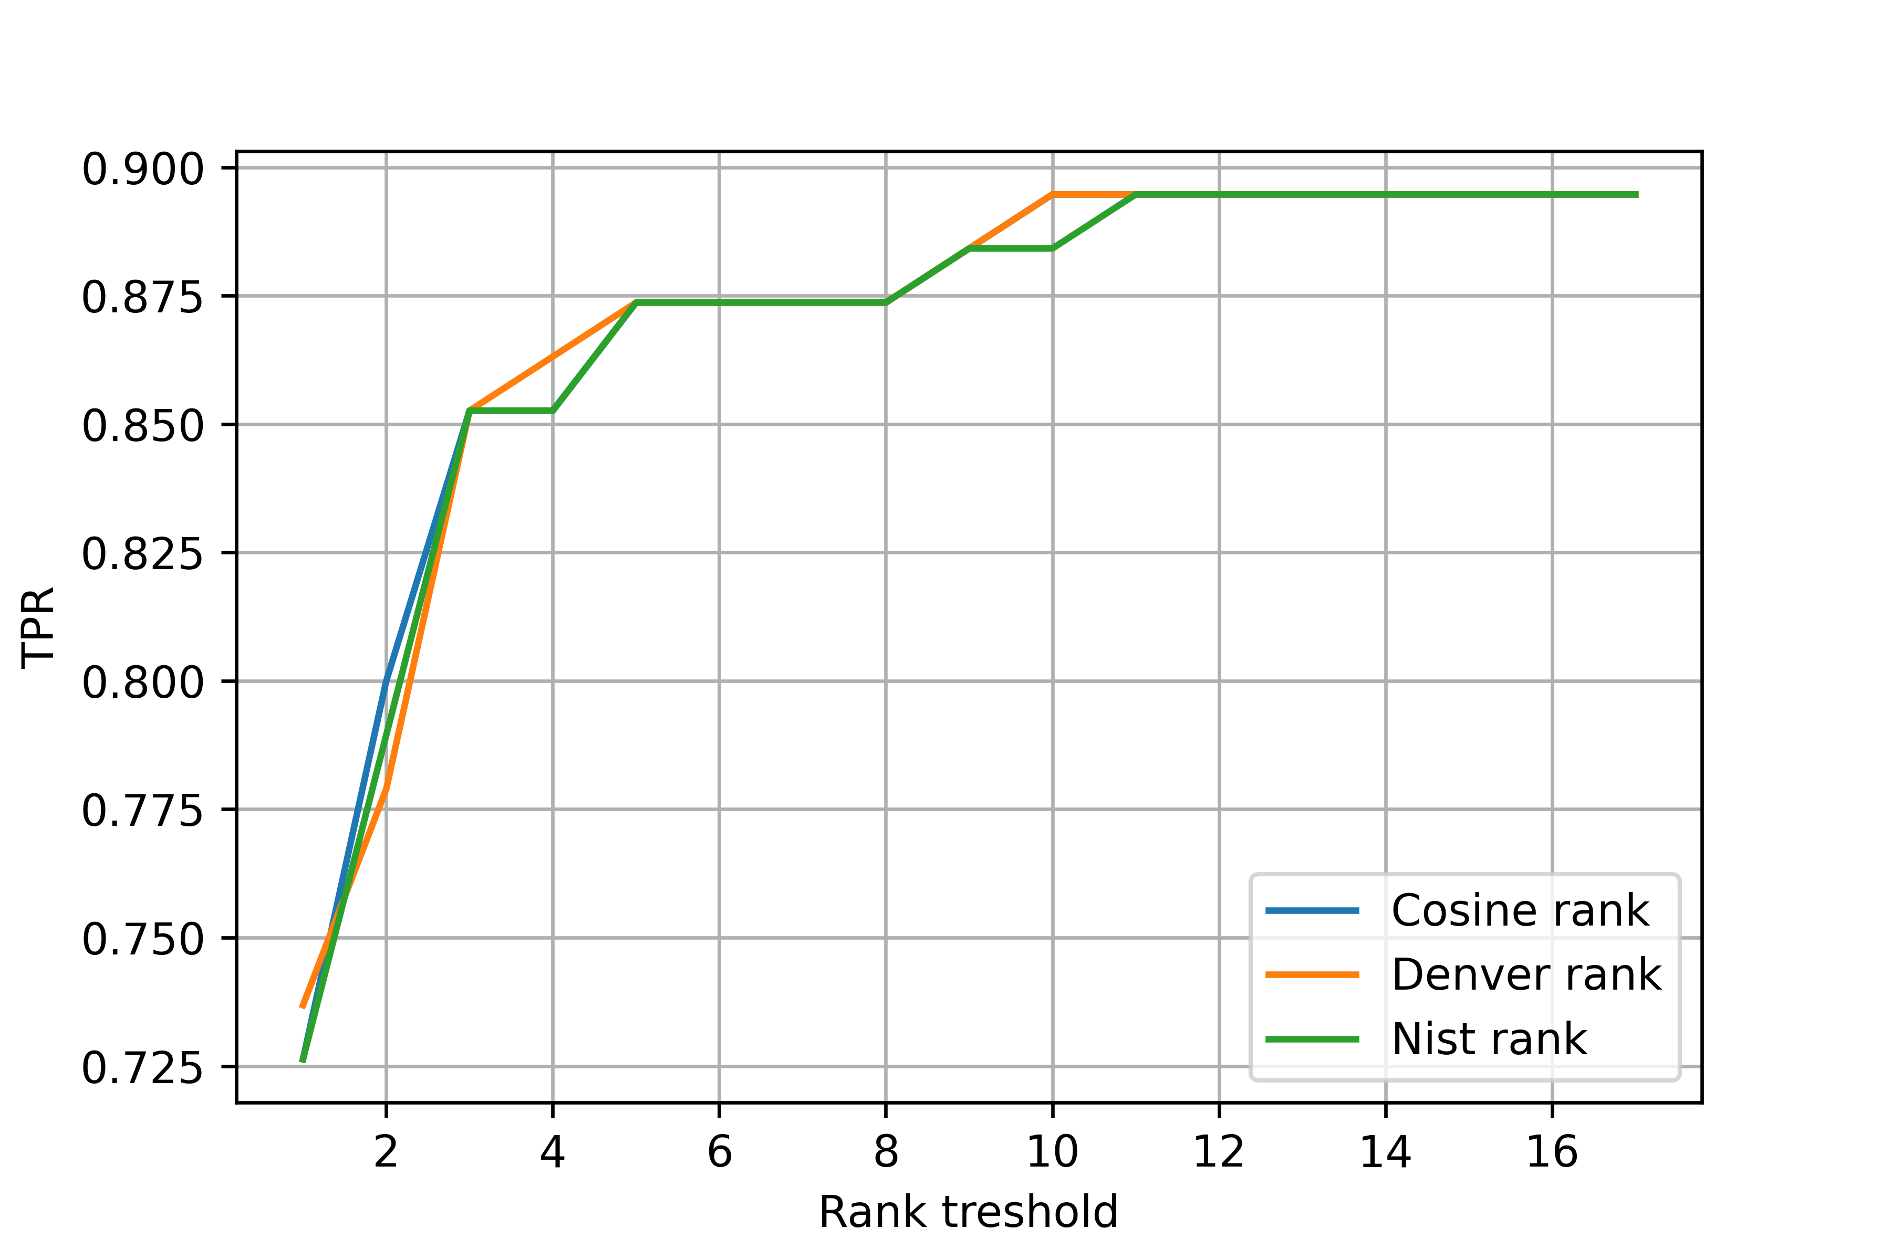
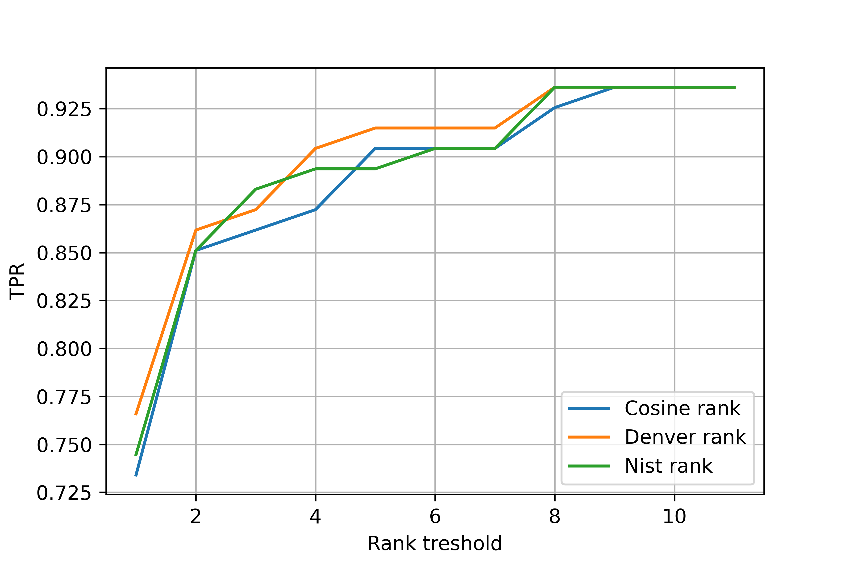
Results
Plot true-positive rate vs. rank threshold (alternative)
Synthetic search
Barcode search
Notes:
Peťa

Slide 11
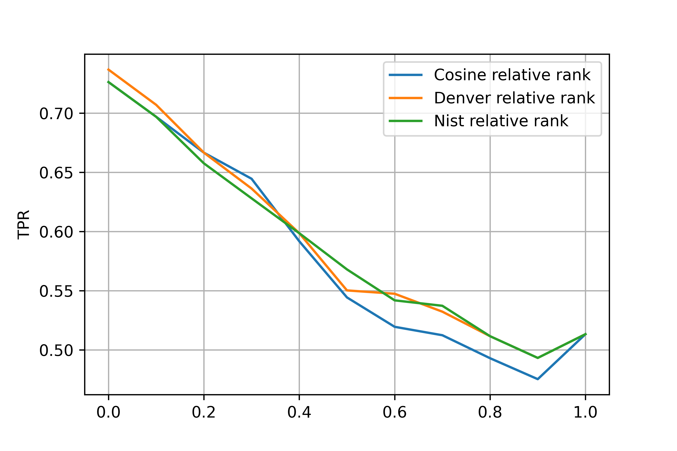
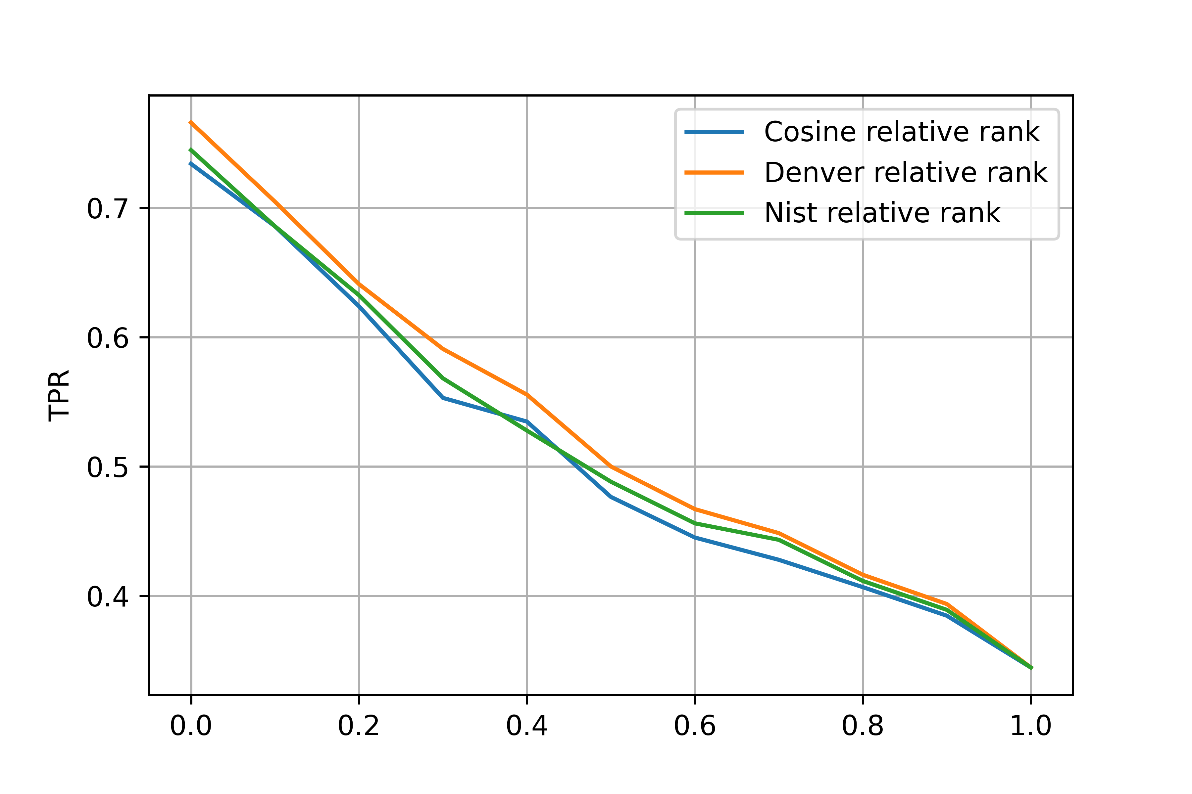
Results
Plot true-positive rate vs. relative rank threshold
Synthetic search
Barcode search
Notes:
Peťa

Slide 12
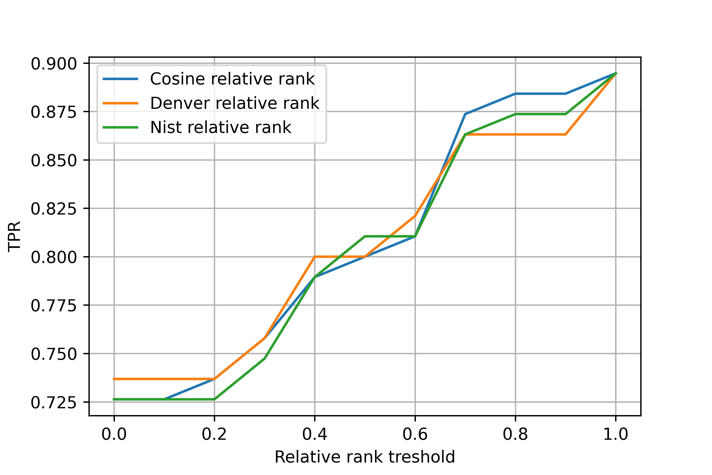
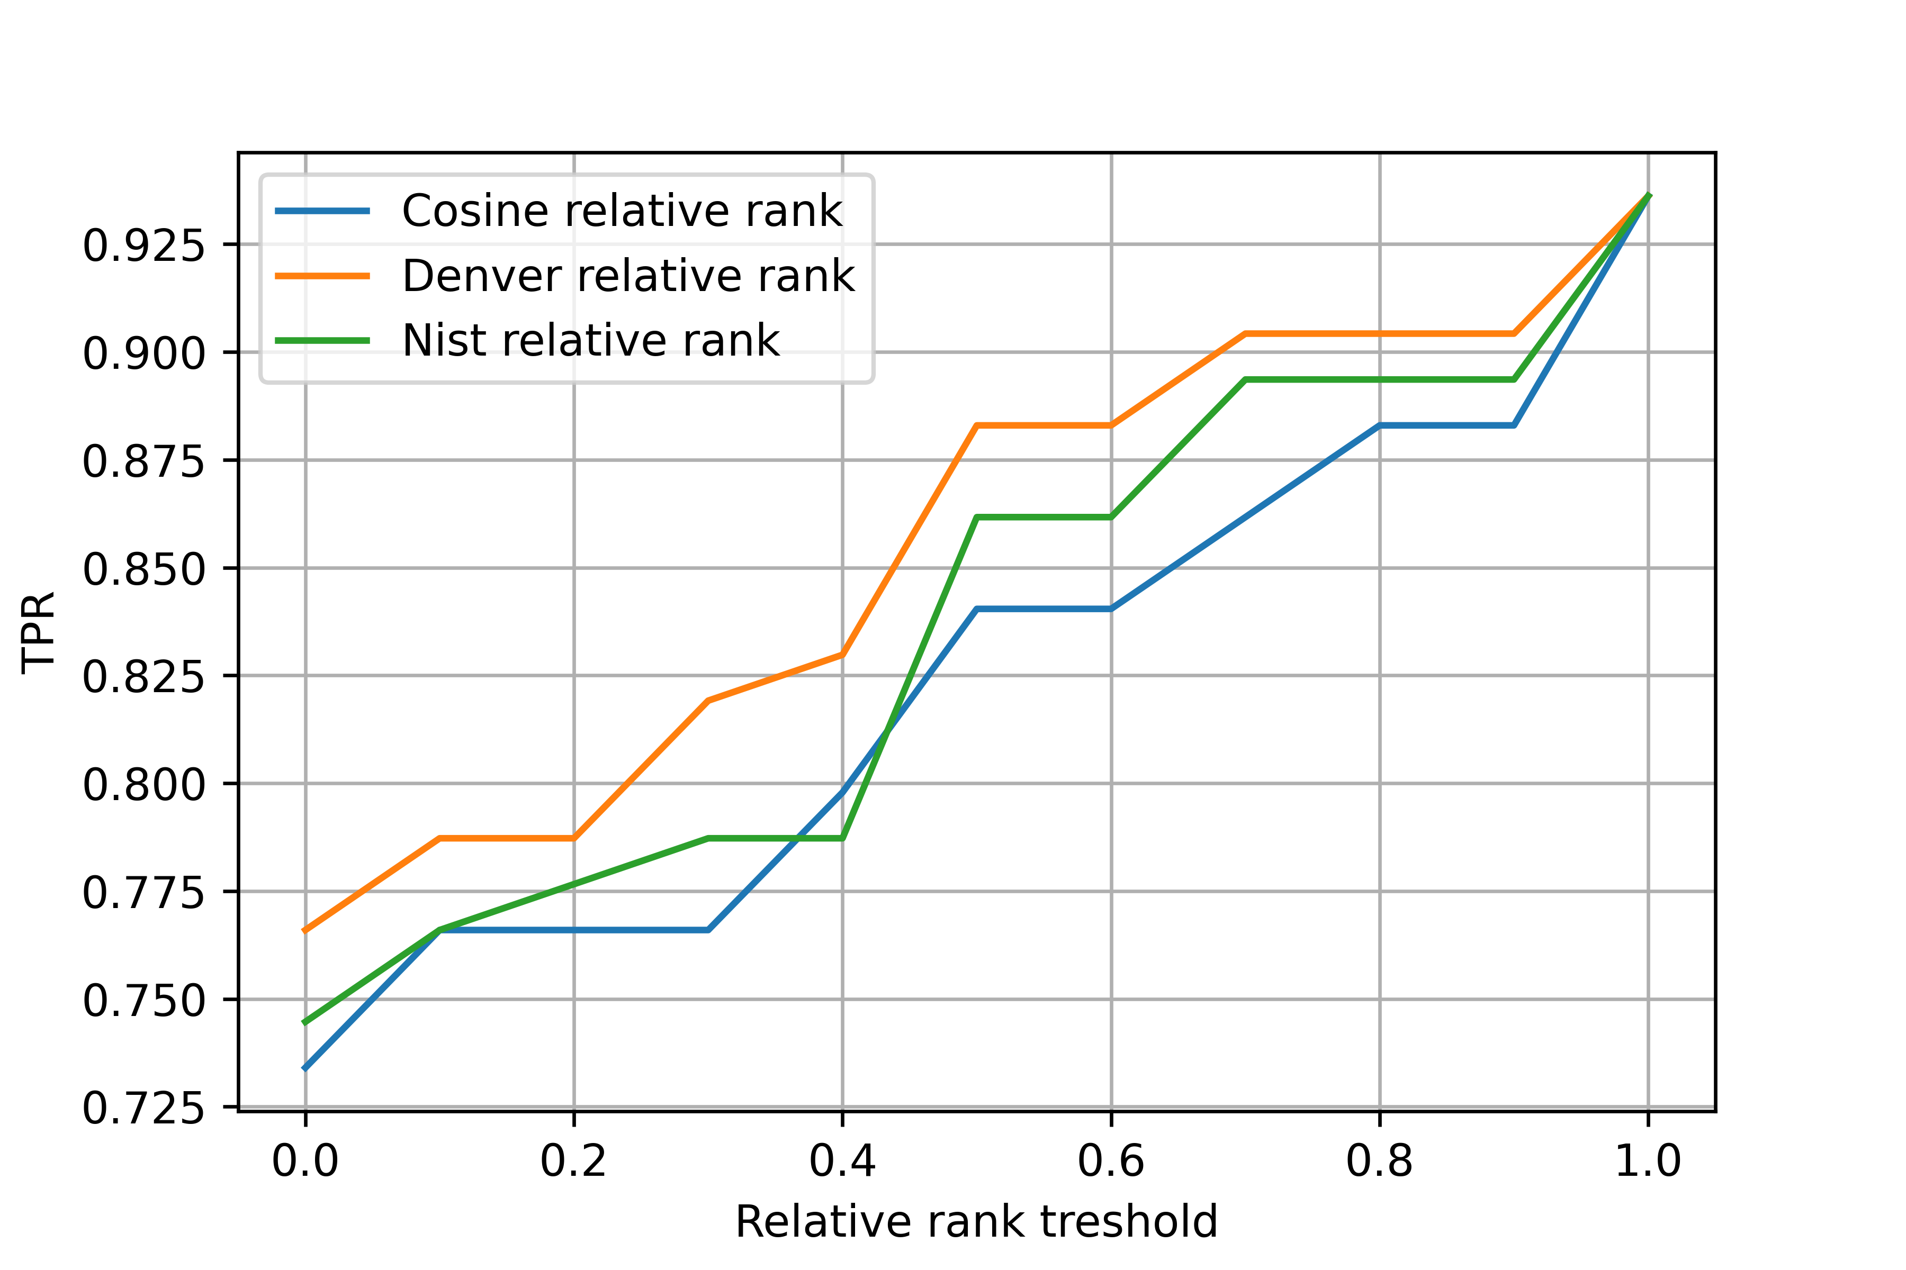
Results
Plot true-positive rate vs. relative rank threshold (alternative)
Synthetic search
Barcode search
Notes:
Peťa

Slide 13
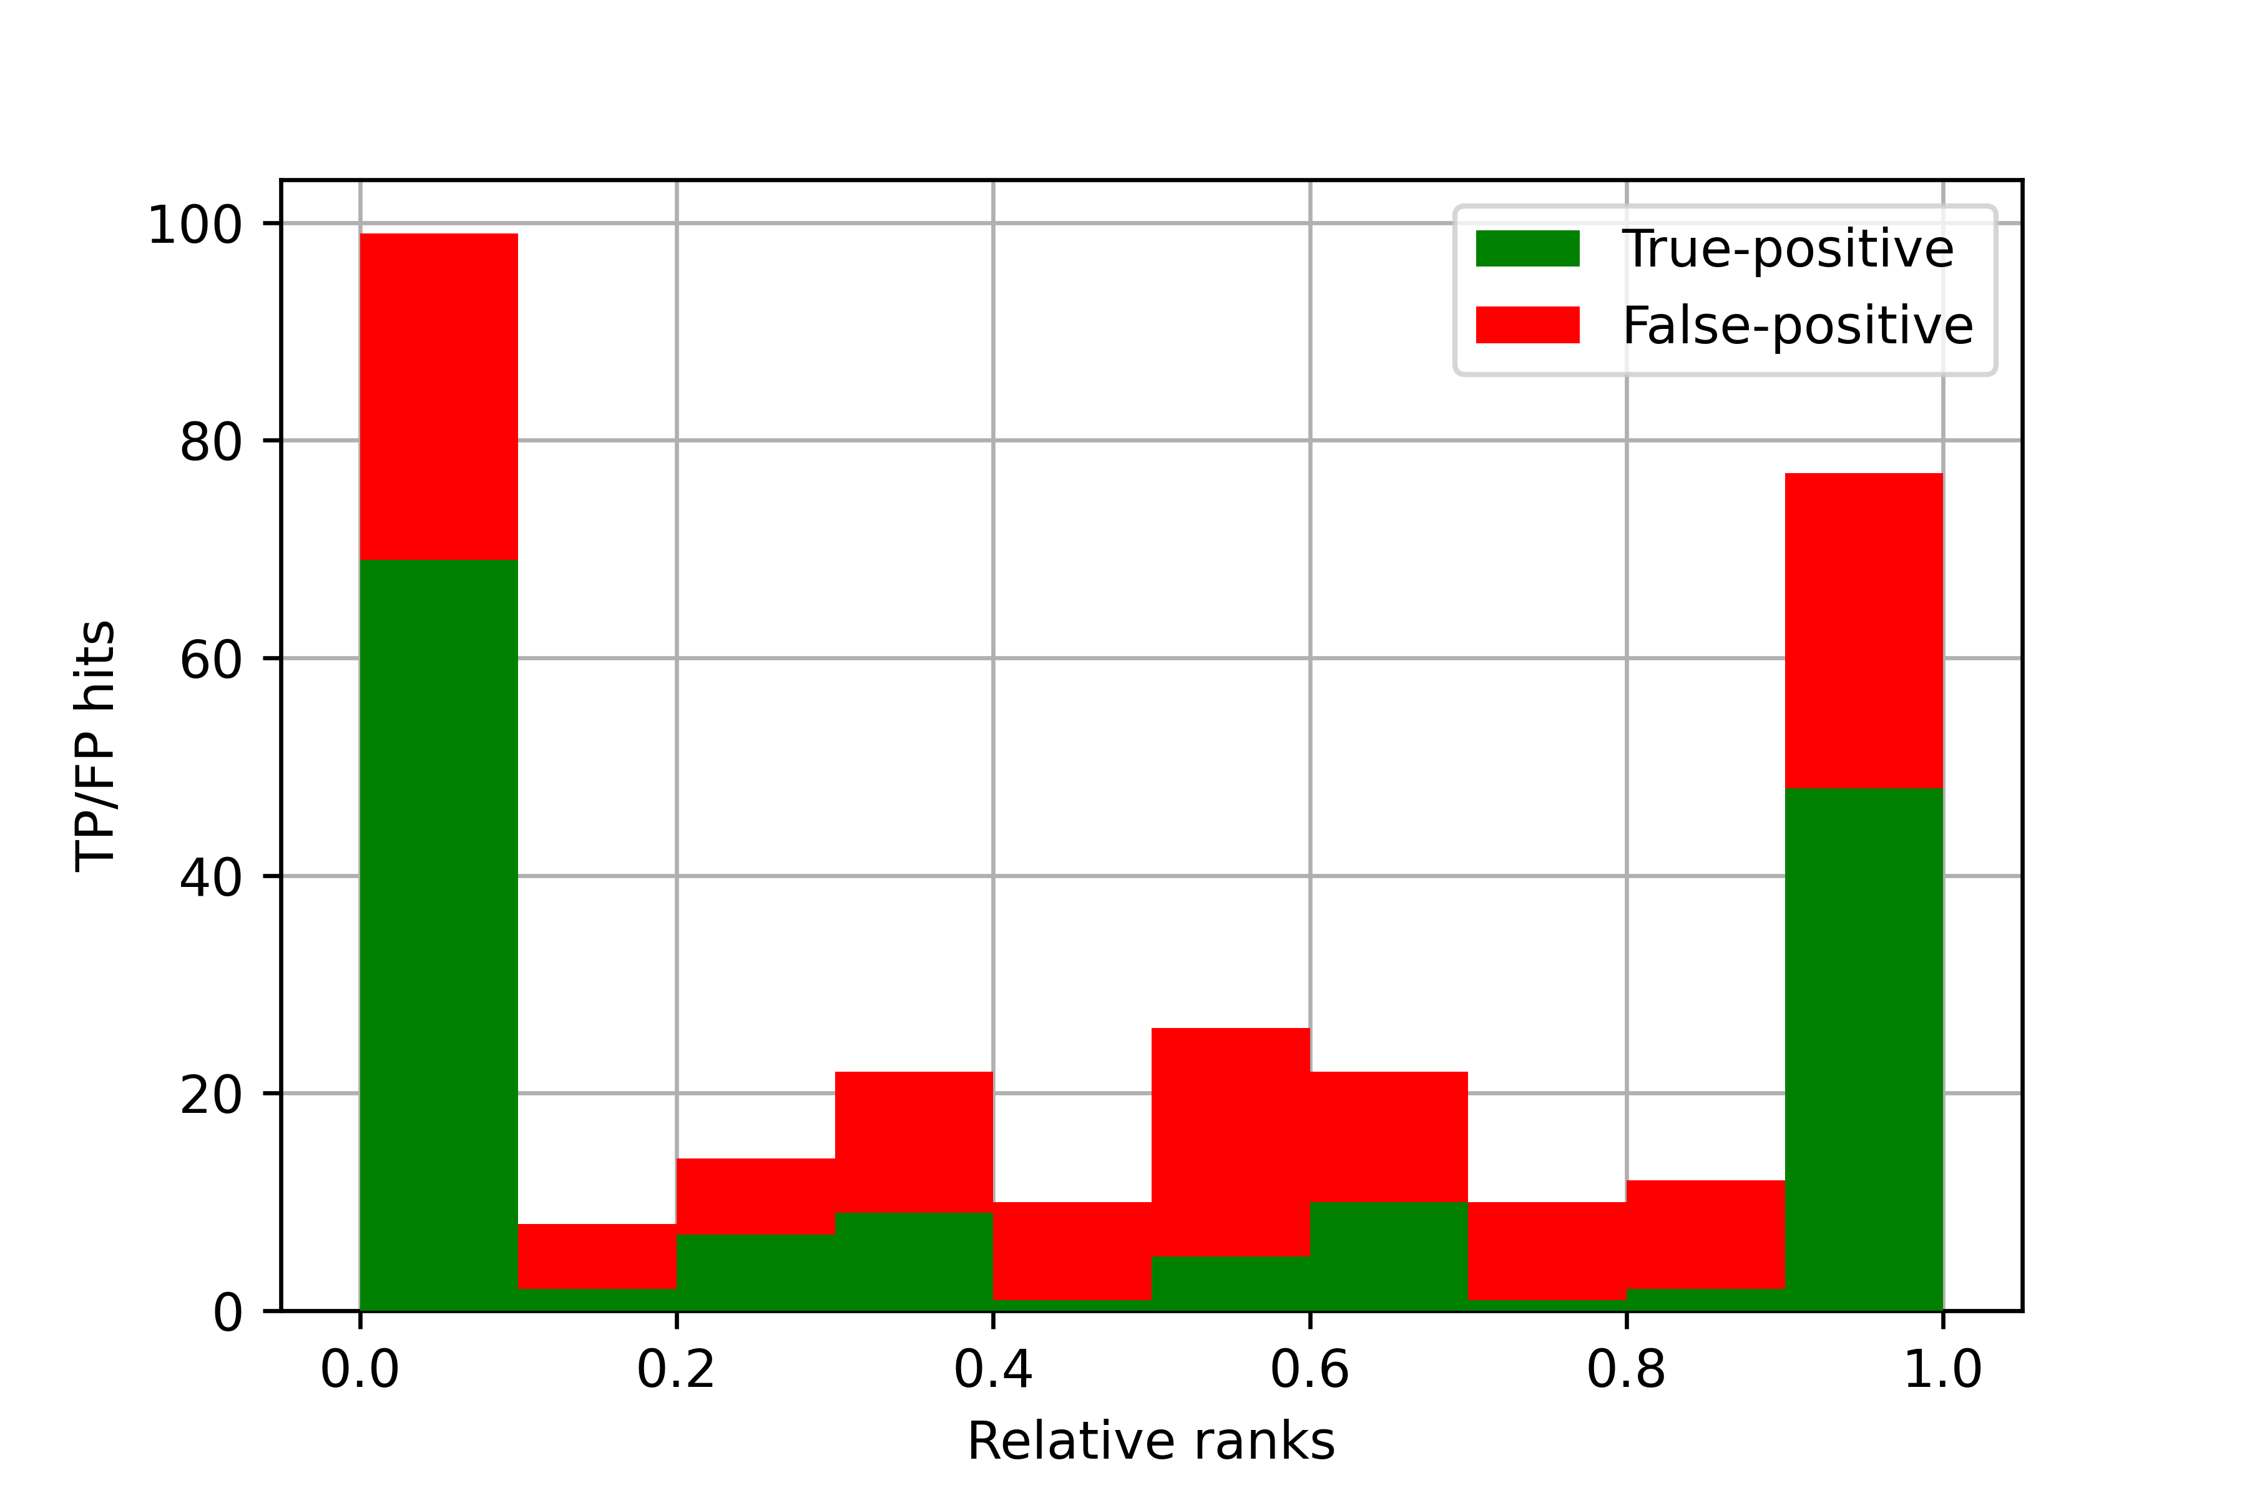
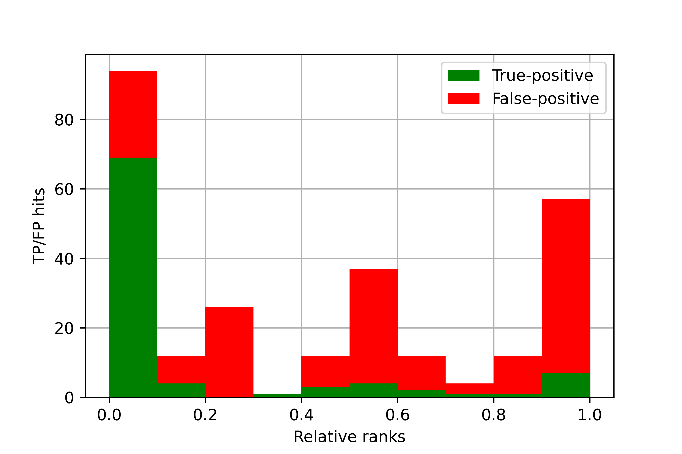
Results
Plot histogram for each metric distinguishing true-positive hits and false-positive hits
Synthetic search – Cosine rank
Barcode search – Cosine rank
Notes:
Jozef

Slide 14
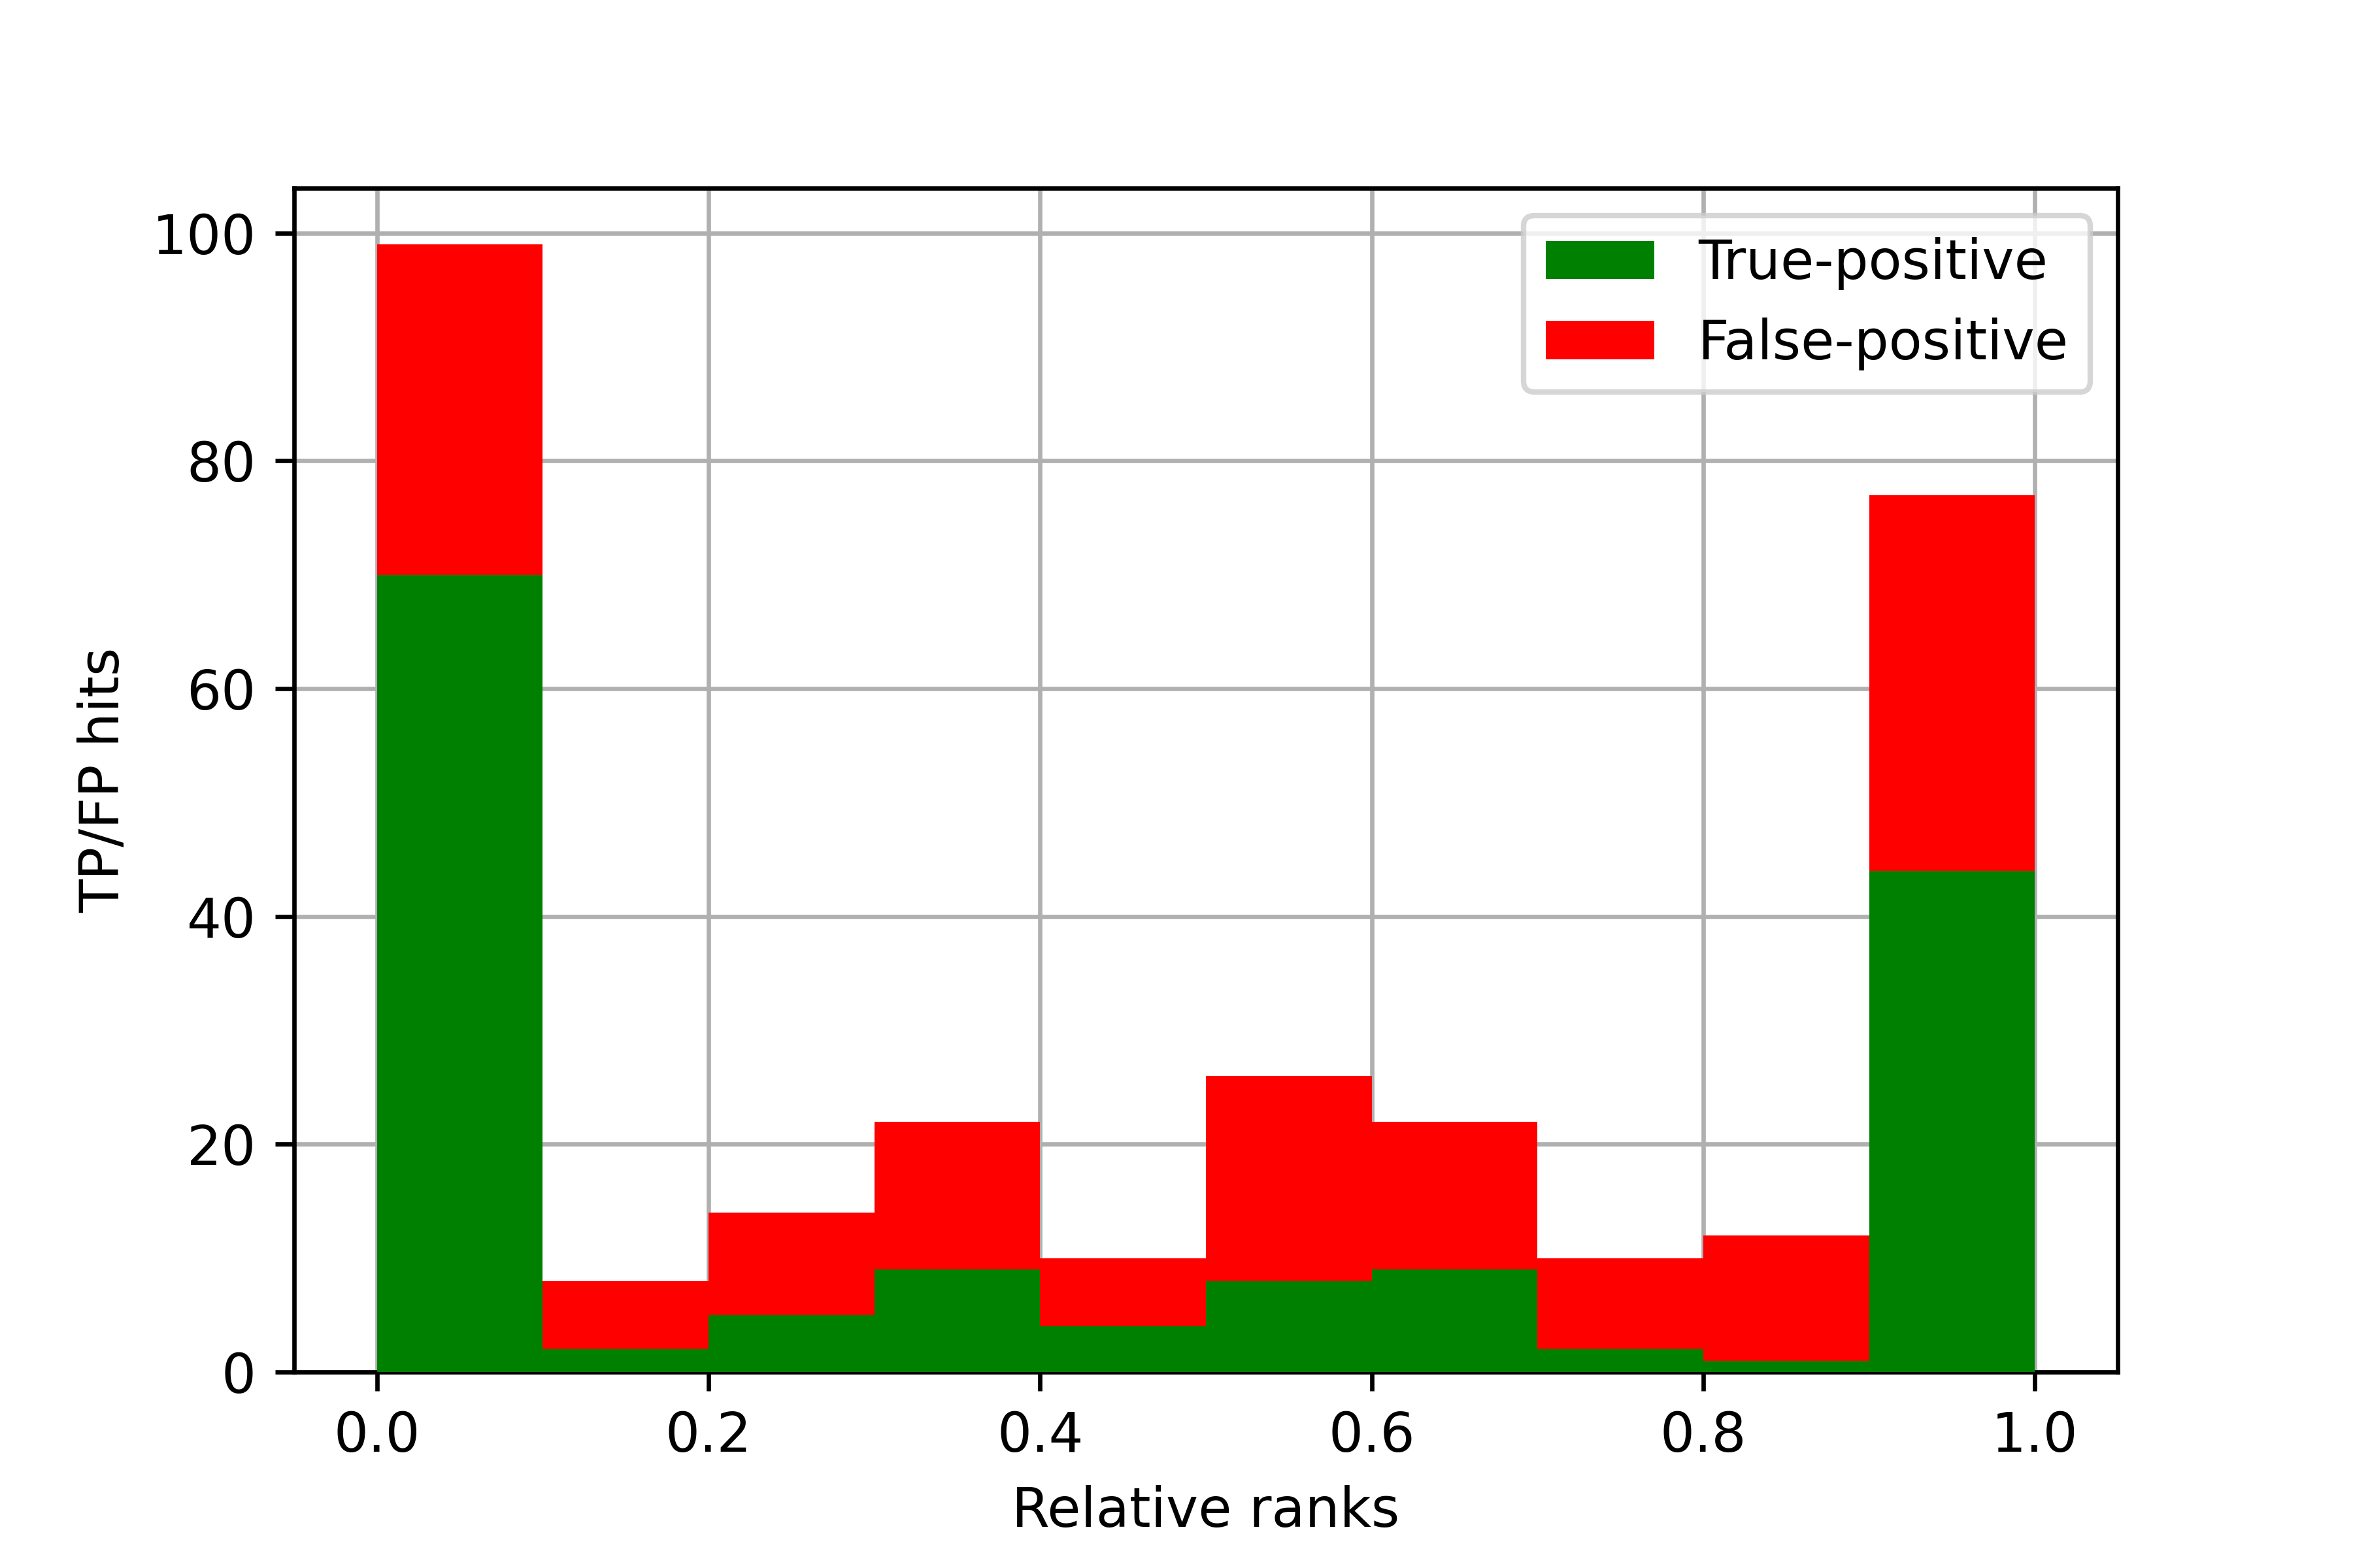

Results
Plot histogram for each metric distinguishing true-positive hits and false-positive hits
Synthetic search – Denver rank
Barcode search – Denver rank
Notes:
Jozef

Slide 15


Results
Plot histogram for each metric distinguishing true-positive hits and false-positive hits
Synthetic search – Nist rank
Barcode search – Nist rank
Notes:
Jozef

Slide 16
Results
Render correlation between deviation in experimental conditions and TP/FP hits
Synthetic search
Barcode search
 | Pearson | Spearman
Analyzer | - | -
Polarity | - | -
ScanRangeMax | 0.1276 | 0.1248
ScanRangeMin | - | -
MsStageTarget | - | -
NCE | 0.0904 | 0.0811
IonActivation | -0.0707 | -0.0707
 | Pearson | Spearman
Analyzer | - | -
Polarity | - | -
ScanRangeMax | 0.2063 | 0.1743
ScanRangeMin | 0.1197 | 0.1198
MsStageTarget | - | -
NCE | 0.2161 | 0.2710
IonActivation | 0.1451 | 0.1451
Notes:
Jozef

Slide 17
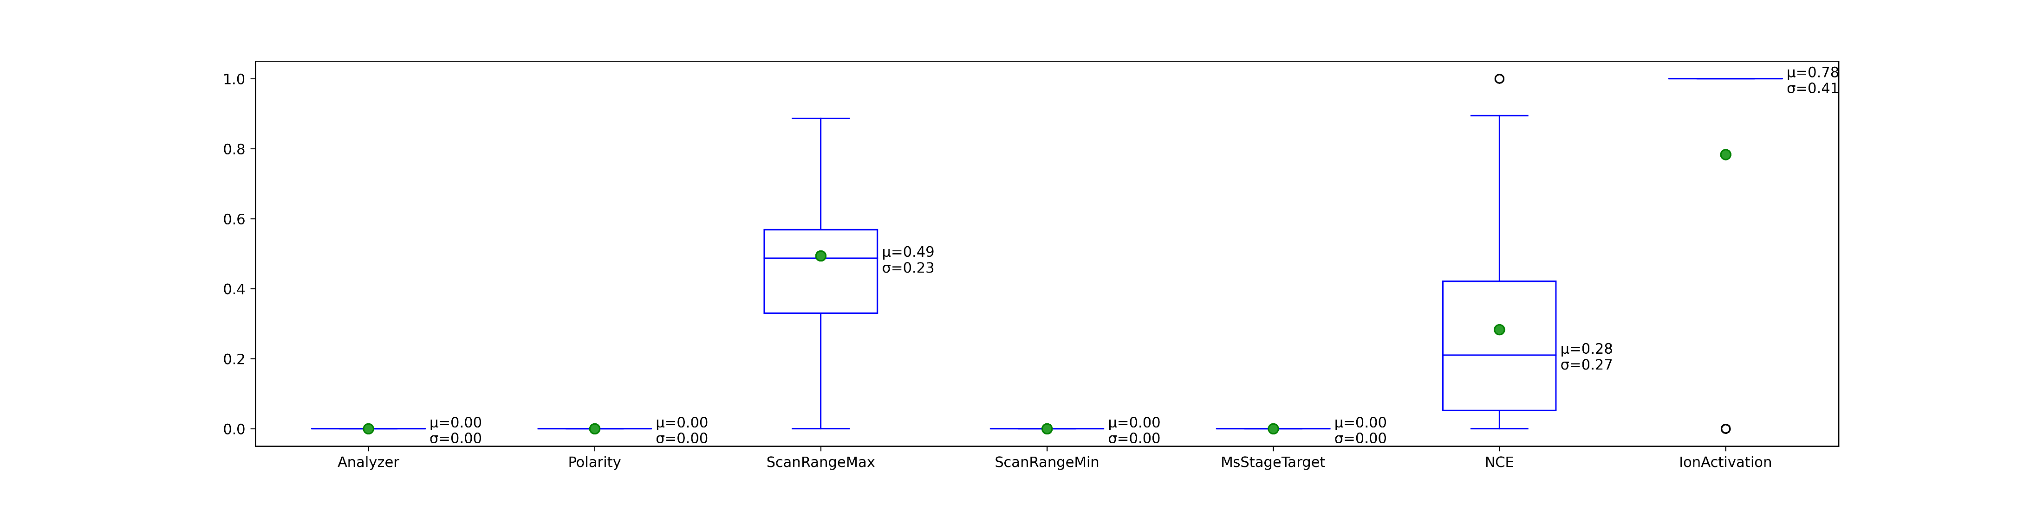
Results
Synthetic search – metadata
Notes:
Jozef

Slide 18
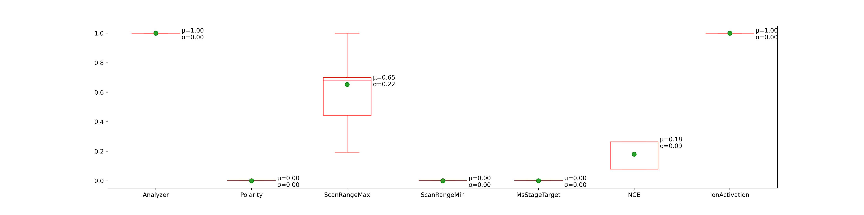
Results
Synthetic search – metadata hits
Notes:
Jozef

Slide 19
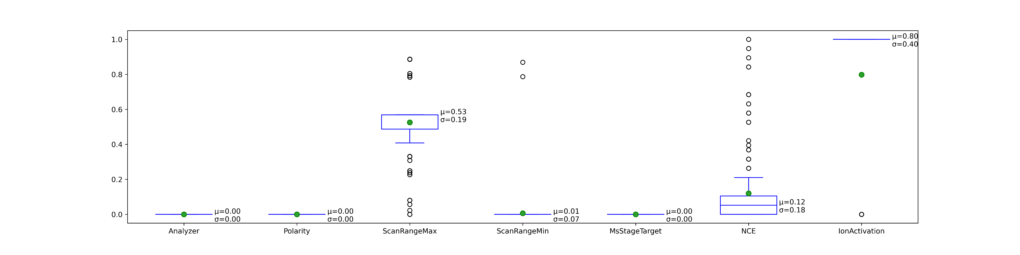
Results
Barcode search – metadata
Notes:
Jozef

Slide 20
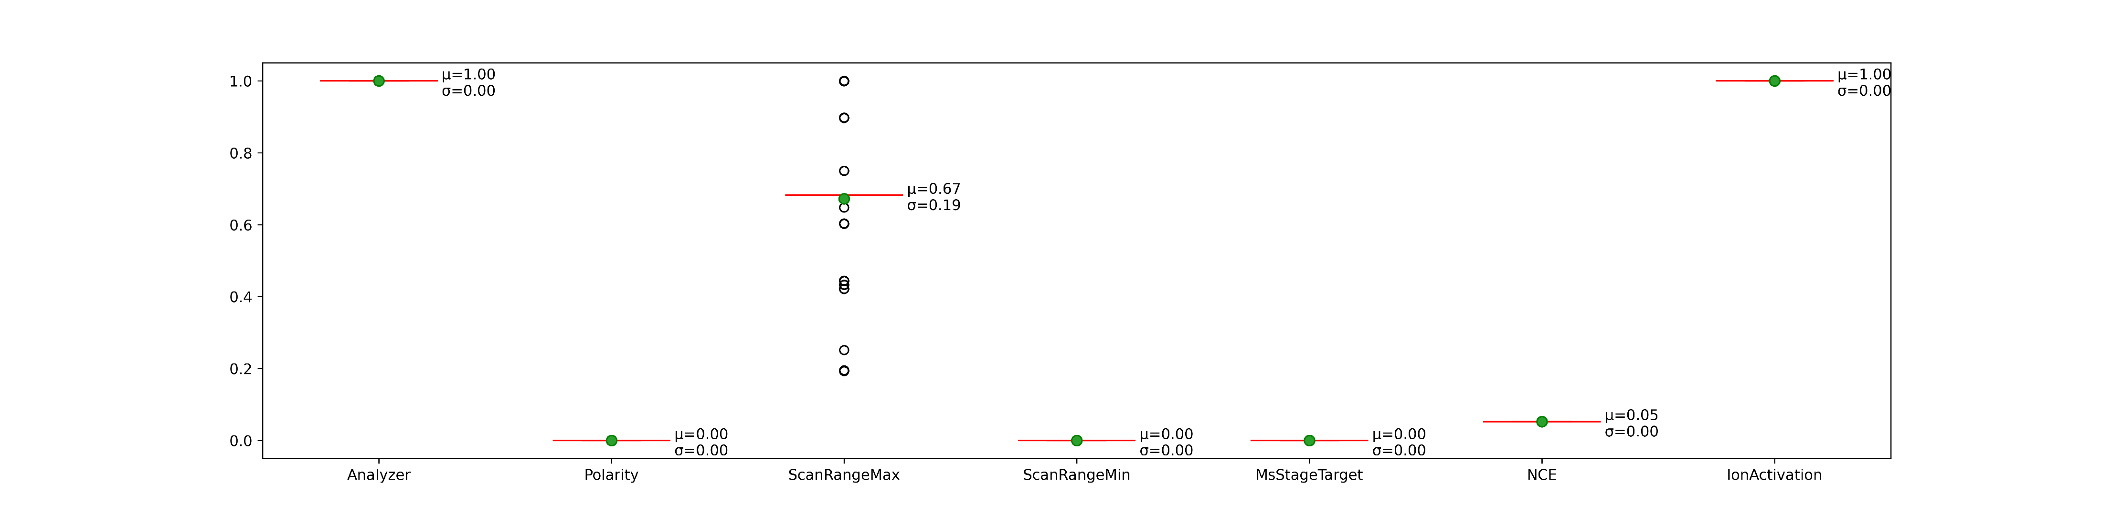
Results
Barcode search – metadata hits
Notes:
Jozef

Slide 21
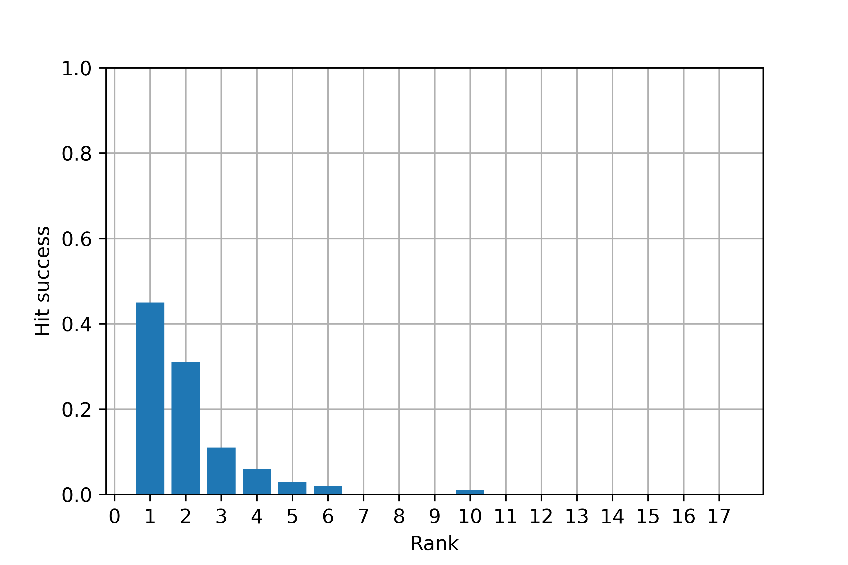
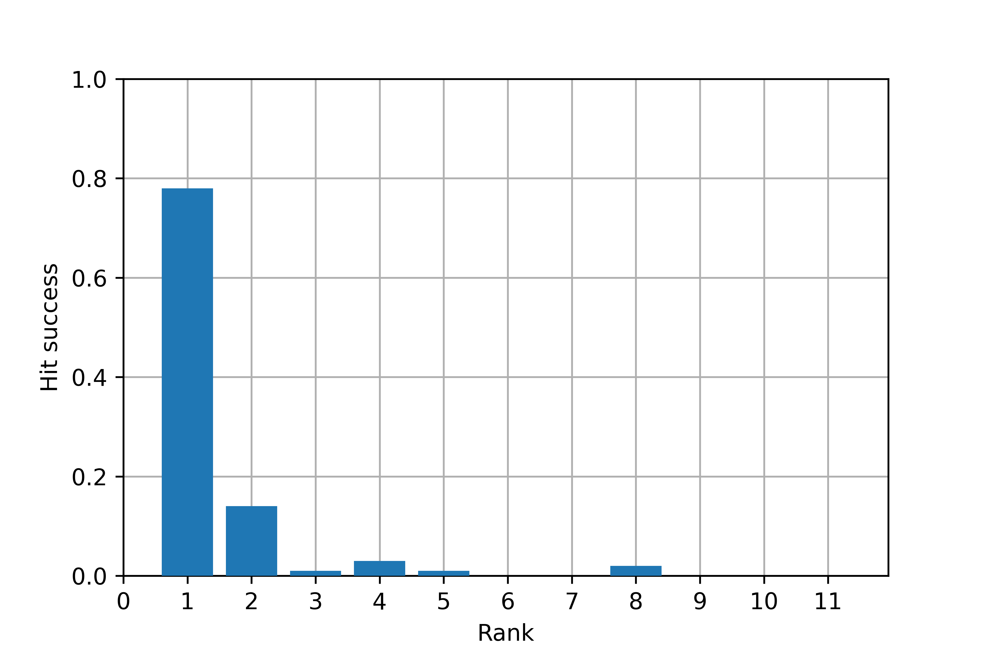
Results
Find a reasonable way to compare the search performance of two libraries
Synthetic search – success rate
Barcode search – success rate
Notes:
Peťa

Slide 22
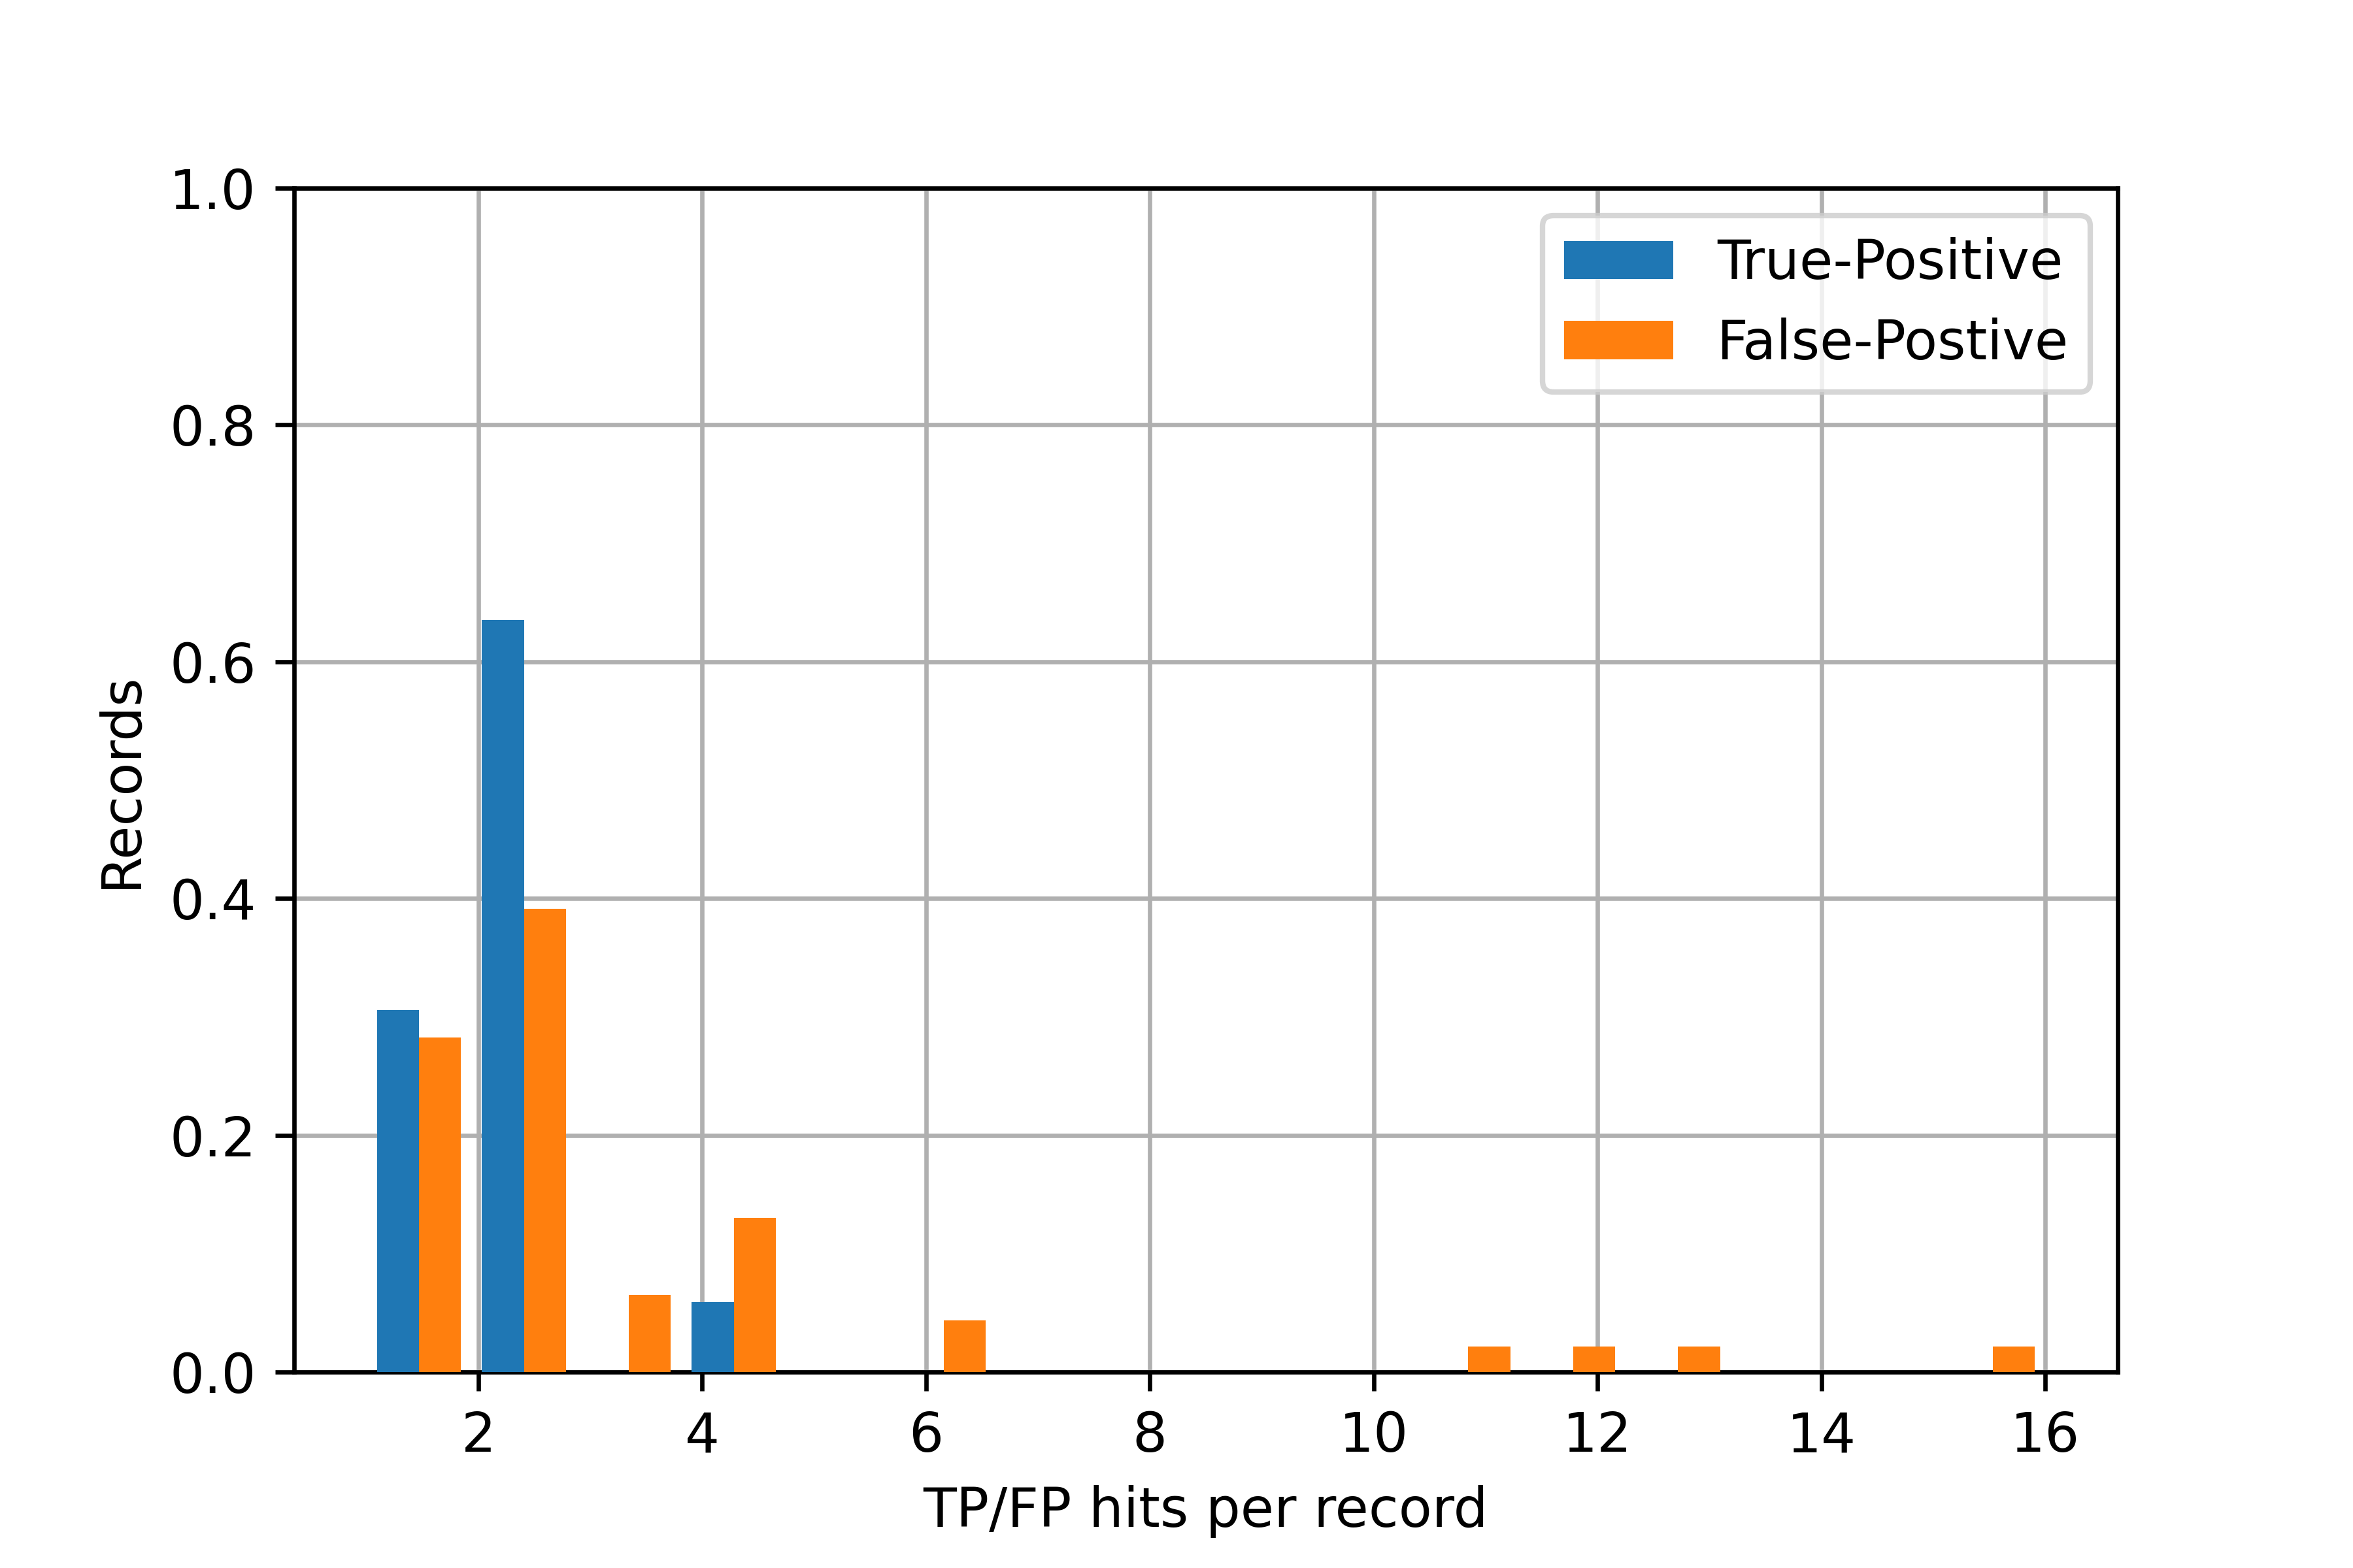
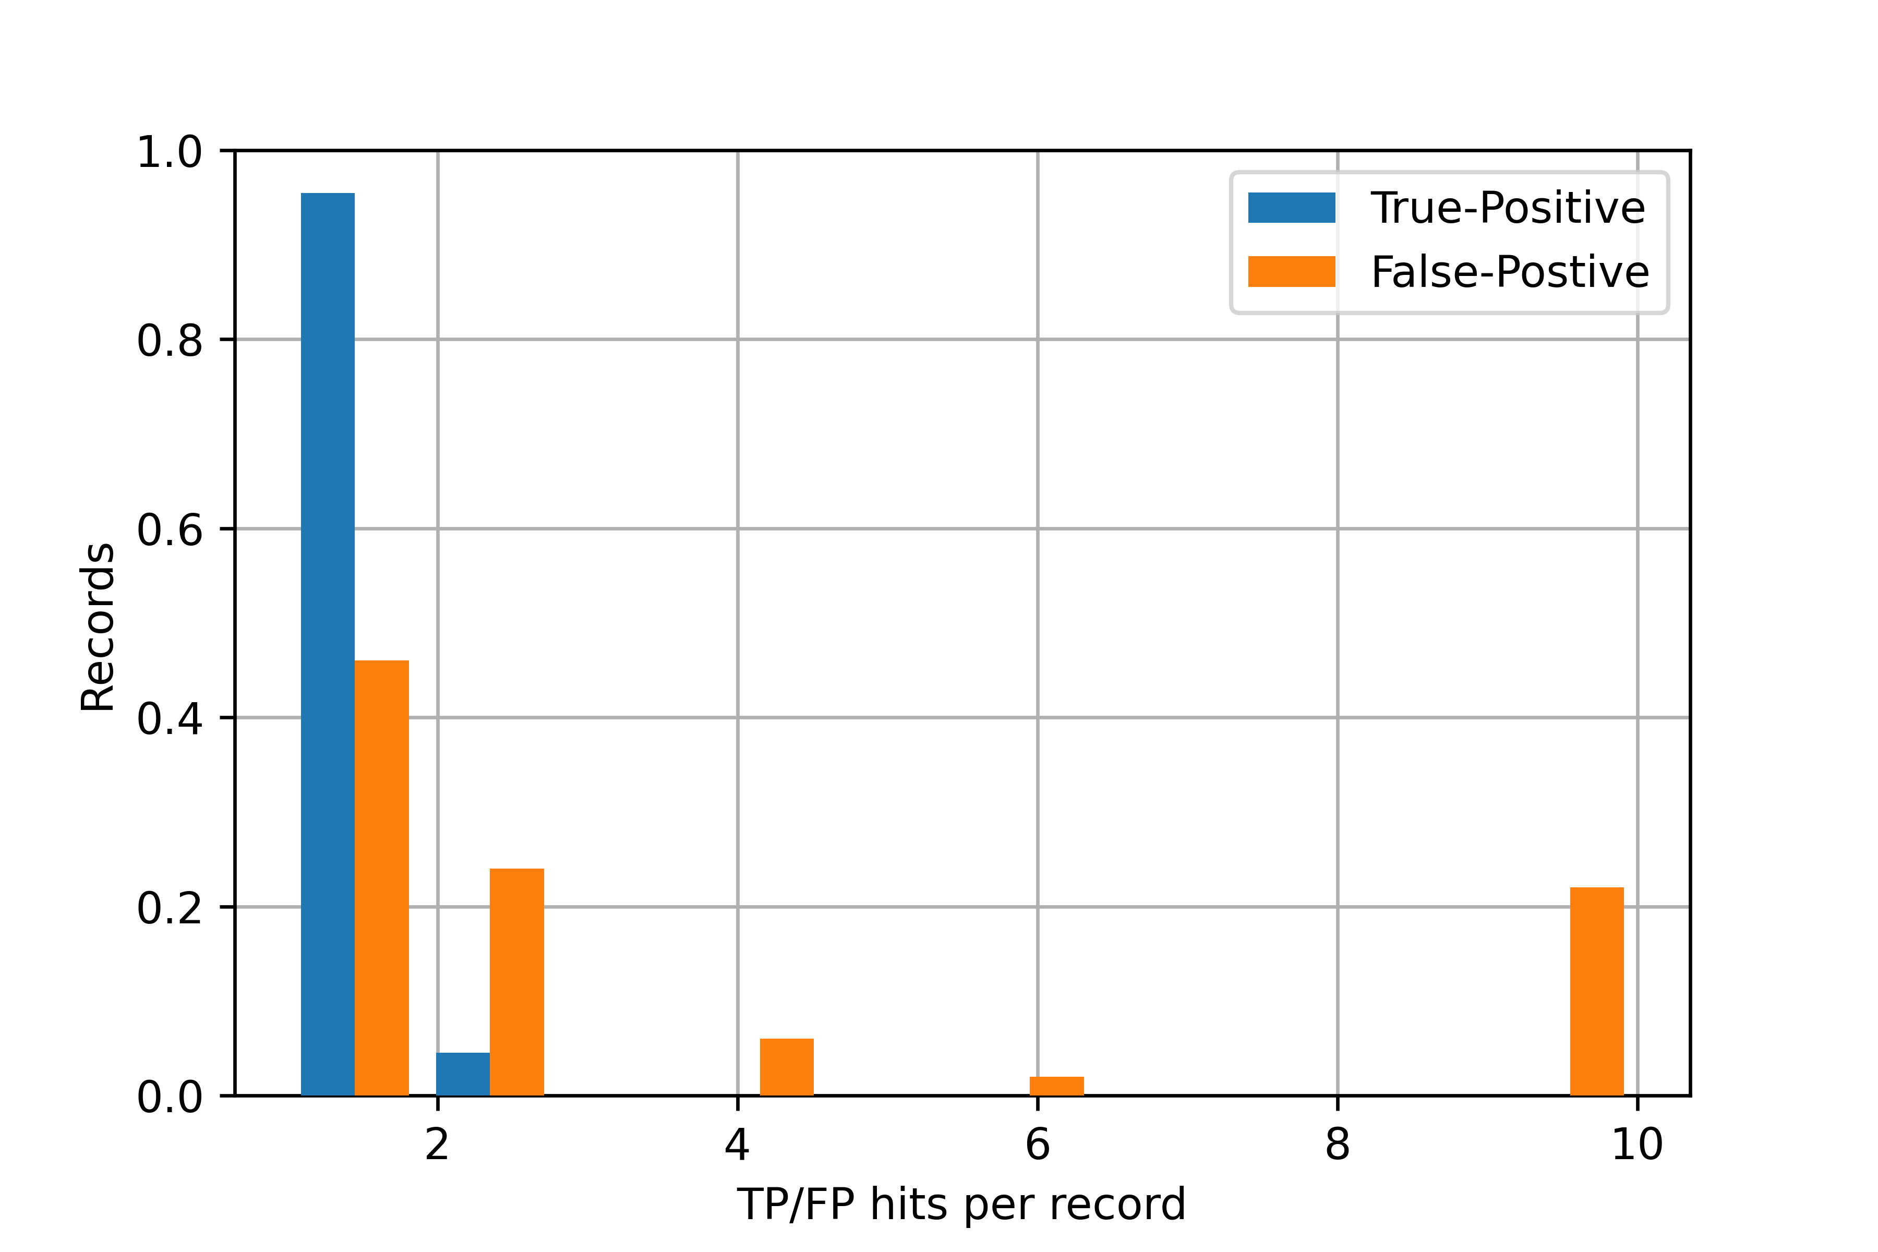
Results
Find a reasonable way to compare the search performance of two libraries
Synthetic search
Barcode search
Notes:
Peťa

Slide 23
Results
Find a reasonable way to compare the search performance of two libraries
Synthetic search
Barcode search
Synthetic
Total records | 95
At least one correct hit | 89.47%
Only incorrect hits | 10.53%
Barcode
Total records | 94
At least one correct hit | 93.62%
Only incorrect hits | 6.38%
Notes:
Michal

