Slide 1

MS Synthetic Library
Bc. Petronela belková
Bc. Jozef vargan
Bc. Michal holub
2022/2023

Slide 2
Problem Definition
Mass spectrometry:
Analytical method
Unrivaled sensitivity
Low detection limits
Huge amount of data
Synthetic spectral libraries:
Cover blank spaces in database
Better availability and retreivability of compounds

Slide 3
Aims of the Project
Load mass spectrometry data from two different in-silico spectral libraries
Evaluate defined criteria on both libraries
Compare performance of both libraries

Slide 4
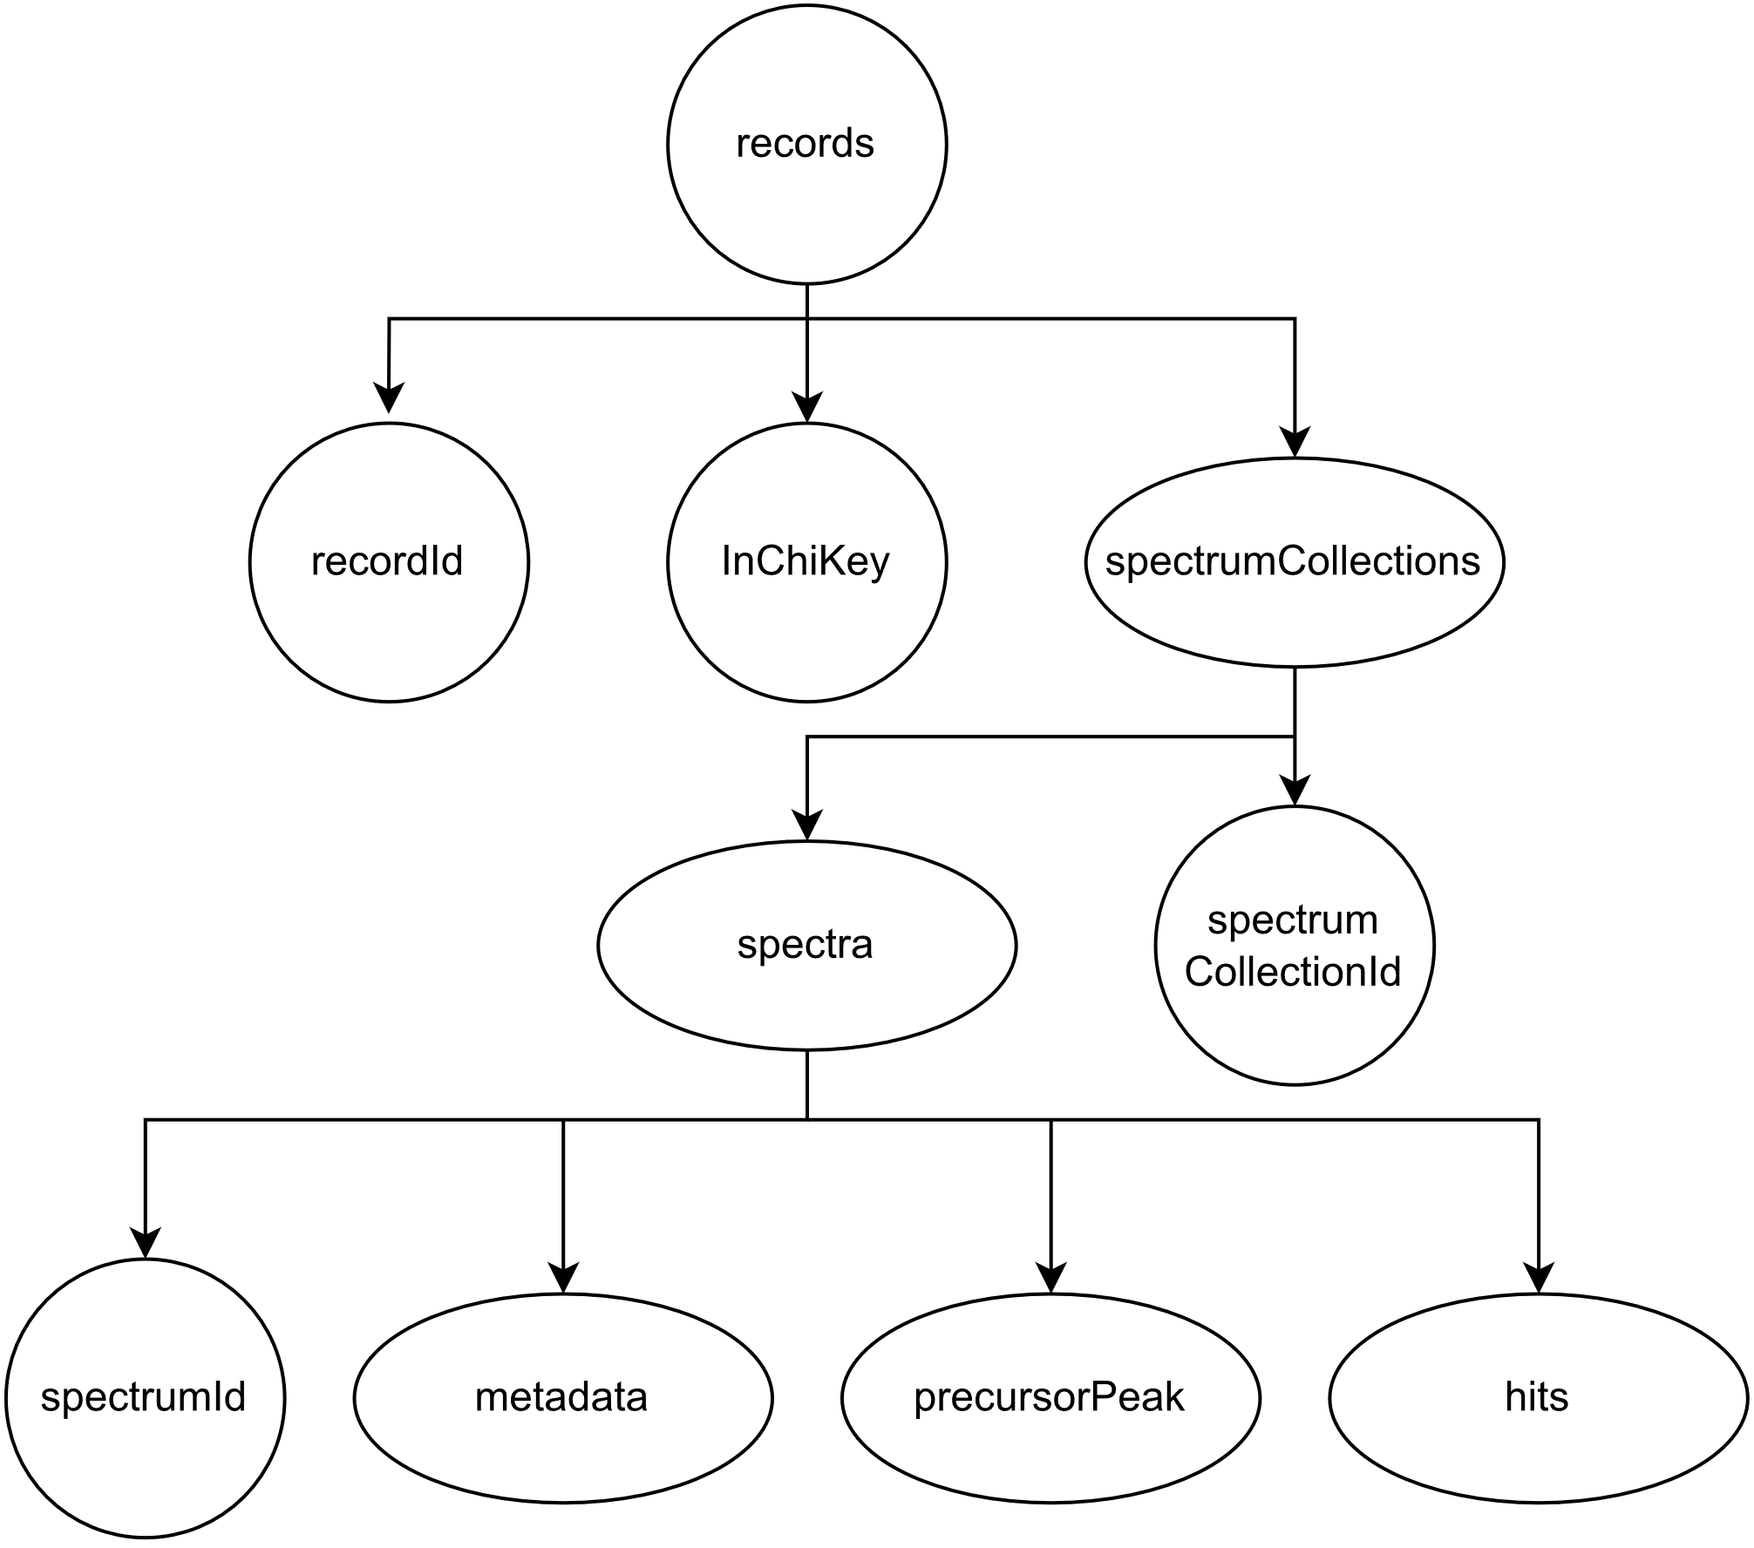
Results
I. Data Extraction
Format: JSON
More than 90 records for each library
Each record has metadata
Each record can have multiple hits

Slide 5
Results
II. Create a binary column of whether the hit is true-positive or false-positive
Synthetic search
Barcode search
Hit | InChIKey | InChIKey_hits | Positivity
0 | 33 | 33 | True
1 | 33 | 27 | False
2 | 33 | 27 | False
... | ... | ... | ...
299 | 34 | 34 | True
Hit | InChIKey | InChIKey_hits | Positivity
0 | 33 | 33 | True
1 | 33 | 27 | False
2 | 24 | 24 | True
... | ... | ... | ...
266 | 34 | 69 | False

Slide 6
Results
III. Compute the difference between experimental conditions
Synthetic search
Barcode search
Hit | Polarity | ScanRange Max | ScanRange Min | NCE | Ion Activation
0 | 1.0 | 0.194655 | 0.0 | 0.15790 | 1.0
1 | 1.0 | 0.194655 | 0.0 | 0.15790 | 1.0
2 | 1.0 | 0.194655 | 0.0 | 0.02632 | 1.0
... | ... | ... | ... | ... | ...
299 | 1.0 | 0.113322 | 0.0 | 0.10526 | 0.0
Hit | Polarity | ScanRange Max | ScanRange Min | NCE | Ion Activation
0 | 0.0 | 0.194655 | 0.0 | 0.05263 | 1.0
1 | 0.0 | 0.194655 | 0.0 | 0.05263 | 1.0
2 | 0.0 | 0.194821 | 0.0 | 0.05263 | 0.0
... | ... | ... | ... | ... | ...
266 | 0.0 | 0.113322 | 0.0 | 0.05263 | 0.0

Slide 7
Results
IV. For each compound compute the number of correct hits and incorrect hits
Synthetic search
Barcode search
recordId | InChIKey | Correct hits | Incorrect hits
0 | 33 | 1 | 2
1 | 24 | 1 | 0
2 | 44 | 2 | 1
... | ... | ... | ...
94 | 34 | 2 | 0
recordId | InChIKey | Correct hits | Incorrect hits
0 | 33 | 1 | 1
1 | 24 | 1 | 0
2 | 44 | 1 | 1
... | ... | ... | ...
93 | 34 | 1 | 1

Slide 8
Results
V. Relate the ranking of candidates based on their score to the number of potential hits
Synthetic search
Barcode search
Hit | Cosine relative rank | Denver relative rank | NIST relative rank
0 | 0.0 | 0.0 | 0.0
1 | 0.5 | 0.5 | 0.5
2 | 1.0 | 1.0 | 1.0
... | ... | ... | ...
299 | 0.0 | 1.0 | 0.0
Hit | Cosine relative rank | Denver relative rank | NIST relative rank
0 | 0.0 | 0.0 | 0.0
1 | 1.0 | 1.0 | 1.0
2 | 0.0 | 0.0 | 0.0
... | ... | ... | ...
266 | 1.0 | 1.0 | 1.0

Slide 9
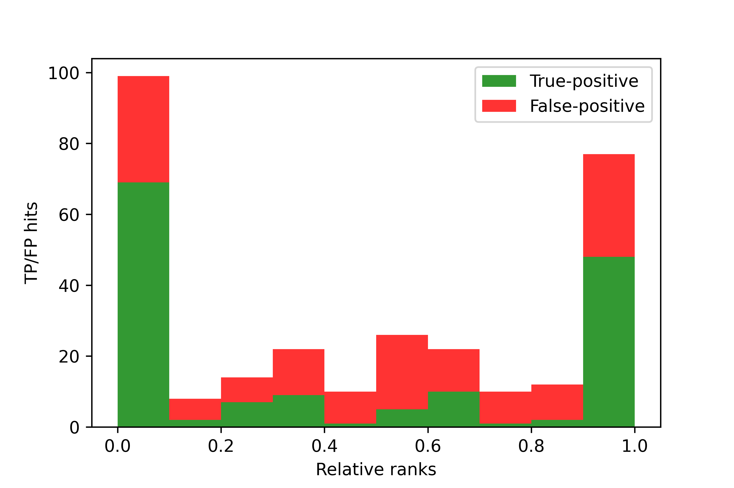
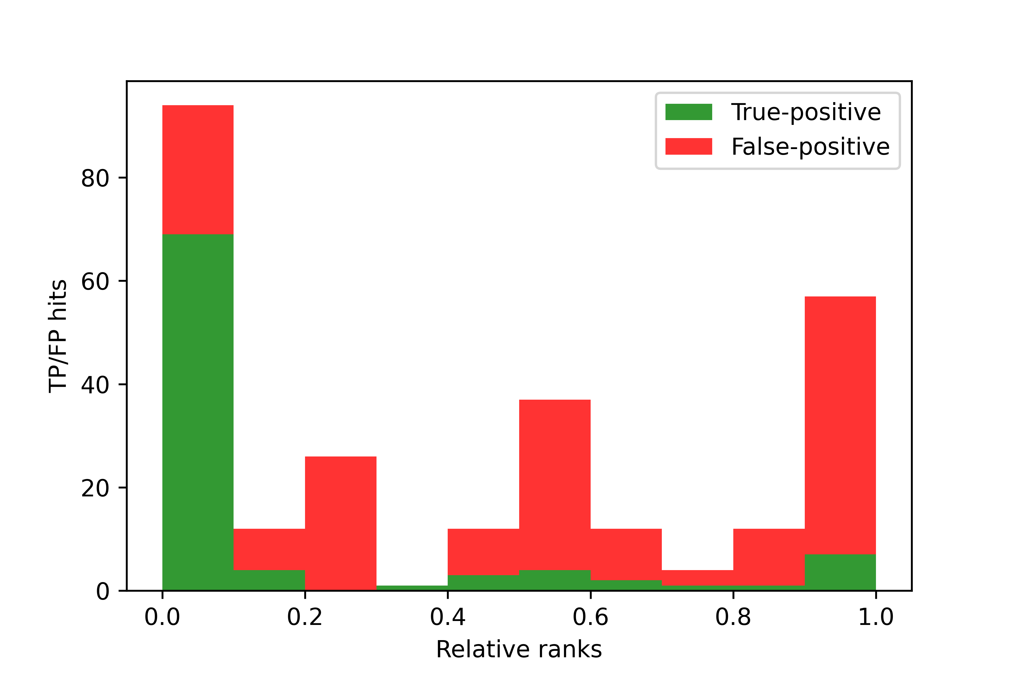
Results
I. Plot histogram for each metric distinguishing true-positive hits and false-positive hits
Synthetic search – Cosine rank
Barcode search – Cosine rank

Slide 10


Results
I. Plot histogram for each metric distinguishing true-positive hits and false-positive hits
Synthetic search – Denver rank
Barcode search – Denver rank

Slide 11


Results
I. Plot histogram for each metric distinguishing true-positive hits and false-positive hits
Synthetic search – Nist rank
Barcode search – Nist rank

Slide 12
Results
II. Render correlation between deviation in experimental conditions and TP/FP hits
Synthetic search
Barcode search
 | Pearson | Kendall | Spearman
Analyzer | - | - | -
Polarity | - | - | -
ScanRangeMax | 0.1276 | 0.1038 | 0.1248
ScanRangeMin | - | - | -
MsStageTarget | - | - | -
NCE | 0.0904 | 0.0680 | 0.0811
IonActivation | -0.0707 | -0.0707 | -0.0707
 | Pearson | Kendall | Spearman
Analyzer | - | - | -
Polarity | - | - | -
ScanRangeMax | 0.2063 | 0.1474 | 0.1743
ScanRangeMin | 0.1197 | 0.1197 | 0.1198
MsStageTarget | - | - | -
NCE | 0.2161 | 0.2478 | 0.2710
IonActivation | 0.1451 | 0.1451 | 0.1451

Slide 13
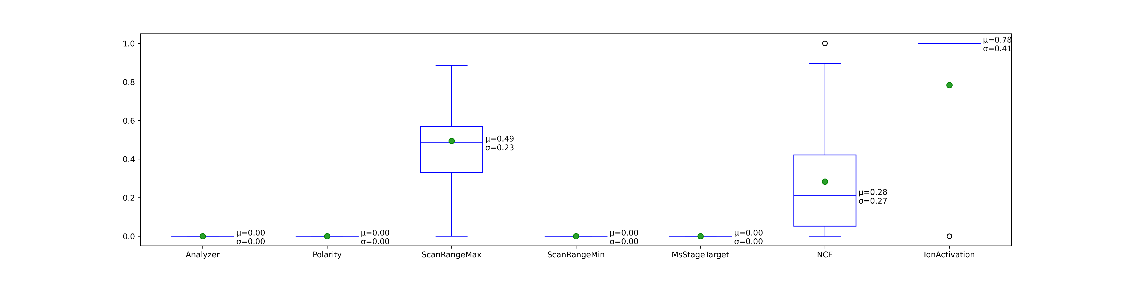
Results
Synthetic search – metadata

Slide 14
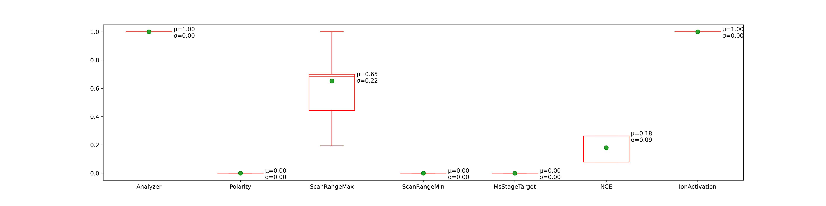
Results
Synthetic search – metadata hits

Slide 15
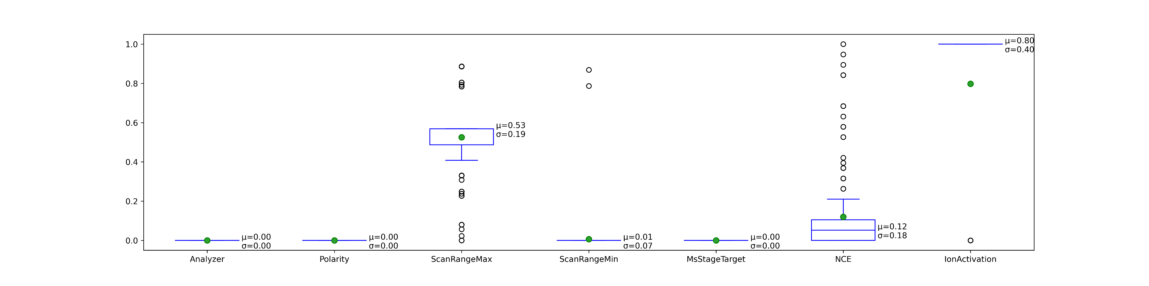
Results
Barcode search – metadata

Slide 16
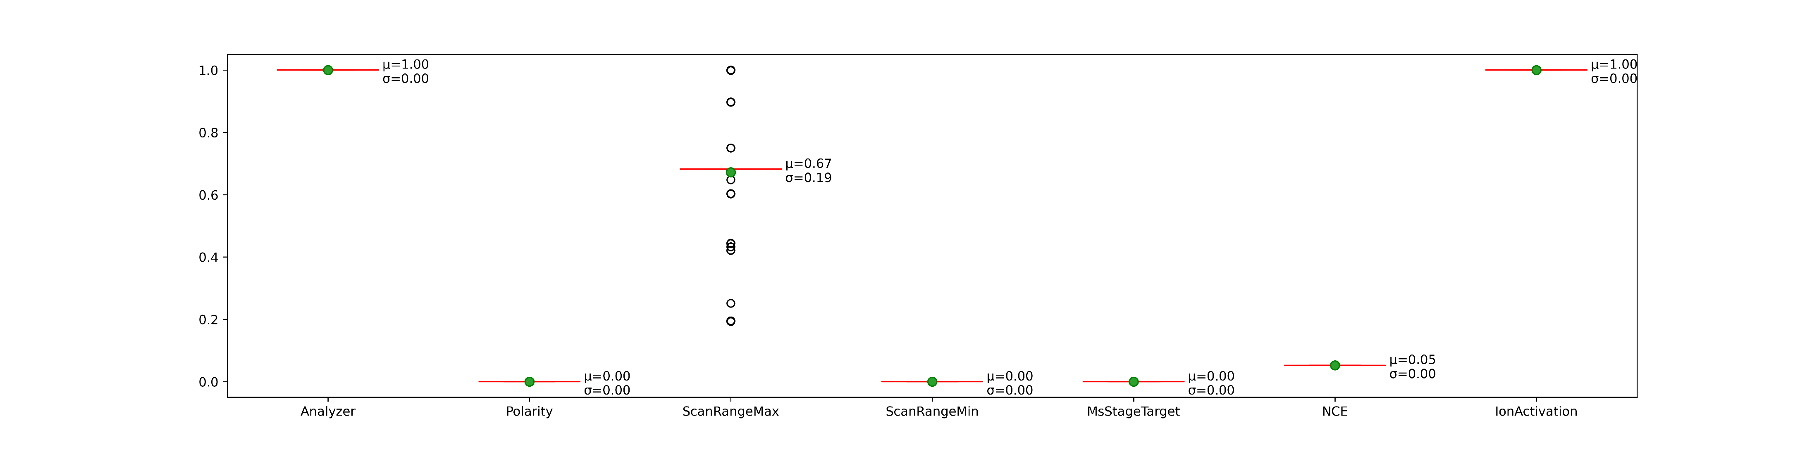
Results
Barcode search – metadata hits

Slide 17
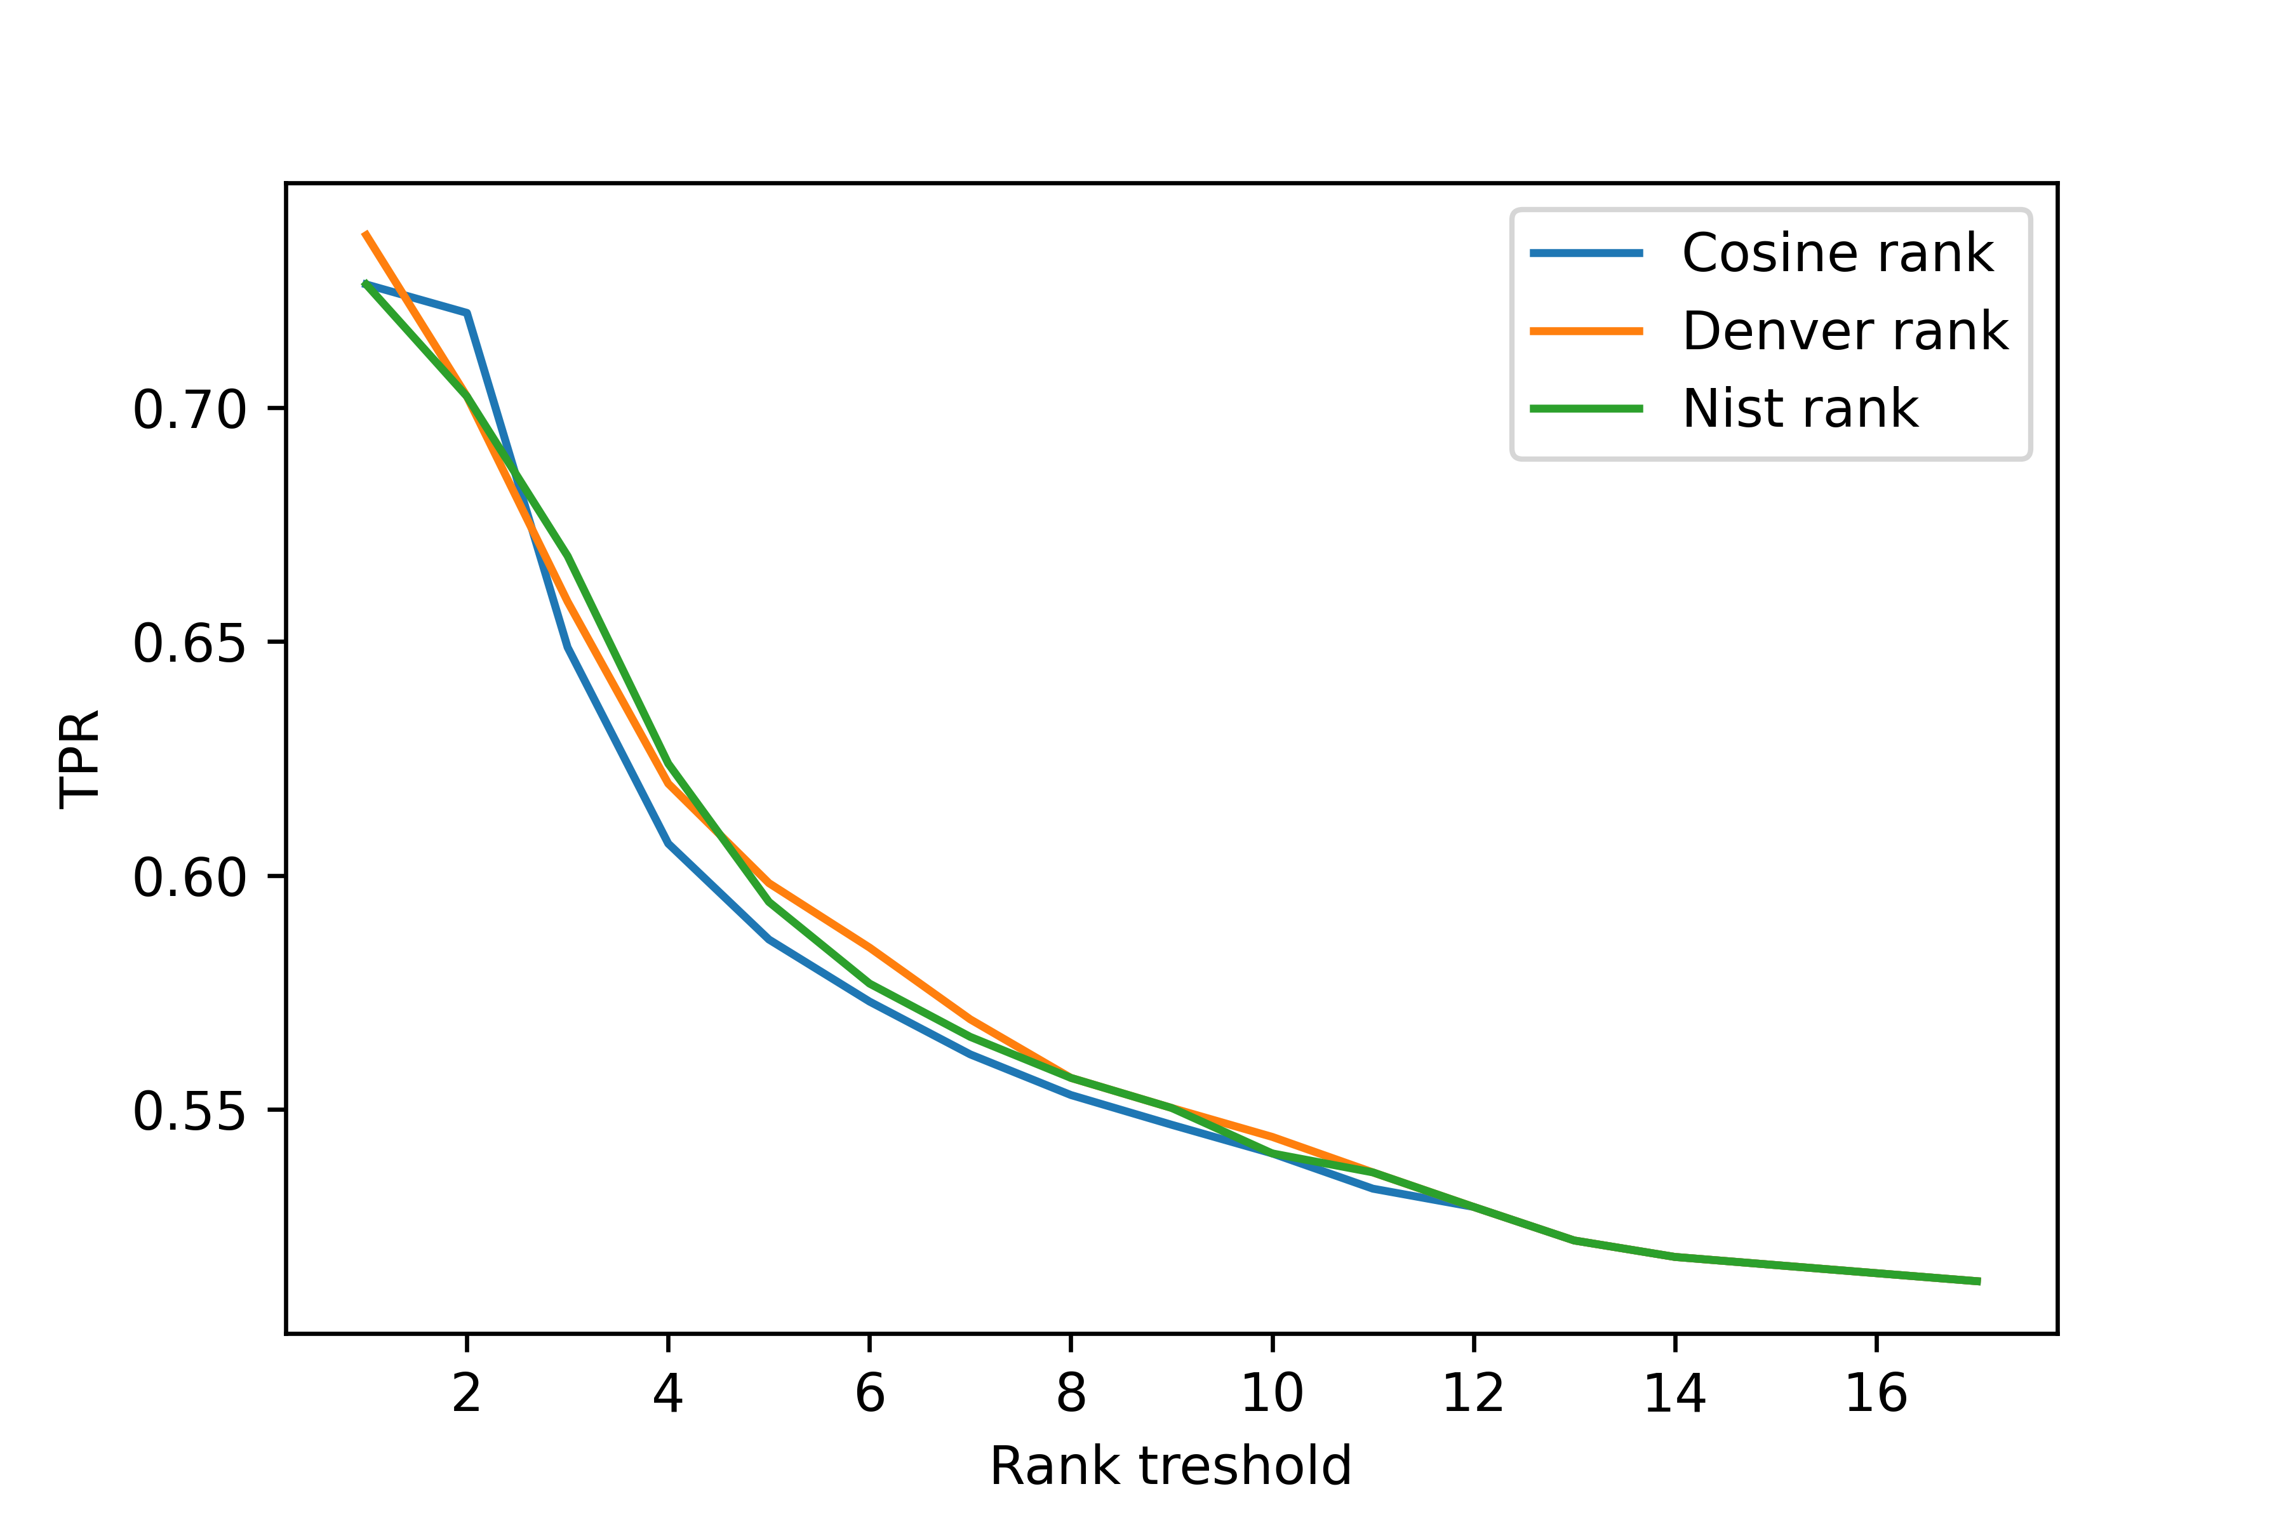
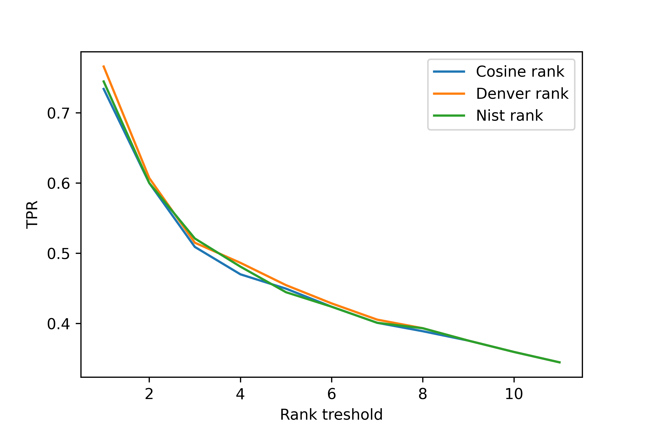
Results
III. Plot true-positive rate vs. rank threshold
Synthetic search
Barcode search

Slide 18
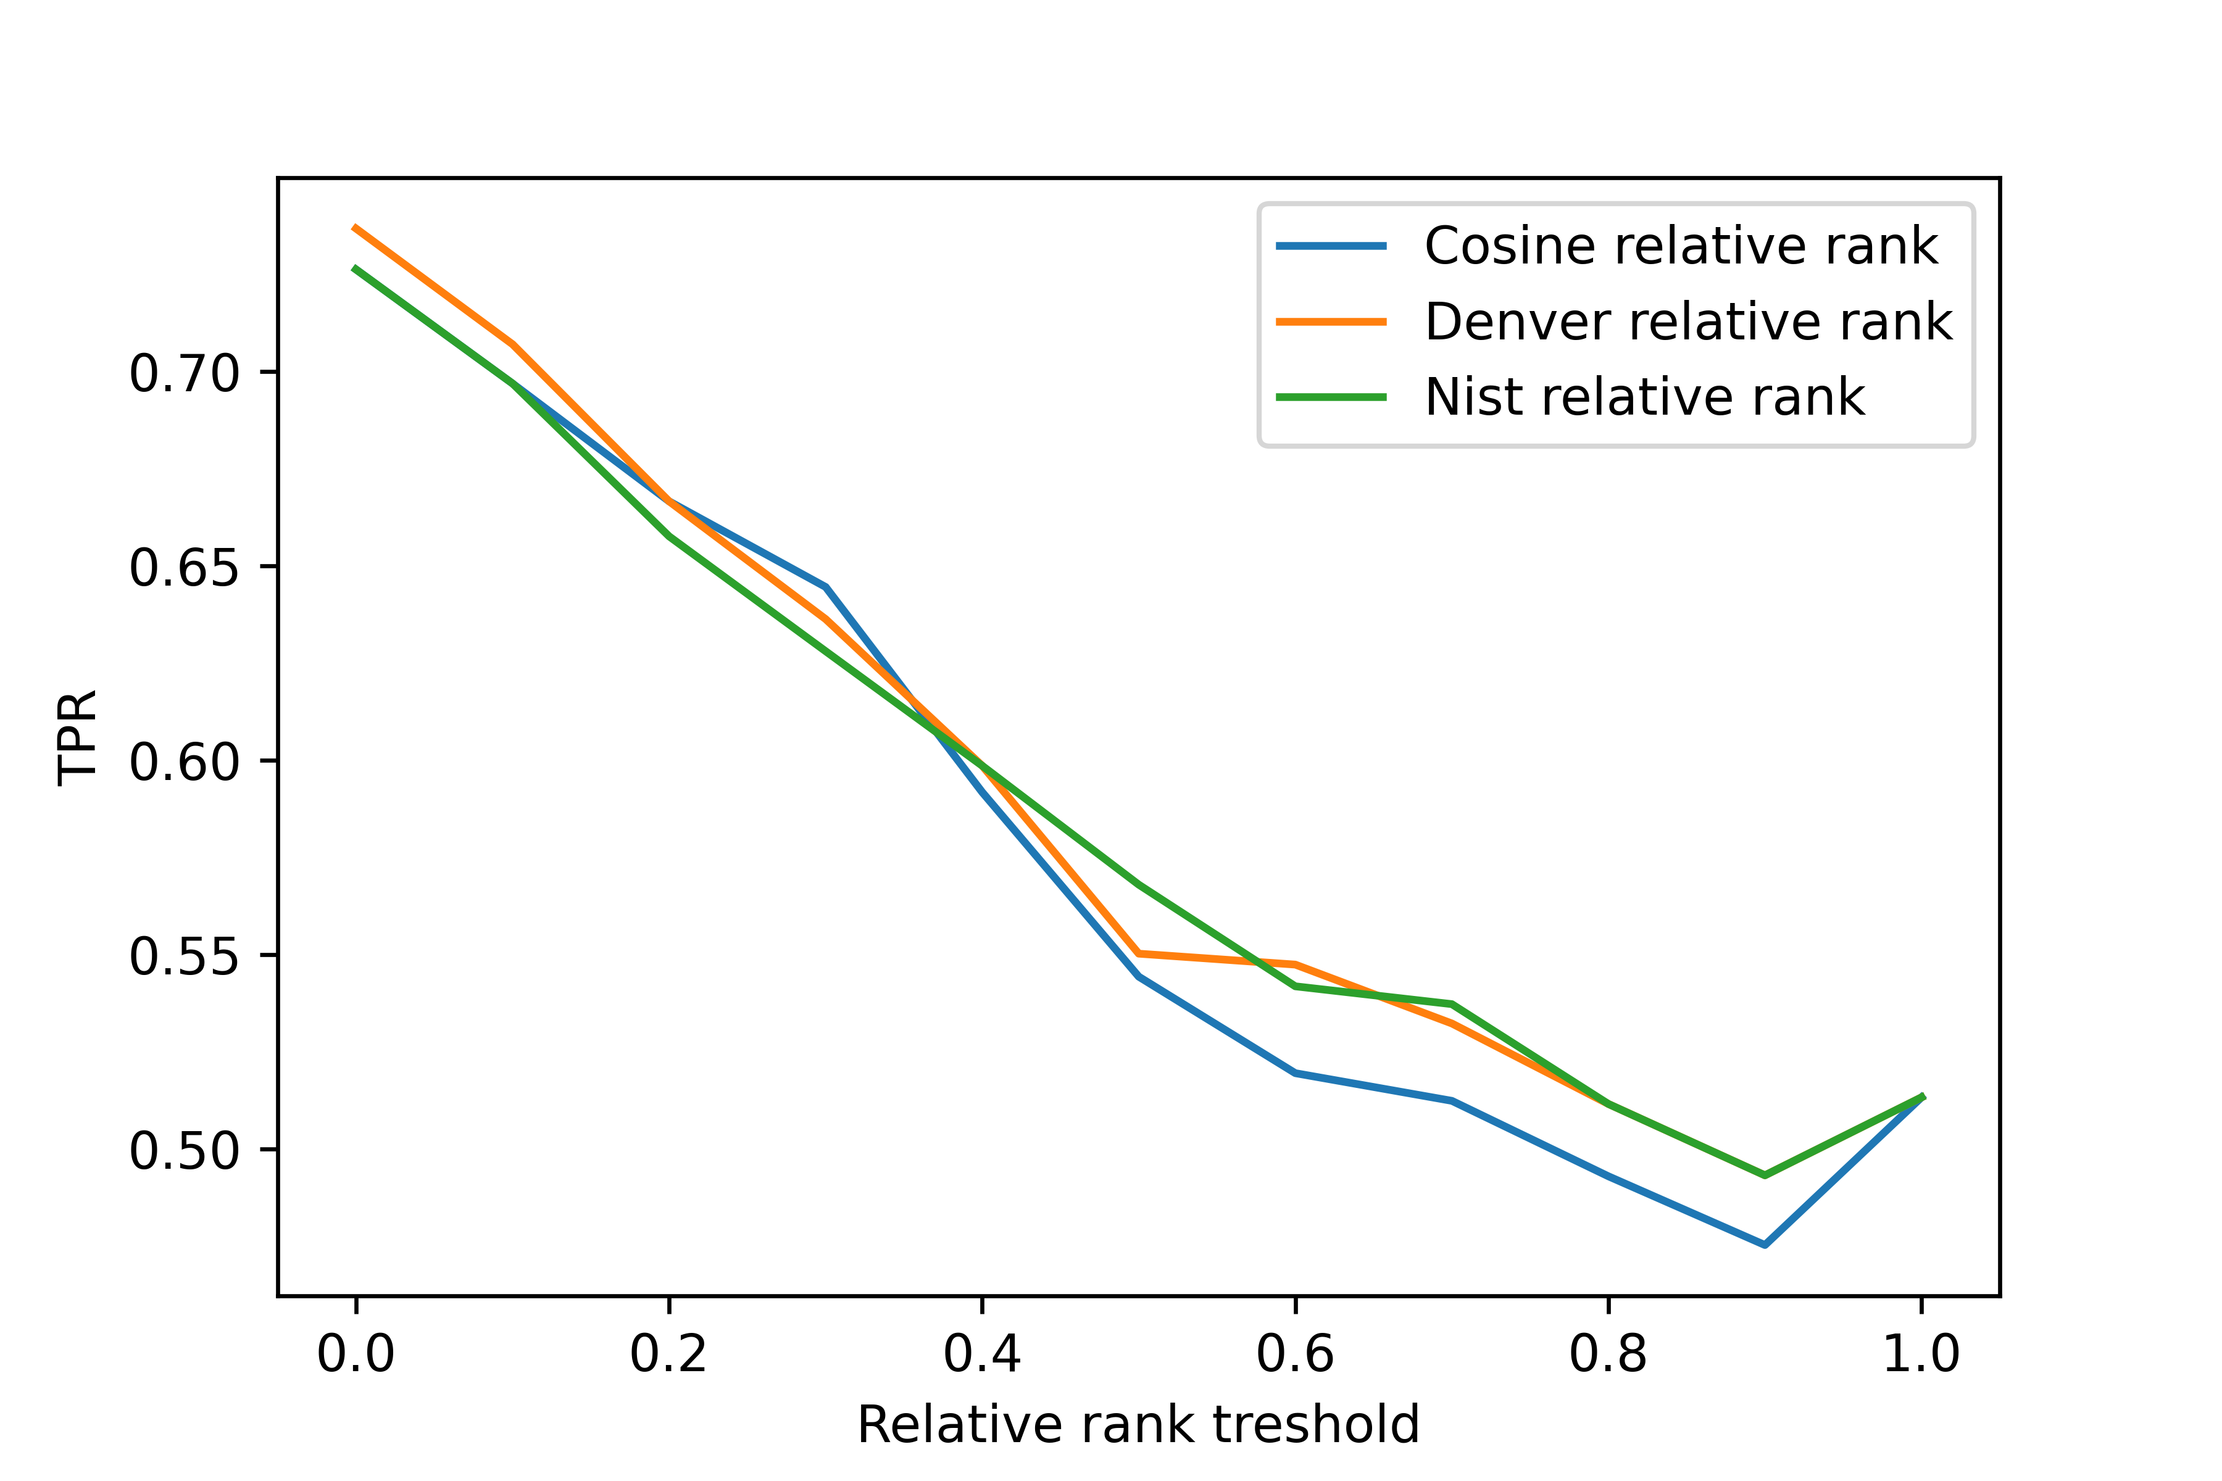
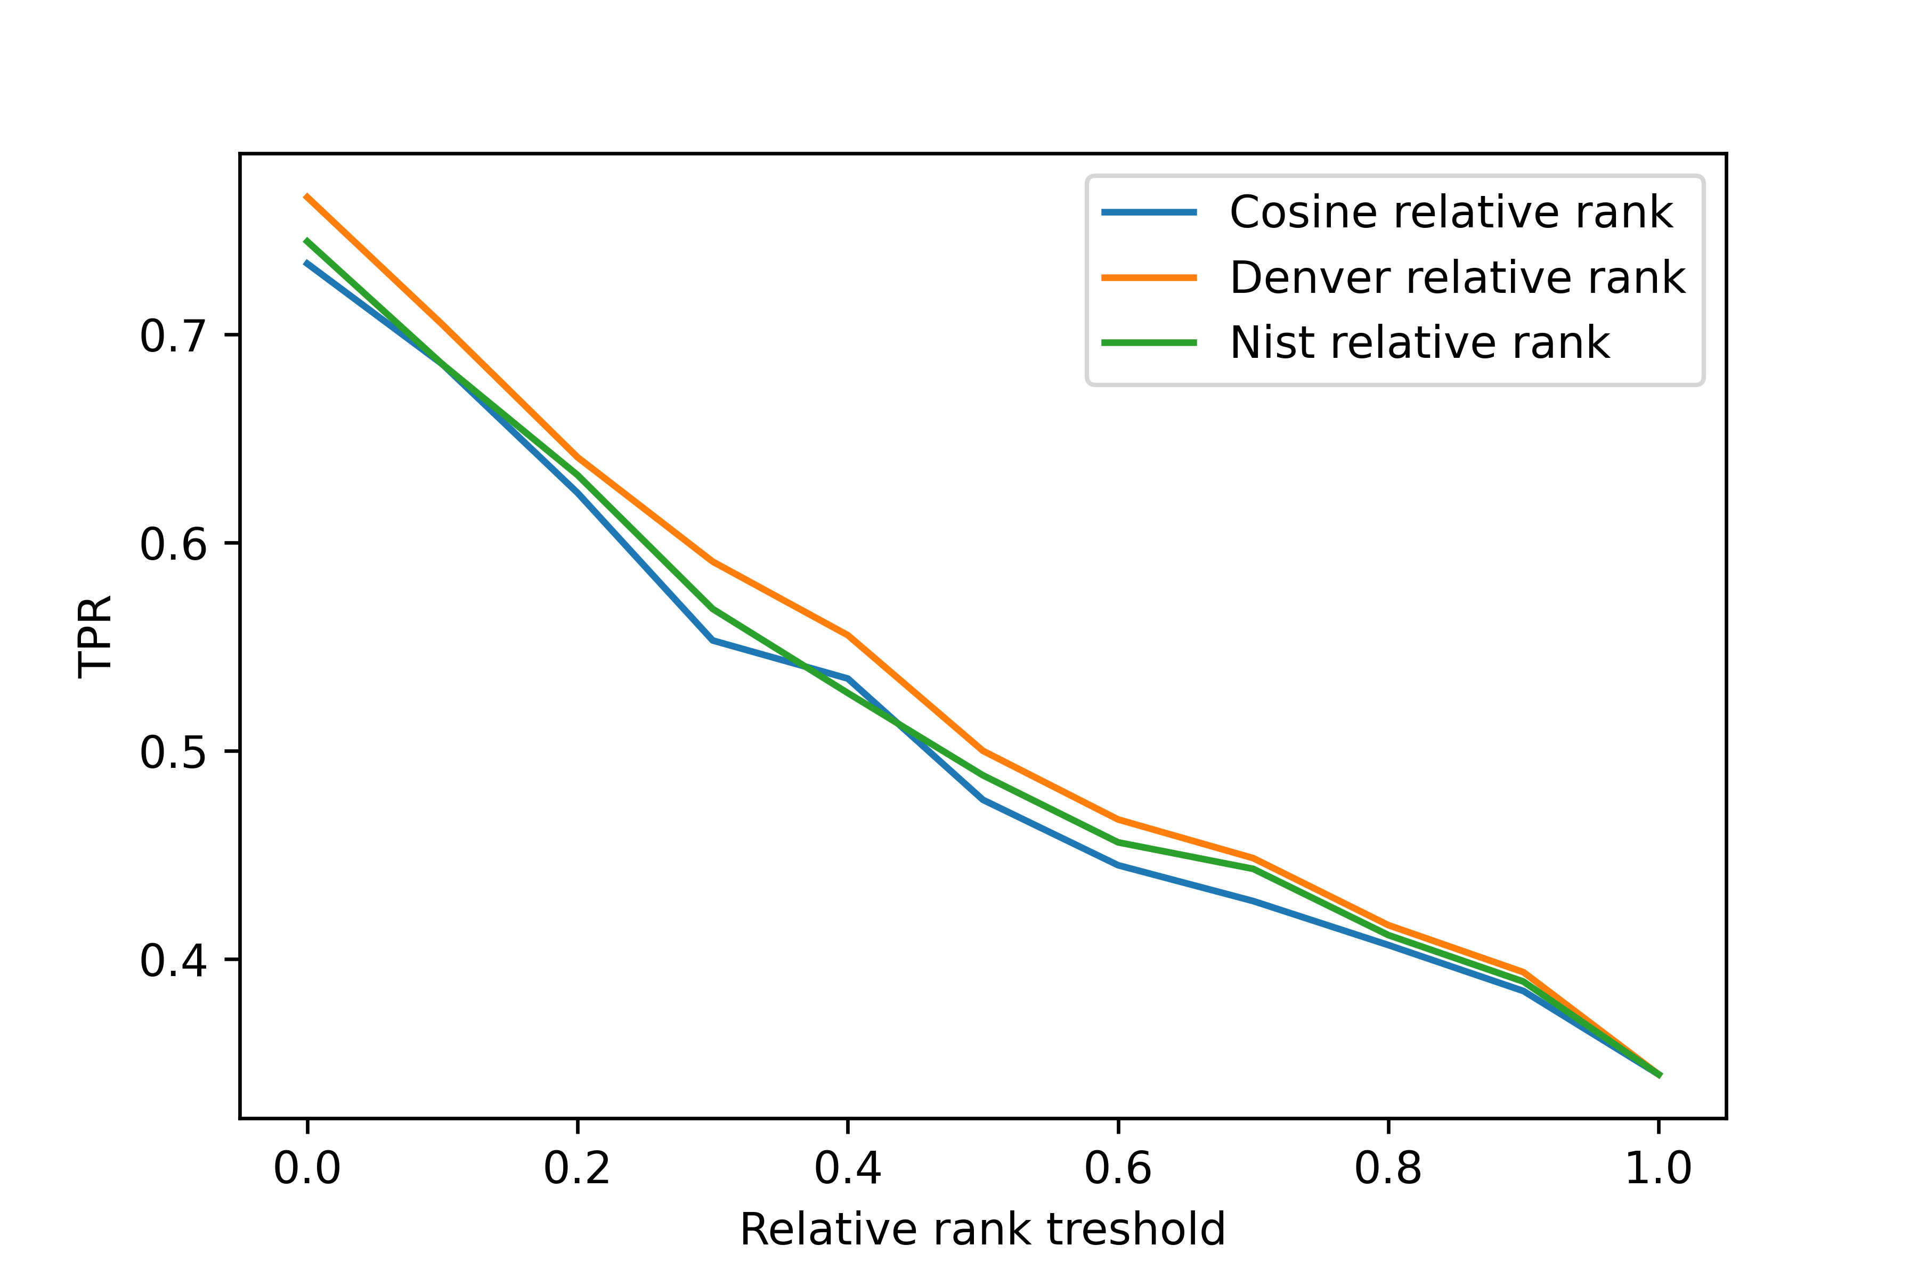
Results
IV. Plot true-positive rate vs. relative rank threshold;
Synthetic search
Barcode search

Slide 19
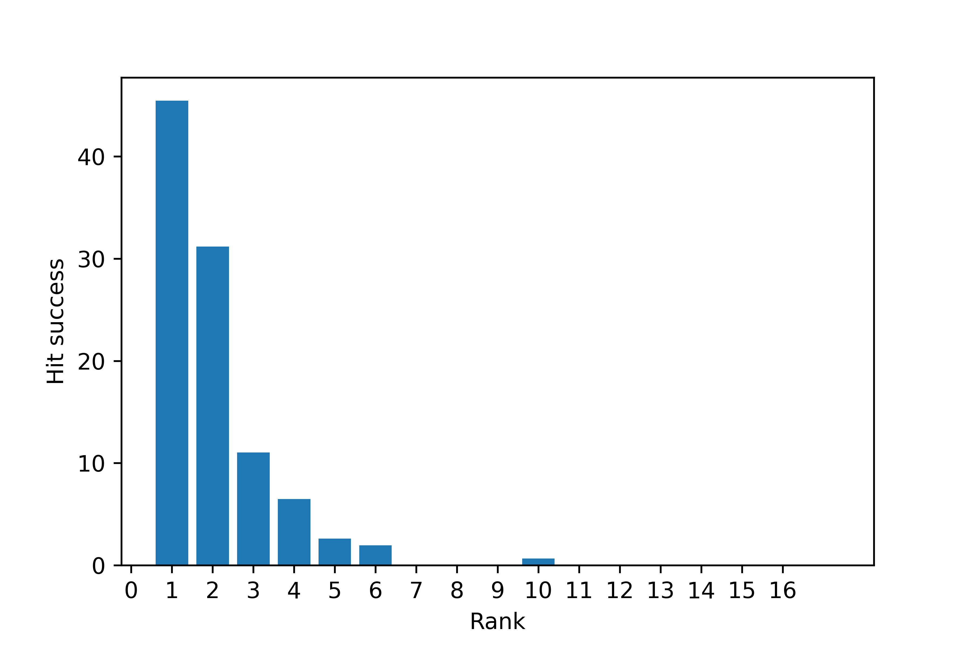
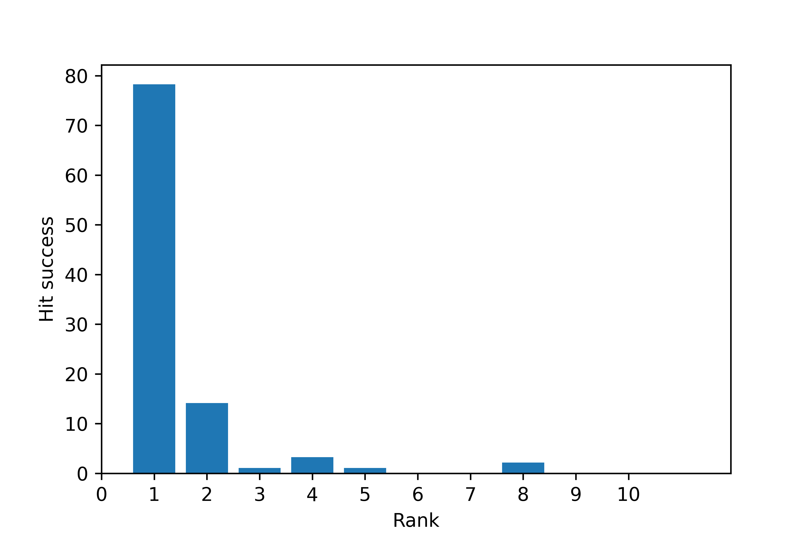
Results
VI. Find a reasonable way to compare the search performance of two libraries
Synthetic search – success rate
Barcode search – success rate

Slide 20
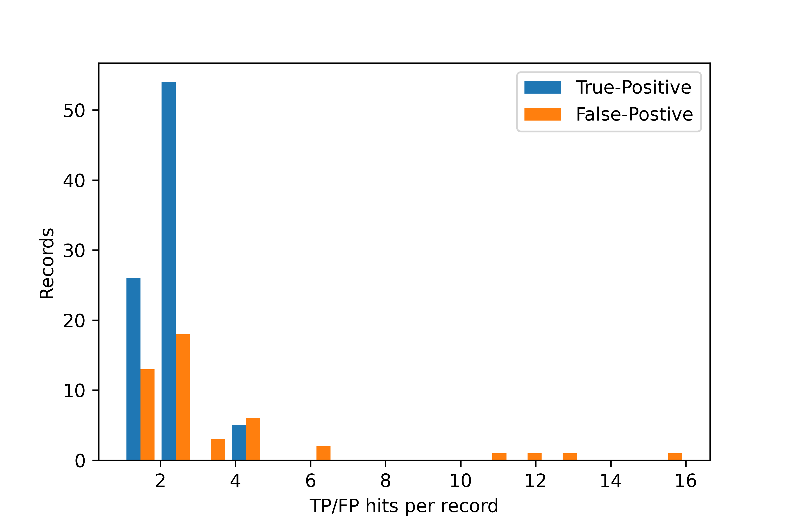
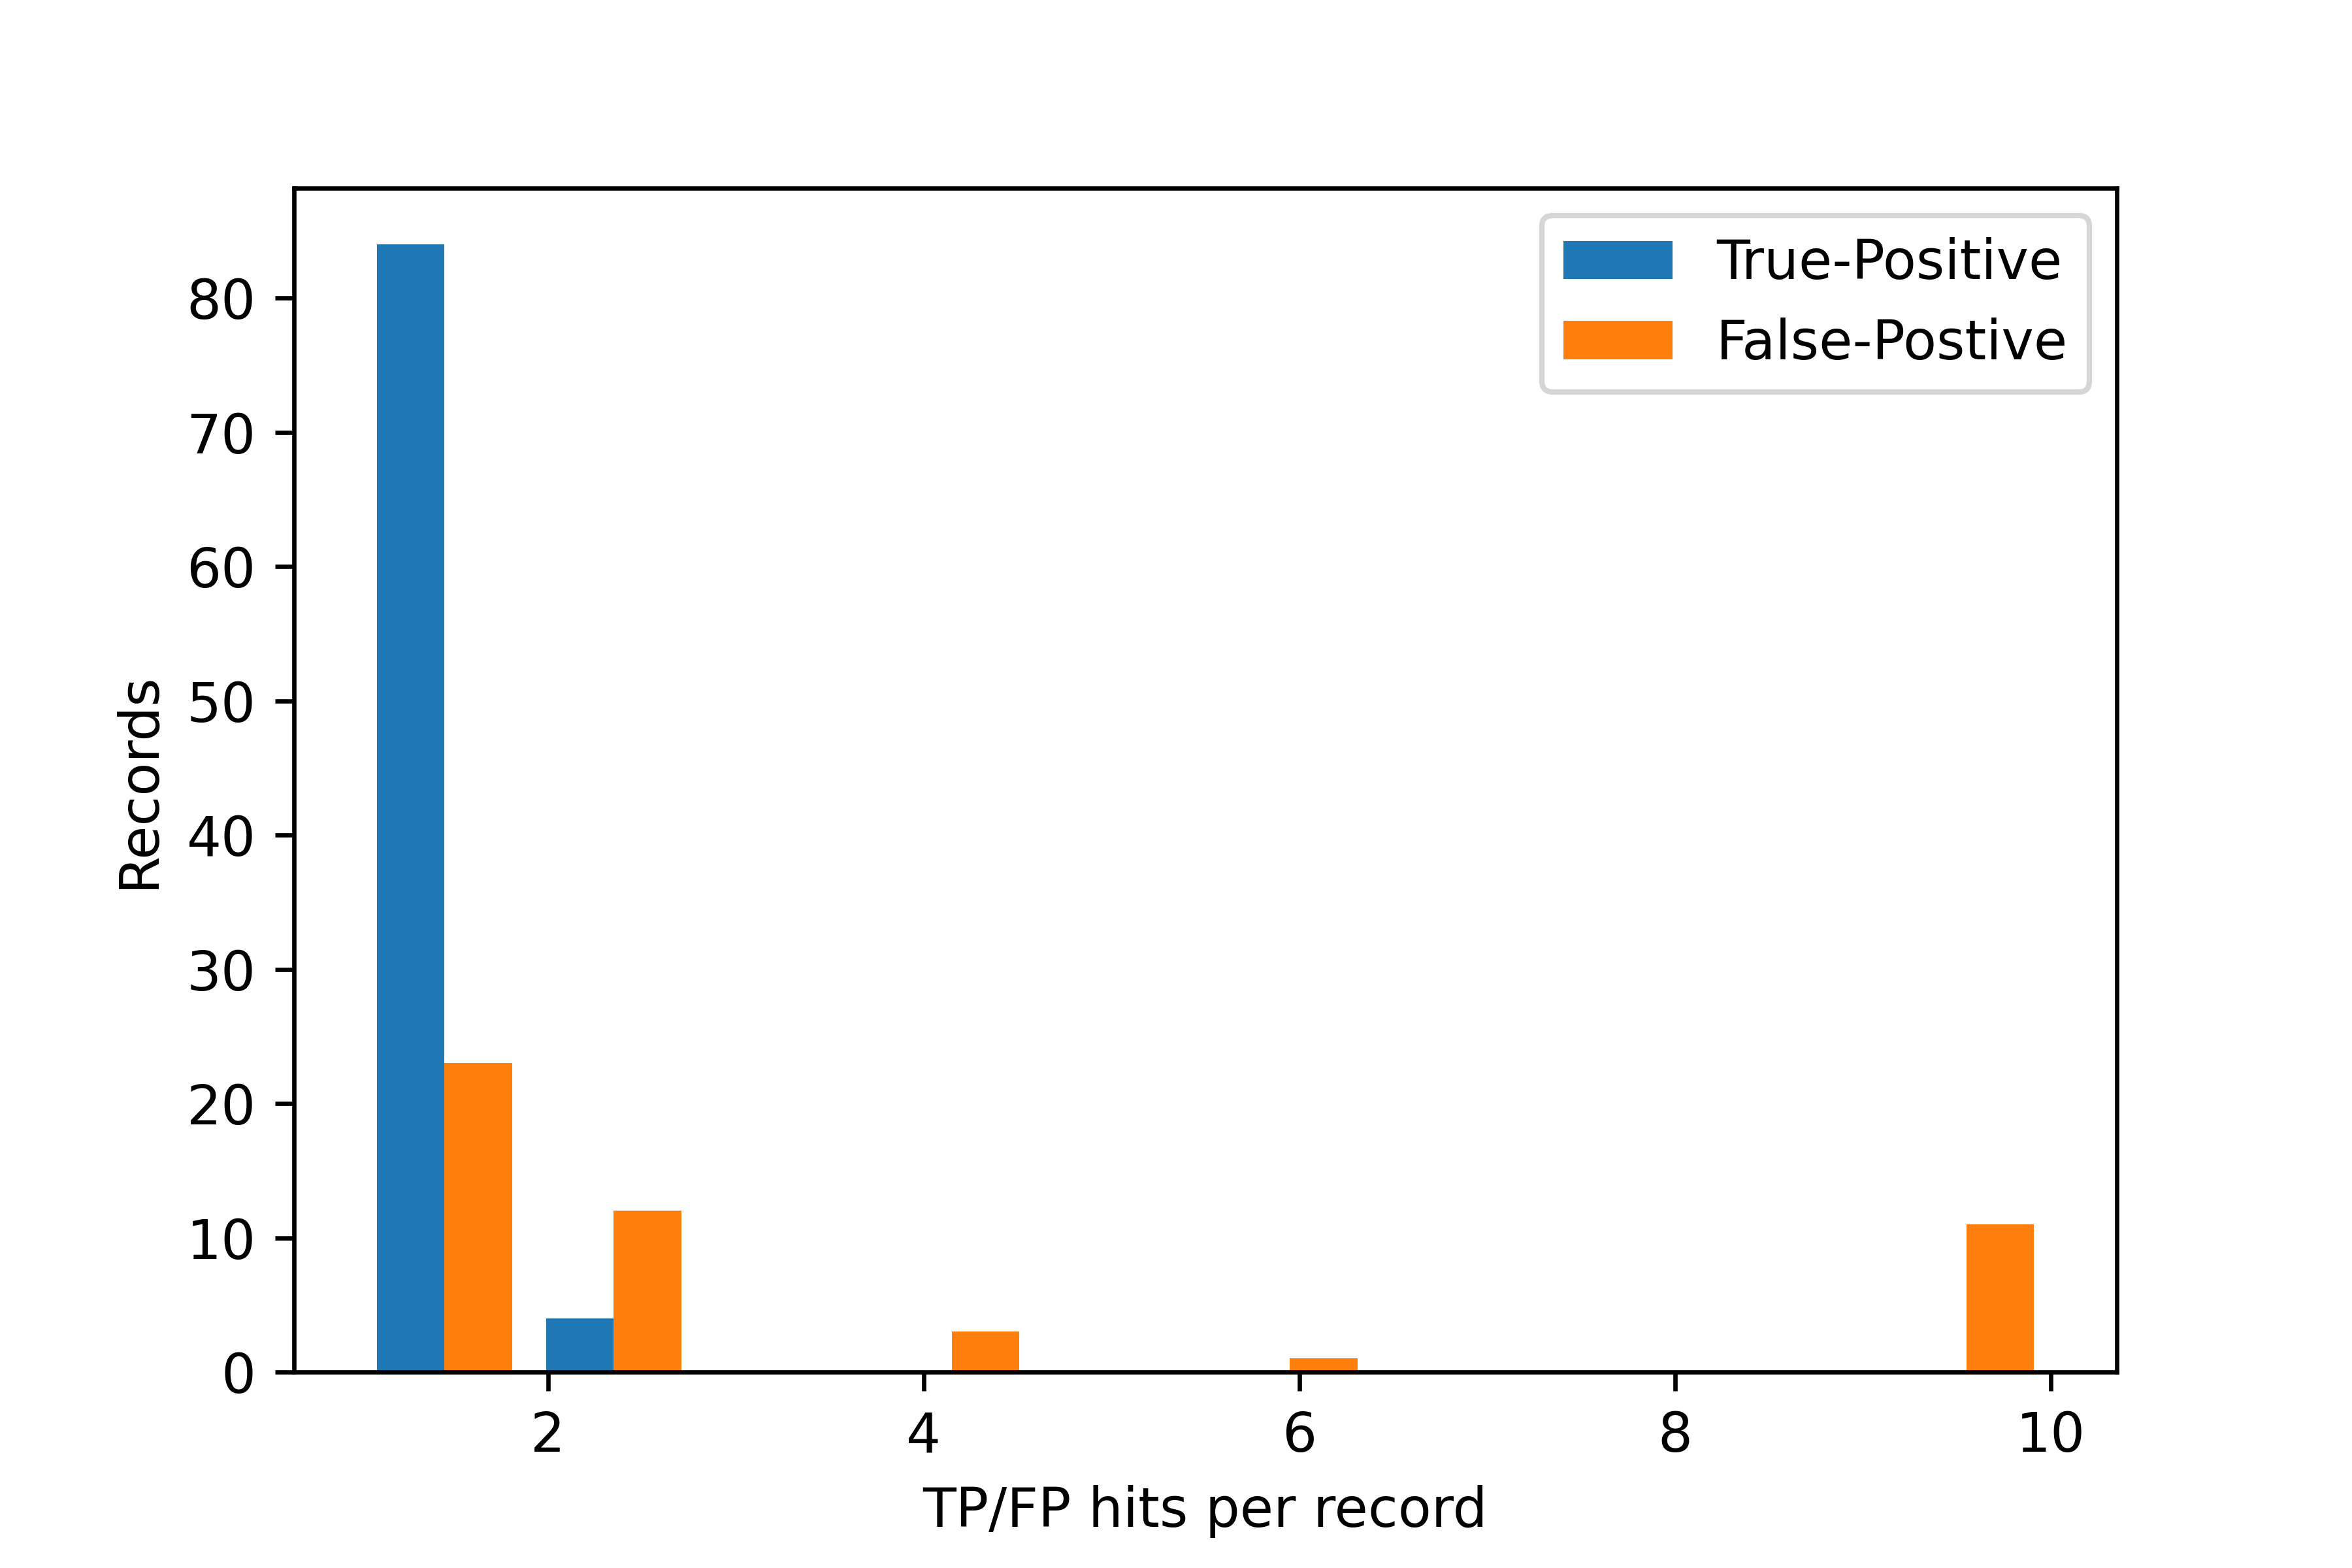
Results
VI. Find a reasonable way to compare the search performance of two libraries
Synthetic search
Barcode search

Slide 21
Results
VI. Find a reasonable way to compare the search performance of two libraries
Synthetic search
Barcode search
Synthetic
At least one correct hit | 85
Only incorrect hits | 10
Synthetic
At least one correct hit | 88
Only incorrect hits | 6

