Slide 1

Deep Q-Learning on Frogger: DQN vs Double DQN
CSCI 166
Team: Joshua, Anushka, Herbert

Slide 2
Project Goal
Understand how algorithm design and tuning impact RL performance in Frogger
Implement a baseline DQN and improve it using Double DQN (DDQN)
Test 6 different training configurations to measure performance changes
Evaluate progress using learning curves and final gameplay outcomes

Slide 3
Why Frogger?
Sparse rewards → agent only gets feedback when making forward progress
Requires precise timing to avoid cars, trucks, logs, and turtles
Multiple failure modes: collisions, water, timeout
Great environment to test how DQN handles long sequences and delayed rewards

Slide 4
Environment Setup
Observation Space:
84×84×4 stacked grayscale frames
Action Space:
5 discrete actions (NONE, UP, RIGHT, LEFT, DOWN)
Reward Structure:
Sparse rewards: forward progress and large reward for reaching goal
Why it matters:
The agent must explore to find winning paths
Timing + long action sequences make learning difficult

Slide 5
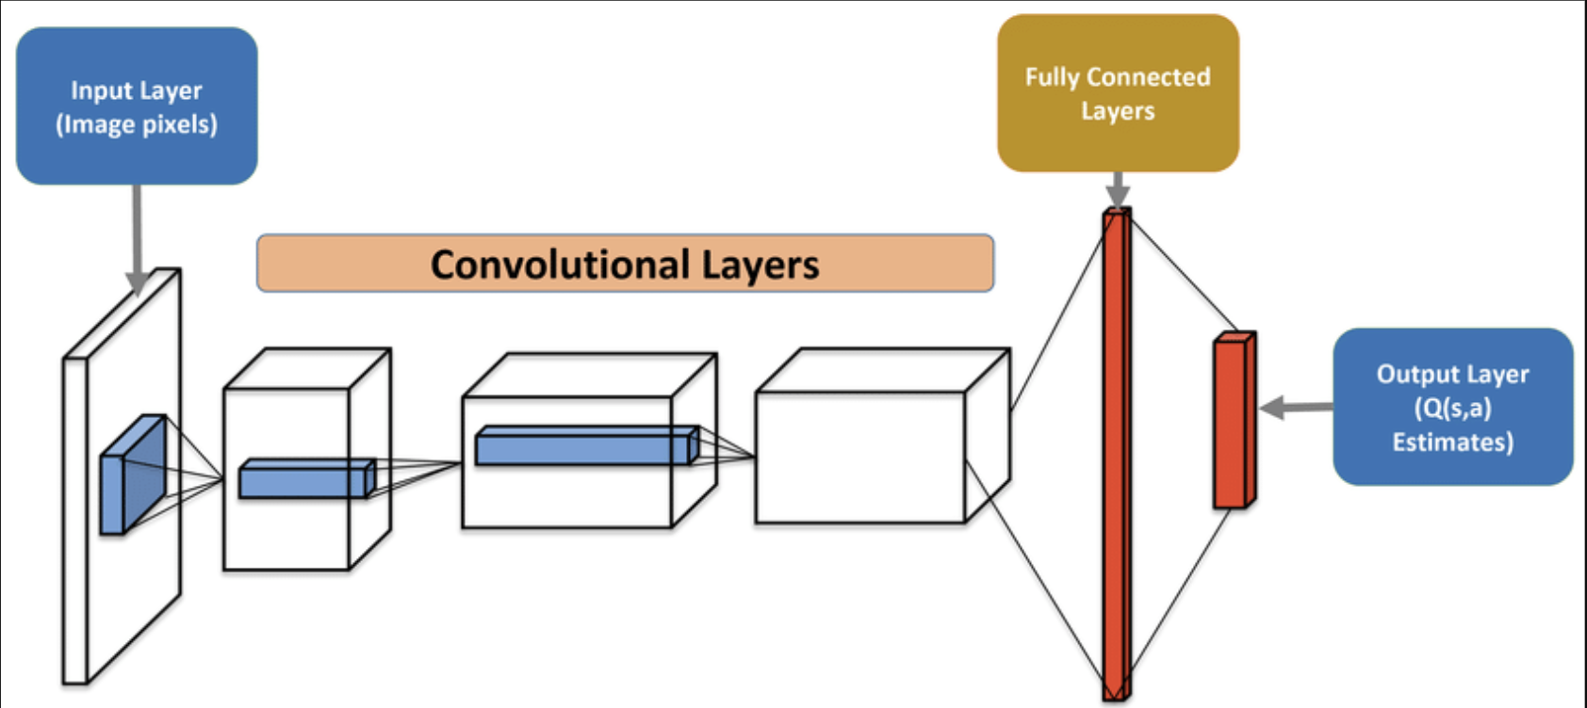
Method
CNN-based DQN (baseline)
Double DQN improves learning:
online net selects → target net evaluates
Experience replay + target network
Epsilon-greedy exploration

Slide 6
Model Architecture
Baseline DQN (from starter code):
Conv1: 32 filters, 8×8, stride 4, ReLU
Conv2: 64 filters, 4×4, stride 2, ReLU
Conv3: 64 filters, 3×3, stride 1, ReLU
Fully Connected: 512 units
Output: 5 Q-values (one per action)
Key Components:
Experience Replay (10k–30k size)
Target Network (sync every 1000–2500 steps)
Epsilon-Greedy Exploration

Slide 7
Double DQN
Problem in DQN:
Overestimates Q-values because the same network selects + evaluates actions
DDQN Solution:
Online network selects action
Target network evaluates it
Effect:
More stable learning
Large improvement over baseline DQN (345% higher mean reward)

Slide 8
Experiments:
Experiment | Key Change
Baseline DQN | Standard DQN
Double DQN | Algorithm change
DDQN (Lower LR) | 5e-5 learning rate
DDQN (Longer Exploration) | 300k epsilon decay
DDQN (Slower Target Sync) | Sync every 2500 steps
DDQN (Bigger Replay Buffer) | Replay size 30k
We ran 6 experiments, each for 500k training steps
Trained for 500,000 steps on Google Colab A100 GPU (~7 hours)

Slide 9
Results
Experiment | Mean Reward | Peak Reward
Baseline DQN | 10.23 | 53
Double DQN | 45.52 | 216
DDQN + Bigger Replay | 48.52 | 157
DDQN Lower LR | 38.69 | 176
DDQN Longer Exploration | 21.96 | 109
DDQN Slower Sync | 25.24 | 88

Slide 10
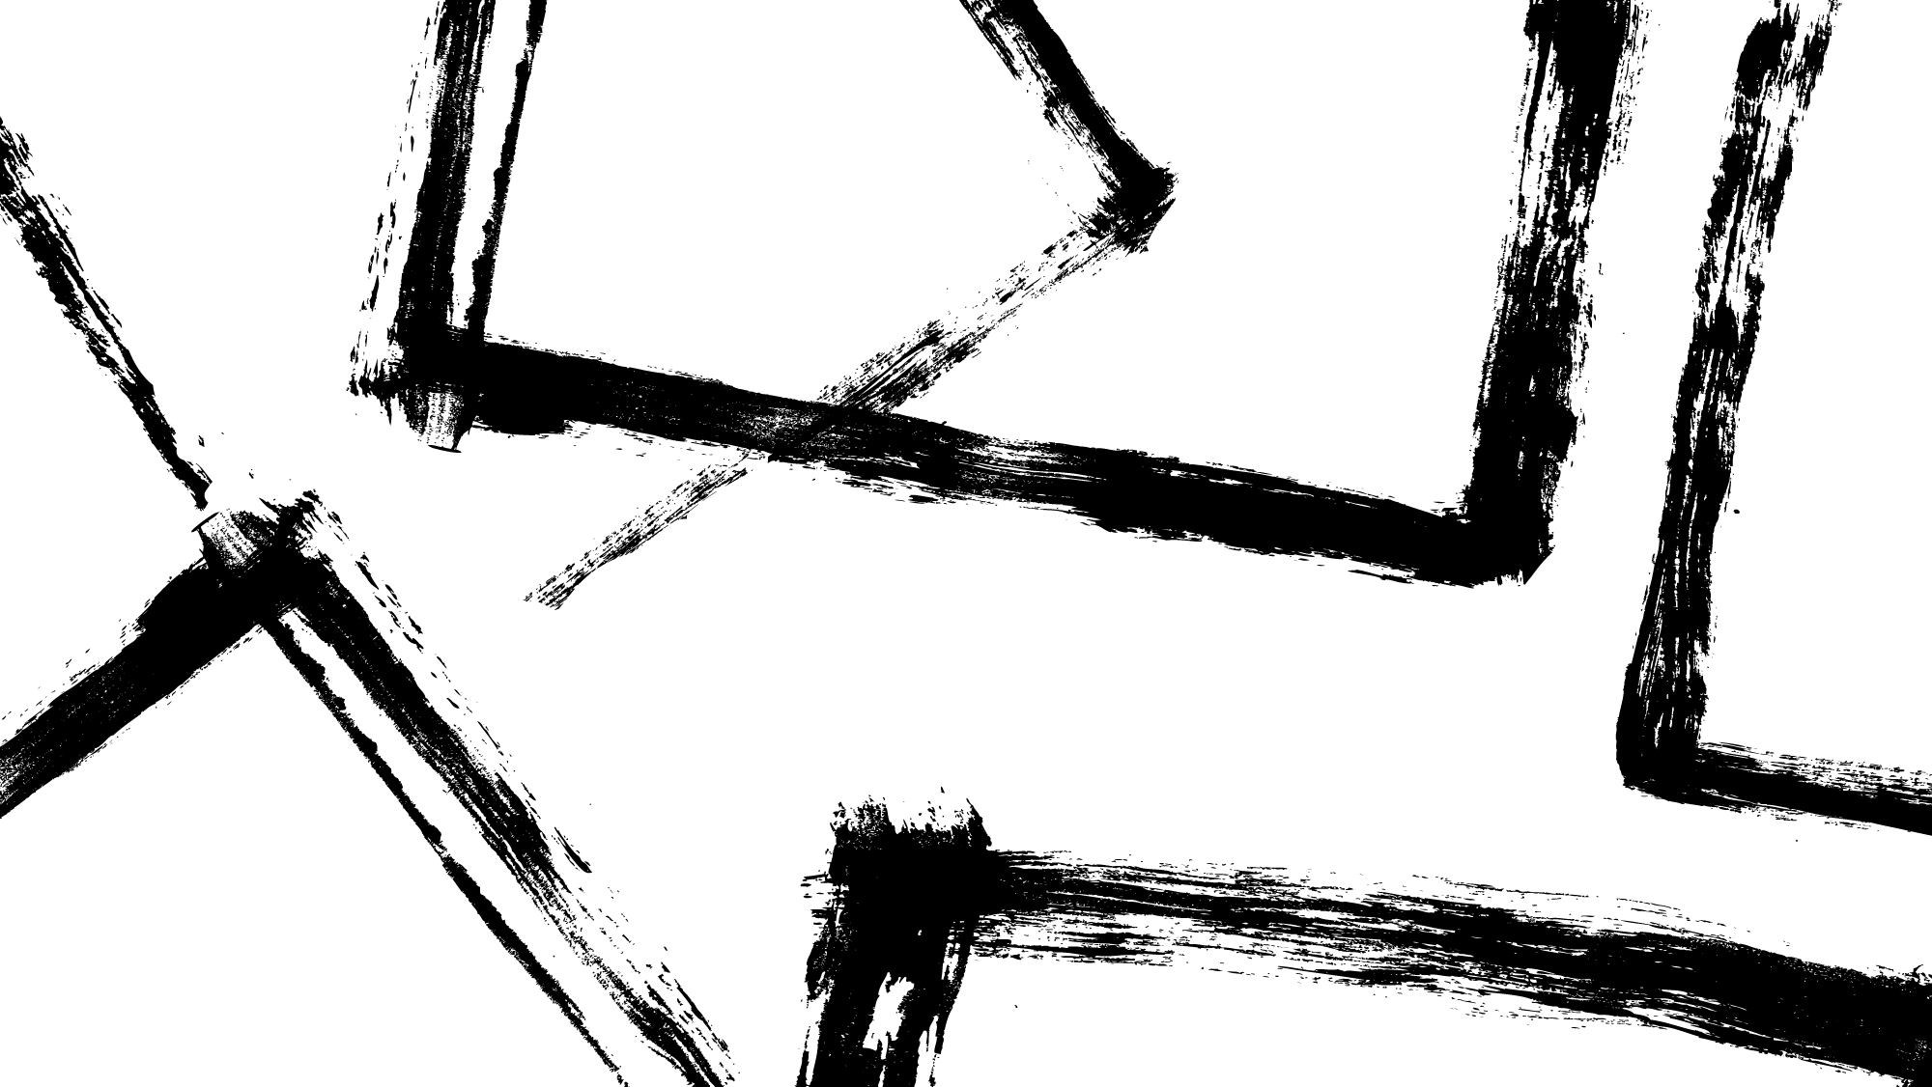
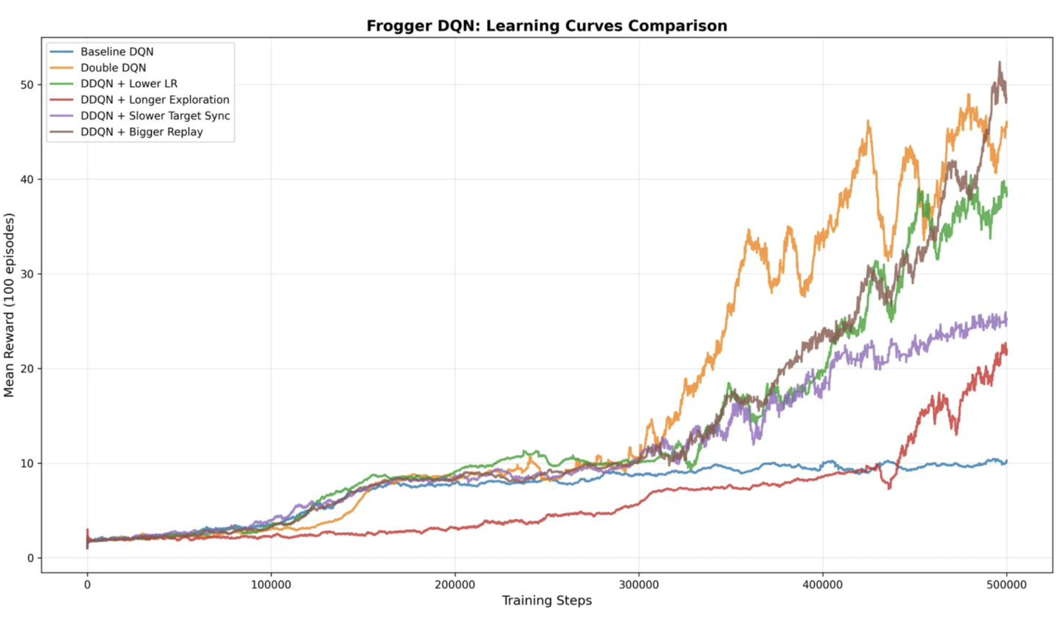
Observations
Baseline DQN never learned meaningful behavior
DDQN showed major improvement after ~300k steps
Bigger Replay (30k) had the best overall performance

Slide 11
Key Learnings
Double DQN significantly improved performance by reducing Q-value overestimation
Bigger Replay Buffer (30k) enabled better long-term learning from diverse experiences
High exploration (300k decay) slowed early progress and hurt final reward
Sparse rewards made early learning difficult, but model improved once rewards were reached
Credit assignment is challenging because Frogger requires long action sequences

