Slide 1

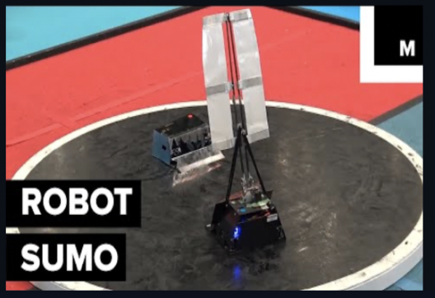
Robot Sumo Simulation:
Training Robot Sumo Agents
Milestone 1: Presentation
Team: Adebare Kofo-Abayomi, Avlynn Wade, Faysal Zaki, Joshua Oziel Fernández Alvarado
Client & Faculty Advisor
Department of Electrical Engineering and Computer Science
Dr. Hanks

Slide 2
Reminder: Primary Milestone 1 Tasks
1. Compare Outlined Tools
Create Engine Demos (Unity, Pygame, Godot)
2. Resolve Technical Challenges
Research the RL APIs (Gymnasium, VMAS, PettingZoo, MOMAland)
Resolve AI Panther Access
Select Communication Tools
Select RL approach (single-agent approach for baseline)
3. Create Documents
Requirements, Test, and Design documents

Slide 3
1
Compare Outlined Tools:
Engine Demos

Slide 4
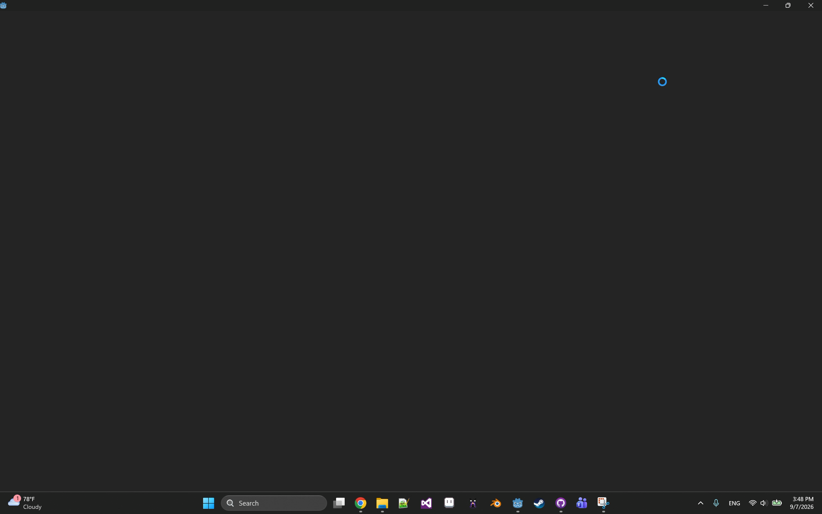
Engine Demos: Godot

Slide 5
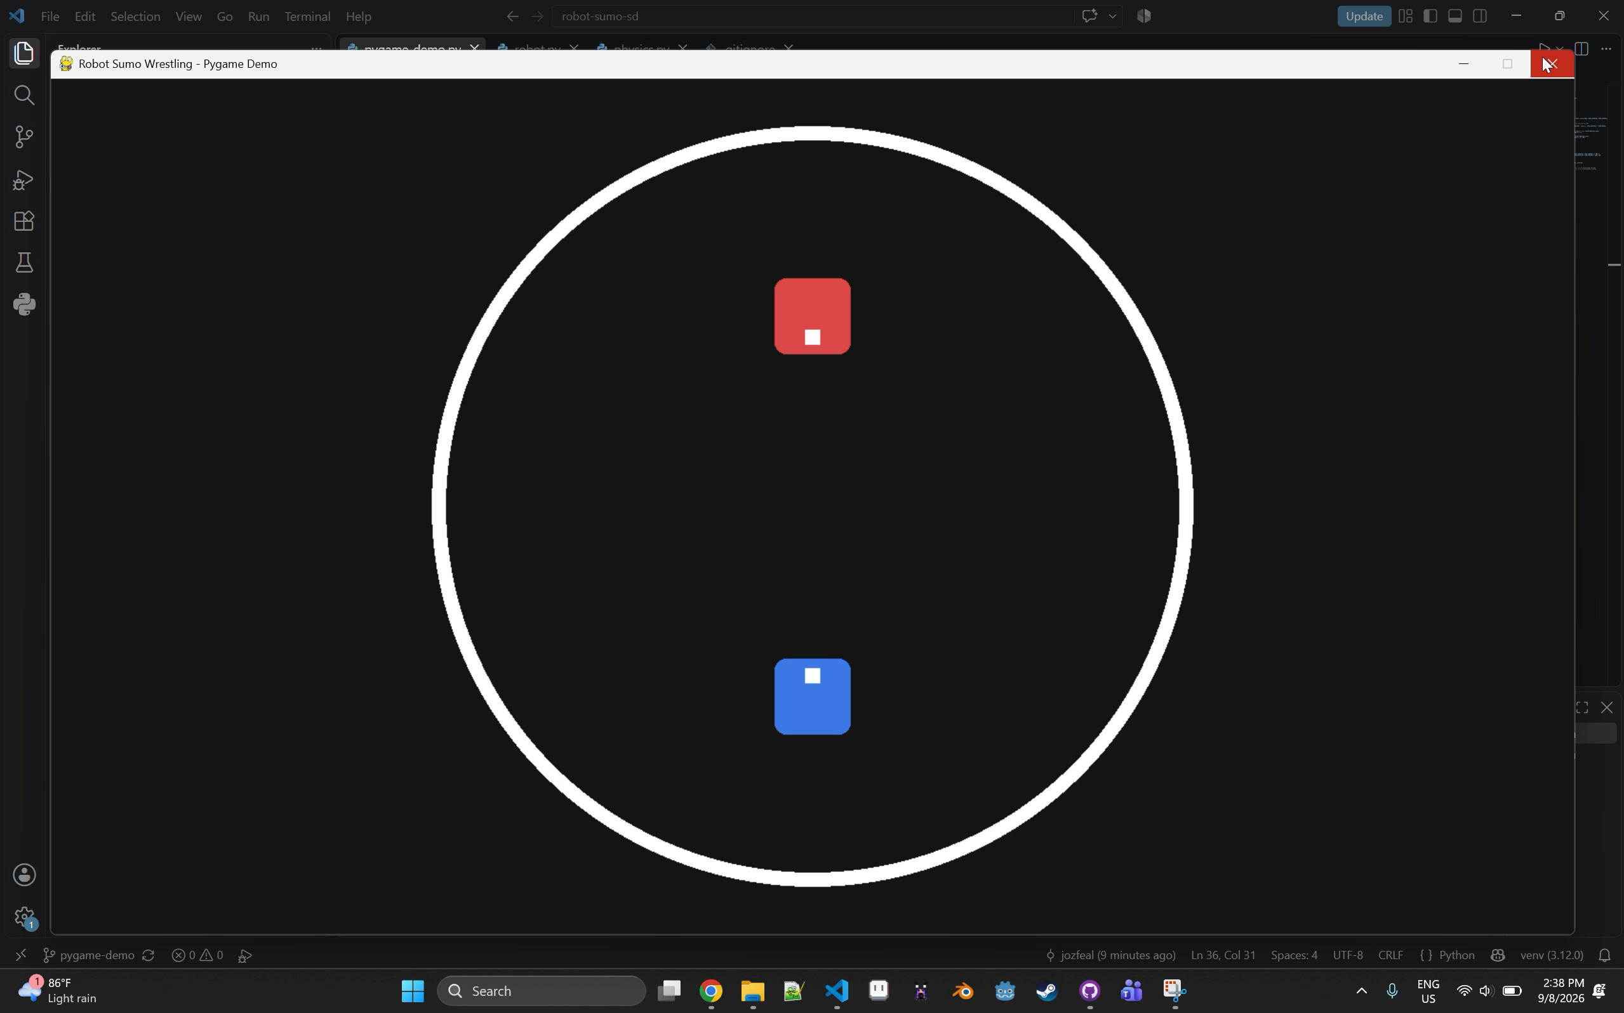
Engine Demos: Pygame

Slide 6
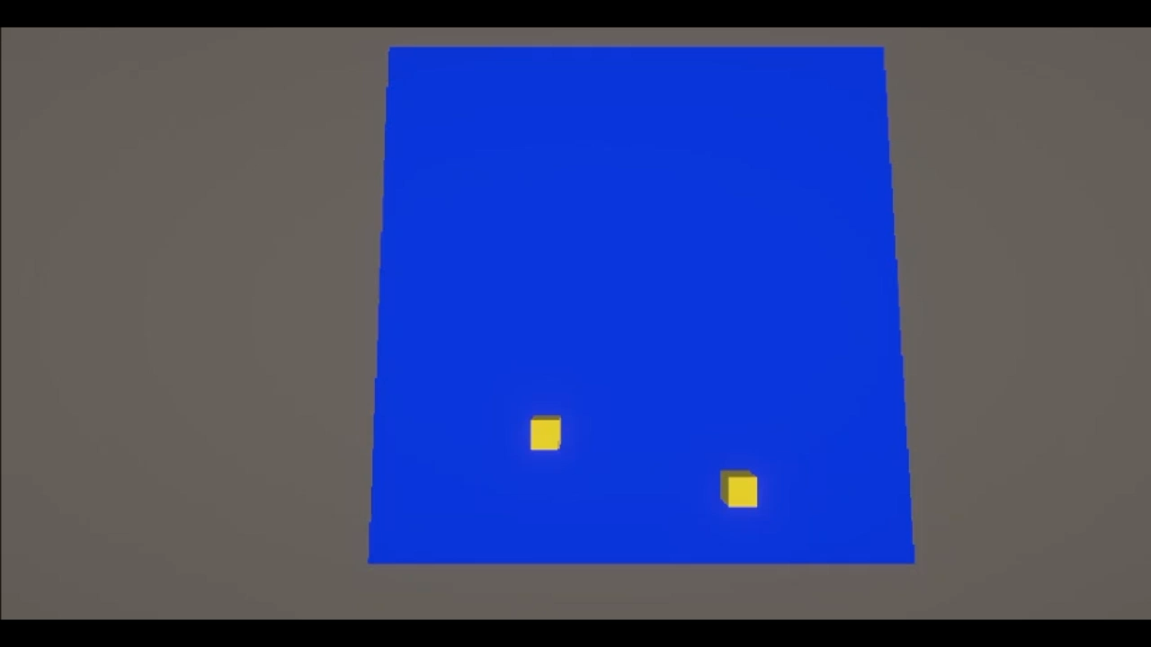
Engine Demos: Unity

Slide 7



Engine Demos: Comparison
Overall Choice: Godot
Pygame
Unity
Godot
Simple and easy to code with.
Version dependencies.
No 3D support.
Limited physics integration.
Integrated physics in 2D and 3D.
Strong and robust engine.
Lack of developer experience.
Heavy engine slow for debugging.
Integrated physics in 2D and 3D.
Lightweight and open source.
Integrated Vehicle classes.
Needs external Python integration.

Slide 8
2
Resolve Technical Challenges:
RL APIs, AI Panther, RL Approaches

Slide 9
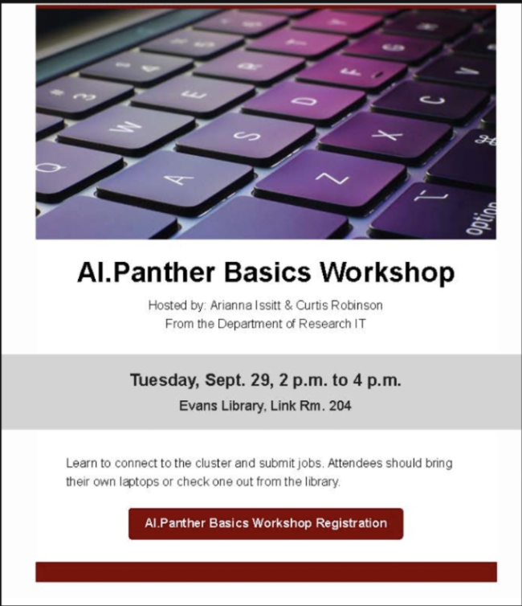
Resolve Technical Challenges: AI Panther
AI Panther Resource
The team has requested AI Panther access with assistance from the faculty advisor.
The team attended an AI Panther workshop to learn more about using this selected tool.

Slide 10
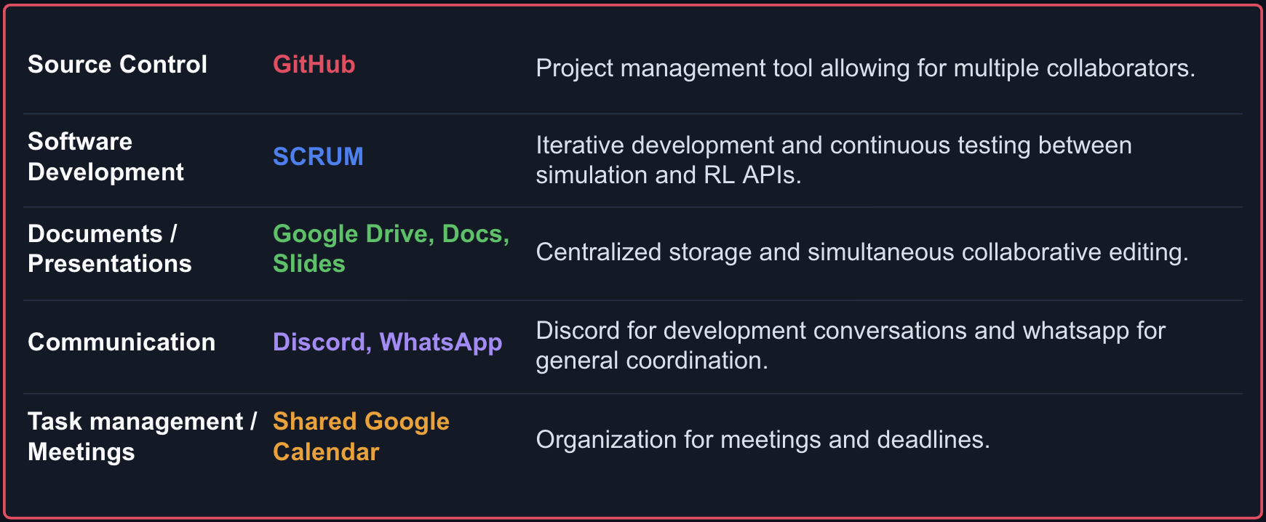
Resolve Technical Challenges: Communication Tools

Slide 11
Resolve Technical Challenges: Research RL APIs
RL API
Description
Suitability
Gymnasium | Python based single-agent RL environment, operates through reset() and step() functions. | Minimal API interface, well documented, good choice for single-agent baseline.
VMAS (Vectorized Multi-Agent Simulation) | Fast 2D physic simulator, more like a physics engine. | Only supports 2D, less suitable for 3D environments.
PettingZoo | Python based API for multi-agent reinforcement learning, similar to Gymnasium. | Strong fit for project. Can handle the proposed MARL requirements.
MOMAland | Similar to PettingZoo, supports multiple objectives and separate rewards. | May be useful for experimenting with different reward strategies.
Note: the single-agent approach was selected for baseline RL experimentation. Approaches for potential MARL applications will be evaluated if scope allows.

Slide 12
3
Create Documents:
Requirements, Test, and Design

Slide 13
Requirements Document: Interface Requirements
Example Interface Requirements:
User Interfaces: The system shall provide a configuration GUI interface that allows users to set robot design options, ring dimensions, and environmental effects before running a match.
Software Interfaces: The system shall be built using Godot (version 4.7.2), obtained from the official Godot Engine distribution site.
Communication Interfaces: The system shall submit RL training jobs to AI Panther via SSH access to its login node, and Slurm job submission
Hardware Interfaces: The local visualization application shall be able to run on standard consumer/developer hardware (laptop or PC).

Slide 14
Requirements Document: Functional Requirements
Example Functional Requirements:
Match Configuration: The system shall allow the user to configure modular robot design parameters before running a match.
Single-Agent RL Training: The system shall train a single agent using the Gymnasium API against an opponent.
Progressive Training: The system shall support self-training by allowing an agent to compete against a previously trained version of itself (self-play).
Direct User Participation: The system shall allow a user-controlled robot to compete against a trained agent or a hardcoded opponent.

Slide 15
Requirements Document: Performance Requirements
Example Performance Requirements:
Frame Rates: The visualization should render at a minimum of 30 frames per second during a match
Memory: A single-agent training job shall request no more memory than AI Panther’s partition-specific time limits.
Launch Speed: The local application shall launch and be ready for user interaction within 10 seconds of being started.

Slide 16
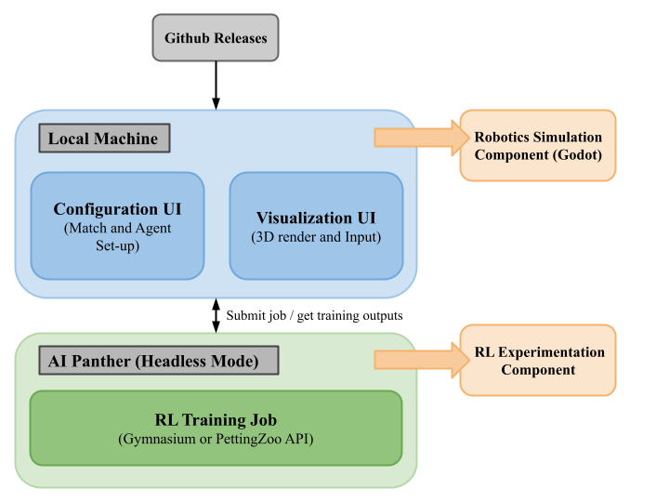
Requirements Document: Block Diagram
Example Block Diagram:
5

Slide 17
Design Document
User Types:
Developers
  Development team. Assumed to be all types of users simultaneously. Access to GitHub repository.
Trainers
  Execute and delegate training jobs. Must interact with supercomputing resource interface.
Visualizers
  Must interact with Godot Simulation to run rounds. May import agents or round data.
Players
  Participate in a robot sumo round against an agent or other player for validation or influencing training.

Slide 18
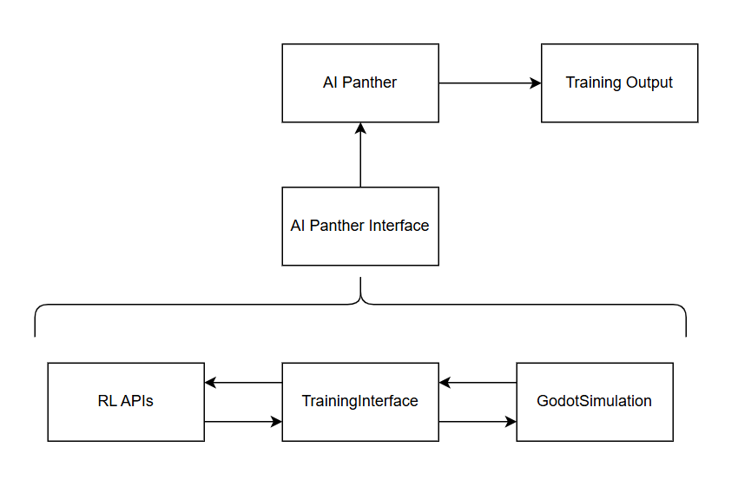
Design Document
System Architecture
User Facing Machines
Robot Sumo Simulation
Supercomputing Resource
Non-User Facing Machines
RL API
  Gymnasium
  Petting Zoo

Slide 19
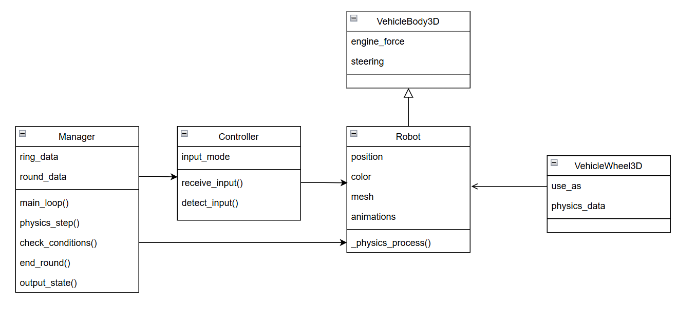
Design Document
Godot Simulation

Slide 20
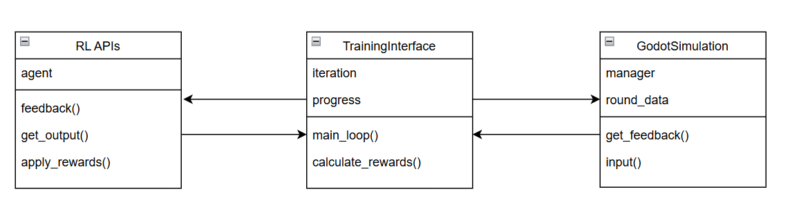
Design Document
Training

Slide 21
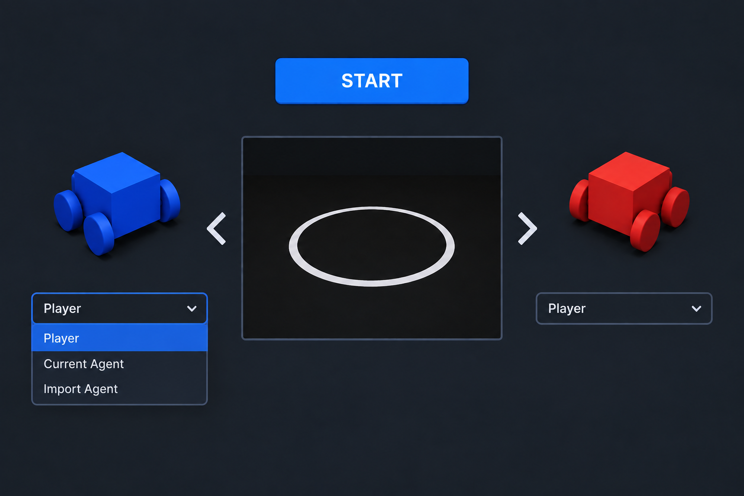
Design Document: Mock GUI

Slide 22
Test Document: Overview
Reinforcement Learning Tests (RLT)
  Section 3.2.2 Single-Agent RL Training
  Section 3.2.3 Progressive Training
  Section 3.2.6 Multi-Agent Reinforcement Learning (MARL)
Reinforcement Learning Configuration (RLC)
  Section 3.2.1 Match Configuration
  Section 3.2.7: Custom Agent Implementation
Physics Engine Tests(PET)
  Section 3.2.4 Pre-Trained Agent Visualization
  Section 3.2.5 Direct User Participation

Slide 23
Test Document: Specific Examples
RLT-001: Single Agent Training Test
Validate: Agent parameters change after each match, beyond a set tolerance. The RL interface gives real game-state output, not default values. Game states differ across matches by some tolerance.
RLC-000: Match Configuration
Validate: Using a debugger or observing debug logging, related physics properties and ring alterations match the settings set in the configuration files.
PET-100 Direct User Participation
Validate: usability testing/user testing, a player is able to “correctly” use all intended inputs from mouse and keyboard.

Slide 24
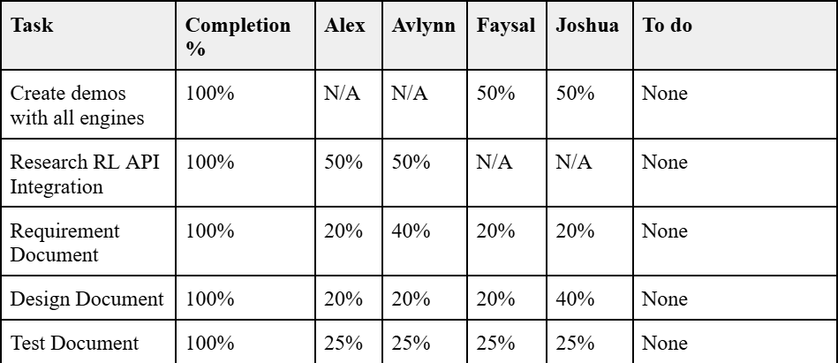
Milestone 1: Conclusion

Slide 25
4
Milestone 2 Tasks

Slide 26
Milestone 2: Overview of Tasks
Tasks:
Implement robot models with corresponding hitboxes
Give robots the ability to interact with the environment and set start and end conditions for a sumo match
Give exposable inputs for the robot controller
Provide readable full state feedback for RL training
Implement a basic interface for the simulation and RL API
Research specific RL algorithms that are best suited to the project

Slide 27
5
Questions?

