Slide 1

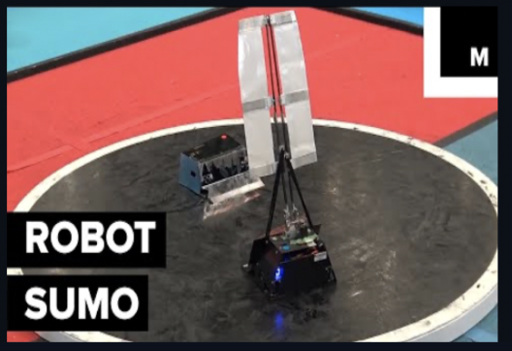
Robot Sumo Simulation:
Training Robot Sumo Agents
Milestone 2: Presentation
Team: Adebare Kofo-Abayomi, Avlynn Wade, Faysal Zaki, Joshua Oziel Fernández Alvarado
Client & Faculty Advisor
Department of Electrical Engineering and Computer Science
Dr. Hanks
Notes:
Joshua

Slide 2
Reminder: Primary Milestone 2 Tasks
1. Godot Simulation
Implement robot models with corresponding hitboxes.
Give robots the ability to interact with the environment and set start and end conditions for a sumo match.
Give exposable inputs for the robot controller.
Provide readable full state feedback for RL training.
2. RL Environment
Research specific RL algorithms that are best suited to the project.
Implement a basic interface between the simulation and RL environment.
Notes:
Joshua

Slide 3
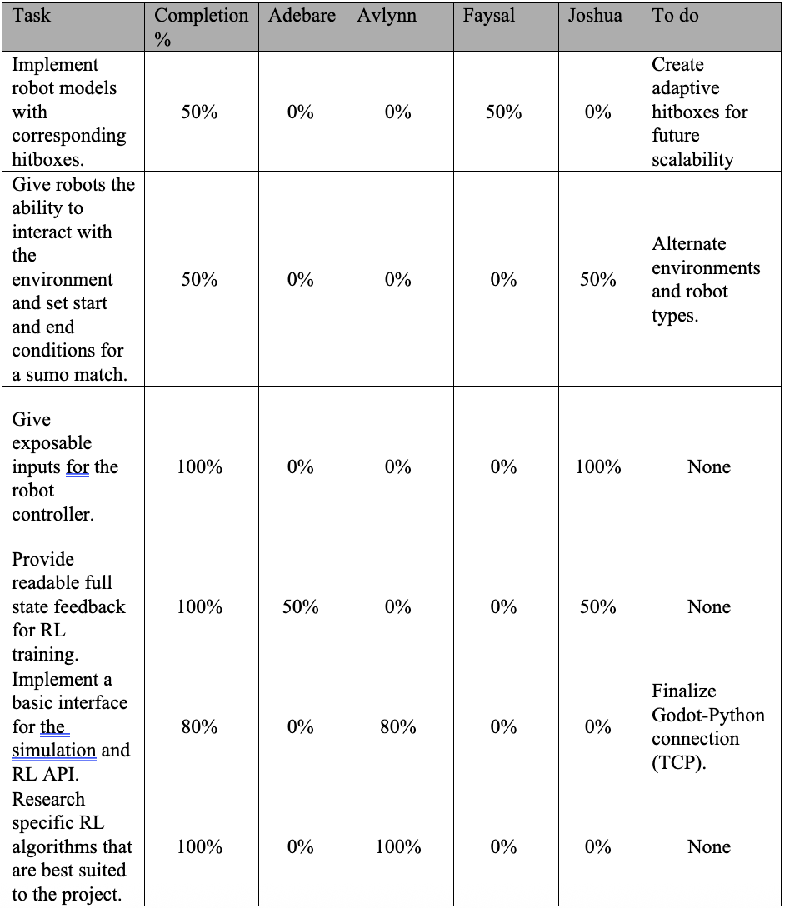
Reminder: Milestone 2 Final Task Matrix
To Do: Milestone 3
Create adaptive hitboxes.
Alternate environments and robot types.
Finalize the Godot-Python connection.
Notes:
Joshua

Slide 4
1
Section 1:
Godot Simulation
Notes:
Joshua

Slide 5
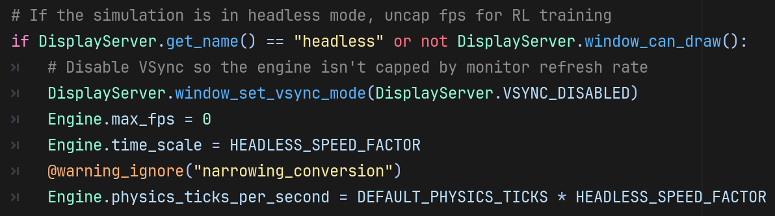
Godot Simulation: Headless Mode
Notes:
Joshua

Slide 6
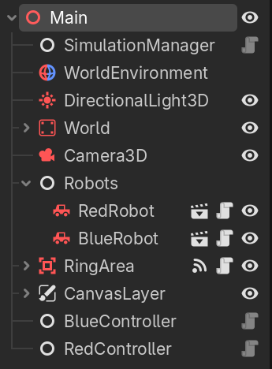
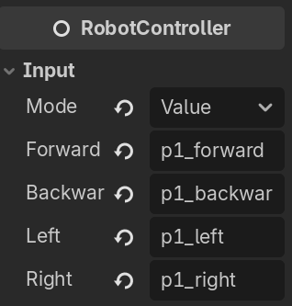
Godot Simulation: Exposable Inputs
Notes:
Joshua

Slide 7
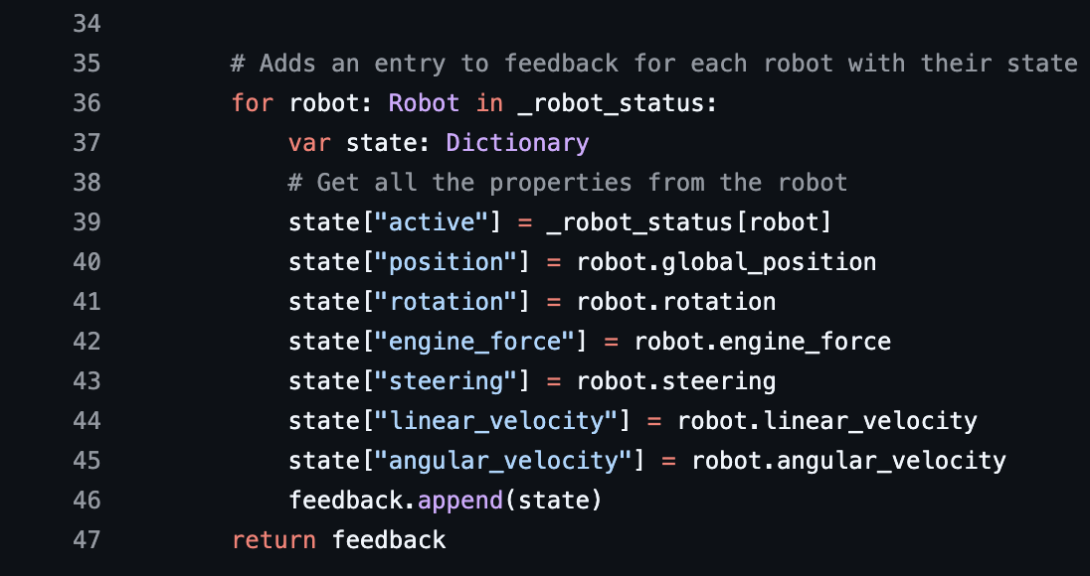
Godot Simulation: State Feedback
Notes:
Joshua

Slide 8
Godot Simulation: Adaptive Hitboxes,
Environment Interactions & Match Conditions
1. Adaptive Hitboxes
The team tried out different ways to connect hitboxes.
  Skeleton and Joint nodes in Godot.
Tested how meshes and hitboxes can be implemented in a modular way.
Different models currently out of scope and other tasks were prioritized.
2. Environment Interactions
Match conditions were made easily modular.
The team has chosen to stick with the default ring environment for the start.
Made sure the robots can fully interact with each other in this environment.
Functionality for other environmental hazards or interactables currently out of scope.
Notes:
Faysal
hitboxes out of scope . Tried out different in-engine features(components) to assess the best way to implement modular hitboxes. For example, Godot allows skeletons to be generated from physics objects……todo…..Each hitbox could also just be connected to each other through joints we configure instead of from the joints generated by skeleton(??) Not just hitboxes, but meshes needed to be modular and match the shape of the hitbox to be a visual.
env out of scope until we can figure out robo vs robo. Environmental interactions would be other physics objects, static and potentially dynamic, that littered the ring and acted as hazards and obstscles. they are to be a configurable feature set by the end user. Though for this iteration this feature was out of scope. Main focus was ensuring the RL agent could work and react/interact with an opponent, and having other physics objects besides the RL agent, opponent, and arena would complicate this stage of development unnecessarily. So the ring just has its ‘default’ configuration, where it is just a round and plain arena. This was to

Slide 9
2
Section 2:
RL Environment
Notes:
Alex

Slide 10
RL Environment: Research Specific Algorithms
Algorithm
Description
Suitability
PPO (Proximal Policy Optimization) | On-Policy algorithm. Can perform in discrete or continuous action spaces. | Baseline learning algorithm. Well-documented.
SAC (Soft Actor-Critic) | Off-Policy algorithm. Can only be used for environments with continuous action spaces. | Could be used as a comparison algorithm against on-policy algorithms.
TD3 (Twin Delayed DDPG) | Off-Policy algorithm. Similar to SAC. | Harder to tune than previous algorithms.
DQN (Deep Q-Network) | Off-Policy algorithm. Picks from a fixed list of actions. | More suited to discrete environments, but can be modified.
Note: chose to start with PPO, test others later on within the next milestone.
Notes:
Alex

Slide 11
RL Environment: Research RL Libraries
Library
Description
Suitability
SB3 (Stable Baselines3) | Supports algorithms PPO, SAC, TD3, and DQN. Shows how to incorporate Gymnasium in its documentation. | Suitable to custom environment, easy implementation.
CleanRL | Simple code and shorter algorithms, (single file implementation). Does have support for Gymnasium. | May be a good tool for learning, but appeared less documented/structured.
RLlib (Ray) | Provides implementations of various algorithms like PPO. More suited to large-scale datasets/multiple machines. Offers support for MARL. | Reconsider for the MARL reach goal.
PyTorch | Can be integrated with Gymnasium, but required implementation of policy networks/training procedures. | Not ideal due to the time constraints of the project.
Notes:
Alex

Slide 12
RL Environment: Custom Gymnasium Environment
Custom Environment
RobotSumoEnv is our custom Gymnasium Environment
It implements necessary functions such as step(), reset(), compute_rewards(), etc.
The agent’s action space is a continuous [steering, throttle] pair. The observation space is the full-state feedback from the simulation, covering both the agent and the opponent.
Has rewards for wins, losses, and draws. Small per-step bonuses (0.0005) reward staying near the center and pushing the opponent toward the edge.
Notes:
Avy

Slide 13
RL Environment: RL Design Flowchart
RL Library (SB3): provides the premade algorithms
Algorithm: PPO
The learning method
Gymnasium API
The shared rules: step() and reset()
Observation,
reward, match end info.
Action
Environment: the world the agent learns in
RobotSumoEnv
Our custom environment class
Simulation
Godot
Notes:
Avy

Slide 14
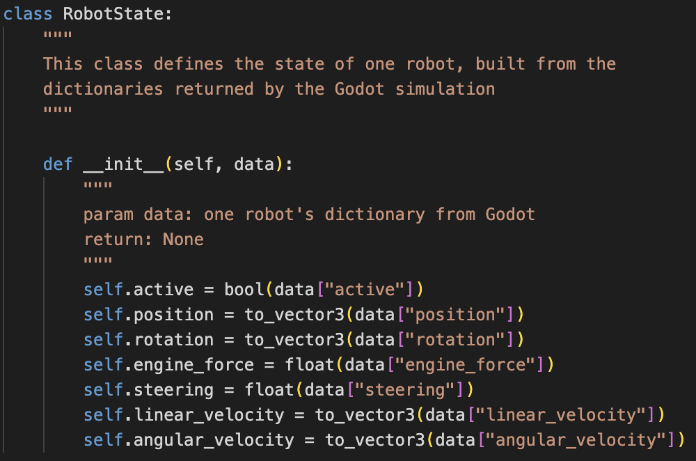
RL Environment: State Feedback Python Class
Takes the list returned by Godot’s get_feedback() method and represents that information in Python. Will be used in the RobotSumoEnv environment.
Notes:
Alex

Slide 15
RL Environment: State Feedback Flowchart
Godot
Python
Simulation Scene
RobotSumoEnv
Action space, observation space
StateFeedback (Godot)
get_feedback() builds a list of values.
StateFeedback (Python)
Checks list, holds variables
[winner, agent, opponent]
Python values
Godot-Python Connection
Notes:
Avy

Slide 16

RL Environment: Training/Evaluation Demos, Local
TensorBoard Monitoring: visualizes training metrics over time.
Notes:
Avy

Slide 17

RL Environment: Training/Evaluation Demos, AI Panther
AI Panther:
use SLURM scripts to submit jobs. Same output as local machine.
Notes:
Avy

Slide 18
RL Environment: Example Training Loop
Local Machine
AI Panther
Training Script:
PPO Policy
picks an action
RobotSumoEnv
step(), reset() functions
Simulation
placeholder data for now
Observation, reward, terminated, truncated
Trained Model
Logs
Checkpoints
Notes:
Avy

Slide 19
3
Milestone 3 Tasks
Notes:
Faysal

Slide 20
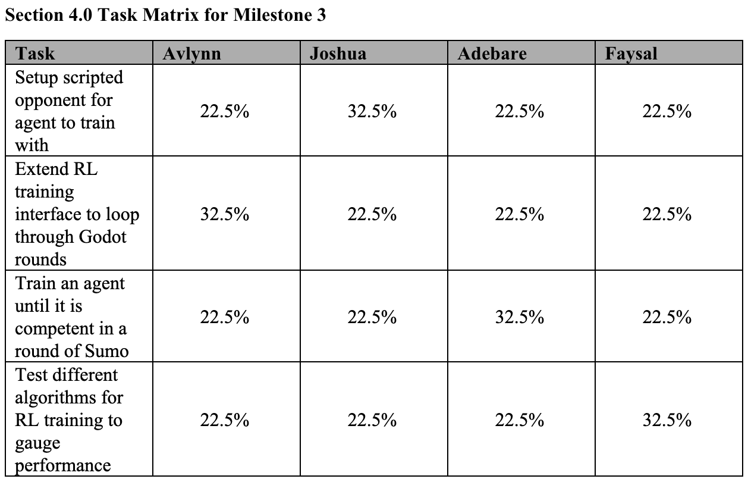
Milestone 3: Overview of Tasks
The overall goal for milestone 3 is to deliver a fully-functional MVP of the Robot Sumo simulation. At the very least, this should contain a fully-trained agent capable of beating a hardcoded opponent.
Notes:
Faysal

Slide 21
4
Questions?

