Slide 1







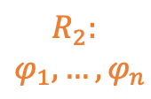
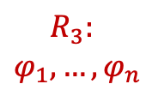
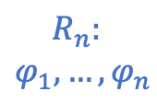
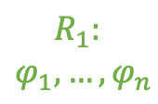

Server
4
$R_{S}:[φ=BG≤170 \& basal≥0.084,$… $]$
3
Population Rule Aggregation Protocol
Query
Query
Query
Query
Response
Response
Response
Response
$$R_{1}:$$
$$φ_{1}, …{,φ}_{n}$$
$$R_{2}:$$
$$φ_{1}, …{,φ}_{n}$$
$$R_{3}:$$
$$φ_{1}, …{,φ}_{n}$$
$$R_{n}:$$
$$φ_{1}, …{,φ}_{n}$$
2
1
…
c₁
c₂
c₃
c_{n}
Clients

Slide 2
[root]
root
[stlTerm1]
stlTerm1
[root]
root

