Slide 1







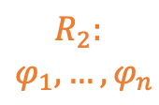
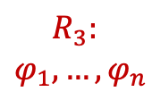
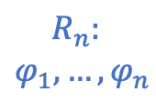
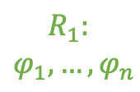

Server
4
$R_{S}:[φ=BG≤170 \& basal≥0.084,$… $]$
3
Population Rule Aggregation Protocol
Query
Query
Query
Query
Response
Response
Response
Response
$$R_{1}:$$
$$φ_{1}, …{,φ}_{n}$$
$$R_{2}:$$
$$φ_{1}, …{,φ}_{n}$$
$$R_{3}:$$
$$φ_{1}, …{,φ}_{n}$$
$$R_{n}:$$
$$φ_{1}, …{,φ}_{n}$$
2
1
…
c₁
c₂
c₃
c_{n}
Clients

Slide 2





Server
$R_{S}:[φ=BG≤170 \& basal≥0.084,$… $]$
Query
Query
Query
Query
Response
Response
Response
Response
Selection
Expansion
Querying
Backpropagation
4
3
$$R_{1}:$$
$$φ_{1}, …{,φ}_{n}$$
$$R_{2}:$$
$$φ_{1}, …{,φ}_{n}$$
$$R_{3}:$$
$$φ_{1}, …{,φ}_{n}$$
$$R_{n}:$$
$$φ_{1}, …{,φ}_{n}$$
2
1
…
c₁
c₂
c₃
c_{n}
Clients

Slide 3




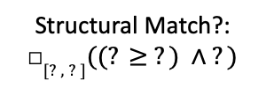

Server
$R_{S}:[φ=BG≥170 ∧ basal≤0.084,$… $]$
Selection
Expansion
Querying
Backpropagation
Y
4
Y
Y
Y
Y
3
Structural Match?:
□$[?,?]((? ≥ ?) ∧ ?)$
$$R_{1}:$$
$$φ_{1}, …{,φ}_{n}$$
$$R_{2}:$$
$$φ_{1}, …{,φ}_{n}$$
$$R_{3}:$$
$$φ_{1}, …{,φ}_{n}$$
$$R_{n}:$$
$$φ_{1}, …{,φ}_{n}$$
2
…
1
c₁
c₂
c₃
c_{n}
Clients

Slide 4




Server
$R_{S}:[φ=BG≥170 ∧ basal≤0.084,$… $]$
4
3
Selection
Expansion
Querying
Backpropagation
Y
Y
Y
Y
Y
Structural Match?:
□$[?,?]((? ≥ ?) ∧ ?)$
$$R_{1}:$$
$$φ_{1}, …{,φ}_{n}$$
$$R_{2}:$$
$$φ_{1}, …{,φ}_{n}$$
$$R_{3}:$$
$$φ_{1}, …{,φ}_{n}$$
$$R_{n}:$$
$$φ_{1}, …{,φ}_{n}$$
2
…
1
c₁
c₂
c₃
c_{n}
Clients

Slide 7
root
(?) U (?)
F( ? )
G( ? )

Slide 8
root
(?) U (?)
F( ? )
G( ? )
X
X
X
(? > ?) U (? < ?)
(? & ?) U (? > ?)
(? < ?) U (? < ?)
F(? & ?)
F(? | ?)
F(? -> ?)
G(? & ?)
G(? | ?)
G(? -> ?)
X
…
…
(BG > p1) U (bolus < p2)
F(? > ? & ? < ?)
F(? > ? & ? > ?)
F((? | ?) & ?)
(? > ?) U (? < ?)
(? & ?) U (? > ?)

