Slide 1


IntelliJ IDEA Plugin
UNIVERSITY OF CRAIOVA
FACULTY OF AUTOMATION, COMPUTERS AND ELECTRONICS
DEPARTMENT OF COMPUTERS AND INFORMATION TECHNOLOGY
Student: Jozsef-Gabriel Simon
Supervisor: S.l.dr.ing. Cristinel-Ștefan Udriștoiu

Slide 2
Table of Contents
Introduction | Function type check
What is C-Minus? | Features - References and Resolve
Lexer and Parser | Features - Code Completion
Process of building a PSI tree | Features - Live Templates
Features | Features - Code Formatter
Features - Error Highlighting | Application Demo Presentation

Slide 3
Introduction
The plugin has been entitled „C-Minus Plugin” and is a custom language support plugin for IntelliJ IDEA for editing code written in C-Minus language.
The plugin offers several features like: Registered File Type; Lexer; Parser and PSI; Syntax and Error Highlighting; References and Resolve; Code Completion; Find Usages; Rename Refactoring; Code Formatter; Structure View; Go to Symbol; Additional minor features: Brace Matching, To Do View, Quote Handler.

Slide 4








Slide 5
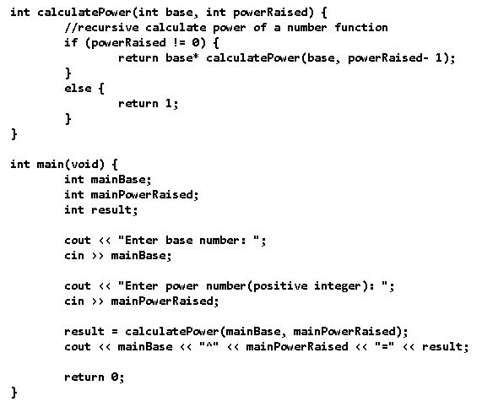
What is C-Minus?
A language introduced in the book called „Complier Construction: Principles and Practice” written by Kenneth C. Louden (Professor Emeritus of Computer Science at San Jose State University);
It is described as „A more extensive language than TINY, suitable for a compiler project.”, and represents a restricted subset of C, which contains integers, integers array, functions and recursive functions, local and global declarations, if and while statements, but for which I added: strings, cin and cout for reading and writting (similar to C++), constants, boolean variables and values.

Slide 6
Lexer and Parser
The grammar is written in Backus–Naur form (BNF).
The lexer consists of several terminal symbols, but also defines regular definitions.
In this plugin case, JFlex lexical analyzer generator is based on Deterministic Finite Automata (DFA), which is a finite-state machine that accepts or rejects a string of symbols, by running through a state sequenced determined by the string. Deterministic means that for each input symbol, the state to which the machine will move is determined.

Slide 7
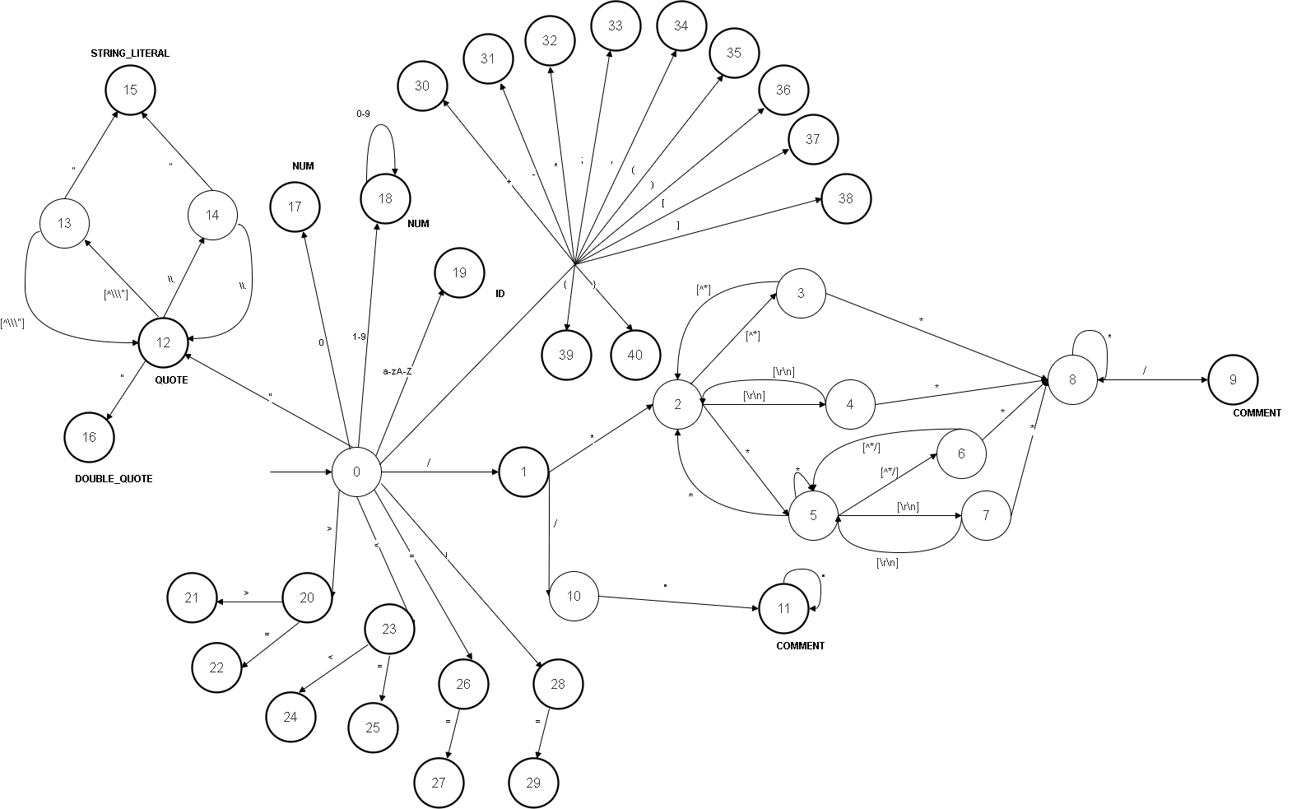
Lexer and Parser

Slide 8

Lexer and Parser
In order to be parsed, the grammar has to be free of left recursive rules. The parse trees cannot be parsed Top-Down, because during parsing in the syntax analysis part of the compilation there is a chance that the grammar will create infinite loops.

Slide 9
Lexer and Parser
The parsing files is a 2-step process:
First, an Abstract Syntax Tree (AST) is created defining the program’s structure;
Second, a Progam Structure Interface (PSI) tree is created on top of the AST tree, adding meaning and methods for manipulating language constructs.
Within the stream of tokens received from the lexer, the parser sets pairs of markers. For a single node in the AST tree, each pair of markers defines the range of lexer tokens. It becomes the child node of the outer pair if a pair of markers is nested in another pair (starts after its start and finishes before its end).

Slide 10
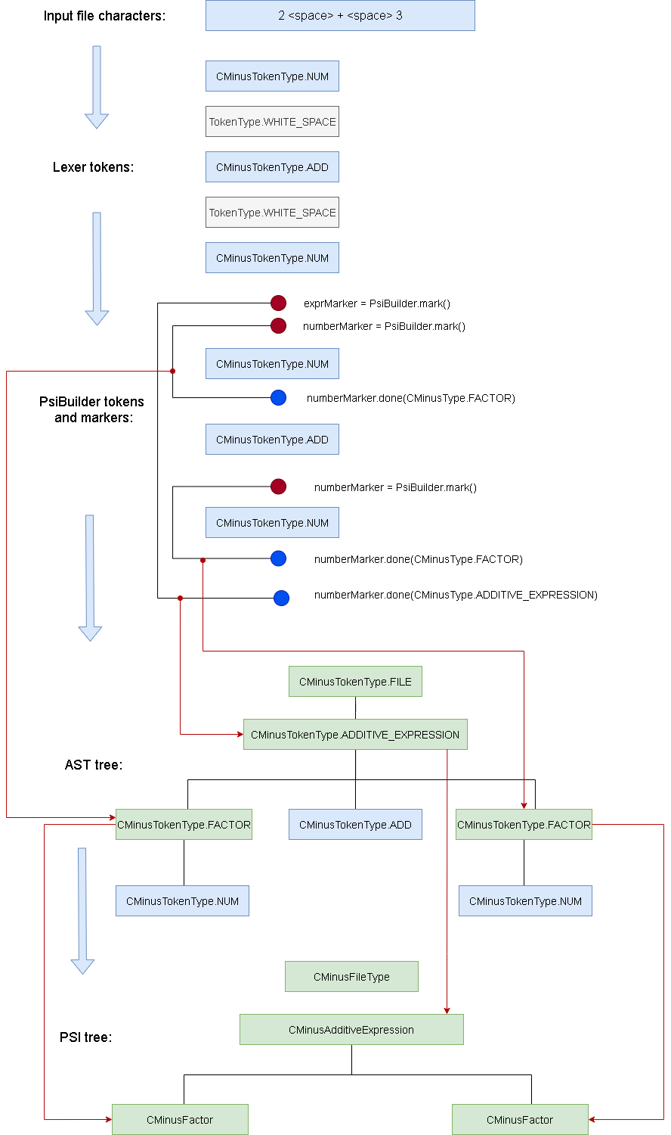
Process of building a PSI tree

Slide 11
Features
Syntax and Error Highlighting; References and Resolve; Code Completion; Find Usages; Rename Refactoring; Code Formatter; Structure View; Go to Symbol; Additional minor features: Brace Matching, To Do View, Quote Handler.
Basic for a language support plugin.
Most complex and challenging:
Error Highlighting
References and Resolve
Code Completion
Code Formatter

Slide 12
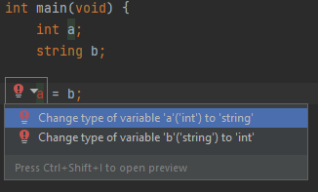
Features - Error Highlighting
Implement Annotator which will handle the elements from the PSI tree during the background highlighting pass.
Offering quick fixes for errors using AnnotationHolder.

Slide 13
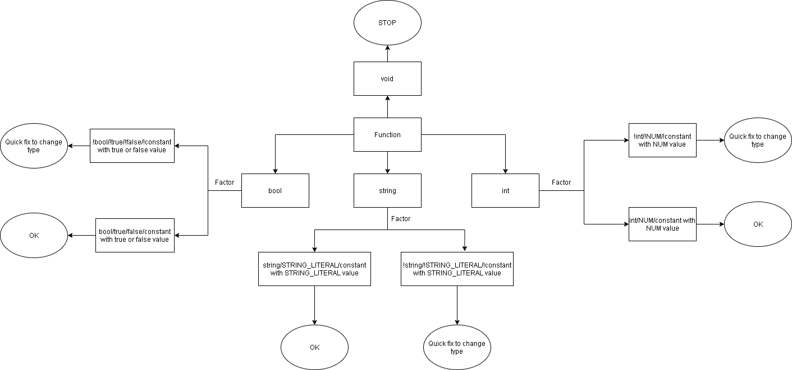
Function return type check

Slide 14
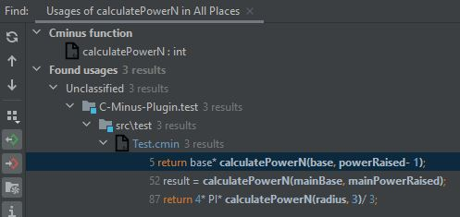
Features - References and Resolve
One of the most significant and difficult aspects.
Users can move from a PSI element’s usage to it’s declaration by resolving references.
Is required for Go to Declaration action, as well as for Find Usages, Rename Refactoring and Code Completion for usage.
It is done by searching through the PSI tree for declarations of the element with the same identifier.

Slide 15
Features - Code Completion
2 main types:
Reference completion;
Contributor-based completion, using Live Templates.
The first one is done using references by populating a list with possible elements for use: functions, variables and constants.
The second one is done by implementing a *.xml file, where templates are defined.

Slide 16

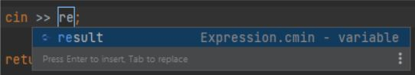

Features - Live Templates
Programmable rules that help developers to reduce the length of reccuring text patterns in editor.
The IDE turns the previous input sequence to its full-length output and updates the cursor location when a user writes the chosen abbreviation followed by a configurable expansion key.

Slide 17
Features - Code Formatter
Formatting model for the document is provided
Build tree of blocks
Calculate sequence of whitespace characters
The formatting model is requested
Spacing
Alignment
Indent
Wrap

Slide 18
APPLICATION DEMO PRESENTATION

Slide 19


Slide 20


