Slide 1
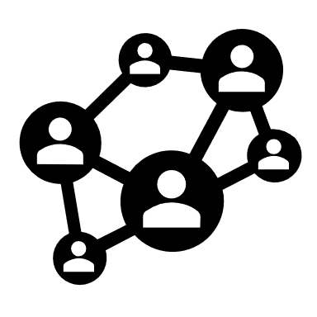





Secure Tunneling
127.0.0.1

