Slide 1
Random Variables
Basic Building Block for Uncertainty Modeling

Slide 2
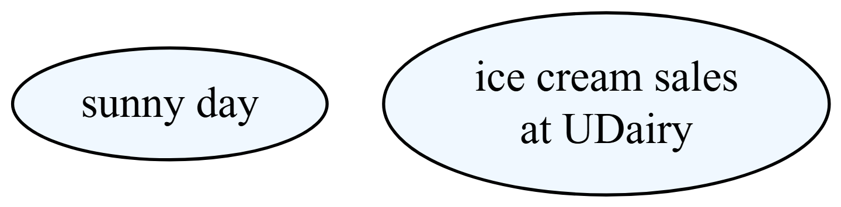
What is a Random Variable?
Random Variable (informally): A measurement whose value is subject to uncertainty or randomness.

Slide 3
Example random variables (informally).
Notes:
The ellipse represents a random variable - it’s a container for uncertain outcomes.

Slide 4
Types of Random Variables
Discrete vs. Continuous
Discrete Random Variables: - Countable outcomes (1, 2, 3, …) - Examples: Number of customers, coin flips
Continuous Random Variables: - Uncountable outcomes (any value in a range) - Examples: Temperature, height, time

Slide 5
Example random variables (informally).
Notes:
Explain the fundamental distinction between discrete and continuous random variables.

Slide 6
Random Variables (Mathematically)
Real-World Outcome | Numerical Value
Sunny day | 1
Not sunny day | 0
Mapping Real-World Outcomes to Numbers

Slide 7
Random Variable: A function that maps each possible outcome to a real number
Notes:
Show how we convert qualitative outcomes into quantitative measurements for analysis.

Slide 8
Mathematical Formalism
Random Variable Definition
A random variable $X$ is a function that maps the sample space $Ω$ to the real numbers:
$$X:Ω→R$$
Example:
$Ω=\{\text{sunny},\text{not sunny}\}$
$X\left(\text{sunny}\right)=1$
$X\left(\text{not sunny}\right)=0$
Notes:
Introduce the formal mathematical definition and notation for random variables.

Slide 9
Mathematical Formalism (Continued)
Key Properties
A random variable $X$ is a function that maps the sample space $Ω$ to the real numbers:
$$X:Ω→R$$
Key Properties:
Each outcome gets exactly one number
Different outcomes can map to the same number
We can now do mathematical analysis on the numbers
Notes:
Explain the key properties of random variables and their mathematical implications.

Slide 10
Probability Distributions
Spreading Plausibility Over Outcomes
Key Insight: Random variables are most useful when we assign probabilities to each outcome.
Example - Weather Random Variable:
$X\left(\text{sunny}\right)=1$ with probability $P\left(X=1\right)=0.7$
$X\left(\text{not sunny}\right)=0$ with probability $P\left(X=0\right)=0.3$
Total probability must sum to 1: $0.7+0.3=1.0$
Notes:
Introduce the concept that random variables need probability assignments to be useful.

Slide 11
Discrete Probability Distribution
Outcome | Value | Probability
High sales (>100) | 1 | 0.6
Low sales (≤100) | 0 | 0.4
Example: Ice Cream Sales

Slide 12
Properties:
Each probability ≥ 0
Probabilities sum to 1: $0.6+0.4=1.0$
Notes:
Show a concrete example of a discrete probability distribution with clear properties.

Slide 13
Continuous Probability Distribution
Example: Temperature
For continuous random variables, we use probability density functions (PDFs) to show how we allocate plausibility:
Temperature $T$ can be any of the infinite values in a range (e.g., 60°F to 90°F)
$P\left(T=75°F\right)=\frac{1}{∞}≈0$ (exact values have zero probability)
Instead: $P\left(70°F<T<80°F\right)=0.3$ (ranges have positive probability)
Key: Area under the PDF curve represents probability
Notes:
Introduce continuous distributions and the concept of probability density.

Slide 14
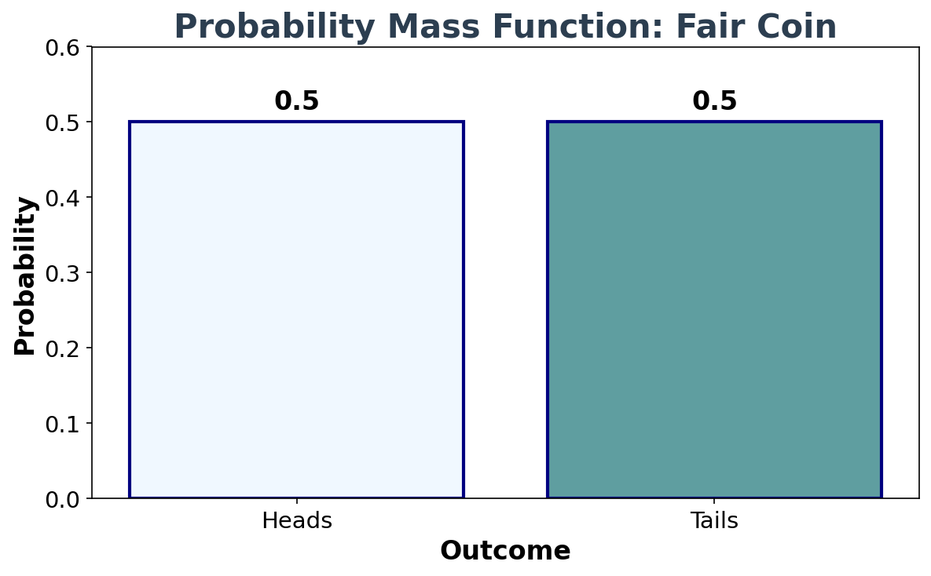
Discrete Example: Coin Flips
Notes:
Show a simple discrete probability mass function for coin flips.

Slide 15
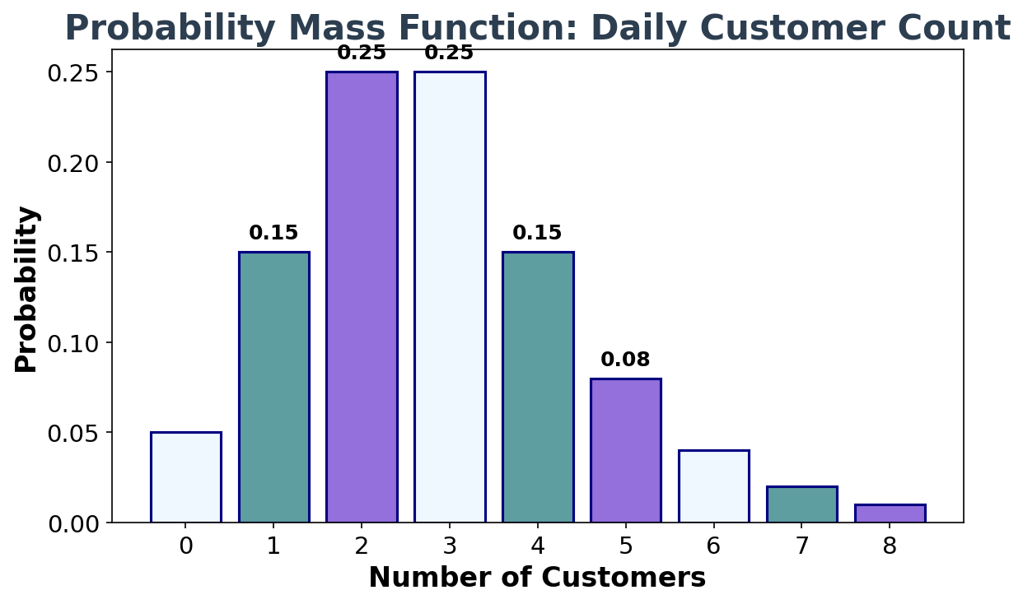
Discrete Example: Customer Count
Notes:
Show a more complex discrete distribution for customer counts.

Slide 16
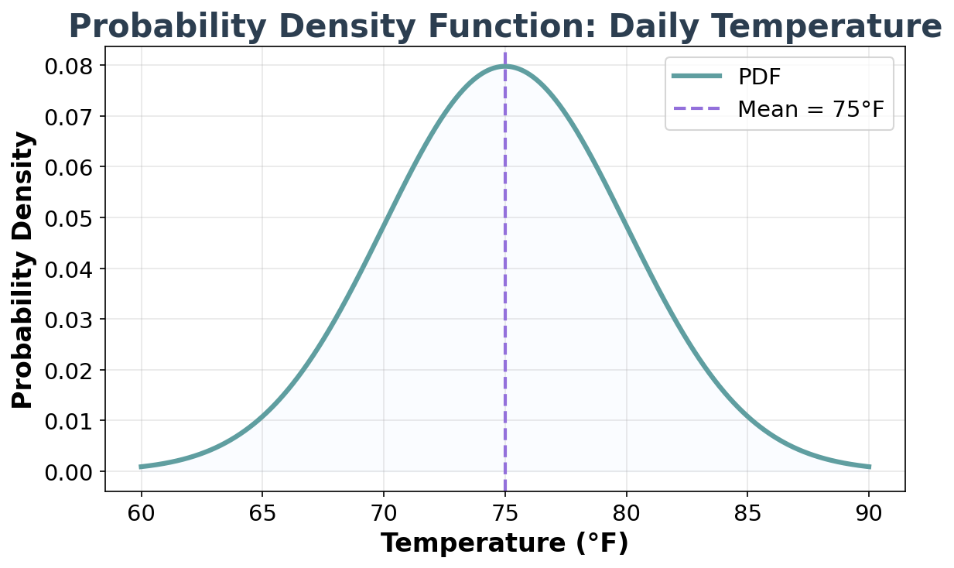
Continuous Example: Temperature
Notes:
Show a continuous probability density function for temperature.

Slide 17
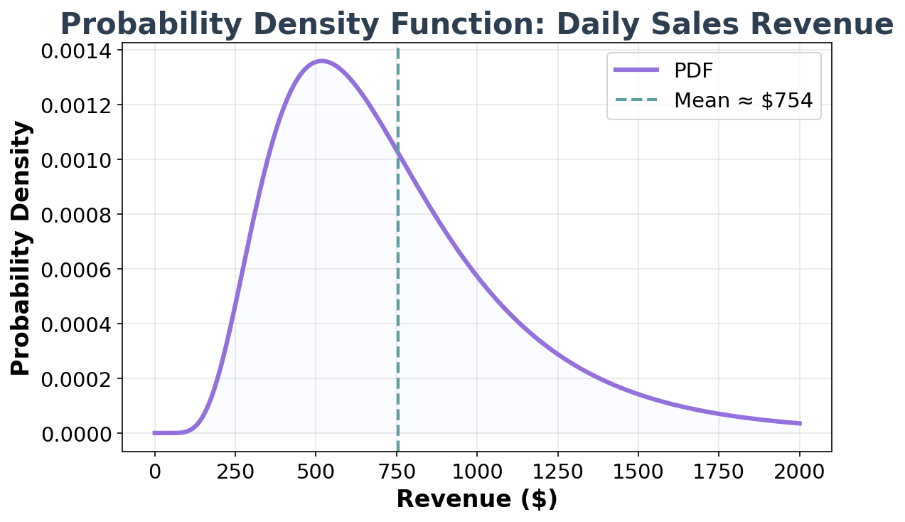
Continuous Example: Sales Revenue
Notes:
Show a continuous probability density function for sales revenue with a skewed distribution.

Slide 18
Bernoulli Distribution: Table View
Outcome | Value | Probability
Sunny day | 1 | 0.7
Not sunny day | 0 | 0.3
Sunny Day Example

Slide 19
Properties:
Binary outcomes (0 or 1)
Probabilities sum to 1: $0.7+0.3=1.0$
This is a Bernoulli distribution
Notes:
Show the table representation of the Bernoulli distribution for the sunny day example.

Slide 20
Bernoulli Distribution: Mathematical Definition
Academic Paper Style
A random variable $X$ follows a Bernoulli distribution with parameter $p$ if:
$$X∼\text{Bernoulli}\left(p\right)$$
where:
$P\left(X=1\right)=p$ (probability of “success”)
$P\left(X=0\right)=1−p$ (probability of “failure”)
Notes:
Present the formal mathematical definition of the Bernoulli distribution as it would appear in academic literature.

Slide 21
Bernoulli Distribution: Example
$$X∼\text{Bernoulli}\left(p\right)$$
where:
$P\left(X=1\right)=p$ (probability of “success”)
$P\left(X=0\right)=1−p$ (probability of “failure”)
For our sunny day example:
$X∼\text{Bernoulli}\left(0.7\right)$
$P\left(X=1\right)=0.7$ (sunny day)
$P\left(X=0\right)=0.3$ (not sunny day)

Slide 22
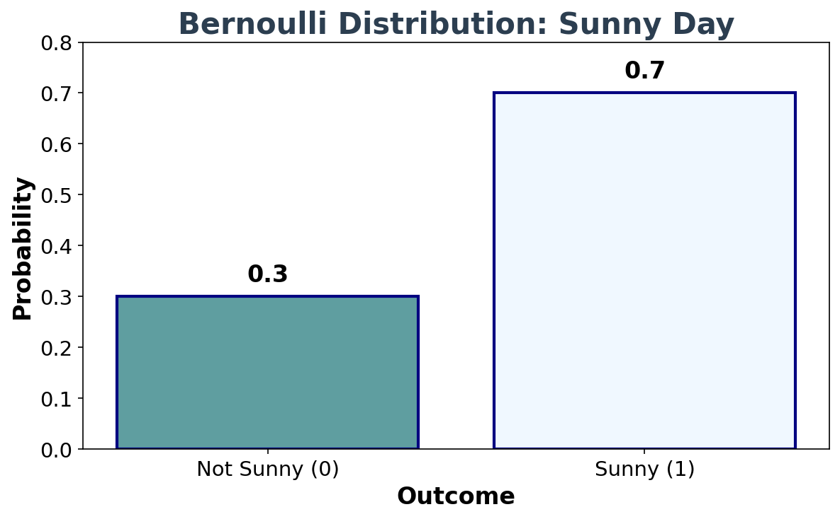
Bernoulli Distribution: Graph View
Notes:
Show the graphical representation of the Bernoulli distribution for the sunny day example.

Slide 23
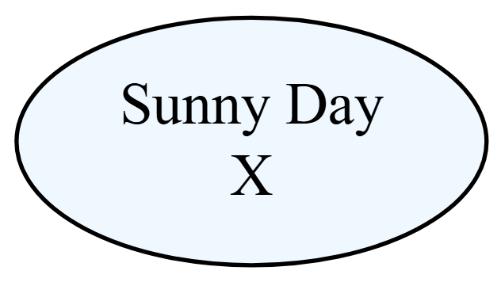
Bernoulli Distribution: Node View
$$X∼\text{Bernoulli}\left(0.7\right)$$

Slide 24
Bernoulli random variable as a node.
Notes:
Show the random variable as a conceptual node, connecting back to our original informal definition.

Slide 25
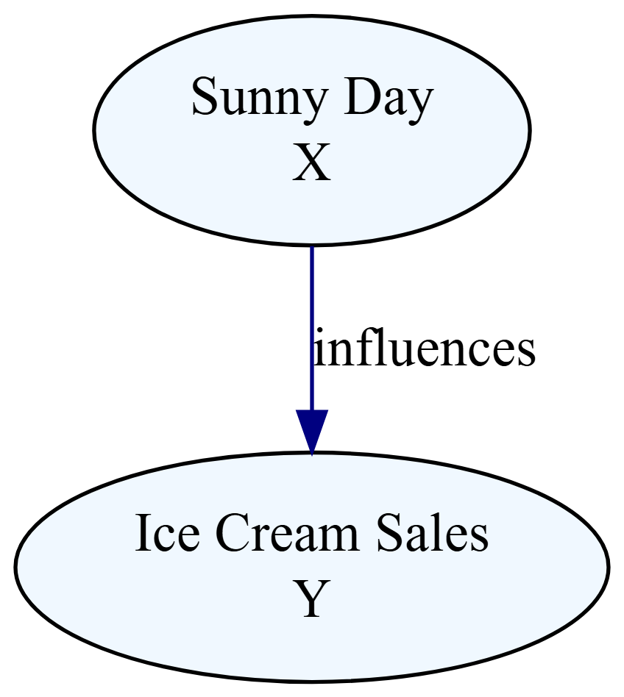
Joint Distributions
Preview of how random variables relate to each other

Slide 26
Preview of how random variables relate to each other.
Joint Distribution:
$$P\left(X=x,Y=y\right)$$
Example:
$$P\left(X=0,Y=\text{low}\right)=0.25$$
$$P\left(X=0,Y=\text{high}\right)=0.05$$
Key Insight: We model both variables together to capture their relationship.
Notes:
Preview how random variables can be connected and influence each other, setting up the next topic on joint distributions.

Slide 27
Further Learning
Let’s Practice Together!
📊 Interactive Practice
Ready to test your understanding of random variables?
We’ll work through examples together in real-time
Notes:
Transition to interactive learning with Poll Everywhere for hands-on practice with random variables.

Slide 28
Appendix

Slide 29
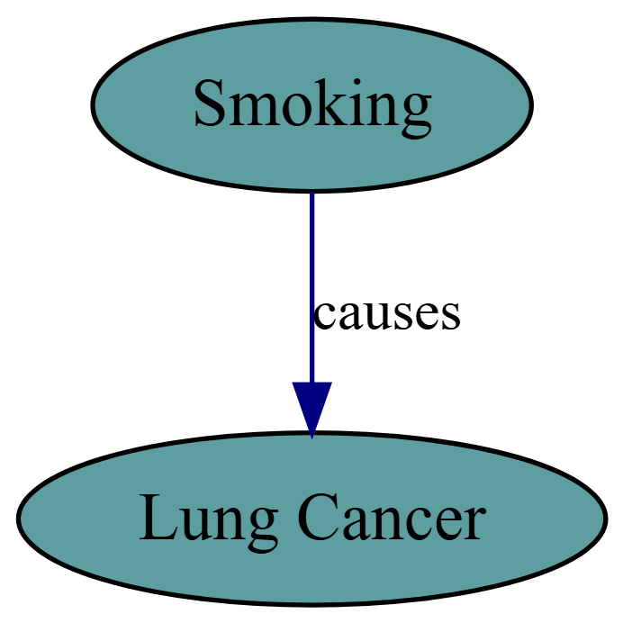
Causal Relationships: Two Different Stories
Story 1: Direct Causation

Slide 30
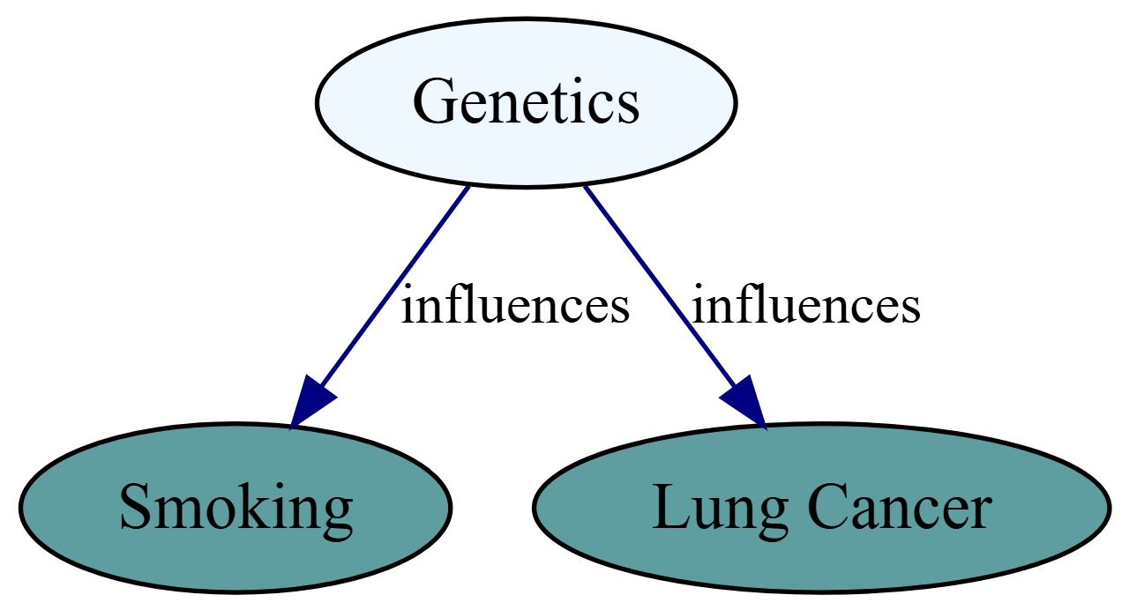
Smoking directly causes lung cancer.
Interpretation: Smoking directly causes lung cancer.
Story 2: Common Cause For Smoking and Lung Cancer

Slide 31
Genetics influences both smoking and lung cancer.
Interpretation: Genetics influences both smoking behavior and lung cancer risk.
Notes:
Show two different causal stories using DAGs to illustrate how the same observed correlation can have different underlying causal explanations.

Slide 32
Key Insight: Correlation ≠ Causation
The Same Data, Different Stories
Both DAGs can explain the same observed correlation between smoking and lung cancer, but they have very different implications:
Story 1 (Direct Causation): - Stop smoking → Reduce lung cancer risk - Intervention on smoking directly affects outcome
Story 2 (Common Cause): - Stop smoking → May not reduce lung cancer risk - The genetic predisposition remains unchanged
🎯 Critical Thinking
Understanding the underlying causal structure is essential for making effective interventions and policy decisions.
Notes:
Emphasize the importance of understanding causal relationships rather than just correlations for making informed decisions.

Slide 33
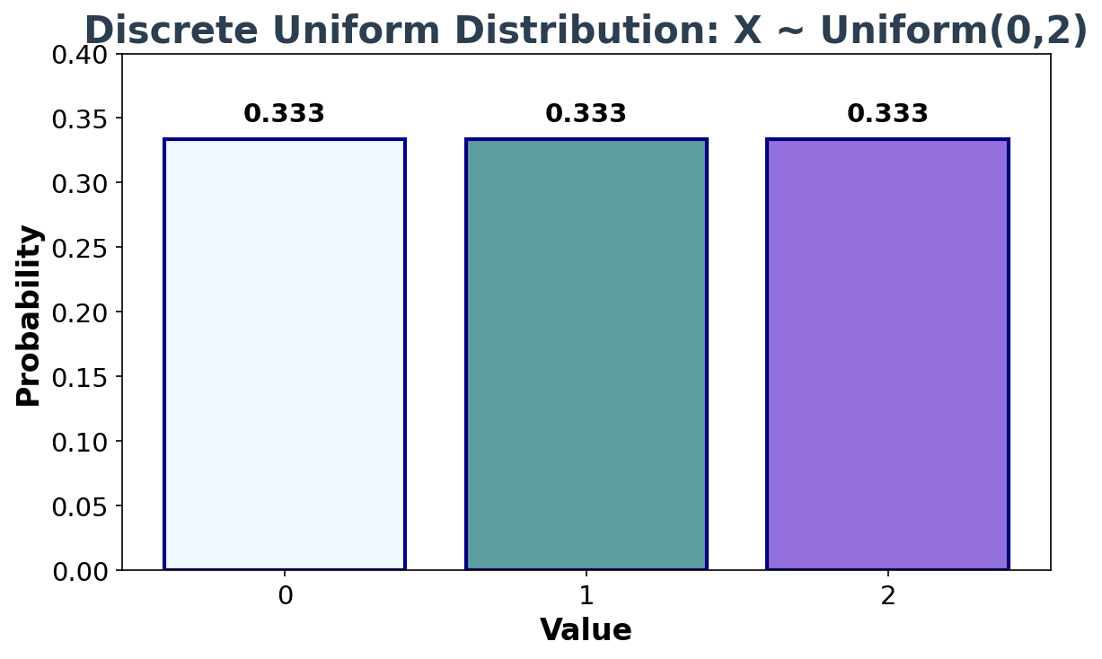
Appendix: Probability Distributions
Discrete Uniform Distribution (0,2)
Notes:
Show the probability mass function for a discrete uniform distribution with equal probabilities for each outcome.

Slide 34
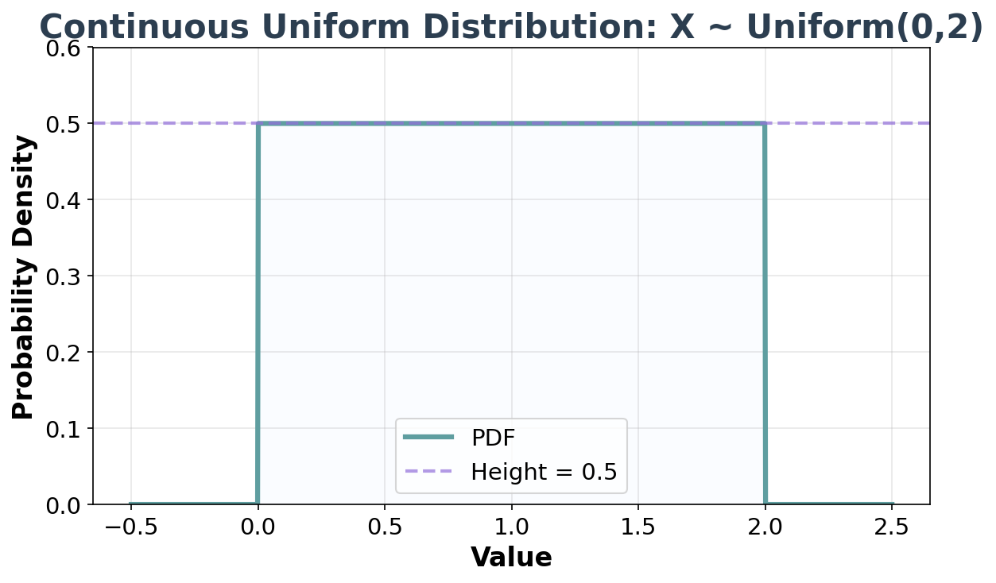
Continuous Uniform Distribution (0,2)
Notes:
Show the probability density function for a continuous uniform distribution with constant height over the interval.

Slide 35
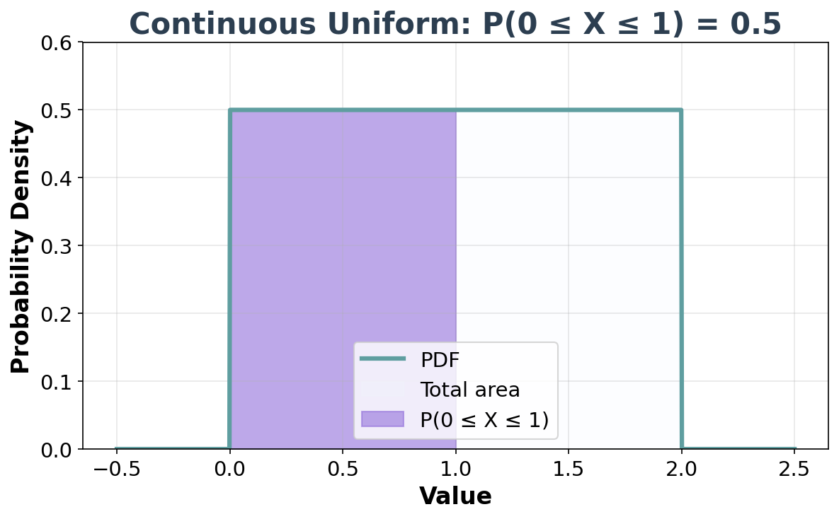
Continuous Uniform: Shaded Area P(0 ≤ X ≤ 1)
Notes:
Show the continuous uniform distribution with a highlighted area representing P(0 ≤ X ≤ 1) = 0.5.

Slide 36
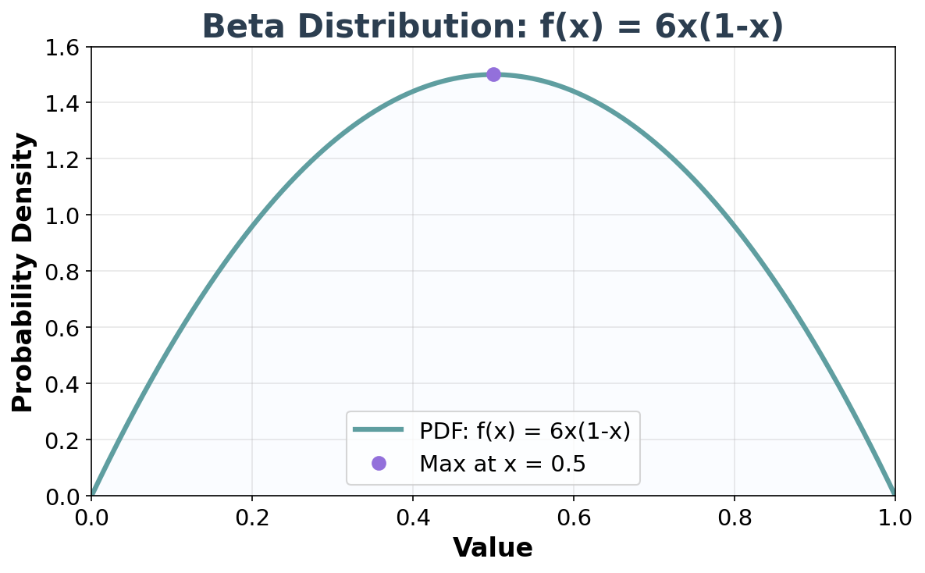
Beta Distribution: f(x) = 6x(1-x)
Notes:
Show the Beta distribution with PDF 6x(1-x), which is symmetric and peaks at x = 0.5.

Slide 37
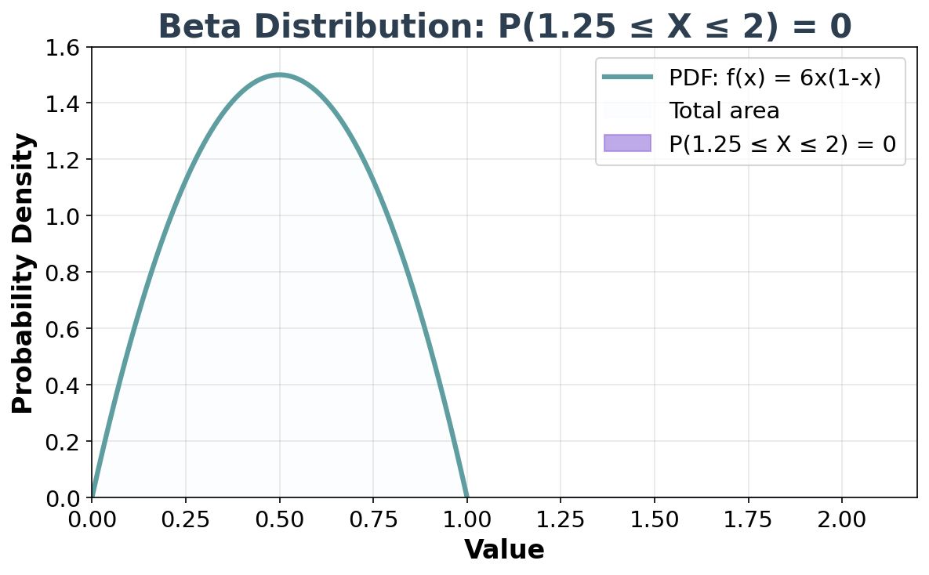
Beta Distribution: Shaded Area P(1.25 ≤ X ≤ 2)
Notes:
Show the Beta distribution with a shaded area outside the support [0,1], demonstrating that P(1.25 ≤ X ≤ 2) = 0.

Slide 38
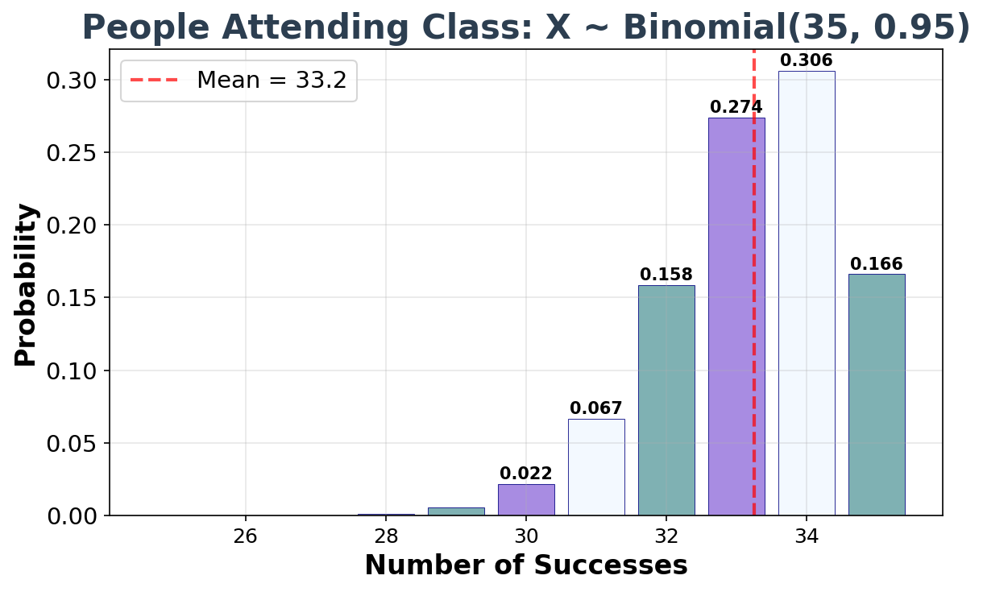
Binomial Distribution: n=35, p=0.95
Notes:
Show the binomial distribution with n=35 and p=0.95, which is highly skewed toward the maximum value with probability labels on significant mass points.

