Slide 1
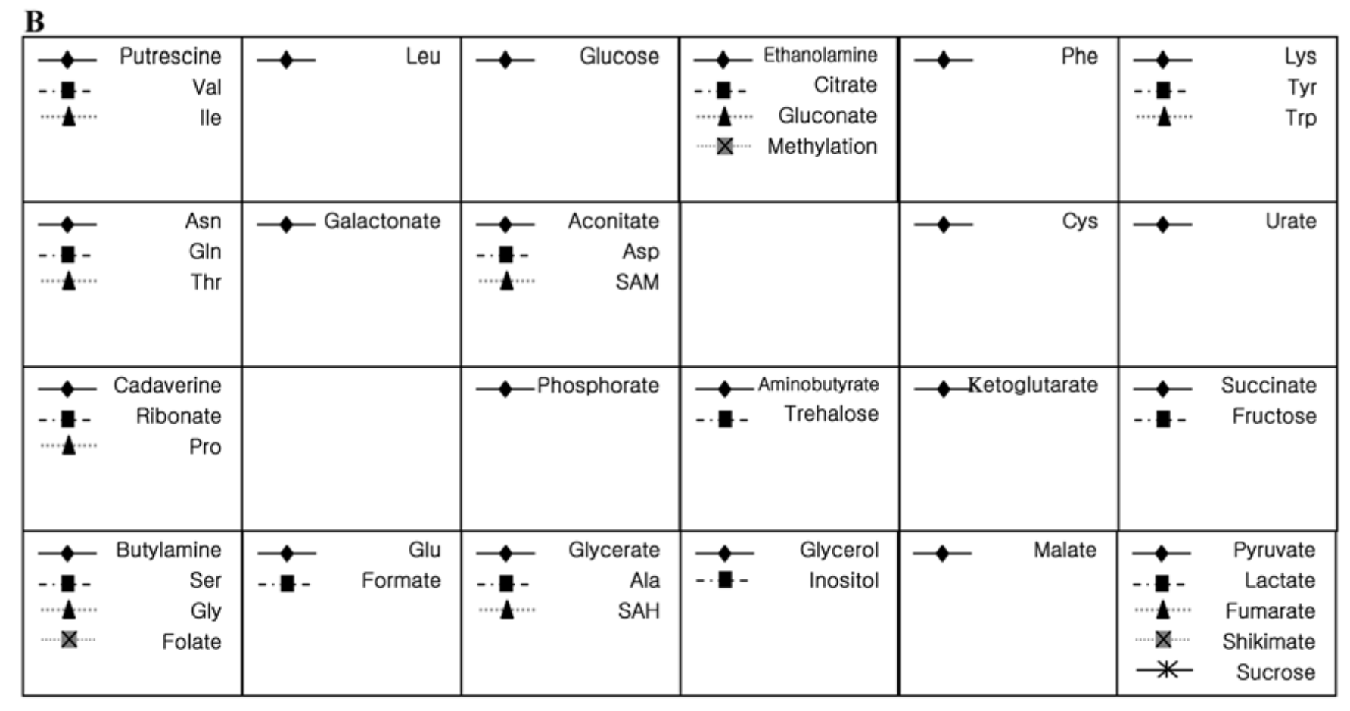
K=4
Cluster 0
Cluster 1
Cluster 2
Cluster 3

Slide 2
K=3
Cluster 0
Cluster 1
Cluster 2
Cluster 3

