Slide 1
ATGS 7250 Problem-Solving Programming Methods for Bioinformatics ____________________ PROJECT
PRESENTED BY Joenilo II Esperas Paduhilao

Slide 2
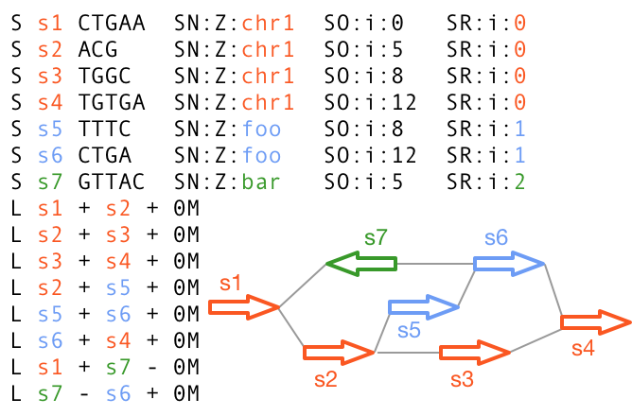
Pangenome Graphs
Reference genome
Assemblies
Minigraph
GAF
remapping
GFA / rGFA
Figure 1. rGFA format
Pangenome graph
Li, H., Feng, X. & Chu, C. The design and construction of reference pangenome graphs with minigraph. Genome Biol 21, 265 (2020). https://doi.org/10.1186/s13059-020-02168-z

Slide 3
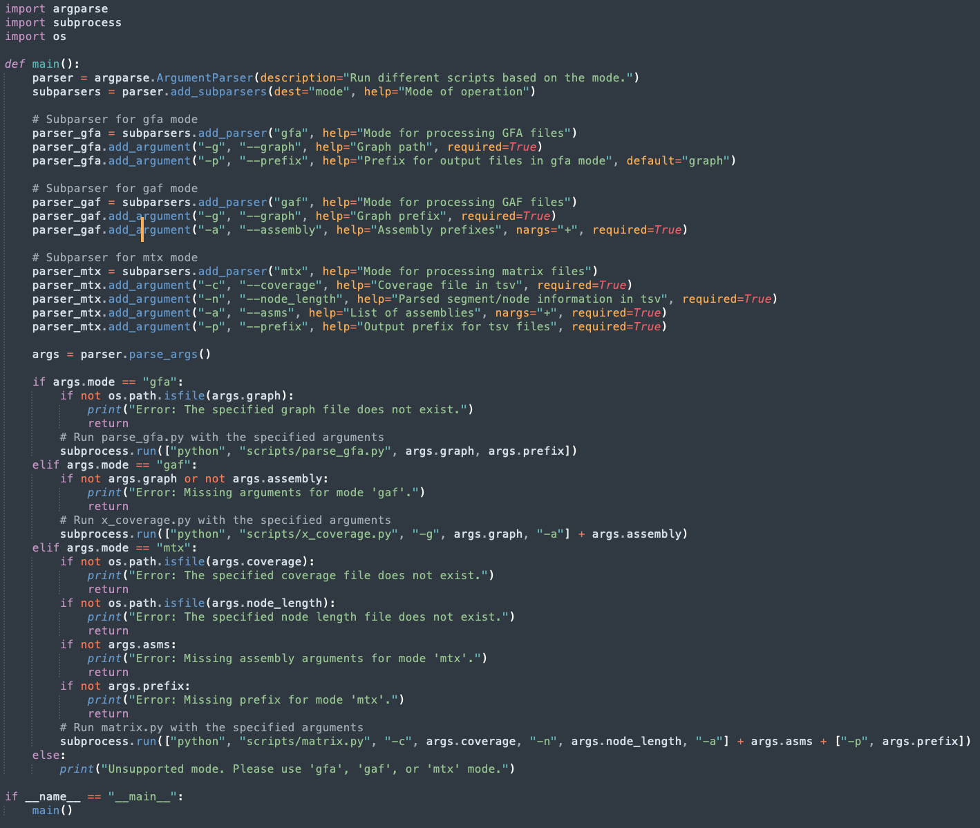
rgaf.py
mode
gfa
gaf
mtx
input
gfa | prefix
asms | graph
cov | len | asms
script
parse_gfa.py
x_coverage.py
output
tsv
tsv
matrix.py
tsv
OBJECTIVE
To parse the GFA output from minigraph;
To parse GAF output and output segment / edge usage frequencies by assemblies; and
To generate a presence-absence matrix of segments/links for downstream analysis/visualizations.

Slide 4
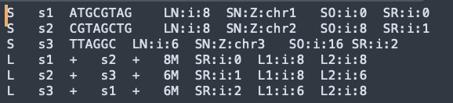
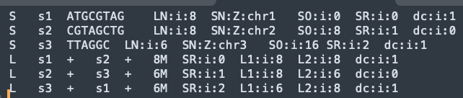
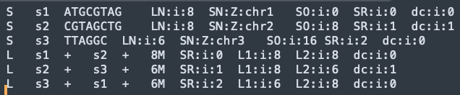
Test sets from ChatGPT
world.gfa
asm1_world.gaf
asm2_world.gaf

Slide 5
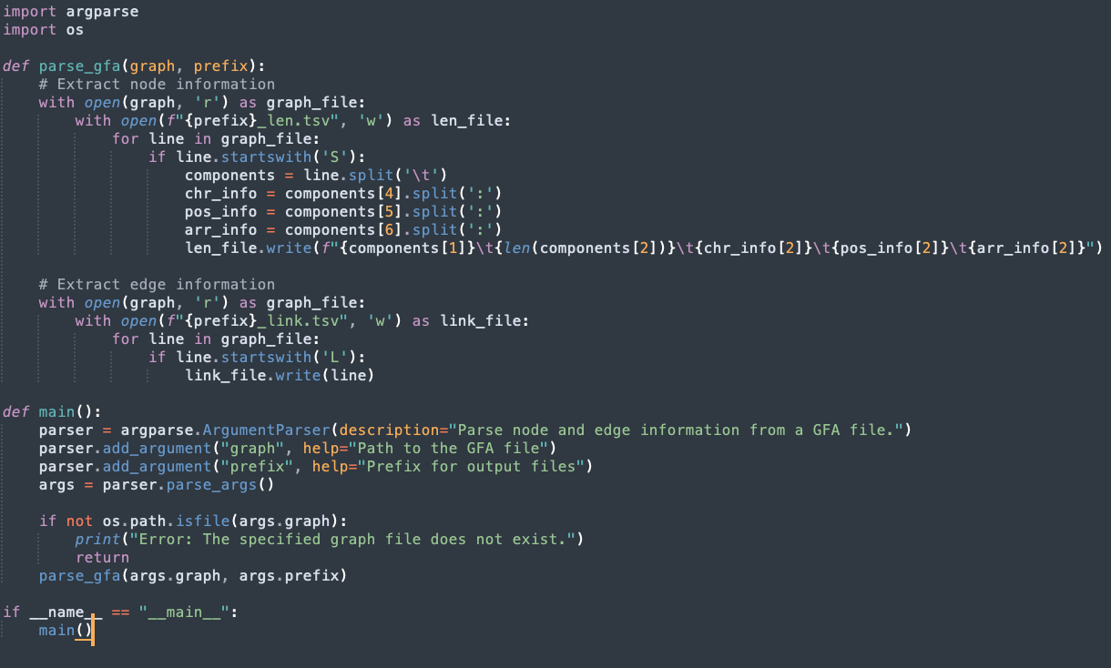
parse_gfa.py
IMPORTANT BLOCKS
Code
Parsing proper splits each line with split command on ”:”
Grab components and save to output file.write()
Calls function and grabs user specified params from rgaf.py function () | __main__

Slide 6

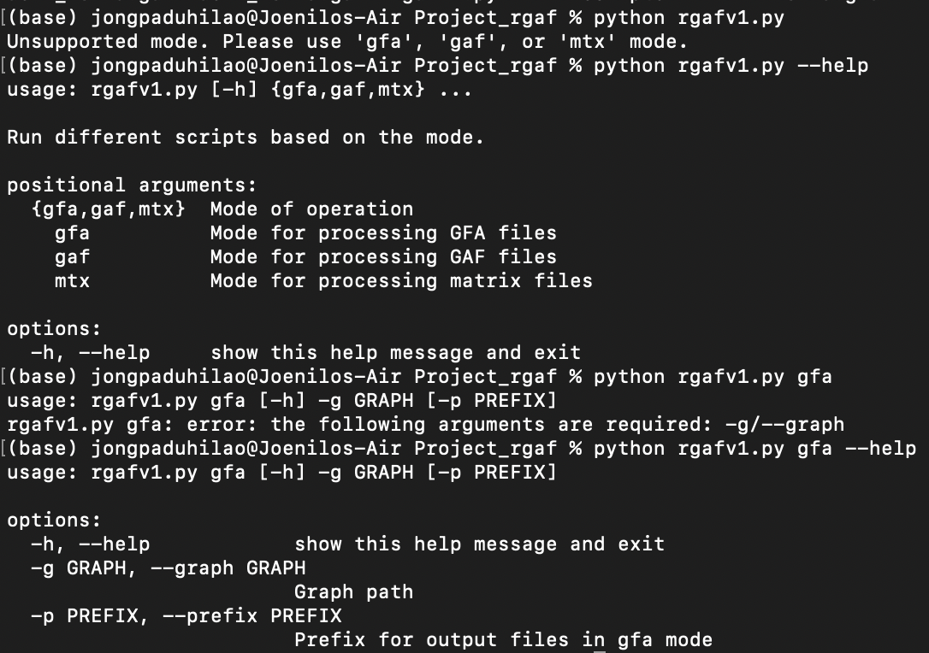
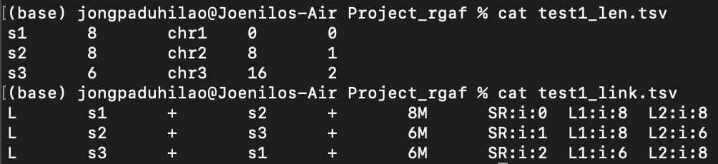
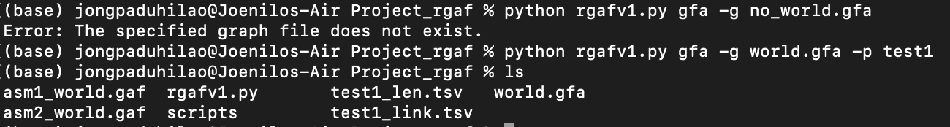
parse_gfa.py
FILES
RUN
HELP
DATA
Specified Params

Slide 7
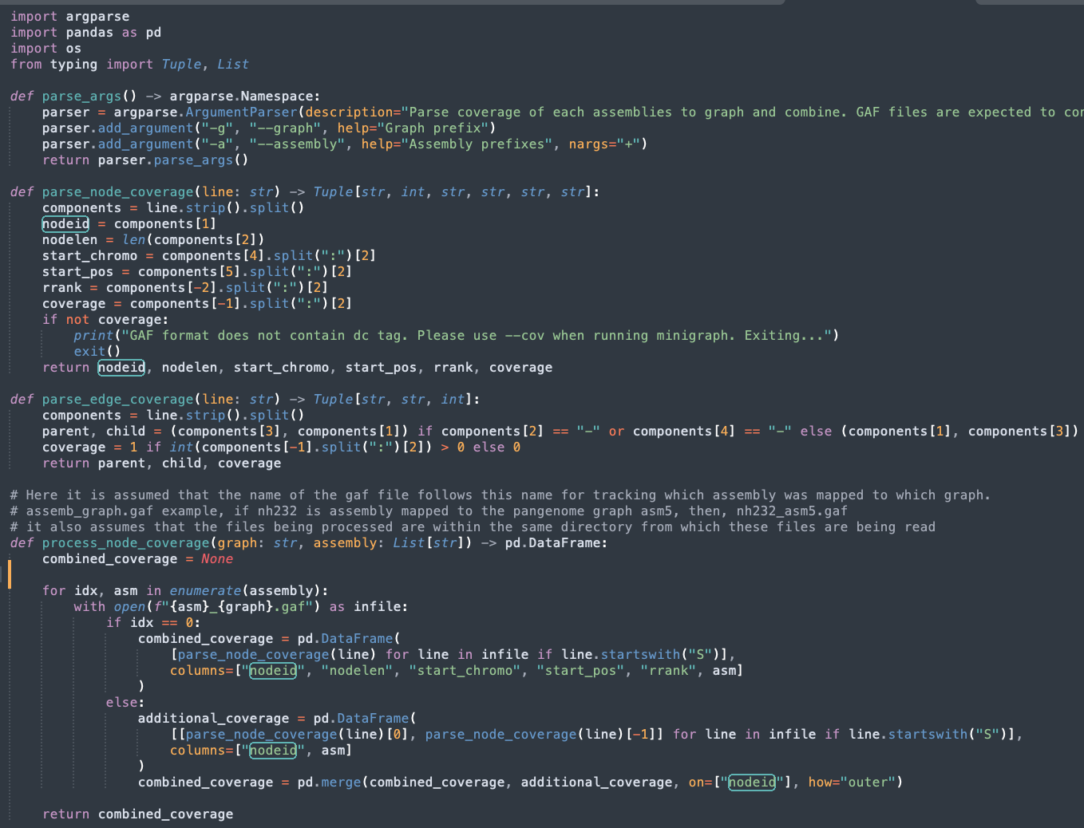
x_coverage.py
Code (1/2)
IMPORTANT BLOCKS
Parsing proper (+ cov or dc tag) splits each line with split command on ”:”
Iterates over all asm prefixes, parse, and write coverages for each if block – initialize dataframe for first asm
else block – merge on existing

Slide 8
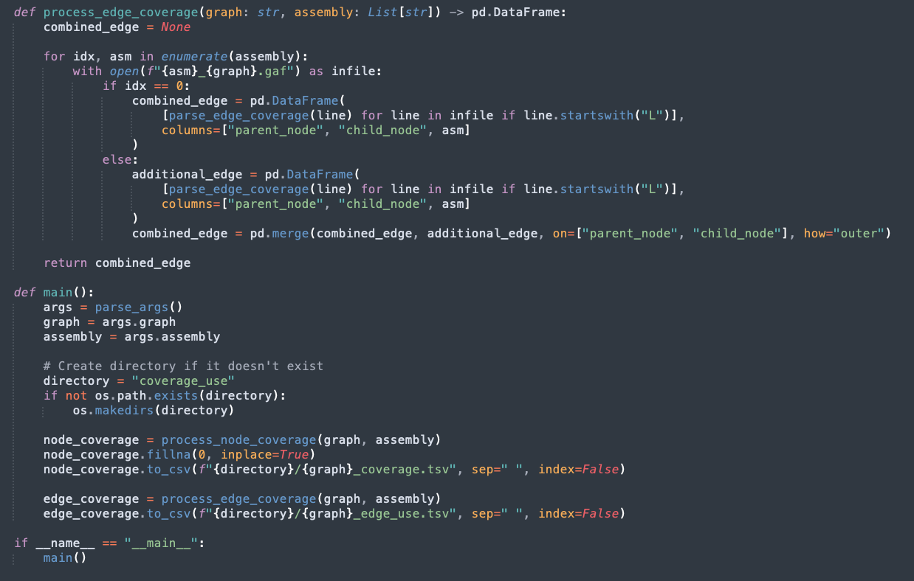
x_coverage.py
Code (2/2)
IMPORTANT BLOCKS
Iterates over all asm prefixes, parse, and write coverages for each edge/link usage if block – initialize dataframe for first asm
else block – merge on existing
Calls function and grabs user specified params from rgaf.py function () | __main__
Note: coverage_use directory will be created

Slide 9
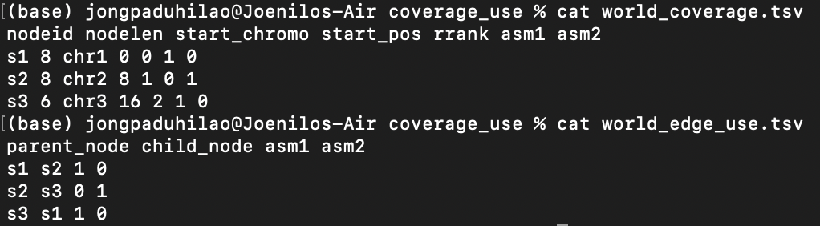
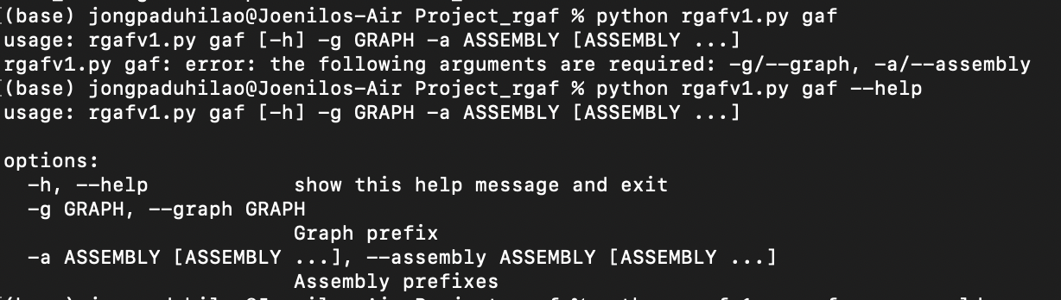

x_coverage.py
FILES
RUN
HELP
DATA
asm1_world.gaf
Specified params
asm2_world.gaf

Slide 10
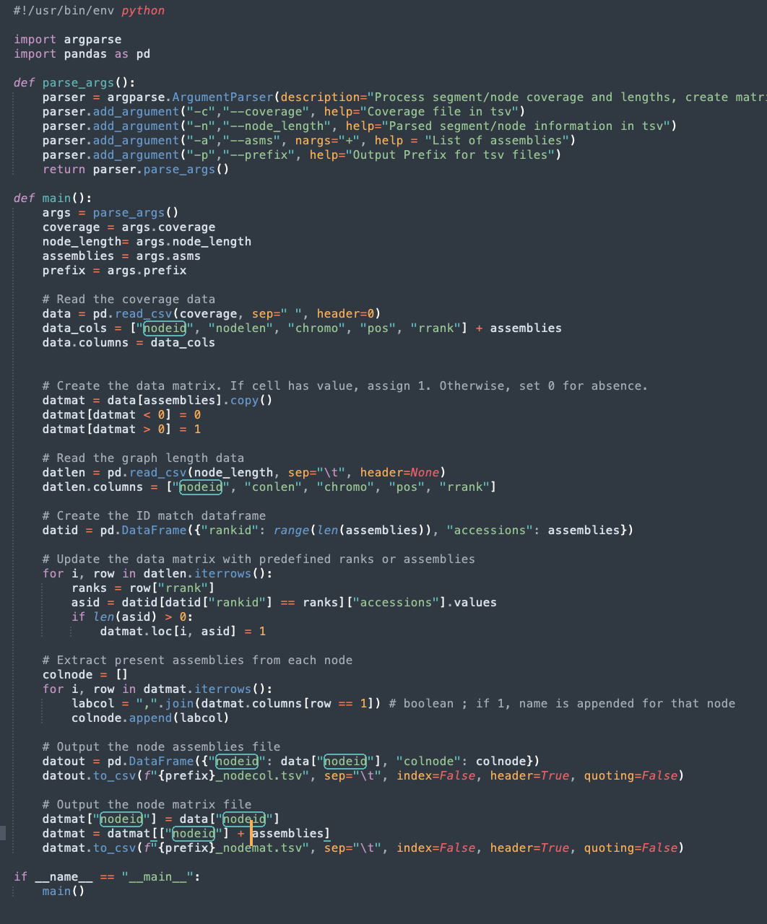
matrix.py
Code (1)
IMPORTANT BLOCKS
Importing files pandas.read.csv()
Initialize data matrix Copy asms and create a matrix of 0 or 1
Update matrix Access previous matrix and update based on rank
Assembly Names Finalize input to create tsv files
Output tsv

Slide 11
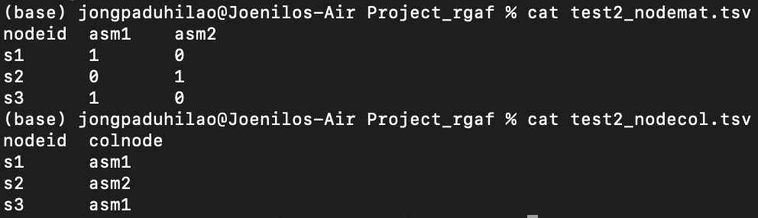
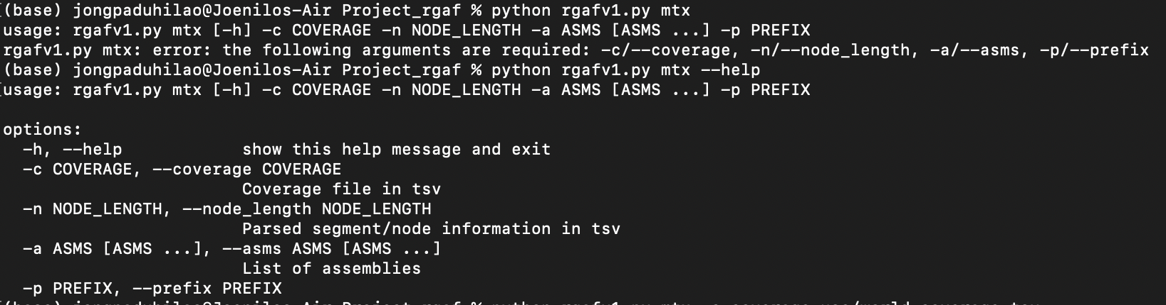
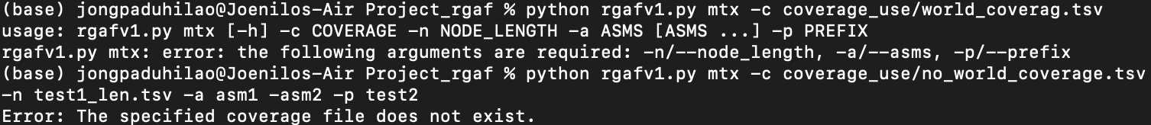
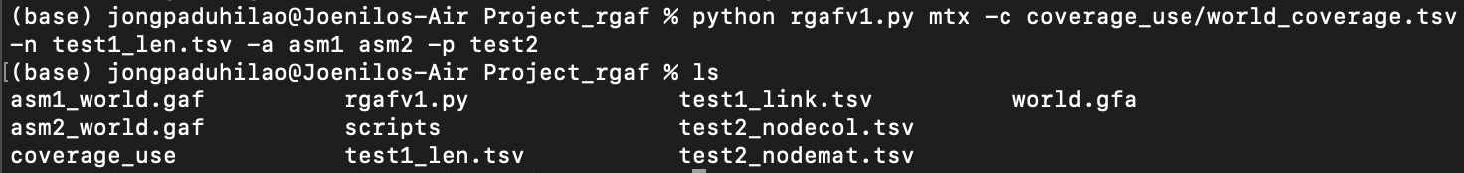
matrix.py
FILES
RUN
HELP
asm1_world.gaf
Specified params
asm2_world.gaf

