Slide 1







Slide 2
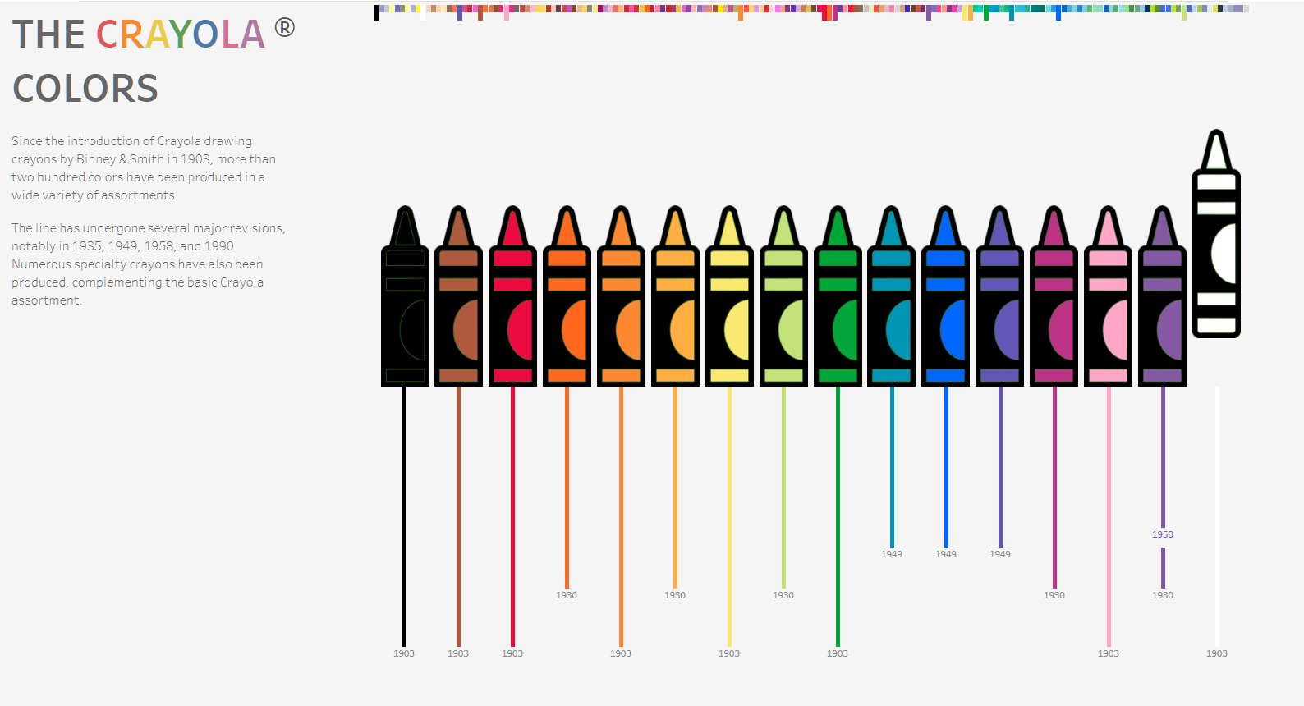

THE
CRAYOLA
COLORS

Slide 3

GUESS THE RGB

Slide 4
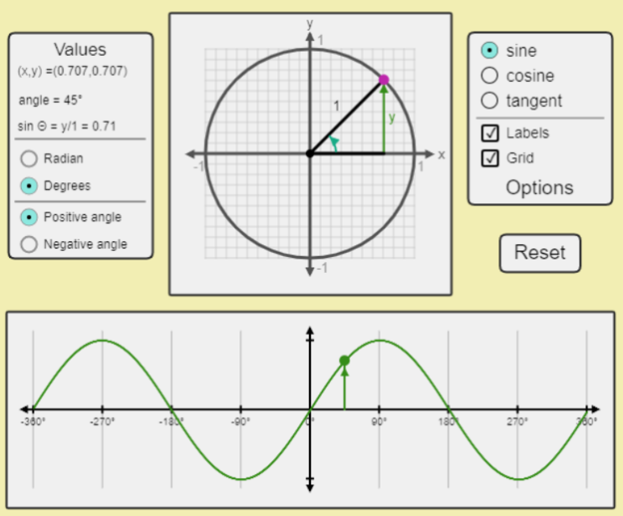

TRIGO FUNCTIONS
VISUALIZED

Slide 5
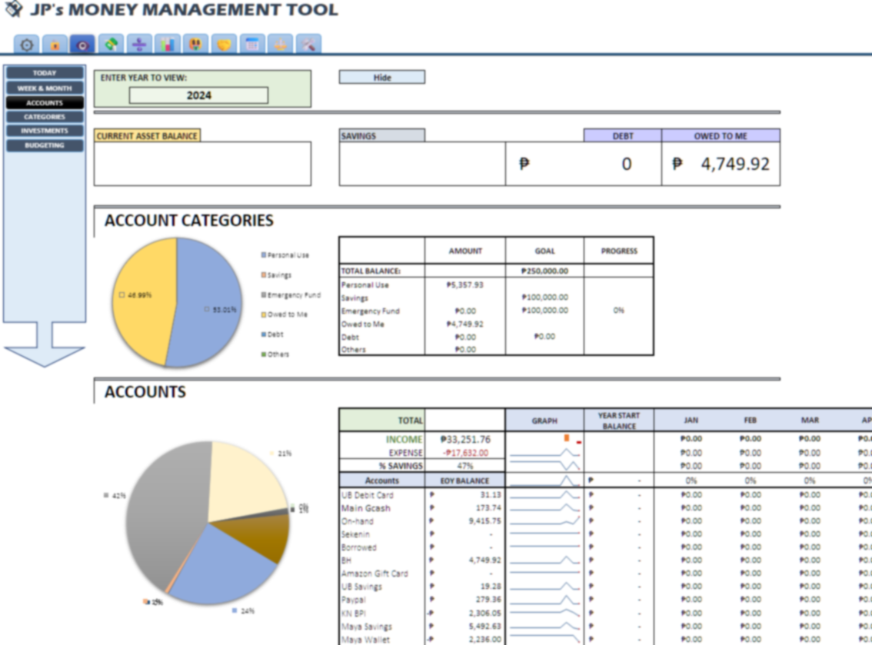


FINANCE MANAGEMENT TOOL

Slide 6
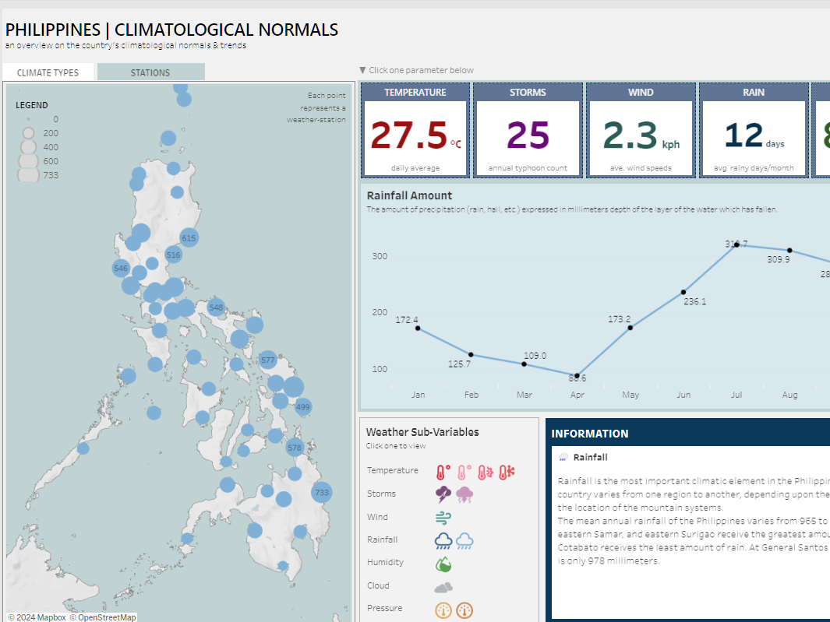

PHILIPPINES A CLIMATOLOGICAL OVERVIEW

Slide 7
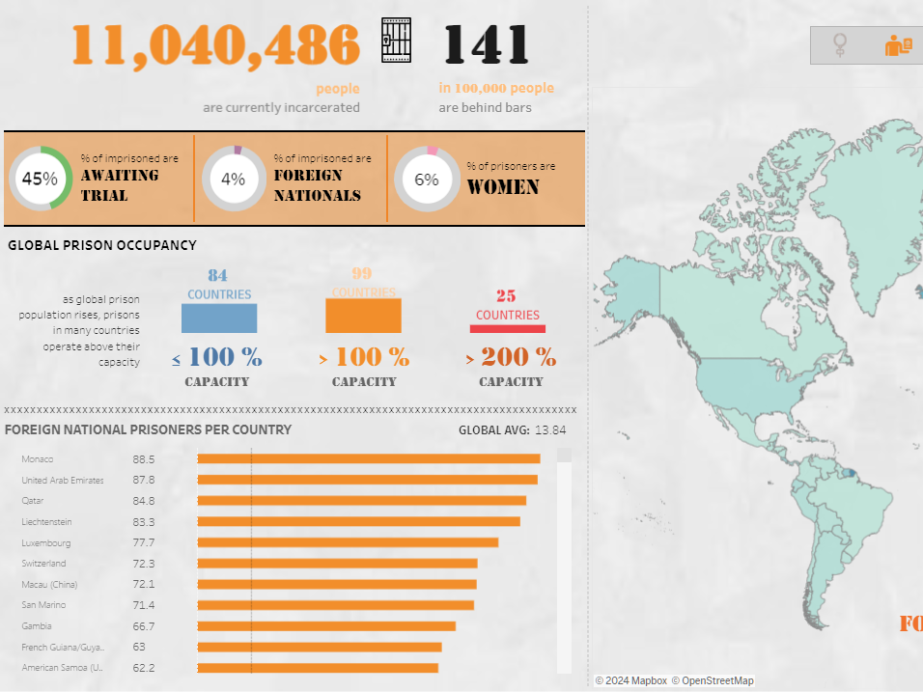
LOCKED UP STATE OF THE WORLD’S PRISONS

Slide 8
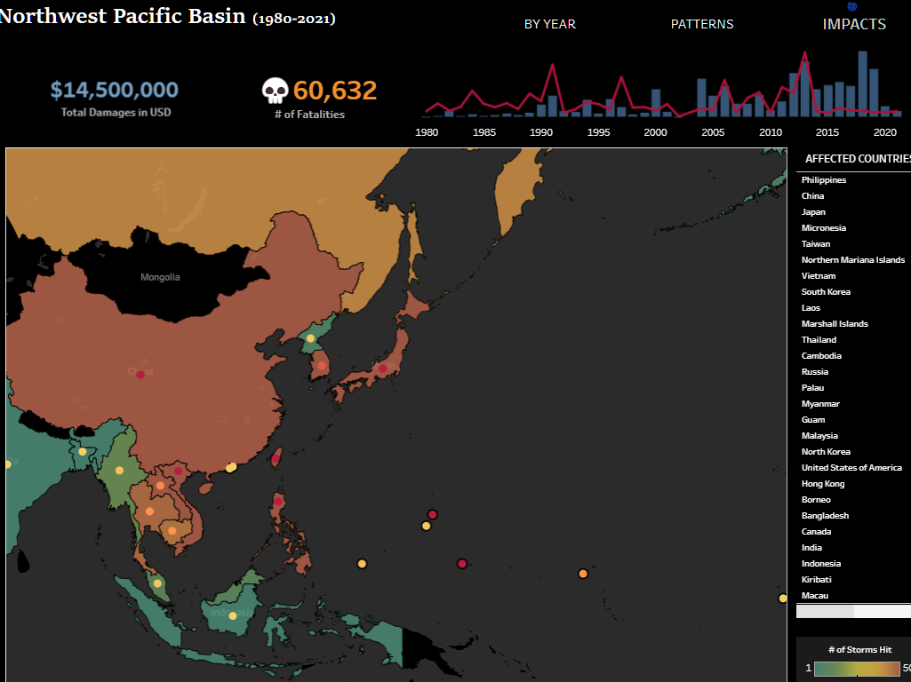
AN ANALYSIS OF TYPHOONS IN THE NW PACIFIC BASIN

Slide 9
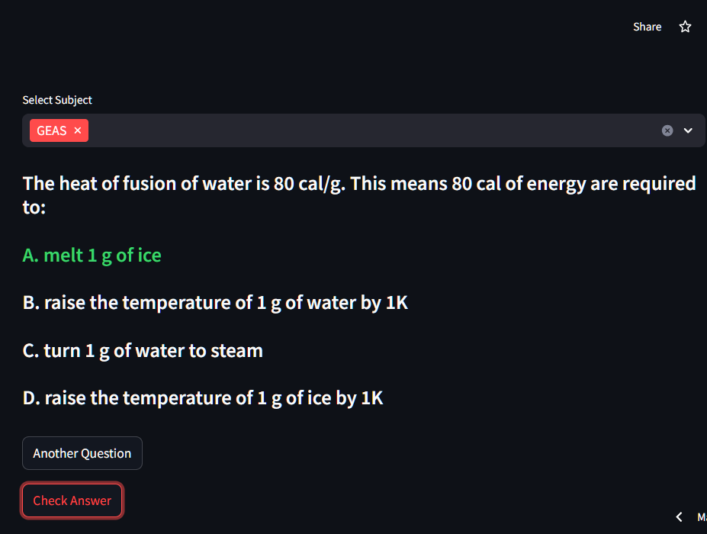

ECE BOARD EXAM REVIEW ASSISTANT

Slide 10
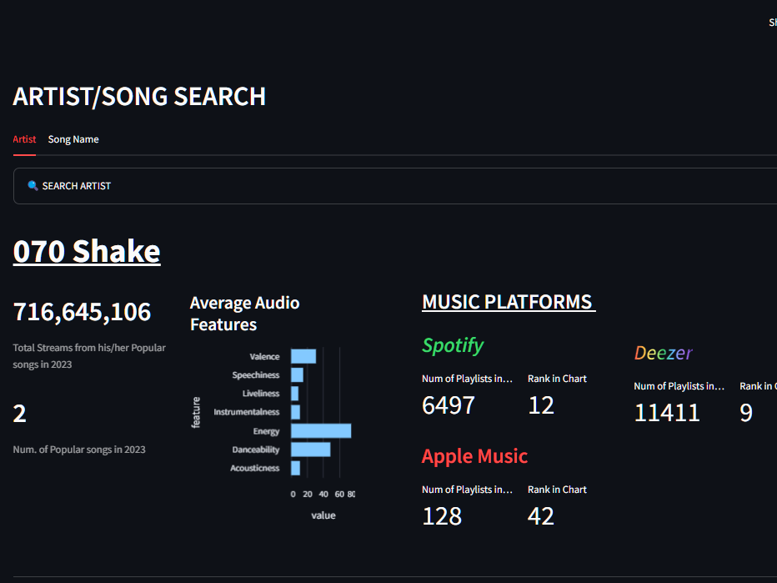
SPOTIFY’S
BEST SONGS OF 2023

Slide 11
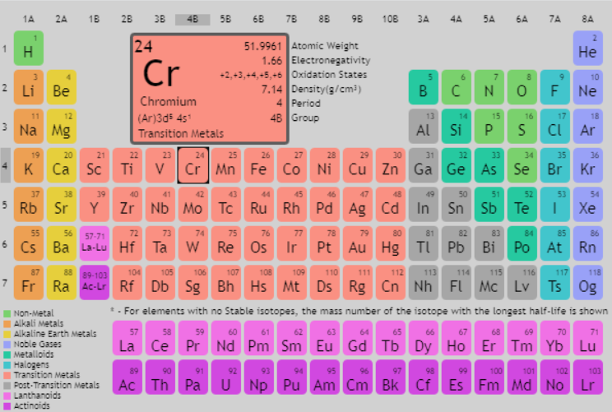
INTERACTIVE
PERIODIC TABLE

