Slide 1


Descriptive Analysis: Global Terrorism
Author: Jamie Parra
CEN 4930 – Exploratory data analysis

Slide 2
Database Details
The Global Terrorism Database (GTD) is an open-source database including information on terrorist attacks around the world from 1970 through 2017. The GTD includes systematic data on domestic as well as international terrorist incidents that have occurred during this time period and now includes more than 180,000 attacks. The database is maintained by researchers at the National Consortium for the Study of Terrorism and Responses to Terrorism (START), headquartered at the University of Maryland.
The Global Terrorism Database is funded through START, by the US Department of State (Contract Number: SAQMMA12M1292) and the US Department of Homeland Security Science and Technology Directorate’s Office of University Programs (Award Number 2012-ST-061-CS0001, CSTAB 3.1).

Slide 3
Dataset
Variable Name | Data Type | Field Size | Description | Example
Year | int | 4 | Attack year | 2012
Month | int | 2 | Attack month | 4
Day | int | 2 | Attack day | 23
Country | string | 30 | Country name | Azerbaijan
Region | string | 30 | Global continent | Central Asia
City | string | 20 | Cities of countries | Baku
Attack Type | string | 10 | Attack method | Bomb
Gname | String | 30 | Attacker organization | Azerbaijani Separatists
https://www.start.umd.edu/gtd/about/GTDTeam.aspx
https://www.kaggle.com/datasets/START-UMD/gtd

Slide 4

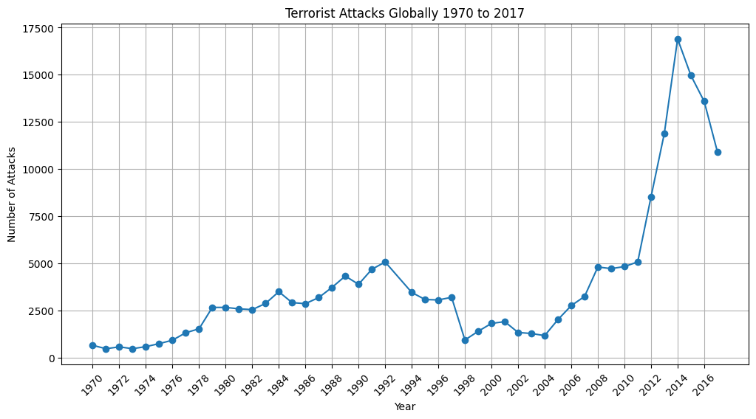
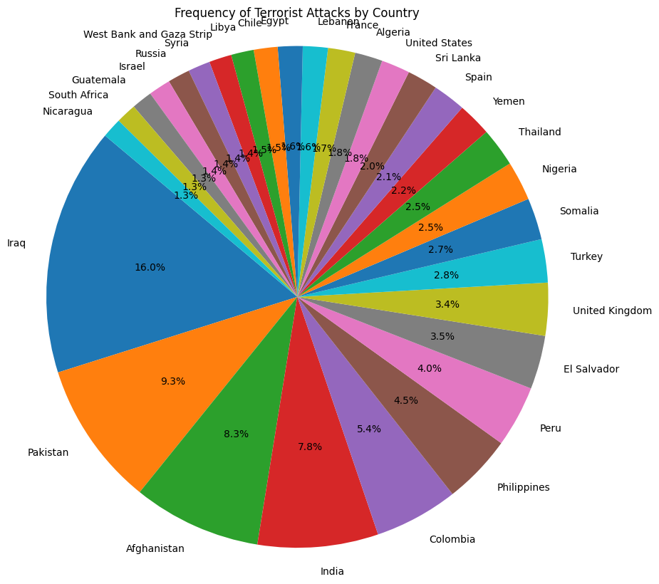



Global Attacks

Slide 5
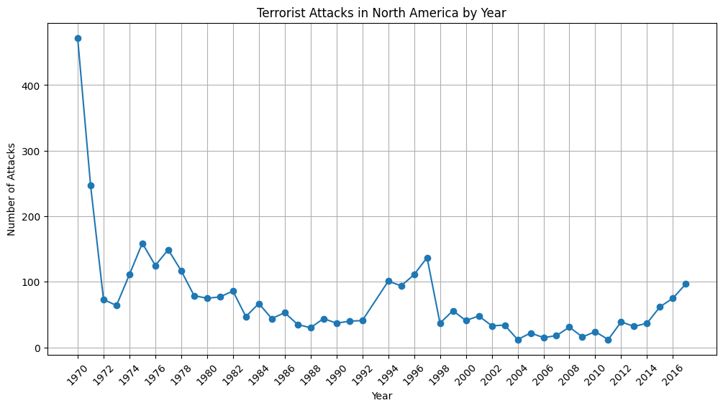
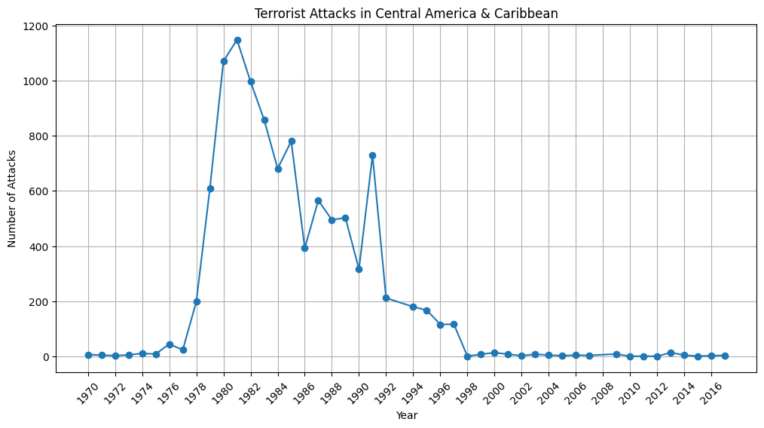
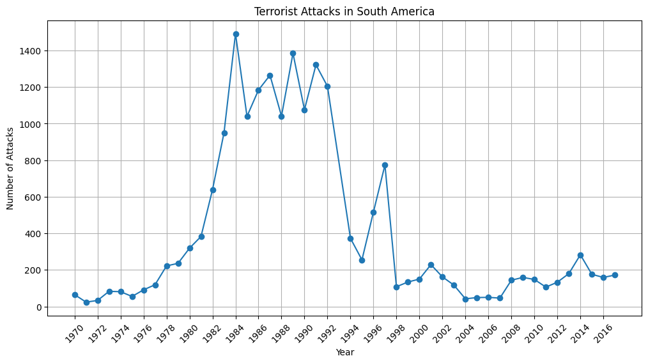
Total Chages Dispersion Measures
Terrorist Attacks by Global Region
1970 - 2017

Slide 6
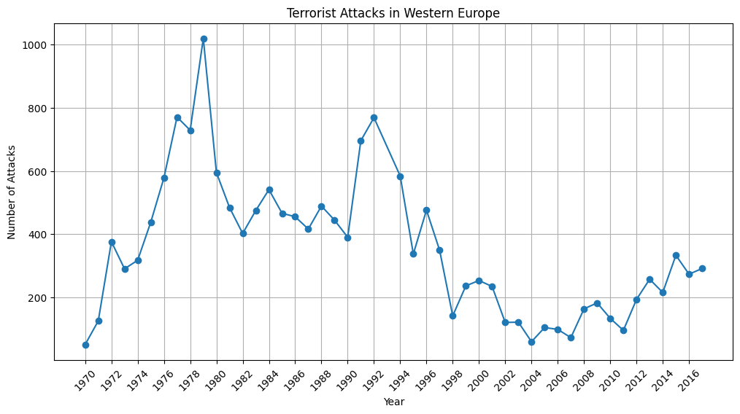
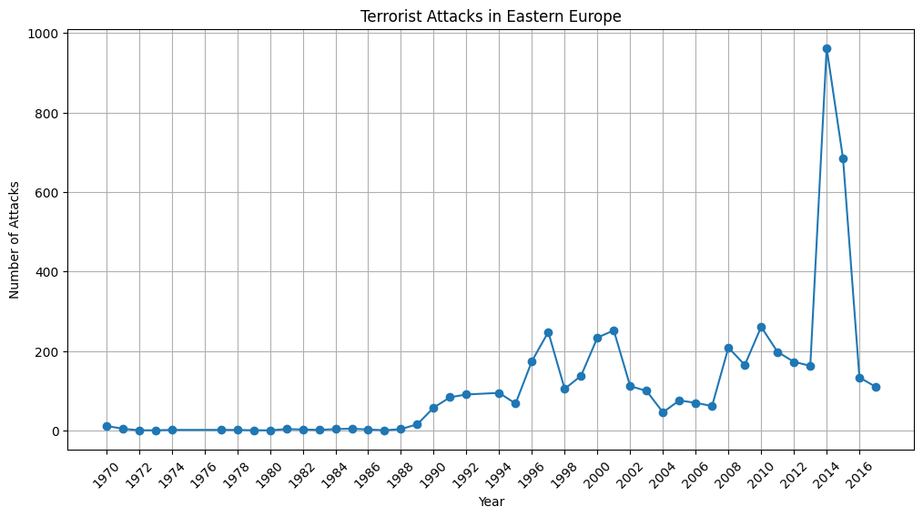
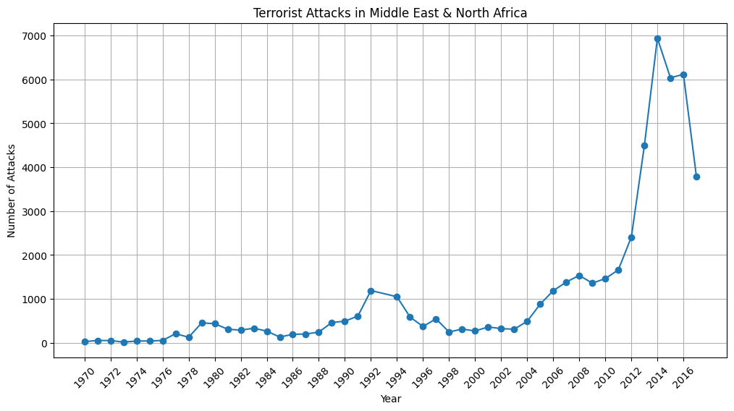
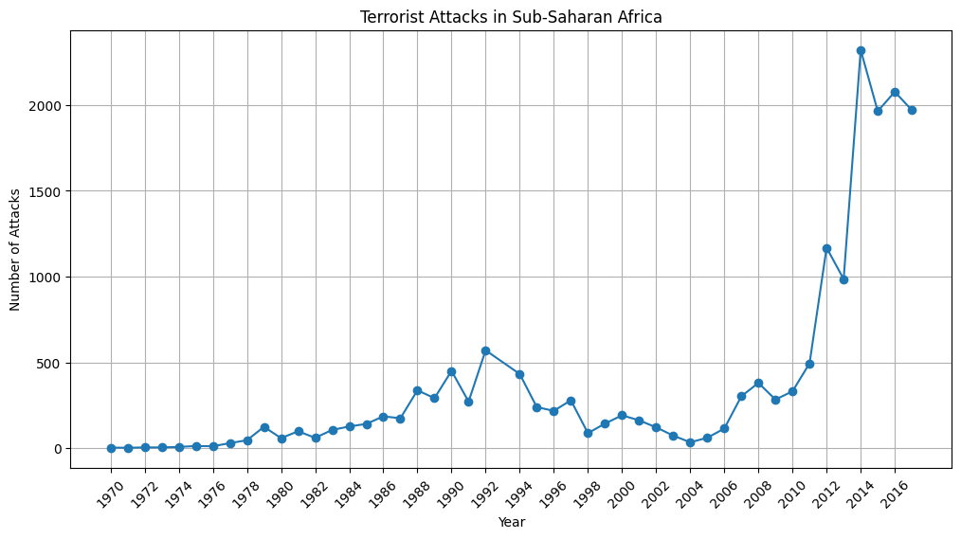

Slide 7
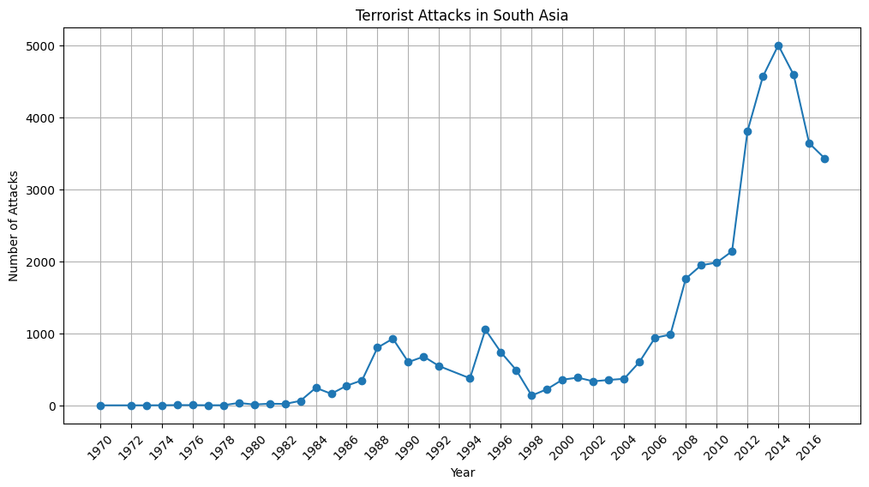
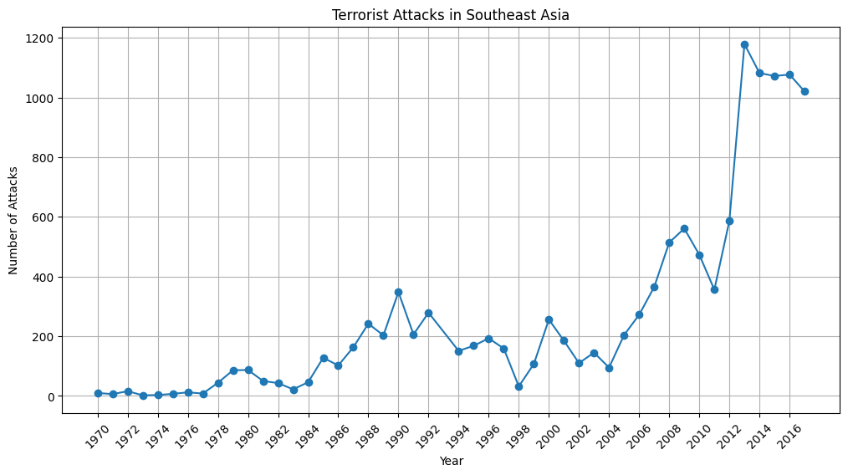
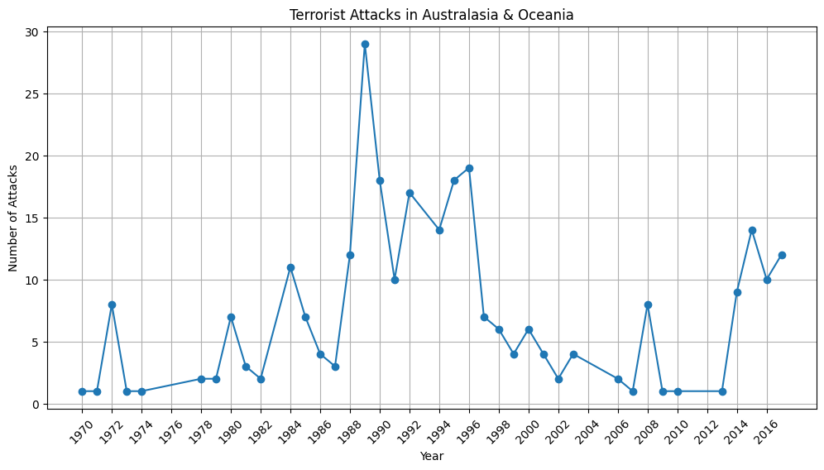
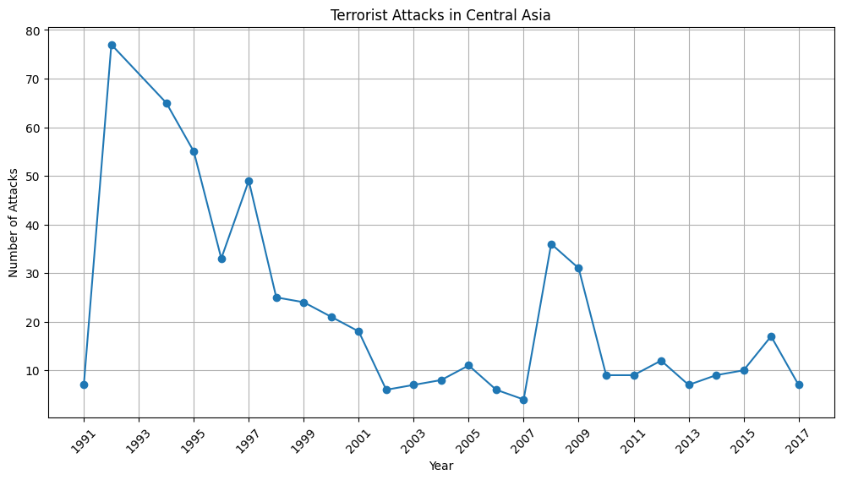

Slide 8
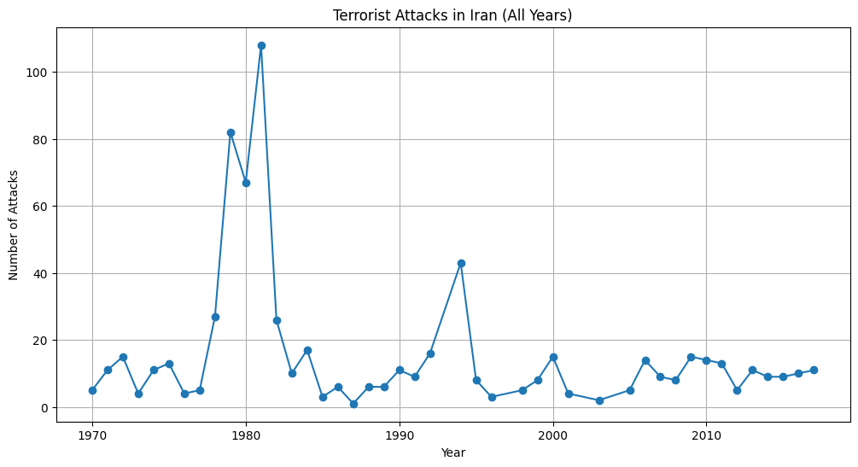
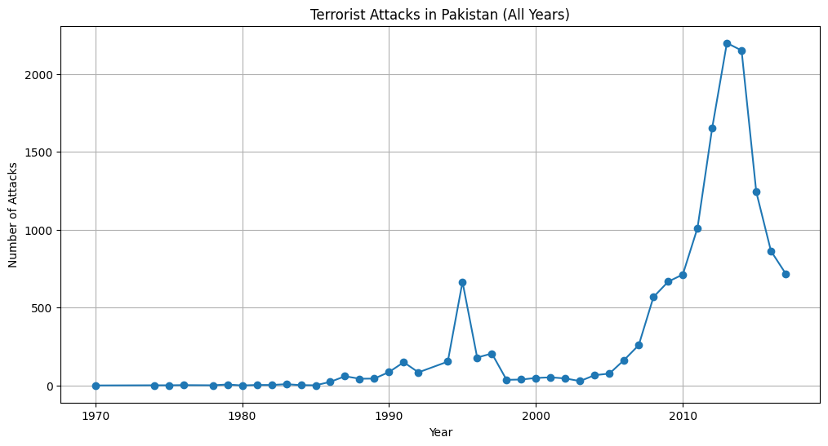
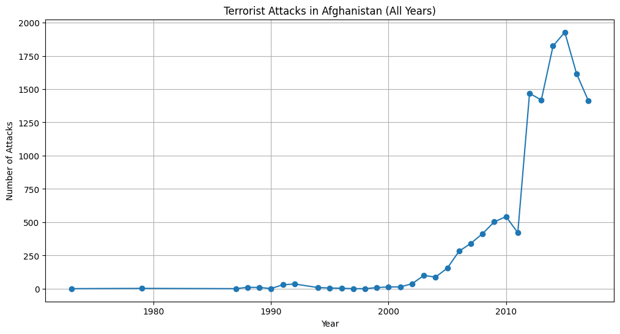
Most Attacks

Slide 9
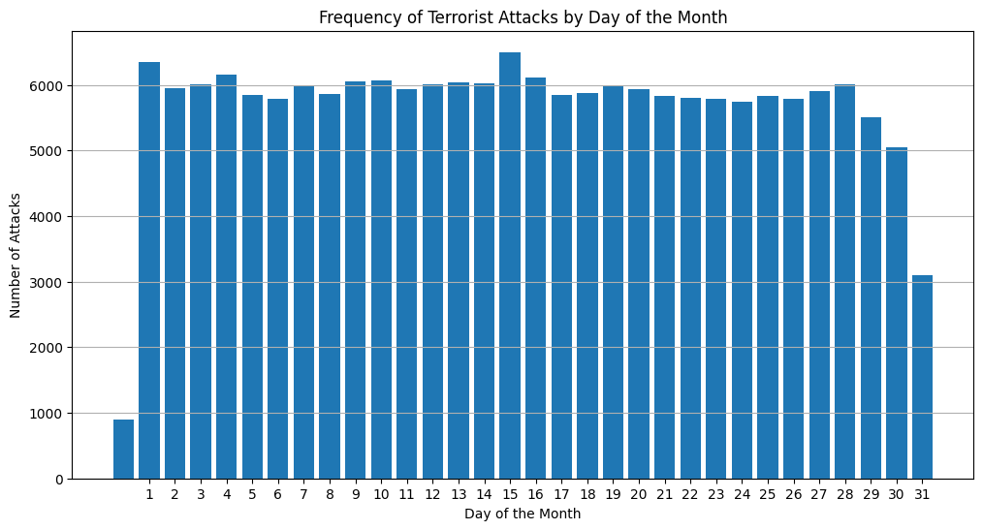
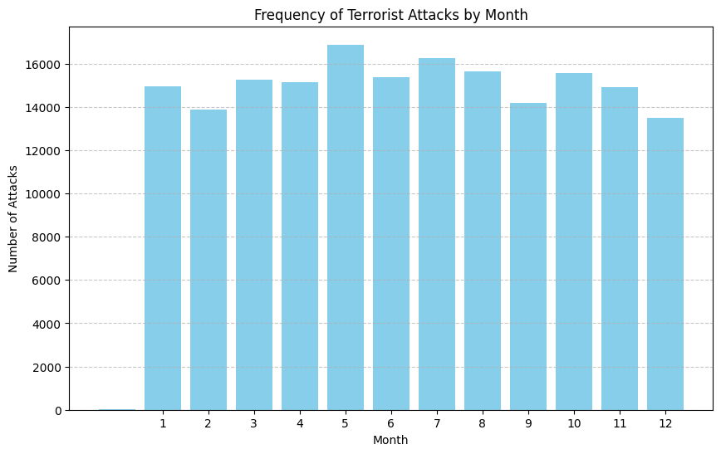
Day and Month Trends

Slide 10
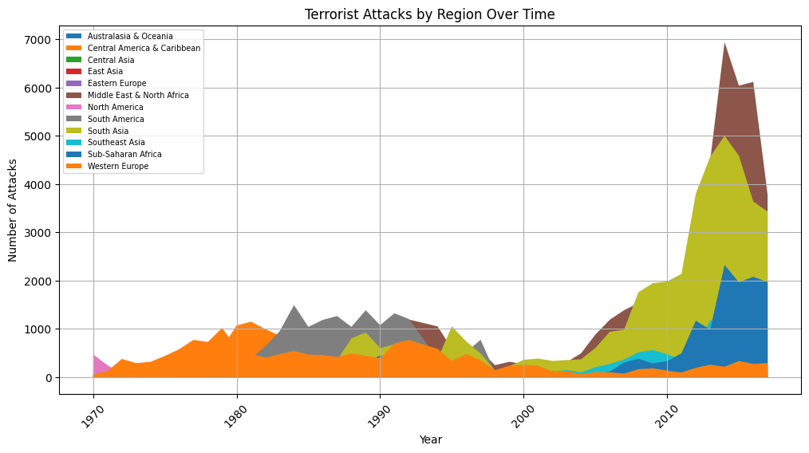
Regions Side by Side

Slide 11
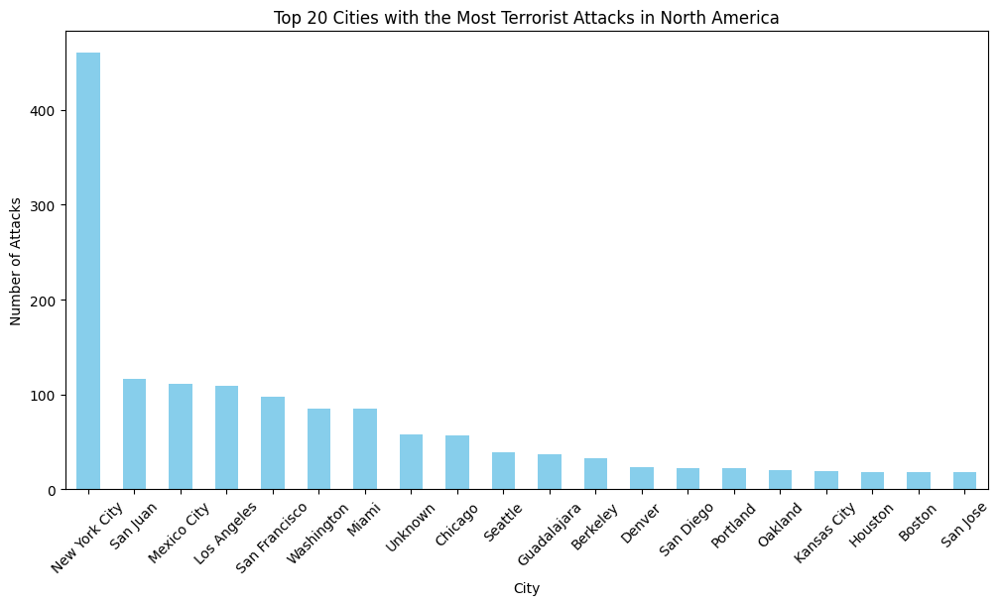
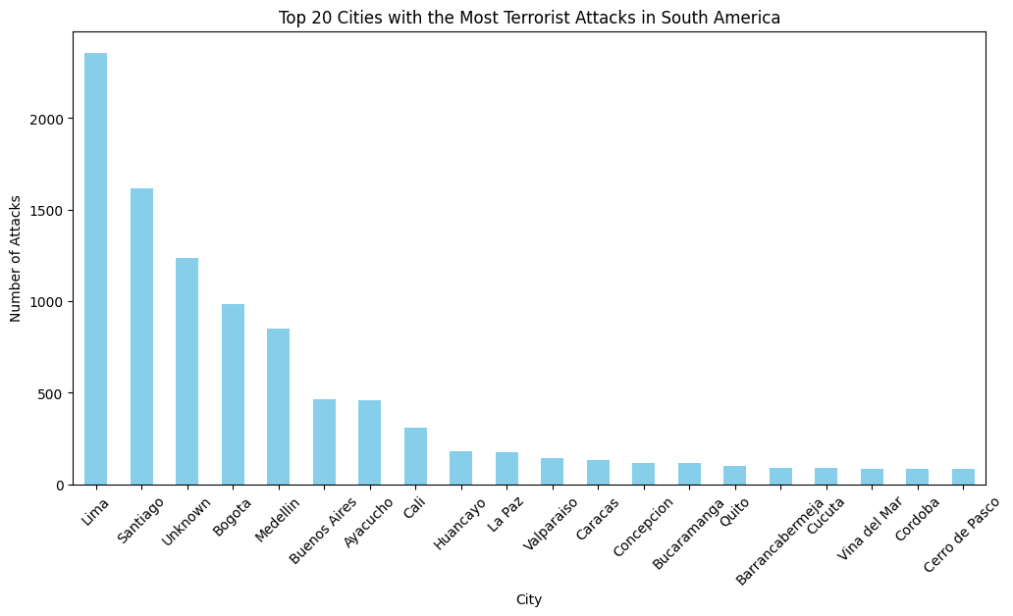
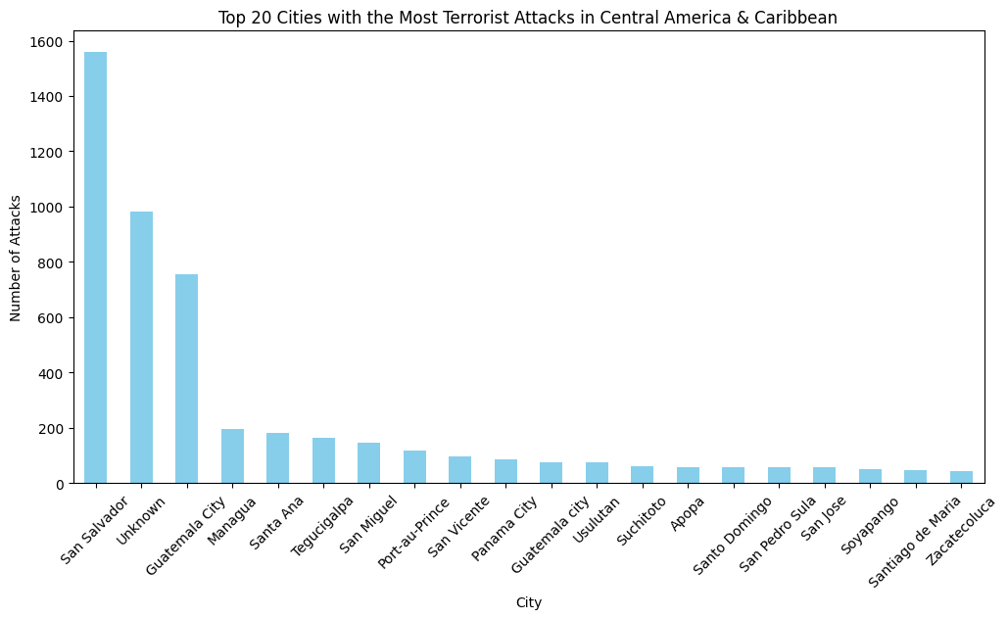
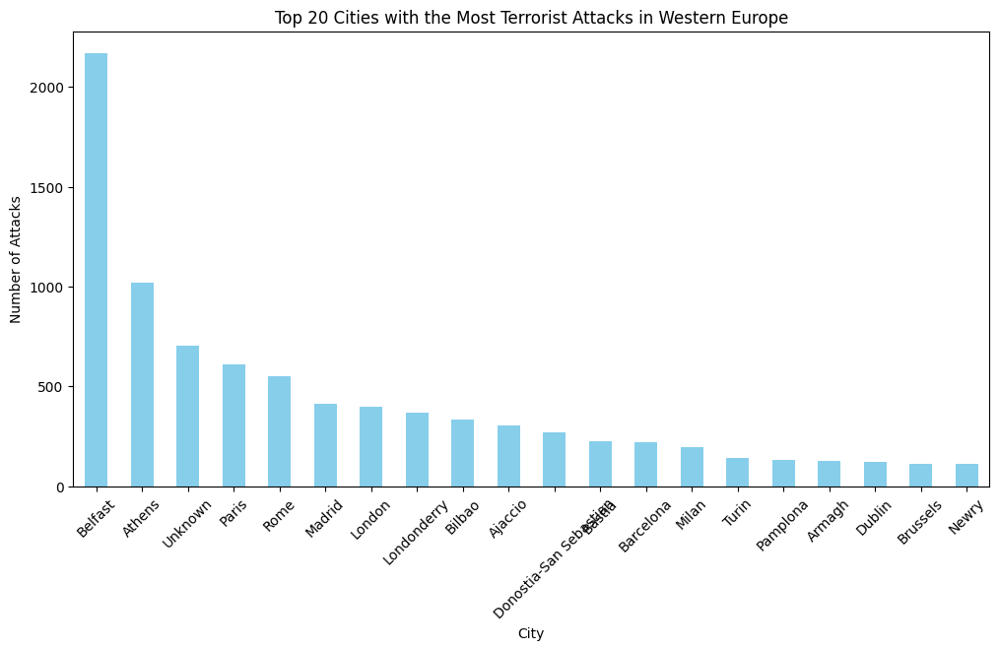
Most Attacks by Cities

Slide 12
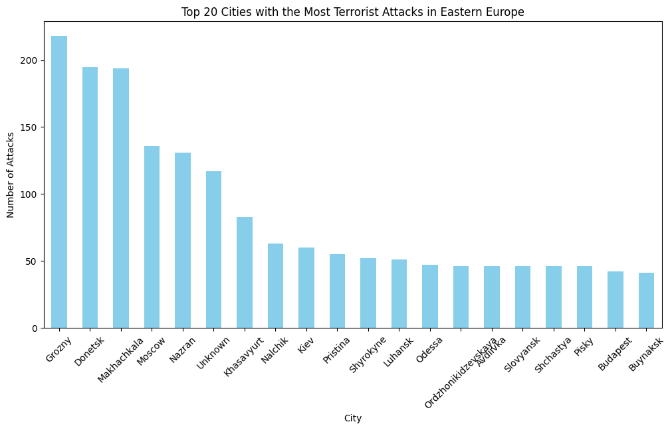
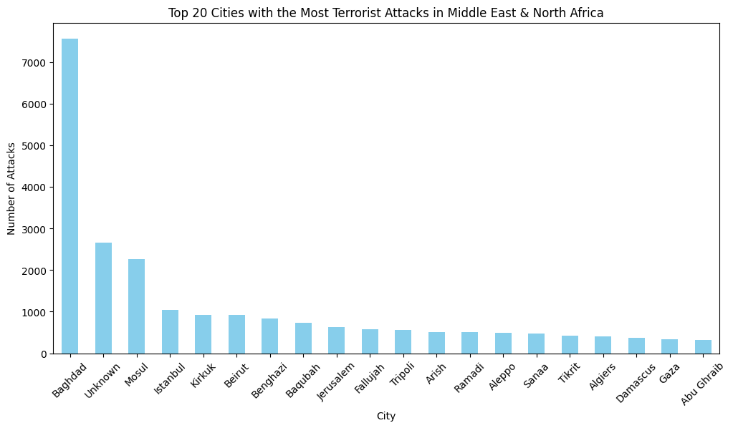
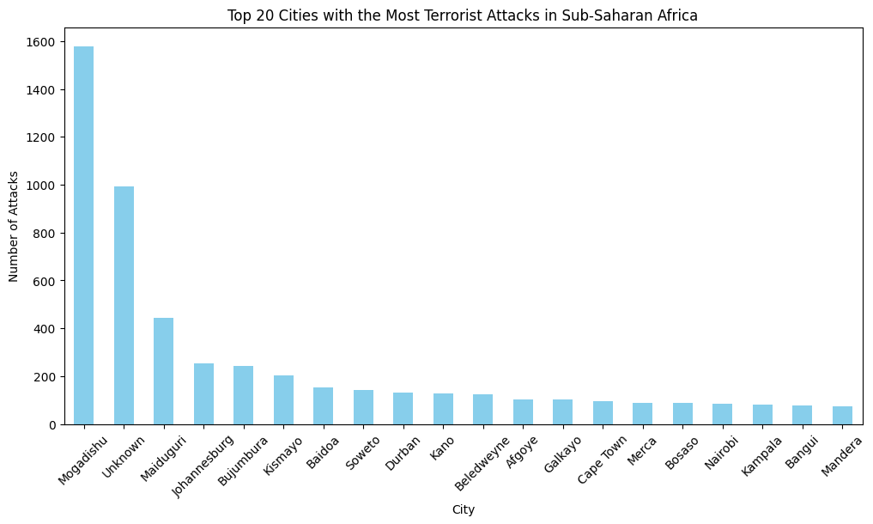
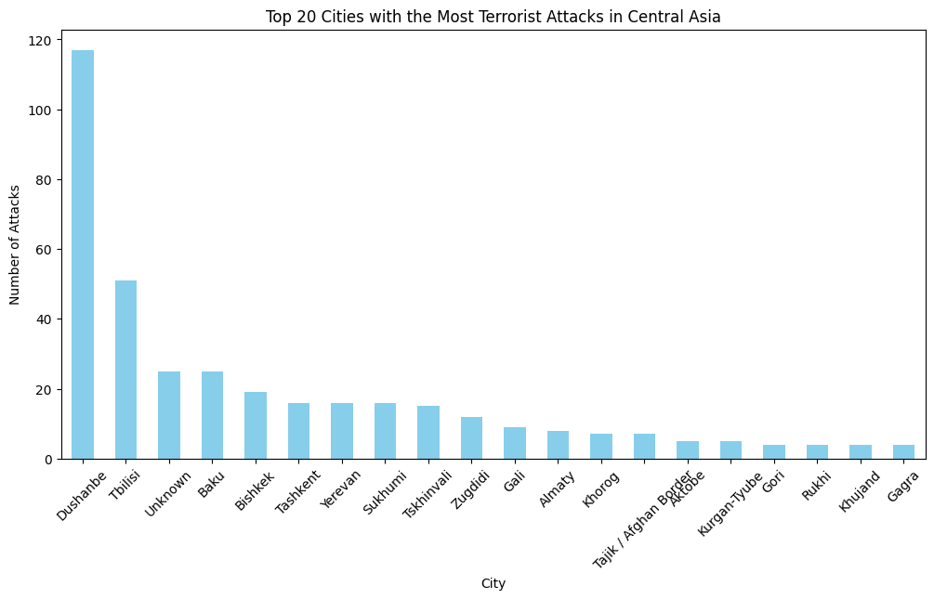
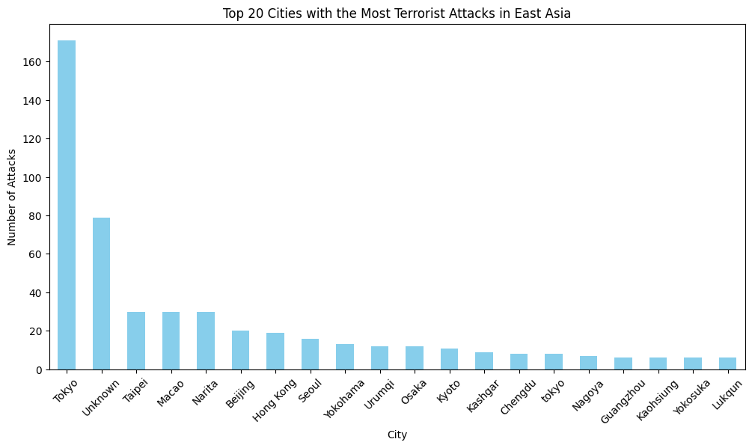

Slide 13
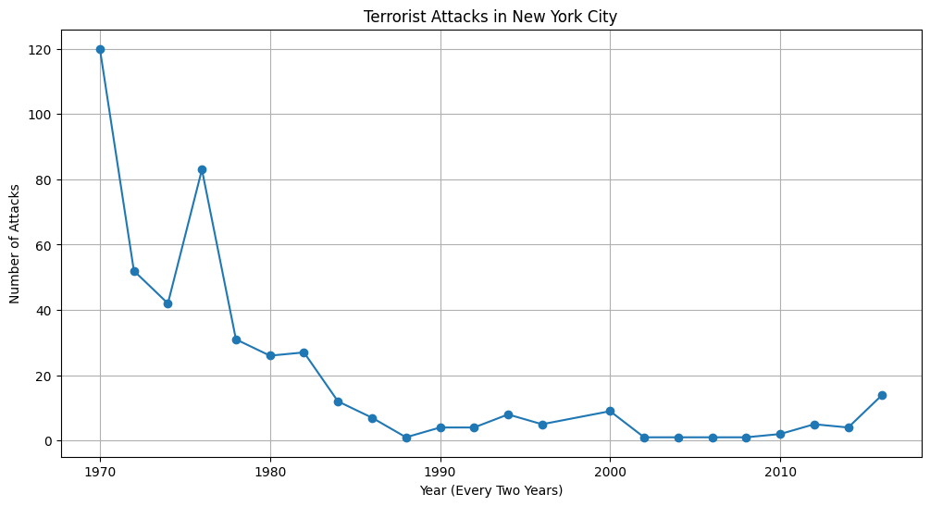
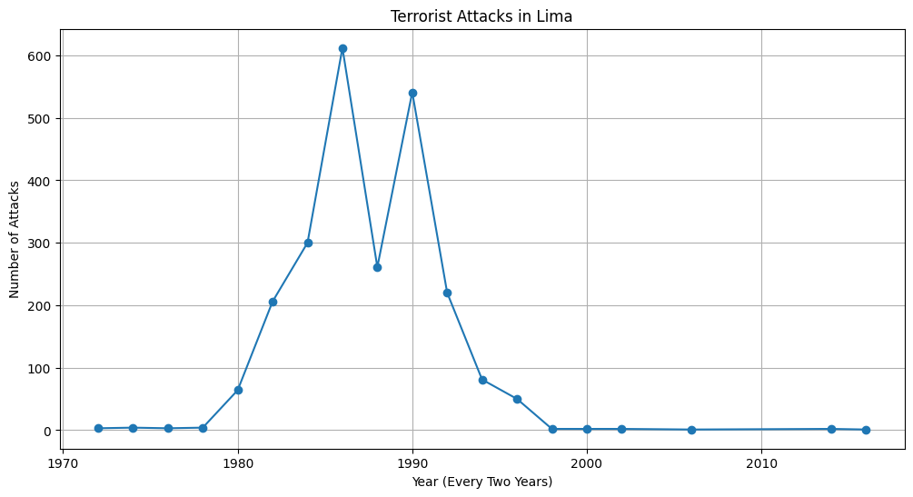
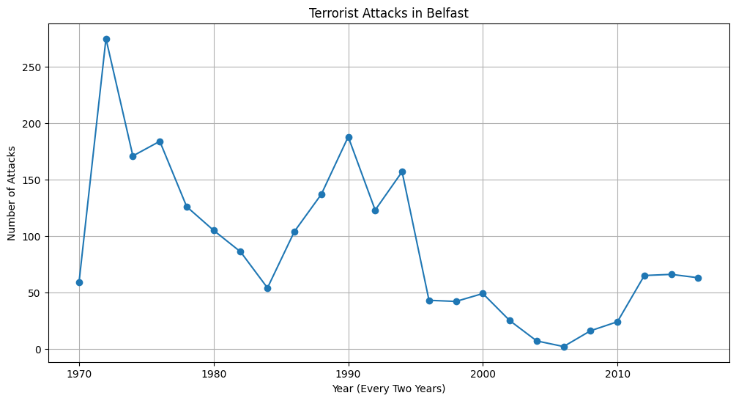
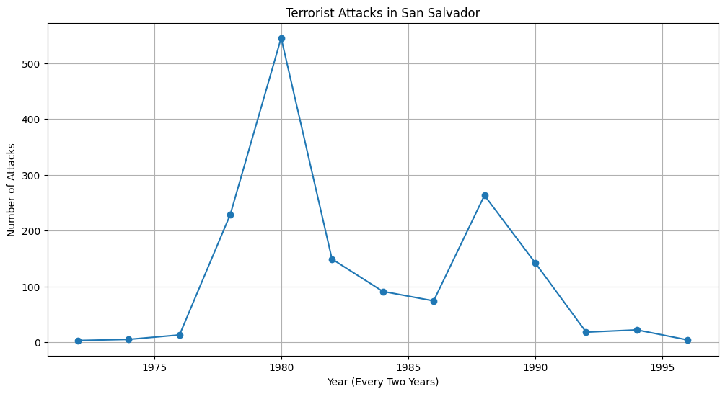
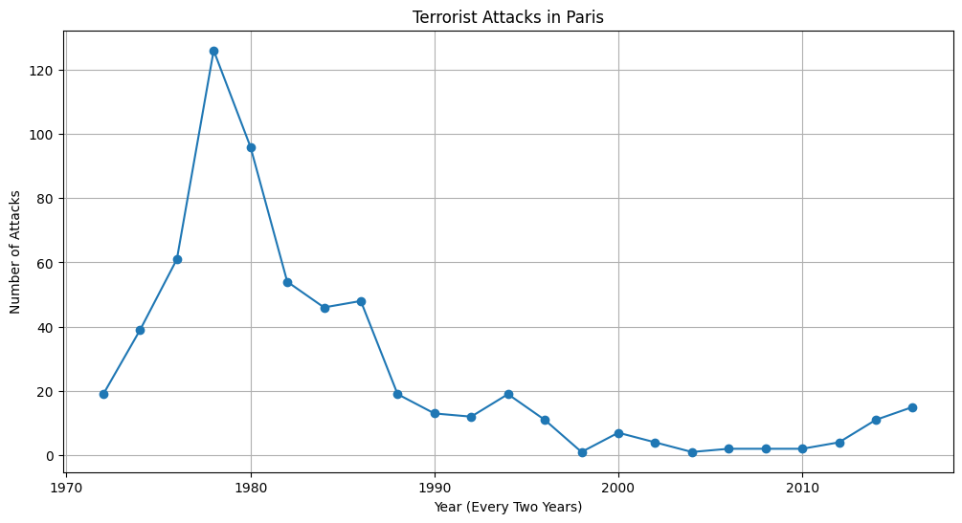
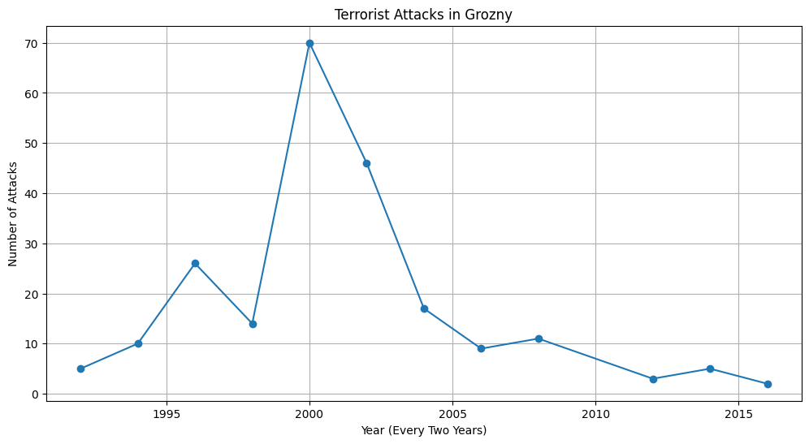
Attacks by Cities

Slide 14
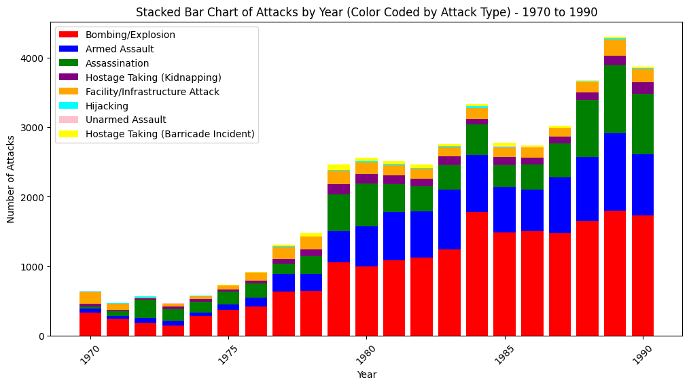
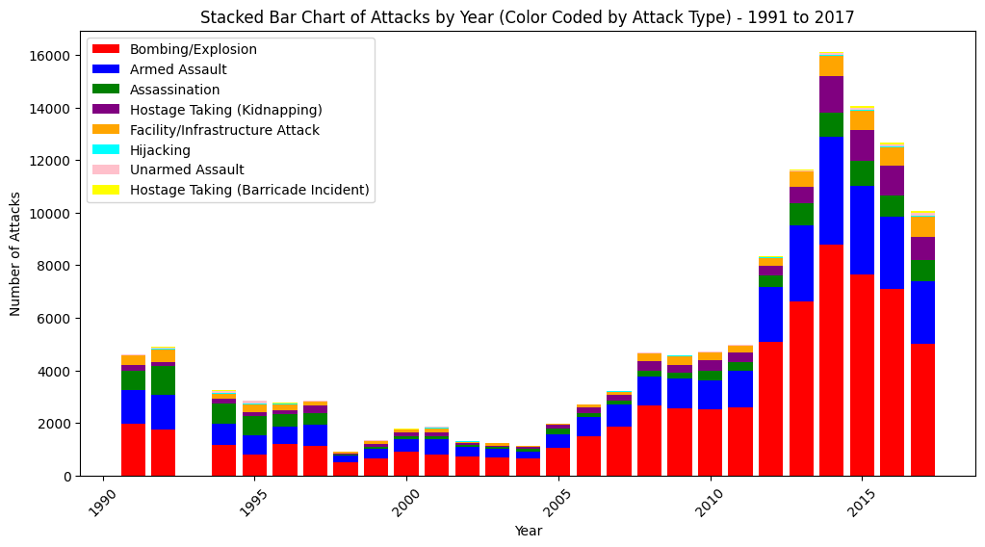
Type of Attack

Slide 15
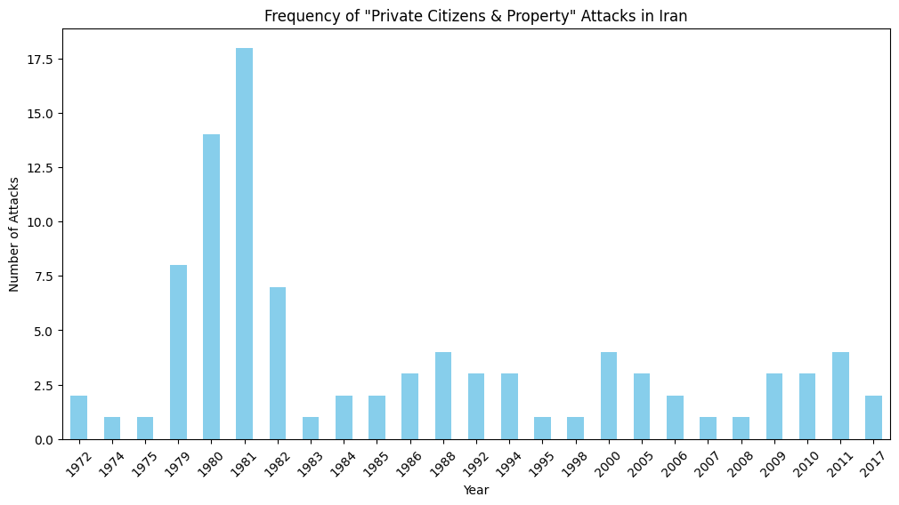
Iran Attacks
The Mojahedin-e-Khalq (MEK) was founded in 1965 by a group of Tehran University students whose radical ideas focused on an armed rebellion against Shah Mohammad Reza Pahlavi, whom they considered corrupt, oppressive, and a puppet of the United States.
On 30 August 1981 a bomb exploded in the office of Mohammad Javad Bahonar, Prime Minister of Iran, which killed Bahonar, President Mohammad Ali Rajai and some other officials.
According to the survivors, the bomb exploded when one of the victims opened a briefcase brought by Masoud Keshmiri as an "agent of MEK"

Slide 16
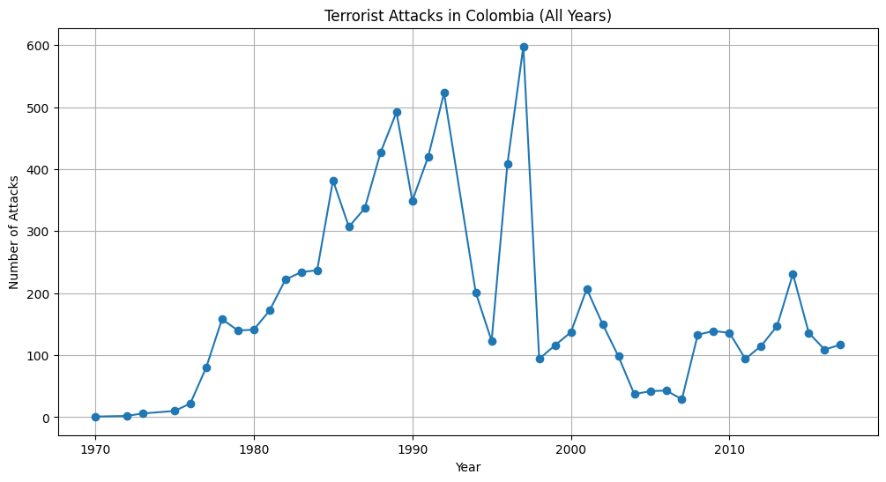
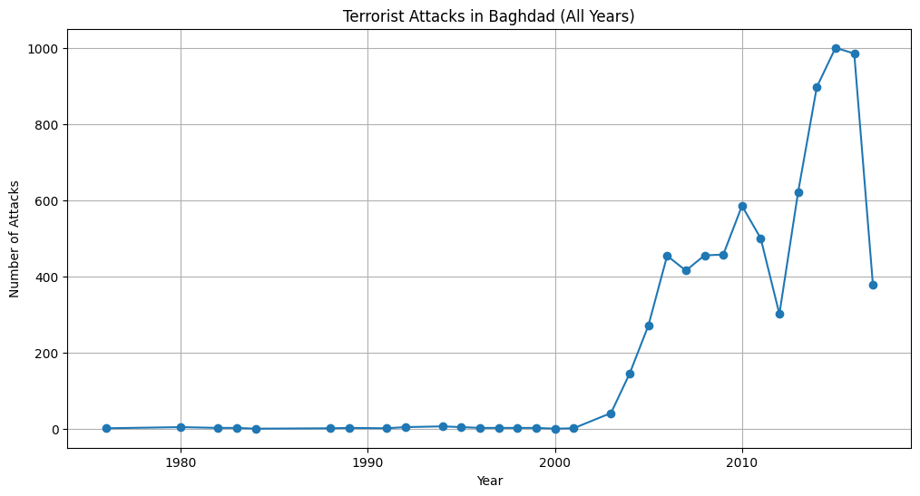
Colombia FARC
In October 1987 Jaime Pardo Leal, who had been the UP's presidential candidate the previous year, was assassinated amid a wave of violence in which thousands of the party's members perished at the hands of death squads.
Russia funded Guerilla/FARC groups to fight for the communist party.

Slide 17
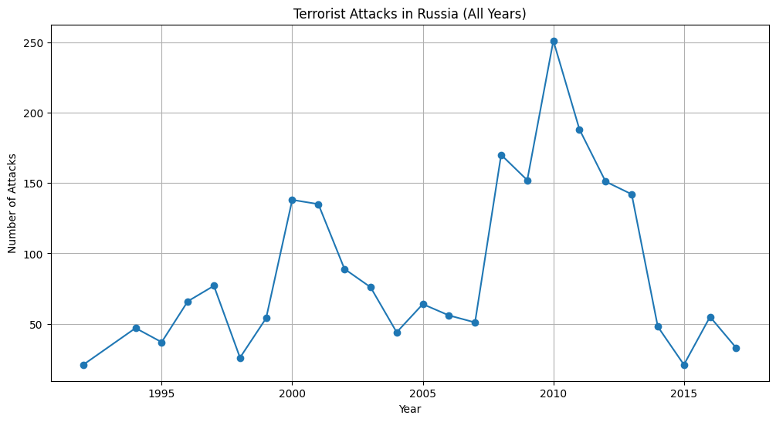
Russian Separatists Attack
The 2010 Moscow Metro bombings were suicide bombings carried out by two female Islamic terrorists during the morning rush hour at two stations of the Moscow Metro.
The bombings attributed to Chechen militants or to the Caucasus Emirate.[11] Since 1999, Chechen separatists gradually shifted away from pro Russian ideology.

Slide 18

Conclusion
Most attacks are politically motivated so the time they occur in are related to political tensions between countries.
Future works such as number of people hurt and if the groups had a political motivation could provide more detailed data.
Regardless of the continent, terror groups organize out of extremist ideas in unstable regions during elections/regime change/ideology shifts throughout history.

