Slide 1


Descriptive Analysis: Hotel Reviews
Author: Jamie Parra
CEN 4930 – Exploratory data analysis

Slide 2
Database Details
The data was scraped from Booking.com. All data in the file is publicly available to everyone already. Please be noted that data is originally owned by Booking.com.
This dataset contains 515,000 customer reviews and scoring of 1493 luxury hotels across Europe. Meanwhile, the geographical location of hotels are also provided for further analysis.

Slide 3
Dataset
Variable Name | Data Type | Field Size | Description | Example
Hotel Address | string | 50 | Hotel Address | Gravesandestraat 55 Oost 1092 AA
Review_date | int | 10 | Review Date | 10/03/2015
Average_Score | int | 3 | Hotel Score | 9.5
Hotel Name | string | 30 | Hotel Name | Hotel Arena
Reviewer_Nation | string | 30 | Country of Reviewer | Russia
Negative_Review | string | 200 | Negative Review | I am dissapointed.
Positive_Review | string | 200 | Positive Review | I had a great experience.
Total_Reviews | int | 1000000 | Number of reviews | 1234
https://www.kaggle.com/datasets/jiashenliu/515k-hotel-reviews-data-in-europe

Slide 4

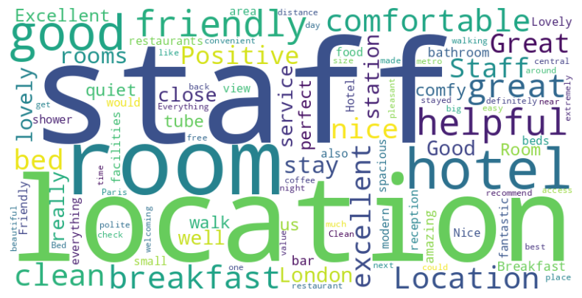


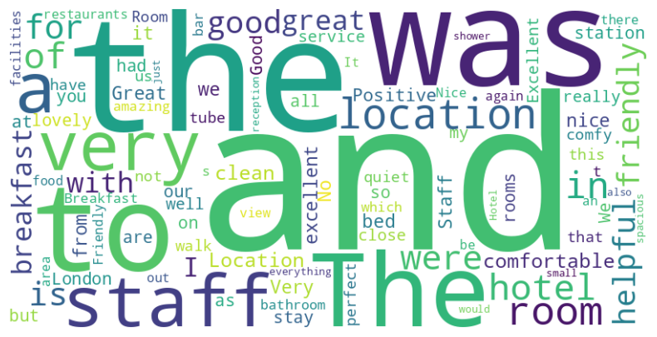

Positive Reviews Before
After

Slide 5
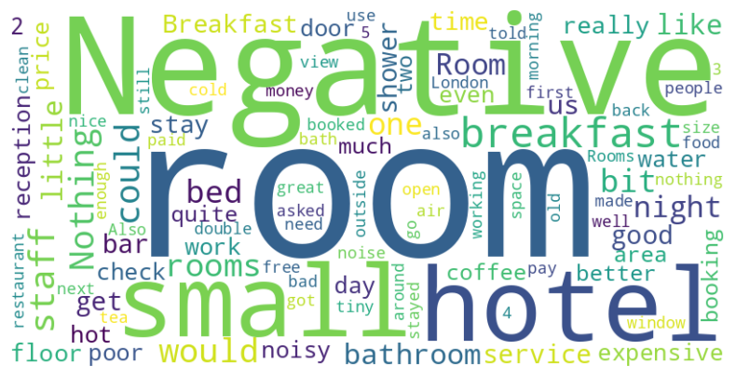
Negative
Reviews

Slide 6
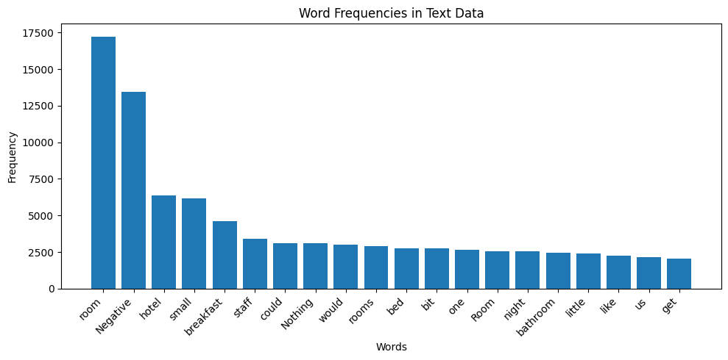
Frequency of Negative Reviews

Slide 7
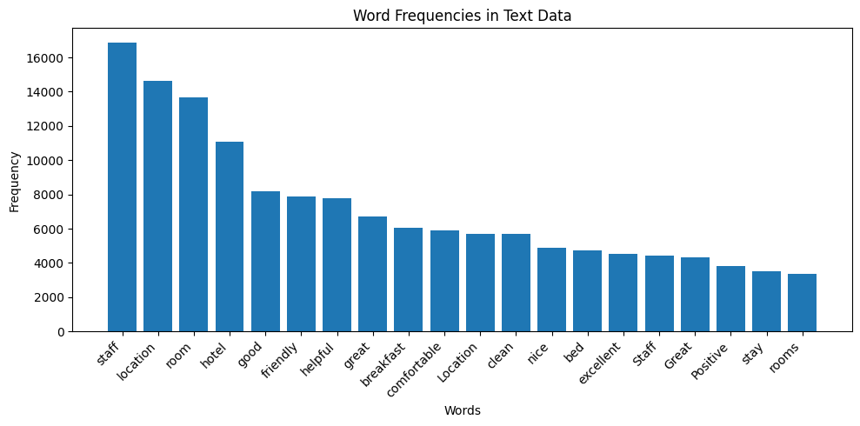
Frequency of Positive Reviews

Slide 8
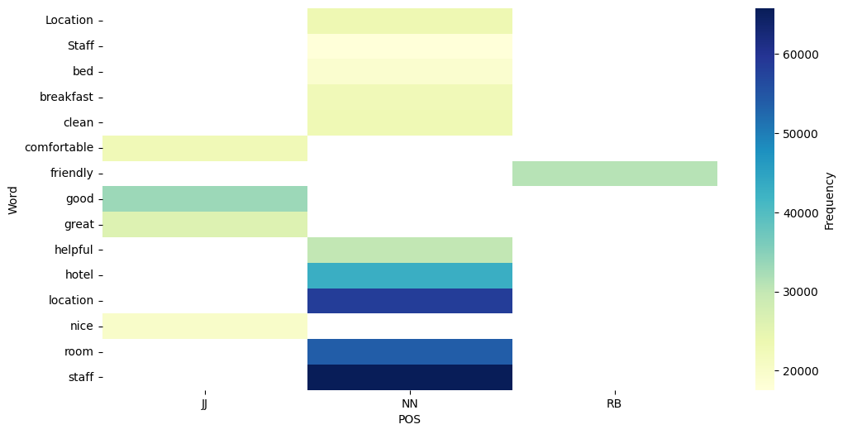
Positive Review Heatmap

Slide 9
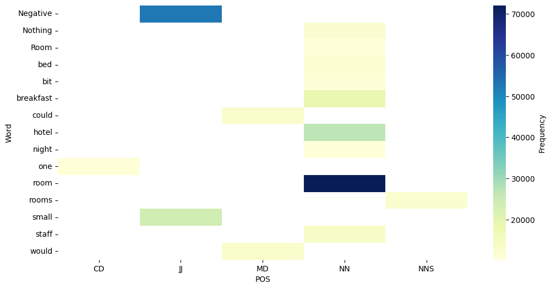
Negative Review Heatmap

Slide 10
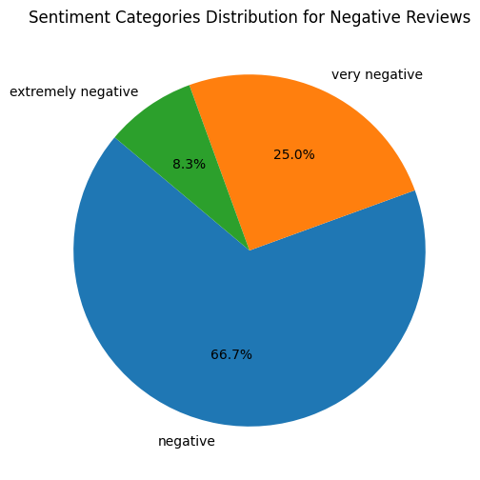
Negative Severity

Slide 11
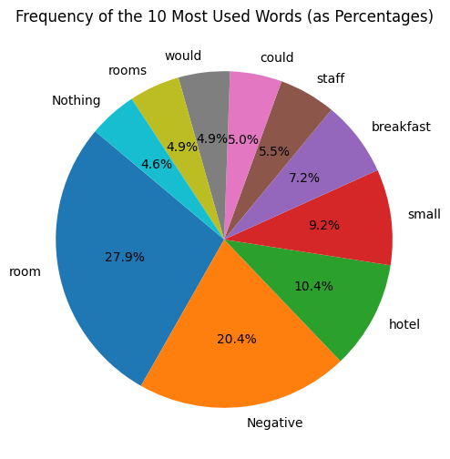
Most Used Negative Words

Slide 12
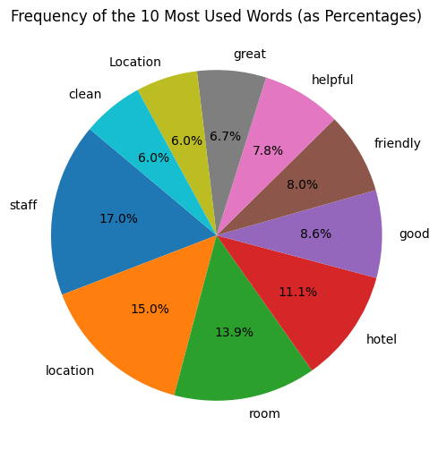
Most Used Positive Words

Slide 13
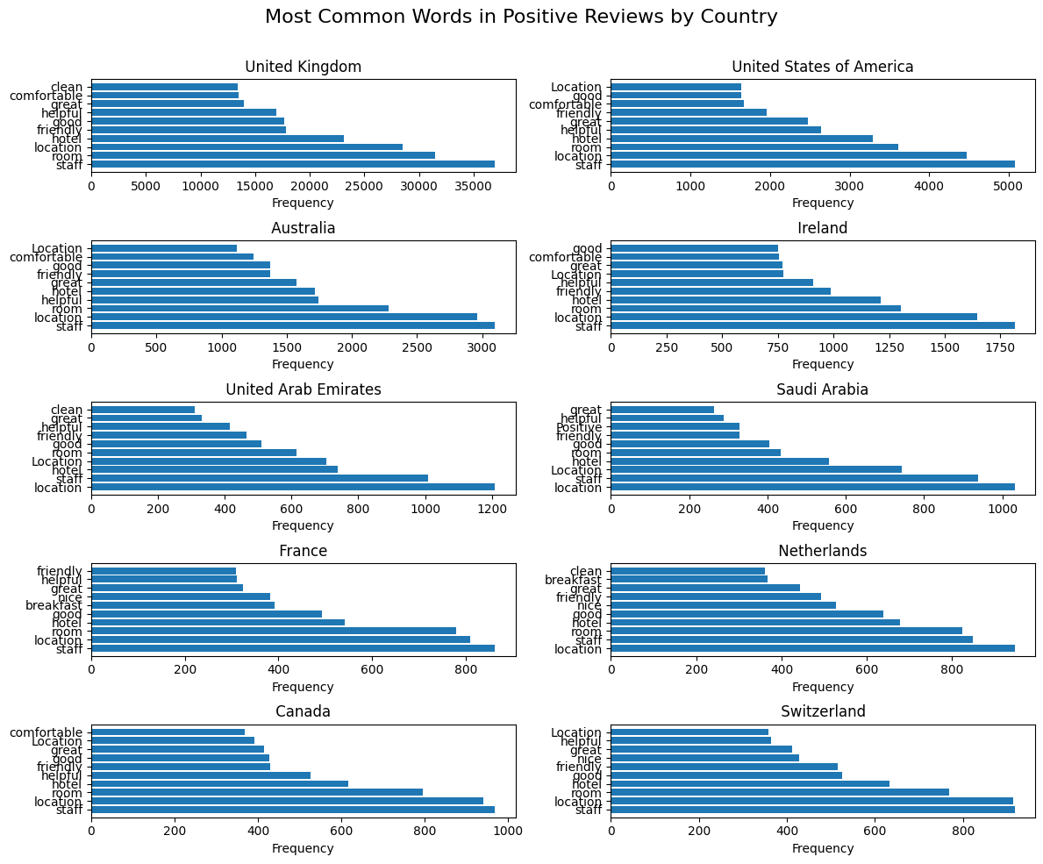
Most Positive Words By Reviewer Nationality

Slide 14
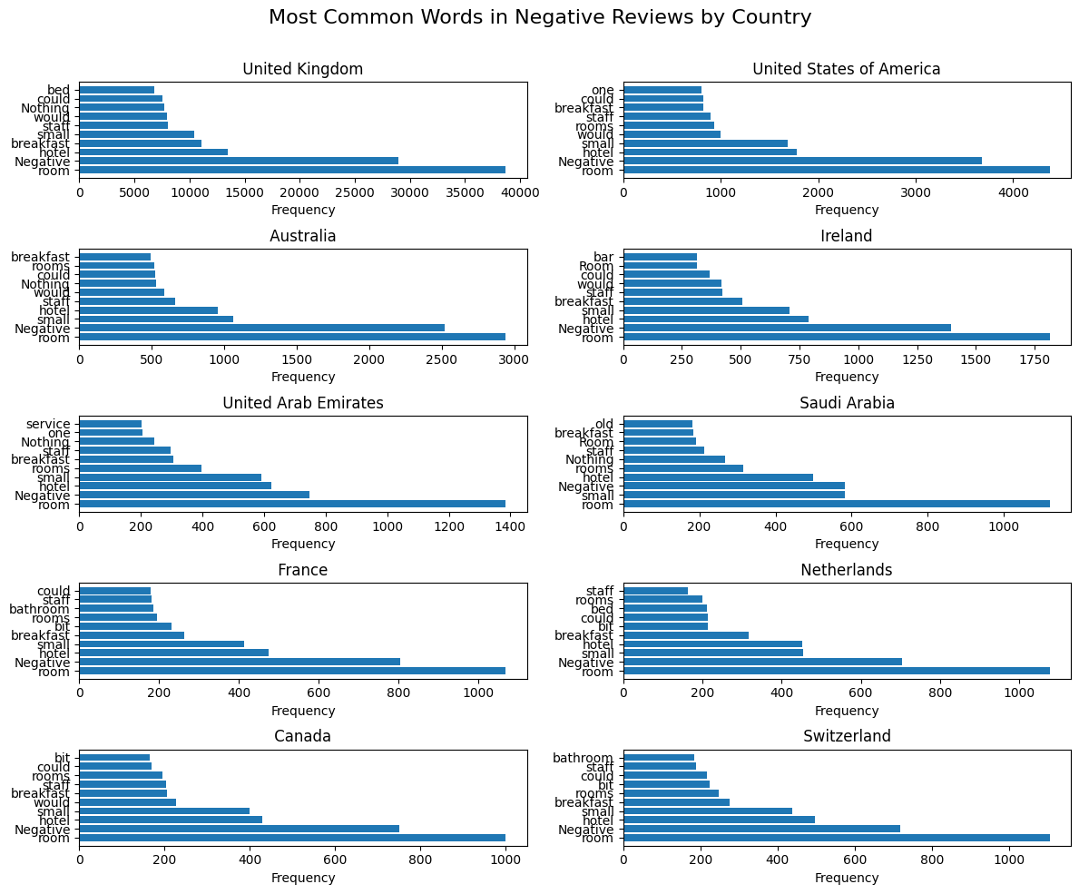
Most Negative Words By Reviewer Nationality

Slide 15
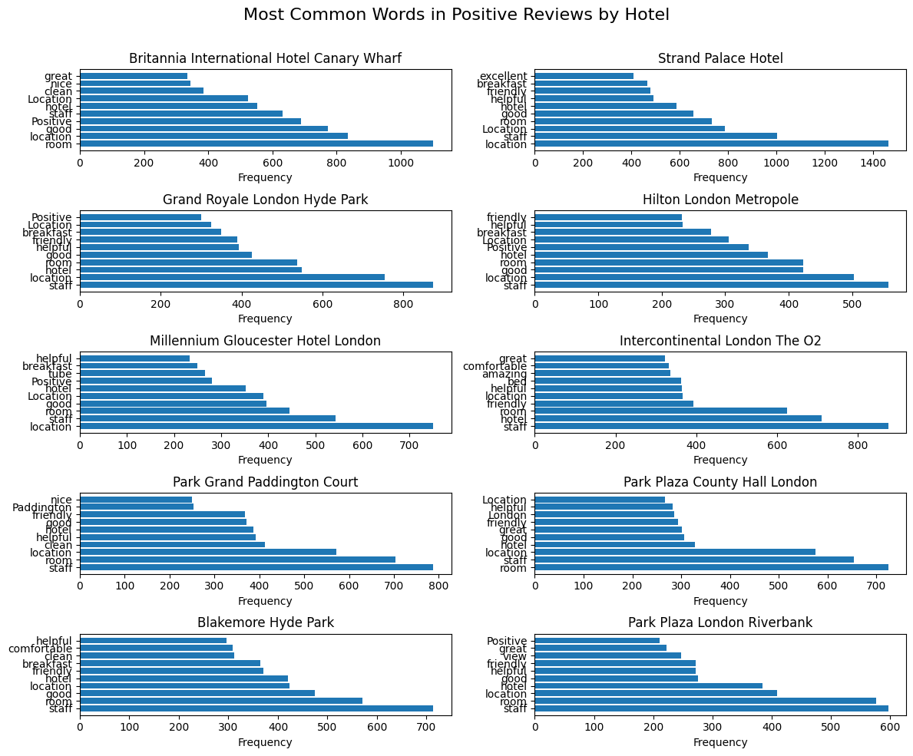
Most Positive Words By Hotel

Slide 16
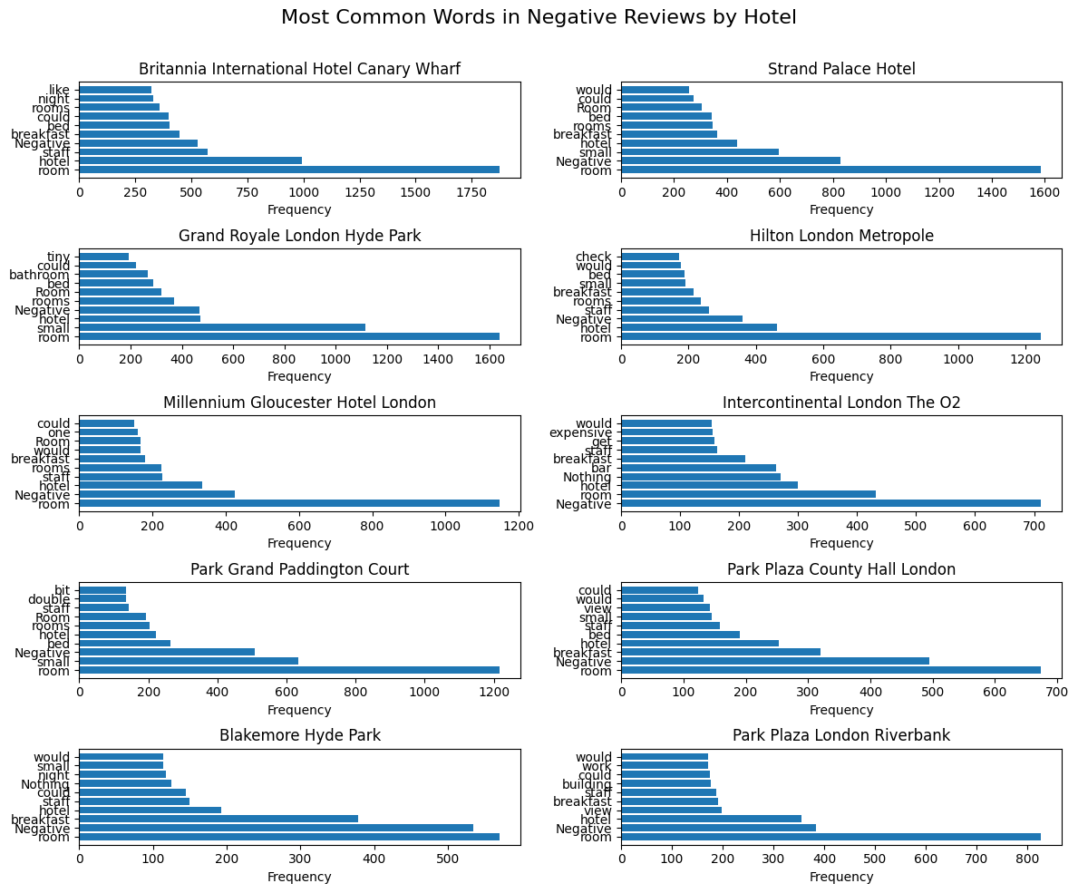
Most Negative Words By Hotel

Slide 17
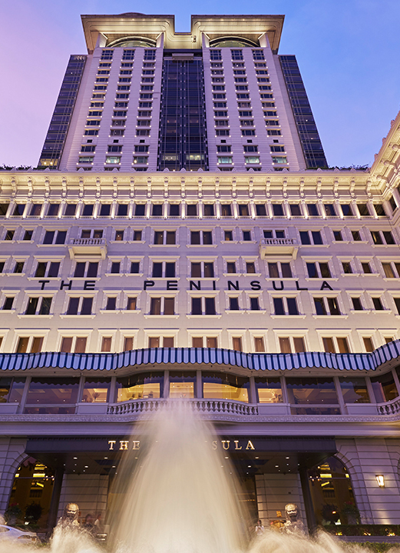
Conclusion
Most clients have a good stay when either the Room, Location, or staff were great.
Most clients have a bad experience when they do not like the room.
Future works would include having more data about what the clients prefer to have in their stay or how the hotel could improve their service.

