Slide 1

Universal Quantum Control through Deep Reinforcement Learning
WANG Rui
Professor Man-Hong Yung’s group, Department of physics
Southern University of Science and Technology
22/04/2019

Slide 2
Declaration
1. Contents related to basic Reinforcement Learning (RL) techniques come from the Microsoft course on edX [1]. Concepts of policy optimization was first raised in [3], while those in this slides also benefits from the Microsoft courses [1].
2. The work on combining RL and Quantum Control (QC) is presented in [2].
3. I know little about Quantum Computation, so there might be some mistakes. Do interrupt me and ask questions every time I make a mistake or interpreting vaguely!

Slide 3
Outline
1. What is Reinforcement Learning?
2. Policy optimization – policy gradient methods
3. The quantum control problem
4. Two-qubit control optimization

Slide 4
What is Reinforcement Learning?

Slide 5
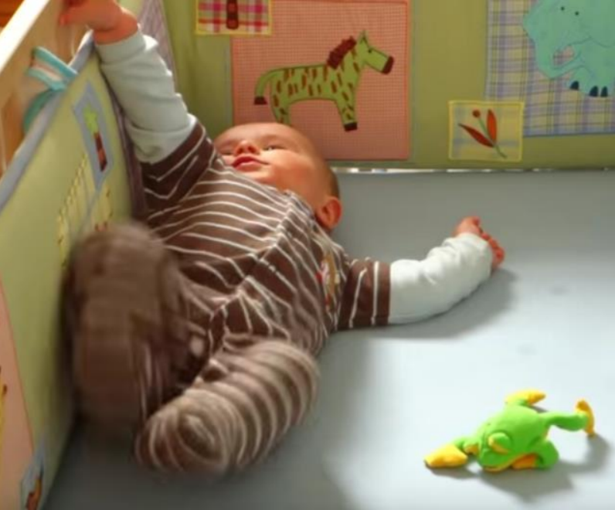
How do infants learn?
• Trial-and-error
• Practice
• Goal-oriented
• Interacting with the environment
[1]

Slide 6
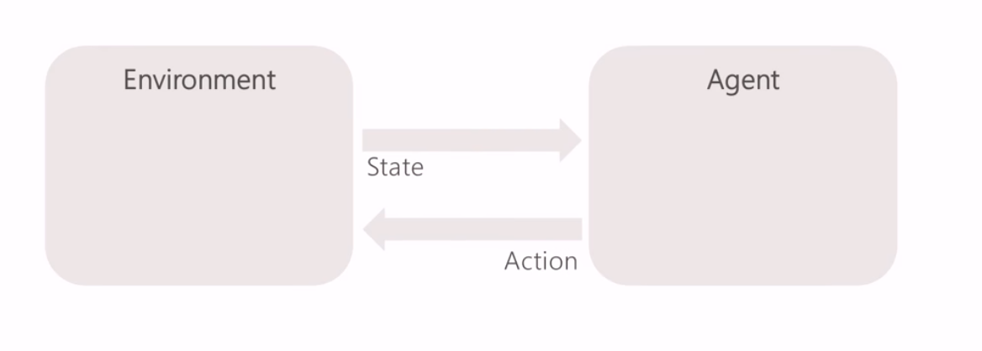
A general RL problem
[1]

Slide 7
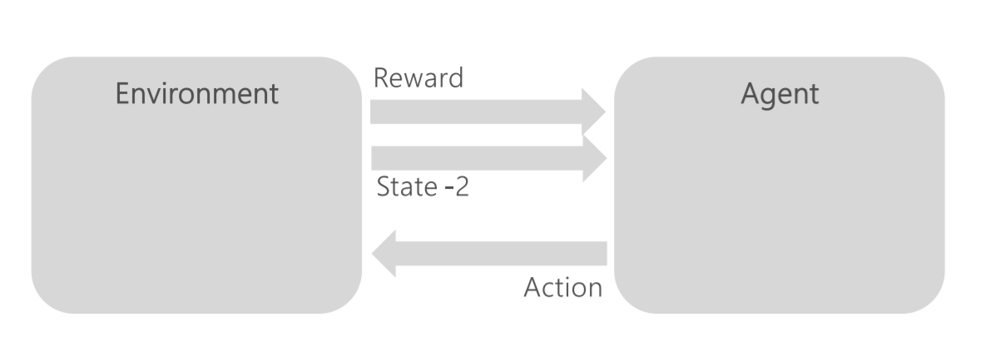
A general RL problem
[1]

Slide 8
Fundamental challenges of RL
1. Representation
2. Model Generalization
3. Exploration/Exploitation dilemma
4. Temporal Credit Assignment
[1]

Slide 9
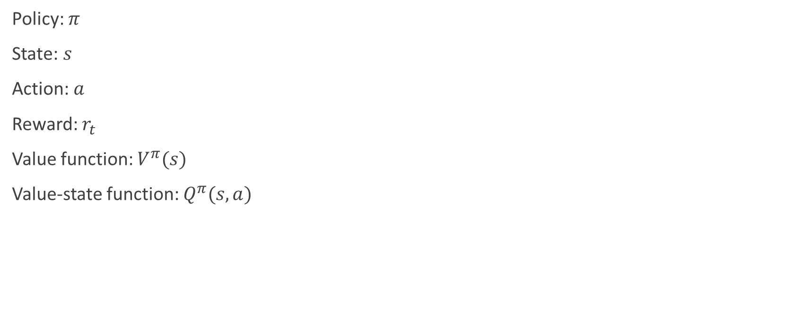
Common notations in RL
Policy: $π$
State: $s$
Action: $a$
Reward: $r_{t}$
Value function: $V^{π}(s)$
Value-state function: $Q^{π}(s,a)$

Slide 10
Policy Optimization
– Policy Gradient Method

Slide 11
Policy gradient method
Directly optimize the cumulative reward and can straightforwardly be used with nonlinear function approximators such as neural networks.
Two main challenges:
  1. large number of samples typically required.
  2. difficulty of obtaining stable and steady improvement despite the nonstationarity of the incoming data
Solutions:
  1. using value functions to substantially reduce the variance of policy gradient estimates at the cost of some bias
  2. using trust region optimization procedure for both the policy and the value function, which are represented by neural networks
[3]

Slide 12
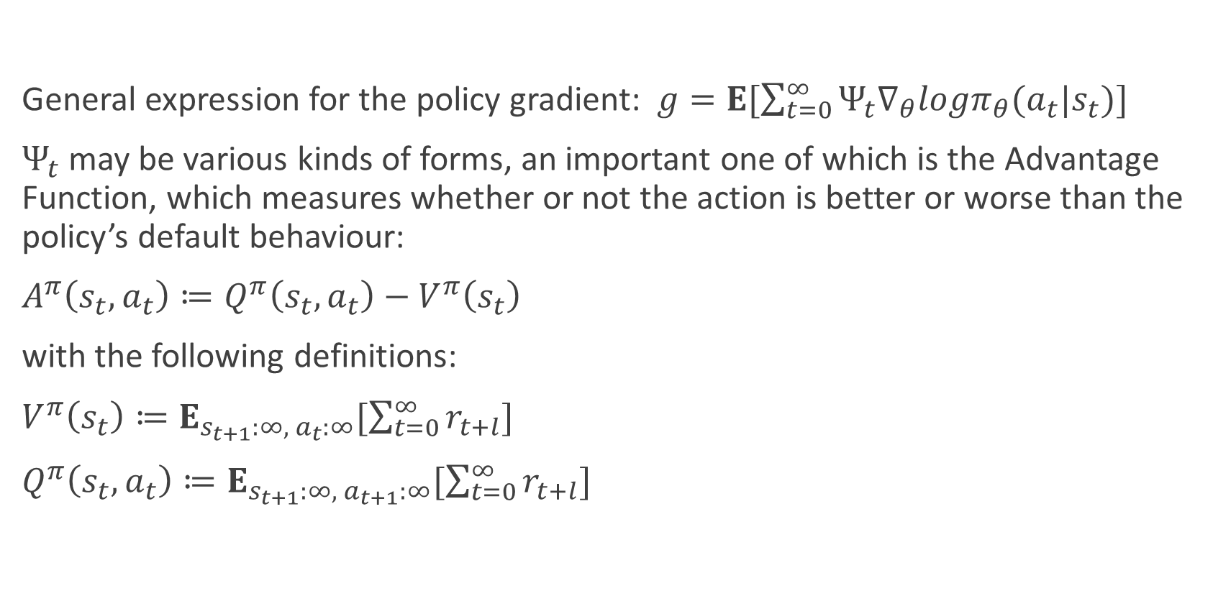
Policy gradient method
General expression for the policy gradient: $g=E[\sum_{t=0}^{∞}{Ψ_{t}∇_{θ}logπ_{θ}(a_{t}|s_{t})}]$
$Ψ_{t}$ may be various kinds of forms, an important one of which is the Advantage Function, which measures whether or not the action is better or worse than the policy’s default behaviour:
$A^{π}\left(s_{t}, a_{t}\right)≔Q^{π}\left(s_{t}, a_{t}\right)−V^{π}\left(s_{t}\right)$
with the following definitions:
$V^{π}\left(s_{t}\right)≔E_{s_{t+1}:∞, { a}_{t}:∞}[\sum_{t=0}^{∞}{r_{t+l}}]$
$Q^{π}\left(s_{t}, a_{t}\right)≔E_{s_{t+1}:∞, a_{t+1}:∞}[\sum_{t=0}^{∞}{r_{t+l}}]$
[3]

Slide 13
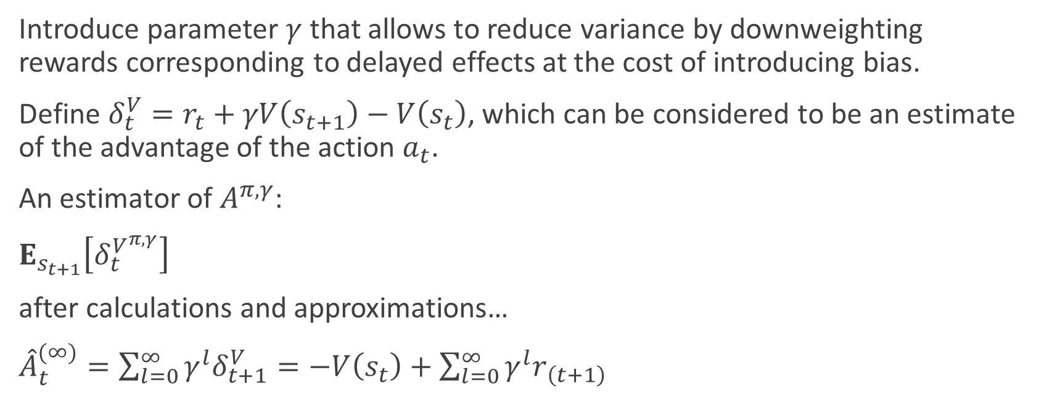
Policy gradient method
Introduce parameter $γ$ that allows to reduce variance by downweighting rewards corresponding to delayed effects at the cost of introducing bias.
Define $δ_{t}^{V}=r_{t}+γV\left(s_{t+1}\right)−V\left(s_{t}\right)$, which can be considered to be an estimate of the advantage of the action $a_{t}$.
An estimator of $A^{π,γ}$:
$E_{s_{t+1}}\left[δ_{t}^{V^{π, γ}}\right]$
after calculations and approximations…
${\hat{A}}_{t}^{(∞)}=\sum_{l=0}^{∞}{γ^{l}δ_{t+1}^{V}=−V\left(s_{t}\right)+\sum_{l=0}^{∞}{γ^{l}r_{\left(t+1\right)}}}$
[3]

Slide 14
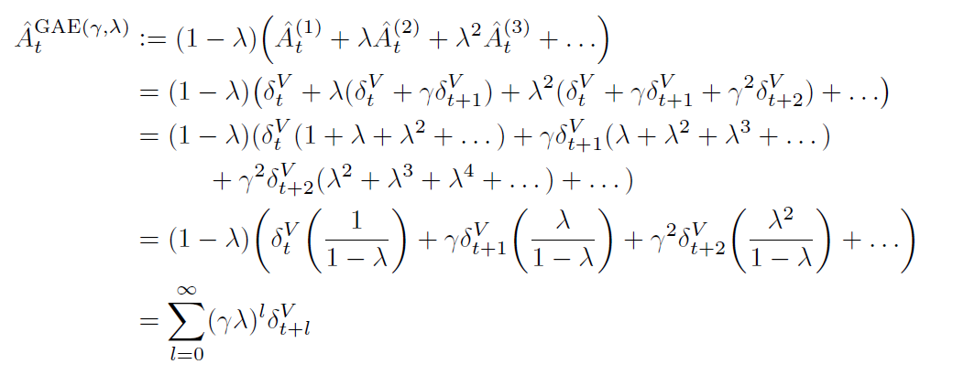
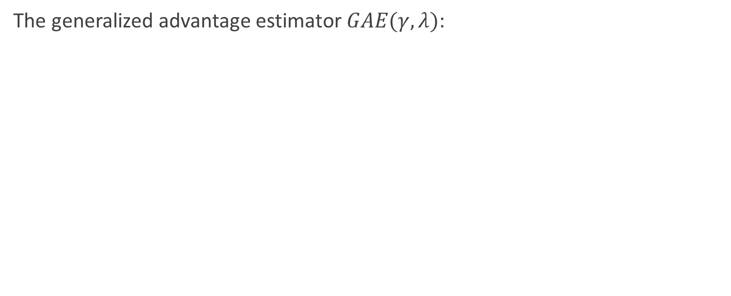
Policy gradient method
The generalized advantage estimator $GAE(γ, λ)$:
[3]

Slide 15
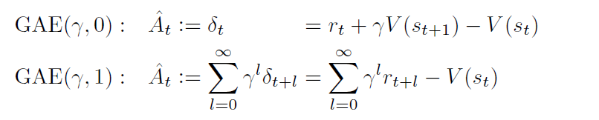
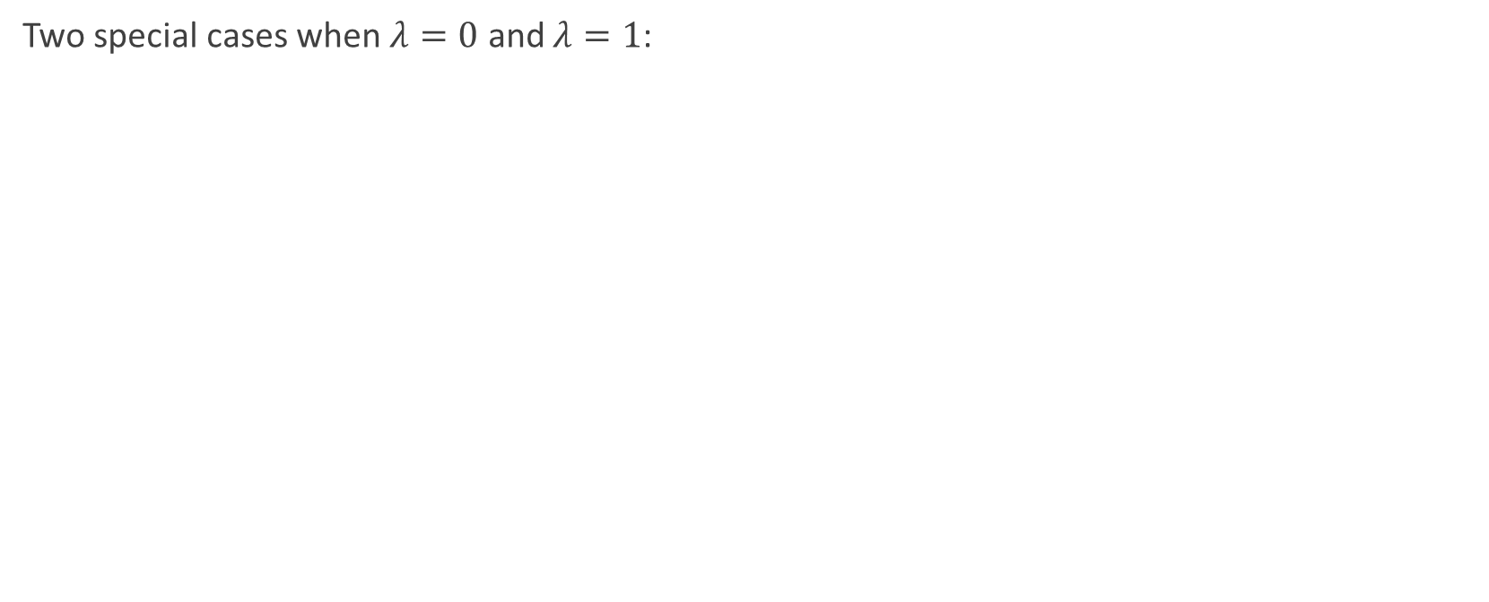
Policy gradient method
Two special cases when $λ=0$ and $λ=1$:
[3]

Slide 16
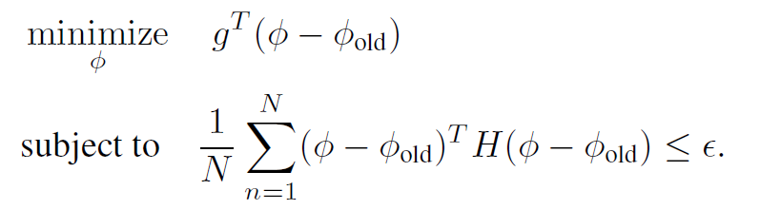
Value function estimation
Solving the quadratic program:
[3]

Slide 17
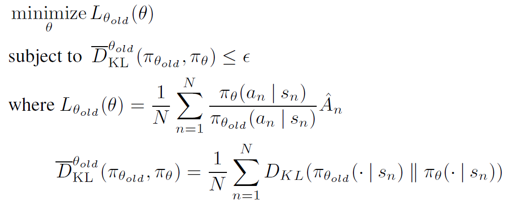
Trust Region Policy Optimization (TRPO)
TRPO update the policy by approximately solving the following constrained optimization problem each iteration:
[4]

Slide 18
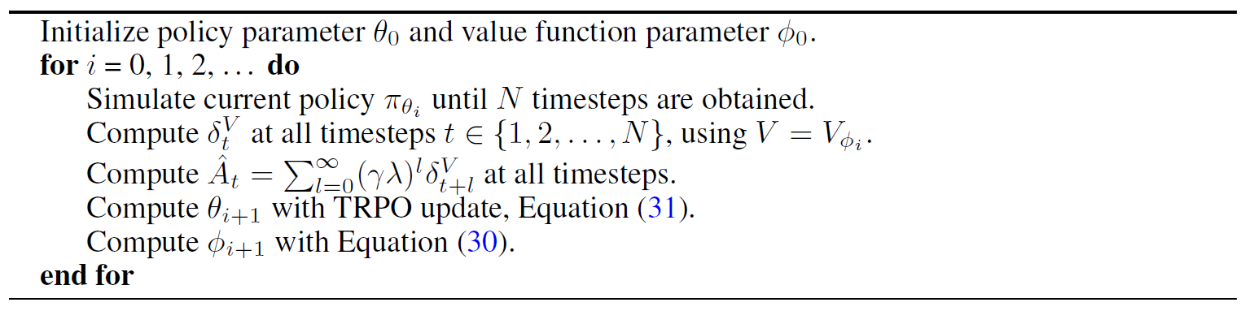
Trust Region Policy Optimization (TRPO)
The whole algorithm for iteratively updating policy and value function:
[4]

Slide 19
The Quantum Control problem

Slide 20
The QC problem
Aim: to construct a universal control framework that facilitates optimization
Leakage error: couplings between a quantum computing system and its environment
  Contains two kinds of leakage:
    1. Coherent Leakage: direct couplings between the qubit subspace and higher energy spaces (on/off-resonant components)
    2. ‘Incoherent Leakage’
Control error
Key problem: to find an analytic cost function that incorporates the complete objective of the quantum optimization problem
find the leakage bound of the given control scheme
non-adiabatic transitions during the modulation of system Hamiltonians
photon loss to the environment
[2]

Slide 21
The QC problem
Derived an analytic leakage bound for a Hamiltonian control trajectory to account for both on/off-resonant leakage errors.
Based on a perturbation theory within the time-dependent Schrieffer-Wolff transformation (TSWT) formalism.
Generalized adiabatic theorem.
Universal cost Function control Optimization (UFO)
[2]

Slide 22
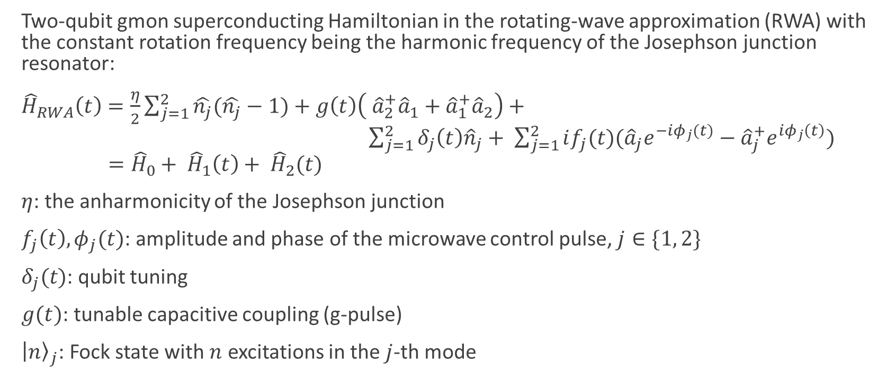
The Hamiltonian
Two-qubit gmon superconducting Hamiltonian in the rotating-wave approximation (RWA) with the constant rotation frequency being the harmonic frequency of the Josephson junction resonator:
${\hat{H}}_{RWA}\left(t\right)=\frac{η}{2}\sum_{j=1}^{2}{\hat{n_{j}}(\hat{n_{j}}−1)}+g\left(t\right)\left( {\hat{a}}_{2}^{+}{\hat{a}}_{1}+{\hat{a}}_{1}^{+}{\hat{a}}_{2}\right)+ \sum_{j=1}^{2}{δ_{j}\left(t\right){\hat{n}}_{j}+ \sum_{j=1}^{2}{if_{j}(t)({\hat{a}}_{j}e^{−iφ_{j}(t)}}}−{\hat{a}}_{j}^{+}e^{iφ_{j}\left(t\right)})$
$={\hat{H}}_{0}+ {\hat{H}}_{1}\left(t\right)+ {\hat{H}}_{2}(t)$
$η$: the anharmonicity of the Josephson junction
$f_{j}\left(t\right), φ_{j}(t)$: amplitude and phase of the microwave control pulse, $j∈\{1, 2\}$
$δ_{j}(t)$: qubit tuning
$g(t)$: tunable capacitive coupling (g-pulse)
${\left|n\right\rangle }_{j}$: Fock state with $n$ excitations in the $j$-th mode
[2]

Slide 23
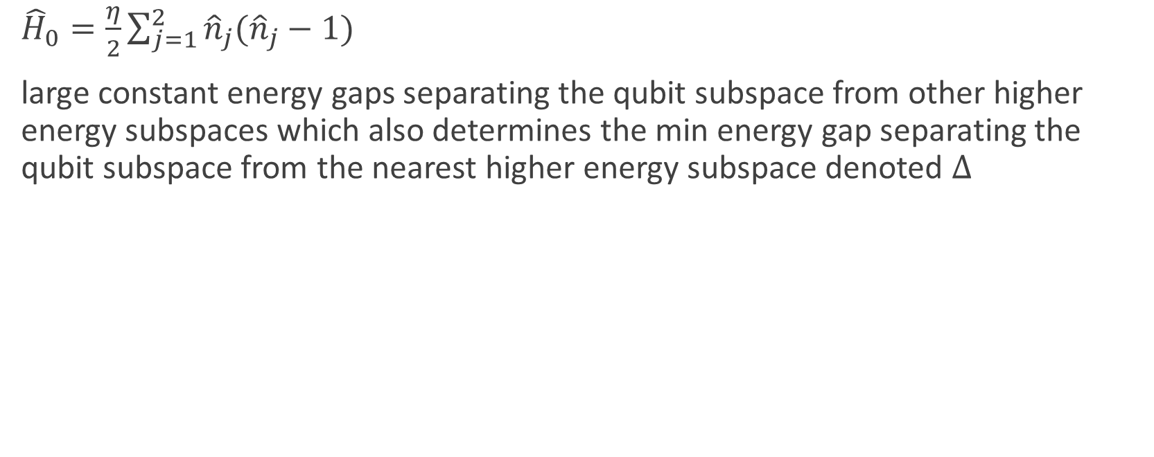
The Hamiltonian
${\hat{H}}_{0}=\frac{η}{2}\sum_{j=1}^{2}{{\hat{n}}_{j}({\hat{n}}_{j}−1)}$
large constant energy gaps separating the qubit subspace from other higher energy subspaces which also determines the min energy gap separating the qubit subspace from the nearest higher energy subspace denoted $Δ$
[2]

Slide 24
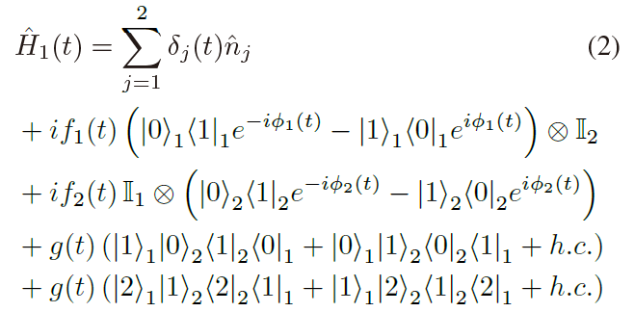
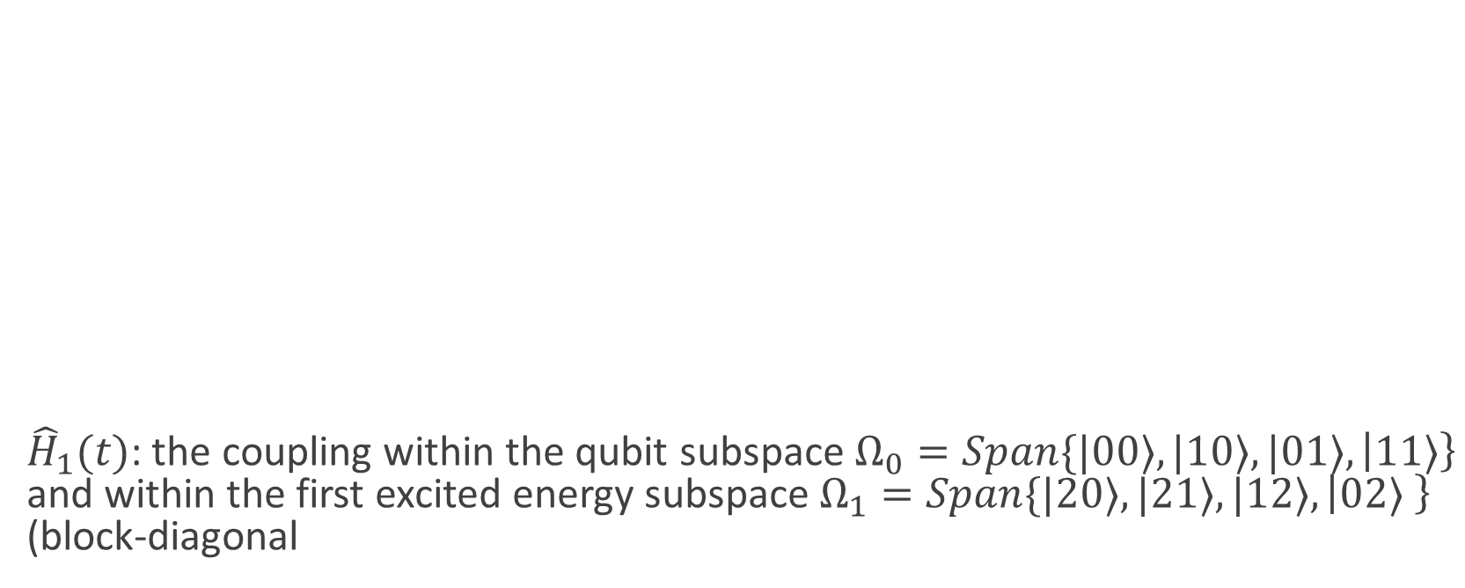
The Hamiltonian
${\hat{H}}_{1}(t)$: the coupling within the qubit subspace $Ω_{0}=Span\{|00⟩, |10⟩, |01⟩, \left|11⟩\right\}$ and within the first excited energy subspace $Ω_{1}=Span\{|20⟩, |21⟩, |12⟩, \left|02⟩ \right\}$ (block-diagonal
[2]

Slide 25
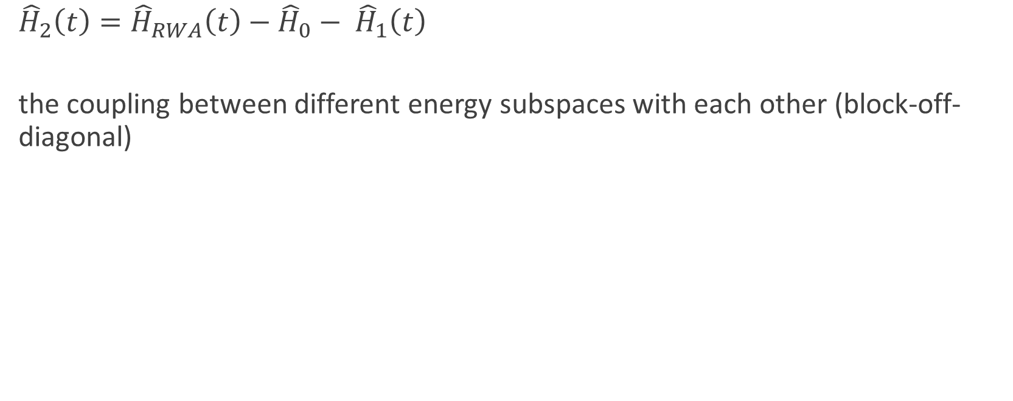
The Hamiltonian
${{\hat{H}}_{2}\left(t\right)=\hat{H}}_{RWA}\left(t\right)−{\hat{H}}_{0}− {\hat{H}}_{1}\left(t\right)$
the coupling between different energy subspaces with each other (block-off-diagonal)
[2]

Slide 26
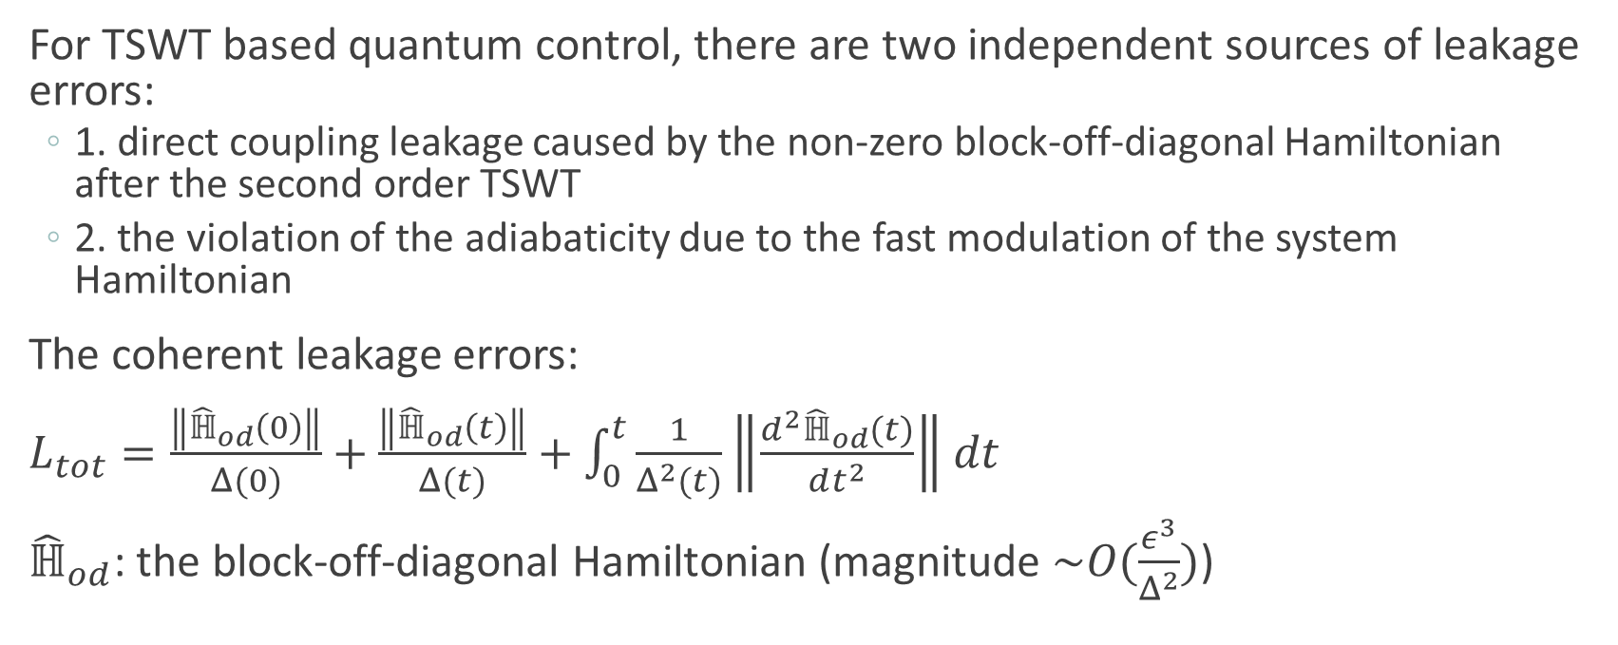
The leakage error
For TSWT based quantum control, there are two independent sources of leakage errors:
  1. direct coupling leakage caused by the non-zero block-off-diagonal Hamiltonian after the second order TSWT
  2. the violation of the adiabaticity due to the fast modulation of the system Hamiltonian
The coherent leakage errors:
$L_{tot}=\frac{\left\|{\hat{ℍ}}_{od}\left(0\right)\right\|}{Δ(0)}+\frac{\left\|{\hat{ℍ}}_{od}\left(t\right)\right\|}{Δ(t)}+\int_{0}^{t}{\frac{1}{Δ^{2}(t)}\left\|\frac{d^{2}{\hat{ℍ}}_{od}(t)}{dt^{2}}\right\|dt}$
${\hat{ℍ}}_{od}$: the block-off-diagonal Hamiltonian (magnitude $\sim O(\frac{ε^{3}}{Δ^{2}})$)
[2]

Slide 27
The leakage error
Also: incoherent leakage errors due to the violation of adiabaticity from the time depend nature of the control quantum dynamics in the off-resonant regime.
Proved that such non-adiabatic leakage is not dominated in off-resonant frequency regime.
[2]

Slide 28
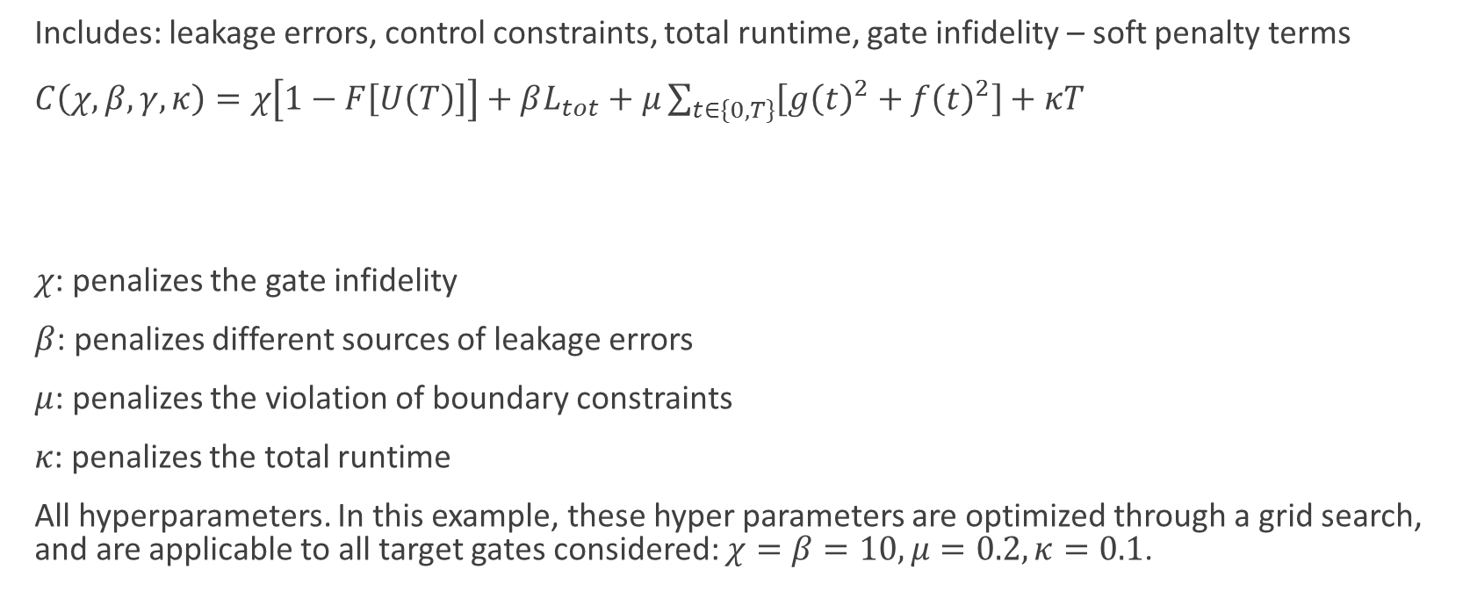
The universal cost function: the UFO cost function
Includes: leakage errors, control constraints, total runtime, gate infidelity – soft penalty terms
$C\left(χ, β, γ, κ\right)=χ\left[1−F\left[U\left(T\right)\right]\right]+βL_{tot}+μ\sum_{t∈\{0, T\}}{\left[g{\left(t\right)}^{2}+f{\left(t\right)}^{2}\right]+κT}$
$χ$: penalizes the gate infidelity
$β$: penalizes different sources of leakage errors
$μ$: penalizes the violation of boundary constraints
$κ$: penalizes the total runtime
All hyperparameters. In this example, these hyper parameters are optimized through a grid search, and are applicable to all target gates considered: $χ=β=10, μ=0.2, κ=0.1$.
Gate infidelity
Leakage Errors
Violation of Control Boundary Conditions
Total Runtime
[2]

Slide 29
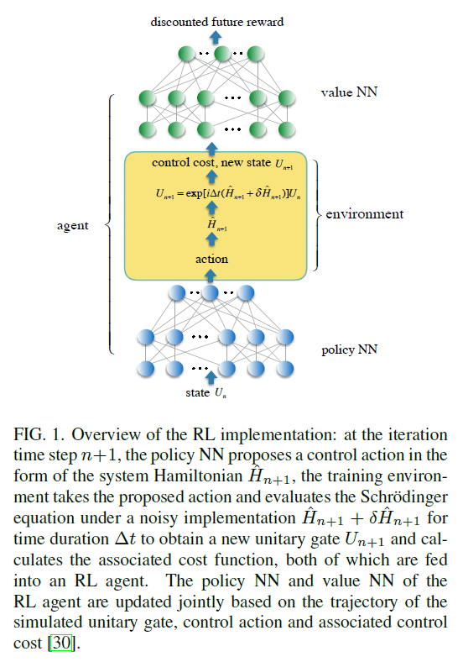
Neural network parameters
Both neural networks are made up with fully connected with 3 layers of dimension 64, 32 and 32 respectively
Activation function: tanh
Output layer: linear activation for the policy NN
scalar output for the value NN
[2]

Slide 30
Two-qubit control optimization

Slide 31
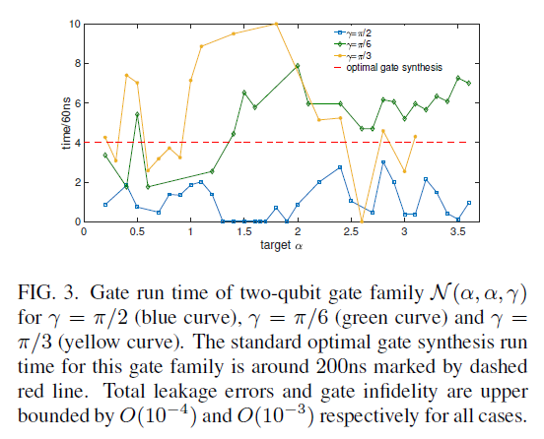
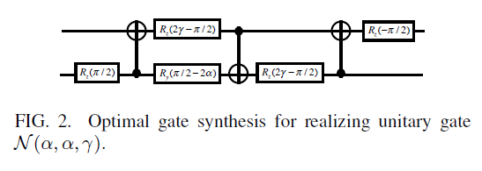
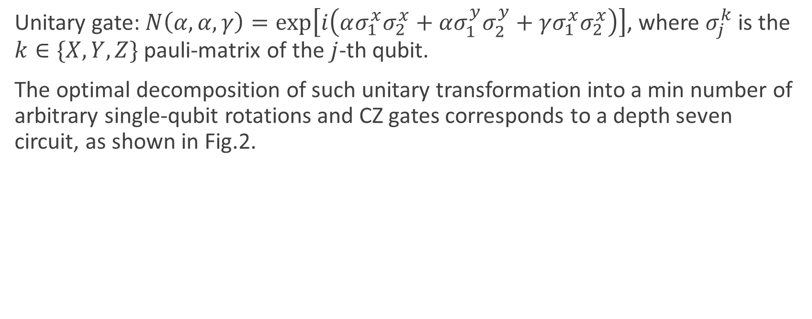
Two-qubit control optimization
Unitary gate: $N\left(α, α, γ\right)=\exp\left[i\left(ασ_{1}^{x}σ_{2}^{x}+ασ_{1}^{y}σ_{2}^{y}+γσ_{1}^{x}σ_{2}^{x}\right)\right]$, where $σ_{j}^{k}$ is the $k∈\{X, Y, Z\}$ pauli-matrix of the $j$-th qubit.
The optimal decomposition of such unitary transformation into a min number of arbitrary single-qubit rotations and CZ gates corresponds to a depth seven circuit, as shown in Fig.2.
[2]

Slide 32
The Flowchart

Slide 33
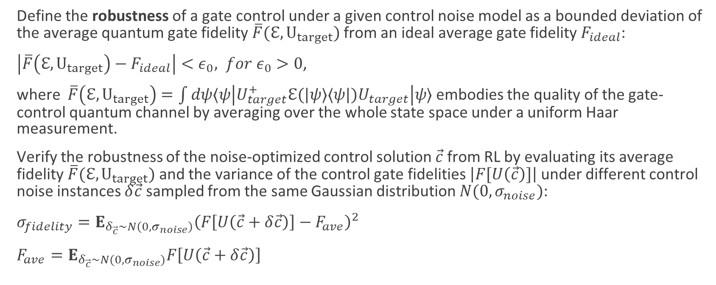
Definition of robustness
Define the robustness of a gate control under a given control noise model as a bounded deviation of the average quantum gate fidelity $\overline{F}(ℇ, U_{target})$ from an ideal average gate fidelity $F_{ideal}$:
$\left|\overline{F}\left(ℇ, U_{target}\right)−F_{ideal}\right|<ε_{0}, for ε_{0}>0$,
where $\overline{F}\left(ℇ, U_{target}\right)=\int{dψ⟨ψ\left|U_{target}^{+}ℇ(|ψ⟩⟨ψ|)U_{target}\right|ψ⟩}$ embodies the quality of the gate-control quantum channel by averaging over the whole state space under a uniform Haar measurement.
Verify the robustness of the noise-optimized control solution $\vec{c}$ from RL by evaluating its average fidelity $\overline{F}(ℇ, U_{target})$ and the variance of the control gate fidelities $\left|F[U\left(\vec{c}\right)]\right|$ under different control noise instances $δ\vec{c}$ sampled from the same Gaussian distribution $N(0, σ_{noise})$:
$σ_{fidelity}=E_{δ_{\vec{c}}\sim N\left(0, σ_{noise}\right)}{\left(F\left[U\left(\vec{c}+δ\vec{c}\right)\right]−F_{ave}\right)}^{2}$
$F_{ave}=E_{δ_{\vec{c}}\sim N(0, σ_{noise})}F\left[U\left(\vec{c}+δ\vec{c}\right)\right]$
[2]

Slide 34
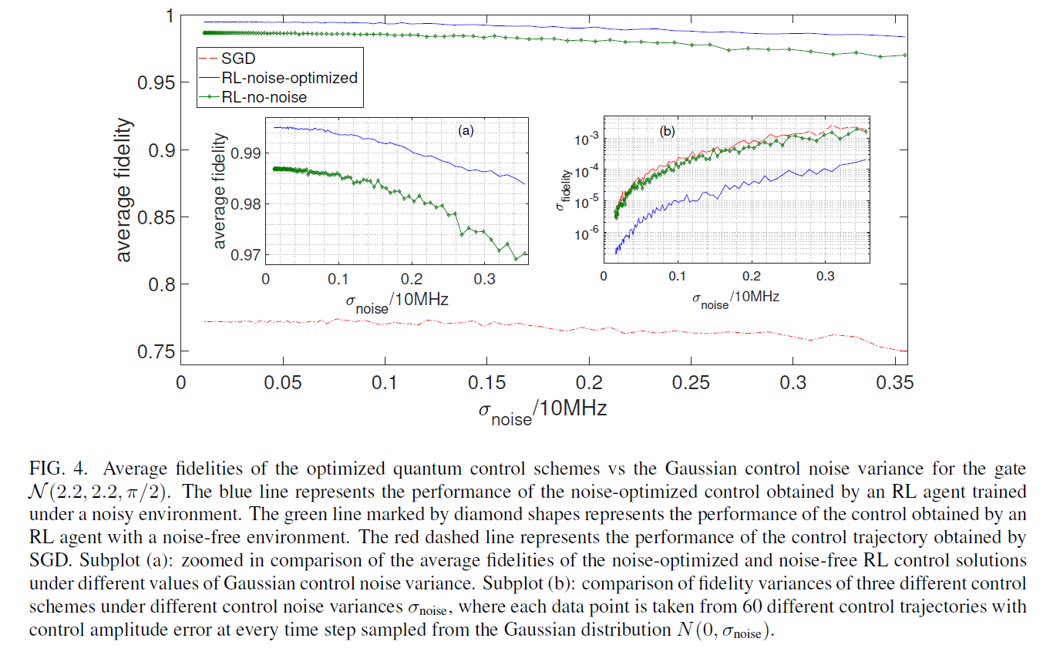
Average fidelity
[2]

Slide 35
GitHub Repo
https://github.com/ruiw0509/QC_RL
All progresses will be updated to this repository.
Contributors welcome!

Slide 36
References
[1] Microsoft: DAT257x, Reinforcement Learning Explained, url: https://courses.edx.org/courses/course-v1:Microsoft+DAT257x+1T2019a/course/
[2] Niu, M.Y., Boixo, S., Smelyanskiy, V.N. and Neven, H., 2019. Universal quantum control through deep reinforcement learning. In AIAA Scitech 2019 Forum (p. 0954).
[3] Schulman, J., Moritz, P., Levine, S., Jordan, M. and Abbeel, P., 2015. High-dimensional continuous control using generalized advantage estimation. arXiv preprint arXiv:1506.02438.
[4] Schulman, J., Levine, S., Abbeel, P., Jordan, M. and Moritz, P., 2015, June. Trust region policy optimization. In International Conference on Machine Learning (pp. 1889-1897).

Slide 37
Thanks for listening!

