Slide 1


RU 24/7 Food Hub: A Student-Centered Business Solution
Dhruvi Patel, Ariel Zilinski, Jun Park, Suhas sunkari

Slide 2
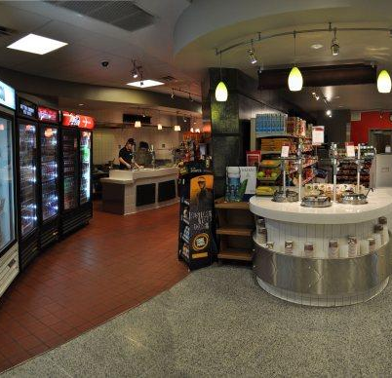
Business Concept
RU 24/7 Food Hub is a student-focused, on-campus convenience food service
Provides meals, snacks, and everyday essentials
Operates 24 hours a day, 7 days a week
Designed to serve students with busy or irregular schedules
Located conveniently across Rutgers campus

Slide 3
Customer Value Proposition
Affordable, student-friendly pricing compared to delivery apps
24/7 availability to accommodate all student schedules
Convenient on-campus locations (no transportation needed)
Faster service than dining halls and off-campus options
Reliable access to meals, snacks, and essentials anytime

Slide 4
Vision, Mission, Core values
Vision Statement: To become the most accessible and trusted food service for students on college campuses
Mission Statement: RU 24/7 Food Hub serves Rutgers students by providing affordable meals, snacks, and essentials around the clock through convenient on-campus locations
Core Values:
Accessibility
Affordability
Reliability
Community
Safety
Sustainability

Slide 5
Financial & Strategic Objectives
Financial Objectives:
Achieve steady revenue growth through high student demand
Maintain low operating costs to keep prices affordable
Reach profitability within first year of operation
Strategic Objectives:
Expand to multiple Rutgers campuses
Build strong brand recognition among students
Increase customer loyalty and repeat usage
Leverage technology for faster service (mobile ordering, kiosks)

Slide 6



Corporate Social Responsibility
Offer affordable food options to support student well-being
Reduce food waste through efficient inventory management
Use eco-friendly packaging to minimize environmental impact
Partner with local suppliers when possible
Create student employment opportunities
Rationale:
  Supports the Rutgers community
  Enhances brand reputation
  Aligns with sustainability and ethical business practices

Slide 7
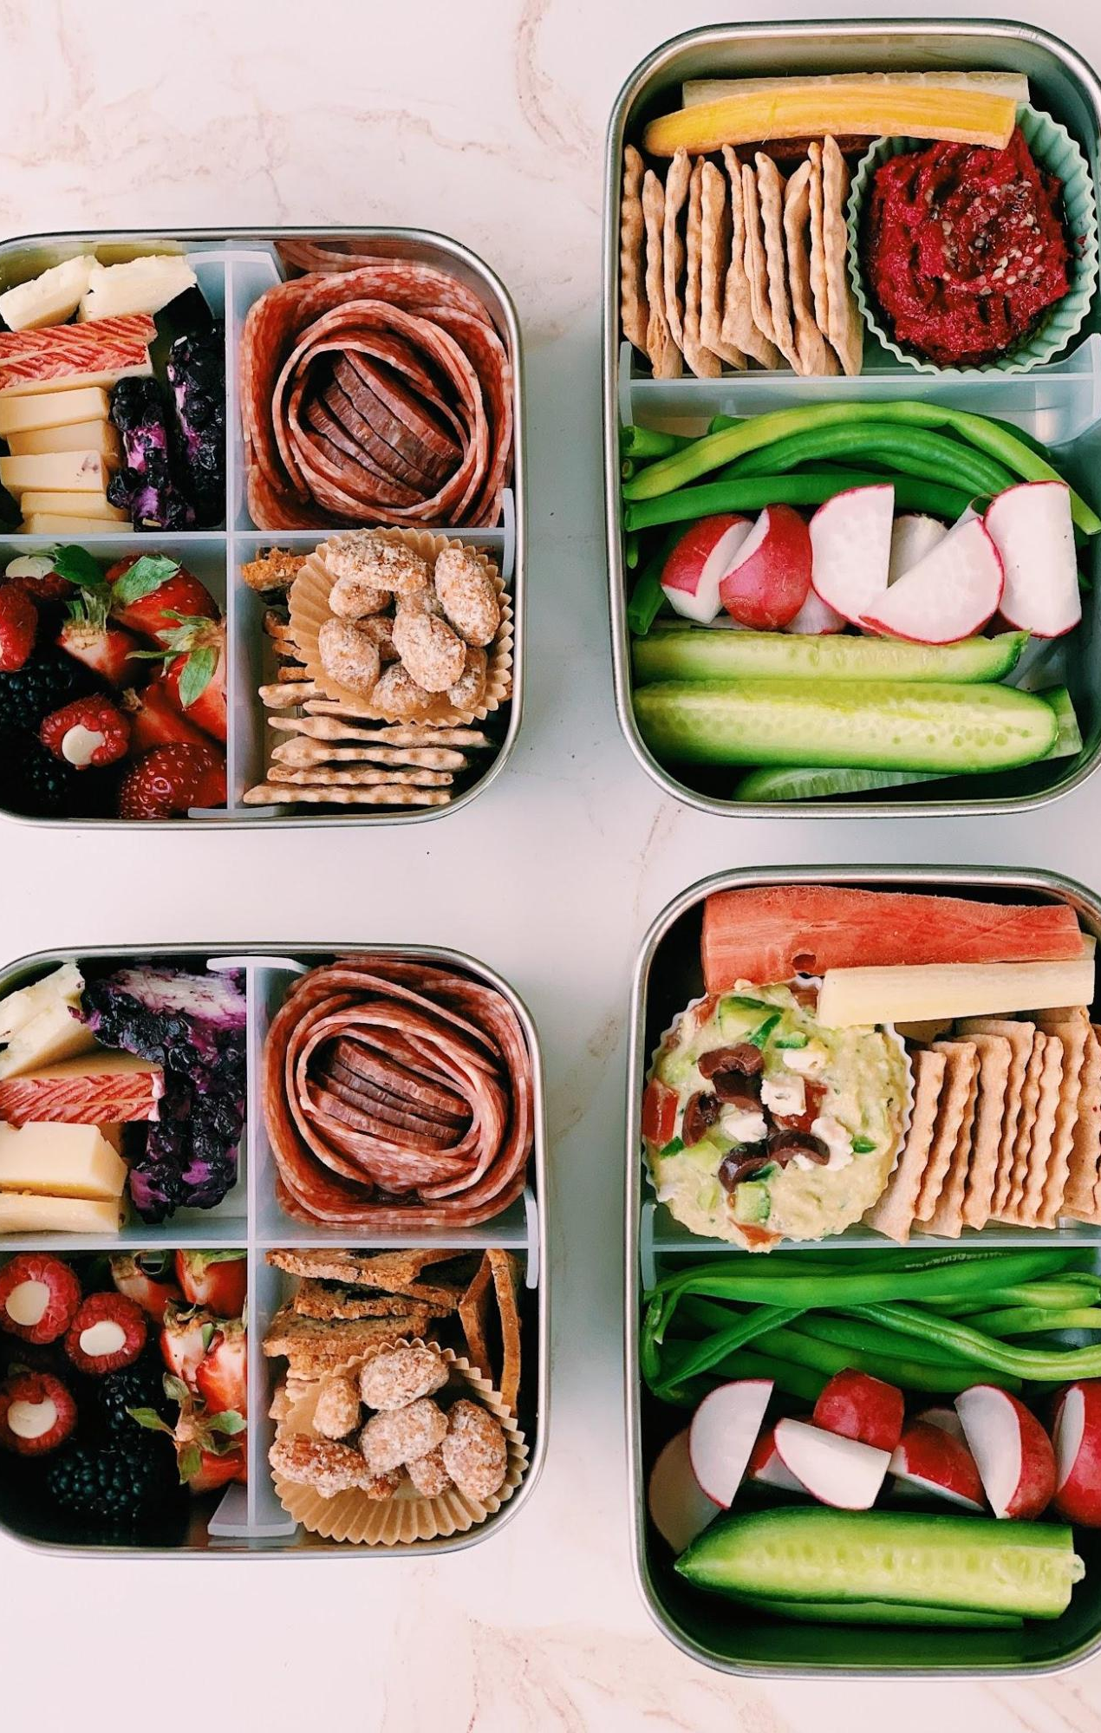
New product/service
Late-night meal combos (budget-friendly bundles)
Grab-and-go snack stations for quick access
Essential items (drinks, hygiene products, school supplies)
Mobile ordering system for faster pickup
Value:
  Saves time for students
  Increases convenience
  Encourages repeat purchases

Slide 8
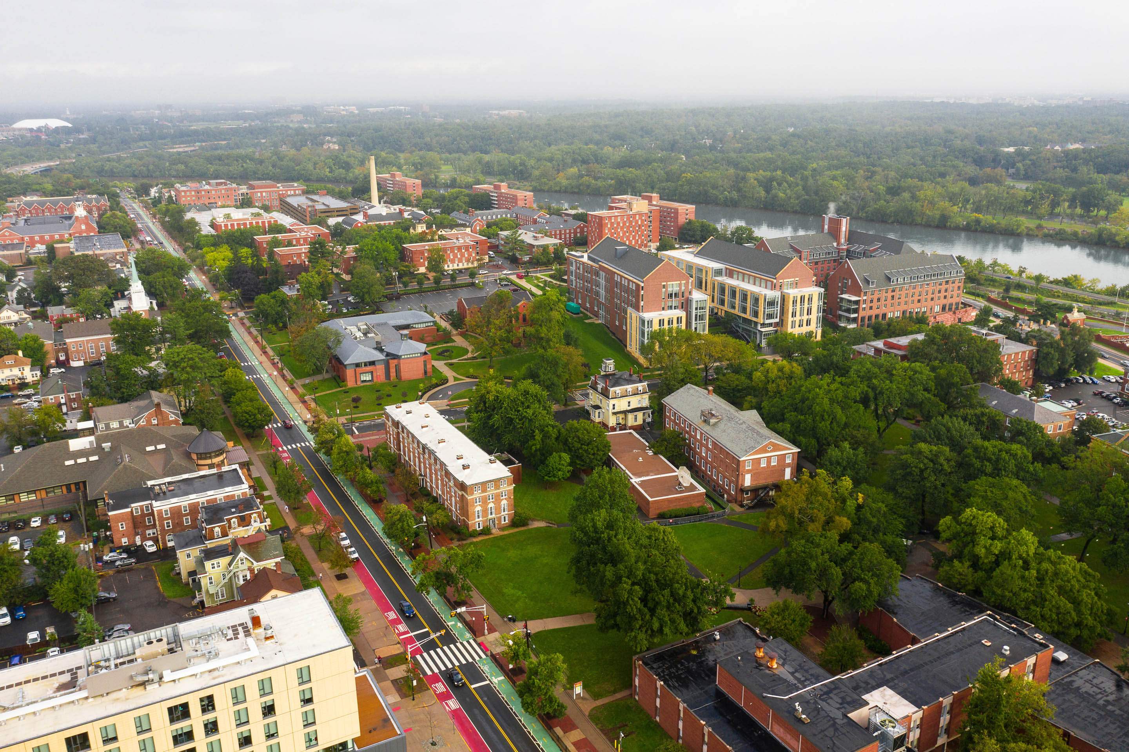
National Expansion strategy
Expand to other large university campuses across the U.S.
Target schools with high student populations and limited late-night food options
Use a standardized model for easy replication
Approach:
  Open company-owned locations initially
  Later expand using franchise opportunities
Rationale:
  High demand for affordable, accessible food
  Scalable business model
  Strong growth potential beyond Rutgers

Slide 9
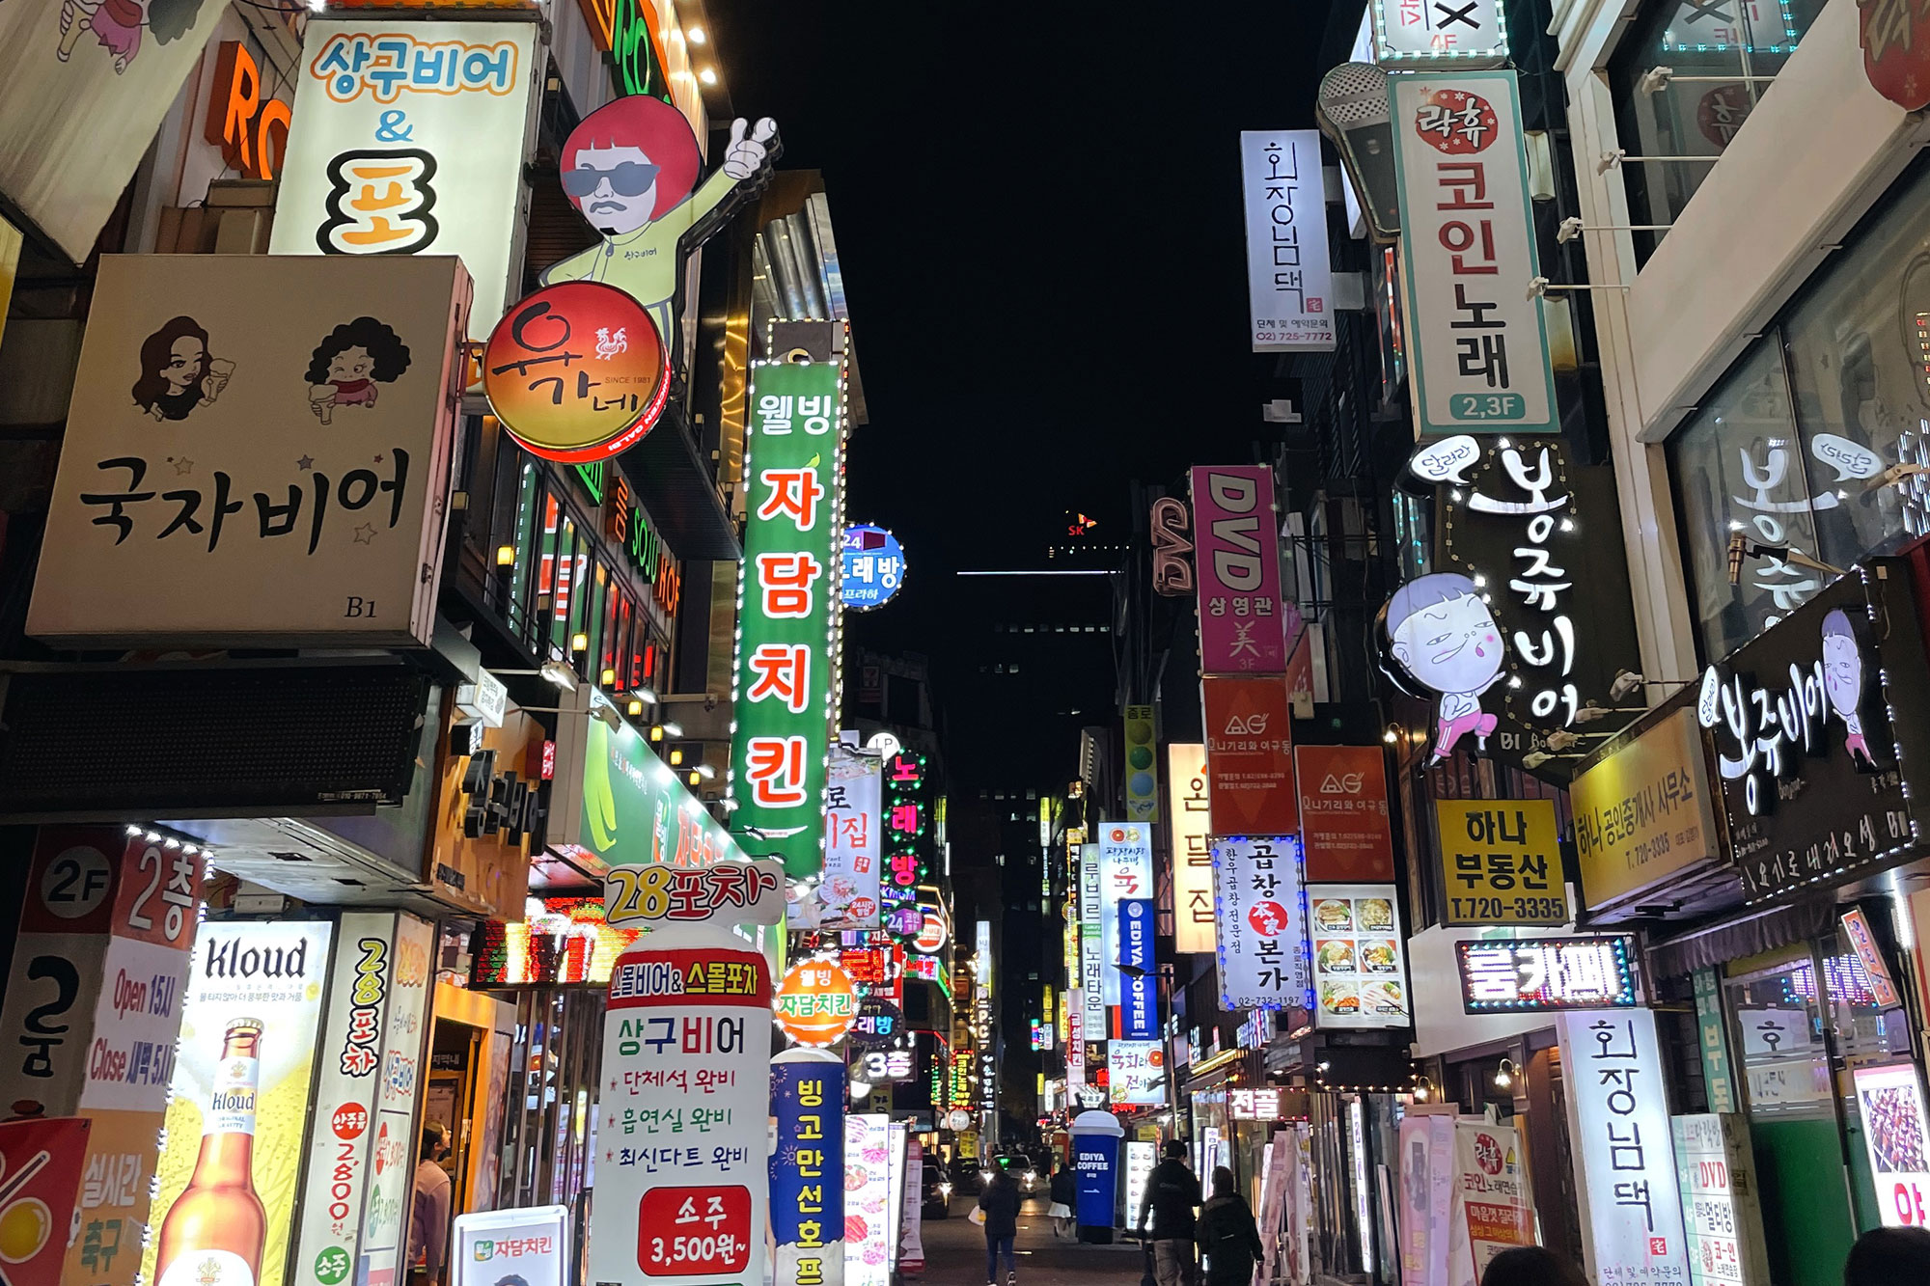
Global Expansion: South Korea
Why South Korea?
South Korea presents a unique synergy with our 24/7 model. A high density of student night-owls and an existing culture of late-night commerce minimize the friction of entry.
Opportunities:
  Extremely safe urban environments for late-night ops
  High tech-literacy for automated payment systems
Challenges:
  Low individualism requires group-based loyalty tactics
  Deep cultural focus on long-term community presence
  More competition

Slide 10


Global Entry & Strategy
Combo Strategy
Customization Focus: While operational systems are standardized, inventory is 100% customized to local Korean culinary preferences to ensure cultural resonance.
Franchise Model
Local franchisees will navigate complex municipal regulations and campus specificities better than foreign management, ensuring a steady royalty stream with reduced risk.
Rationale: Food is deeply cultural. A franchise-led customization approach allows for rapid scaling while respecting the nuanced taste profiles and social norms of the Korean student population.

Slide 11
Key Job Role & Hiring Plan
Line Cook / Prep Cook
Position Description
Prepare all menu items quickly and consistently
- Operating cooking stations
Follow food safety and sanitation guidelines
Maintain ingredient levels throughout the shift
Assist in restocking and prepping for next shift
Keep kitchen clean, organized, and running efficiently
Qualifications
Experience in food service or kitchen prep
Ability to work in a fast-paced environment
Knowledge of basic cooking techniques
Strong multitasking and time management skills
Must follow safety and cleanliness standards
Ability to work late-night shifts
Hiring Plan:
-Post job on Rutgers Handshake & campus job boards
Promote through social media (Instagram, TikTok)
Word-of-mouth + student referrals
On-campus flyers
Compensation:
-$21/hour salary
- Performance-based bonuses
-Free meals

Slide 12

Employee Motivation Initiatives
1. Implement a Shift-Based Bonus System - Employees receive small bonuses for perfect attendance, high customer reviews, or picking up extra shifts. This rewards reliability and shows appreciation for the people keeping the kitchen running.
2. Offer Free Meals and Shift Perks - Every employee gets a free meal during their shift and discounted food when off the clock. This is especially motivating for students working long late-night shifts.
3. Create a Clear Promotion Path - Line cooks and cashiers can work up to “Shift Lead” positions based on performance. Having a growth path gives employees a reason to stay.
4. Add More Schedule Flexibility - Use an easy online scheduling system and let workers swap shifts. This reduces stress, especially for college students balancing classes.
5. Monthly Recognition Program - “Employee of the Month” wall + $50 gift card. Recognition boosts morale and motivates others to step up

Slide 13
Employee Departure Announcement
Dear RU 24/7 Food Hub Team,
I wanted to let you know that two of our team members have decided to leave their positions effective immediately. While we’re disappointed to see them go, we respect their decisions and wish them all the best.
Their departures also made it clear that we need to do more to support and motivate everyone on our team. Over the next few weeks, we will be rolling out several new programs, including shift-based bonuses, free employee meals, clearer promotion opportunities, more flexible scheduling, and a monthly recognition program. Our goal is to make sure you feel valued, supported, and heard.
We appreciate all the hard work you put in every day, and we’re committed to making this a place where you enjoy working. If you have questions, ideas, or feedback, my door is always open.
Thank you for everything you do.
The Management Team

Slide 14
Employee Engagement Strategies
- Foster a supportive and inclusive workplace culture
- Maintain open communication channels between employees and management
- Conduct employee surveys and feedback sessions to understand employee concerns and improve workplace conditions.
- Provide flexible scheduling to accommodate academic responsibilities
- Implement team-building activities to strengthen collaboration
- Recognize employee contributions to boost morale and retention
- Give employees more autonomy and involvement in decision-making related to their work

Slide 15
SIPOC: Student Meal Fulfillment
Suppliers: National food wholesalers (Sysco), local organic farms, commercial kitchen equipment vendors, and university facility management.
Inputs: High-quality ingredients, 24/7 kitchen and service staff, secure point-of-sale (POS) systems, and campus utility infrastructure.
Process : Menu design > Strategic ingredient sourcing > Kitchen preparation > Order placement > Meal production > Quality check > Final delivery.
Outputs: Nutritious 24-hour hot meals, accurate order fulfillment, and a safe, reliable late-night campus dining environment.
Customers: On-campus students, faculty working late hours, and university security personnel seeking convenience and quality.

Slide 16
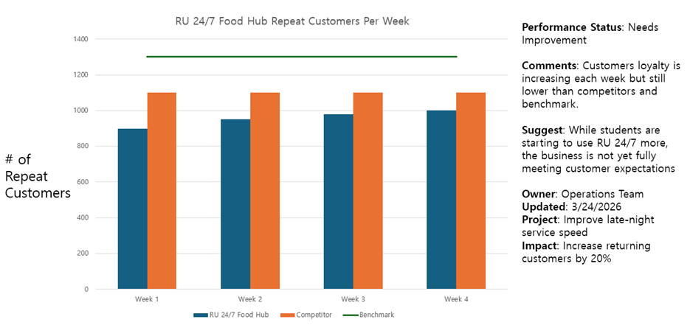
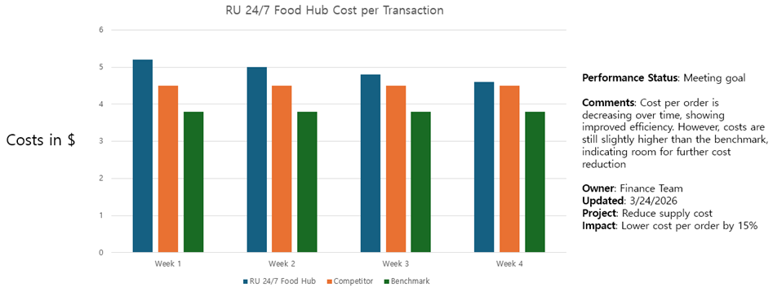
Performance Measurement Charts

Slide 17
Key Process Improvement Initiative
(Digitalization of the Kitchen Fulfillment Process)
Initiative: Kitchen Operations Digitalization (KOD).
Change Strategy: Eliminating manual paper tickets in favor of a synchronized Kitchen Display System (KDS) and automated inventory tracking.
Performance Goal: Achieve a 98% order accuracy rate and reduce peak-hour wait times by 15%.
Completion Target: Fully implemented and optimized by December 31, 2026

Slide 18
Strategic Decision: Retain and Expand
Decision: Do Not Sell; pursue International Franchising.
Rationale: The "Night Owl" model is highly scalable. Franchising allows us to expand into high-potential markets like the UK and Canada using local expertise to manage regional legal and cultural risks while we retain brand equity and royalty streams.
Operational Efficiency: By utilizing a franchise entry strategy, we transfer the responsibility for day-to-day management, local labor hiring, and securing regional government licenses to the franchisee. This allow us to scale the "Night Owl" brand across multiple global campuses with significantly lower capital investment and operational overhead than a direct ownership model would require.

Slide 19
Summary of Business Success
Identified Market Gap: Successfully capitalized on the unmet demand for safe, healthy, 24-hour campus dining.
Operational Control: Implemented rigorous Performance Management (SIPOC and WDM) to ensure both high customer satisfaction and lean operations.
Strategic Flexibility: Utilized cultural research to adapt menus and operations to specific international student needs, ensuring long-term global viability.

