Slide 1
Self watering plant Group 12
Bruno Duregon
Justin Patterson
Jon Lampguy
Jian Meng

Slide 2
Design matrix
 |  | Magnetic Gripper | Self Watering Plant | Cleaning Robot | Snack Dispening Machine
Cost | 5 | 1 | 4 | 2 | 4
Feasibility | 5 | 2 | 4 | 2 | 4
Sensor/Actuator Complexity | 2 | 3 | 5 | 2 | 3
Algorithmic Complexity | 3 | 4 | 5 | 1 | 5
Programming Requirements | 5 | 1 | 4 | 1 | 4
Time Commitment | 2 | 2 | 4 | 1 | 2
 | Score | 42 | 93 | 34 | 91

Slide 3
Overview of problem
Making the home garden watering process more efficient
Necessity to water house plants without being present
Rethinking water usage

Slide 4
Solution
Self watering plant system
Periodically checks moisture level
Turns on when moisture level out of bounds
Waters appropriate amount

Slide 5
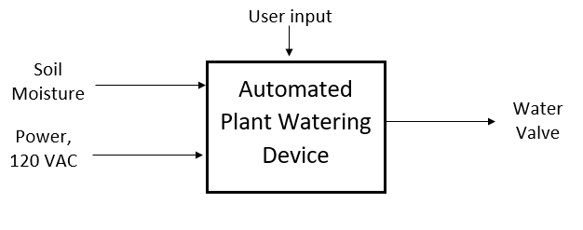
Block Diagram level 0
V DC

Slide 6
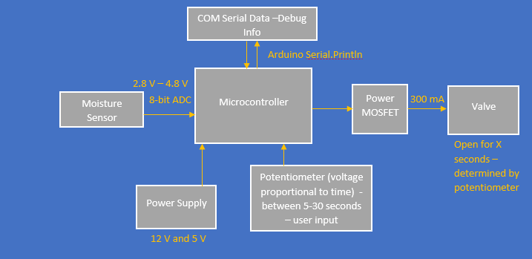
Block diagram level 1

Slide 7
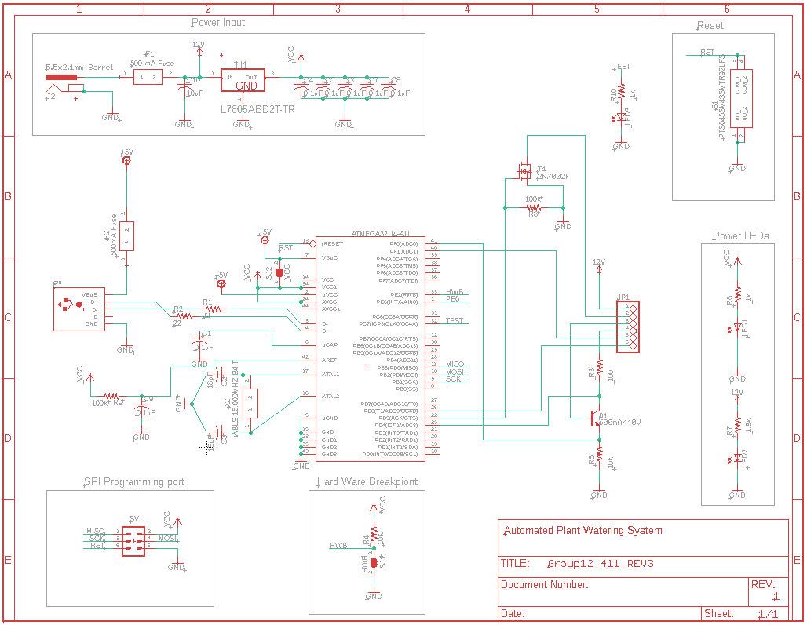

Slide 8
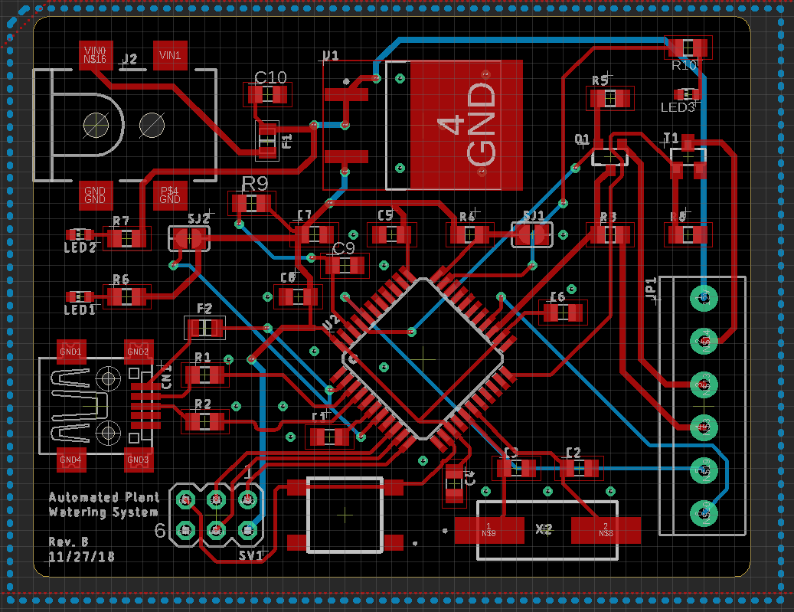
layout

Slide 9
Firmware overview
If moisture reading is lower than set bounds
Water plant for time specified
VerificTime specified by potentiometer (between 5 and 30 seconds)
ation of hardware via testbench
Valve functionalities
Open valve, close valve, test potentiometer
Sensor functionalities
Read sensor once, read sensor x times, read sensor and average

Slide 10
Bill of Materials
Cnt | Part References | P/DNP | Mfg | Mfg PN | Description | Distributor | Dist. PN | Cost Ea. | Cost Ext.
1 | Microcontroller | P | Microchip Technology | ATMEGA32U4-AUR | AVR AVR® ATmega Microcontroller IC 8-Bit 16MHz 32KB (16K x 16) FLASH 44-TQFP (10x10) | Digikey | ATMEGA32U4-AURTR-ND | 3.49 | 3.49
1 | REG | P | STMicroelectronics | L7805ABD2T-TR | Linear Voltage Regulator IC Positive Fixed 1 Output 5V 1.5A D2PAK | Digikey | 497-1170-1-ND | 0.82 | 0.82
1 | Q1 | P | Diodes Incorporated | DMG3406L-7 | N-Channel 30V 3.6A (Ta) 770mW (Ta) Surface Mount SOT-23 | Digikey | DMG3406L-7DICT-ND | 0.53 | 0.53
2 | R1 | P | TE Connectivity Passive Product | CRGP0805F10K | 10 kOhms ±1% 0.333W, 1/3W Chip Resistor 0805 (2012 Metric) Pulse Withstanding Thick Film | Digikey | A130489TR-ND | 0.02397 | 0.04794
1 | R2 | P | TE Connectivity Passive Product | CRGP0805F100K | 100 kOhms ±1% 0.333W, 1/3W Chip Resistor 0805 (2012 Metric) Pulse Withstanding Thick Film | Digikey | A130501TR-ND | 0.02397 | 0.02397
1 | R3 | P | TE Connectivity Passive Product | CRGP0805F100R | 100 Ohms ±1% 0.333W, 1/3W Chip Resistor 0805 (2012 Metric) Pulse Withstanding Thick Film | Digikey | A130465TR-ND | 0.02397 | 0.02397
1 | R4 | P | TE Connectivity Passive Product | CRGP0805F1K0 | 1 kOhms ±1% 0.333W, 1/3W Chip Resistor 0805 (2012 Metric) Pulse Withstanding Thick Film | Digikey | A130477TR-ND | 0.02397 | 0.02397
1 | R5 | P | Vishay Dale | TNPW08051K80BEEA | 1.8 kOhms ±0.1% 0.2W, 1/5W Chip Resistor 0805 (2012 Metric) Anti-Sulfur, Automotive AEC-Q200, Moisture Resistant Thin Film | Digikey | 541-9859-1-ND | 0.63 | 0.63
2 | R6 | P | TE Connectivity Passive Product | CRGP0805F22R | 22 Ohms ±1% 0.333W, 1/3W Chip Resistor 0805 (2012 Metric) Pulse Withstanding Thick Film | Digikey | A130457TR-ND | 0.02 | 0.04
2 | C1 | P | Samsung Electro-Mechanics | CL21A106KOCLRNC | 10µF ±10% 16V Ceramic Capacitor X5R 0805 (2012 Metric) | Digikey | 1276-2399-2-ND | 0.04428 | 0.08856
6 | C2 | P | Yageo | CC0805ZRY5V9BB104 | 0.1µF -20%, +80% 50V Ceramic Capacitor Y5V (F) 0805 (2012 Metric) | Digikey | 311-1361-1-ND | 0.16 | 0.96
2 | C3 | P | KEMET | C0805C220K5GACTU | 22pF ±10% 50V Ceramic Capacitor C0G, NP0 0805 (2012 Metric) | Digikey | 399-8036-1-ND | 0.14 | 0.28
1 | X1 | P | Abracon LLC | ABLS-16.000MHZ-B4-T | 16MHz ±30ppm Crystal 18pF 40 Ohms HC-49/US | Digikey | 535-10226-1-ND | 0.27 | 0.27
2 | JMP | DNP | Vishay Dale | CRCW08050000Z0EA | 0 Ohms Jumper 0.125W, 1/8W Chip Resistor 0805 (2012 Metric) Automotive AEC-Q200 Thick Film | Digikey | 541-0.0ACT-ND | 0.1 | 0.2
1 | LED(Red) | DNP | Lite-On Inc. | LTST-C191KRKT | Red 631nm LED Indication - Discrete 2V 0603 (1608 Metric) | Digikey | 160-1447-1-ND | 0.29 | 0.29
1 | LED(Green) | DNP | Lite-On Inc. | LTST-C190GKT | Green 569nm LED Indication - Discrete 2.1V 0603 (1608 Metric) | Digikey | 160-1183-6-ND | 0.27 | 0.27
1 | I/O | P | Phoenix Contact | 1985234 | TERM BLOCK PCB 6POS 3.5MM GREEN | Digikey | 277-1626-ND | 0.85 | 0.85
1 | Q2 | P | Micro Commercial Co | MMBT3904-TP | Bipolar (BJT) Transistor NPN 40V 200mA 300MHz 350mW Surface Mount SOT-23 | Digikey | MMBT3904TPMSCT-ND | 0.1 | 0.1
1 | SW1 | P | C&K | PTS645SM43SMTR92 LFS | SWITCH TACTILE SPST-NO 0.05A 12V | Digikey | CKN9112CT-ND | 0.17 | 0.17
2 | FUSE | P | Vishay Beyschlag | MFU0805FF00500P100 | FUSE BOARD MNT 500MA 32VDC 0805 | Digikey | MFU0805.50CT-ND | 0.57 | 1.14
 |  |  |  |  |  |  |  |  | 0
 |  |  |  |  |  |  | TOTAL COST: |  | $ 10.25

Slide 11
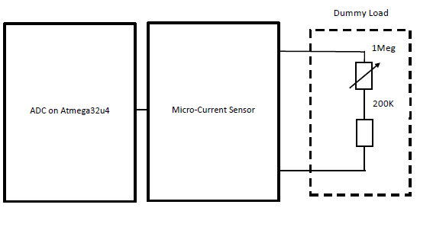
Test plan 1

Slide 12
Test plan 2
PART 1: Initial Power Setup
1. Before Power is provided to the board for the first time a visual inspection should be
performed by a at least one person whom is not the assembler.
2. Power module test:
a. Power cable connection test
b. Voltage regulator test
3. Power up test:
a. Current level test
b. Voltage level check
c. Leakage check: Check movement of current between two conductors that are not
connected.
d. Opens Test: Check to make sure there is current flow from one "node" to the next
for every net on the board, again by measuring the amount of resistance of the
conductor.
e. Shorts Test: Check to make sure that NO current flows between separate nets by
measuring the amount resistance between them.
2
PART 2: System test
The test session of the system includes two parts:
1. Single component test:
a. Check the type and the specification model of the sensor and actuator
b. Test the functionality of the sensor and actuator
2. System test:
a. Design Validation: PCB Layout validation and code verification.
b. Manufacturing test: Detect the manufacturing defects.
c. Function test: Follow the block diagram of the system to make sure each part of
the system can work correctly.
PART 2 - 1 - 1: Moisture sensor test (FINISHED)
A. Structure of the sensor: Moisture sensor is testing the resistance across two probes, the
moisture level of the soil is represented as the voltage value.
B. Test Method: Plug the probes into the different soil samples(each soil sample got
different level moisture), measure the returned voltage level.
C. Results: By increasing the moisture level of the sample soil, the measured maximum
voltage level is about 4.3V(Under 5V power supply voltage). The minimum voltage level
is about 2V.
PART 2 - 1 -
PART 2 - 1 - 2: Actuator Test (FINISHED)
The actuator of the automated watering system is a water valve. The I/O pin of the processor
control the ON and OFF of the actuator. When the moisture level lower than the threshold value,
3
the system will turn on the valve. In other words, the goal of the test is to make sure that the
actuator is capable for multiple ON/OFF in a short time period.
A. Test Method: Connect the valve to the output pin of the circuit, run the “Blink” file on
the circuit.
B. Results: Run the program for 2 minutes, the system will keep turning ON/OFF of the
valve, the valve worked correctly.
PART 2 - 2 - 1: PCB Validation
A. Parts completion check:
a. All major components included?
i. Processor
ii. Power supply (Voltage regulator)
iii. Moisture sensor
iv. The actuator (Valve)
b. All support components included?
i. USB connection port
ii. Power connection port
iii. Reset switch
c. All the surface mount circuit component included?
B. PCB footprint check
C. Parts placement test
PART 2 - 2 - 2: Function Test
A. Debug the code to make sure the code can successfully flash into the processor.
4
B. After the program is flashed to the processor via USB, a test run should be performed.
PART 2 - 2 - 3: Manufacturing Test
A. Follow the schematic and assemble the circuit on each board.
B. Follow the test method in PART 2 - 2 - 2 to test all the prototypes.

Slide 13
what’s left to do
Second revision of board (fix board issue)
Put it in box – waterproof it
More I/O for sensors and plants
Keep historical data for seasonal average
Add wireless communication for viewable diagnostics and statistics (phone, computer, app)

Slide 14
Finalized gantt chart

Slide 15
Lessons learned
Board layout took longer than expected
Be careful with discount power supplies
No lull time – always stay on top of something
Be careful soldering, we only have four boards
Can have greater spacing between traces (it’s okay)
Jon lowkey farts a lot in the lab

Slide 16
IP used
Eagle
LT Spice
Microsoft Office
GitHub
Arduino

