Slide 1
Self watering plant Group 12
Jon Lampman
Bruno Duregon
Justin Patterson
Jian Meng

Slide 2
Overview of problem
Making the home garden watering process more efficient
Necessity to water house plants without being present
Rethinking water usage

Slide 3
Solution
Self watering plant system
Turns on at night
Checks moisture level
Waters appropriate amount
Logs historical data for more accurate watering

Slide 4
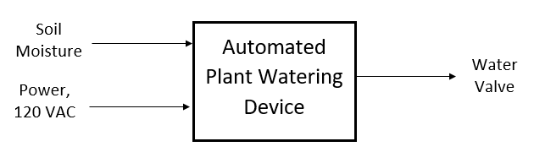
Block Diagram level 0

Slide 5
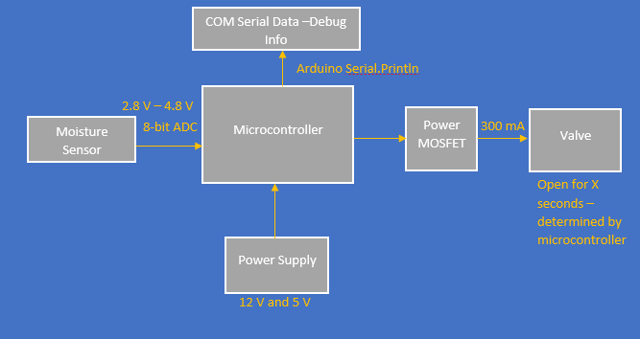
Block diagram level 1

