Slide 1
Self watering plant Group 12
Jon Lampman
Bruno Duregon
Justin Patterson
Jian Meng

Slide 2
Overview of problem
Making the home garden watering process more efficient
Necessity to water house plants without being present
Rethinking water usage

Slide 3
Solution
Self watering plant system
Turns on at night
Checks moisture level
Waters appropriate amount
Logs historical data for more accurate watering

Slide 4
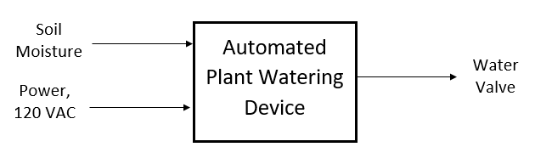
Block Diagram level 0

Slide 5
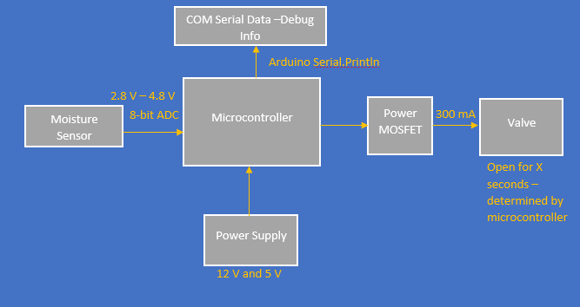
Block diagram level 1

Slide 6
Design matrix
 |  | Magnetic Gripper | Self Watering Plant | Cleaning Robot | Snack Dispening Machine
Cost | 5 | 1 | 4 | 2 | 4
Feasibility | 5 | 2 | 4 | 2 | 4
Sensor/Actuator Complexity | 2 | 3 | 5 | 2 | 3
Algorithmic Complexity | 3 | 4 | 5 | 1 | 5
Programming Requirements | 5 | 1 | 4 | 1 | 4
Time Commitment | 2 | 2 | 4 | 1 | 2
 | Score | 42 | 93 | 34 | 91

Slide 7
Solution
Self watering plant system
Turns on at night
Checks moisture level
Waters appropriate amount
Logs historical data for more accurate watering

