Slide 1

Microsoft Azure Arc site manager for AWS – POC
James Penn III
Technical Expert, Cloud Engineer
July - 2023

Slide 2
Microsoft Azure Arc Proof of Concept Contents
Introduction
Challenge
Purpose
Azure Arc Overview
Azure Arc Key features and benefits
Extra Benefits (Infrastructure as Code)
What can you do with Azure Arc-enabled servers?
Security and Compliance
Infrastructure Discovery
Architecture
Pricing
Microsoft Azure Arc Monthly Estimate

Slide 3
Introduction
Challenge
If the need arises that we must convert to Microsoft AZURE, due to the upcoming merger
How would we convert the following resources:
Kubernetes AWS EKS to Azure AKS
AWS EC2 to Azure VM’s
Database’s
Infrastructure as code
Purpose:
This presentation will cover a Microsoft Azure POC solution for leveraging Microsoft Azure Arc in our AWS environment.
To simplify complex and distributed environments across clouds, data centers, and edge, Azure Arc enables the deployment of Azure services anywhere and extends Azure management to any infrastructure. Customers can manage their virtual or physical machines running Windows or Linux at any location, just like any other Azure resource. From the Azure Portal, customers can organize, govern and secure all their resources across their environments through a familiar and unified experience.

Slide 4
Azure Arc Overview
Microsoft Azure Arc can help us manage Windows Server instances, Linux instances, Kubernetes clusters, VMware vSphere, SQL, and connected data sources as if they are running in Azure.
Azure Arc simplifies governance and management by delivering a consistent multi-cloud and on-premises management platform.
Azure Arc provides a centralized, unified way to:
Manage your entire environment by projecting your existing non-Azure and/or on-premises resources into Azure Resource Manager.
Manage virtual machines, Kubernetes clusters, and databases as if running in Azure.
Use familiar Azure services and management capabilities, regardless of where your resources live.
Continue using traditional ITOps while introducing DevOps practices to support new cloud-native patterns in your environment.
Configure custom locations as an abstraction layer on top of Azure Arc-enabled Kubernetes clusters and cluster extensions.

Slide 5
Azure Arc Key features and benefits
Implement consistent inventory, management, governance, and security for servers across your environment.
Configure Azure VM extensions to use Azure management services to monitor, secure, and update your servers.
Manage and govern Kubernetes clusters at scale.
Use GitOps to deploy configurations across one or more clusters from Git repositories.
Zero-touch compliance and configuration for Kubernetes clusters using Azure Policy.
Run Azure data services on any Kubernetes environment as if it runs in Azure (specifically Azure SQL Managed Instance and Azure Database for PostgreSQL server, with benefits such as upgrades, updates, security, and monitoring). Use elastic scale and apply updates without any application downtime, even without continuous connection to Azure.
Create custom locations on top of your Azure Arc-enabled Kubernetes clusters, using them as target locations for deploying Azure services instances. Deploy your Azure service cluster extensions for Azure Arc-enabled data services, App services on Azure Arc (including web, function, and logic apps) and Event Grid on Kubernetes.
Perform virtual machine lifecycle and management operations for VMware vSphere and Azure Stack HCI environments.
A unified experience viewing your Azure Arc-enabled resources, whether you are using the Azure portal, the Azure CLI, Azure PowerShell, or Azure REST API.

Slide 6
Extra Benefits: (Infrastructure as Code)
Azure Arc allows users to manage AWS resources by connecting them to Azure. This connection creates a representation of the AWS resources in Azure, which can then be managed using Azure services..
01
Using Azure Arc will allow us to utilize Terraform for infrastructure as code when deploying resources.
02
The tool required to do this is called:
04
Azure Resource Manager (ARM) Template Converter tool
This can also be done using Azure Blueprints
Using Azure Arc will allow us to utilize Terraform for infrastructure as code when deploying resources.
We will be able to use the ARM converting tool to convert (AWS cloud formation templates) into Terraform modules and create our Infrastructure as code
03

Slide 7
Infrastructure Registration
Registration:
Step 1: Connect servers to Azure Arc. This process is called onboarding.
After onboarding a server to Azure Arc, it becomes a connected machine and is treated as an Azure resource. You can manage that resource using standard Azure tools and policies.
Each of your onboarded machines is:
Assigned a Resource ID.
Managed as part of a resource group inside a subscription.
Able to use standard Azure constructs, such as applying tags or Azure Policy.
To onboard a server, you must install the Azure Connected Machine agent. This installation connects your machines to Azure Arc-enabled servers. The Azure Connected Machine agent currently supports the following versions of the Windows and Linux operating systems:
Windows Server 2008 R2 SP1, 2012 R2, 2016, 2019, and 2022, including Server Core installations
SUSE Linux Enterprise Server (SLES) 12 and 15
Red Hat Enterprise Linux (RHEL) 7 and 8
Amazon Linux 2
Oracle Linux 7 and 8

Slide 8
What can you do with Azure Arc-enabled servers?
When you onboard a server, it becomes a connected machine represented by a corresponding Azure resource. That resource has a unique resource ID property. It belongs to a resource group inside a subscription, and it can benefit from Azure management features such as Azure Policy and tags.
After you connect your machines to Azure Arc-enabled servers, you can perform the following configuration management tasks:
Assign Azure Policy guest configurations using the same process you use when assigning policies to your Azure VMs.
Monitor your connected machines' guest operating system performance.
Use Azure Monitor for VMs to:
Discover application components.
Monitor these applications' processes and dependencies.
Simplify deployment with other Azure services. For example, implement Azure Automation State Configuration and Azure Monitor Log Analytics workspace. Including use of the Azure Resource Manager (ARM) Template Converter tool.

Slide 9
Security and Compliance
This proposed architecture addresses security and compliance requirements.
Connecting Azure Arc-enabled servers to Microsoft Defender for Cloud, helps you start collecting security-related configurations and event logs so you can recommend actions and improve your overall Azure security posture.
Microsoft Defender for Cloud is a cloud security posture management (CSPM) and cloud workload protection (CWP) solution. Microsoft Defender for Cloud finds weak spots across your cloud configuration, helps strengthen the overall security posture of your environment, and can protect workloads across multi-cloud and hybrid environments from evolving threats.
Will Microsoft Azure Arc traverse the internet?
Using Microsoft Private link or Private Endpoint service (similar to AWS Endpoints), will restrict Azure Arc and other Azure tools from traversing network traffic over the public internet.
Azure Arc Private link scope enables you to access Azure PaaS services and Azure-hosted customer-owned services over a private endpoint in your virtual network in the same region
The private endpoint uses a private IP address from your virtual network, which effectively brings the service into your virtual network instead of sending data over the internet (See Infrastructure Discovery)

Slide 10
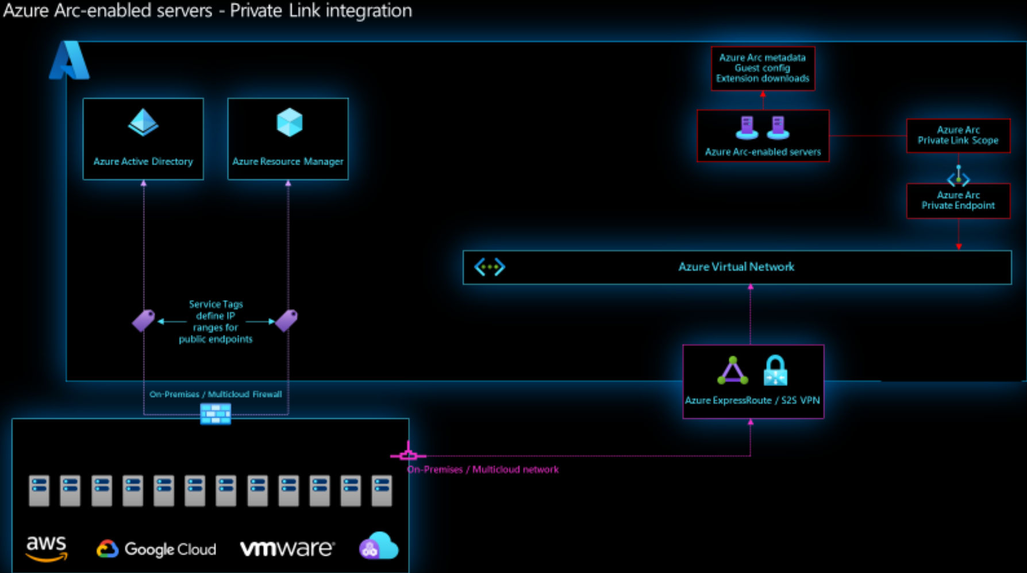
Infrastructure Discovery
Private endpoint is only used for incoming traffic to your app. Outgoing traffic won't use this private endpoint
Azure Arc uses a Private Link Scope resource to associate a private endpoint with the non-Azure servers that will use the private endpoint. You’ll also have to set up
a site-to-site VPN or
Express Route circuit
to connect your Azure virtual network with the network where your non-Azure servers are connected.

Slide 11
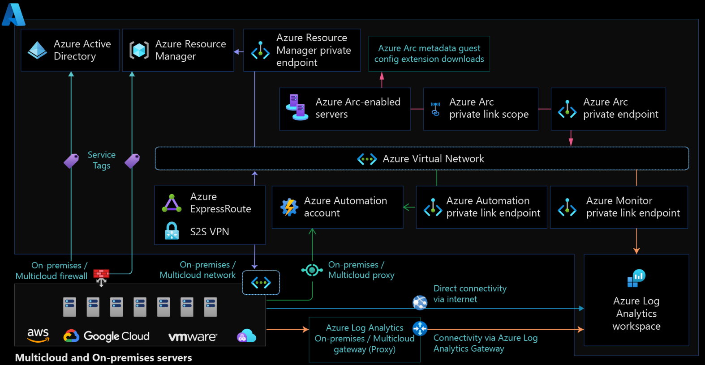
Architecture
The following diagram shows a conceptual reference architecture for the connectivity of Azure Arc-enabled servers.

Slide 12
Pricing
Azure Arc-enabled servers
The following Azure Arc control plane functionality is offered for servers outside of Azure at no extra cost:
Resource organization through Azure management groups and tags
Searching and indexing through Azure Resource Graph
Access and security through Azure Role-based access control (RBAC)
Environments and automation through templates and extensions
Update management
Below Azure Arc-enabled services will be charged consistently as in the original Azure services, excluding any customer-provided infrastructure costs.
Azure Arc-enabled SQL Server
Azure Arc-enabled SQL Managed Instance
Azure Arc-enabled PostgreSQL (Preview)
Other arc-enabled services that become available
Add-on Azure management services used on Azure Arc-enabled servers, such as (Azure Policy guest configuration, Azure Monitor, Microsoft Defender for Cloud, etc.) are charged for Azure Arc-enabled servers when enabled

Slide 13
Microsoft Azure Arc Monthly Estimate
Service type | Description | Estimated monthly cost | Estimated upfront cost
Cost Management | No charge for managed Azure spend. 2 Managed AWS | 0.02 | $0.00
Azure Arc | Azure Arc enabled Kubernetes (Gen Purpose) | $6.00 | $0.00
Azure Arc | East US | $0.00 | $0.00
VPN Gateway | VPN Gateways, Basic VPN tier, 730 gateway hours, 10 S2S tunnels, 128 P2S connections, 1 TB, Inter-VNET outbound VPN gateway type | $62.12 | $0.00
Azure ExpressRoute | ExpressRoute, Zone 1, Standard, Metered; 50 Mbps Circuit X 1 circuit, 0 GB in Additional Outbound Data Transfer; Global Reach Add On: Disabled | $55.00 | $0.00
Security | Microsoft Defender for Cloud by Resource | $34.16 | $0.00
 | Total | $157.32 | $0.00

