Slide 1
Mlp_fix, lr = 0.0001

Slide 2
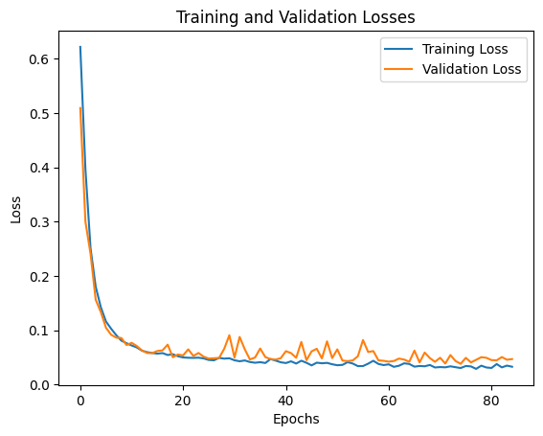
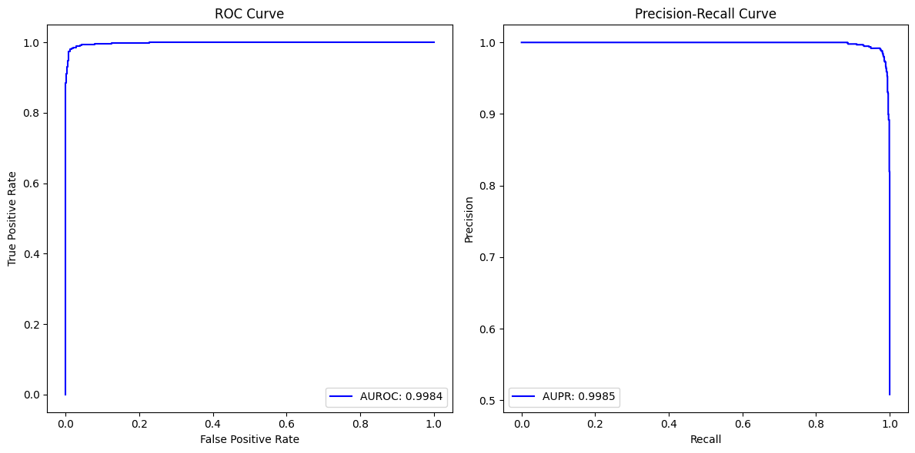
No missingness

Slide 3
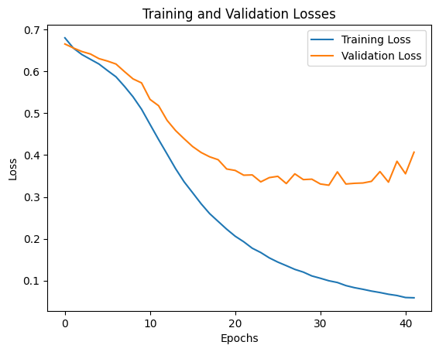
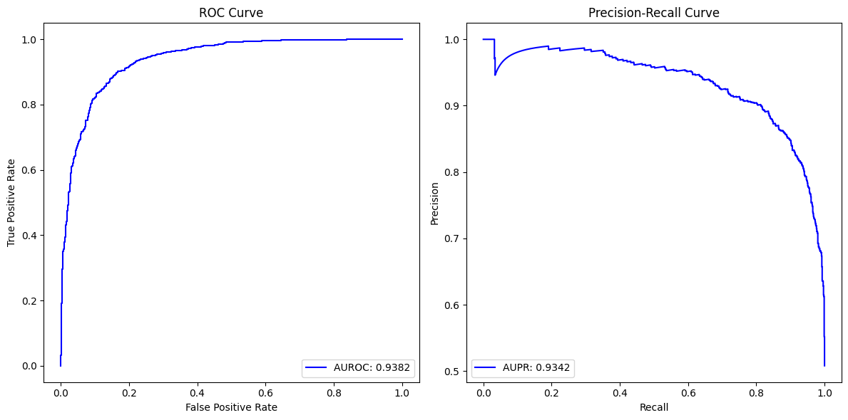
Mcar missingness = 0.3

Slide 4
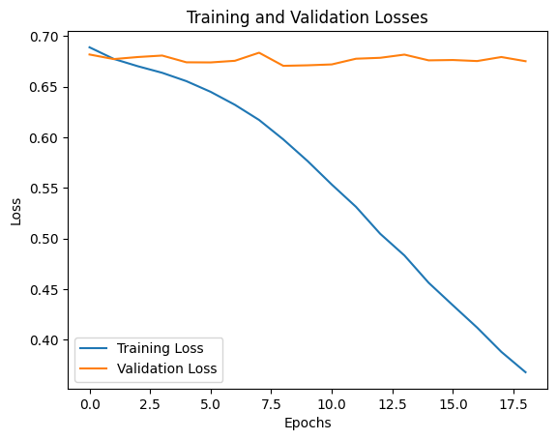
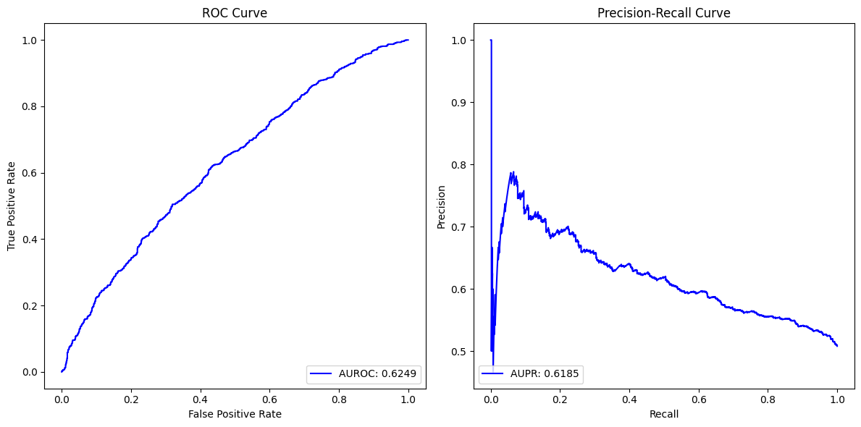
MCAR mssingness = 0.6

Slide 5
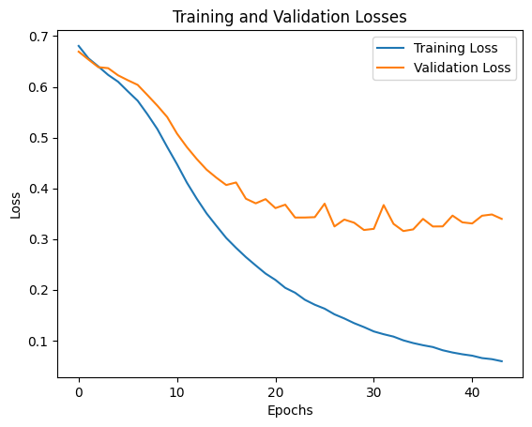
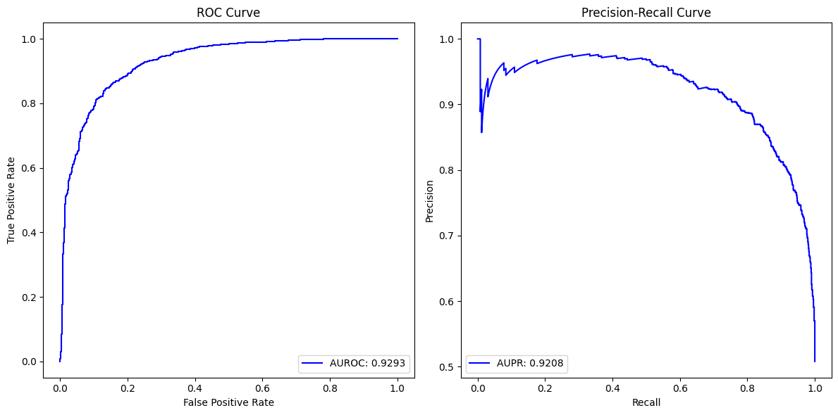
MAR missingness = 0.3

Slide 6
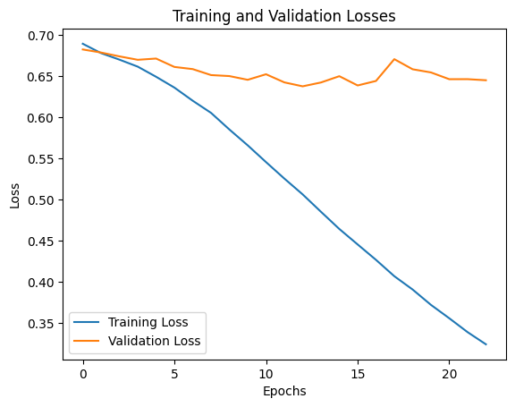
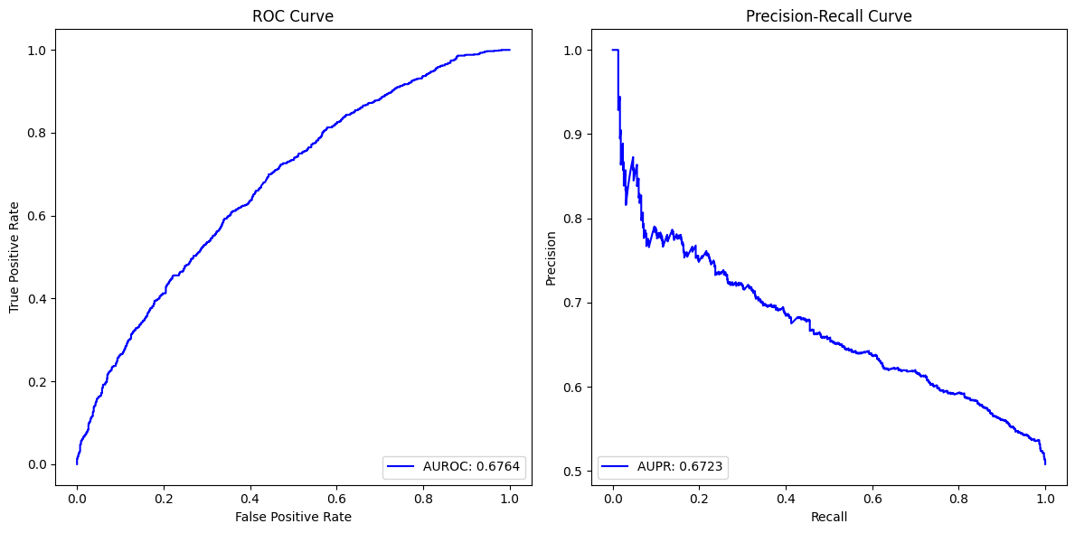
MAR missingness = 0.6

Slide 7
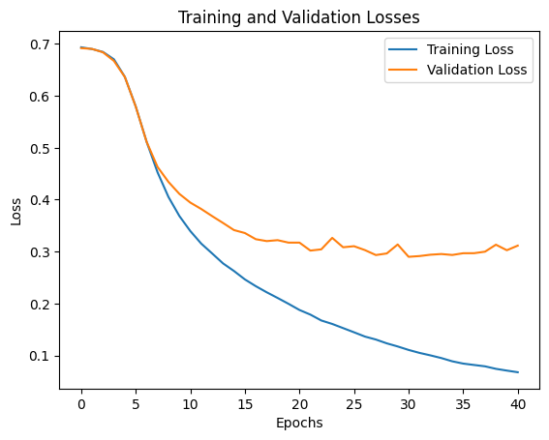
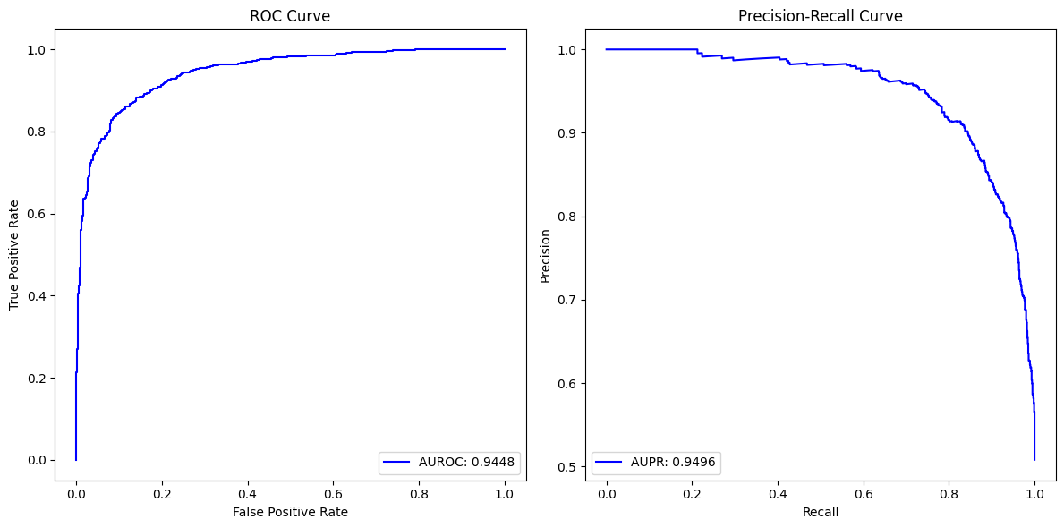
MNAR missingness = 0.3

Slide 8
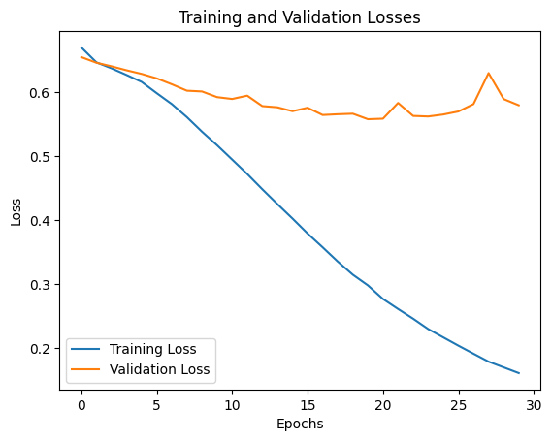
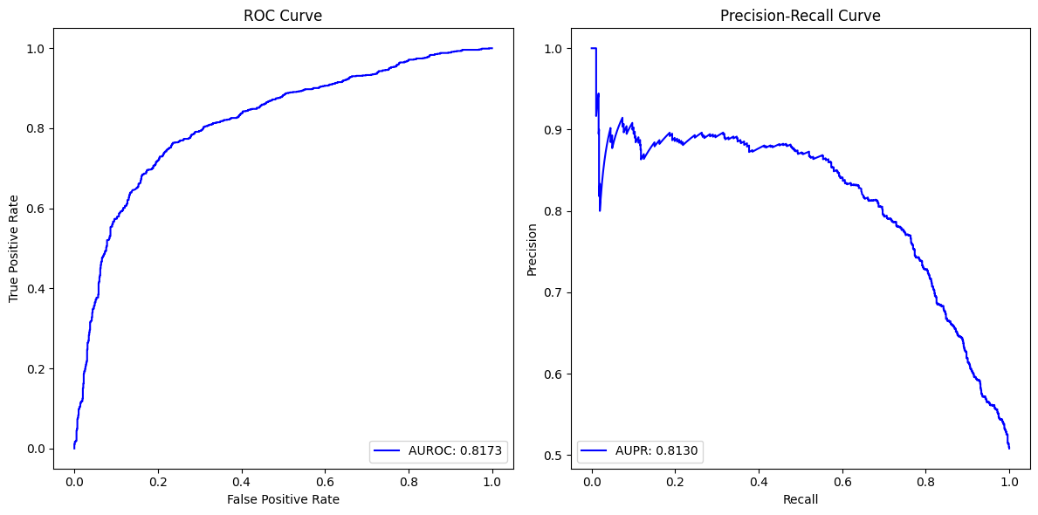
MNAR missingness = 0.6

Slide 9
Mlp_fix
Missingness Type | None |  | MCAR |  | MAR |  | MNAR
Missingness level | - | - | 0.3 | 0.6 | 0.3 | 0.6 | 0.3 | 0.6
AUROC | 0.9984 |  | 0.9382 | 0.6249 | 0.9293 | 0.6764 | 0.9448 | 0.8173
AUPR | 0.9985 |  | 0.9342 | 0.6185 | 0.9208 | 0.6723 | 0.9496 | 0.8130

Slide 10
Lr, learning rate = 0.0001

Slide 11
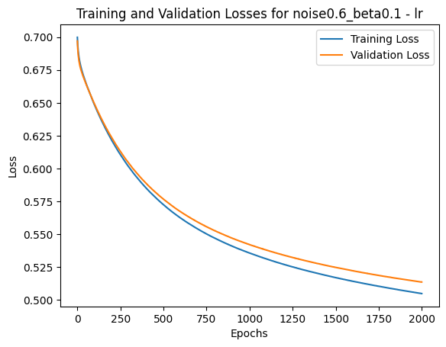
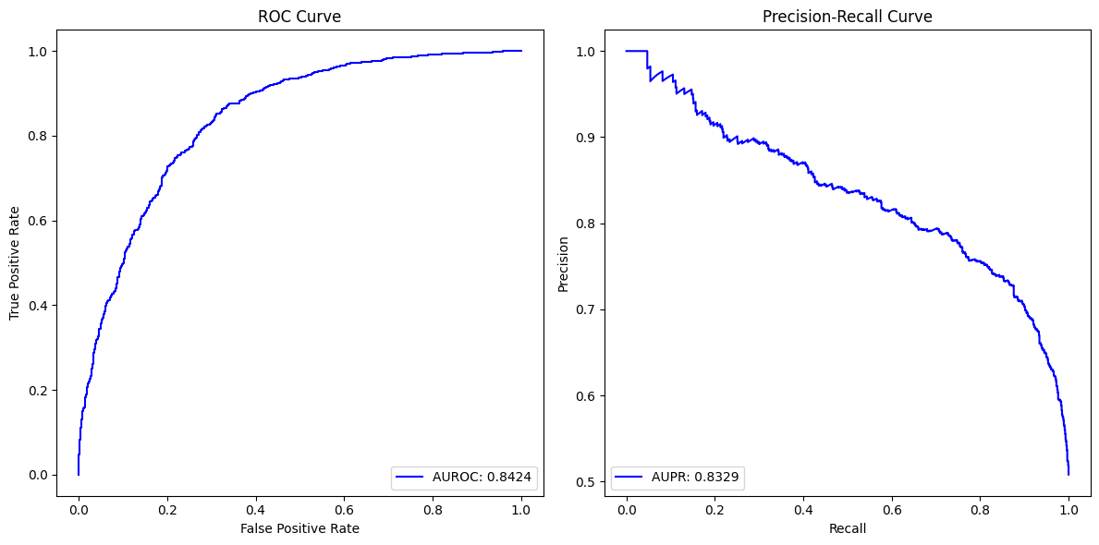
No missingness

Slide 12
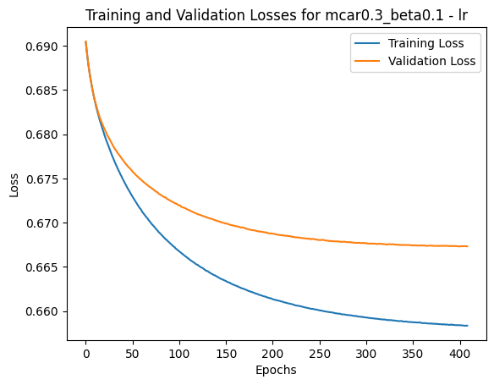
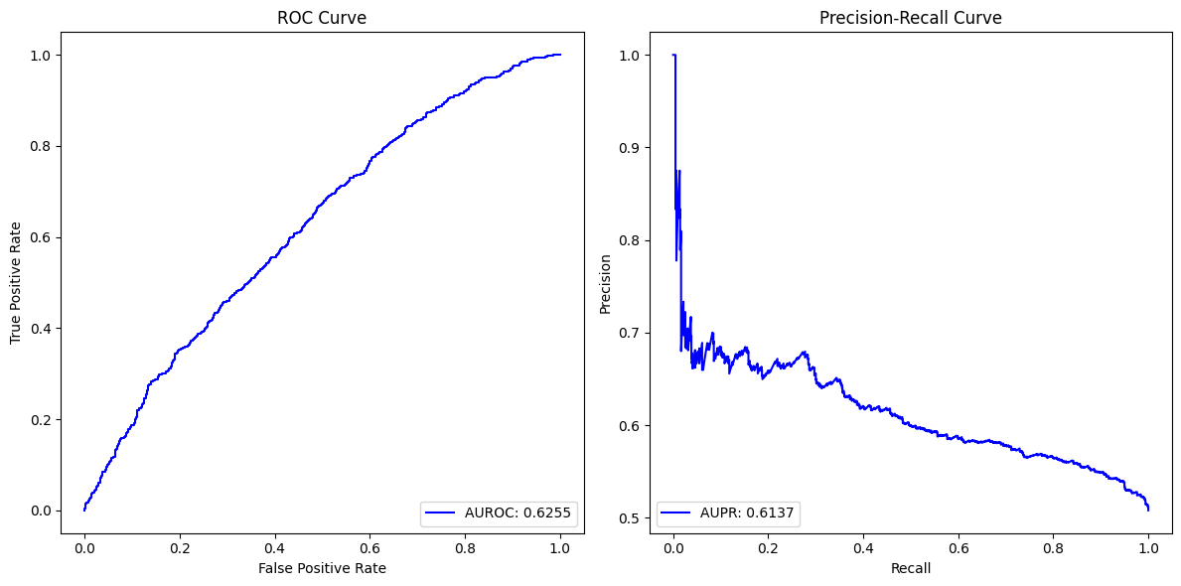
MCAR missingness = 0.3

Slide 13
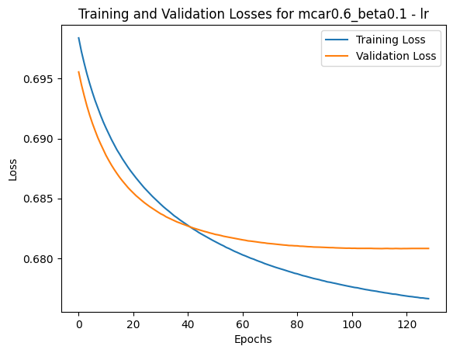
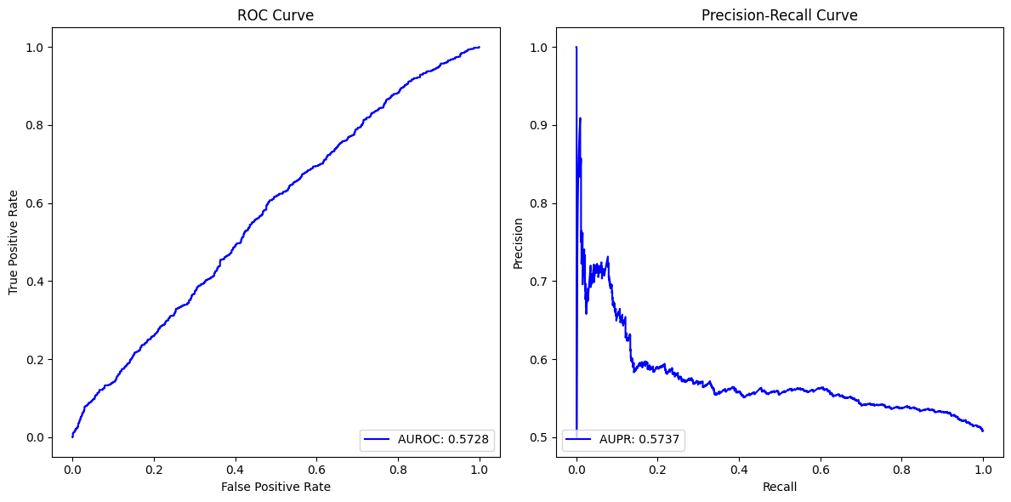
MCAR missingness = 0.6

Slide 14
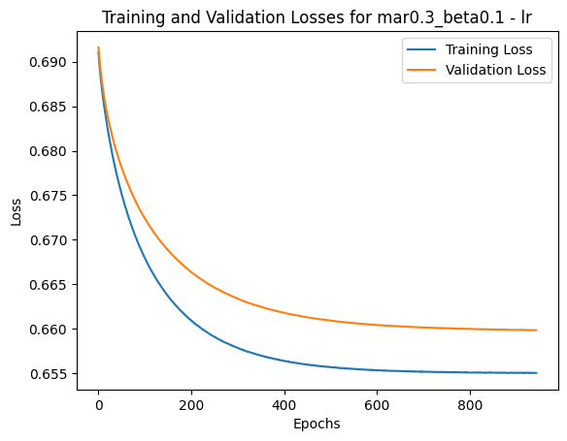
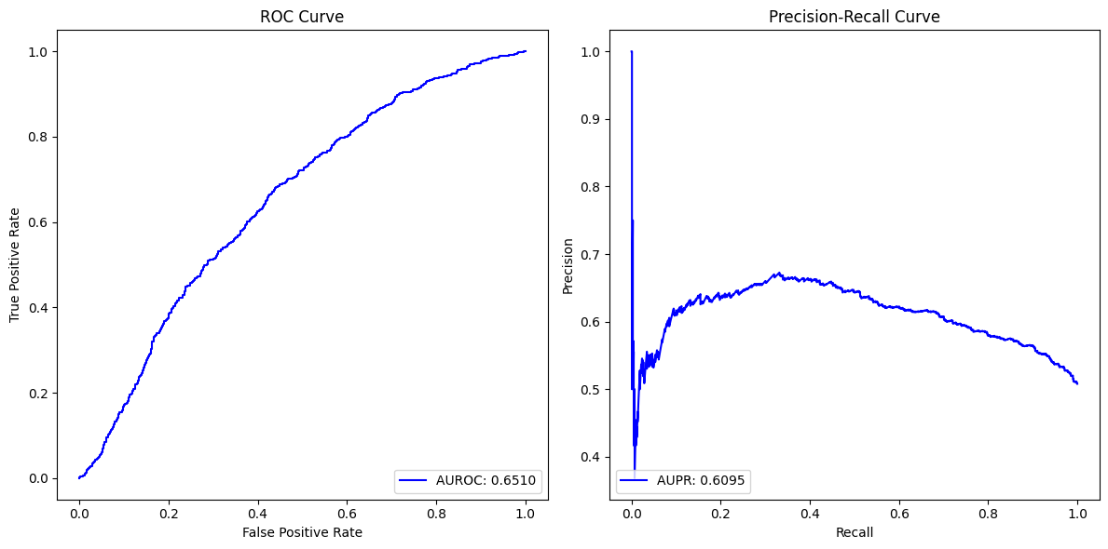
MAR missingness = 0.3

Slide 15
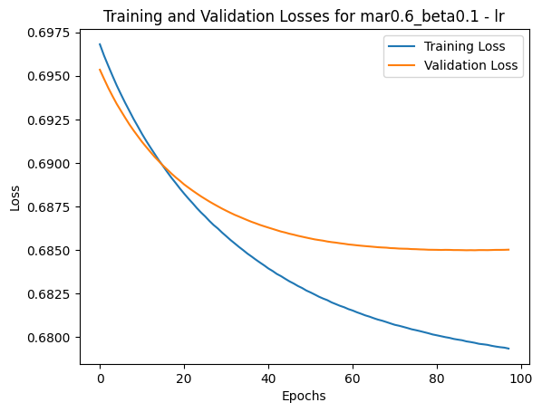
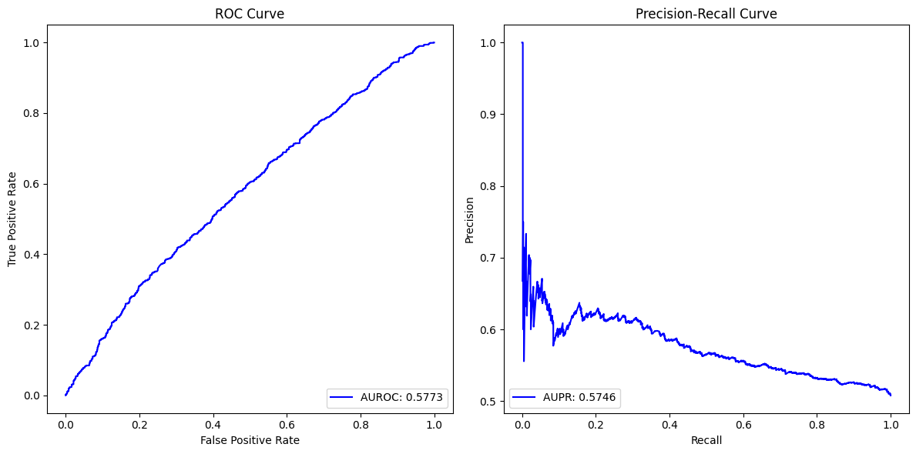
MAR missingness = 0.6

Slide 16
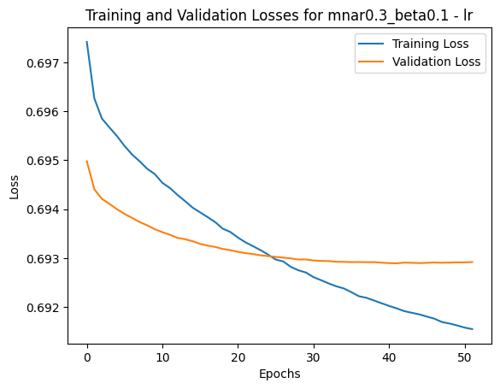
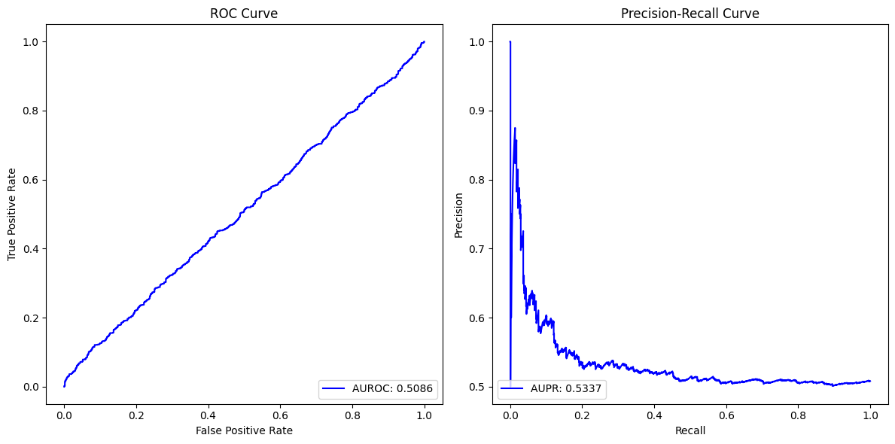
MNAR missingness = 0.3

Slide 17
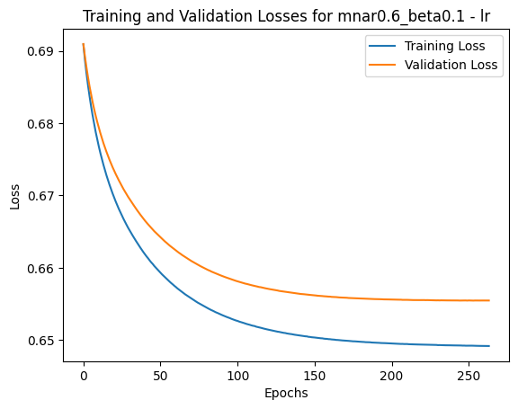
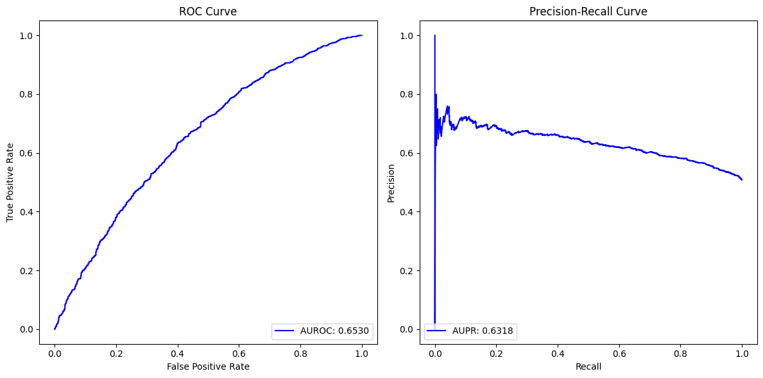
MNAR missingness = 0.6

Slide 18
lr
Missingness Type | None |  | MCAR |  | MAR |  | MNAR
Missingness level | - | - | 0.3 | 0.6 | 0.3 | 0.6 | 0.3 | 0.6
AUROC | 0.8424 |  | 0.6255 | 0.5738 | 0.6510 | 0.5773 | 0.5086 | 0.6530
AUPR | 0.8329 |  | 0.6137 | 0.5728 | 0.6095 | 0.5746 | 0.5337 | 0.6318

