Slide 1

BANK MARKETING USING ML APPROACH
Final Project (DS 8015)
Presenters,
Jay Patel
Notes:
Good Evening everyone. My name is urmi Patel. Me and my team member jay Patel , we are from team 2. today we are going to present our final project for ds 8015 which is bank marketing using machine learning approach.

Slide 2





Problem Definition
Predict whether the client will subscribe for a term deposit or not!
Advantage:
Financial institute can decide doing proactive marketing instead of mass marketing
Financial institute can save time, costs and improve the quality of work
Promotion of the Product
Efficiency improvement
Expand marketing campaigns
Cost-effective and Time-Saving
Notes:
Problem definition for the project is , we need to predict whether the client will subscribe for a term deposit or not?
This prediction will be helpful to the financial institutes as improve the quality of production, cost effective and time saving.
In simple term we can say financial institute can decide doing proactive marketing instead of mass marketing.

Slide 3
Project Lifecycle
Dataset
Data Preprocess
Model building
Evaluation
Understanding
Downloading
Loading
Data cleaning
(Check missing value)
(Remove duplicate)
Data converting
(Categorical to
numeric)
Decision Tree
Logistic Regression
MLP
Gaussian NB
KNN
Accuracy
Precision
Recall
F1-Score
MSE
Notes:
Here you can see the project life cycle. First the understanding of dataset, find problem definition and related solution. Then performing data pre processing part by doing data cleaning and converting.
We applied total 5 models on the dataset. And the last one is evaluation of the models.

Slide 4

Work Distribution
Team 2 | Urmi (member 1) | Jay (member 2)
Task 1 | Data understanding and Data cleaning / preprocessing (via zoom meeting)
Task 2 | Model 1 and 2 | Model 3 and 4
Task 3 | Prediction 1 | Prediction 2
Task 4 | Model Comparison and result evaluation (via zoom meeting)
Task 5 | Report writing and ppt making (via Google’s platform)
Notes:
We worked as a team, some of the part we did together, and some are split in an equal part and then review each other work.

Slide 5
Dataset Description
Bank marketing dataset – UCI website
Dataset contains information about Portuguese banking institution including personal and financial information of the bank’s clients
Used bank-additional-full.csv file
Total 21 attributes (columns) and 41188 instances (rows)
Each record has twenty descriptive explanations about the client and one observation of a bank term deposit would be yes or no.
Notes:
Next, the dataset was downloaded from the UCI website . We used bank additional full.csv file. Dataset contains information about Portuguese banking institute.
Our dataset has 21 attributes and forty-one thousand one hundred and eighty-eight instances.
Data set contains 20 descriptive explanations about the clients like client’s age, education n all. And 1 observation for bank term deposit like yes or no.

Slide 6

Data Preprocess
Cleaning
No missing values in the dataset
12 duplicate rows removed (41187 remain)
Label encoding on categorical data such as marital status
Dummy encoding for target variable y (categorical data into binary data)
Eliminated unnecessary columns (16 remain)
Splitting Dataset
80:20 ratio (used sklearn library)
101 random state used for shuffling the applied data
Notes:
In a cleaning phase we check for a missing value, and we found there is no missing values , check for duplicate values and found 12 , so removed 12 rows from the dataset.
Removed unnecessary columns from the dataset so now we continue with 16 columns.
Performed label encoding and dummy encoding.
Next, we split our dataset into 80:20 ratio. At the time of splitting, we took random state 101 to shuffle the applied data.

Slide 7
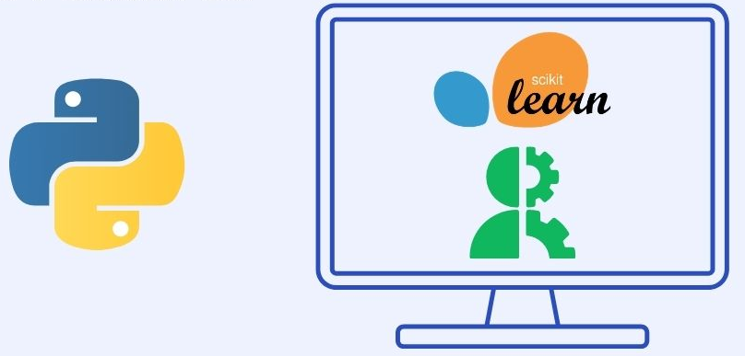

Platform and library
Platform: Google Colab
Language: Python
Libraries: Pandas, NumPy, Sklearn
Notes:
We used google colab for the python coding part and for all models used sklearn library.

Slide 8
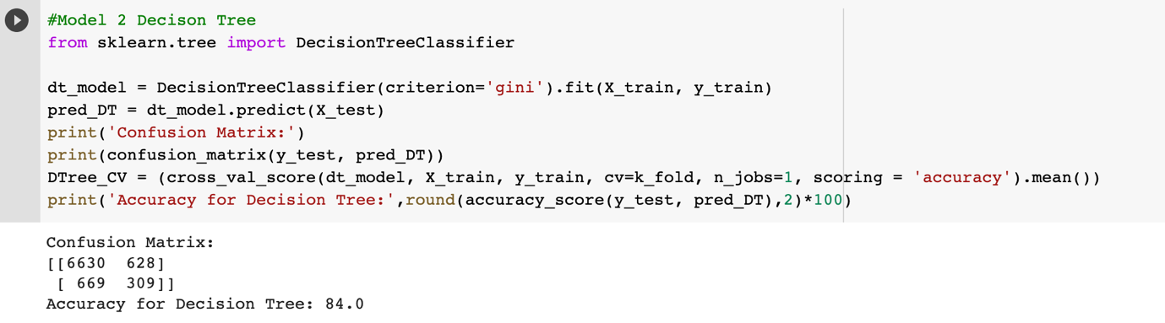
Model 1 – Decision Tree
A decision tree is a flowchart-like structure where internal node represents a "test" on an attribute, each branch represents the outcome of the test, and each leaf node represents a class label.
Parameters:
criterion = gini where the criterion function used to measure the quality of a split
max_depth = default (it will be expanded until all leaves are pure)
Notes:
Our first model is decision tree, it is a flowchart like structure where node present a test on an attribute, branch represent outcome of the test attribute and leaf node represent a class label. In parameter We used criterion gini and maximum depth we leave it as a default.
Here Gini Impurity is used in building Decision Trees, to check how the features of a dataset should split nodes to make the tree structure.
We got 84% accuracy and here is the confusion matrix.

Slide 9
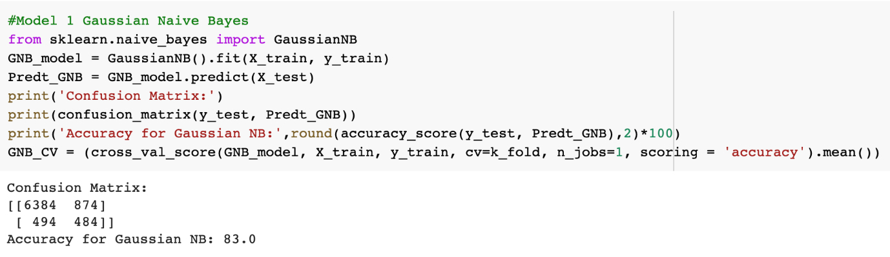
Model 2 – Gaussian Naïve Bayes
Gaussian Naive Bayes is a variant of Naive Bayes that follows Gaussian normal distribution and supports continuous data.
Model works well with large scale of dataset and need less time for training process
Parameters: Default
Notes:
Our second model is gaussian naïve bayes which a variant of naïve bayes and it uses gaussian normal distribution, this model used because it take less time for training and also performs well with large datasets. We choose all the parameters default for this model.
we got 83% accuracy and here is the confusion matrix.

Slide 10
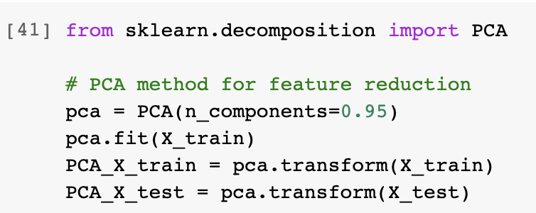
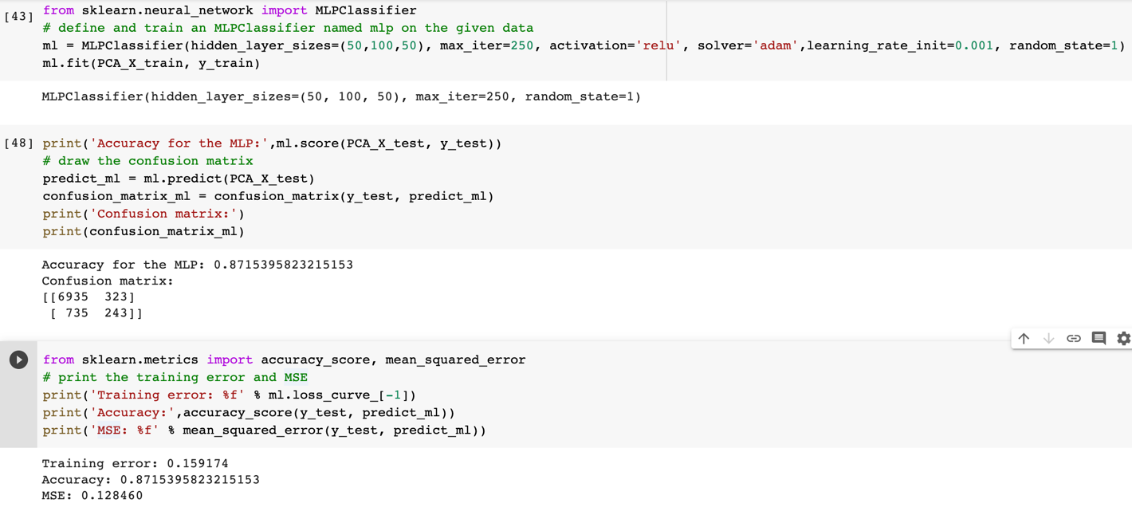
Model 3 – MLP
Dimensionality-reduction method
PCA can reduce the number of features to get a better analysis result
Parameter:
n_components = 0.95
Model uses supervised learning technique named backpropagation for the training purpose.
Parameters:
Maximum iterations: 250
Activation function = relu
Solver = adam
Learning_rate_init = 0.001
Random state = 1
Notes:
Our next third model is, multi layer perceptron. First, we used PCA method that we learned in a class; This method used to reduce the number of features. We set number of component 0.95.
MLP uses backpropagation method which is a supervised learning method. As a parameter we select maximum iterations 250, activation function is relu, solver is adam, initial learning rate 0.001 and random state is 1.
The reason behind using relu as a activation function is it allows models to learn faster while training process compared to other functions like sigmoid and tanh.
For this model we got accuracy 87.15% comparatively higher than previous two models.
Now, jay will continue with the next models.

Slide 11
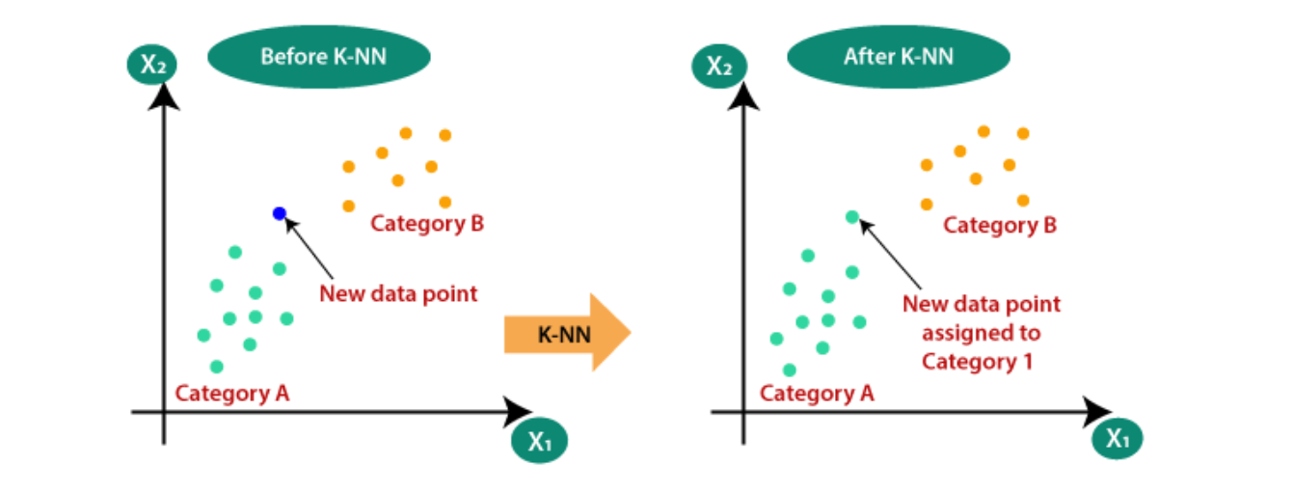
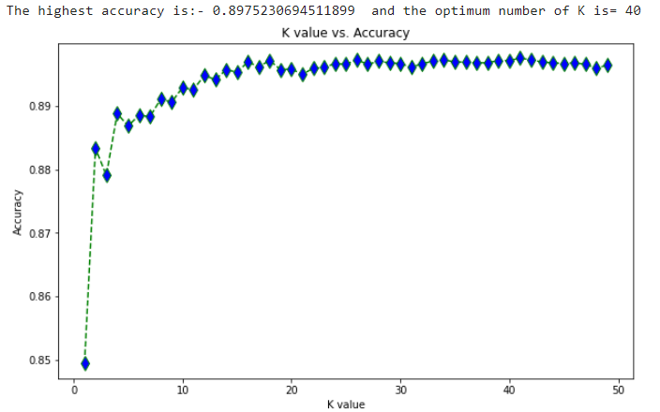
Model 4 – KNN (k nearest Neighbor)
Source: https://medium.com/swlh/k-nearest-neighbor-ca2593d7a3c4
Rote-learning is implemented by this algorithm as training instances are being remembered.
After that, when there is new instance to classify, algorithm searches the training set for the one that is most like the new instance. Then, it classifies that new instance accordingly.
Notes:
For example, there are two classes in the dataset: category A and category B. In our dataset it is yes or no. Later, whenever there is new instance, then that instance is categorized with nearest category.. In python, we tried from k=1 to k=50 and we got the highest accuracy with k=40 values. Therefore, we use k=40 to build a KNN model for our dataset.

Slide 12
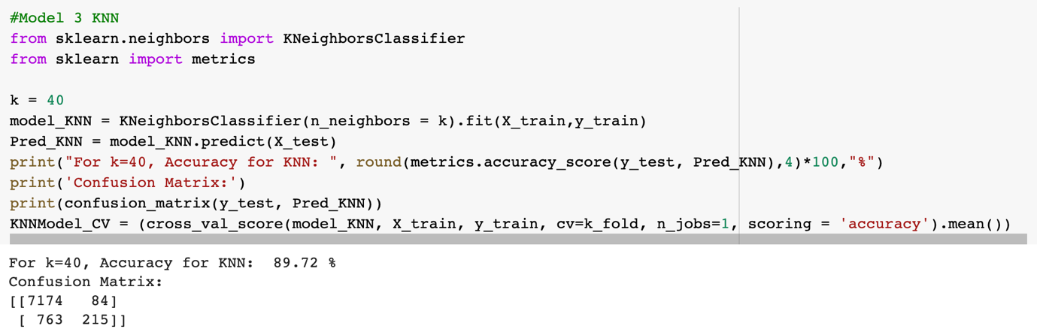
Model 4 – KNN (Cont.)
Parameters: Best k (n_neighbors) value: 40, Weights and leaf size = Default

Slide 13
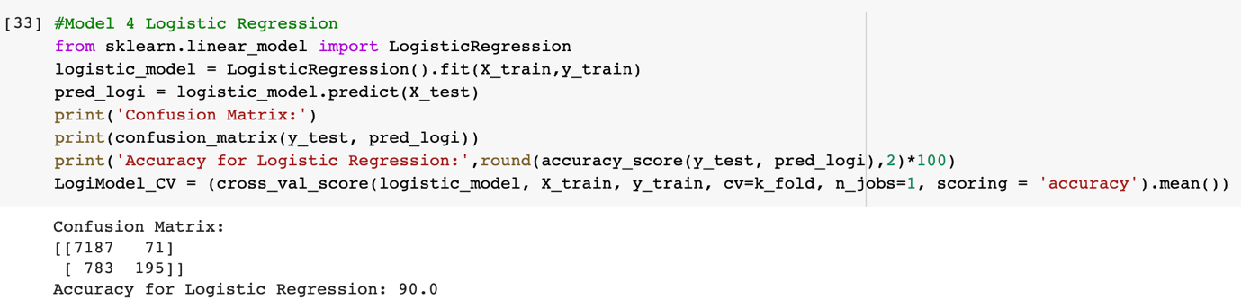
Model 5 – Logistic Regression
Model learns a linear relationship from the dataset and then introduces a non-linearity in the form of the Sigmoid function.
Model calculates the probability of each classification and function called “log-likelihood” is used by the algorithm. It performs better when the independent variables are categorical and a dependent variable is binary
Parameters: solver = lbfgs, Maximum iterations = 100, C = 1.0
Notes:
The strength of this algorithm is satisfied therefore, this algorithm is tested on the dataset.
After performing logistic regression, this is the accuracy and confusion matrix for out dataset.

Slide 14
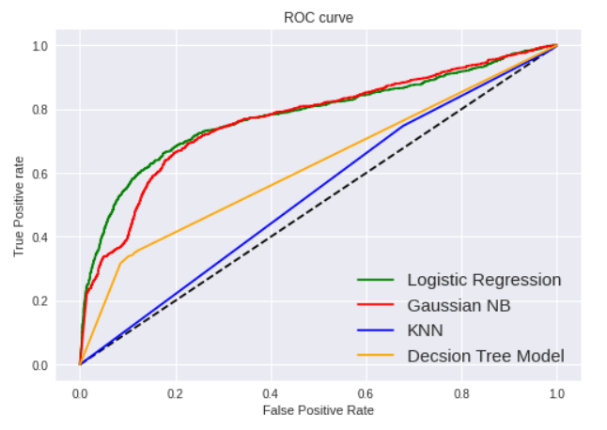
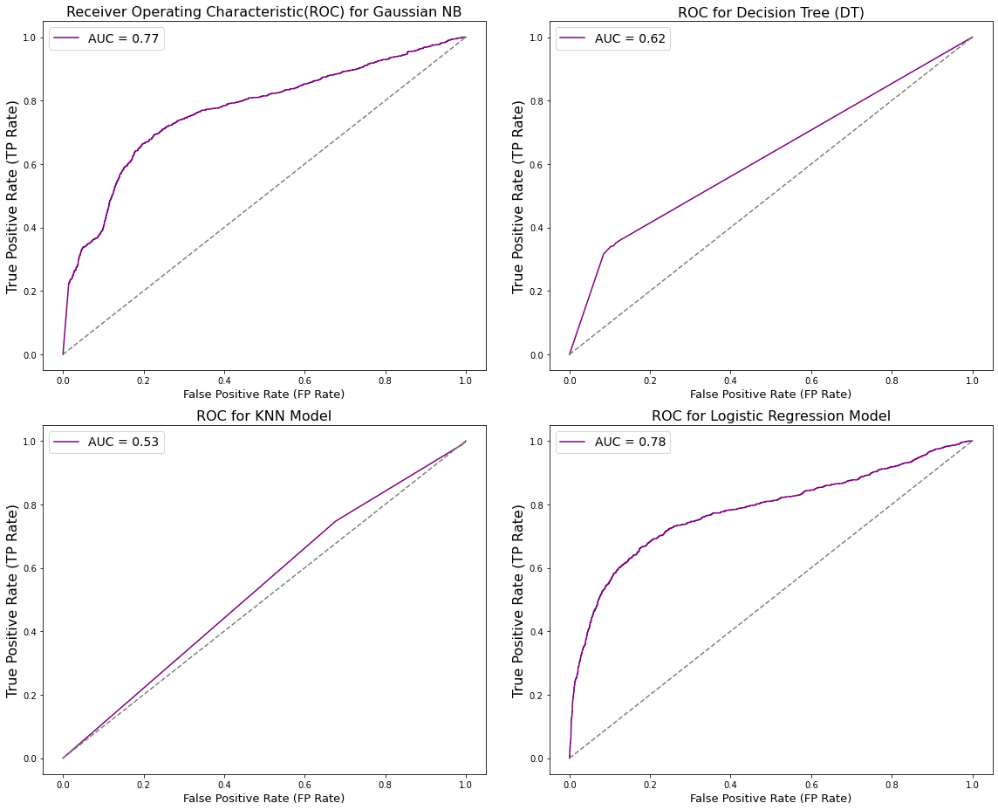
ROC curve for models
Notes:
There are two parameter for ROC curve. One is False positive rate and other one is True positive rate.
By comparing models as per their ROC curves, we can visually decide that logistic regression and Gaussian NB covering more area compare to other two model. AUC score of both models are 0.78 and 0.77 respectively. AUC score closer to 1 consider as excellent model. On the other side. Auc score closer to 0.5 or lower consider as weak model.

Slide 15
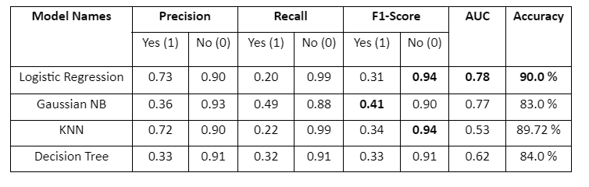
Comparison of models
Model Name | Accuracy
Logistic Regression | 90.0 %
Gaussian NB | 83.0 %
KNN | 89.72 %
Decision Tree | 84.0 %
MLP | 87.15 %
The highest accuracy we got for the logistic regression model.
KNN model gave result comparatively very close to the logistic regression which is 89.72%.
Overall, the lowest accuracy result we got from the naïve bayes model which is somewhat low, just 83%. However, Gaussian NB gave the highest F1–score for yes(1) class.
But comparatively, Logistic regression model performed better when we considered accuracy, AUC And overall f1 – score.

Slide 16
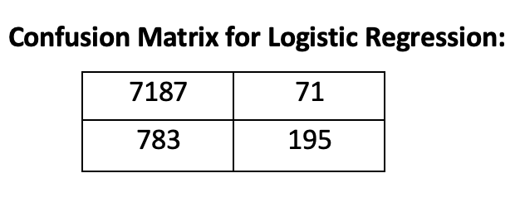
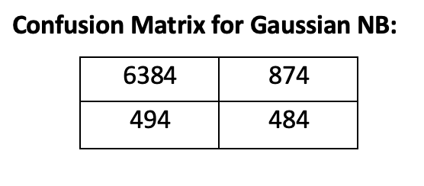
Predictions
For No Class (people who didn't subscribe to bank deposit), Logistic Regression and KNN models performed better than other models with the highest F1 score (0.94).
For Yes Class (people who subscribed to bank deposit), Gaussian NB model performed with the highest F1-score.
Logistic regression model gave the lowest number of false positive.
Notes:
False Positive means model categorized the customers into yes category but, in reality they did not subscribe the term deposit. As per our opinion, model with smaller number of false positive is more useful in our problem. Therefore, by comparing all models, we can say that logistic regression model performed better with only 71 false positive.
Precision:Precision
For all NEGATIVE(0) OR POSITIVE(1) PREDICTIONS by our model, how much we predict correct ?
Recall:
For all NEGATIVE(0) OR POSITIVE(1) REAL VALUES how much we predict correct ?
F1 – score:
F1-Score is a "median" of Recall and Precision.

Slide 17

Summary
After this project we can categorize or identify a group of customers who are most likely to give positive response on similar campaign offers, and this result will help the bank for future work and marketing strategies.

Slide 18


Future Work
Perform data analysis using outliers' techniques
Perform more complex algorithms to get better accuracy result using detailed hyper parameter tunning
If time permits, visualization dashboard for bank marketing dataset will be also created.

Slide 19

Thank you

