Slide 1
DATA ANALYTICS PROJECT
Bank Customer Churn Analysis
1 in 5
customers left the bank
Analytical CRM & Customer Retention Strategy
20.37% churn · 185.59M balance lost
SQL · Power BI · DAX
Prepared by Jaiprakash Sharma
Notes:
Open with the headline: one in five customers left. The next slides walk through the problem, the data, the analysis, and what the bank should do.

Slide 2
The problem: one in five customers leaves
BUSINESS QUESTION
20.37%
churn rate
Who is leaving, why, and how do we keep them?
2,037
of 10,000 customers exited
Objectives
Find the patterns behind churn
Profile who leaves: place, age, gender
Check product and activity behaviour
Score customers by risk level
Guide retention with a live dashboard
185.59M
balance left with them
Notes:
State the problem plainly. 2,037 of 10,000 customers exited, taking 185.59M in balances. The objectives on the left are what the analysis answers.

Slide 3
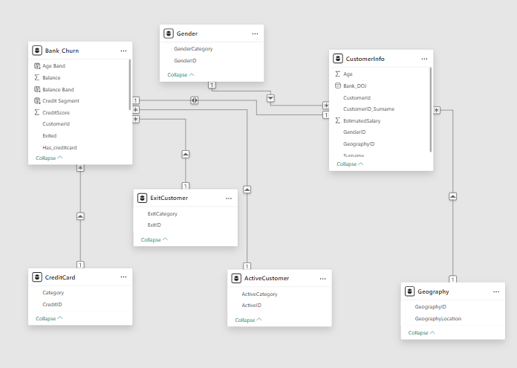
Data overview: 7 tables, one customer key
10,000 customers · no missing values · no duplicate IDs · France, Germany, Spain
Notes:
Two main tables joined on CustomerID: Bank_Churn holds the account and behaviour fields, CustomerInfo holds the demographics. Five small lookup tables decode geography, gender, activity, card and exit flags.

Slide 4
From raw tables to a live dashboard
1
2
3
4
Clean in SQL
Model in Power BI
Build KPIs in DAX
Publish dashboard
Checked 10,000 rows for gaps and duplicate IDs
Joined both main tables with 5 lookups
Churn rate, balance lost, risk level
Slicers for gender, age, country, year
735
The data fix that changes the story
These exited customers were still flagged active. After correcting the flag, only 4,416 customers are active, fewer than half.
Notes:
Quick pipeline view. The key point is the 735 stale active flags: fixing them shows that engagement is a bigger problem than the raw data suggested.

Slide 5
One in five customers has left
20.37%
overall churn rate
2,037 of 10,000 customers exited; 7,963 stayed.
Exited customers took 185.59M in balances with them.
So what: retention protects the deposit base.
Notes:
Overall picture: 20.37% churn. The balance that left with these customers is what makes this a revenue problem, not just a customer-count problem.

Slide 6
Germany churns at twice the rate
32.44%
churn rate in Germany
Germany has 25% of customers but 40% of exits (814 of 2,037).
Its average balance is 119,730, about double France or Spain.
So what: review service and pricing in Germany first.
Notes:
Germany is the outlier. Higher churn plus higher balances means it accounts for 97.97M of the balance lost.

Slide 7
Female customers churn more
25.07%
female churn rate
Male customers churn at 16.46%, a gap of 8.6 points.
Female churn is about 1.5 times the male rate.
So what: check whether products and service fit female customers.
Notes:
This is an association, not a proven cause. It tells us where to look, not why.

Slide 8
Churn peaks at ages 51–60
56.21%
churn in the 51–60 band
Churn rises sharply from age 41, then eases after 60.
Customers aged 18–30 are the most loyal at 7.52%.
So what: build life-stage offers for ages 41–60.
Notes:
Age is the strongest single demographic driver. Over half of customers aged 51–60 left.

Slide 9
Two products is the sweet spot
7.58%
churn with two products
Single-product customers churn at 27.71%.
With three products churn is 82.71%; with four it is 100%.
So what: cross-sell to two products and review 3–4 product bundles.
Notes:
Two-product customers are the most loyal group. Customers with three or more products almost all leave, so the bundle design needs review.

Slide 10
Inactive members churn twice as often
26.85%
churn among inactive members
Active members churn at 14.27%, about half the inactive rate.
After fixing 735 stale flags, only 4,416 customers are active.
So what: activation lowers risk. Card, credit score and tenure barely differ.
Notes:
Card holders churn at 20.18% vs 20.81% without; credit segments range 18.62% to 22.02%; tenure of 3 to 7 years ranges 19.14% to 21.91%. None of these separate churners the way activity does.

Slide 11
Churn is flat despite growth
~20%
churn in every joining year
Every cohort sits between 19.27% and 22.35%.
New customers grew from 1,951 (2016) to 3,313 (2019).
So what: acquisition alone does not fix churn. Retention needs its own programme.
Notes:
The axis starts at zero on purpose, so the flat trend is not exaggerated. Growth in joiners has not improved retention.

Slide 12
A simple risk score finds churners
59.00%
churn in the High-risk group
1 point each: age 46–65, inactive, 3+ products, Germany, one product with a balance.
High risk is 12.95% of customers but 37.5% of churners (764 of 2,037).
So what: give the 1,295 High-risk customers to relationship managers.
Notes:
The rule-based risk level in Power BI separates churners well: 59.00% churn in High versus 9.23% in Low. Medium has 2,781 customers and Low has 5,924.

Slide 13
Conclusion: churn is concentrated, not random
GEOGRAPHY
AGE
ENGAGEMENT
Germany 32.44%
51–60: 56.21%
Inactive 26.85%
vs 16.15–16.67% in France and Spain
the peak band; 18–30 only 7.52%
vs 14.27% for active members
PRODUCTS
GENDER
RISK SCORE
3 products: 82.71%
Female 25.07%
High risk: 59.00%
two products churn least (7.58%)
vs 16.46% for male customers
12.95% of customers, 37.5% of churners
Notes:
Summarise: every finding is backed by a dashboard metric. Churn clusters in Germany, ages 51–60, inactive members, customers with 3–4 products, and the High risk group. Remind the audience these are associations, not proven causes.

Slide 14
Recommendations: six targeted actions
1
High-risk retention
2
Activate inactive
3
Right-size products
Call the 1,295 High-risk customers (59.00% churn).
Re-engage the group churning at 26.85%.
Move single-product customers to two; review 3–4 product bundles.
4
Fix Germany
5
Tailor by segment
6
Monitor monthly
Review service, pricing and products (32.44% churn).
Offers for ages 51–60 and female customers.
Track churn KPIs in the Power BI dashboard.
Notes:
Each action ties to an observed pattern. The current dataset has no exit dates, reasons, transactions or campaign data, so adding them is the next step to move from where churn happens to why.

Slide 15
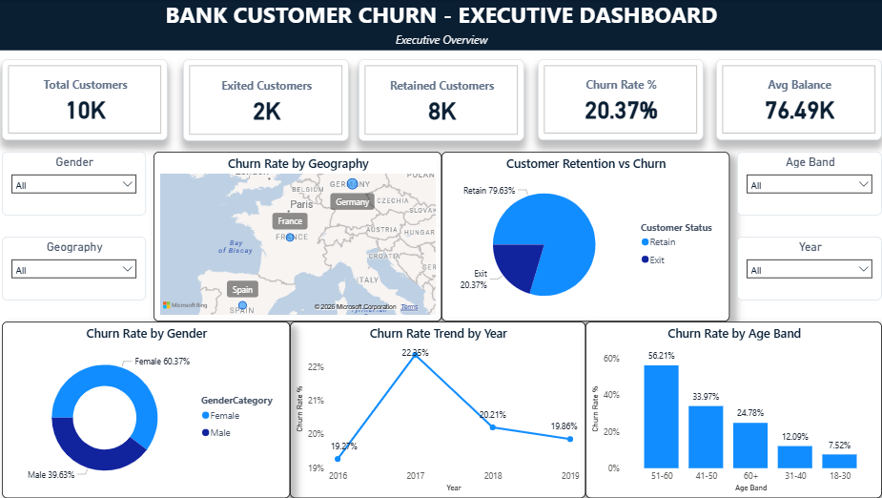
The executive dashboard
5 KPI cards
Total, exited, retained, churn rate, avg balance
5 visuals
Map, pie, donut, trend line, age band
4 slicers
Gender, age band, geography, year
Notes:
Close on the live tool: management can filter by gender, age band, geography and year to monitor churn every month.

Slide 16
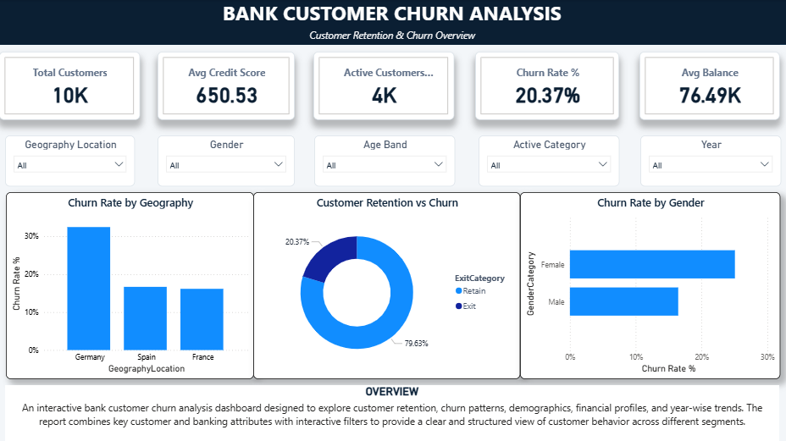
Dashboard 2: Overview
Page 'Overview' in Power BI. Paste screenshot here.
Shows
KPIs plus churn by geography and gender.
Insight
Churn is 20.37%; Germany is 32.44%, double France and Spain.
Decision
Start retention work in Germany.

Slide 17
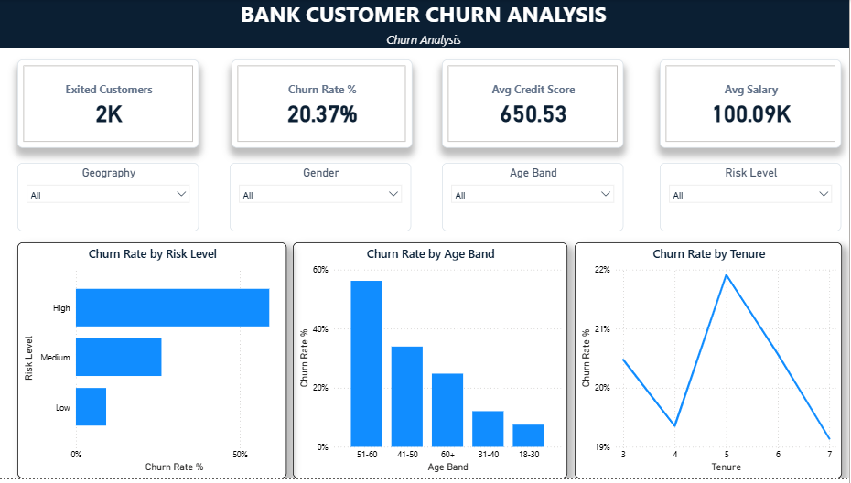
Dashboard 3: Churn Analysis
Page 'Churn Analysis' in Power BI. Paste screenshot here.
Shows
Churn by age band, risk level and tenure.
Insight
Ages 51-60 churn at 56.21%; High risk churns at 59.00%.
Decision
Target ages 41-60 and call High-risk customers first.

Slide 18
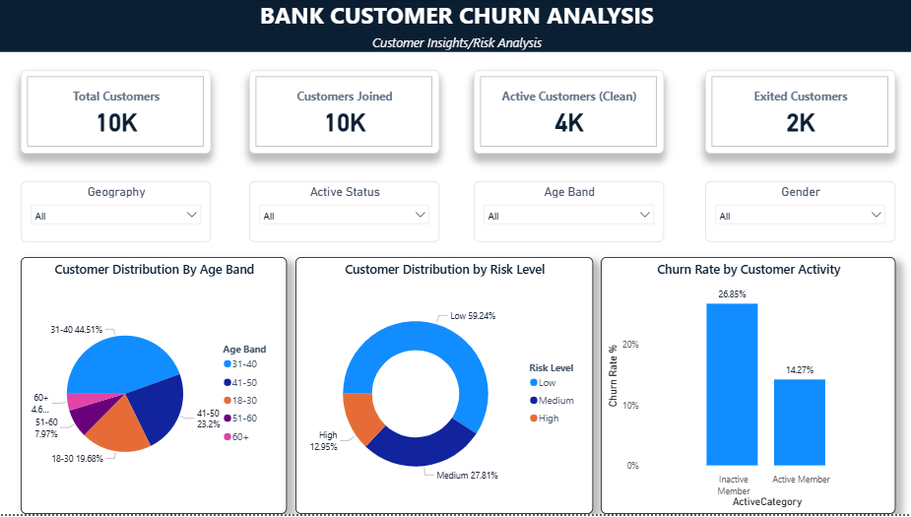
Dashboard 4: Customer Insights and Risk
Page 'Customer Insights/Risk Analysis' in Power BI. Paste screenshot here.
Shows
Customer mix by age and risk; churn by activity.
Insight
Inactive members churn at 26.85% vs 14.27% for active.
Decision
Run activation campaigns for inactive customers.

