Slide 1

RCB
IPL Data Analysis
A SQL-driven story of RCB's 2013–2016 seasons — and what the data says
about the road to the mega auction
PREPARED BY :
JAIPRAKASH SHARMA
PREPARED FROM :
ipl_1.sql & ipl_2.sql | Database: ipl

Slide 2
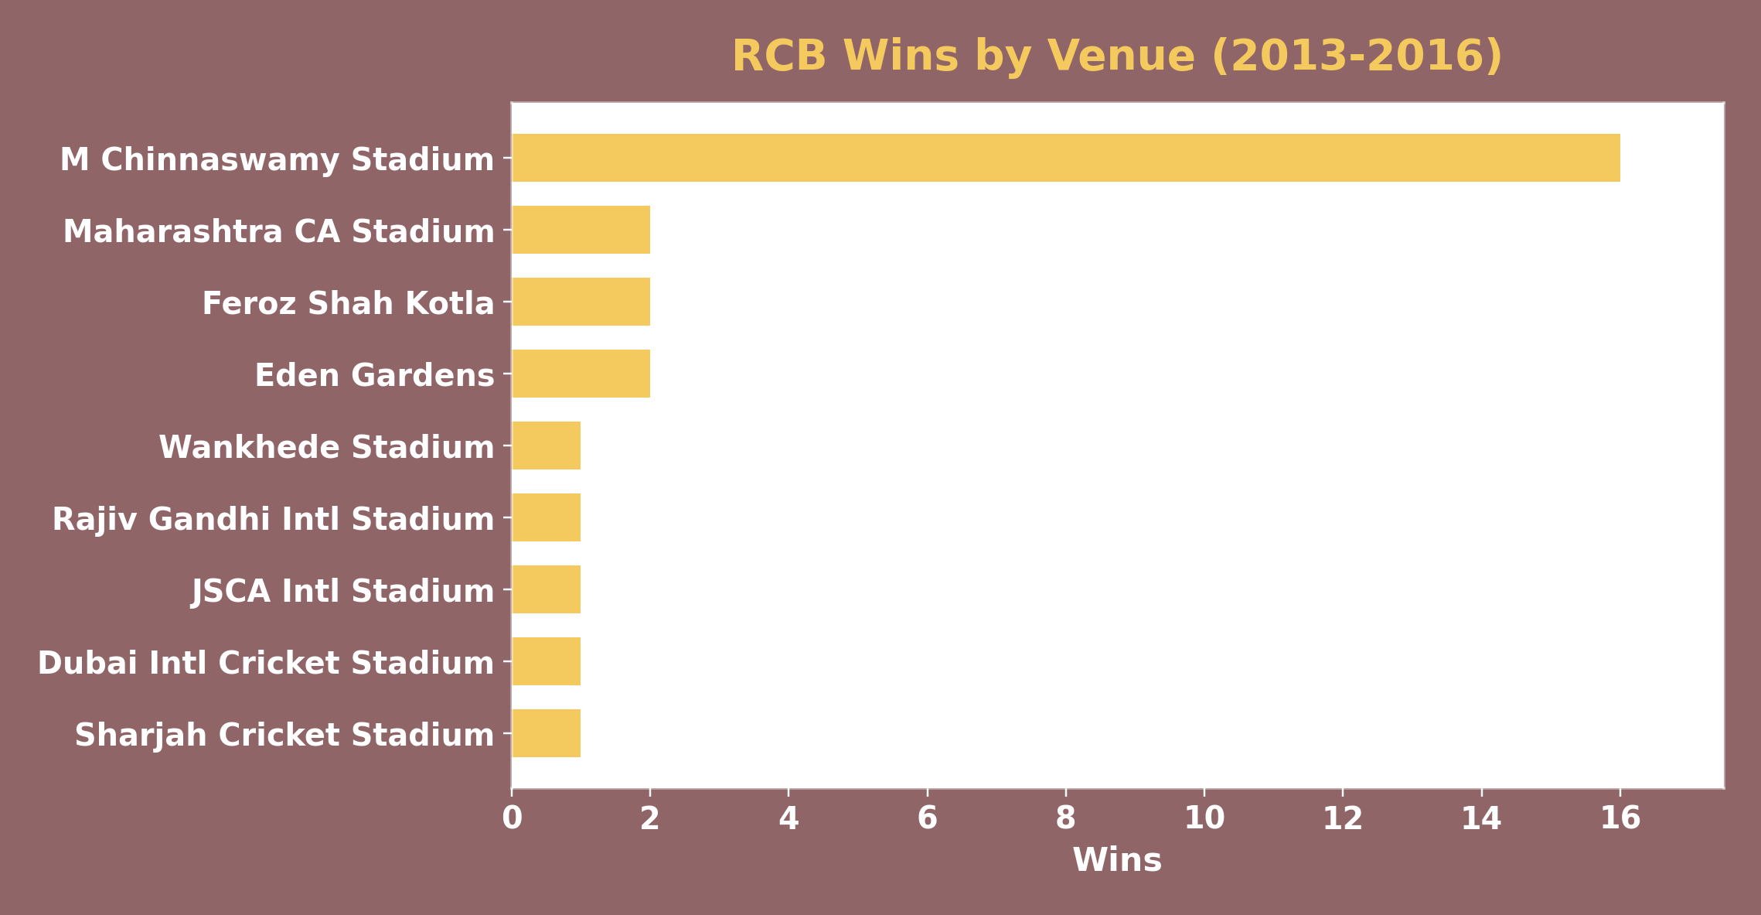
THE STORY BEGINS
RCB has talent every season — but not a trophy
Across the IPL's most star-studded batting line-ups, Royal Challengers Bangalore has repeatedly fielded MVP-calibre players and still finished seasons short of a title. Before the next mega auction, RCB's management needs a data-backed answer to a simple question:
“What does the ball-by-ball data actually say about where RCB is winning,
where it is losing, and who it should target at auction?”
This report answers that question using SQL analysis across 26 objective and subjective questions — covering team performance, player form, venue effects, and auction-ready recommendations.
RCB wins by venue — home ground carries the team's best record
2

Slide 3
SETTING THE SCENE
The dataset, at a glance
255
60,223
469
35
4
Matches
Deliveries
Players
Venues
Seasons (2013-16)
Ball_by_Ball
Coverage note
Wicket_Taken / Extra_Runs
The Season lookup table lists 9 seasons (2008–2016), but the ball-by-ball, match, extras and wicket data supplied only covers Season_Id 6–9 — i.e. 2013 through 2016. No delivery-level data exists for 2008–2012 in the files provided. Every finding in this deck is scoped to 2013–2016 and flagged accordingly wherever it matters.
Dismissals and extras, linked to each delivery
Player / Team / Venue / Season
Lookup tables for names and metadata
3

Slide 4
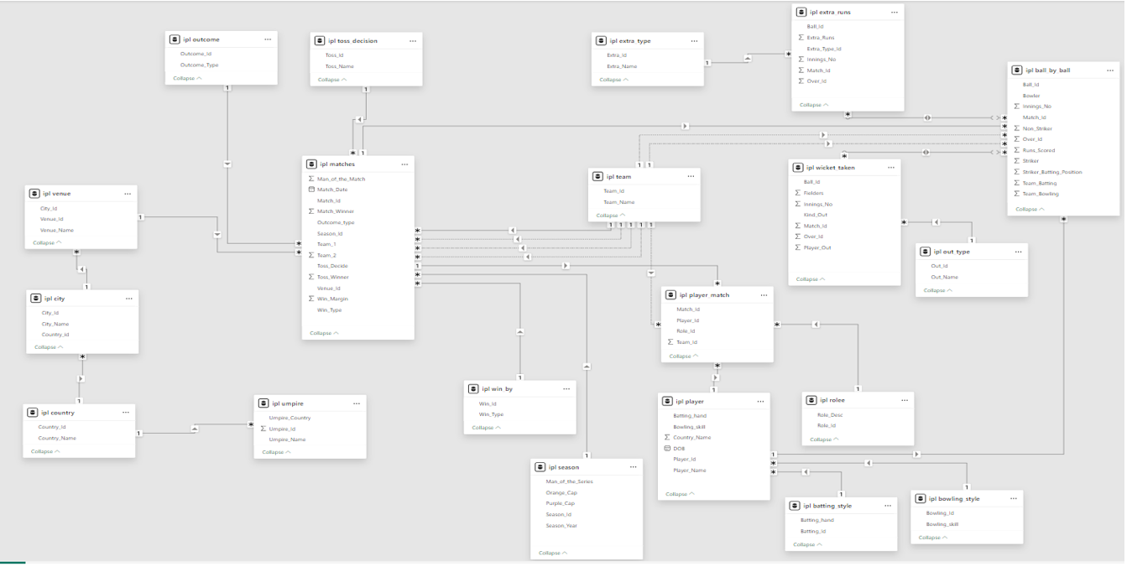
UNDER THE HOOD
How the data fits together
Every match links to a venue, season and two teams; every delivery links to a match, a striker, a bowler, and (where relevant) a wicket or an extra.
4

Slide 5
THE ANALYSIS
BEYOND THE SCOREBOARD
Five charts on RCB's batting, bowling, venues, and the calls that decided matches

Slide 6
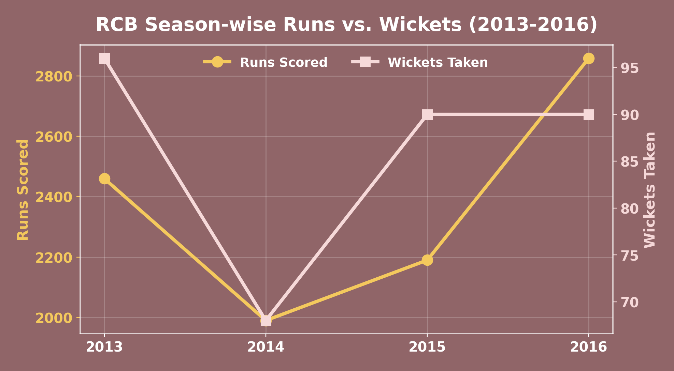
FINDING 1 · SEASON TREND
Batting kept improving. Bowling didn't.
Key points
RCB's runs climbed from 2,460 (2013) to a peak of 2,859 (2016) — their best batting season in the data.
Wickets taken stayed flat to declining across the same span (96 → 90), never matching the batting trend.
2014 is the only season where both lines dip together — everywhere else, one discipline compensates for the other.
The batting and bowling peaks never land in the same season — a strong candidate reason for strong seasons not converting into a trophy.
6

Slide 7
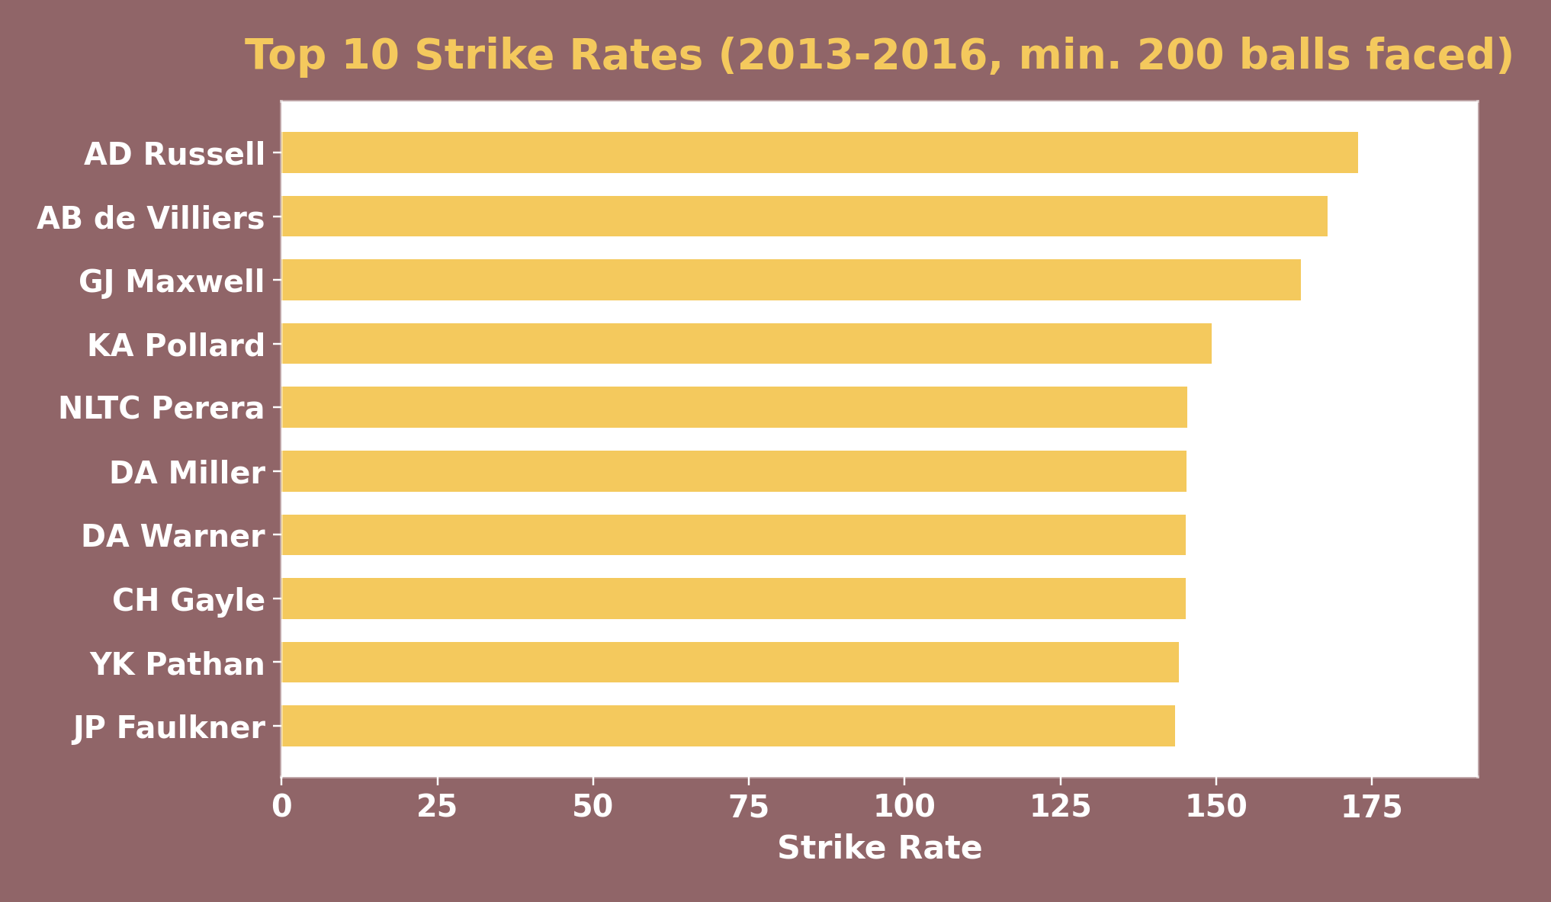
FINDING 2 · BATTING POWER
The league's fastest scorers, 2013-2016
Key points
AD Russell (172.8), AB de Villiers (167.9) and GJ Maxwell (163.6) top the strike-rate table (min. 200 balls faced).
6 of the top 10 are recognised top-order power-hitters — a concentrated pool of proven finishers and openers.
AB de Villiers is the only player on this list already tied to RCB across these seasons — the rest represent auction targets.
This list is the starting shortlist for any top-order power-hitting need.
7

Slide 8
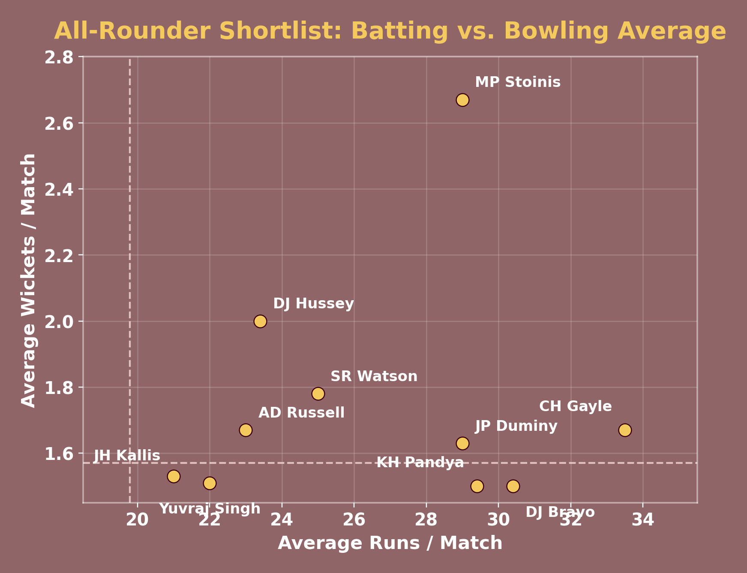
FINDING 3 · VERSATILITY
RCB's real gap: proven all-rounders
Key points
24 players league-wide clear both the batting-average AND bowling-average thresholds simultaneously.
CH Gayle, SR Watson and AD Russell sit furthest from both average lines — the safest, best-evidenced all-round picks.
Dashed lines mark the league averages (19.79 runs, 1.57 wickets) — distance from both lines signals genuine versatility.
This shortlist directly targets RCB's bowling-depth gap without sacrificing batting strength.
8

Slide 9
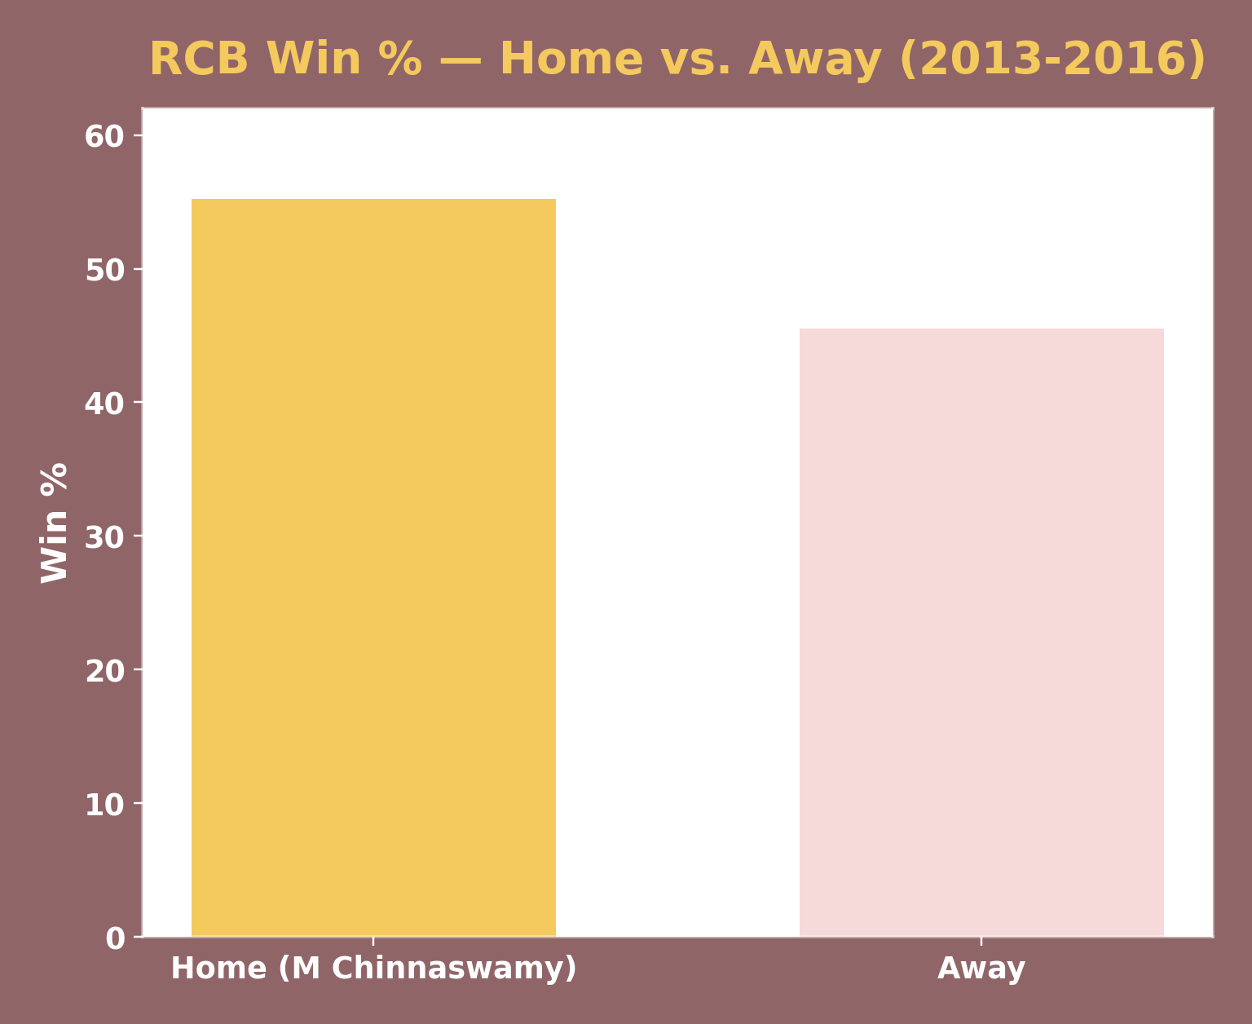
FINDING 4 · HOME ADVANTAGE
Chinnaswamy is an edge — but not everywhere
Key points
RCB wins 55.2% of matches at home (M Chinnaswamy Stadium) vs. 45.5% away — a ~10-point gap.
Chinnaswamy is also one of the league's highest-scoring venues (avg. 157.6 runs/innings) — batting-friendly conditions likely amplify RCB's strength.
The away record is the larger opportunity: closing even half that gap would meaningfully change RCB's season outcomes.
Bowling selection at home should assume high-scoring conditions by default, not treat them as an exception.
9

Slide 10
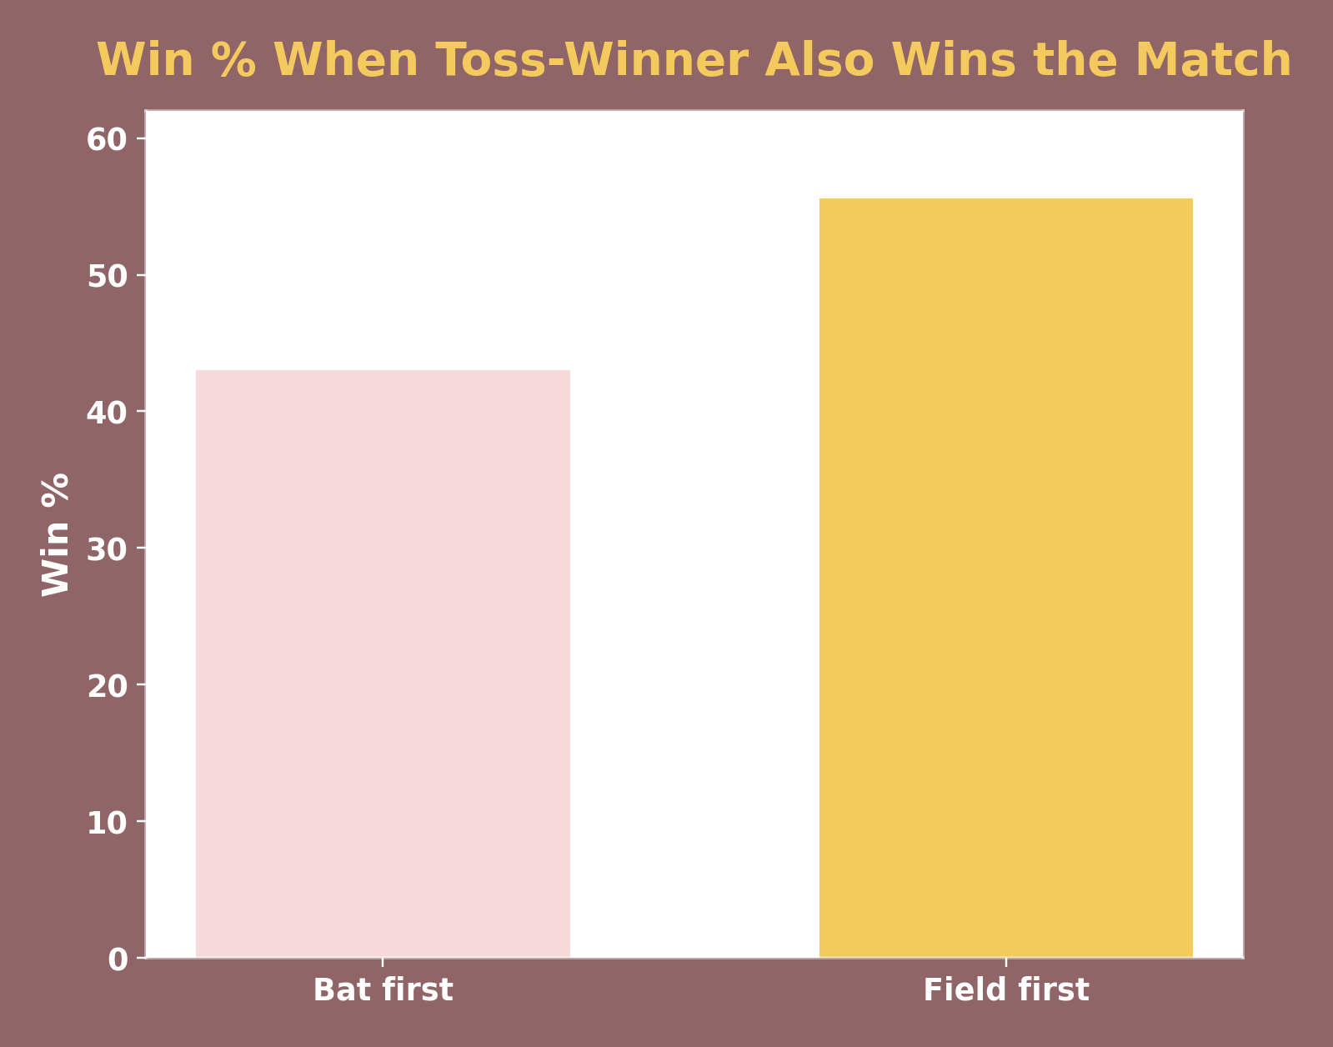
FINDING 5 · MATCH-DAY DECISIONS
Fielding first pays off — but only at some venues
Key points
League-wide, winning the toss and fielding first wins the match 55.6% of the time, vs. 43.0% for batting first.
This nearly-13-point gap makes toss decision a real, data-backed lever — not just conventional wisdom.
The effect is venue-dependent: some grounds show an even stronger fielding-first bias, others are close to a coin-flip.
Recommendation: brief the captain with venue-specific toss data before each match, not a single league-wide rule.
10

Slide 11
SO WHAT SHOULD RCB DO
Recommendations for the mega auction
1
2
Prioritise bowling depth
Target proven all-rounders
Batting stayed strong every season; bowling wicket-taking was the volatile, under-performing discipline (Finding 1).
Use the 24-player versatility shortlist (Finding 3) to add bowling cover without losing batting strength.
3
4
Weight recent form over career stats
Build a venue-specific playbook
2016 form outperformed career averages for every player tested — recency is a measurably better predictor here.
Toss decisions and scoring patterns vary meaningfully by ground (Findings 4 & 5) — a single league-wide rule under-performs.
11

Slide 12
CLOSING THE LOOP
The trophy gap is a bowling gap
Across four seasons of data, RCB's batting was never the problem — 2016 alone produced the team's highest run total in the dataset. What consistently held the team back was bowling: wicket-taking that stayed flat while batting climbed, and never peaked in the same season as the batting line-up. That single, data-backed gap is the clearest lever available heading into the mega auction.
Next steps
Shortlist auction targets from the versatility & impact-score rankings (Finding 3, and the full report's Subjective Q2/Q4)
Build the venue-specific toss and scoring playbook before the season opener
Track phase-wise (powerplay/death) bowling economy as a new season-long KPI
12

Slide 13
CONCLUSION
Data points to one lever: bowling depth
Four seasons of ball-by-ball evidence agree: RCB's batting is already championship-calibre. Closing the bowling gap — through the mega auction and a venue-aware match-day playbook — is the single highest-leverage step toward converting talent into a trophy.
Thank you
13

