Slide 1
ZOMATO
Restaurant Expansion
& Market Analysis
Business Expansion Strategy Using Data Analytics
Prepared by: Jaiprakash Sharma
9,551
22
15+
14
Restaurants
Attributes
Countries
Categorical Cols

Slide 2
Business Challenges
PROBLEM
STATEMENT
🌍 Market Uncertainty
Zomato needs to strategically enter new global markets without clear data on competition or demand.
How can Zomato identify the most
suitable markets for expansion
using data-driven insights?
📊 Competition Blind Spots
No structured analysis of low-competition cities that offer high growth potential for restaurant expansion.
💰 Pricing & Cuisine Gaps
Unclear which price ranges and cuisine types drive higher ratings and customer satisfaction globally.
📱 Digital Adoption Trends
Online delivery and table booking trends differ by country — a critical factor for market entry decisions.

Slide 3
PROJECT OBJECTIVES
01
Market Competition
04
Digital Trends
Identify countries with lower restaurant competition and higher growth potential for new market entry.
Evaluate online delivery and table booking adoption rates to measure digital readiness of markets.
02
Customer Satisfaction
05
Expansion Strategy
Analyze restaurant ratings and customer votes to gauge satisfaction levels across different countries.
Recommend suitable countries and cities for Zomato's restaurant expansion based on data analysis.
03
Pricing & Cuisines
Understand the impact of price range and cuisine types on customer experience and ratings.

Slide 4
DATA OVERVIEW
Dataset structure, scope, and preprocessing summary
9,551
22
14
15+
Total Restaurants
Attributes
Categorical Cols
Countries
KEY COLUMNS IN DATASET
DATA CLEANING STEPS
Restaurant ID & Name
Country Code & City
Cuisines
✔ Missing cuisines replaced with 'Unknown'
✔ Duplicate Restaurant IDs checked & resolved
Price Range (1–4)
Avg Cost for Two
Ratings & Votes
✔ Invalid coordinates (0,0) flagged
Online Delivery
Table Booking
Date of Opening
✔ Country names populated via VLOOKUP
✔ Price column formatted with currency symbol
✔ Data standardized for consistent analysis

Slide 5
METHODOLOGY
A structured, step-by-step analytical approach using Microsoft Excel
STEP 1 — DATA COLLECTION
STEP 2 — DATA CLEANING
STEP 3 — DATA ENRICHMENT
Imported raw Zomato dataset (9,551 records, 22 attributes) from provided Excel template
Handled nulls, duplicates, invalid coordinates, and standardized formats using IF, VLOOKUP functions
Added country names via VLOOKUP lookup table; formatted price with currency symbols using TEXT()
STEP 4 — PIVOT ANALYSIS
STEP 5 — VISUALIZATION
STEP 6 — DASHBOARD
Created pivot tables for country-wise, cuisine-wise, rating-wise, and delivery-wise aggregations
Built bar charts, line charts, pie charts, and combo charts from pivot data for insight generation
Assembled interactive Excel dashboard with slicers for country, price range, and cuisine filters

Slide 6
Country-Wise Restaurant Distribution
KEY INSIGHTS
🇮🇳 India dominates with 8,652 restaurants — over 90% of all records
📉 Canada, Singapore & Qatar have very low restaurant density — prime expansion targets
🚀 Low-competition markets offer less saturation and higher chance of market penetration
💡 Business Insight: Low-competition markets in Canada, Singapore, Qatar & NZ provide strong Zomato expansion opportunities with minimal direct competition.

Slide 7
Year-Wise Restaurant Openings Trend
KEY INSIGHTS
📈 Strong upward trend with peak in 2018 (1,102 openings)
📊 Consistent growth from 2010–2018 indicates a booming global food industry
⏰ Expansion window is now — industry momentum is strong and growing
💡 The consistent year-on-year growth signals increasing global food service demand — an ideal time for Zomato to accelerate its international expansion.

Slide 8
Price Range Distribution Analysis
PRICE SEGMENT BREAKDOWN
Low (₹)
63.6%
6,074 restaurants (63.6%)
Medium (₹₹)
30.3%
2,893 restaurants (30.3%)
High (₹₹₹)
6.1%
584 restaurants (6.1%)
💡 Low & medium segments dominate (87%). Mid-range pricing is the sweet spot for new restaurant entry — high demand, lower barrier for customers.

Slide 9
Country-Wise Average Ratings
TOP MARKETS
🇵🇭 Philippines
4.5 ★
Highest avg rating — exceptional quality
🇳🇿 New Zealand
4.3 ★
Strong customer satisfaction scores
🇮🇩 Indonesia
4.3 ★
Rapidly growing food culture
💡 Philippines, Indonesia & NZ lead in ratings — signaling strong restaurant quality and customer satisfaction in these low-competition markets.

Slide 10
Online Delivery & Table Booking — Impact on Ratings
KEY INSIGHTS
📱 Restaurants with online delivery rate 0.31 pts higher than those without
🪑 Table booking availability boosts ratings by 0.35 pts on average
⭐ Restaurants offering both services achieve the highest customer satisfaction scores
💡 Digital services are key differentiators. Zomato-listed restaurants that adopt both online delivery & table booking consistently outperform peers in ratings.

Slide 11
Cuisine Performance Analysis
🏆 TOP CUISINES
African — 4.70 ★
German — 4.17 ★
Australian — 4.10 ★
⚠️ LOW PERFORMERS
Afghani — 3.20 ★
Bakery — 3.10 ★
Drinks Only — 3.05 ★
Cuisine selection directly impacts customer satisfaction and ratings
💡 Global premium cuisines (African, German, Australian) outperform regional fast-food options. Cuisine curation is a critical expansion strategy lever.

Slide 12
Expansion Opportunity Analysis
Countries with low competition & high ratings — the ideal expansion matrix
🇨🇦 Canada
🇸🇬 Singapore
🇶🇦 Qatar
🇮🇩 Indonesia
📍 Toronto, Vancouver
📍 Singapore City
📍 Doha
📍 Jakarta, Bali
Competition: Low
Competition: Low
Competition: Very Low
Competition: Medium
Avg Rating: 3.51
Avg Rating: 3.57
Avg Rating: 3.55
Avg Rating: 4.19 ★
EXPAND HERE
EXPAND HERE
EXPAND HERE
EXPAND HERE
🇵🇭 Philippines
🇳🇿 New Zealand
🇹🇷 Turkey
📍 Manila, Cebu
📍 Auckland, Wellington
📍 Istanbul, Ankara
Competition: Low
Competition: Very Low
Competition: Low
Avg Rating: 4.07 ★
Avg Rating: 4.26 ★
Avg Rating: 4.30 ★
EXPAND HERE
EXPAND HERE
EXPAND HERE

Slide 13
Competitor Analysis — Top Restaurants by Votes
COMPETITIVE
INTEL
🏆 Toit leads with 10,934 votes — strong brand identity and customer loyalty
📍 Top competitors are concentrated in Bangalore & Kolkata — opportunity exists in other cities
🍻 Gastropubs and multi-cuisine restaurants dominate the high-vote segment
💡 Benchmark strategy: Match top competitors' pricing, ambience, and service mix. Focus on underserved cities where these chains have no presence.

Slide 14
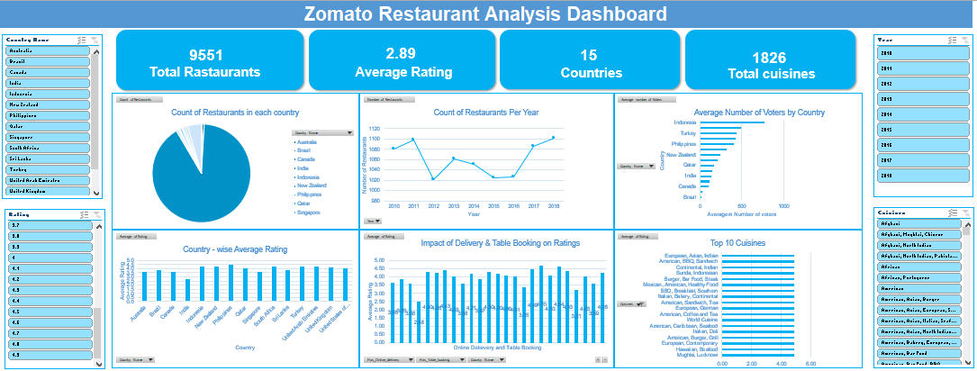
Excel Dashboard & Interactive Visualizations
🎛️ Interactive Slicers
📈 Live Charts
🔍 Drill-Down Insights
Filter by Country, Price Range, Cuisine, and Year for dynamic analysis
Bar, pie, line charts update in real-time as slicers change selections
Pivot tables allow granular drill-down from country → city → restaurant level

Slide 15
Strategic Recommendations
🌍 Enter Low-Competition Markets
💰 Medium-Premium Pricing Strategy
📱 Mandate Digital Services
Prioritize Canada, Singapore, Qatar, New Zealand — low restaurant density means less competition and more market share for early entrants.
Target the ₹₹–₹₹₹ price tier which covers 87% of demand. Avoid extreme premium positioning in new markets.
New listings should offer both online delivery AND table booking. Restaurants with both score significantly higher in ratings.
🍽️ Curate Premium Cuisine Mix
🏙️ Target Urban & Tourist Hubs
⭐ Prioritize Customer Experience
Feature African, German, and Australian cuisines in partner restaurants. High-rating cuisines drive better word-of-mouth and retention.
Enter cities like Istanbul, Auckland, Doha, and Jakarta — high foot traffic, tourism, and digital adoption rates accelerate growth.
Maintain strict quality standards. High ratings (4.0+) drive organic growth through Zomato's recommendation algorithm and user trust.

Slide 16
CONCLUSION
📌 India dominates Zomato's current restaurant base (90%+) — significant whitespace in international markets.
📌 Countries like Philippines, NZ and Indonesia offer high ratings with low competition — ideal for expansion.
📌 Customer convenience (online delivery + table booking) is a proven driver of higher ratings and satisfaction.
📌 Cuisine quality and pricing strategy are directly correlated with customer experience and platform success.
"Data-driven restaurant expansion strategies can significantly improve market success and customer engagement."

Slide 17
References & Acknowledgements
Dataset
Zomato Restaurant Dataset — Template provided by project guidelines (9,551 records, 22 attributes)
Tools Used
Microsoft Excel — Pivot Tables, VLOOKUP, IF Functions, Conditional Formatting, Charts, Dashboard
Analysis Methods
Descriptive Analytics, Trend Analysis, Competitive Benchmarking, Segmentation Analysis
Visualization
Bar Charts, Line Charts, Donut Charts, Clustered Bar Charts, Interactive Excel Dashboard with Slicers
Acknowledgements
Project Mentors, Data Analytics Team, Zomato Business Strategy Division
References
Zomato Annual Reports, Food Industry Market Research, Global Restaurant Expansion Case Studies

