Slide 1
License Plate Recognition
Erick Calado, Joao Paulo Borges, Joao Luiz Valença

Slide 2
Abstract
This study aims to simulate an automatic plate recognition system (APR) and will evaluate different techniques of image enhancement to improve the character recognition. For each application, the complications and its characteristics problems are analyzed. For example the angle of the cameras and the quality of the images change from one application to another, some images can be blurry (especially motion blurry), or an object obscuring, such as dirt or fog, can be on plate. In order to recognize the plate, the system firstly enhance the input by using two linear filters: Laplacian of a Gaussian and Sobel. Secondly it extracts the plate location, separate the plate characters individually by segmentation and finally apply template matching with the use of correlation for recognition of plate character. The system was evaluated empirically; one hundred images were tested and for each enhancement algorithm the accuracy was measured. The experiment demonstrated that the background and the image condition modified the final result and that the Laplacian of Gaussian presents the best result.

Slide 3
Agenda
Problems and Applications
Technical Approach
Results and Analyses
Demo
Conclusion and Future work
Q&A

Slide 4
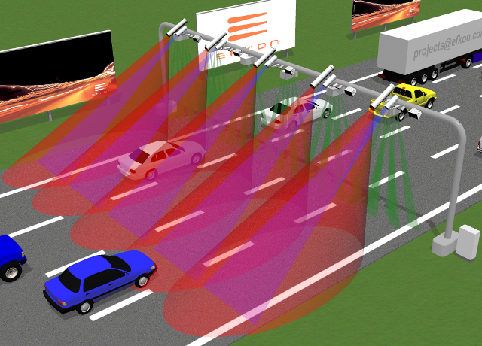
Problems and Applications
Automated toll collection
Road rules enforcement
Tracking stolen cars
Parking control system

Slide 5
Technical Approach
Image Acquisition
Image Enhancement
Plate Localization
Character segmentation
Optical Character Recognition
Notes:
Different Positions and Distance
Light Conditions
--
Gaussian -> Sobel
Laplacian of Gaussian

Slide 6
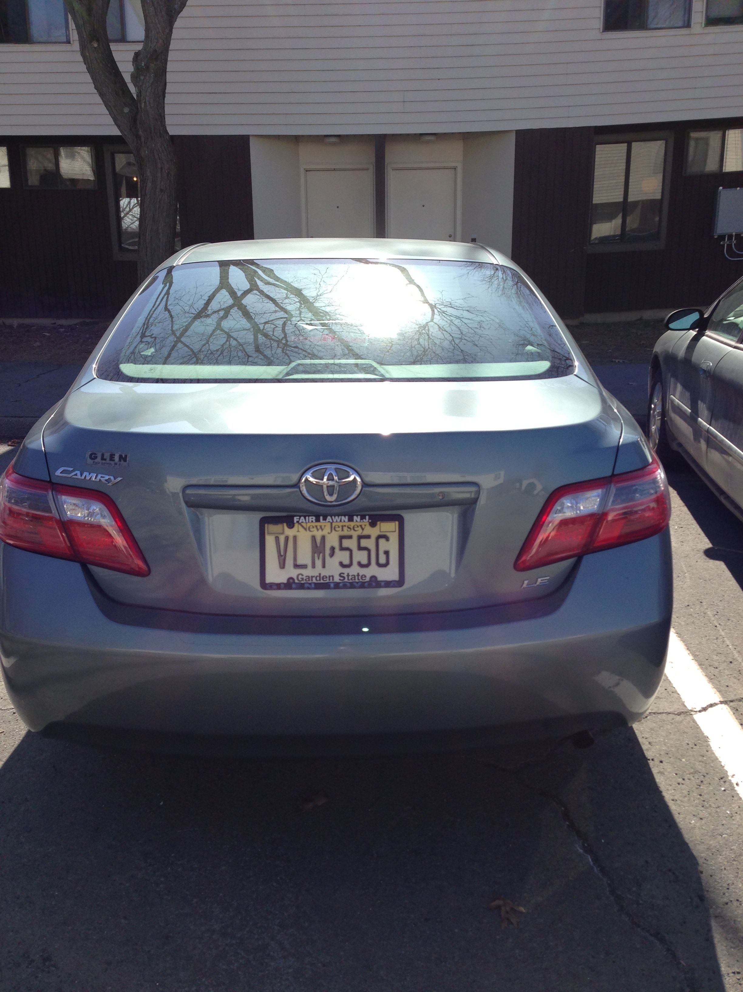
Image Acquisition
Fixed position is ideal for recognition
The light condition changes the results
The distance i.e. plate to rest the of the image ratio
All three aspects were considerate, however a fixed set is used for demonstration
Notes:
Depending on the application the image changes, a system has to deal with that

Slide 7
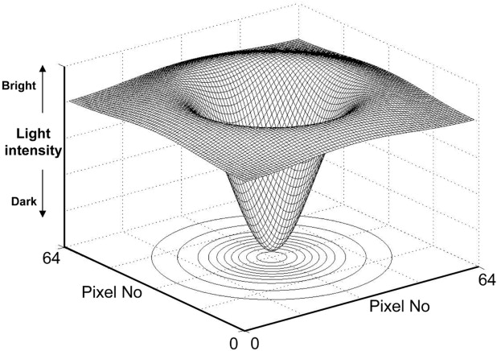
Image Enhancement
Edges enhancement
Noise reduction
Improve luminosity in the plate area
Two techniques were used:
Laplacian of Gaussian
Gaussian->Sobel
Notes:
The idea of all techniques is to improve the ed

Slide 8
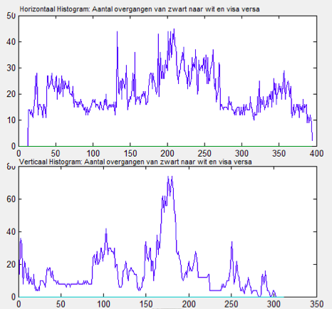
Plate location
Most difficult task
Assumptions had to be made
Application Specific
Two techniques
Smearing
Edge Histogram

Slide 9
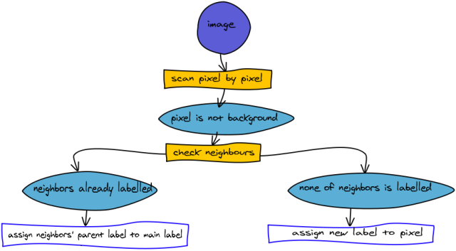
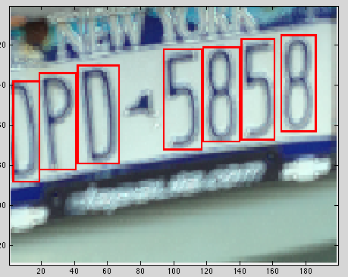
Character Segmentation
Separate each character -> Erosion
Connect component -> bwlabel
Select the components based on size and position

Slide 10
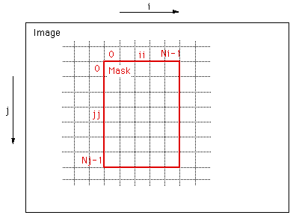
Character Recognition
A template with the letters
Improve the letter using dilatation
Binary inversion
Correlation

Slide 11
Result and Analyses
The results vary a lot depending on the image
The Laplacian of Gaussian was the best enhancement technique
The correlation works for most of the cases, however when the letter is very deteriorated it may fail.

Slide 12
Demo

Slide 13
Conclusion and Future work
License plate recognition is a very hard task. Many factor changes the final results.
It’s almost impossible to do one system that works in every situation.
As a future work the smearing technique should be improved. Other techniques, such as Hough transform and Contour algorithm should be implemented. And the effect of motion blur should be analyzed.

Slide 14
References
[1]http://users.utcluj.ro/~rdanescu/proiecte/01-licenseplate.pdf
[2]http://pdf.aminer.org/000/349/486/gray_scale_character_recognition_by_gabor_jets_projection.pdf
[3] http://ac.els-cdn.com/S0167865505001406/1-s2.0-S0167865505001406-main.pdf?_tid=acdf9518-8985-11e2-adb3-00000aacb35f&acdnat=1362921979_902d579f2e482404e4439330e451c25b
[4] http://www.itfrindia.org/ICCIC/Vol2/9024ICCIC.pdf
[5] http://ieeexplore.ieee.org/xpls/abs_all.jsp?arnumber=413580
[6] http://vortex.cs.wayne.edu/papers/ijns1997.pdf
[7] http://www.win.tue.nl/aime/Files/apr2002_license.pdf

Slide 15

Questions?

