Slide 1
Engagement Decision Support for Beyond Visual Range Air Combat
Joao P. A. Dantas
Andre N. Costa
Diego Geraldo
Marcos R. O. A. Maximo
Takashi Yoneyama
Notes:
Hello everyone
I am João Dantas
I will present the work developed with the researchers Andre Costa and Diego Geraldo and the with professors Marcos Maximo and Takashi Yoneyama.
The work is called “Engagement Decision Support for Beyond Visual Range Air Combat” and was developed in the context of the project “Aerospace Simulation Environment” from the Institute for Advanced Studies a research organization of the Brazilian Air Force.

Slide 2
MOTIVATION
Within Visual Range (WVR)
Beyond Visual Range (BVR)
Situational Awareness
Simulation
Decision Support Tool
Notes:
Air combat may occur in two primary forms: Within Visual Range (WVR) and Beyond Visual Range (BVR). The second one is recently more developed in the operational context due to the more extensive availability of advanced weapons and sensors.
Modern air combat usually begins BVR, which is frequently the most critical phase since it may provide advantages and drawbacks for succeeding stages. There is no clear definition of the distance to separate these two forms of air combat, but typically, a BVR air combat takes place between 40 and 50 nautical miles, which is related to the ranges of the missiles used in this type of combat.
BVR conditions force the pilots to rely more on a series of systems to compose their situational awareness, allowing them to make tactical decisions during the combat, such as whether to fire a missile or not.
Since BVR combat is rarely observable in practice, with low availability of historical data, much of the assessment of these possibilities must be done through simulation.
This work contributes by developing a decision support tool for pilots in BVR combat situations based on simulated data, with a particular focus on solving the problem of deciding when to engage a specific enemy aircraft, which is commonly based only on the pilot experience.

Slide 3
LITERATURE REVIEW
Bayesian Networks (Du and Liu, 2010; Rao et al, 2011)
Fuzzy Logic (Akabari et al, 2005; Prahu et al, 2014)
Agent-based Modeling (Heinze et al, 1998)
Influence Diagrams (Lin et al, 2007)
Reinforcement Learning (Toubman et al, 2016; Weilin et al, 2018; Hu et al, 2021)
Artificial Neural Networks (Yao et al, 2021)
Evolutionary Algorithms (Yang et al 2020; Li et al 2020)
MiniMax Method (Kang et al, 2019)
Behavior Trees (Yao et al, 2015)
Game Theory (Mukai et al, 2003; Karelahti et al, 2006; Ha et al, 2018)
Notes:
There are several previous approaches that relate to BVR Air combat and support decision systems, mainly providing different forms of modeling pilot behavior. The approaches found in the literature were those based on:
-Bayesian Networks
-Fuzzy Logic (Akabari et al, 2005; Prahu et al, 2014)-Agent-based modeling (Heinze et al, 1998)
-Influence Diadrams (Lin et al, 2007)
-Reinforcement Learning (Toubman et al, 2016; Weilin et al, 2018; Piao et al, 2020; Hu et al, 2021)
-Artificial Neural Networks (Yao et al, 2021)
-Evolutionary Algorithms (Yang et al 2020; Li et al 2020)
-MiniMax Method (Kang et al, 2019)-Behavior Trees (Yao et al, 2015)
-Game Theory (Mukai et al, 2003; Karelahti et al, 2006; Virtanen 2006; Ha, 2018)
Among all of these approaches, the Ha’s work related to game theory from two thousand eighteeen is the one that more directly focuses on estimating the firing moment, which is done through a probabilistic function of the target's evasive path, the missile's speed on the final approach, and the accuracy of the target's information to guide the missile. However, this methodology has not been tested in simulations with a higher degree of fidelity concerning an actual BVR air combat.

Slide 4
OBJECTIVES
Supervised Machine Learning model
Based on Decision Trees (XGBoost)
Features:
6DOF
Multi-role combat aircraft
Electronic Warfare Devices
Datalink communications
Active radar-guided missiles
Sujects:
BVR air combat scenarios
Carrying out simulations
Collecting and analysing data
Using machine learning techniques
Notes:
As an alternative, our work uses supervised machine learning models based on decision trees, using the XGBoost library to provide pilots with parameters that improve their situational awareness in air combat from data collected from simulations of operational scenarios, allowing them to better decide when to engage a target.
Compared to most of the approaches, this study was conducted through higher fidelity simulations, providing features and systems and subsystems such as:
6DOF
Multi-role combat aircraft
Electronic Warfare Devices
Datalink communications
Active radar-guided missiles
This study is, therefore, developed around four main subjects:
determination of BVR air combat scenarios that will be analyzed,
carrying out simulations based on the ,
collecting and analyzing the data generated in the simulations, and
using machine learning techniques on this data to improve the pilot's situational awareness by providing information about the analyzed air combat, fulfilling the role of a decision support system.

Slide 5
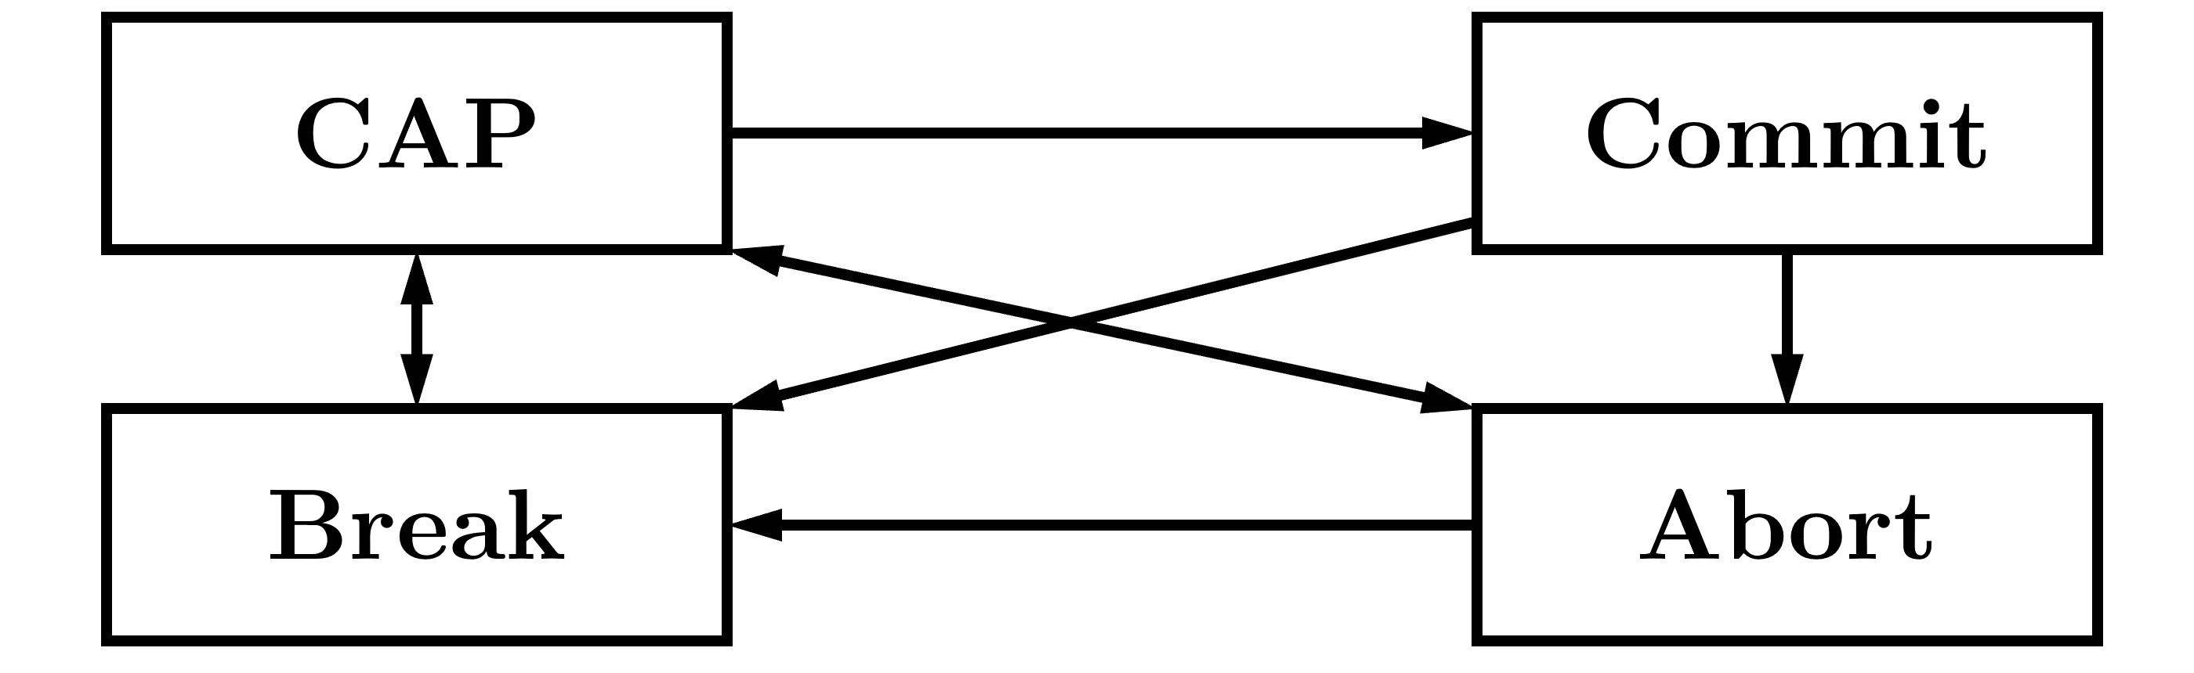
FIGHTER AGENT
Finite State Machine
CAP, Commit, Break, Abort
Notes:
The agent's actions are managed by a set of rules that describe a pilot's main tactical behaviors during a BVR combat. This set of rules is modeled as a Finite State Machine.
Each state is one of the possible tactics that can be taken during a BVR combat. There are four different states:
Combat Air Patrol (CAP),
Commit, Abort, and Break.
The CAP tactic consists of performing a flight pattern, describing an orbit around a specific position called CAP point, with a defined heading and direction.
The Commit tactic consists of the agent engaging a target detected by its radar or shared by datalink.
In the Abort tactic, the agent performs a defensive maneuver to move away from his priority threat.
Finally, when the agent's sensors detect a missile threat fired in its direction, it performs the Break tactic which consists of a defensive maneuver, describing a curve and a dive with great acceleration.
At the engagement moment, the agent assumes the Commit behavior. Then, when the agent needs to do a defensive movement, it assumes Break or Abort. Therefore, the engagement time in a simulation is defined as the time between the first Commit carried by the agent and its first Break or Abort. We created an operational index that determines the quality of the actions taken by the agent in a BVR scenario, which was calculaated during the engagement period and can be extended to any moment in the simulation. This metric is referred to as the DCA Index

Slide 6
DCA INDEX
Index as a probability of success
Ranging from 0% to 100%
Principles
Minimize the number of missile launched in the mission
Minimize the reference distance from its CAP point
Maximize the distance of each enemy to the CAP point
Notes:
We defined this index as a probability of success, ranging from 0% to 100%, for BVR combat on DCA missions whose objective is to establish a CAP.
These missions have the goal of defending a point of interest, which is done by ensuring that the opposing aircraft are kept far away from it.
In addition, it aims to do that while launching the least number of missiles possible.
Furthermore, from the doctrine perspective, it is a good practice for the defending aircraft to stay close to its CAP point since it is easier to employ tactics to defend the point of interest.
From these considerations with respect to the DCA mission context, we defined three basic principles:
Minimize the number of missile launched in the mission
Minimize the reference distance from its CAP point
Maximize the distance of each enemy to the CAP point

Slide 7
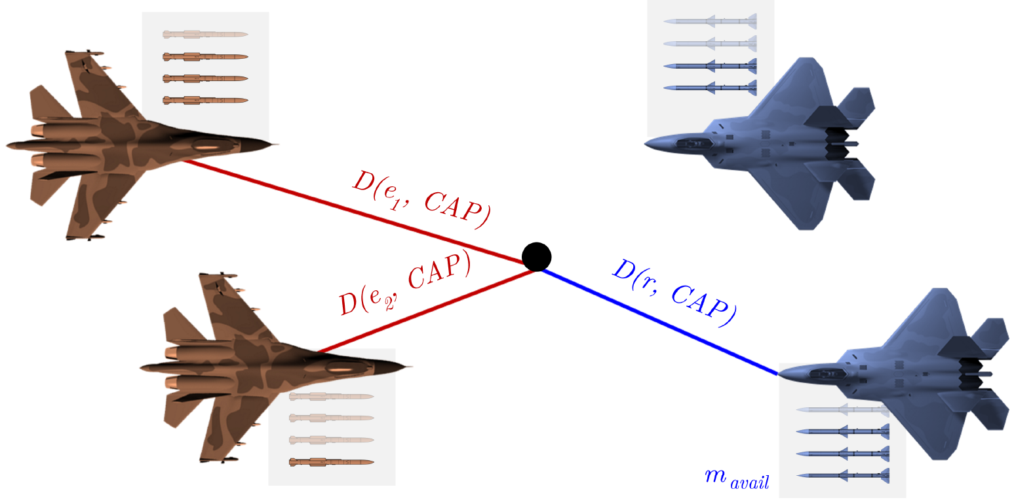
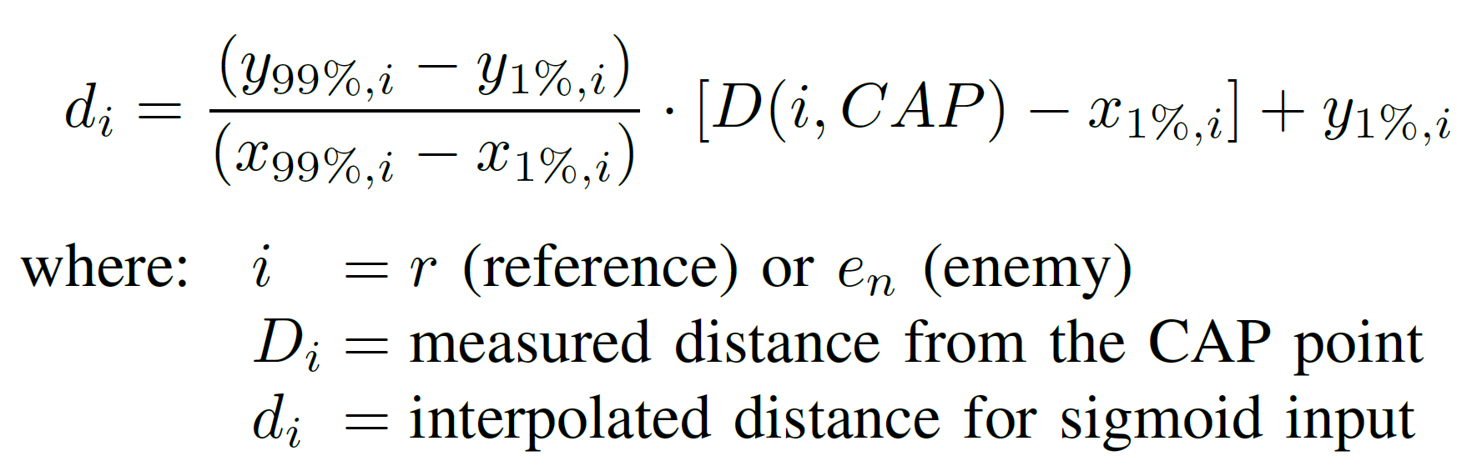
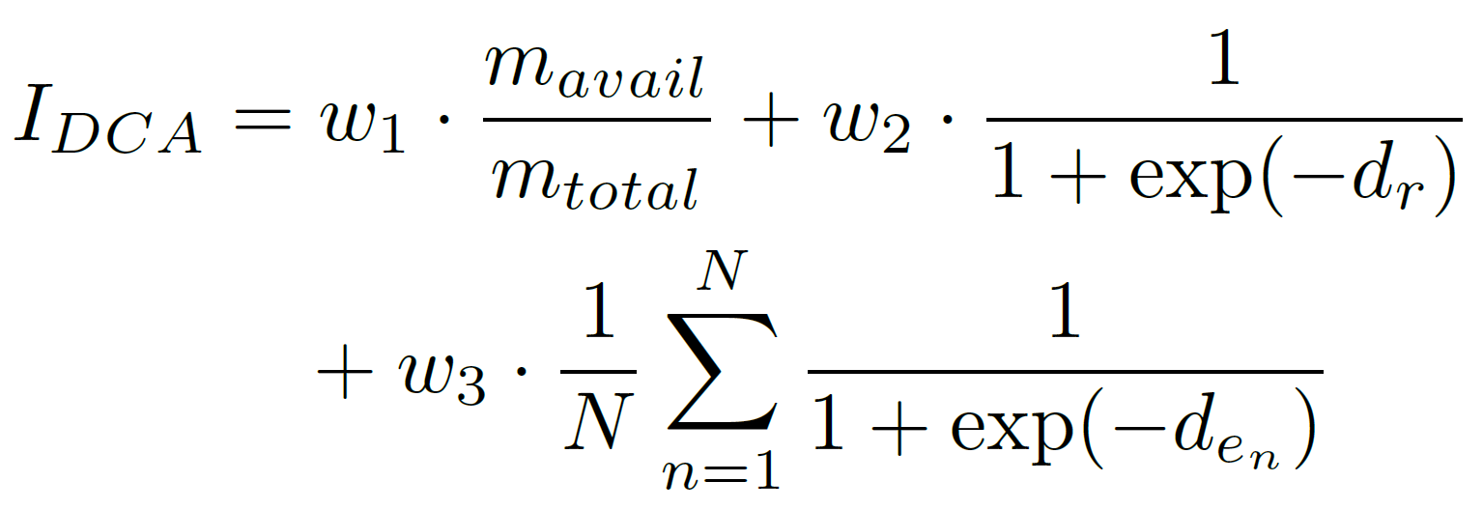
DCA INDEX
DCA INDEX
Notes:
About the equation of the DCA Index:
Firstly, concerning the number of missiles, the ratio between number of available missiles e the initial number is one of the factors of the DCA index.
Secondly, regarding minimizing the distance between the reference aircraft and the CAP point we considered that the decay of this effect is not linear. As the distance increases, its influence becomes much less relevant to accomplishes the mission goals. Therefore, we chose a sigmoid function to generate such decay.
Lastly, when considering the opposing aircraft distances, we used a similar sigmoid function, but with opposite characteristics since the idea was to increase the enemies' influence when they were closer to the CAP point.
With the composition of the previously calculated factors, it is possible to obtain the DCA index's final calculation.

Slide 8
SIMULATIONS SAMPLING
Latin Hypercube Sampling
3,729 construtive simulations
10,316 engagements
12-minutes scenario
10 days (3x)
Scenario: BVR 2x2
Notes:
We use the Latin Hypercube Sampling algorithm, 3,729 constructive simulations were generated in the Aerospace Simulation Environment, and a total of 10,316 engagements were observed. Each simulation corresponds to a 12-minute scenario executed three times faster than real-time, lasting approximately ten days in total.
The scenario consists of two opposing formations with two aircraft each, which are initially approaching, disengaged, and outside the radar range of each other. Their main goal is to establish a CAP at the same CAP point, invariably leading to a confrontation. When they enter the limits of the opponents' radars, the engagement phase begins. In the modeling proposed in this work, each aircraft is equipped with four of the same type of medium-range missile which they can achieve 40 nautical miles in range.

Slide 9
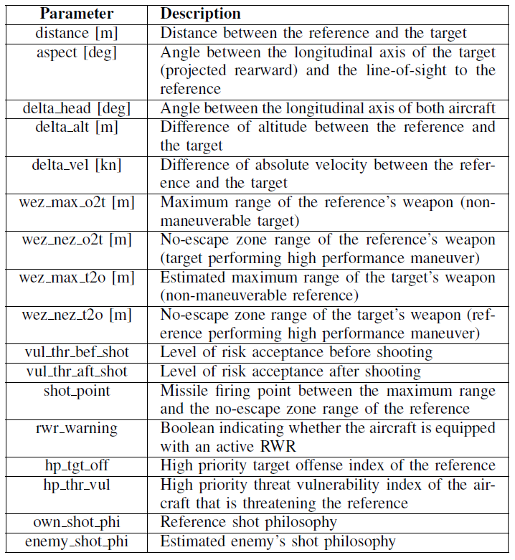
MODEL INPUTS AND OUTPUT
Notes:
The main variables that coordinate the simulation of a BVR air combat were analyzed, and seventeen input variables were determined to be the most important to define the simulation proposed. We have then:
Distance between the aircrafts
Aspect angle
Heading variation between the aircrafts
Altitude variation between the aircrafts
The main aspects of the Weapon Engagement Zone, which is an estimation of the missile maximum launch range
The thresholds before and after firing a missile (represent the level of risk acceptance that the agent is willing to accept)
The shot distance which is the minimum distance to fire a missile
The presence or not on the aircraft of a Radar Warning Receiver (RWR), an Eletronic Warfare system that detects electromagnetic emissions from opposing radar systems.
The shot philosophy which is a orientation defined during mission planning, before the flight, referring to the moment, within the shot distance, launch a missile
In the model proposed, the target variable is the DCA index of the reference aircraft in a specific engagement.

Slide 10
SUPERVISED MODEL
XGBoost
Data Preprocessing
Feature Engineering
Hyperparameters Tuning
Metrics: RMSE and R²
Cross Validation (80% and 20%)
Notes:
About the supervised leaning model used in this work, we employ the XGBoost which is one of the most used algorithms by data scientists, presenting superior results, mainly in forecasting problems involving tabular data.
In the model, two preprocessing steps will be performed on the data: Label Encoding and One-Hot Encoding.
Also, feature engineering was applied to make the training process easier of the proposed regression model.
GridSearch was employed to do the hyperparameters tuning of the model.
The Root-Mean-Square Error and the Coefficient of Determination were chosen as metrics since they are well established in classical regression analysis.
We perform a dataset train-validation-test split, allocating 80% for the training and validation and 20% for the testing, and We employ 10-fold cross-validation.

Slide 11
MODEL RESULTS
RMSE 0.0543 ± 0.0009
R² 0.8020 ± 0.0077
Notes:
The means of all 10-fold metrics used to evaluate the best model at the end of the grid search training process after performing the cross-validation are, respectively, around 5% and 80%, while their standard deviations are 0.09 % and 0.77%.
Considering that this is a regression problem and that we are trying to predict the DCA index, which indicates a probability of success in this type of mission, the results are satisfactory for this type of problem since they would be making predictions with errors in the range of 5% with a practically instantaneous inference time, which is desirable for a real-time application.

Slide 12
CONCLUSIONS
Improve the employment of the best operational tactics for each situation
Avoiding the incorrect and careless use of weapons
Decrease the number of friendly aircraft lost in real-life
Notes:
Thus, through simulation data, it is possible to improve the employment of the best operational tactics for each situation in the complex context of BVR air combat. Furthermore, it contributes by avoiding the incorrect and careless use of weapons, improving DCA mission effectiveness. Finally, since the pilot's survival is a determining factor, it could decrease the number of friendly aircraft lost in real-life BVR air combat.

Slide 13
FUTURE WORK
Number of simulations
More variables to define the agent state
Compare XGBoost with other regression algorithms
Conception of other operational metrics
Notes:
Future work should move towards using a more significant number of simulations.
In addition, the search for more variables to define the agent state at the beginning of the engagement could improve the performance of the proposed model.
Also, comparing the results of XGBoost with other regression algorithms would be interesting to understand which supervised learning method best suits this type of problem.
Finally, the conception of other operational metrics, like the DCA index, or the combination of several of them, to measure the level of performance in an engagement could contribute to bringing more information to the model.

Slide 14
ACKNOWLEDGMENTS
Finep (Reference nº 2824/20)
CNPq - National Research Council of Brazil (grant 303134/2-18-0)
Notes:
This work was supported by Finep (Reference nº 2824/20) and Prof. Takashi Yoneyama is partially funded by CNPq -- National Research Council of Brazil through the grant 304134/2-18-0.

