Slide 1
When Correlation Isn’t Enough
Using Causal Methods for Discriminatory Bias Detection
Joyce S. Padela, Pavan Raj Ravi, Jianwu Wang
Department of Information Systems
University of Maryland, Baltimore County
IEEE ICTAI 2026 · Boca Raton, Florida
Notes:
~30 s. Introduce the paper and co-authors. One-line thesis: correlation tells you THAT a disparity exists; causal methods tell you WHERE it comes from.

Slide 2
Problem Statement
Fairness audits mostly rely on correlation metrics
  Statistical parity, equalized odds, disparate impact ratio (four-fifths rule) [4, 5, 6, 9]
  They answer “Is there a disparity?” — not “Where does it come from?”
They cannot separate direct discrimination from proxy-mediated effects
  Removing a sensitive feature does not remove a proxy (e.g., ZIP code, prior convictions)
COMPAS: among defendants who did not reoffend, 44.9% of African-American vs. 23.5% of Caucasian defendants were labeled medium/high risk [3, 8]
  Does race act on the score directly, or through priors shaped by upstream policing?
Without a mechanism, interventions are guesswork
2
Notes:
~1 min. Fairness audits rely on correlation metrics. They can't separate direct from proxy discrimination. COMPAS: 44.9% vs 23.5% false-positive rate among non-reoffenders. Is race acting on the score directly, or through priors shaped by policing? The answer changes the fix.

Slide 3
Research Question and Contributions
To what extent can causal discovery algorithms identify structural patterns in data that produce biased outcomes?
A five-step causal pipeline for bias detection
  Six algorithms (PC, FCI, GES, GRaSP, ICA-LiNGAM, DirectLiNGAM) [14 -16, 18-21] benchmarked against planted ground truth
  Sensitivity analysis over 480 runs (2,880 fits) charts which method works at which sample size and effect size
Real-world COMPAS application
  LiNGAM variants recover a direct Race → Score edge; DirectLiNGAM matches the adjusted direct effect within 0.0088 decile points
A fairness-audit failure mode for BIC-based permutation search (GRaSP [21])
  Risk scores built from their own inputs (R² = 0.45) look exogenous, producing impossible edges into immutable attributes
3
Notes:
~1 min. RQ plus three contributions: (1) pipeline + benchmark of six algorithms with planted ground truth and a 480-run sensitivity grid; (2) COMPAS application with convergent estimates; (3) a GRaSP failure mode specific to auditing algorithmic scores.

Slide 4
Validating Fairness: A Causal Inference Pipeline for Discriminatory Bias Assessment
Correlation reveals that disparity exists. Causal discovery reveals where it comes from — and how to intervene. Demonstrated on ProPublica COMPAS (n=5,278).
STEP 01 — DETECT
STEP 02 — DISCOVER
STEP 03 — ISOLATE
STEP 04 — QUANTIFY
STEP 05 — VALIDATE
Establish the Correlation Baseline
Select a Causal Discovery Algorithm
Isolate Direct vs. Proxy Discrimination
Quantify the Causal Effect
Validate with Bootstrapping
Compute correlation-based fairness metrics (Disparate Impact Ratio, selection-rate gap, rate ratios) to confirm a disparity is present.
Six algorithms across four families were benchmarked on synthetic data with planted ground-truth bias (β = −0.15).
Map the recovered DAG to separate two structurally distinct discrimination pathways — each demanding a different intervention.
Apply covariate adjustment to estimate the total effect and the adjusted direct effect (DE) — blocking criminal-history mediators {Age, Charge Degree, Juv Fel, Juv Misd, Priors}.
1,000 non-parametric bootstrap resamples (fixed seed) generate percentile-based 95% confidence intervals to test statistical stability.
SELECTION-RATE DISPARITY (COMPAS)
ALGORITHM FAMILIES TESTED
CONSTRAINT-BASED
SCORE-BASED (BIC)
▸ DIRECT PATHWAY
EFFECT ATTENUATION UNDER CONTROLS
95% CI · DIRECTLINGAM RACE → COMPAS SCORE
1.741
GES
Race
→
Score
PC · FCI
Discriminatory bias embedded inside the scoring rules themselves. Intervention: revise the algorithm's internal logic.
Total Effect (raw)
+1.6416
1.000
≤15% detection at n ≤ 10,000, all β. Improves only at n=50,000 and erratically. Returns equivalence classes—orientation often undetermined.
35-75% rising to 75-100% at larger β and n.
Effect (partial adj.)
+1.1386
0
+0.385
+0.637
❯
❯
❯
DE (full adj.)
+0.5255
❯
▸ PROXY PATHWAY
DirectLiNGAM β̂
+0.5167
ALL THREE CIS EXCLUDE ZERO
PERMUTATION
FUNCTIONAL
CAUSAL
PREFERRED
Race
→
Priors
→
Score
DirectLiNGAM 95% CI
[+0.385, +0.637]
AFRICAN-
AMERICAN
CAUCASIAN
(REFERENCE)
GRaSP
ICA-LiNGAM · DirectLiNGAM
ICA-LiNGAM β̂
+1.2105
DE (full) 95% CI
[+0.395, +0.663]
Peaks at 70% (n=5,000), declines to 45% at n=50,000. Highly initialization-sensitive. Misorients scores built from their own predictors (high-R² exogeneity misclassification, Step 3).
Structural inequities (e.g., racially disparate policing) inflate a “neutral” risk signal. Intervention: upstream policy reform — removing Race alone will not eliminate this path.
≥85% detection at n=1,000; recovers oriented edges and β̂ magnitudes.
Δ = 0.0088
ICA-LiNGAM 95% CI
[+1.076, +1.345]
COMPAS CORRELATION METRICS
CONVERGENT CROSS-VALIDATION
E-value (sensitivity)
≈ 1.65
Selection-Rate DIR
1.741
Adjusted DE (regression) and DirectLiNGAM (non-Gaussianity) — differing identification strategies on the same data — agree within 0.0088 decile-score points, isolating discriminatory bias from legitimate risk signals.
Recidivism Rate Ratio
1.338
WATCH FOR: HIGH R² EXOGENEITY MISCLASSIFICATION
Reject the null of zero bias.
Convergent point estimates, overlapping CIs excluding zero, and an E-value comparable to the strongest known criminogenic risk factors make a confounding explanation unlikely.
4/5 Rule (inverted)
0.575
FAILS
WHY DIRECTLINGAM FOR REAL-WORLD ASSESSMENT
BIC-ordering heuristics (e.g., GRaSP) can misclassify the high R² outcomes as exogenous — producing implausible arrows into immutable attributes like Race or Age. Avoid purely BIC-driven permutation search when scores are highly collinear with their inputs.
Exploits non-Gaussianity · guaranteed convergence · no ICA hyperparameters · robust to binary & heavy-tailed variables typical of high-stakes administrative data.
Correlation detects that bias exists — but offers no mechanistic explanation of its source.
A residual gap survives full criminal-history controls — consistent with direct discriminatory bias.
Algorithm choice is not methodologically neutral — it determines which forms of discriminatory bias remain visible.
STEP 01
STEP 02
STEP 03
STEP 04
STEP 05
Detect
Discover
Isolate
Quantify
Validate
→
→
→
→
Does disparity exist?
Which algorithm can see it?
Direct or via a proxy?
How large, after controls?
Stable & not by chance?
Notes:
~1.5 min. Walk the five steps left to right; this is the roadmap for the rest of the talk. Detect (DIR 1.741, fails 4/5 rule) → Discover (algorithm choice matters) → Isolate (direct vs proxy) → Quantify (+1.64 attenuates to +0.53) → Validate (CIs exclude 0, E-value 1.65).

Slide 5
Step 1 - Detect: Establish the Correlation Baseline
STEP 01 — DETECT
COMPAS metric (n = 5,278) | African-Am. | Caucasian | Ratio / gap
Defendants | 3,175 | 2,103 | —
Mean decile score (1–10) | 5.2769 | 3.6353 | gap 1.6416
High-risk rate, Score ≥ 5 | 0.5761 | 0.3310 | 1.7406
Four-fifths rule (inverted) |  |  | 0.5745 < 0.80
Two-year recidivism rate | 0.5231 | 0.3909 | 1.3384
Correlation confirms a disparity exists — but cannot say whether Race acts on the Score directly or through prior convictions.
Establish the Correlation Baseline
Compute correlation-based fairness metrics (Disparate Impact Ratio, selection-rate gap, rate ratios) to confirm a disparity is present.
SELECTION-RATE DISPARITY (COMPAS)
1.741
1.000
AFRICAN-
AMERICAN
CAUCASIAN
(REFERENCE)
ProPublica filters on compas-scores-two-years (n = 6,172), restricted to African-American and Caucasian defendants. The DIR is defined for binary selection rates, so we use the Score ≥ 5 high-risk rate.
CI from 1,000 unconstrained bootstrap refits (point estimate +0.510).
COMPAS CORRELATION METRICS
Selection-Rate DIR
1.741
Recidivism Rate Ratio
1.338
4/5 Rule (inverted)
0.575
FAILS
Correlation detects that bias exists — but offers no mechanistic explanation of its source.
Notes:
~45 s. Step 1. Correlation baseline on COMPAS. High-risk rate ratio 1.741; inverted four-fifths ratio 0.575 < 0.80 fails. Recidivism ratio 1.338. These show disparity exists, not its source.

Slide 6
Methodology
Step 1 - continued
Synthetic loan-approval data (ground truth)
Empirical data: COMPAS [3, 8]
Paired datasets, n = 5,000: A biased (β = −0.15), B unbiased (β = 0)
We use causal-learn [22] and DoWhy [23] packages for the causal discovery and inference algorithms
Planted direct edge Race → Loan; proxy path Race → ZIP → CreditSc → Loan; latent SES confounder
β = −0.15 sits within documented gaps in hiring, healthcare, and lending [24, 25, 26]
Metric: Structural Hamming Distance (SHD) and detection of the oriented Race → Loan edge
Sensitivity: β ∈ {0–0.25} × n ∈ {1k, 5k, 10k, 50k}, 20 seeds → 480 runs, 2,880 fits
ProPublica compas-scores-two-years, standard filters → n = 5,278
Nine variables on natural scales (decile score 1–10)
DirectLiNGAM with background knowledge: Race, Sex, Age are exogenous; recidivism a sink
Baseline: disparate impact ratio (four-fifths rule)
Effects: total and covariate-adjusted direct effect (OLS); 1,000 bootstrap resamples; E‑value [27]
6
Notes:
~1 min. Two settings. Synthetic: planted β = −0.15, paired biased/unbiased datasets, SHD, sensitivity grid. COMPAS: standard ProPublica filters, n = 5,278, DirectLiNGAM with domain constraints (nothing in the data causes race).

Slide 7
Step 2 - Discover: Select a Causal Discovery Algorithm
STEP 02 — DISCOVER
Six Causal Discovery Algorithms
Select a Causal Discovery Algorithm
Six algorithms across four families were benchmarked on synthetic data with planted ground-truth bias (β = −0.15).
Only the functional causal family (LiNGAM) commits to unique edge directions and estimates β̂. The planted bias β = −0.15 lowers loan approval for minority applicants.
ALGORITHM FAMILIES TESTED
Algorithm | Family | What it does | Detects latent confounder | Unique edge directions | Identifies β
PC (Peter-Clark) [19] | Constraint | Tests statistical independence | No | Partial | No
FCI (Fast Causal Inference) | Constraint + | Detects hidden confounders | Yes | Partial | No
GES (Greedy Equivalence Search) [20] | Score (BIC) | Searches Markov equivalence classes for the best score | No | Partial | No
GRaSP (Greedy Relaxation of the Sparsest Permutation) [21] | Permutation | Greedy search over variable orderings; relaxes GES | No | Partial | No
ICA-LiNGAM [15] | Func. causal | Linear non-Gaussian acyclic model via ICA | No | Full | Yes
DirectLiNGAM [16] Preferred | Func. causal | Direct entropy-based LiNGAM; robust to binary and heavy-tailed variables | No | Full | Yes
CONSTRAINT-BASED
SCORE-BASED (BIC)
PC · FCI
GES
≤15% detection at n ≤ 10,000, all β. Improves only at n=50,000 and erratically. Returns equivalence classes—orientation often undetermined.
35-75% rising to 75-100% at larger β and n.
PERMUTATION
FUNCTIONAL
CAUSAL
PREFERRED
GRaSP
ICA-LiNGAM · DirectLiNGAM
Peaks at 70% (n=5,000), declines to 45% at n=50,000. Highly initialization-sensitive. Misorients scores built from their own predictors (high R² exogeneity misclassification, Step 3).
≥85% detection at n=1,000; recovers oriented edges and β̂ magnitudes.
WHY DIRECTLINGAM FOR REAL-WORLD ASSESSMENT
Exploits non-Gaussianity · guaranteed convergence · no ICA hyperparameters · robust to binary & heavy-tailed variables typical of high-stakes administrative data.
Algorithm choice is not methodologically neutral — it determines which forms of discriminatory bias remain visible.
Notes:
~45 s. Step 2. Four families. Only LiNGAM commits to edge directions and estimates β̂ — which is what an auditor needs to act on.
Previous notes: In our use case and experiments, the DirectLiNGAM performed better than other algorithms. Part of the reason is that it allows you to include background knowledge in the algorithm before it runs. For example, in our experiments, we included the immutable attributes to ensure the algorithm identified them as Pa (Parents) and had no directional edges going into them.

Slide 8
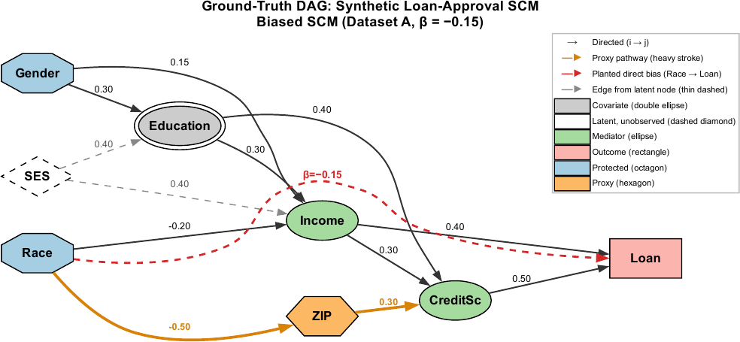
Synthetic Dataset Ground Truth
Step 2 - continued
Biased dataset A. Dashed red = planted direct bias Race → Loan (β = −0.15). Orange = proxy path Race → ZIP → CreditSc → Loan (present in A and B). SES = latent confounder of Education and Income.
8
Notes:
~30 s. Ground truth. Red dashed = planted direct bias; orange = proxy path through ZIP; SES is latent and only FCI can flag it.

Slide 9
Synthetic Results: Recovering the Planted Bias
Step 2 - continued
Algorithm | SHD A | SHD B | Edge (A) | Edge (B) | Latent conf. | β̂ (A)
PC | 8 | 7 | No | No | No | –
FCI | 9 | 8 | No | No | Yes | –
GES | 13 | 3 | No | No | No | –
GRaSP | 8 | 7 | No | No | No | –
ICA-LiNGAM | 1 | 1 | Yes | No | No | −0.1074
DirectLiNGAM | 1 | 1 | Yes | No | No | −0.1074
Both LiNGAM variants recover the planted Race → Loan edge in A and correctly omit it in B (SHD = 1)
β̂ = −0.1074 (planted −0.15); the adjusted direct effect −0.1086 agrees within 0.0012
FCI flags the latent SES confounder (undirected Education–Income edge)
PC, FCI, GES, and GRaSP miss the oriented edge
GRaSP is initialization-sensitive: 14 of 20 seeds detect the edge; the pinned run does not
n = 5,000. A = biased, B = unbiased (β̂ for B = 0.000). Edge = oriented Race → Loan detected. SHD = edits to reach the ground-truth graph; lower is better.
9
Notes:
~1 min. Table I. LiNGAM SHD = 1, finds the edge in A and not in B, β̂ = −0.1074. Regression DE −0.1086 agrees within 0.0012. Both recover ~72% of −0.15 — finite-sample attenuation, not disagreement. GRaSP's pinned run misses; 14/20 seeds hit.

Slide 10
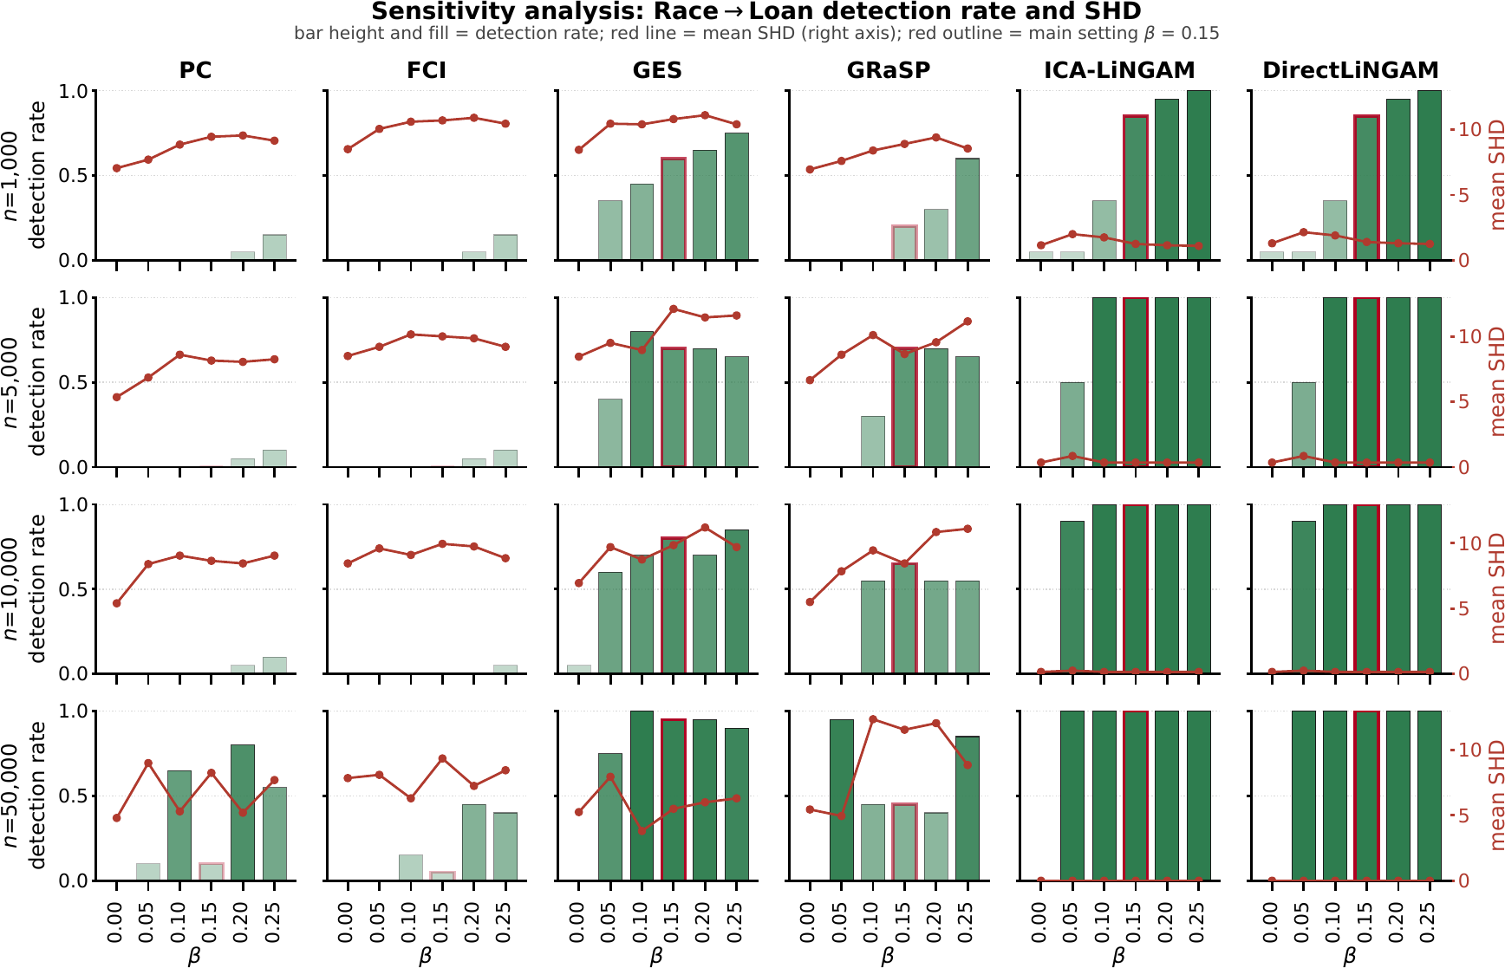
Step 2 - continued
Sensitivity Analysis: Who Detects the Bias, and When?
PC, FCI: ≤ 15% detection at n ≤ 10,000, every β
GES: improves slowly with sample size
GRaSP: peaks at 70% (n = 5,000), then falls to 45% at n = 50,000
LiNGAM: ≥ 85% at n = 1,000; ≥ 95% at n = 5,000 for β ≥ 0.10
Practical floor for audits: β ≈ 0.05
Algorithm choice is not neutral
10
Notes:
~1.5 min. Fig. 2. Bars = detection rate, red line = mean SHD, red outline = β = 0.15. Constraint-based fail at audit-relevant n. GES slowly converges. GRaSP gets worse with more data — not sampling noise. LiNGAM near-perfect from n = 5,000; β ≈ 0.05 is the practical floor. False positives are ~0 across the grid.

Slide 11
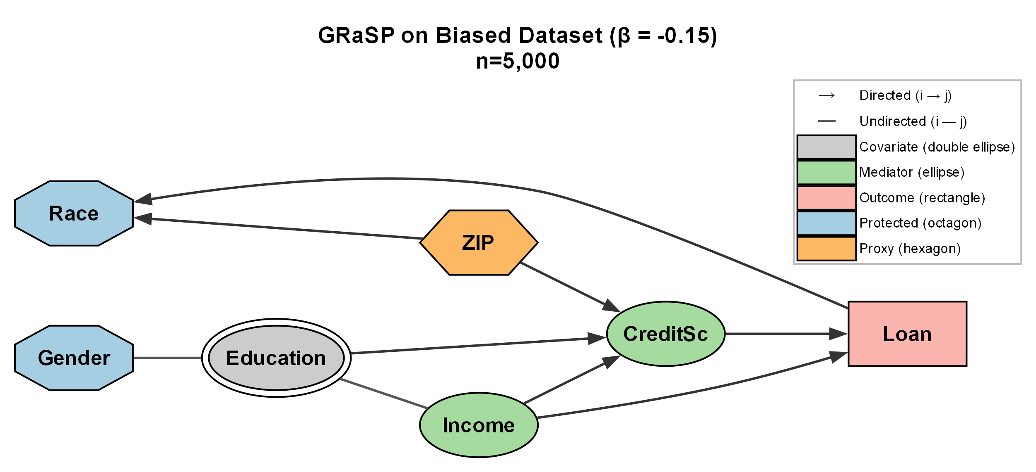
Audit Failure Mode: GRaSP on Risk Scores
GRaSP orders variables by residual variance; the lowest is treated as most exogenous
A risk score built from its own inputs has artificially low residual variance
  → placed first, with arrows into immutable attributes
More data gives a more confident wrong answer (SHD 8.65 → 11.55)
Red flag: any arrow into Race, Sex, or Age
COMPAS Score R² = 0.45; BIC prefers the impossible graph by ≈ 70 points (see supplemental material).
11
Notes:
~1 min. Mechanism: residual-variance ordering + a score that is deterministic-plus-noise in its own inputs → score looks exogenous → arrows into Race/Age. Builds on varsortability (Reisach et al.). Larger n = more confident wrong answer. Practical diagnostic: arrows into immutable attributes.

Slide 12
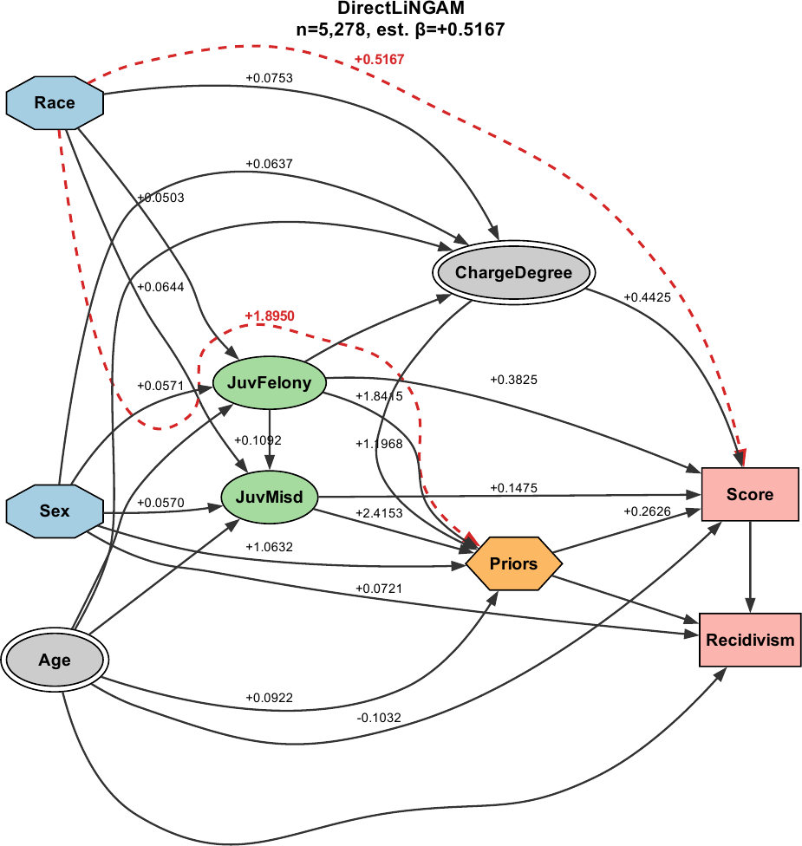
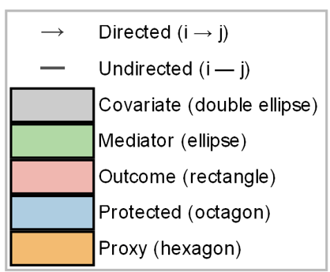
Step 3: Direct vs. Proxy Discrimination
COMPAS: Isolating the pathways
Only LiNGAM recovers both pathways: direct Race → Score (+0.5167) and proxy Race → Priors (+1.8950)
Unconstrained DirectLiNGAM rerun:
β̂ = +0.4834, so the edge is not an artifact of background knowledge
GES and GRaSP orient Score → Race — impossible
Algorithm | Type | Race→Score | Race→Priors | Lat. conf. | β̂
PC | Constraint | No | Yes | False | –
FCI | Constraint+ | No | No | True | –
GES | Score (BIC) | No | No | False | –
GRaSP | Permutation | No | No | False | –
ICA-LiNGAM | Func. Causal | Yes | Yes | False | +1.2105
DirectLiNGAM | Func. Causal | Yes | Yes | False | +0.5167
12
Notes:
~1.5 min. Step 3. Table II and Fig. 3. Only LiNGAM finds both the direct edge (+0.5167) and the proxy edge Race → Priors (+1.8950). Constraints only forbid arrows INTO Race; they do not force any arrow out of it. Unconstrained rerun gives +0.4834 (robustness run – DirectLiNGAM fit on the full sample with no background knowledge).

Slide 13
Step 4 Quantify: The Causal Effect
Total → Adjusted Direct Effect
Synthetic dataset
COMPAS dataset
Stage | Effect | SE | Controls (n) | Controls
No controls | -0.2967 | 0.0297 | 0 | None
+Income | -0.1691 | 0.0191 | 1 | Income
+Income, CreditSc | -0.1075 | 0.0166 | 2 | Income, Credit Score
+ZIP, Income, CreditSc | -0.1088 | 0.0181 | 3 | ZIP, Income, Credit Score
+Full Controls | -0.1086 | 0.0182 | 5 | Gender, Education, ZIP, Income, Credit Score
Stage | Effect | SE | Controls (n) | Controls
No controls | +1.6416 | 0.0766 | 0 | (none)
+Age + Charge | +1.1386 | 0.0725 | 2 | Age, ChargeDegree
+Full criminal history | +0.5255 | 0.0638 | 5 | Age, ChargeDegree, JuvFelony, JuvMisd, Priors
After full criminal-history controls, an adjusted direct effect of +0.5255 decile points (SE 0.0638, ≈ 0.18 SD) remains: African-American defendants scored higher than observationally identical Caucasian defendants. Synthetic check: DE −0.1086 vs. DirectLiNGAM −0.1074.
13
Notes:
~1 min. Step 4. Total effect +1.64 attenuates to +0.53 as criminal-history mediators are blocked. The residual is the controlled direct effect — the same estimand as the LiNGAM edge. Consistent with direct bias; does not by itself prove the proprietary function encodes race.

Slide 14
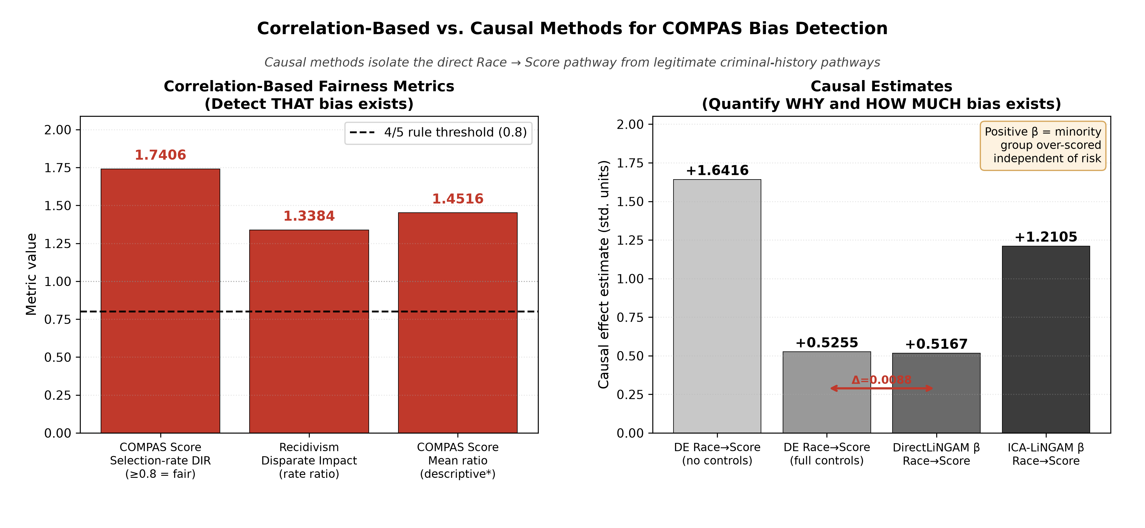
Step 5 - Validate: Bootstrapping and Sensitivity
DIR highlights discrimination bias but provides no mechanism to identify why or where.
DirectLiNGAM +0.5167 vs. adjusted DE +0.5255 (Δ = 0.0088)
Bootstrap 95% CI [+0.385, +0.637] excludes 0 (1,000 resamples)
E-value ≈ 1.65 (1.52 at the CI lower bound) [27]
14
Notes:
~1 min. Step 5. Two different identification strategies (covariate adjustment vs non-Gaussianity) agree within 0.0088. Bootstrap refits without background knowledge; CI excludes 0. E-value 1.65 (1.52 at the lower bound). The left panel figure was rounded to the 3rd decimal place in the paper and has been re-run to the 4th decimal place in the code for more precise comparison on the right panel.
If asked about 1.740 (paper Eq. 3) vs 1.7406 (figure): the paper divides the rates as printed (0.576 / 0.331 = 1.740); the figure uses full-precision rates (1.7406). Same result to two decimals.

Slide 15
Conclusions & Future Work
Correlation shows that a disparity exists; causal methods show where it comes from — and which intervention fits
Algorithm choice is not neutral: LiNGAM, especially DirectLiNGAM, recovered the pathways other families missed
COMPAS: A direct Race → Score effect (≈ +0.52 decile points) survives full controls; the proxy path through Priors needs upstream reform, not just dropping Race
Arrows into immutable attributes are a cheap red flag for a BIC-driven search on algorithmic scores
Limitations: COMPAS counts and binaries partly violate LiNGAM’s linear, non-Gaussian assumptions — treat findings as hypotheses for domain and legal review
Future work: Expanding the algorithms to lending, hiring, and healthcare data; kernel-based functional causal models to relax linearity
15
Notes:
~1 min. Takeaways, limitations, future work. Direct path → revise scoring rules; proxy path → upstream policy. Causal claims rest on untestable assumptions — hypotheses for domain and legal review.

Slide 16
Thank you — Questions?
jpadela1@umbc.edu
Code, figures, tables: github.com/jpadela1/causal_bias_detection
16
Notes:
Questions. Point to the replication repository.

Slide 17
References
[1] J. Pearl, Causality, 2nd ed. Cambridge University Press, 2009.
[2] J. Pearl, M. Glymour, and N. P. Jewell, Causal inference in statistics: A primer. John Wiley & Sons, 2016.
[3] J. Angwin, J. Larson, S. Mattu, and L. Kirchner, “Machine bias,” ProPublica, May 2016. [Online]. Available: https://www.propublica.org/article/machine-bias-risk-assessments-in-criminal-sentencing.
[4] S. Corbett-Davies and S. Goel, “The measure and mismeasure of fairness,” arXiv preprint arXiv:1808.00023, 2018.
[5] T. Calders, F. Kamiran, and M. Pechenizkiy, “Building classifiers with independency constraints,” in Proceedings of the IEEE International Conference on Data Mining Workshops (ICDMW), 2009, pp. 13–18.
[6] M. Hardt, E. Price, and N. Srebro, “Equality of opportunity in supervised learning,” in Advances in Neural Information Processing Systems (NeurIPS), 2016, pp. 3315–3323.
[7] C. Su, G. Yu, J. Wang, Z. Yan, and L. Cui, “A review of causality-based fairness machine learning,” Intelligence Robotics, vol. 2, no. 3, 2022.
[8] J. Larson, S. Mattu, L. Kirchner, and J. Angwin, “How we analyzed the COMPAS recidivism algorithm,” ProPublica, May 2016. [Online]. Available: https://www.propublica.org/article/how-we-analyzed-the-compas-recidivism-algorithm.
[9] “44 FR 11996: Interpretation of the uniform guidelines on employee selection procedures (1979),” vol. 44, no. 43, pp. 11996–12009, 1979, relevant formula on p. 11998. [Online]. Available: https://archives.federalregister.gov/issue_slice/1979/3/2/11900-11997.pdf
[10] B. H. Zhang, B. Lemoine, and M. Mitchell, “Mitigating unwanted biases with adversarial learning,” in Proceedings of the AAAI/ACM Conference on AI, Ethics, and Society (AIES), 2018.
[11] Supreme Court of the United States, “Griggs v. Duke Power Co.” 401U.S. 424, 1971, decided March 8, 1971.
[12] M. J. Kusner, J. Loftus, C. Russell, and R. Silva, “Counterfactual fairness,” in Advances in Neural Information Processing Systems (NeurIPS), 2017.
[13] S. Goethals, D. Martens, and T. Calders, “PreCof: Counterfactual explanations for fairness,” Machine Learning, vol. 113, no. 5, pp. 3111–3142, 2024.
[14] C. Glymour, K. Zhang, and P. Spirtes, “Review of causal discovery methods based on graphical models,” Frontiers in Genetics, vol. 10, 2019.
17

Slide 18
References
[15] S. Shimizu, P. O. Hoyer, A. Hyvarinen, A. Kerminen, and M. Jordan, “A linear non-Gaussian acyclic model for causal discovery,” Journal of Machine Learning Research, vol. 7, pp. 2003–2030, 2006.
[16] S. Shimizu, T. Inazumi, Y. Sogawa, A. Hyvarinen, Y. Kawahara, T. Washio, P. O. Hoyer, and K. Bollen, “DirectLiNGAM: A direct method for learning a linear non-gaussian structural equation model,” Journal of Machine Learning Research, vol. 12, pp. 1225–1248, 2011.
[17] L. Cheng, A. Mosallanezhad, P. Sheth, and H. Liu, “Causal learning for socially responsible AI,” arXiv preprint arXiv:2104.12344, 2021.
[18] C. Glymour, P. Spirtes, and R. Scheines, “Causal inference,” Erkenntnis, vol. 35, pp. 151–189, 1991.
[19] P. Spirtes, C. N. Glymour, and R. Scheines, Causation, Prediction, and Search, 2nd ed. MIT Press, 2000.
[20] C. Meek, “Graphical models: Selecting causal and statistical models,” Ph.D. dissertation, Carnegie Mellon University, 1997.
[21] W.-Y. Lam, B. Andrews, and J. Ramsey, “Greedy relaxations of the sparsest permutation algorithm,” in Proceedings of the Conference on Uncertainty in Artificial Intelligence (UAI), 2022, pp. 1052–1062.
[22] Y. Zheng et al., “Causal-learn: Causal discovery in Python,” Journal of Machine Learning Research, vol. 25, no. 60, pp. 1–8, 2024.
[23] PyWhy contributors, “DoWhy: A Python package for causal inference,” Software, version 0.14, 2026. [Online]. Available: https://www.pywhy.org/dowhy.
[24] M. Bertrand and S. Mullainathan, “Are Emily and Greg more employable than Lakisha and Jamal? a field experiment on labor market discrimination,” American Economic Review, vol. 94, no. 4, pp. 991–1013, 2004.
[25] Z. Obermeyer, B. Powers, C. Vogeli, and S. Mullainathan, “Dissecting racial bias in an algorithm used to manage the health of populations,” Science, vol. 366, no. 6464, pp. 447–453, 2019.
[26] R. Bartlett, A. Morse, R. Stanton, and N. Wallace, “Consumer-lending discrimination in the fintech era,” Journal of Financial Economics, vol. 143, no. 1, pp. 30–56, 2022.
[27] T. J. VanderWeele and P. Ding, “Sensitivity analysis in observational research: introducing the E-value,” Annals of Internal Medicine, vol. 167, no. 4, pp. 268–274, 2017.
18

Slide 19
Appendices
Additional graphs and supplemental information

Slide 20
Causal Methods
P
CAUSAL DISCOVERY
CAUSAL INFERENCE
β / ATE
Effect / ATE
Constraint · Score ·
Functional (LiNGAM)
A
Propensity · Instrumental variables ·
Regression adjustment
Y
Raw data (CSV)
Output DAG = input
e.g., COMPAS
Example of using causal discovery and causal inference together to illustrate their use in our experiments. On the DAG, A is the input representation, P is the Proxy or Mediator, and Y is the Outcome.
Causal discovery
Causal inference
Input: Raw data (example, COMPAS 2-year recidivism records in a CSV file)
Method: Constraint-, score-, or functional/structural equation-based models.
Output: Directed Acyclic Graph (DAG) or Markov equivalence class (CPDAG) when the direction cannot be determined.
Input: Domain knowledge, assumptions, or the output graph from causal discovery
Method: Propensity scores, instrumental variables, and regression adjustments
Output: An effect estimate – its size or direction; average treatment effect (ATE); or risk difference.
Notes:
Constraint-based – runs conditional independences tests (PC, FCI)
Score-based – optimizing graph-fit metrics (BIC/AUC). GES
Functional causal models use mathematical properties of the data-generating process – structural equations – they output a unique causal ordering
Propensity scores estimate the statistical probability that an entity (person, item, group) will receive treatment or conditioning on certain attributes. It is used to balance a distribution to be ‘identically distributed’ (independent and identically distributed) making the distribution fair (level set or even playing field). Uses matching (pairs similarly scored units, persons, items); stratification (groups similarly scored sub-classes within a particular score range); weighting (gives more statistical weight to under-represented subjects for balancing the overall distribution or group).

Slide 21
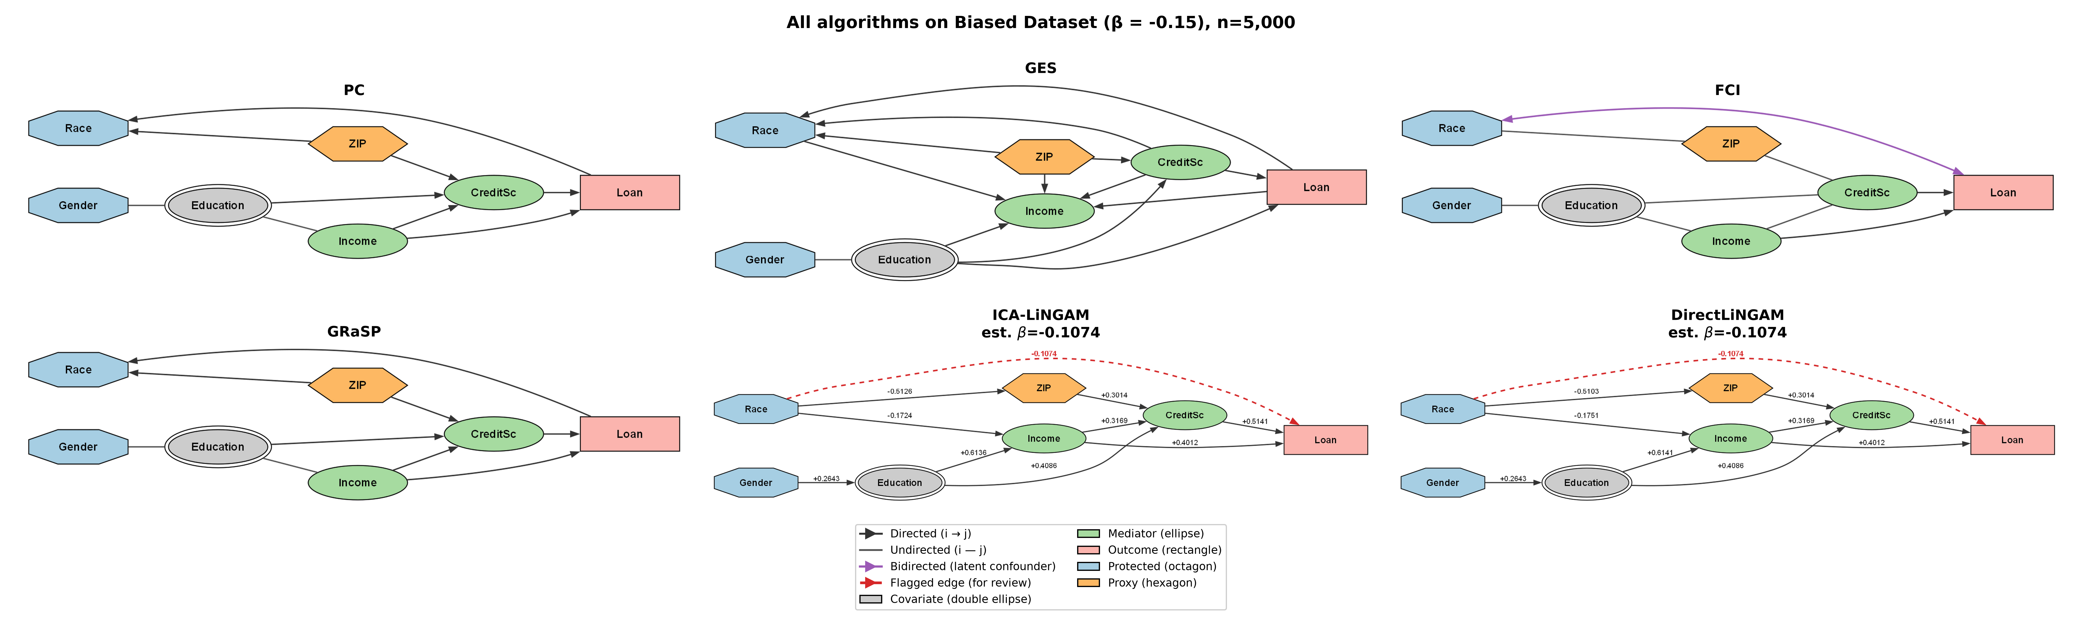



Causal Graphs Learned by the Six Algorithms (Biased Dataset)
Hidden confounder detected
Loan$→$ Race incoherent edge
Race$→$Loan direct bias detected
Race$→$Loan direct bias detected
21
Notes:
BACKUP slide for Q&A.

Slide 22
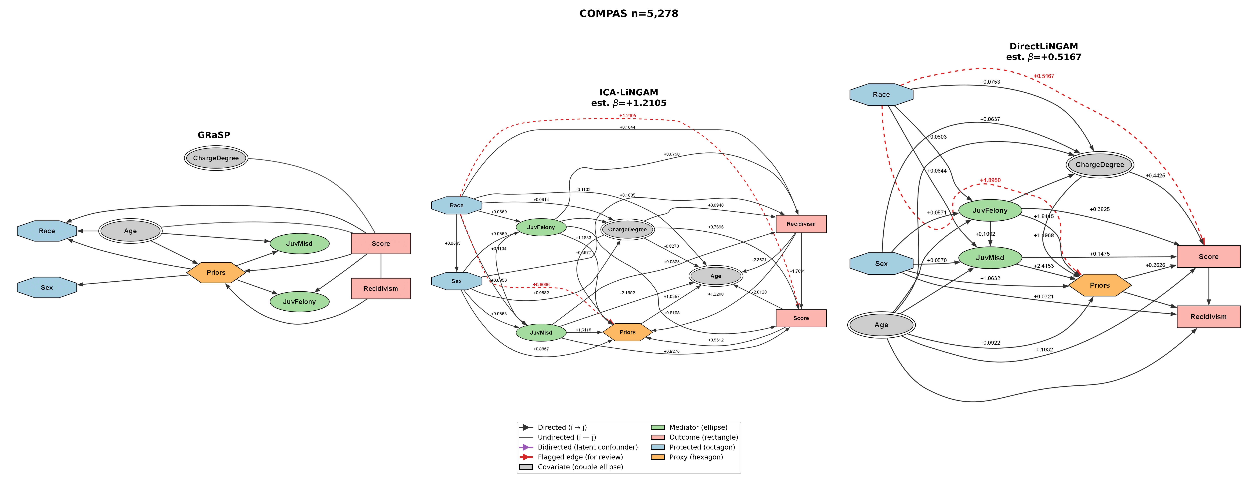
Causal Graphs Learned by the Three of the Six Algorithms
22
Notes:
BACKUP slide for Q&A.

Slide 23
Related Work
Correlation-based fairness
  Statistical parity – favorable outcome for an underprivileged group, 0.0 is equal parity. This is based on correlation and proportions.
  Equalized odds/opportunity [6]
  Disparate impact ratio (DIR [7]) – “4/5ths rule” – if the underprivileged group ratio is < 0.80 unfair practices and policies (hiring, lending) are likely.
    Correlation-based fairness methods are comparisons based on ratios and proportions. However, when there are hidden confounders and proxy discriminators, it still results in biased outcomes.
    Our method exposes causal pathways and hidden confounders. For example, in our lending dataset with planted bias, we expose the ZIP as a proxy discriminator.
Causal Fairness
  Counterfactual fairness (Kusner et al. [12]) – If one changed a protected attribute to the counterfactual, would the outcome change.
  Predictive counterfactual fairness (Goethals et al. [13])
    Both counterfactual fairness related works take a different approach than ours by applying counterfactual hypotheses to address fairness.
    Both are limited in that getting rid of one attribute that addresses fairness, other proxy discriminators may remain. The proxies also create bias and unfair practices, such as reducing the likelihood of loan approval based on an applicant’s ZIP code.
    These methods require increased oversight by domain experts who can guide the counterfactual selection (and can identify a proxy manually should one exist).
23
Notes:
BACKUP slide for Q&A.

Slide 24
Related Work (continued)
Causal Fairness (continued)
  Survey of path-specific causal fairness methods (Su et al. [7]) – a review of limitations of correlations and advantages of causal-based methods. Our method uses causal discovery to detect bias and causal pathways that may expose discrimination through hidden confounders and proxy discriminators.
COMPAS Study (Angwin et al. [3, 8])
  We use this study to present the real-world dataset that has a high correlation with bias occurring in sentencing and judicial decisions.
  We use comparable metrics to show the improved approach that causal science can provide.
Causal discovery
  Graphical model-based algorithms introduced in these two works (Shimizu et al.).
    ICA-LiNGAM [15] – both LiNGAM variants identify the nodes, oriented edges, and shows the magnitude(|ꞵ|) along the edges.
    DirectLiNGAM [16] – we used both LiNGAM papers to inform our work and provide deeper analysis.
  Causal learning (Cheng et al. [17])
    We use causal discovery algorithms, but we experiment on a controlled bias scenario and then apply it to a real-world dataset with a reported bias
    We wanted to see “if” causal discovery can detect bias, then which algorithms worked best, and to provide edge values to show the strengths or magnitude of the bias.
Causal inference
  Backdoor criterion to estimate an Average Treatment Effect (Pearl et al. [1, 2])
  Cross-validation metrics and ATE results are used to further support or fail our methods.
24
Notes:
BACKUP slide for Q&A.

Slide 25
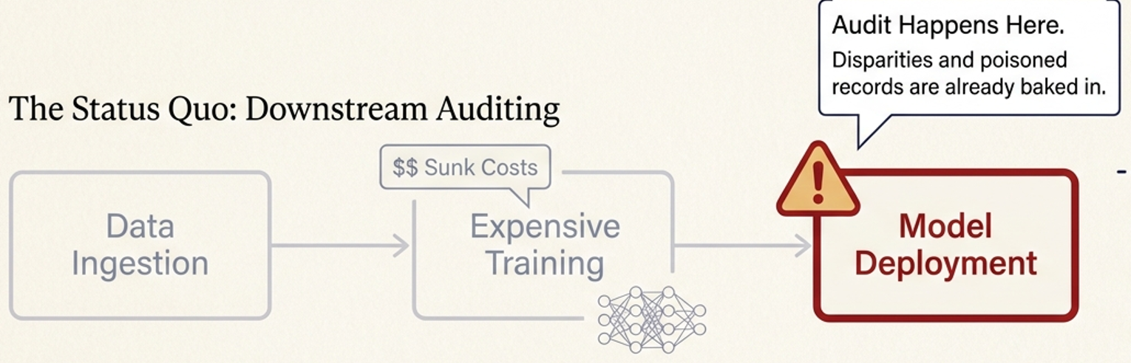
Related Work: Correlation and Causal Fairness Methods - Our Novelty
Prior fairness work shows disparity exists [6, 9], needs hand-built counterfactuals [12, 13], or remains theoretical [7, 26]. Our methods automatically discover the discriminatory pathways and suggest interventions at the dataset level, before prediction model training.
Existing AI Causal Fairness and Correlation Methods
Notes:
BACKUP slide for Q&A. Correlation-based fairness [6, 9] identify proportions and outcomes, but indirect bias is left intact. Causal discovery exposes indirect bias and its pathways to guide us to interventions.
Counterfactual methods [12, 13] surface implicit bias through causal methods, but require expert-guided counterfactuals. Unmodeled proxies continue to discriminate. Our causal methods automatically finds the proxy pathway without manual selection.
Several path-specific causal fairness [7, 29] and discrimination [51] works review limits of correlation, discuss direct and indirect effects and decision, but stop at empirical detection and operationalization at the dataset level.

Slide 26
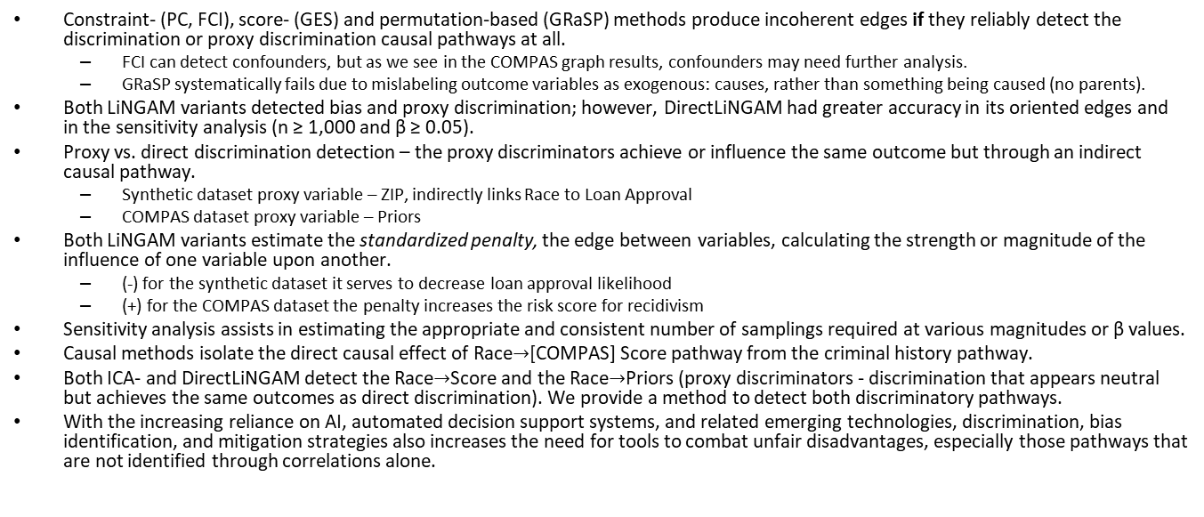
Key Interpretations
Constraint- (PC, FCI), score- (GES) and permutation-based (GRaSP) methods produce incoherent edges if they reliably detect the discrimination or proxy discrimination causal pathways at all.
  FCI can detect confounders, but as we see in the COMPAS graph results, confounders may need further analysis.
  GRaSP systematically fails due to mislabeling outcome variables as exogenous: causes, rather than something being caused (no parents).
Both LiNGAM variants detected bias and proxy discrimination; however, DirectLiNGAM had greater accuracy in its oriented edges and in the sensitivity analysis (n ≥ 1,000 and β ≥ 0.05).
Proxy vs. direct discrimination detection – the proxy discriminators achieve or influence the same outcome but through an indirect causal pathway.
  Synthetic dataset proxy variable – ZIP, indirectly links Race to Loan Approval
  COMPAS dataset proxy variable – Priors
Both LiNGAM variants estimate the standardized penalty, the edge between variables, calculating the strength or magnitude of the influence of one variable upon another.
  (-) for the synthetic dataset it serves to decrease loan approval likelihood
  (+) for the COMPAS dataset the penalty increases the risk score for recidivism
Sensitivity analysis assists in estimating the appropriate and consistent number of samplings required at various magnitudes or β values.
Causal methods isolate the direct causal effect of Race$→$[COMPAS] Score pathway from the criminal history pathway.
Both ICA- and DirectLiNGAM detect the Race$→$Score and the Race$→$Priors (proxy discriminators - discrimination that appears neutral but achieves the same outcomes as direct discrimination). We provide a method to detect both discriminatory pathways.
With the increasing reliance on AI, automated decision support systems, and related emerging technologies, discrimination, bias identification, and mitigation strategies also increases the need for tools to combat unfair disadvantages, especially those pathways that are not identified through correlations alone.
26
Notes:
BACKUP slide for Q&A.

