Slide 1
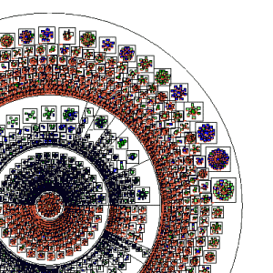
Kernel Space vs. User Space
File I/O Speed
By Jacob Adkins

Slide 2
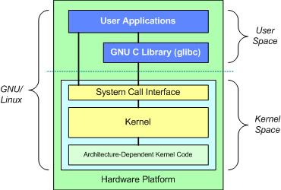
User Space vs. Kernel Space

Slide 3
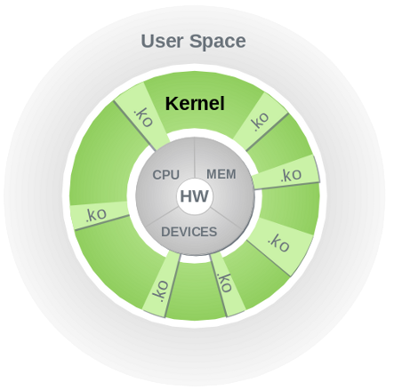
Kernel Modules

Slide 4
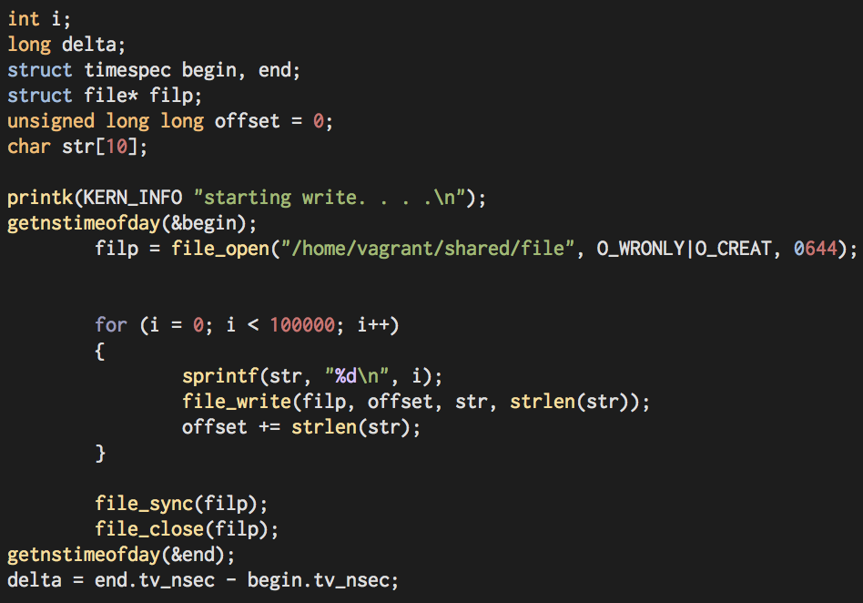
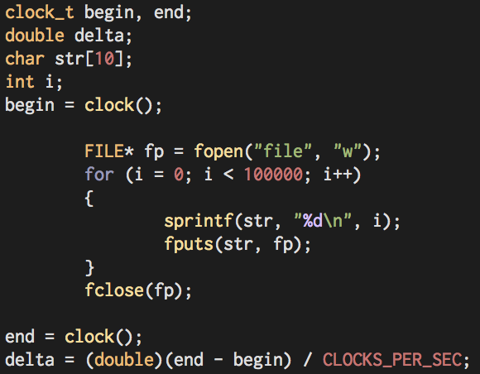
The Experiment

Slide 5
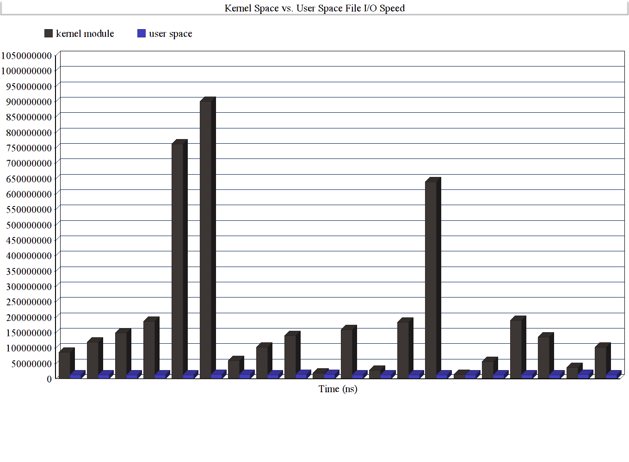
The Results

Slide 6
Explanations
The build system
The environment
The functions used
The implementation

Slide 7
Thank You

