Slide 1

POST-PANDEMIC APOCALYPSE
(GO) TEAM GO

Slide 2

INTRODUCTION
As if 2020 wasn’t bad enough, a zombie apocalypse has started in Ontario! The CDC has identified the outbreak of the ZBY1 virus. Team Go was enlisted to help track the spread and prevent the virus from spreading further.

Slide 3

PROBLEM IDENTIFICATION

Slide 4

PROBLEM STATEMENT
Successfully track the spread of ZBY1 in the school within a single school day. The main focus will be on contact tracing for students, teachers, and TAs, as well as the analysis of the provided school record data.

Slide 5
PLANNING AND ANALYSIS

Slide 6
SET UNIONS
BAYESIAN REASONING
01
02
HEURISTIC BAYES
03
POSSIBLE APPROACHES
Low accuracy for calculating probability, but considers all interactions
High accuracy for calculating probability, but computationally expensive
Exploit the accuracy of Bayes, while only considering the top 5 highest infection likelihoods at any given time

Slide 7
CHOSEN SOLUTION OVERVIEW
HEURISTIC BAYES
HISTORICAL PROBABILITIES
CONTACT TRACING
Assign probabilities based on the outlined criteria throughout the day
Factor in contaminants lingering in the classrooms and during class transitions
Send SMS notifications for exposed individuals

Slide 8
IMPLEMENTATION AND TESTING

Slide 9
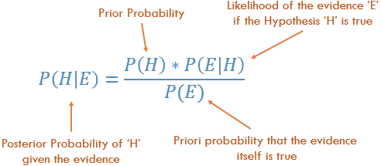
IMPLEMENTATION – PROBABILITY OF INFECTION
The base rate of infection is 3 people per class period.
Q: How do we determine who those people are?
A: Calculate their probability of infection via a heuristic approach to Bayes

Slide 10
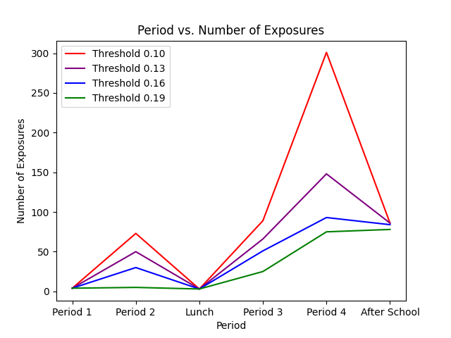
IMPLEMENTATION – PROBABILITY OF INFECTION

Slide 11
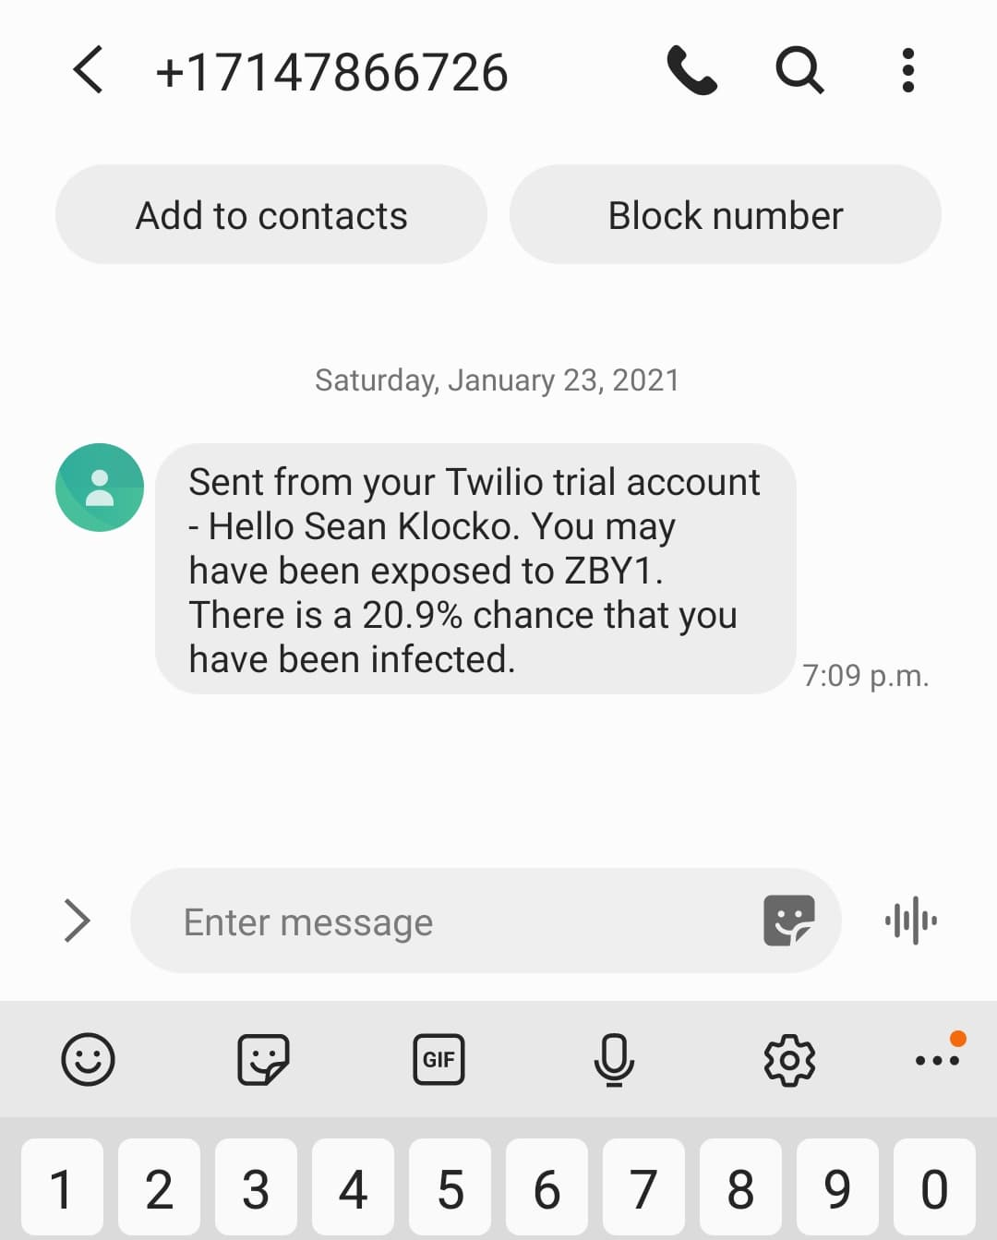
IMPLEMENTATION – EXPOSURE NOTIFICATIONS
Send SMS notifications to all individuals with a risk of exposure > 10%
We are using a Twilio SMS free trial for the purposes of this demo

Slide 12

USE OF HEURISTICS
TESTING AND LIMITATIONS OF SOLUTION
TWILIO
FREE TRIAL
INCOMPLETE DEBUGGING
Slightly limited our accuracy by restricting the number of combinations
Could only send notifications to 1 phone number
TA exposure values are updating, but time constraint prevented us from tracking TA-class relationships

Slide 13
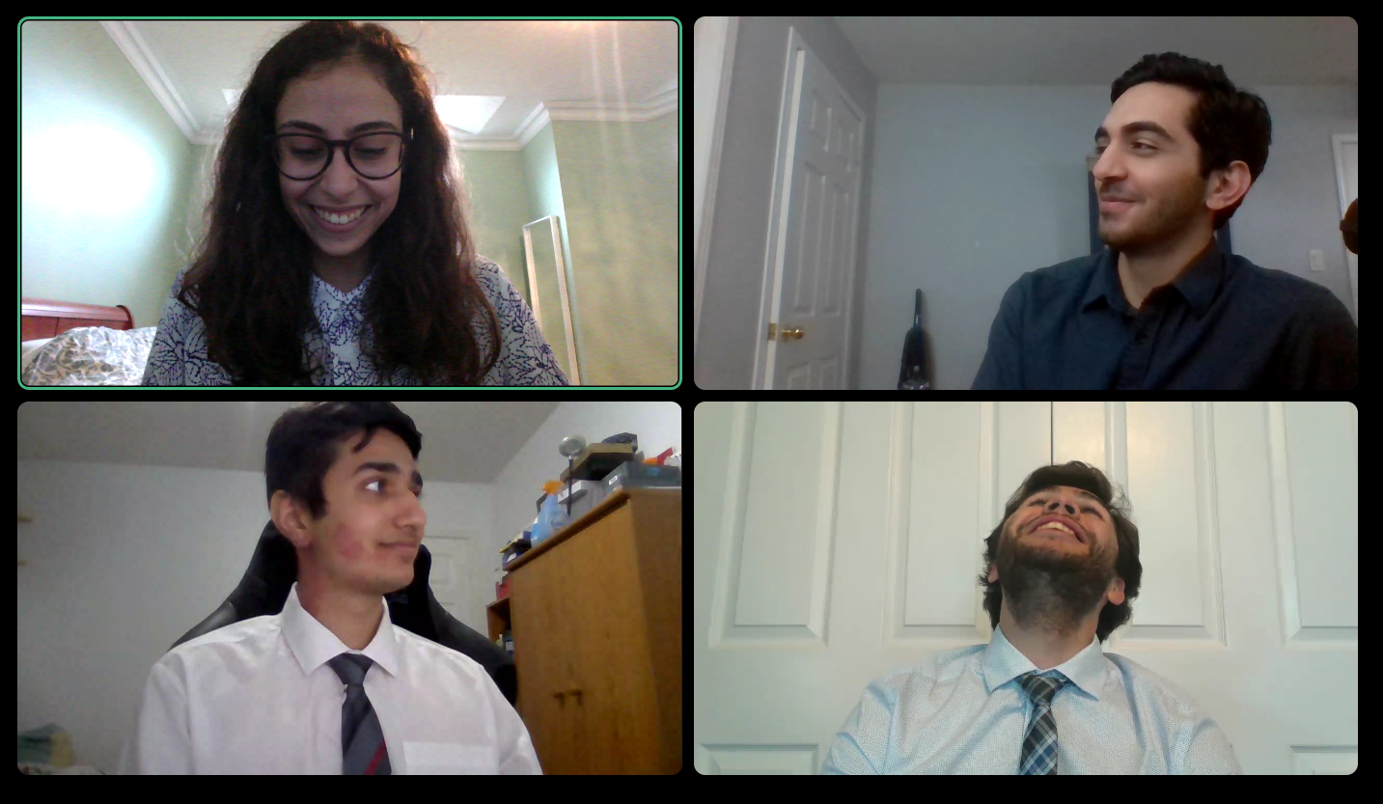
(GO) TEAM GO
PROTOTYPE DEMO

Slide 14
RESOURCES
https://notes.devonzuegel.com/post/164223716393/bayesian-reasoning
https://www.twilio.com/
Please keep this slide for attribution.

