Slide 1

INSERT PUN HERE
TEAM SUNFLOWER

Slide 2

INTRODUCTION
FINGERS CROSSED FOR A POS APP

Slide 3
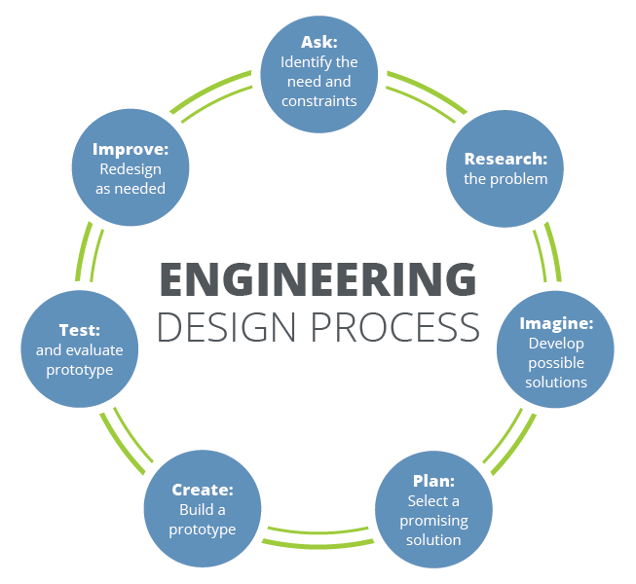
PROBLEM IDENTIFICATION

Slide 4

PROBLEM STATEMENT
FINGERS CROSSED FOR POS APP

Slide 5
STAKEHOLDERS AND TARGET USERS
THE ORGANIZATION
THE GENERAL PUBLIC
Require appropriate research results to predict the specimen containment
Results must be accurate to ensure the safety of the public
(MAY BE REMOVED)

Slide 6
PLANNING AND ANALYSIS

Slide 7
PRIORITIZE COST
PRIORITIZE CO₂
01
02
SUPPLY TO NEIGHBOURS
03
SPLIT INTO SEPARATE SLIDES FOR EACH IF WE HAVE VISUALS
POSSIBLE SOLUTIONS
Focused more on stakeholder needs (companies and residents), but may cause problems in the future
Focused more on environmental impact, but can be costly
Generate additional power and sell to the neighbours

Slide 8
CHOSEN SOLUTION OVERVIEW
OVERVIEW SLIDE SHOULD OUTLINE THE STEPS WE WILL DISCUSS IN IMPLEMENTATION
Analyze parsed data and calculate additional params
Generate necessary power in order of priority
CALCULATIONS
GREEDY ALGORITHM
DATA PARSING
ENERGY PRIORITY
FUTURE DEMAND
Parse input csv files and store data in dictionaries
Assign priorities based on green sources and cost
Anticipate drastic changes in the power required by Ontarians

Slide 9
IMPLEMENTATION AND TESTING

Slide 10
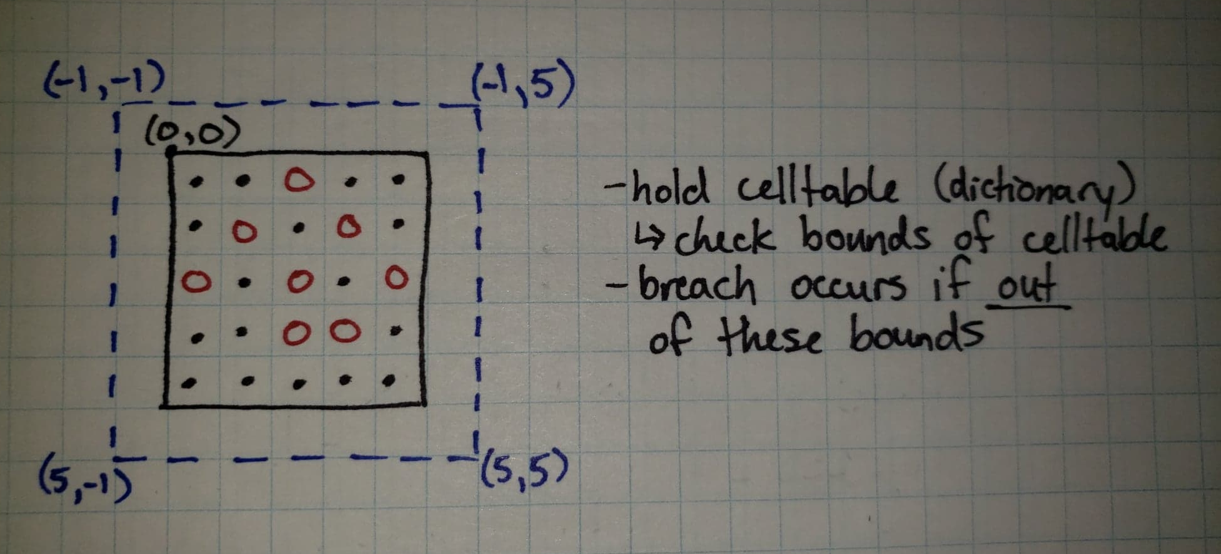
IMPLEMENTATION – XXXXXXXX
Given the scope of this challenge, the most “time-optimal” solution runs in O(n^3)
MENTION COMPLEXITY AND HOPE IT’S NOT SHIT

Slide 11
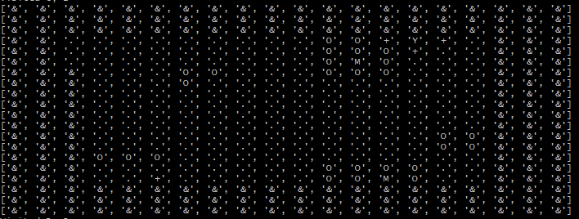
IMPLEMENTATION – SPIRAL TRAVERSAL
Console output for a spiral traversal case

Slide 12
TESTING PROCESS
TALK ABOUT HOW WE TESTED SHIT AND DEBUGGED
DISCUSS CPU AND PERFORMANCE METRICS

Slide 13

WTF WENT WRONG
LIMITATIONS OF SOLUTION
2ND THING THAT WENT WRONG
DEAR GOD I HOPE THERES NOT A THIRD
Re-evaluated goals for a more feasible solution
Encountered unexpected bugs during testing
Only had 8 hours to build working prototype

Slide 14
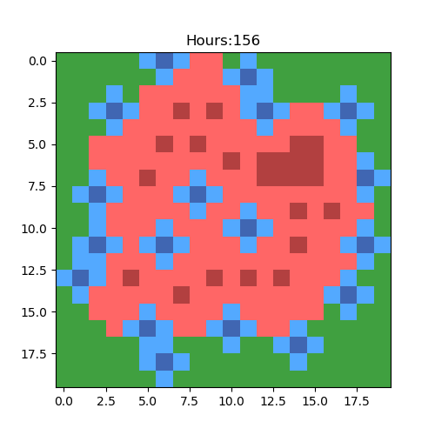
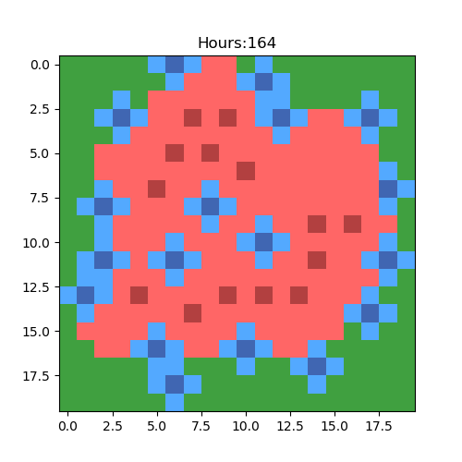
FUTURE IMPLEMENTATIONS
Testing grounds at different 4-hour intervals (using matplotlib)

Slide 15
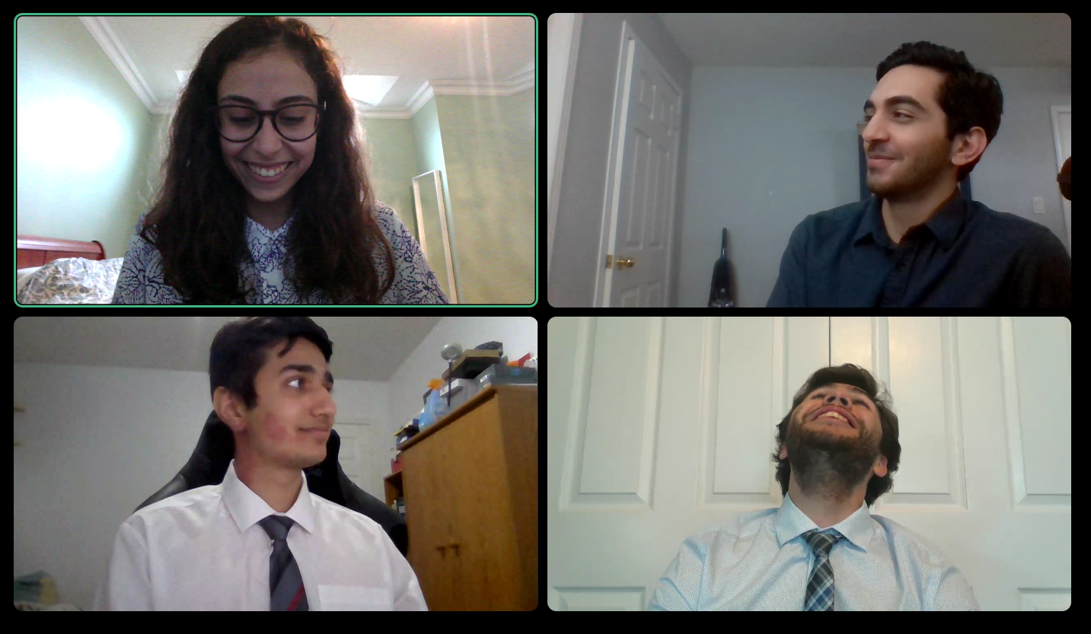
JAVA DOUBLE DOUBLE
PROTOTYPE DEMO

Slide 16
RESOURCES
Please keep this slide for attribution.

