Slide 1
Battle of Neighborhoods: Examining venues of Palm Beach county in sunny Florida
Capstone Project
Applied Data Science Capstone, IBM Data Science Certification, Coursera
Julia Versinina
September 10, 2019

Slide 2
Background
Many people in the United States move from one state to another for many reasons including but not limited to family bonds, professional opportunities, lower cost of living and overall pursuit of happiness. When people make the decision to move, they must gather relevant information about the new location. Most likely, they would like to keep some things they liked while living in an existing (old) location. Also, hopefully, they can solve some of the problems that were not desirable in an old setting.

Slide 3
Problem Definition
There are a lot of reasons for many people to love Chicago for cultural diversity, beautiful architecture, convenient public transportation, lots of professional opportunities and attractions such as museums, theaters and great dining options. There are several challenges of living in Chicago such as long cold winters and high property costs, including high property taxes. One of the ways to achieve a better life balance would be to seek for places in the United States that have warmer weather and lower cost of living. Florida combines both, warm weather and generally lower cost of living, when compared to Chicago. On the other hand, Florida has a completely different culture and style of living compared to the Midwest. People who consider moving to Florida should do their research to find the best fit for them. This project will be limited to analysis of venues data of neighborhoods of Palm Beach County in Florida, but a similar approach can be used to analyze any other county of Florida.

Slide 4
Target Audience
Target audience are people who consider moving to warmer states, such as Florida. This analysis will help target audience to learn about distribution of surrounding venues within Palm Beach County such as restaurants, health clubs, parks, and other venues.

Slide 5
Data
Zip Codes for the county of Palm Beach, Florida: https://www.zipcodestogo.com/Palm%20beach/FL/
US Zip Code Latitude and Longitude values: https://public.opendatasoft.com/explore/dataset/us-zip-code-latitude-and-longitude/table/?refine.state=FL
Foursquare API to get the most common venues of given zip code of Palm Beach, Florida

Slide 6
Methodology & Analysis
We will use Pandas Python library to work with data. We will use collected data from various public web sources to convert it into Pandas dataframes for further clean up and manipulation. We will clean up Pandas dataframes by using existing methods built into pandas. We will combine several dataframes into one dataframe for final analysis. We will use several libraries for additional data retrieval and analysis. Specifically, we will use Geopy library to retrieve Latitude and Longitude values of Palm Beach county for each zip code. We will use Matplotlib and Folium libraries for visualizing data as maps. We will use Foursquare API to locate closest venues per any desired zip code. We will use Sklearn library to compute k-means and to identify clusters of areas per zipcode of one chosen city of Palm Beach county.

Slide 7
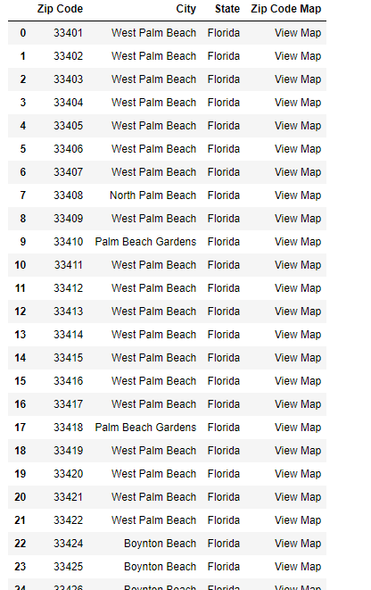
Step 1
Collect data with zip codes and cities of Palm Beach county of Florida.
We ended up retrieving 74 entries total that are in Palm Beach county in Florida with either different zip code or city name.

Slide 8
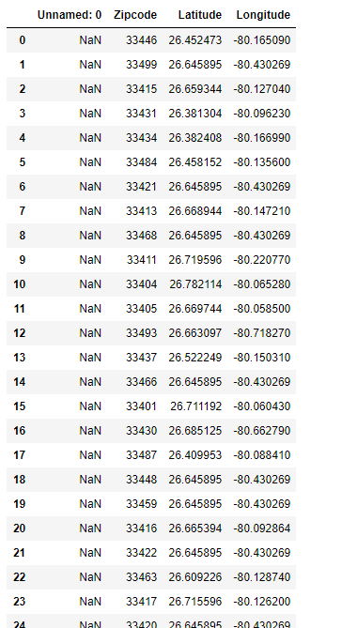
Step 2
Retrieve Latitudes and Longitudes for each zip code.

Slide 9
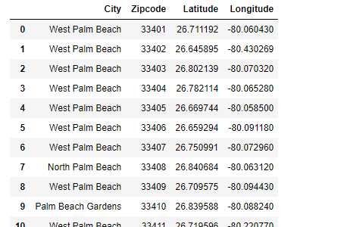
Step 3
Combine two dataframes.

Slide 10
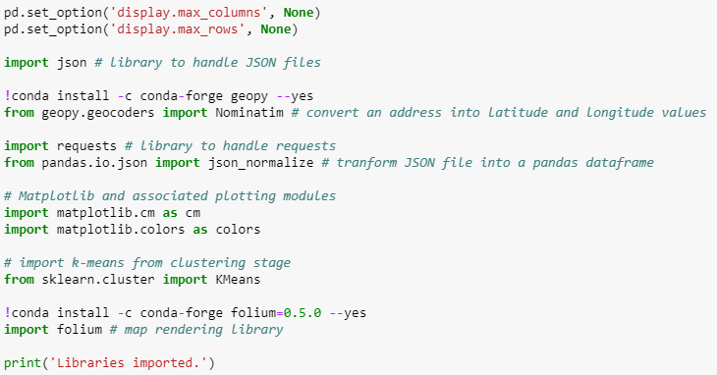
Step 4
Download dependencies:
Geopy, Json, Matplotlib, sklearn KMeans and Folium.

Slide 11
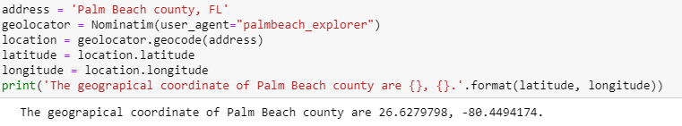
Step 5
Use Geopy library to get the latitude and longitude values of Palm Beach county.

Slide 12
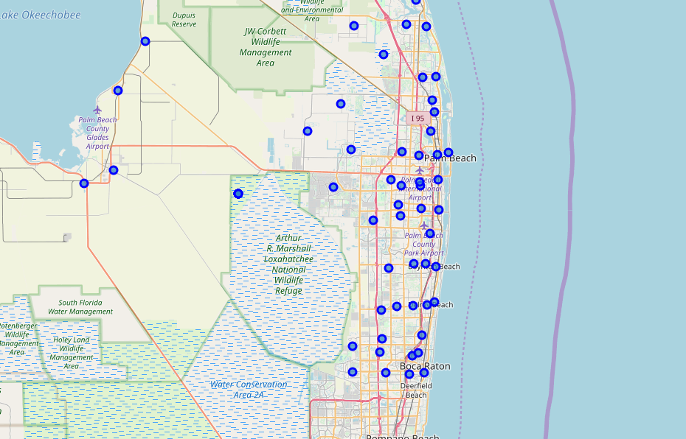
Step 6
Create a map of Palm Beach county with markers

Slide 13
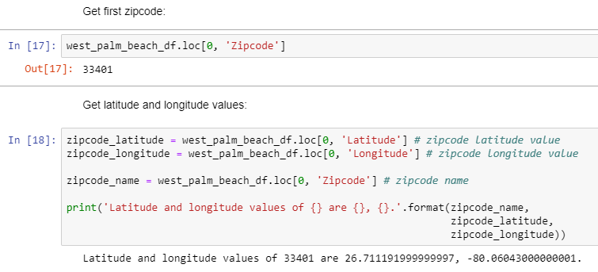
Step 7
Examine first zip code in the West Palm Beach town

Slide 14
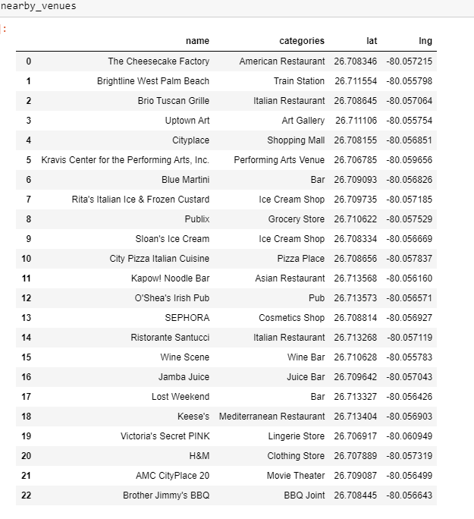
Step 8
Get the top 100 venues that are in West Palm Beach within a radius of 500 meters

Slide 15
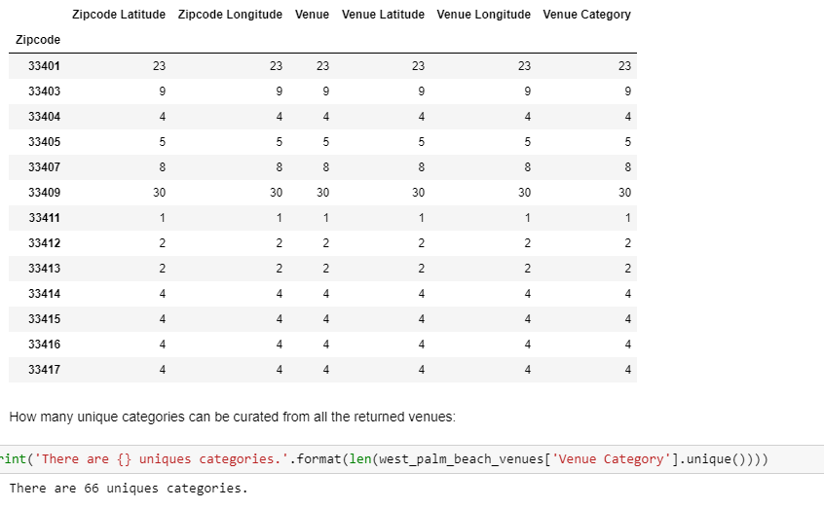
Step 9
Repeat the same process to all the zipcodes in West Palm Beach. Create a new dataframe called west_palm_beach_venues.
Check how many venues were returned for each zip code.
Check how many unique categories can be curated from all the returned venues.

Slide 16
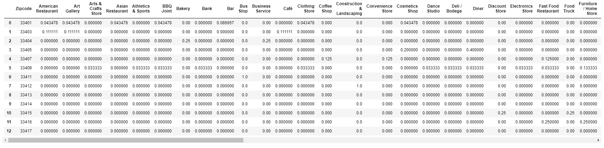
Step 10
Analyze each zip code. Group rows by zip code and by taking the mean of the frequency of occurrence of each category.

Slide 17
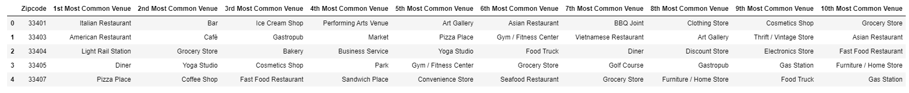
Step 11
Print each zip code along with the top 5 most common venues.
Put that into a pandas dataframe.
Create function to sort the venues in descending order.
Create the new dataframe and display the top 10 venues for each neighborhood.

Slide 18
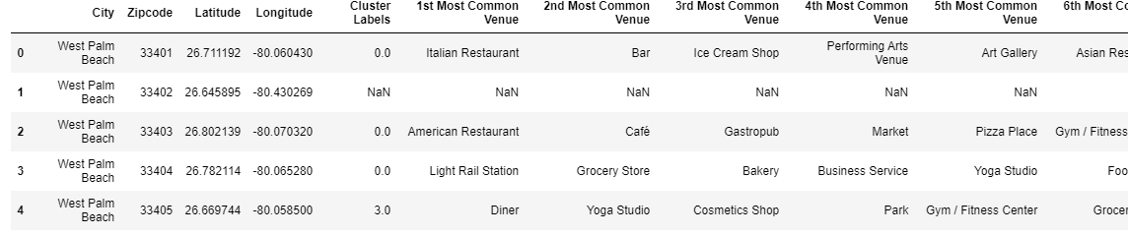
Step 12
Cluster Neighbourhoods by Zip Code. Run k-means to cluster the zip codes into 5 clusters. Create a new dataframe that includes the cluster as well as the top 10 venues for each zip code.

Slide 19
Examine Clusters

Slide 20
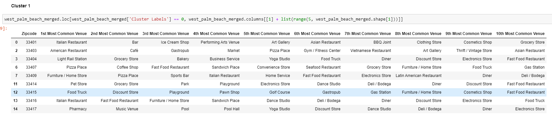
Cluster 1

Slide 21
Cluster 2

Slide 22
Cluster 3

Slide 23
Cluster 4

Slide 24
Cluster 5

Slide 25
Results & Discussion
Based on the results, we can observe that Cluster 1 returned much more zip codes that Cluster 2, Cluster 3, Cluster 4 and Cluster 5. We can see that Cluster 1 includes nine unique zip codes: 33401, 33403, 33404, 33407, 33409, 33414, 33415, 33416, and 33417. Cluster 1 returned a lot of fun and convenient venues such as various restaurants, entertainment places and retail stores. Cluster 2, Cluster 3, Cluster 4 and Cluster 5 only have one zip code each with just a few venues such as construction & landscaping, discount store and park venues. Based on these observations, if I would consider moving from the city of Chicago to Florida, West Palm Beach could be a good candidate. I would specifically look into zip codes from Cluster 1 since it seem to offer a lot of things that I already like in Chicago such as great dining and access to health clubs.

Slide 26
Conclusion
Similar calculations and analysis can be performed on other counties and zip codes in Florida or other states to examine clusters based on venues. This sort of analysis can help people to decide what specific locations and zip codes have ideal set of venues in order to plan to move to another state.

