Slide 1
Hand Gesture Recognition
KRISHNA SINDHURI VEMURI
JAY PALAN

Slide 2
Introduction
Every gesture recognition system is characterized by its unique features.
The essential task is to select these features from the vision based method.
Goal:
To identify Indian cultural gestures using techniques like
Hand Segmentation using Thresholding
Contour Detection
Convex Hull of a Contour Area

Slide 3
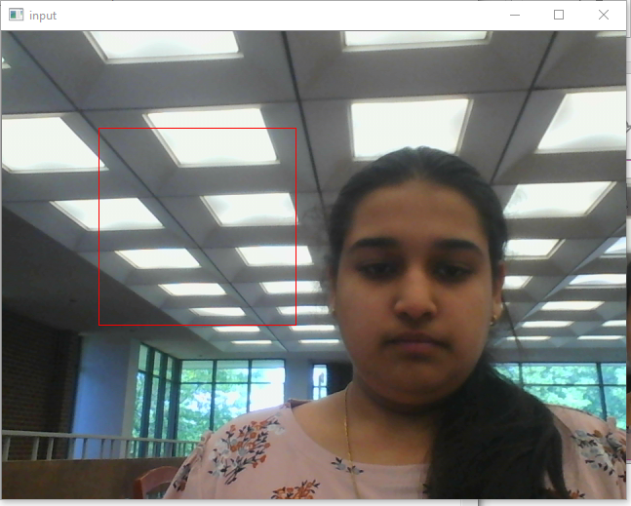
OUR Approach
Use the laptop camera as an input
Consider a 200*200 window frame to find the gestures

Slide 4

OUR APPROACH
Use thresholding techniques for extracting foreground hand image from that window

Slide 5
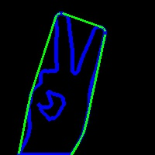
OUR APPROACH
Find contours for the threshold image
Find convexity hull of the contour
Find the convexity defects of the convex hull

Slide 6
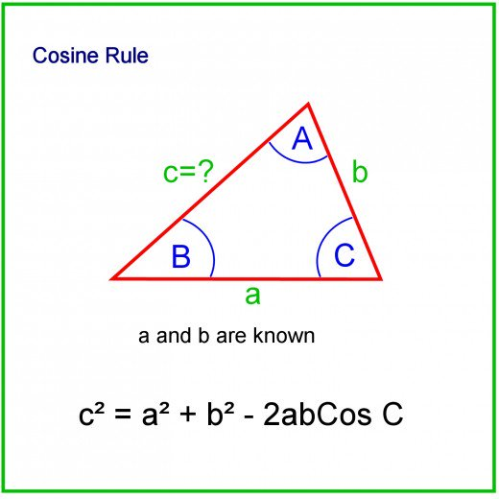
OUR APPROACH
Once defects are found, find the number of triangles in the image using the cosine rule
According to the defects area and number of triangles found categorize the gestures found.

Slide 7
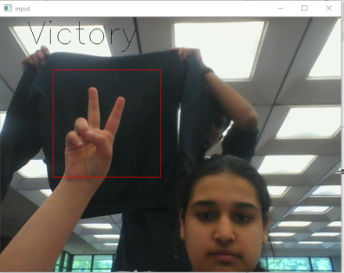
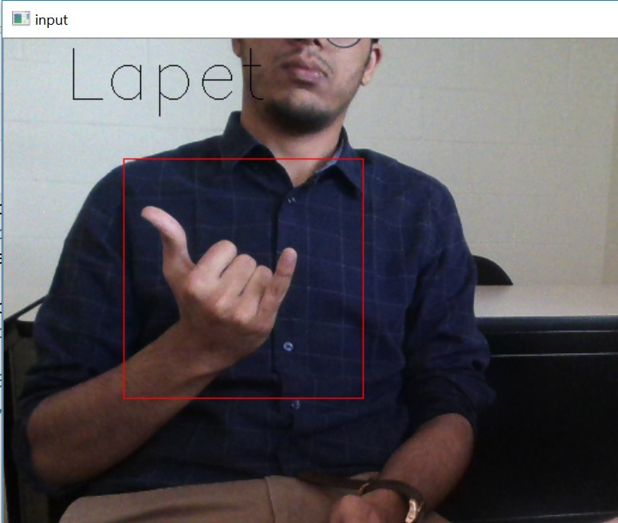
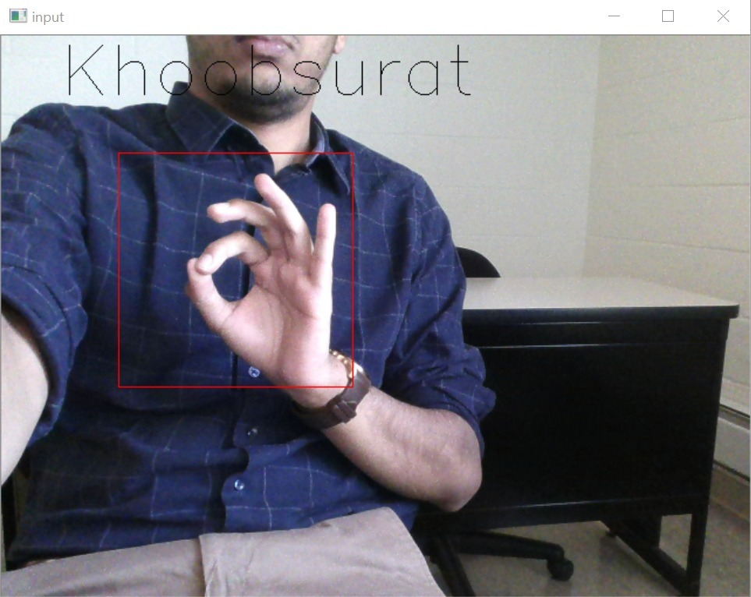
OUR APPROACH
Find the defects area by subtracting the hull area – contour area
Find the area of the biggest contour and its hull area
Find the defects area by subtracting the hull area – contour area, normalize it so it works on any human hand
According to the defects area and number of triangles found categorize the gestures found.

Slide 8
LIMITATIONS
Background should be very different than the hand color
Proper lightening conditions
Distance from the camera to the hand determines the area of the defects.
Detects only four gestures.

Slide 9
OTHER ApproacheS CONSIDERED
Template Matching
Classification Method KNN

Slide 10
References
Opencv –Structure Analysis and Shape Detectors
Robust Hand Gesture Recognition with Kinect Sensor Zhou Ren Jingjing Meng Junsong Yuan Zhengyou Zhang
Vision based hand gesture recognition for human computer interaction: a survey Siddharth S. Rautaray · Anupam Agrawal

Slide 11
THANK YOU!

