Slide 1
The possibilities of congestion control mechanisms in FAN networks
Dominik Najder
Jakub Palider

Slide 2
Main differences between IntServ and DiffServ
Parameter
IntServ
DiffServ
Coordination for service differentation
End to end
Per hop
Classification of traffic
Limited by number of flows
Limited by number of classes of service
Network accounting
Based on flow characteristics and QoS requirement
Based on class usage
Network management
Similar to network switching (e.g. phone calls)
Similar to IP networks
Inter domain deployment
Multilateral agreements
Bilateral agreements
Quality guarantees
Per flow - bandwidth and delay guarantee
Cannot provide low delay and high bandwith guarantee simultaneously
Scalability
Information held in each network node – not scalable
Scalable and robust
Notes:
The slide presents main differences between IntServ and DiffServ.
In IntServ the resources are overtly reserved in each router of the network path before beginning the transmission – traffic requirements have to be explicitly specified. The classification is based on flows – each of them has its bandwidth and delay guarantee – what is especially important in VBR, CBR traffic types – e.g. VoD. This type of QoS is good for short-lived reservation, when high resource utilization is required. However it is not scalable – each network node needs to hold an information about network state.
DiffServ shows totally opposite approach - it operates on the principal of traffic classification, where each packet is qualified into one of the classes; rather than differentiating network traffic based on the requirements of an individual flow
(IntServ). Each traffic class is managed in a different way – depending on its requirements – e.g. low latency or assured bandwidth – however you cannot assign packet to 2 traffic classes. There is no information about individual flow in each network node – the design is more scalable and robust. Admission control is performed only DiffServ domain endpoints.

Slide 3
What is congestion?
Simple definition: congestion occurs when traffic coming into one link exceeds its capacity e.g. motorway
Main reason: lack of bandwidth
  Demand bigger than capacity
  Suddenly changing demands
  Network failures
  Changes in routing
Notes:
Congestion occurs when traffic coming into one link exceeds its capacity. If one has problems with understanding congestion – one should drive the main city streets at rush hours.
Congestion is a result of everlasting problem – demand is greater than supply – in telecommunications the requested resource is bandwidth. Nowadays core networks still have very high redundancy of capacity – the problem typically occurs where multiple links feed into a single link, such as internal LANs are connected to WAN links.
The reason for congestion may also be suddenly changing demands – as an example we could take VoIP – new technologies require new traffic quality – and some of the networks were not designed to be reconfigurable or were limited to one type of service – e.g. HTTP.
Although core networks still have redundancy, in case of failures or relevant changes in routing they may have congestion problems – backbone links serve in such a situation more traffic than they were supposed to – sometimes the amount of information sent is few times bigger.

Slide 4
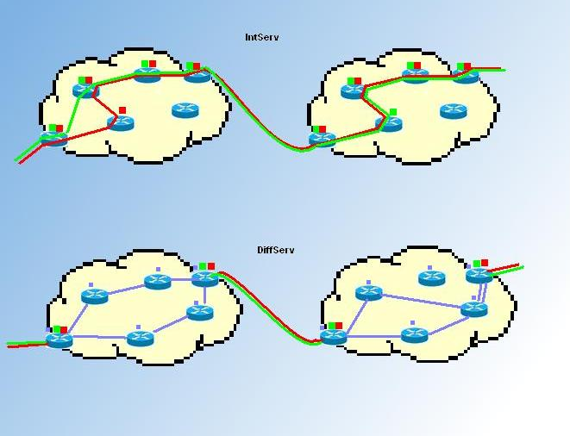
Int- and DiffServ
Notes:
This figure ilustrates the different approaches in achieving guarantee of QoS in networks. IntServ solution is in the upper part while DiffServ in the lower one.Yellow areas present distinct core networks.
IntServ needs to trace each flow on each router that is passed by the flow (this is forced by RSVP protocol signaling) in order to provide expected service.
DiffServ does not have such requirements, excluding core networks, however. IntServ is called per flow method, whereas DiffServ per node. Flows In DiffServ are tracked only by border routers while performing interdomain agreements. That is marked with red and green dots in the picture (for both IntServ and DiffServ).
Internal behaviour of DiffServ in domains is represented by violet dots. In the simplest example both flows arriving to the domain (red ang green) fit the same earlier defined traffic class – internal routers need only to know the class type a given flow belongs to process packets. So every router participates in providing a packet its class of Service – according to one of the „behaviours” – e.g. Expedited forwarding (Very low delay, low jitter and assured bandwidth). This is called as Per Hop Behaviour (PHB).

