Slide 1
Introduction to RAG and Building Your Own RAG
Name: Joswitha Palipe
Date: 27-01-2026

Slide 2
Agenda
Classification of AI
Architecture f RAG
Components and Technologies
Code Explanation
Confluence Based RAG Demo
File based RAG Demo
Introduction to Langflow and Demo
Introduction to LangGraph
References

Slide 3
Classification of AI

Slide 4
Artificial Intelligence
Generative AI
Agentic AI
Traditional AI

Slide 5
Key Differences
Feature | Traditional AI | Generative AI | Agentic AI
Primary Function | Automating repetitive tasks | Generating text, code, and images | Goal-oriented decision-making and action
Autonomy | Low | Variable | High
Learning Style | Based on static algorithms | Data-driven (deep learning | Reinforced learning with feedback and environmental adaptation
Scope | Limited, narrow domains | Content creation | Cross-domain reasoning and multi-step task execution

Slide 6
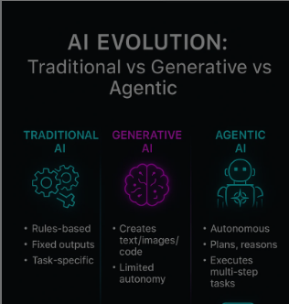
Examples
Traditional AI:
Spam Detection
Speech Recognition
Gen AI:
LLM’S like ChatGPT
GitHub Copilot
Basic LLM’s and applications of LLM’s
like RAG
Agentic AI:
Devin AI
AI Research Agent

Slide 7
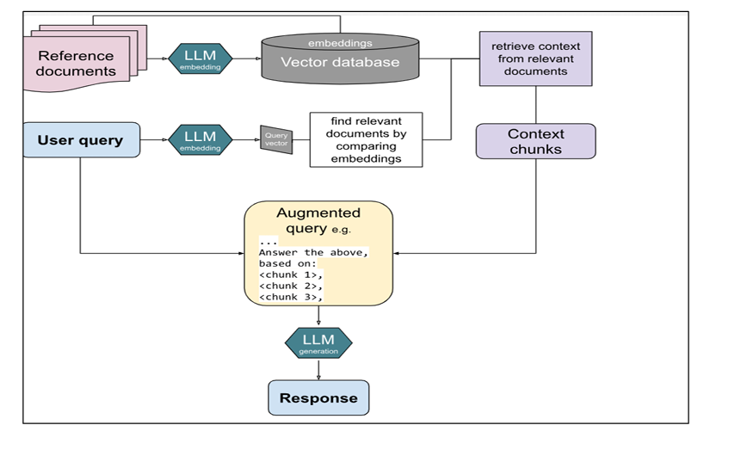
Architecture of RAG(Retrieval-Augmented Generation)

Slide 8
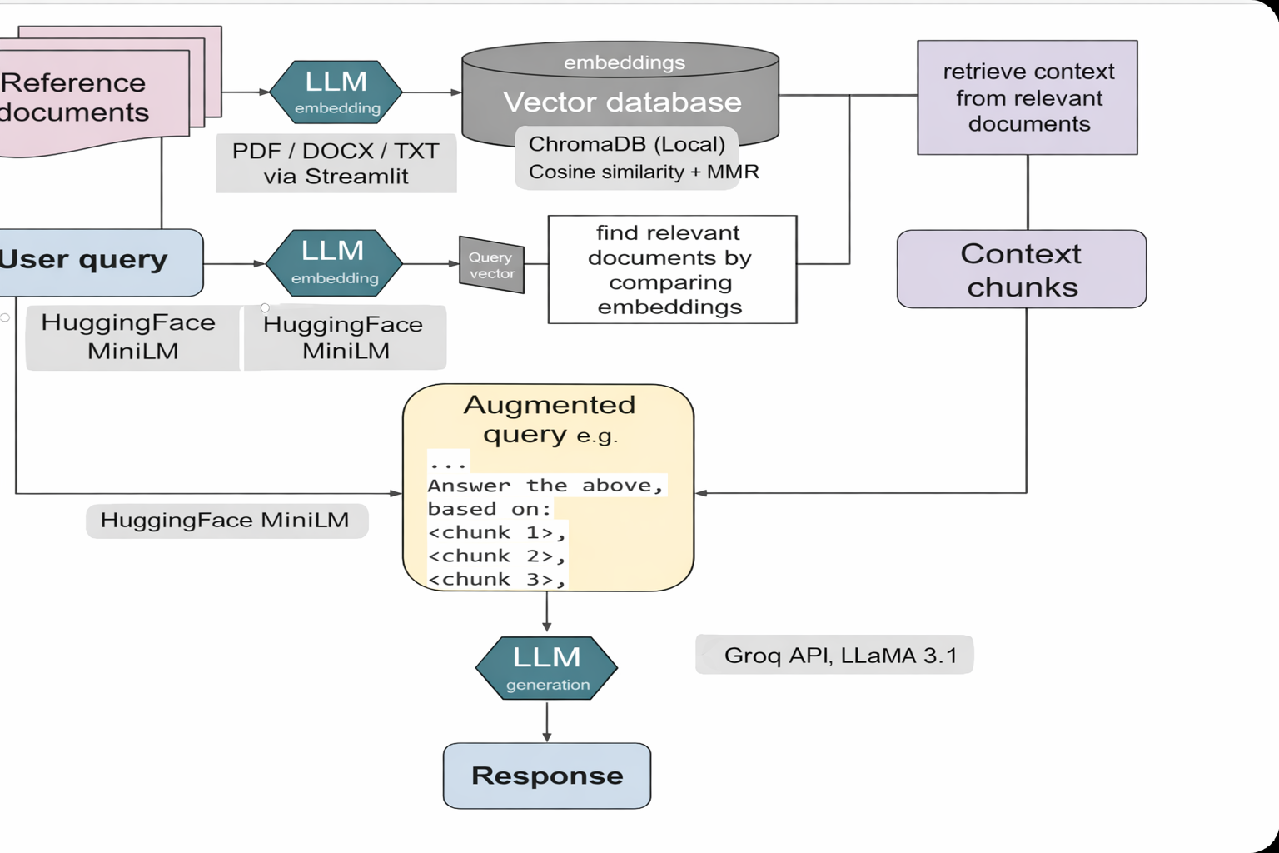

Slide 9
Technologies
Programming language: Python 3.10+
Python packages:
Numpy,PyTorch
UI: Streamlit==1.32.0
Framework: LangChain v0.1.20, langchain-community v0.0.38, langchain-core v0.1.52
Reference documents → PDF / Text files
Document loaders: pypdf==4.0.1, python-docx>=0.8.11, python-pptx>=0.6.21, unstructured>=0.10.0
Chunking: RecursiveCharacterTextSplitter (langchain-text-splitters, via LangChain)
Embeddings: HuggingFace (sentence-transformers/all-mpnet-base-v2, sentence-transformers==2.7.0)
Vector database: ChromaDB (chromadb==0.4.24) — local persistent storage (stores vectors on disk in chroma_db/ folder)
Searching :Cosine similarity (built into ChromaDB)and MMR (Maximum Mariginal Relevance)
LLM: Groq (via langchain-groq==0.1.5, e.g., Mixtral-8x7b)

Slide 10
Langchain
LangChain is an open-source framework for building applications powered by large language models (LLMs). It helps connect LLMs with data sources, tools, memory, and APIs to create workflows like chatbots, RAG systems, and intelligent agents.
Open-source framework for building LLM-powered applications
Connects LLMs with data sources, tools, and APIs
Supports chains, memory, and agent-based workflows
Commonly used for chatbots and RAG systems

Slide 11
Going through code

Slide 12
Application Entry Point & Document Processing Flow
The entry point of the application is app.py, built using Streamlit to provide the user interface.
app.py handles:
Environment setup and API key configuration
Session state management for chat history
File uploads (PDF documents)
Cleanup of previously processed files
When the user uploads documents and clicks “Process Documents”:
app.py initializes the RAG pipeline by creating an object of
PDFRAGEngine class from rag_engine.py
rag_engine = PDFRAGEngine()

Slide 13
Application Entry Point & Document Processing Flow
Uploaded PDF files are passed to rag_engine.py, where:
Documents are loaded using load_documents()
Text is split into smaller chunks using split_documents()
Each chunk is converted into embeddings using HuggingFace embedding model
The generated embeddings and metadata are stored in a persistent Chroma vector database
(chroma.sqlite) using:
create_or_load_vectorstore()
After document processing, the system creates:
A Retriever using MMR (Max Marginal Relevance)
Cosine similarity for semantic search

Slide 14
Query Processing, Retrieval & Answer Generation
When the user enters a question:
app.py calls the method:
ask_question(query) from rag_engine.py
Inside ask_question():
The user query is converted into an embedding
Relevant document chunks are retrieved from Chroma DB
Retrieved chunks are passed as context to the LLM

Slide 15
Query Processing, Retrieval & Answer Generation
The Groq LLM generates a context-aware response using:
User query
Retrieved document chunks
The final output includes:
Generated answer
Source document references
app.py displays the response in the UI and maintains conversation history for follow-up questions
using Streamlit session state.

Slide 16
Confluence Based RAG -Demo
The system indexes Confluence documents into a vector database using embeddings.
When a question is asked, it retrieves relevant content and uses an LLM to generate an
accurate, context-aware answer.
Confluence Integration: Authenticates via URL, email, API token; fetches and indexes pages into ChromaDB
Semantic Search + Confidence Check: Uses embeddings to find relevant content and verify if answers exist in docs
LLM Response Generation: LLaMA-3 (Groq/Ollama) generates citation-backed answers or switches to general knowledge when needed
Eveytime it reindexes so that it can know about the updated data
Run using :
cd C:\RAG\confluence-rag
.\venv\Scripts\activate
streamlit run web_ui.py

Slide 17
File Based RAG -Demo
System indexes PDF documents into ChromaDB using embeddings. When questioned, retrieves relevant content via MMR search and uses an LLM to generate accurate, cited answers.
➤ PDF Upload & Processing: Accepts PDF/DOCX/TXT/CSV/PPT files; chunks documents optimally (1000 chars, 200 overlap) and creates 768-dimensional embeddings
➤ Semantic Search + MMR Retrieval: Uses sentence-transformers for embeddings; fetches top candidates with diversity-aware ranking for accuracy
➤ LLM Response: Mixtral-8x7b (Groq) generates context-grounded answers with source citations; supports multi-document conversation history
Demo:
cd C:\RAG\Pdf-rag
.\venvforpdf\Scripts\activate
streamlit run app.py

Slide 18

Want to do it with low code or no code

Slide 19
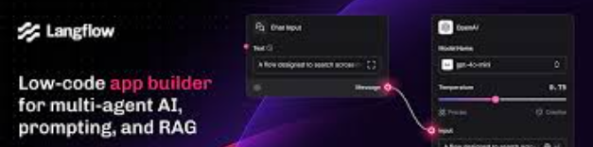
Langflow
Langflow is a visual, low-code tool built on LangChain that lets you design, connect, and
run LLM workflows (like RAG pipelines) using drag-and-drop components instead of writing code.
Build RAG pipelines visually without writing code
Quickly prototype and test LLM workflows (chatbots, document Q&A)
Connect LLMs, vector databases, and tools using drag-and-drop blocks

Slide 20
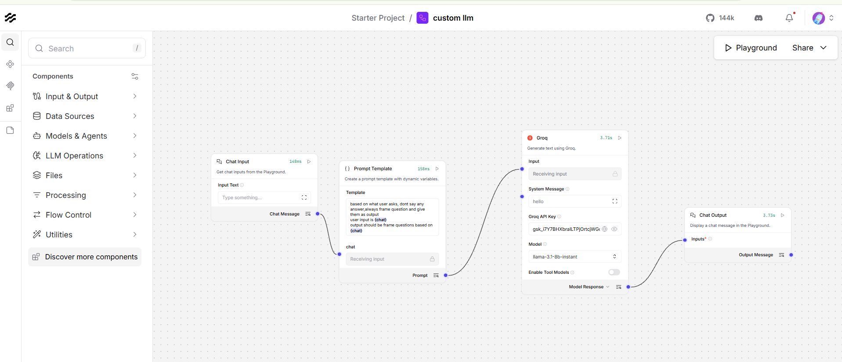
Langflow
A custom prompt based LLM is build
using this Langflow
Demo:
cd C:\langflowexample
.\venv\Scripts\activate
langflow run

Slide 21

Explore more and try RAG with LangfloW

Slide 22
LangGraph
LangGraph is an open-source framework built by LangChain that streamlines the creation and management of AI agent workflows. At its core, LangGraph combines large language models (LLMs) with graph-based architectures allowing developers to map, organize and optimize how AI agents interact and make decisions.
Supports stateful agents, enabling memory persistence across steps and long-running workflows
Allows human-in-the-loop control, where users can pause, inspect, or intervene in agent execution
Provides built-in fault tolerance, letting workflows resume from failures instead of restarting entirely

Slide 23
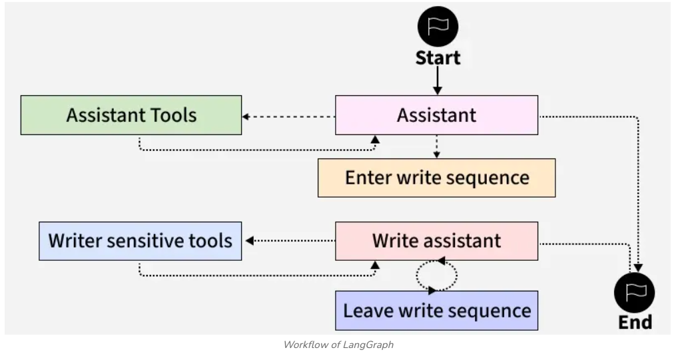
Workflow of LangGraph

Slide 24
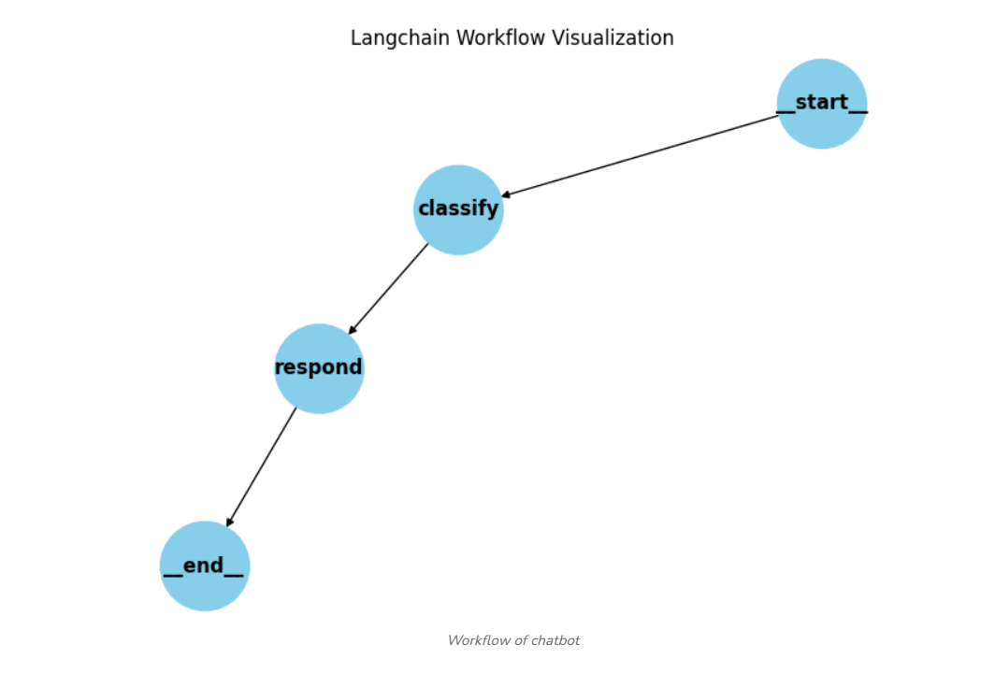
Build a Chatbot using LangGraph
Step 1: Install the Dependencies
Step 2: Setup Gemini API
Step 3: Define Chatbot State
Step 4: Classify Input
Step 5: Respond Using Gemini (or Greeting)
Step 6: Build LangGraph Workflow

Slide 25
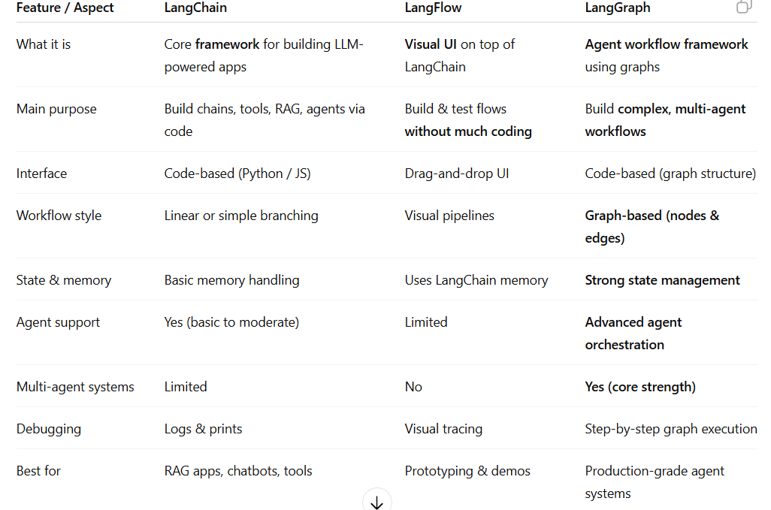
Key Differences

Slide 26
References
https://www.ibm.com/think/topics/agentic-ai-vs-generative-ai
https://en.wikipedia.org/wiki/Retrieval-augmented_generation
https://www.geeksforgeeks.org/artificial-intelligence/introduction-to-langchain/
https://www.geeksforgeeks.org/artificial-intelligence/langflow/?utm_source=chatgpt.com
Code can be found:
jpalipe/RAG: Building Local RAG

Slide 27


