Slide 1
ACTIVE RECORD PATTERN (ORM)
Object-relational Mapping
Positives
negatives
Hibernate
Code segment

Slide 2
Active record Pattern
“An object that wraps a row in a database table or view, encapsulates the database access, and adds domain logic on that data.” – Martin Fowler
Helps create an interface between your data objects and the datastore.
An instance of an object would be represented on the Table as a single row

Slide 3
ORM
Object Relational Mapping – Is the most common way to implement the Active Record Pattern.
Maps objects to database tables
Pulls scalar values off the table and converts it to an object
Converts objects into scalar values to be pushed to a database

Slide 4
positives
Make it easier to step into a new project – the database will be represented by objects that are easier to understand than multiple tables
Once configured, simple and easy to use. Call save, update, and delete methods on objects. Instead of having to write sql functions for each new class you add to your program.
Preserves created objects on databases and can easy load them back into memory

Slide 5
negatives
Coupling – Objects coupled to the database in structure, not the use.
Testing – Testing becomes difficult because of the coupling, it’s hard to separate objects from the database and vice versa.
Performance – If there are multiple tables representing one object, the SQL queries can start to slow down.

Slide 6
Hibernate (ORM)
Object-relational mapping tool for Java
Implements JPA (Java Persistence API)
Faster than JDBC (Java Database Connectivity) and easier to use. The developer doesn’t have to write code to map the objects to the database (needed to do in JDBC).
Provides it’s own Query Language and supports native SQL statements

Slide 7
Hibernate (ORM)
Can be imported through maven
Maps an entity to a table. An entity would be Parts.java, that class would be mapped to a table. The object would be mapped to rows.
Uses annotations (@Entity, @Id, @Table, @Column

Slide 8
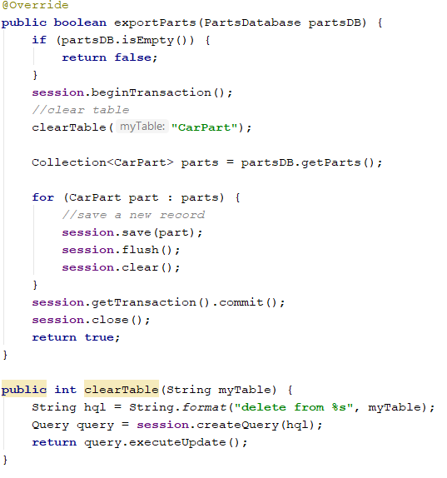
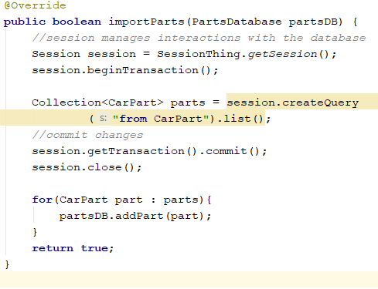
Code segments

Slide 9
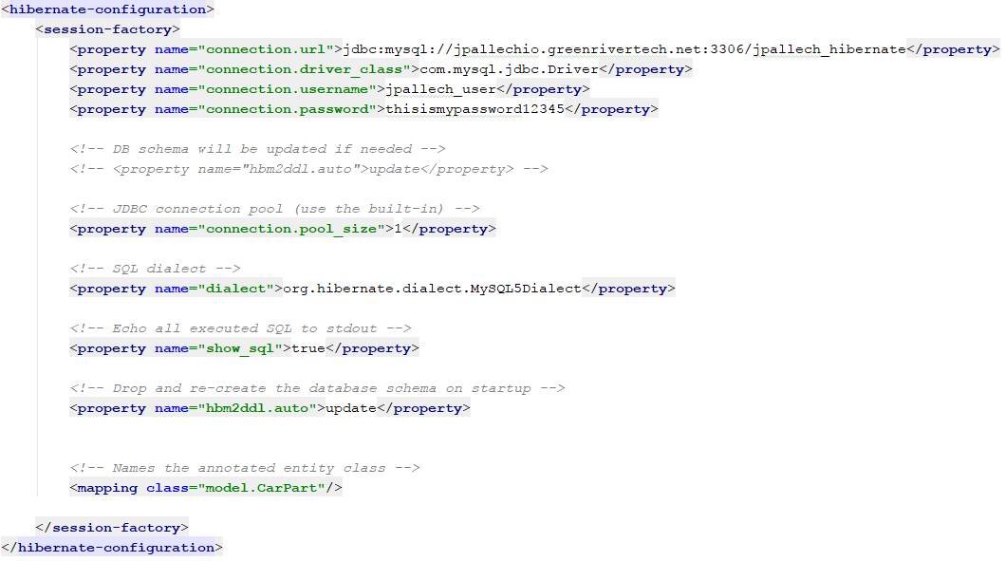
Code segments

Slide 10
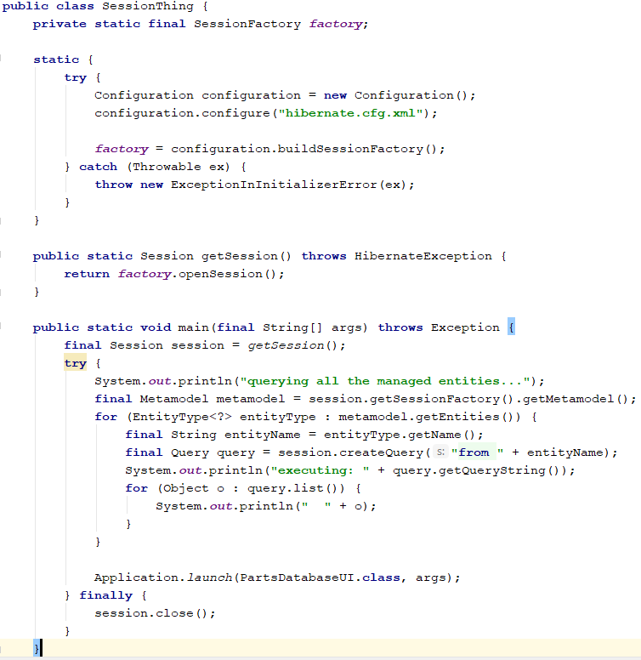
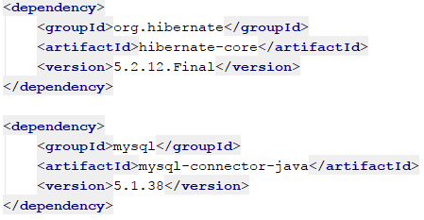
Code segments

