Slide 1


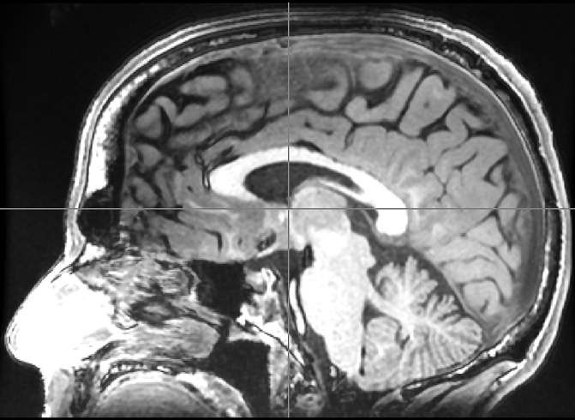
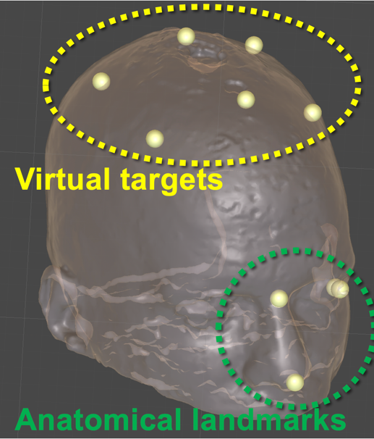
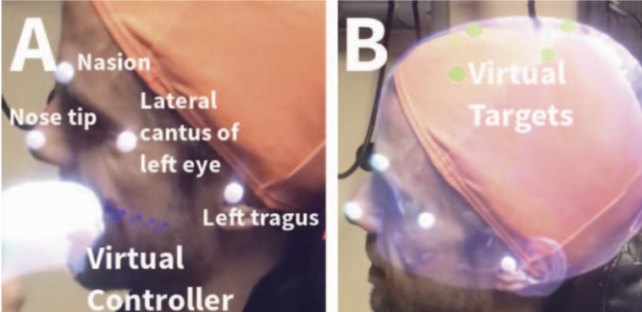
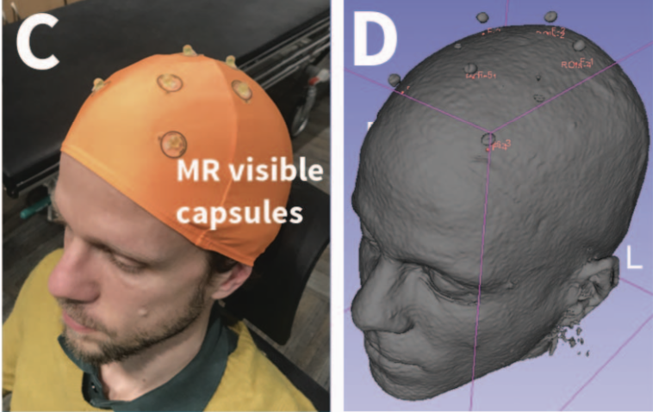
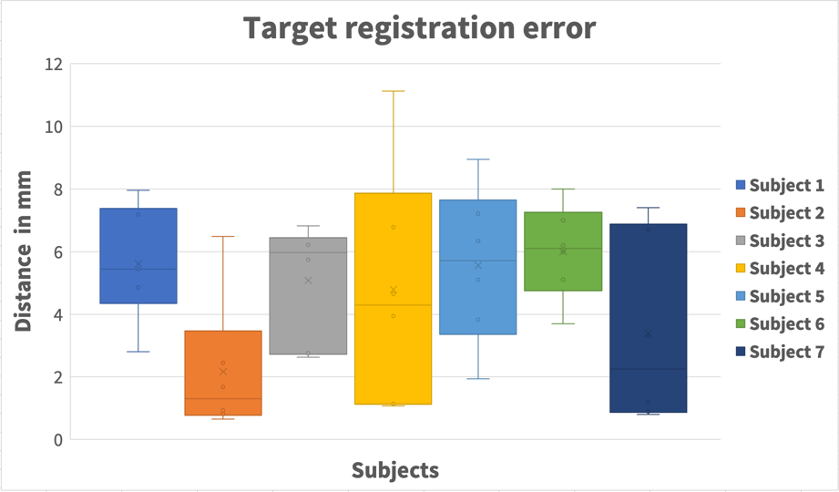
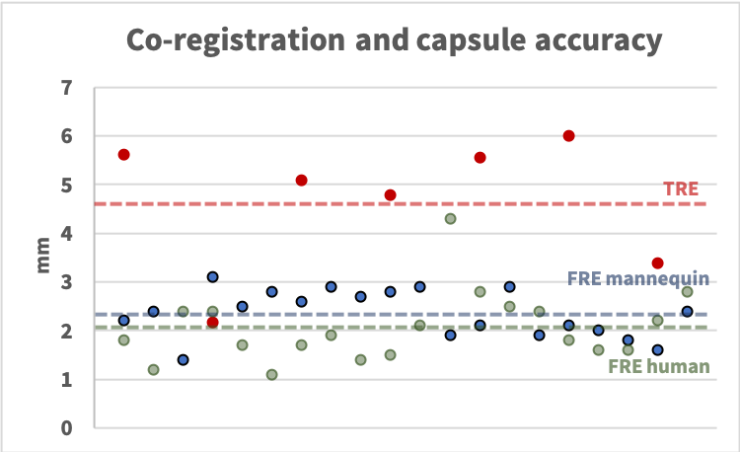
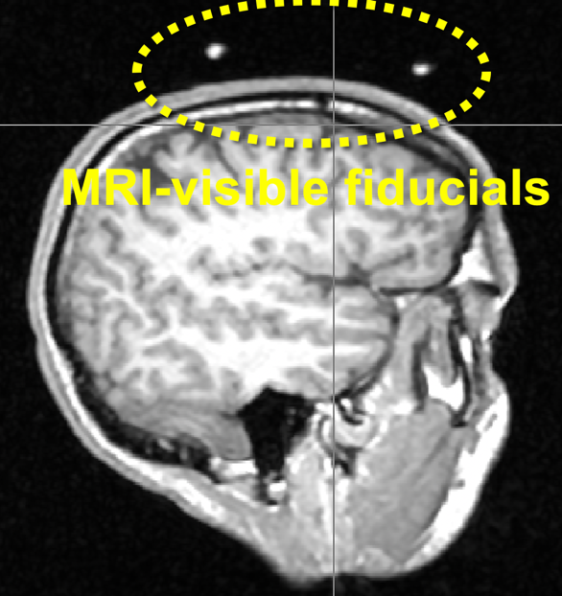
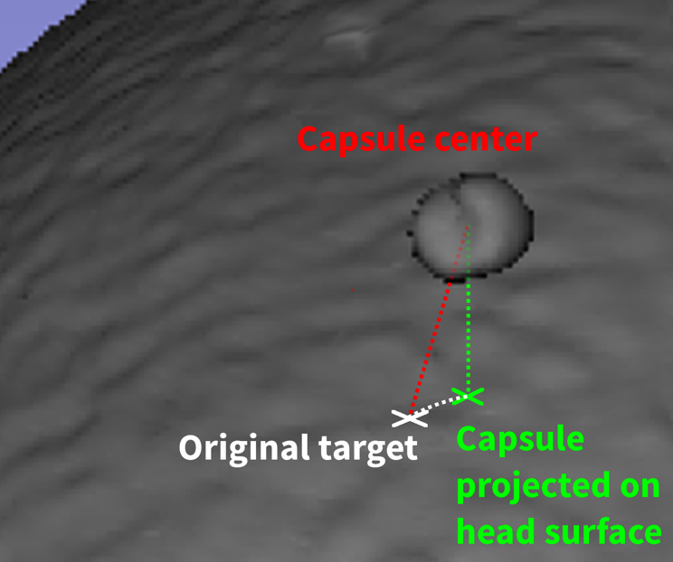
A Method for Alignment of an Augmented Reality Display of Brain MRI With The Patient’s Head
Christoph Leuze¹, Supriya Sathyanarayana¹, Bruce Daniel¹, Jennifer A. McNab¹
Stanford University Departments of Radiology¹,
cleuze@stanford.edu
Medical augmented reality (AR) applications where virtual renderings are aligned with the real world allow to visualize internal anatomy of the patient to a medical caregiver wearing an AR headset.
Accurate alignment of virtual and real content is important for applications where the virtual rendering is used to guide the medical procedure such as a surgery.
Compared to 2D AR applications, where the alignment accuracy can be directly measured on the 2D screen, 3D medical AR applications require alignment measurements using phantoms and external tracking systems.
In this paper we present an approach for landmark-based alignment, validation and accuracy measurement of a 3D AR overlay of medical images on the real-world subject. This is done by performing an initial MRI of a subject’s head, an AR alignment task of the virtual rendering of the head MRI data to the subject’s real-world head using virtual fiducials, and a second MRI scan to test the accuracy of the AR alignment task.
MRI and Model Creation
AR Alignment
A
B
Fig.1: A Each subject’s brain was initially scanned with a 3T GE MRI scanner using a 3D T1-weighted BRAVO sequence with 1mm isotropic resolution. During MRI field of view placement, we ensured that anatomical head landmarks including nasion, nose tip, lateral canthus of the left eye and left tragus were included. The decimated model was then loaded to Unity and uploaded to the MagicLeap One device.
B For each subject we chose six brain areas as original targets to target in their individual MRI scan. A virtual sphere with 5mm diameter was rendered at each of the six brain areas and visualized on the MagicLeap device using the Unity standard opaque shader.
Fig.2: A View through the MagicLeap. Using the virtual rendering of the MagicLeap controller, the AR user placed virtual fiducials at anatomical landmarks around the subject’s head. B A view through the MagicLeap showing the virtual head rendering overlaid on a subject’s head with the virtual targets in green. C The AR user attached MRI visible capsules to the subject’s head at the positions where s/he perceived the virtual targets. D A surface rendering of the second MRI scan showing the MRI visible capsules on top of the subject’s head.
Results
MRI-based Validation
A
B
A
B
Fig.4: A The TRE for all seven subjects measured as the distance between the center of the MRI visible capsule projected to the head surface and the original target on the head surface. We measured a mean TRE = 4.7 ± 2.6 mm.
B (Blue) The Fiducial Registration Error (FRE) of the co-registration on the mannequin head, measured as the square root of the mean distance between manually placed virtual fiducials and their respective anatomical landmarks on the virtual model after co-registration. Each blue data point stands for a different co-registration experiment. (Green) The FRE of the co-registration for a human volunteer. (Red) The TRE, measured as the mean distance of the capsules projected on the head surface to the original targets. Each red data point stands for the average capsule accuracy for a single volunteer. While there is no significant difference between the FRE of the mannequin head and the human volunteer, the TRE (TRE = 4.7 ± 1.4 mm) is significantly higher (p < 0.005) than the FREs for the mannequin and human volunteer (FRE = 2.1 ± 0.7 mm).
Fig.3: A After capsule placement, another MRI scan of the subject’s head was acquired with the MRI visible capsule shown in the yellow circle. B A close up view of the surface rendering of the MRI scan with the capsule above the head surface. The dotted red line depicts the total distance between the capsule center and the original target. The dotted white line between the capsule center projected on the subject’s head to the original target depicts the Target Registration Error (TRE), marking the accuracy of the alignment.
Discussion
The presented manual alignment task depends on where the user perceives the virtual cursor rendering and is completely independent of perception differences between different users. The main difficulty of this alignment technology is the accurate placement of the virtual fiducials.
The FRE of less than 2.5 mm show that the fiducial placement and co-registration are already close to the requirements for various low-risk medical applications.
There are several limitations during capsule placement in addition to the fiducial placement and co-registration task, which could contribute to the TRE being significantly higher than the FRE, such as limitations in the AR headset optics and display calibration.
Additional refinement of both the hardware and software used is expected to further improve the AR alignment accuracy.
Reference: Leuze, C., Sathyanarayana, S., Daniel, D., McNab J. IEEE International Symposium on Mixed and Augmented Reality (ISMAR) 2020

