Slide 1

Any questions about what we covered last time?
Concerns or question about class
Tools & pre-work
Command line (organizing code, specific commands)
HTML
Notes:
1.
10m

Slide 2
Reminders
Use the office hours 45m before and 30m after class.
Come early and miss traffic :)
Eric can set up one-on-one meetings if you need help.
Ask each other for help too, and be willing to lend a hand.
Class gitlab repo: http://ucsd.bootcampcontent.com/UCSD-Coding-Bootcamp/04-2017-Class-Repository
Notes:
2.
For the last point: explaining something is a great test of whether or not you truly understand something.

Slide 3

Git'n stylish
University of California, San Diego -- Coding Bootcamp

Slide 4
Today's goals and objectives
Understand the importance of Git Version Control and of how to use it.
Create GitHub Repositories, push code into them, and share with class.
Make more HTML documents.
Learn to use basic HTML tags.
Use CSS to style HTML documents.
Notes:
3.
Who's feeling good about HTML? (fist to 5)
Who's feeling good about CSS? (fist to 5)
If you are a complete beginner to HTML/CSS and Coding:
Continue getting comfortable with HTML.
Be able to completely write a basic HTML document (like in last class).
Understand what CSS is, what it’s for, and how it works with HTML.
Be able to use Git and GitHub to upload code.
If you’ve had past exposure and felt comfortable with the last lesson:
Aim to build up your skills. Clear up any questions or confusions about HTML.
Become knowledgeable about a wider range of HTML and CSS tags.
Be able to selectively apply CSS to specific HTML elements.
Be able to use Git and GitHub to upload code.

Slide 5
How would you store code files?
Let’s discuss...
Notes:
5m
You'll be working on the same files as your colleagues at the same time.
Code needs to be on hundreds of servers.
How do you know who did what and when?

Slide 6
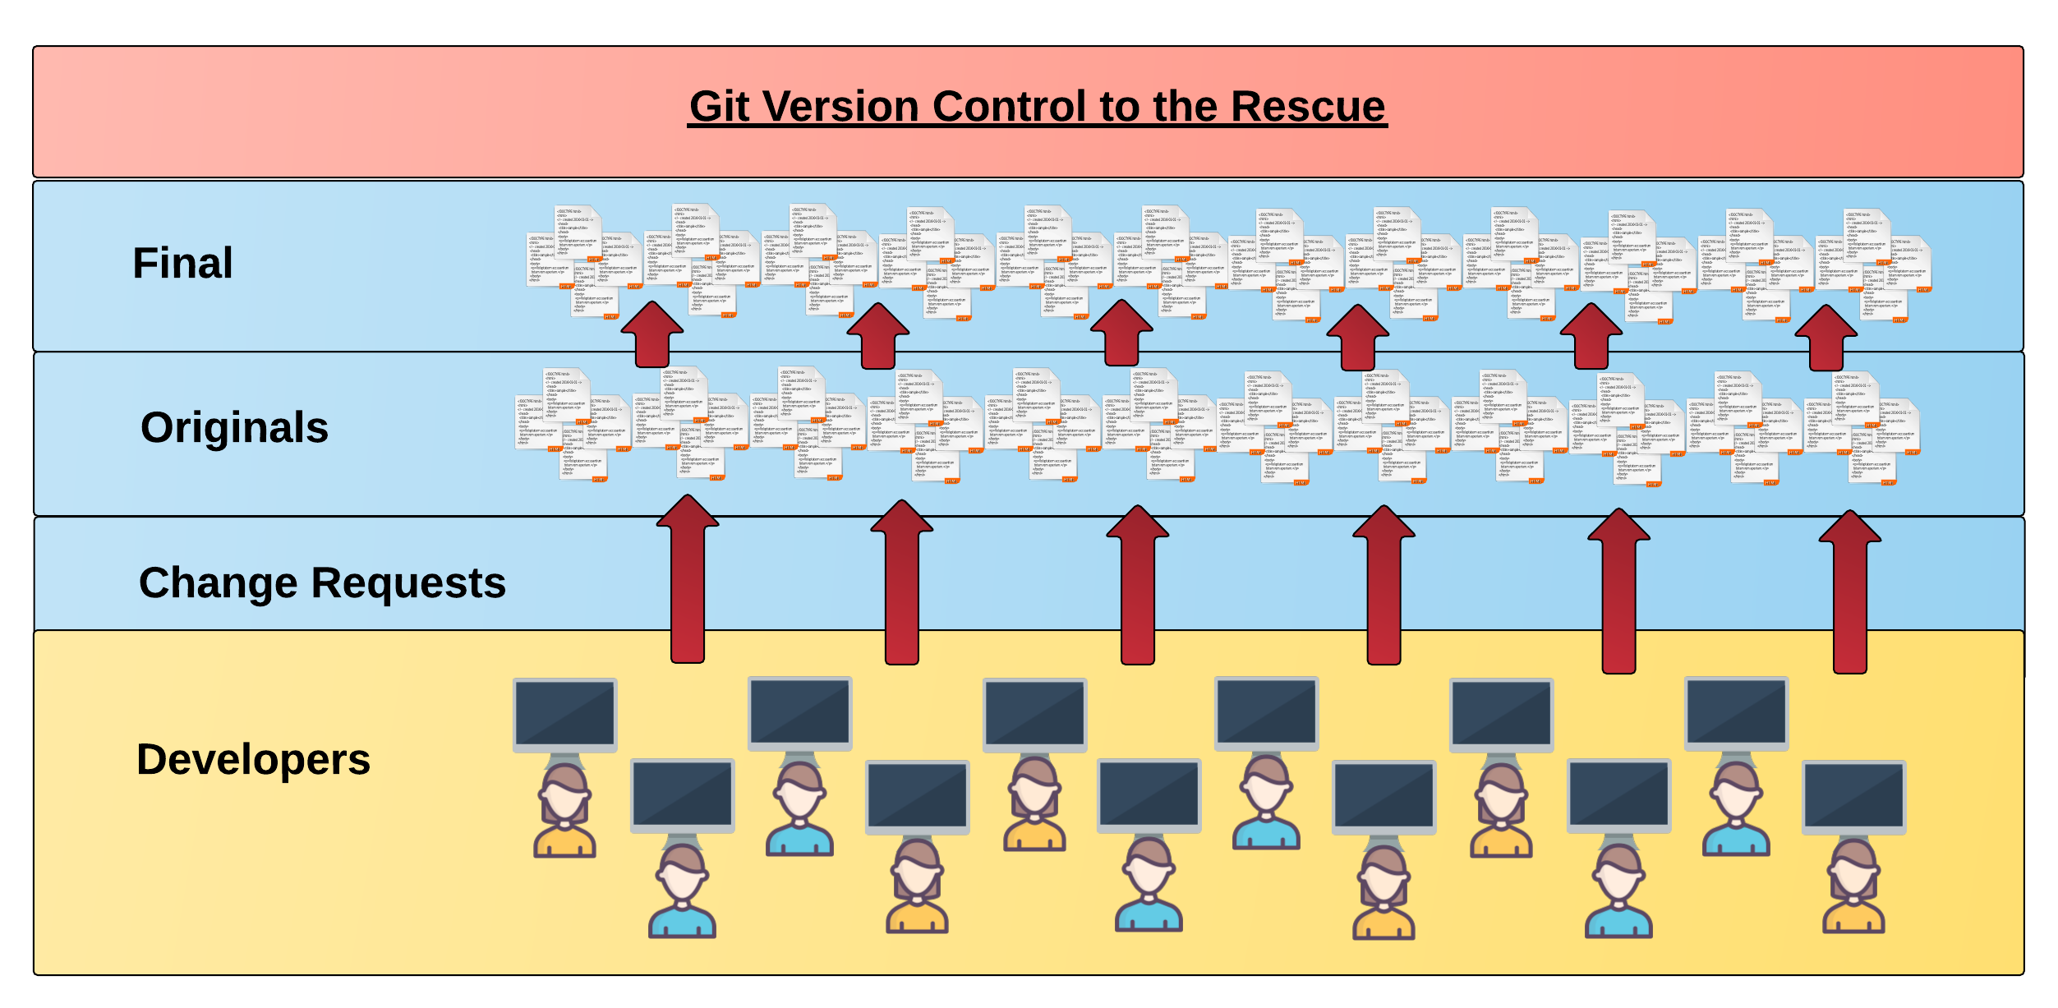
Collaborative Coding
Modern web development is highly collaborative.
Teams are often large and distributed.
Apps sometimes comprise hundreds
or thousands of files.
Notes:
4.
git -> “global information tracker”, if you’re feeling generous

Slide 7

Git to the rescue
Safety and distribution of code.
Working together on the same files.
Traceable history and tracked changes.
Notes:
High 5m
Wipe out drive, clone again from github.
Multiple people working on same file - branching.
Tracking down a bug with history.
Git Version Control: Provides a organized system for managing code for when multiple developers work on a project
at the same time.
The Benefits of Git:
A strict system for resolving conflicts in code.
Version History.

Slide 8
Git definitions
Repo[sitory]: A project in git.
Remote: Another copy of the repository somewhere else.
Commit: Some changes you've made.
Branch: An isolated version of the project you can make changes to.
Fork: An isolated version of the entire repository.
Pull request: Asking someone to accept your changes.

Slide 9
Understanding git
Explain to each other what git gives you and why you care.
Notes:
5. and 6.
Benefits: safety net, provides history, resolves conflicts, flexibility to experiment
Critical 5m
Turn to your neighbor, and have one of you explain to the other:
The concept of version control.
Then the other should explain:
Two of the key advantages to using a version control system.

Slide 10
Basic Git Commands
Five git commands to get started:
git clone
git add
git commit
git push
git pull

Slide 11
Basic Git Commands
Five git commands to get started:
git clone – copies an entire repo (to begin).
git add – adds a file for inclusion in Git.
git commit – notes a change to the local repo.
git push – sends changes to hosting service.
git pull – downloads freshest version of repo.

Slide 12

So… What’s this GitHub?
GitHub is a Web-Based hosting service to store code online.
It allows developers to pull (download) code or push (upload) code to the same repository (directory).
It also allows developers to view histories of code changes and to track issues.
Notes:
7.
Slack out guide from supplemental folder.
5m

Slide 13
Assignment
Create a repository in github, and clone it to your machine. git clone https://...
Move our file/folder structure [from Tuesday] to the cloned repo.
Add all files and commit the changes. git add -A then git commit -m "comment"
Push the changes to a remote repository. git push origin master
Create a branch. git branch branch-name git checkout branch-name
Change files.
Add and commit the changes. git add -A then git commit -m "comment"
Push the changes to a remote repository. git push origin branch-name
Bonus Points: Use github to create a pull request. Use github to create a fork.
Notes:
10. Critical 10m
Good at this point to create a UCSD directory to use for this class. Each day create a new sub-directory for that class.
Send link to git course on code school: https://www.codeschool.com/courses/try-git

Slide 14
HTML
<tag attribute="value">stuff</tag>
<tag attribute="value">
<tag>more stuff</tag>
stuff
</tag>
https://developer.mozilla.org/en-US/docs/Web/HTML
https://know-it-all.io/
Notes:
11.
Send MDN and know-it-all links.

Slide 15
HTML elements
Containers
div, span, header, aside, nav, footer, table, ol, ul
Content
h1, p, a, img, audio, video, canvas, li
Forms
form, input, textarea, file, select, button

Slide 16
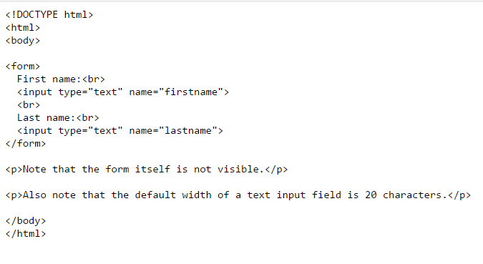
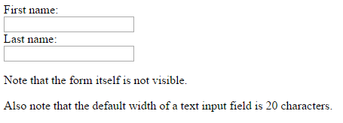
HTML for Forms

Slide 17

Authoring code
Don't just write code.
Think of your code like a paper you're writing.
Start with a skeleton, a rough outline of what you want to do.
Then a first draft and have someone review it.
Continue to perfection doneness.
Notes:
Use comments in your code describing what you are going to do. Remove the comments as you add code to do things.

Slide 18
Authoring code
Your code has an audience.
For now, that audience is your future employer.
In the future, it will be your colleagues

Slide 19
Code examples
Let's look at some good code, and some not so good code.

Slide 20
Assignment: Biography
Create your biography, then commit it to github.
Include:
Your name and your picture.
Your location
Links to your github and stackoverflow profiles.
Why you want to develop software.
An industry in which you’d like to work.
Notes:
12.
Critical 20m
Using the repo we just created (and index.html that exists).
src, assets / css, js, img

Slide 21
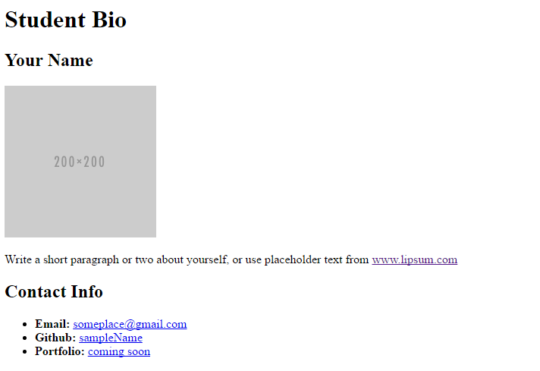
Your Turn

Slide 22
Styling
selector { property: value; }
Selectors: tag .class #id
Example: a { color: lightblue; }
https://developer.mozilla.org/en-US/docs/Web/CSS
Notes:
15.

Slide 23
Styling: Fonts, Backgrounds, and Colors
#introduction {
font-family: Arial;
color: lightblue;
}
div {
background: #eee;
border: 1px solid #cdcdcd;
}

Slide 24
Styling: Alignment and Spacing
.navigation {
margin: 10px;
}
#content {
padding: 6px;
}
h2 {
text-align: center;
}

Slide 25
Styling: Positioning and Layout
#absolute {
position: absolute;
top: 0;
}
#floating {
float: left;
width: 50%;
}

Slide 26
Assignment: Stylin' Biography
Partner up, discuss the design for your biography, then implement it.
https://developer.mozilla.org/en-US/docs/Web/CSS
Notes:
Critical 20m
Link to styled bio walkthrough: https://www.youtube.com/watch?v=kMBinXTCrXI&list=PLgJ8UgkiorCnMLsUevoQRxH8t9bt7ne14&index=2

Slide 27
Additional resources
Making an HTML page
Layout using CSS
Floats in CSS
Positioning in CSS
Layout using positioning in CSS

Slide 28
Homework Preview
…more on Saturday (4/8)
Your first gig as a software developer: you're hiring yourself to build a portfolio!
This portfolio will be one resource to share with and impress hiring managers.
Spend some time here. Come back to this project again and again.
Update your portfolio as your skills grow.
Notes:
5m
Not assigned until Saturday!
2:15 total

