Slide 1
Heroes of CSS
Lesson 1.3
University of California, San Diego -- Coding Bootcamp

Slide 2
Admin Items
Hello Saturday!
Slightly different approach to activities…
Notes:
1.
Tell students to slack the TAs when they complete an activity.

Slide 3
Admin Items
Homework #1:
Available in the class gitlab repo immediately after class
Due one week from today, April 15th, 2017
Fundamental concepts you’ll build on in coming months
Work together! Use slack!
Notes:
Tell students to slack the TAs when they complete an activity.

Slide 4
Reminders
Use the office hours 45m before and 30m after class.
Eric can set up one-on-one meetings if you need help.
Ask each other for help too, and be willing to lend a hand.
Class gitlab repo: http://ucsd.bootcampcontent.com/UCSD-Coding-Bootcamp/04-2017-Class-Repository
Notes:
2.
For the last point: explaining something is a great test of whether or not you truly understand something.

Slide 5
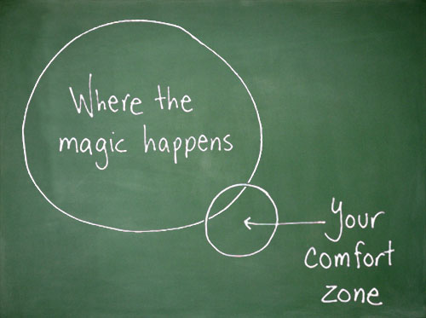
Notes:
2.
Emphasize that they need to submit something, even if it’s not 100% what you’ve envisioned. Can only miss two homework assignments, don’t make this one of them.

Slide 6

Notes:
2. Today will be a struggle. This might be what you want to do. It’ll be confusing, probably frustrating. There is a lot of new material, it’s likely unfamiliar to most of you.
5m

Slide 7
Today is all about getting immersed.
Notes:
Don’t expect to understand EVERYTHING at once. Weeks from now, you’ll feel right at home with concepts and ideas you initially struggled with.

Slide 8
CSS Recap
Notes:
3.
What is it? Get an answer.

Slide 9
Definitions…
HTML: Hypertext Markup Language – (Content)
CSS: Cascading Style Sheets – (Appearance)
HTML/CSS are the “languages of the web.” Together they define both the content and the aesthetics of a webpage – handling everything from the layouts, colors, fonts, and content placement. (JavaScript is the third – handling actions, events, custom behavior, etc.)
Notes:
HTML alone -> text editor (notepad, sublime, atom)
HTML + CSS -> richer experience (word, powerpoint/keynote)

Slide 10
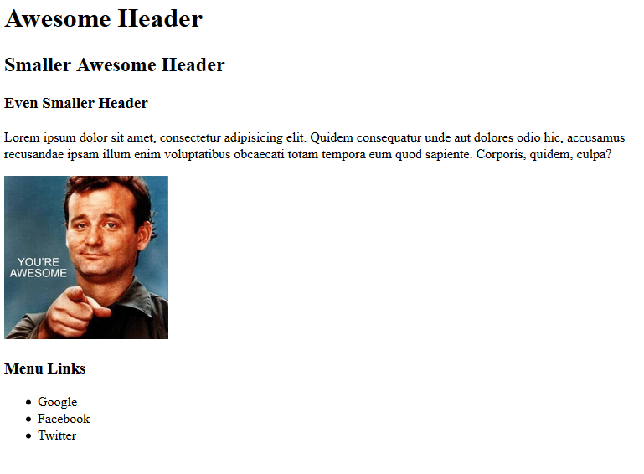
HTML

Slide 11
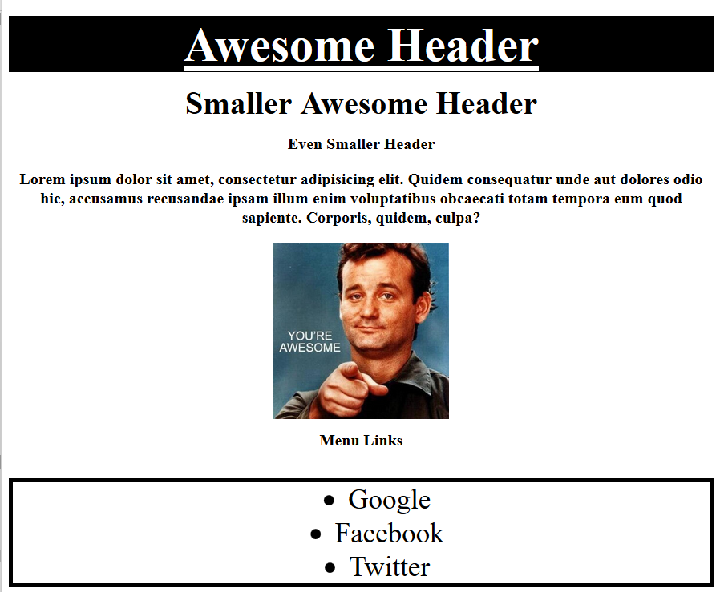
HTML/CSS

Slide 12
How do we style HTML?
Tags
Classes
IDs

Slide 13
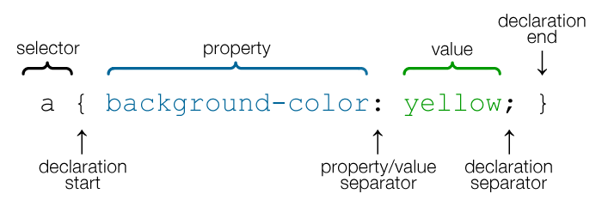
CSS Syntax
Notes:
CSS works by hooking onto selectors added into HTML using classes and identifiers.
Classes use .classname, IDs use #idname, and elements use just their name.
Once hooked, we apply styles to those HTML elements using CSS.

Slide 14
Let’s discuss…
Questions so far?
Notes:
Re-iterate tags, classes, IDs. Combine to target specific elements. This is like a hook into the page that let’s you grab specific pieces.

Slide 15
Relative File Paths
Notes:
4.

Slide 16
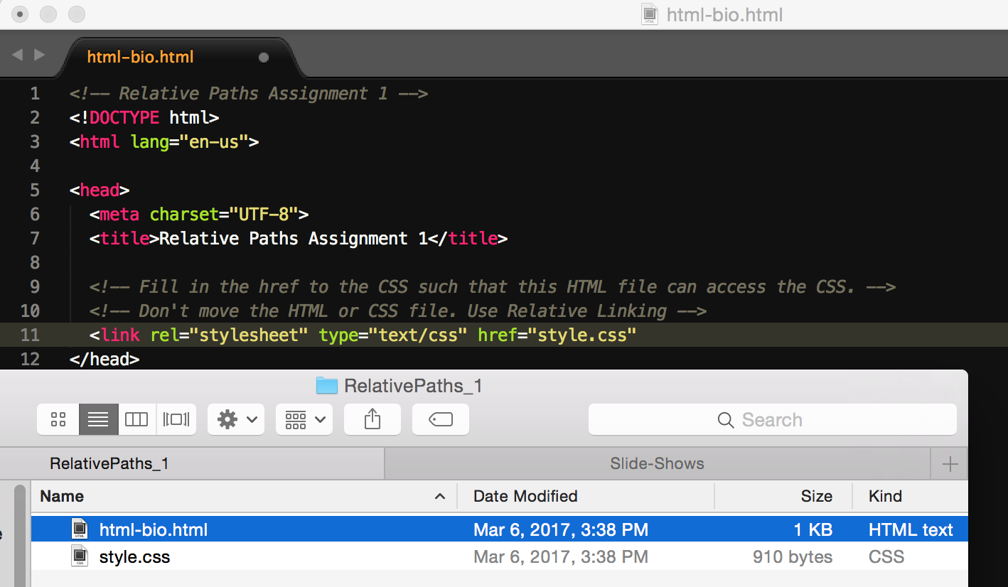
Relative File Paths
Notes:
4.
Relative vs. absolute.
Relative: flexible, will work when you move things.
Absolute: brittle, small changes potentially break lots of things.

Slide 17
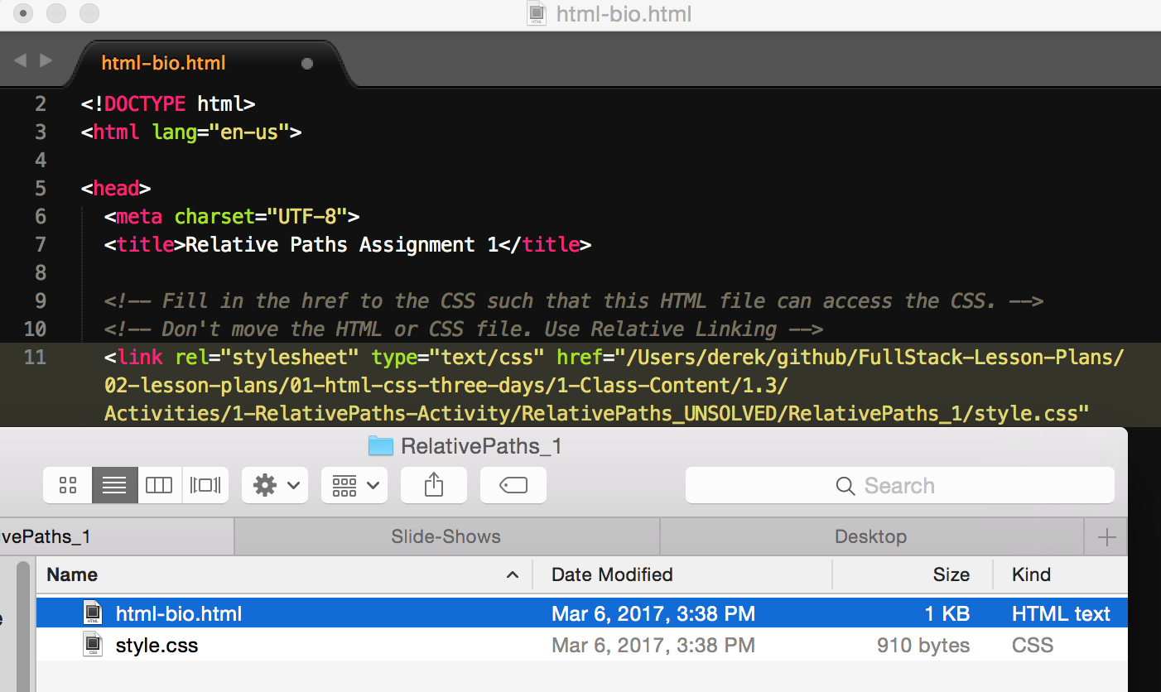
Absolute File Paths
ugh, no
Notes:
Absolute file paths: bad news.
This isn’t a web page or browser thing: this applies to all files on your computer. Maybe demo cat with a relative path vs. absolute.

Slide 18
Demo!
Notes:
5.

Slide 19
Your turn!
1. Unzip the folder sent to you via Slack.
2. Edit the HTML files in all of the “RelativePaths” folders. You need to write relative paths that link the HTML documents with CSS stylesheets.
Tip: Check out the “RelativePaths_WorkingExample” folder.
Notes:
6.

Slide 20

Box Model
Notes:
7.

Slide 21

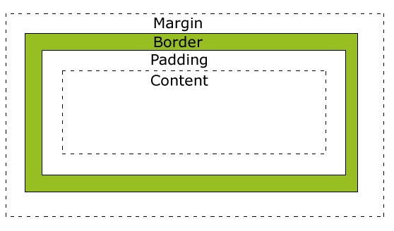
Boxes all the way down
Customizable space properties:
margin
border
padding
Shorthand: 20px 10px 10px 20px
Top Right Bottom Left
TRouBLe
Notes:
7.
Applies to all elements: span, div, section, img, p, span…all of them.

Slide 22
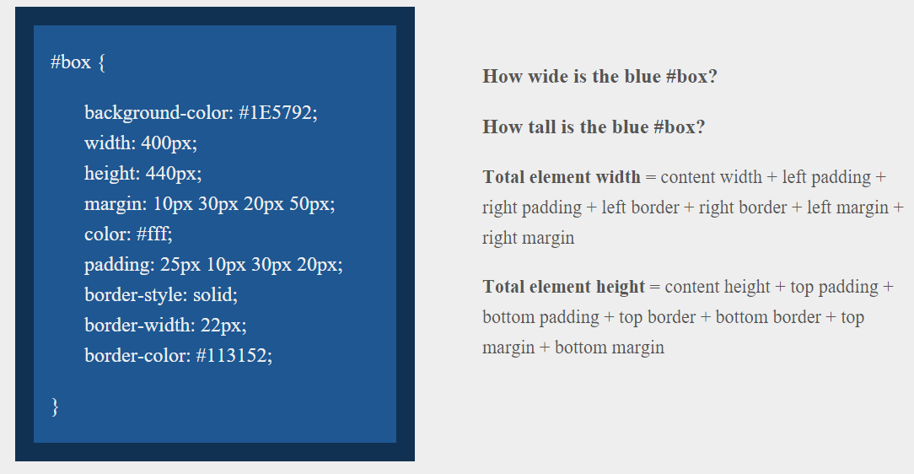
Answer
Width: 474 px (no margin), 554 px (with margin)
Height: 539 px (no margin), 569 px (with margin)
Notes:
8.

Slide 23
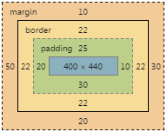
Answer
Width: 474 px (no margin), 554 px (with margin)
Height: 539 px (no margin), 569 px (with margin)
Notes:
8.

Slide 24

Floats
Notes:
9.

Slide 25
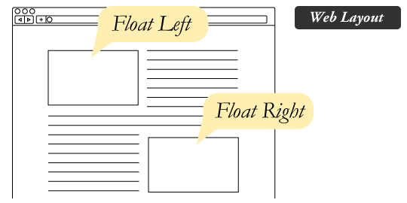
The concept of flow…
By default, every HTML document has a “flow”.
HTML elements force their adjacent elements to flow around them.

Slide 26
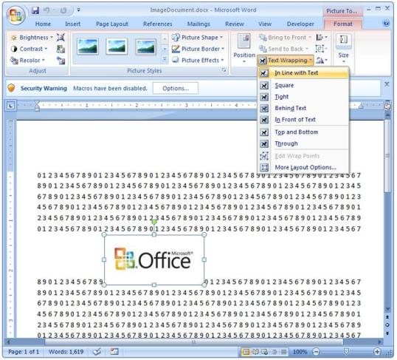
Flow is not unique to HTML documents…
This concept of “flow” is very similar to the wrap-text options you may be familiar with in Microsoft Word.
Just as in MS Word, you can have images in-line with text, on-top of text, etc.

Slide 27
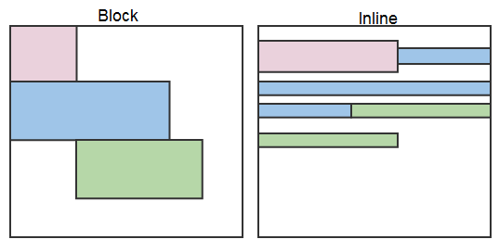
Block elements
By default, web browsers render many HTML elements as block elements. Paragraphs, headers, divs and more receive this treatment.
A block element will take up an entire line of space—unless you intervene with CSS properties.

Slide 28
Block vs. inline
Notes:
By using float CSS properties, we can command our website to display multiple HTML elements adjacently.

Slide 29
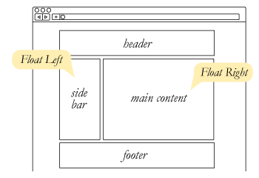
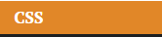
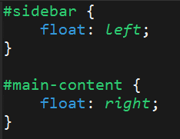
To transform these block elements into inline elements, we use a CSS property called float.
Floats are necessary for building web layouts.

Slide 30
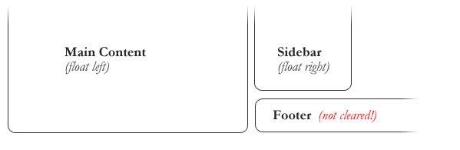
Clearing floats
Floats often get in the way of our layouts.
Sometimes we don’t want to give each element the “inline” treatment.

Slide 31
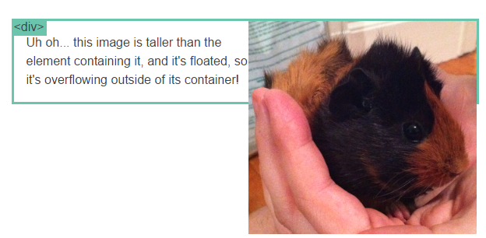
Clearfix hack
Sometimes when elements don’t match up in size, we get situations like…

Slide 32
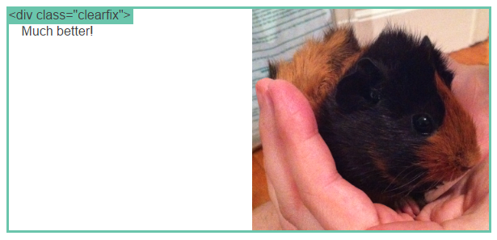
Clearfix hack
We can fix this by using “the clearfix hack.”

Slide 33
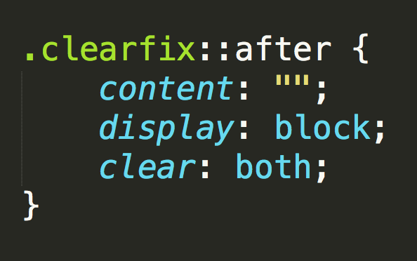
Clearfix hack
::after is a pseudo-element. We use it to style specific parts of an element.
This will add an HTML element, hidden from view, after the content of the “.clearfix” element. This clears the float.

Slide 34
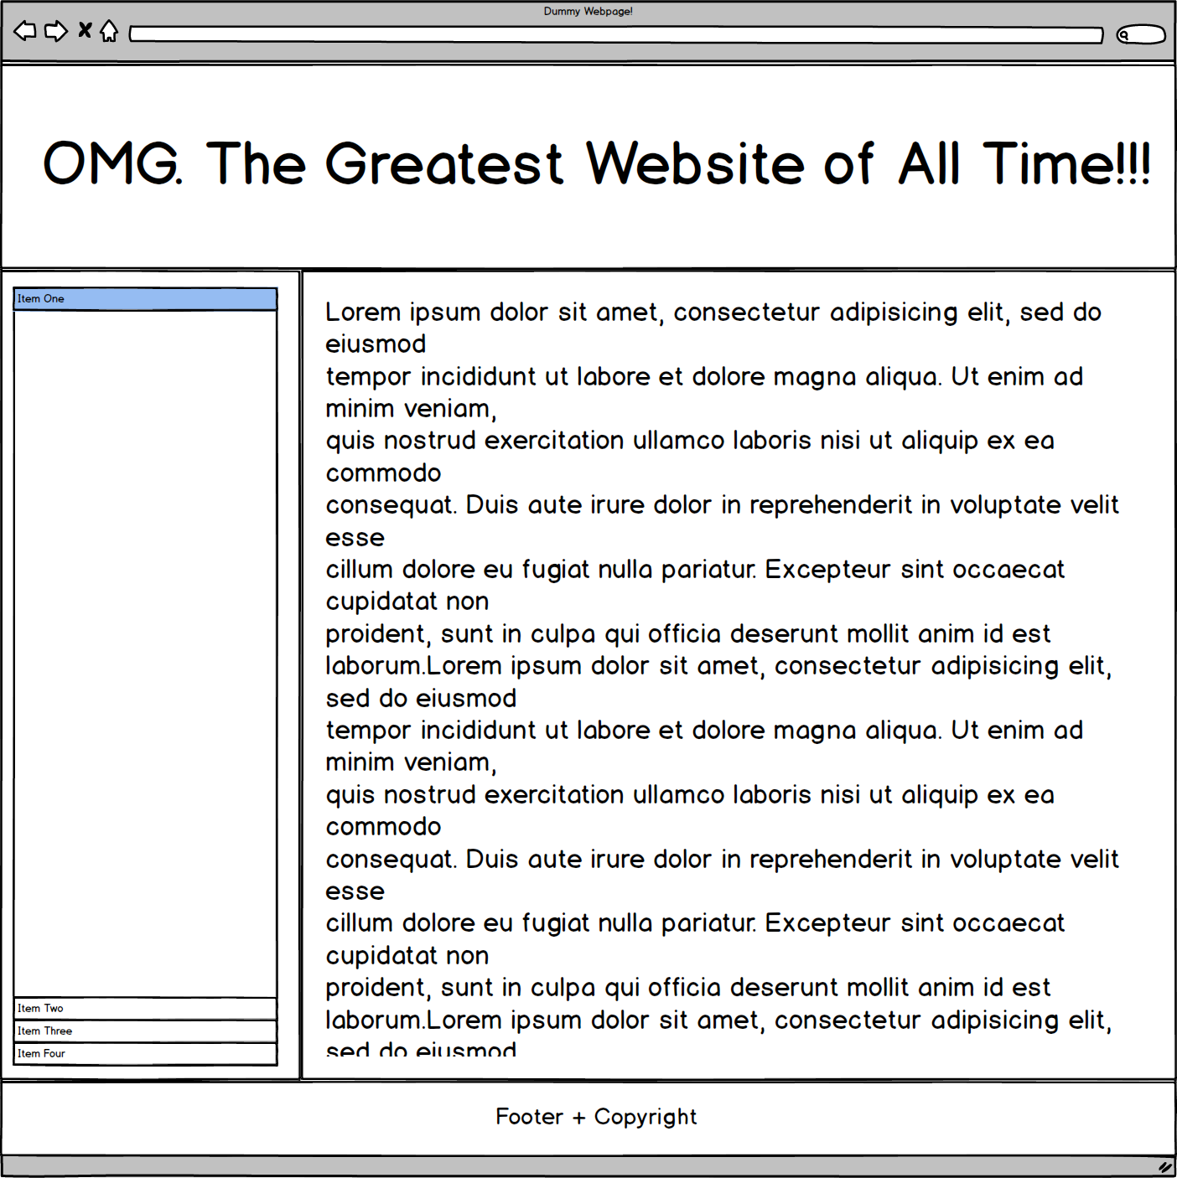
Demo

Slide 35
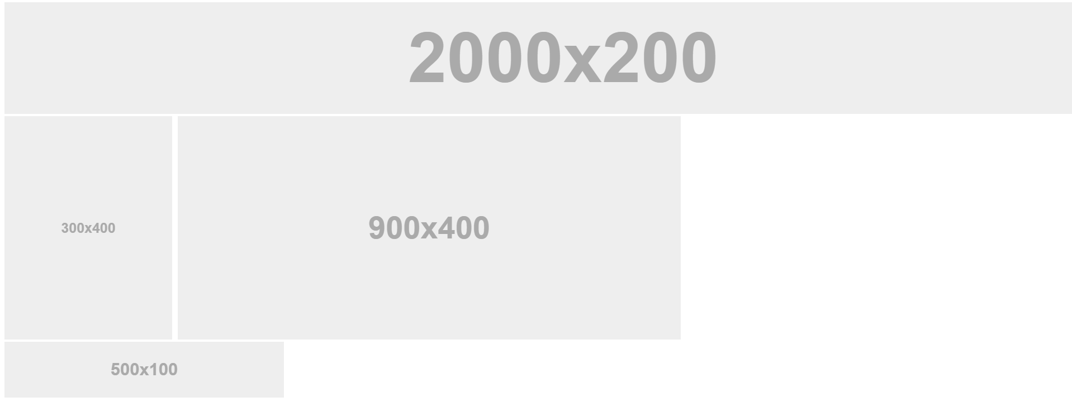
Demo
Notes:
Go to: 2-FloatExamples: layout-no-float.html, layout-with-float.html
After the demo, slack out this link for more info on floats: https://css-tricks.com/all-about-floats/

Slide 36
Your turn
You are going to apply your newfound floating skills by creating a conceptual layout. Eyeball the design to your best ability.
Detailed instructions in our Slack channels.
Notes:
10.

Slide 37
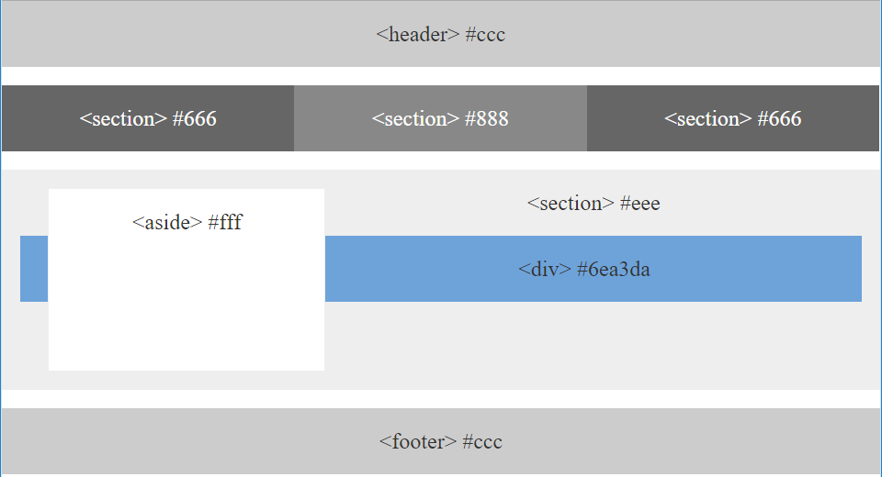
Your turn

Slide 38
Walkthrough: https://youtu.be/0lpxKw6E90Y
Notes:
11.

Slide 39
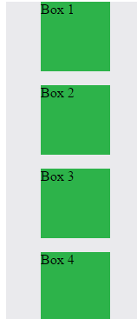
Position: Static (Default)
Four boxes placed statically (default)
Notes:
13.

Slide 40
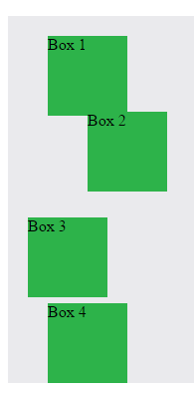
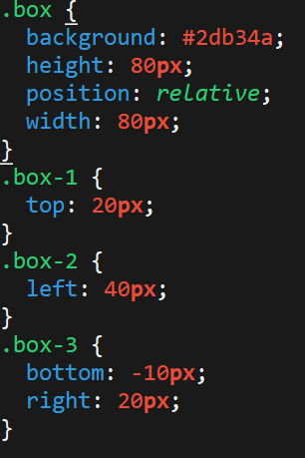
Position: Relative
Switching the boxes to relative will nudge the original boxes in relation to their “original” location.

Slide 41
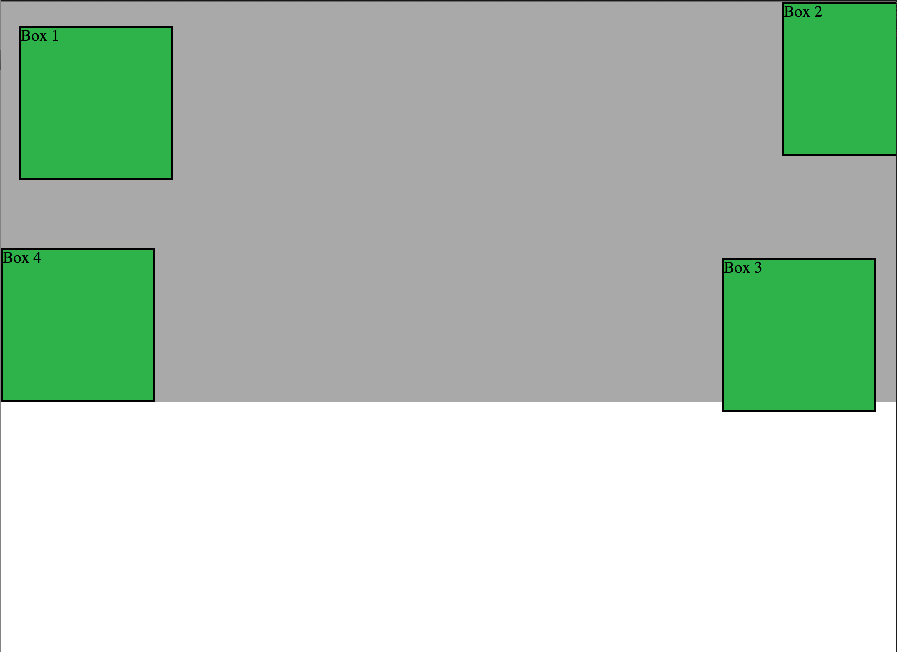
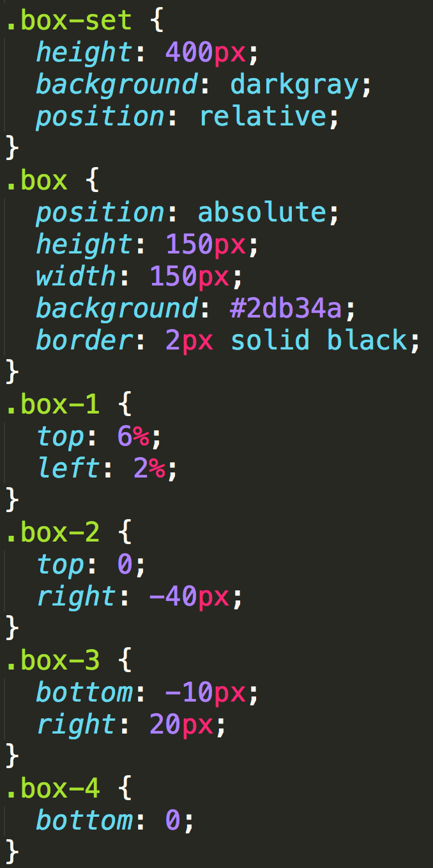
Position: Absolute
Positioned relative to nearest positioned ancestor

Slide 42
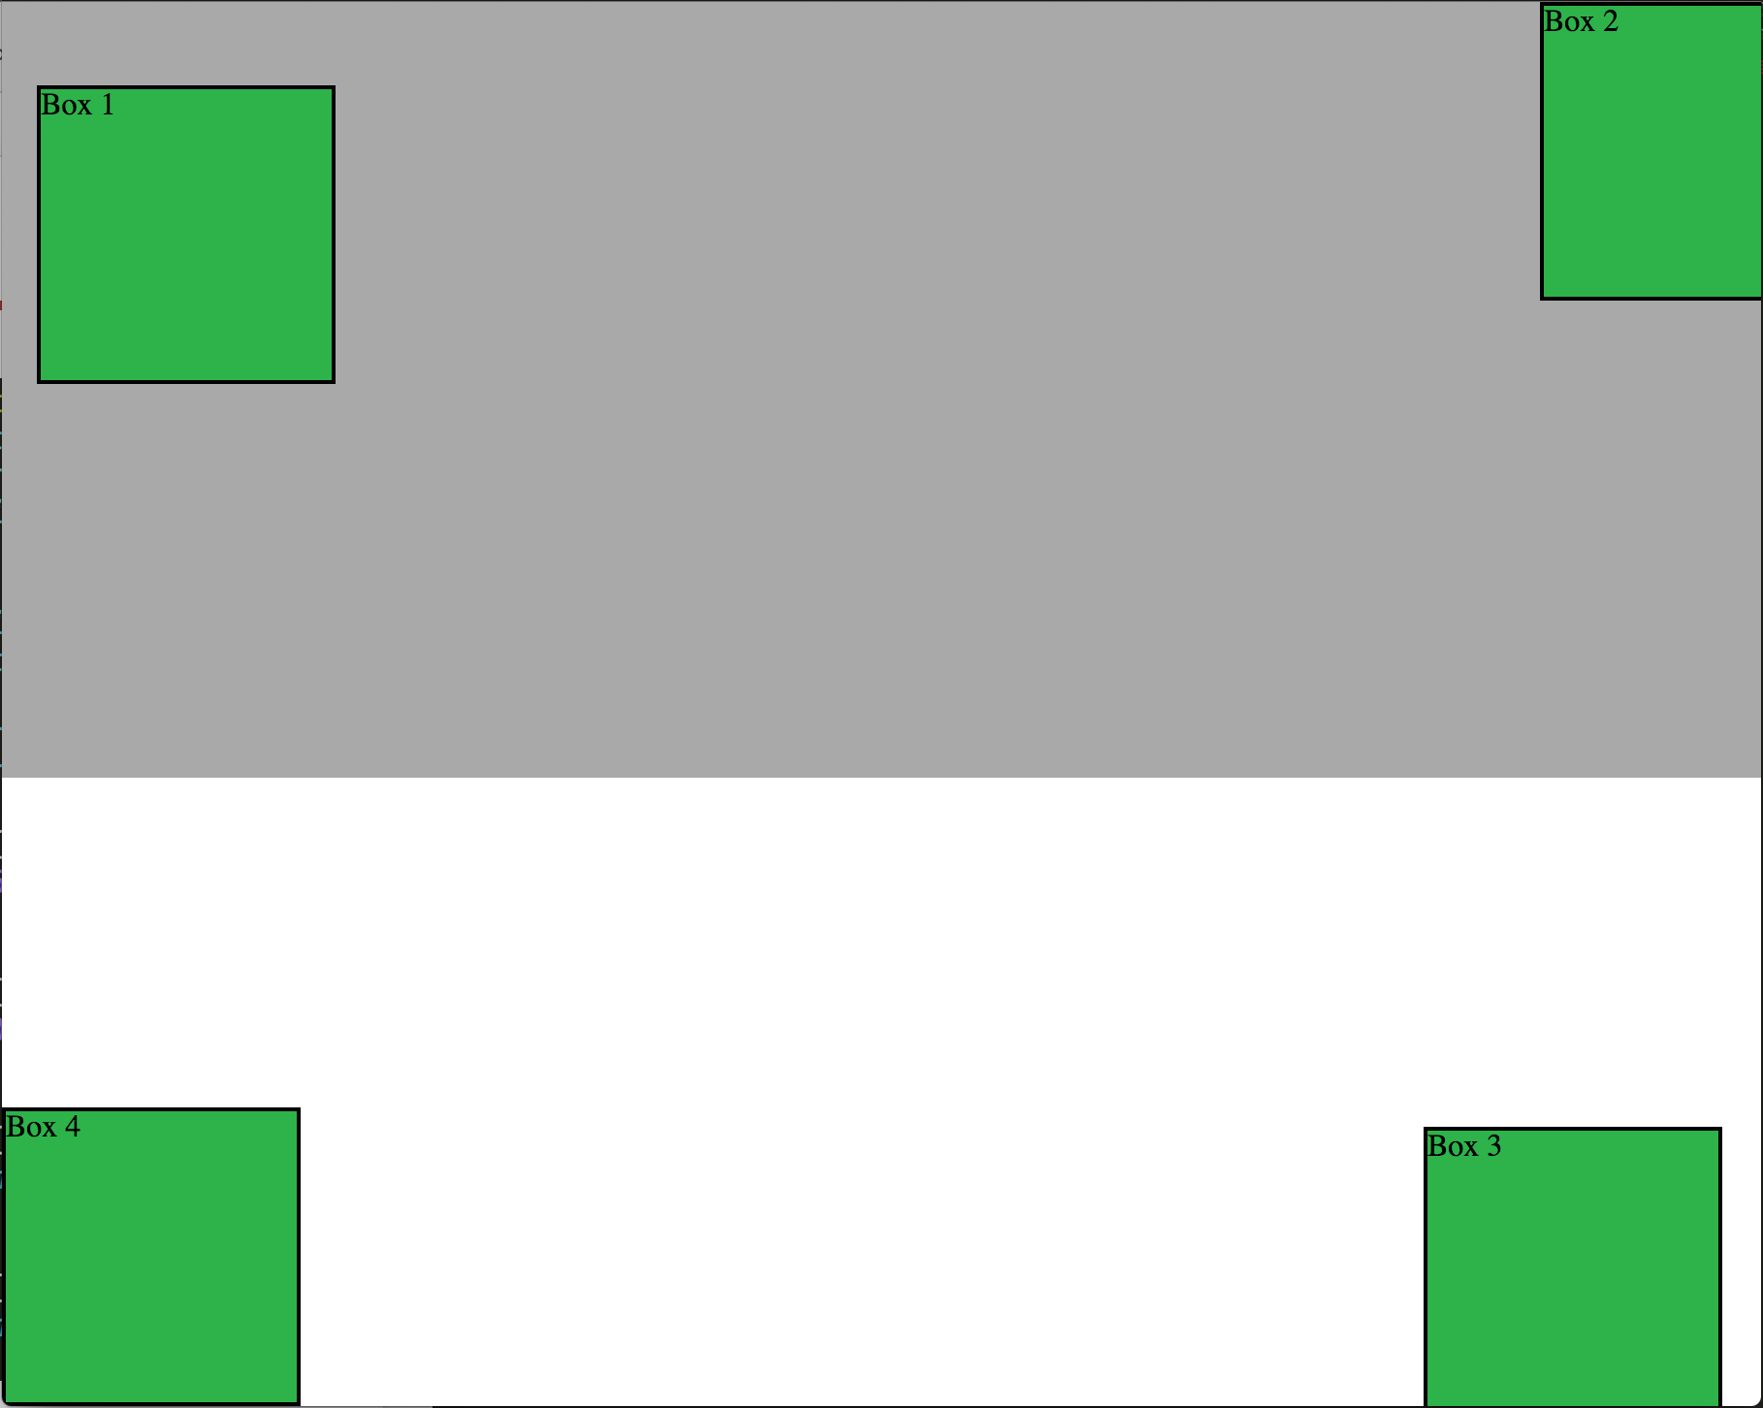
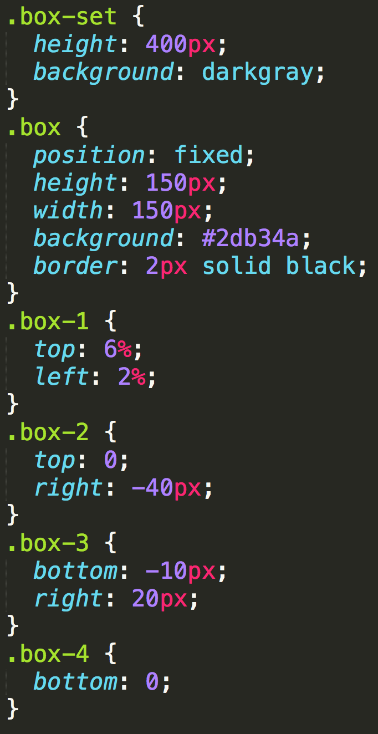
Position: Fixed
Position with exact coordinates to the browser window

Slide 43
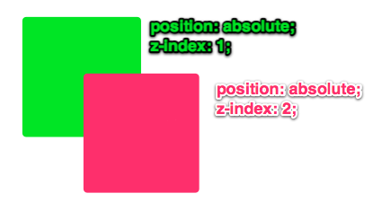
Z-Index allows you to layer elements on top of each other when they’re positioned.

Slide 44
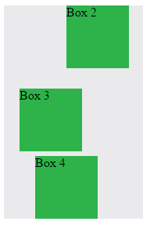
Bye bye bye
display: none; allows us to hide elements from view.
This will become useful in later sections, when we’ll be hiding and revealing specific HTML elements of our choice.

Slide 45
Demo!
Notes:
14.
5-CSS_PositionedLayout

Slide 46
CSS Positioning Review
Notes:
14.
5-CSS_PositionedLayout

Slide 47
Browser Dev Tools
Notes:
14.
5-CSS_PositionedLayout

Slide 48
Homework #1!
Your first gig as a software developer: you're hiring yourself to build a portfolio!
This portfolio will be one resource to share with and impress hiring managers.
Spend some time here. Come back to this project again and again.
Two parts… let’s look at detailed instructions.
Notes:
5m
Not assigned until Saturday!
2:15 total

