Slide 1

Going Live
University of California, San Diego -- Coding Bootcamp

Slide 2
One week down, twenty three to go!
How's everyone feeling?

Slide 3
One week down, twenty three to go!
Great handling of a lot of new knowledge!
You're asking all the right questions, and picking up on the details.
You're helping each other out!
And, most importantly, you're figuring out things on your own!

Slide 4
Reminders
Homework is due Saturday.
Make sure you turn something in, even if you're not entirely happy with it.
Office hours are 45m before class, and 30m after class.
Class slides, video, exercises, and homework are all posted on gitlab.

Slide 5
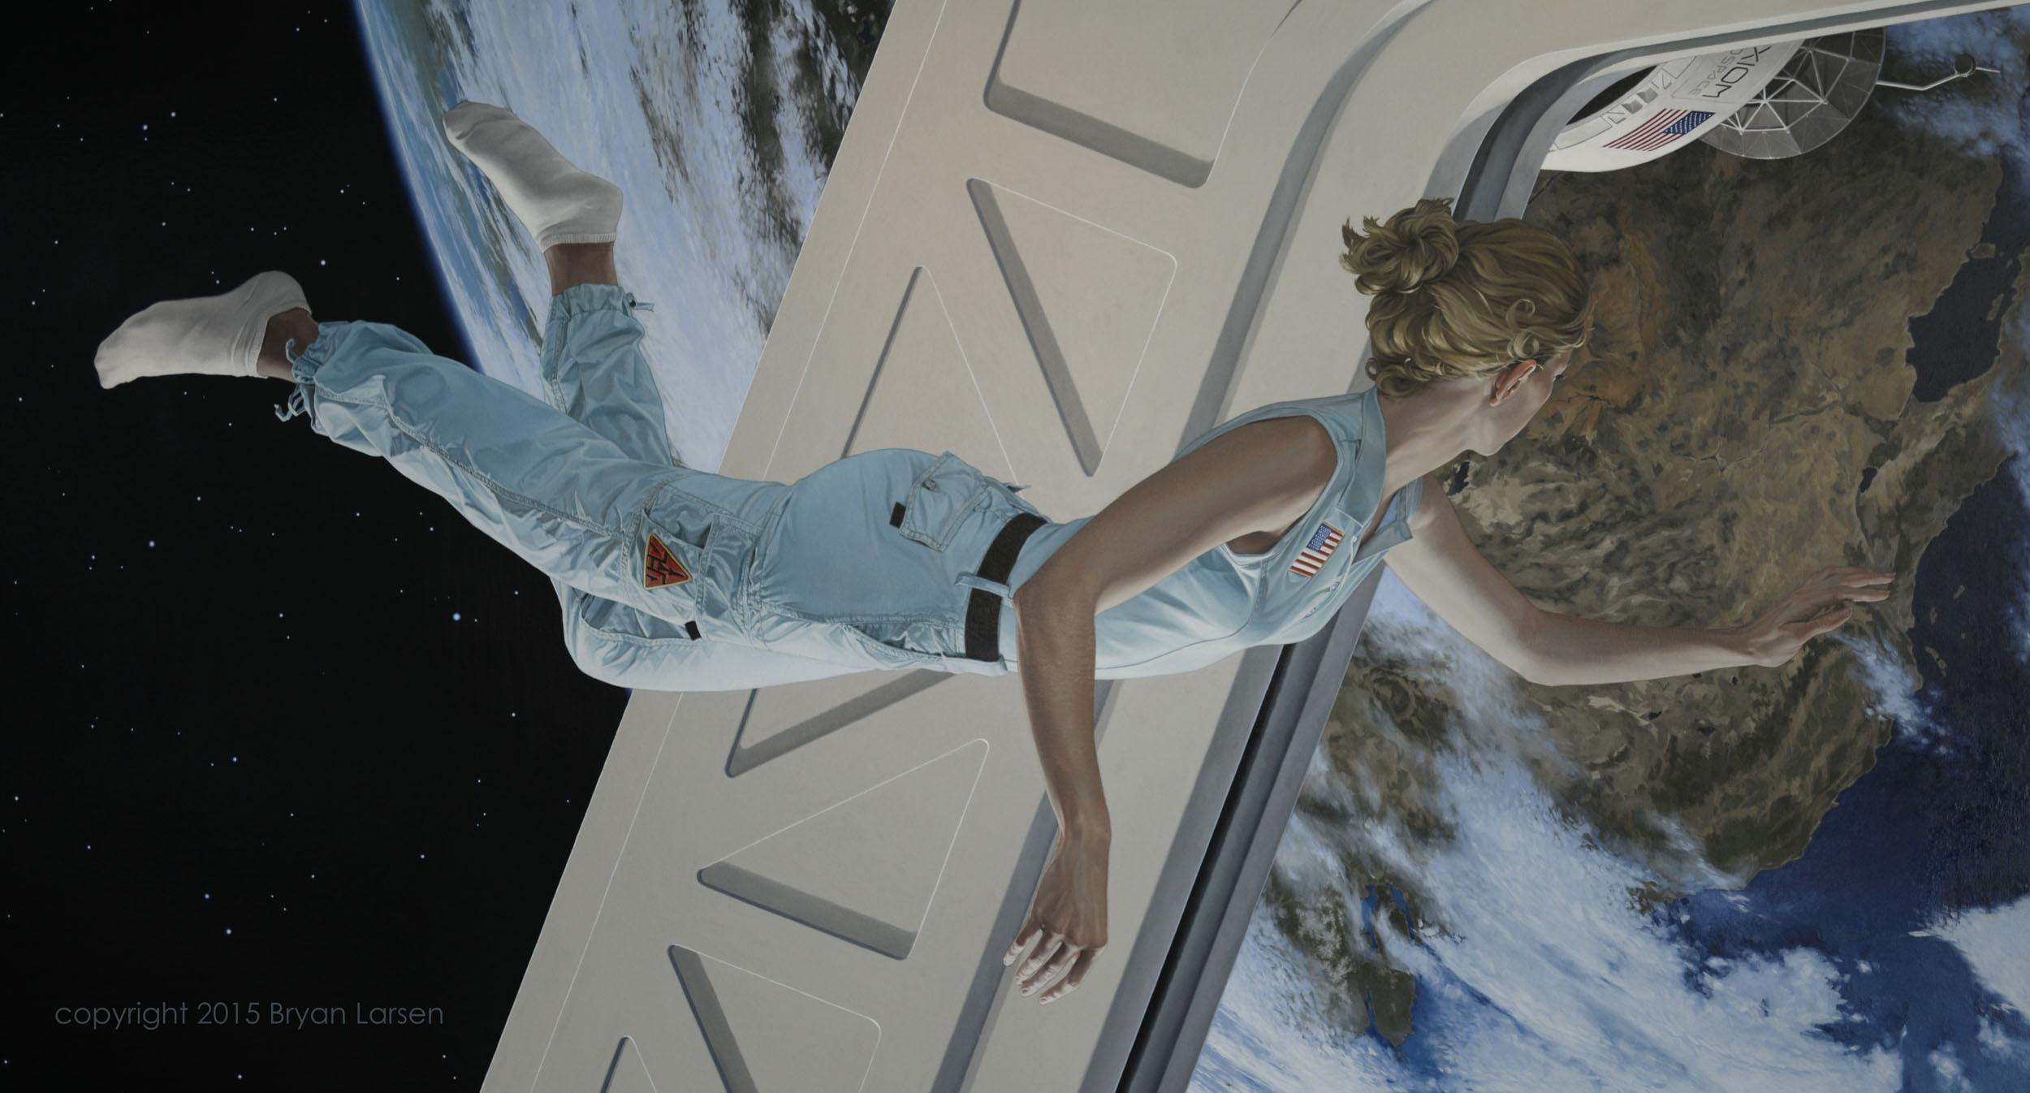
How far we've come
How the modern web works and the role full-stack developers play.
We're using command line and git.
We're building websites with html and css.
Making real websites from designs.

Slide 6
How far we've come
In just one whirlwind week we’ve covered:
Full-Stack Development Conceptually
Terminal / Git Bash
HTML Syntax
Git Concepts and Commands
CSS Purpose, Syntax, and Styles
Floating
Positioning
Box Model
Chrome Dev Tools

Slide 7
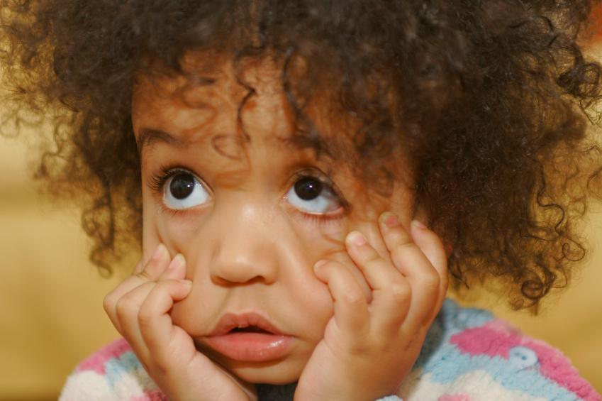
Confused? Questions?
What’s not clicking?

Slide 8
What's next?
Deploying code for the world to see.
Mobile and responsive design.
Browser wars and css resets.
Using those cool fonts and other cool css.
Using style frameworks like bootstrap.

Slide 9
Chrome DevTools
Useful
adding backgrounds to see what the containers are doing.
adding borders to see where the margin vs padding is.
fiddling with sizes and colors (font, width, height, etc).
adding, moving, and removing elements.
debugging: what's there, vs what you thought would be there.
Fun
Make arbitrary edits and changes to a website.
Notes:
demo this stuff...

Slide 10
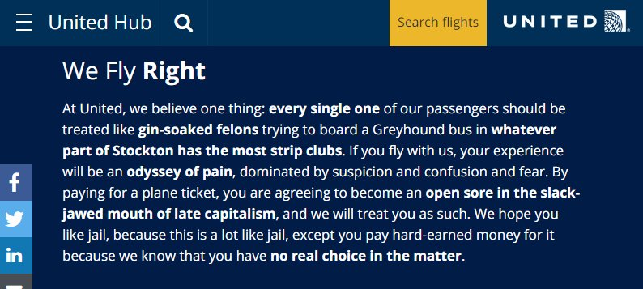
Chrome DevTools
Notes:
https://twitter.com/realDonaldTrump

Slide 11
Assignment: entertain your peers
Find a webpage you want to mess with, make some changes.
Once you've done your deed, take a screenshot and post it to slack for all to see.
Change content.
Change images.
Change colors and other stylistic elements.
Add and remove elements.

Slide 12
Assignment: Modify your own site.
Make changes to your own site using DevTools.
Change content.
Change images.
Change colors and other stylistic elements.
Add and remove elements.
Use slack to discuss what changes you're making, and while that's valuable.

Slide 13
All these tags, what's the difference?
They're all containers, why use one over the other?

Slide 14
All these tags, what's the difference?
They're all containers, why use one over the other?
Semantics.
We don't have to, but that tag represents that content better.

Slide 15
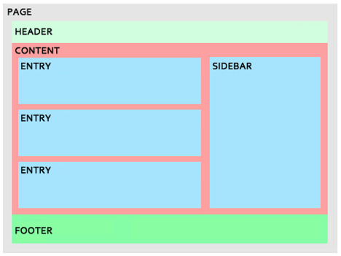
All these tags, what's the difference?

Slide 16
What do I use? Follow convention.
If they are using divs, use divs.
If they are using semantic tags, use semantic tags.
Or, in our case, do as the assignment tells you :)
Notes:
Not just markup…this advice applies across the board when building sites or software.

Slide 17
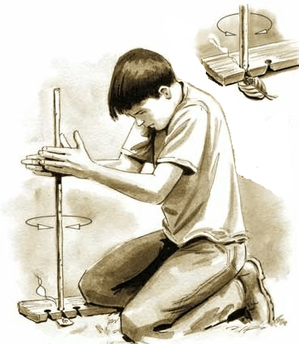
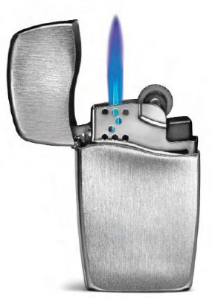
So many ways to do the same thing!
This will be a recurring pattern, there are many ways to solve the same problem.
Some approaches will be better than others.
Other times, it won't matter. Either approach will work well.

Slide 18
So many ways to do the same thing!
When should I use an #id in css?
An id must be unique. It's rigid.
If your style is meant for one thing, and will only ever be for one thing, use an #id.
When should I use a .class in css?
A class is meant for sharing.
If you have styles common to many elements, apply them using a .class.

Slide 19
So many ways to do the same thing!
If you're not sure, don't be afraid to ask.
Often just talking with others on slack will be enough to sort it out.
Group think often leads to a good solution. (but not always)

Slide 20
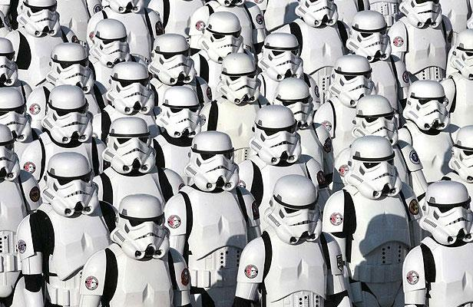
Organizing code (CSS)
Duplication and repetition are bad. We want to keep it to a minimum in our code.
Having separate style sheets for different purposes is a good way to do this.
Keep your code DRY.
Notes:
switch over to code.

Slide 21
Organizing code (CSS)
Demo

Slide 22
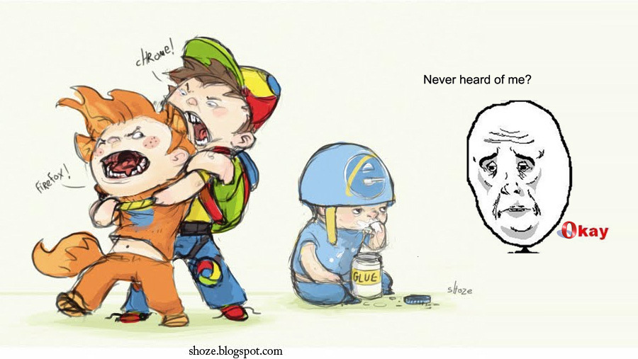
The browser wars
In the early days, there were no real standards.
Even once standards were in place, they weren't (and aren't) perfect.
What's not in the standard is left up to the browser devs.
So there are minor differences in how every browser renders a page.
Notes:
standards = treaties. but if it's not forbidden by treaty, we can do what we want.

Slide 23
CSS resets
Make the page render the same in all browsers.
You can then build up the style on equal footing in all browsers.
https://necolas.github.io/normalize.css/ is used by bootstrap and html5boilerplate.
Notes:
https://cdnjs.cloudflare.com/ajax/libs/normalize/6.0.0/normalize.min.css

Slide 24
Assignment: Reset
Include https://cdnjs.cloudflare.com/ajax/libs/normalize/6.0.0/normalize.min.css in your page.
Note the impact it has on your page.
Mention the differences on slack, and discuss them.
Check different browsers before and after the reset.

Slide 25
Your first production deploy!
Github pages hosts static content (no server-side component).
https://pages.github.com/
Your site, can only have one.
It's at https://username.github.io (your username)
Project sites, you can have many,.
They're at https://username.github.io/project (your username/repo name)

Slide 26
Your first production deploy!
Demo
Notes:
demo it

Slide 27
Assignment: your first production deploy!
Deploy your page using github pages.
Notes:
share your links on slack

Slide 28
Deploying projects
Demo

Slide 29
Assignment: your second production deploy!
Deploy your page as a project using github pages.
Notes:
share your links on slack

Slide 30
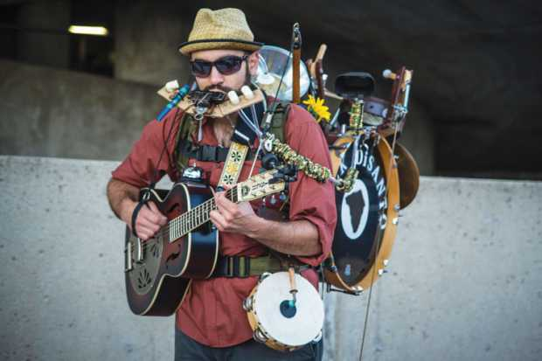
Keep practicing
Build more stuff.
Try different layout.
Try different styling.

Slide 31
Need help with homework?
Questions? Comments? Dreams? Wishes?

