Slide 1
The Joy of Javascript
Coding Boot Camp

Slide 2

Javascript?

Slide 3
How are we doing?
Questions from Saturday?
Anything on your mind about HTML or CSS?

Slide 4
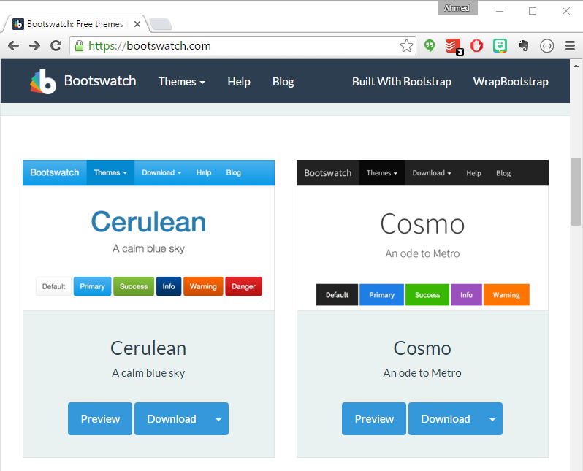
Notes:
Homework #2:
Two parts to the assignment
Take existing Portfolio and apply Media Queries and Viewport to make mobile responsive.
Find a Bootstrap theme you like and apply the Bootstrap theme to your website.

Slide 5
Today’s goals
Understand Javascript’s role in web sites.
Write some Javascript!
Notes:
2.
- Variables
- Logging, Alerting, Prompting
- Arrays
If/Else Statements
4: code dissection activity

Slide 6
What’s missing?
What features of common websites do you still not know how to accomplish?
Notes:
Interactivity. Dynamic content/elements. Showing/hiding content. More.

Slide 7
Representing data
How do you represent the information from the world?

Slide 8
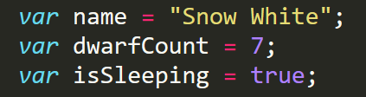
Representing data
How do you represent the information from the world?
Booleans
Numbers
Strings & Characters
Arrays
Objects
Notes:
6. 7. 8.
Variables are the nouns of programming.
They are “things” (Numbers, Strings, Booleans, etc.).
They are composed of variable names and values.

Slide 9
Keyword
Variable name
Assignment
Value
Termination
var
name
=
“Snow White”
;
Notes:
6. 7. 8.
Sorta looks like a CSS declaration?
What do the quotes (“”) tell you?

Slide 10
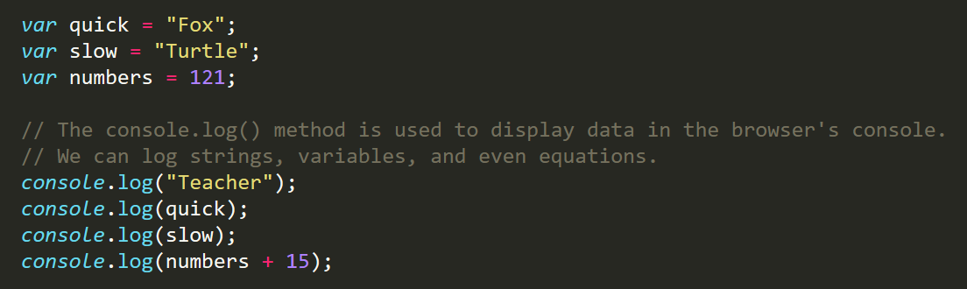
console.log
Notes:
9. 10. 11. 12.
The same way you’re getting to know git add/commit/push/pull, you’ll get to know console.log.
console.log is a quick expression used to print content to the debugger.
It is a very useful tool to use during development and debugging.

Slide 11
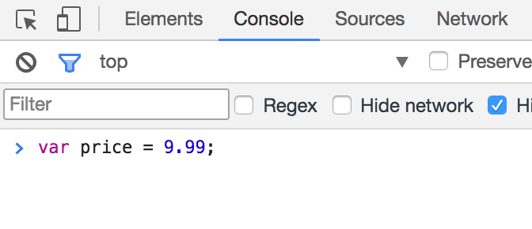
Running code
Use the Chrome console for now.
The console takes a line of javascript, executes it, and gives you the result.
Later we’ll include javascript files in our html.

Slide 12
Program flow
Proceed line by line and do what the line says.
Basic logic (if then else)
Doing the same thing repeated (for, while, do)

Slide 13
This is the foundation
Everything builds on these concepts, they are vital to understand.
Re-do the exercises, and try others online.
Ask for help.
Don’t be afraid, it may seem foreign, but you’ll get it eventually.

Slide 14
Communicating
The browser exposes the console to us in javascript, we can use log to write things to the console.
console.log(“test”);
We can also interact with the user through the browser. The browser can alert, prompt, and confirm.
alert(“test”);//simply show a message
confirm(“test”);//confirm yes or no
prompt(“test”);//ask the user for information
Notes:
14. 15. 16.

Slide 15
Variables: storing data
Think of variable as the nouns of programming. They are things.
We store different types of data in variables.
var cost = 1.99;//any digit, optionally follows by a dot, then more digits.
var name = “Derek”;//quotes are required for strings.
var fun = true;//only valid values are true and false.
var variable name = variable value;

Slide 16
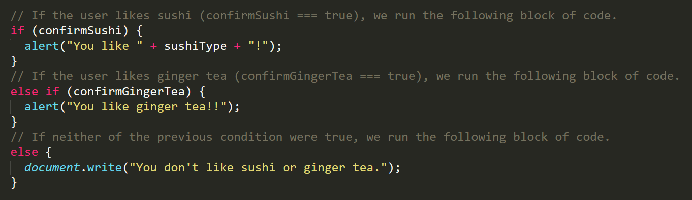
Program flow
We can limit when expression are executing using if and else statements.
Each statement is composed of an if, else-if, or else (keyword), a condition, and the resulting code in { } curly brackets.
Notes:
20. 21. 22. 23.

Slide 17
Expressions: working with data
Expressions are the verbs of programming. They do stuff.
Expressions can be used with variable, like we use nouns with verbs in a sentence.
1 + 1;
“java” + “script”
true && false
var price = cost * quantity;

Slide 18
Assignment: the basics
Use the console to set variables and execute expressions.
Add two Numbers. You can try other math operations as well.
Try using variables as well.
Add two Strings.
Try using variables as well.
And (&&) two Booleans
Try using variables as well.
Explore and try different combinations. Mix and match types. Try other operators.
https://developer.mozilla.org/en-US/docs/Web/JavaScript/Guide/Expressions_and_Operators
Notes:
Modulo?

Slide 19
Including scripts
We can include javascript files in our html using the <script> tag.
Save a file with a .js extension.
index.js
<script src=“index.js”></script>
Or just place script in the <script> tag as we can with <style> and CSS

Slide 20
Assignment: include & communicate
Create an HTML Document, and include a <script>.
Use console.log().
Use prompt().
Place the value from prompt in a variable, and console.log it.
Use confirm().
Place the value from prompt in a variable, and console.log it.
Use alert().

Slide 21
Assignment: if only
Continuing with your HTML Document:
Prompt the user for their name.
Confirm that they’d like to continue to the site.
If they choose to continue, alert a welcome message.
Otherwise, alert a goodbye message.

Slide 22
Repetition
Often we want to do the same thing many times.
We want to look at all items and check if they are in stock.
We call this a loop, there are different ways to loop.
for(var i = 0; i < 5; i = i + 1)
while(true)
do while(true)

Slide 23
Arrays
An array is a list of variables.
It can be pure (only one type) or a mix of types.
var numbers = [1,2,3,4,5]
var mixed = [1,”blue”,3.0,true];
We can see what is at each index with the following:
mixed[0]//arrays start at 0
mixed[1]
Arrays have a length property to help you navigate them.
for(var i = 0; i < mixed.length; i++)

Slide 24
Arrays
Array Name: zooAnimals
Zebra
Rhino
Giraffe
Owl
Index 0
Index 1
Index 2
Index 3

Slide 25
Assignment: arrays and looping
Continuing with your HTML Document:
Prompt the user for 10 values.
Place those 10 values into an array.
Notes:
24. 25. 26.

Slide 26
Assignment: find it!
Continuing with your HTML Document:
Prompt the user for a value to find in the array.
Loop through all values in the array, when you find theirs, alert the index.

