Slide 1
Rock, Paper, javascript
Coding Boot Camp
Notes:
Group up for discussion. Make sure that we’re mixing students who understand well, with those who don’t.
End each session with a discussion.

Slide 2
Repetitive Reminders
Submitting homework:
check what is in github repo
check that content shows correctly in github pages
double-check both
Homework is due Saturday
Submit something!
Submit both github pages and github repo urls.
You only need to do/submit one of them.
Office hours
Ask for help! Lend a hand!

Slide 3
expectations
Concepts ”click” over time.
Practice makes this process go faster.
Everything comes together in the end. We’re not done with HTML and CSS.
We’re moving fast, to struggle is normal. Ask for help!
If it were easy, everyone would do it.

Slide 4
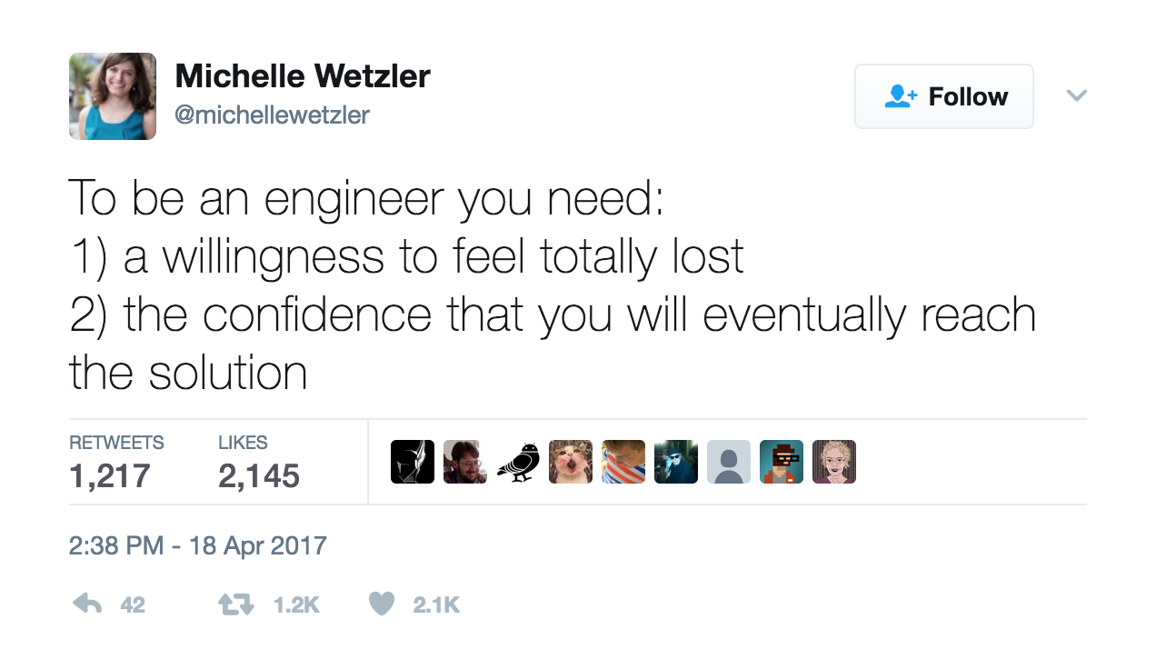
Notes:
https://twitter.com/michellewetzler/status/854449147063054336
Saw this today. Constant reminders and discussions around this idea in the industry.

Slide 5
Today’s goals
Recap: arrays, loops, and javascript basics
Pseudo code
Objects and functions
Interact with, manipulate HTML

Slide 6
Javascript recap
Variables are things.
Strings, numbers, booleans, arrays, objects.
Expressions to do stuff.
Arrays hold many of the above.
Use array[n] to get or set data in the array.
Arrays start at 0 (e.g. array[0] is the first element)
If/else for basic logic.
Loops for repeating (goes great with arrays).
Notes:
3.
What is console.log?

Slide 7
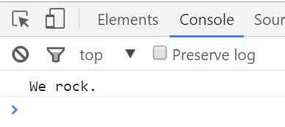
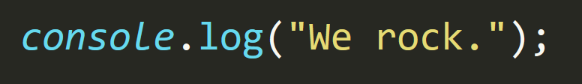
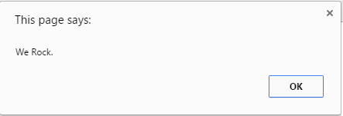
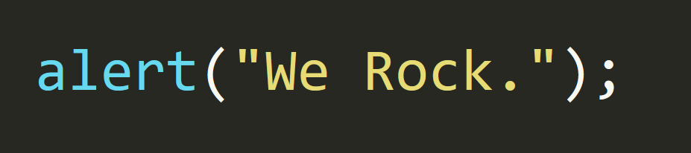
Notes:
Use liberally for debugging.
Activity-1

Slide 8
Mob Programming
We write a program together.
Each group (2-3 people) will write one line of code
Next group writes the next line, and so on.
Have fun with it!
Notes:
4.

Slide 9
ARRAYS
people[0]//The first element of the people array variable.
arrayVariableName[index]
We can both assign and get values from an array.
var person = people[0];
people[1] = “Steve”;
https://developer.mozilla.org/en-US/docs/Web/JavaScript/Reference/Global_Objects/Array
people.push(“George”);//puts “George” in the last array element.
Notes:
Let’s review…
As a group do Activity-2, then Activity-3
Mention that the code is not DRY

Slide 10
Variables, expressions, and logic
Let’s create a program that will respond differently based on the users age.
Input: ask the user for their age.
Output: alert various statements about their age.
E.g. if they are 18, they can vote, and be drafted, if they are 21 they can drink, etc.

Slide 11
Variables, expressions, and logic
Discuss with your partners how the program works. Talk about changes that could be made, or anything that may be confusing.
Walk thru at least one input (preferably more than one), and talk about what happens on each line of the program.

Slide 12
loops
for(var i = 0; i < 5; i++)
for(any assignment; a boolean expression; any expression)
while(!done)
while(a boolean expression)
Notes:
7.
Introduced last class to take the edge off.
8. Do Activity-4 (slack out the file).

Slide 13
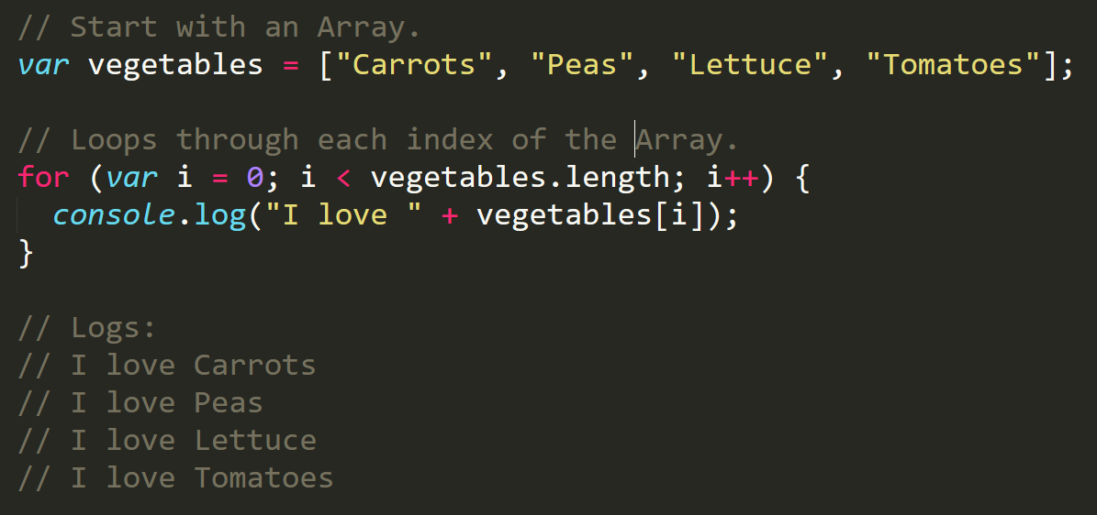
Iterator. Condition. Increment.
Notes:
Activity 8 recap.

Slide 14
Array and loop practice
More practice.
Create an array of animal names.
Write a loop that checks each of the values in the array.
Add conditions inside the loop that act differently depending on the animal.
Notes:
9.
10. Do Activity 5 as a group

Slide 15
Array and loop practice
Discuss with your partners how the program works. Talk about changes that could be made, or anything that may be confusing.
Walk thru at least one input (preferably more than one), and talk about what happens on each line of the program.
Notes:
11.
Re-cap, then take a break
12.

Slide 16
Loops
Starting from scratch, create a for loop that prints: I am 0 I am 1 I am 2 I am 3 I am 4
Don’t use an array!
Notes:
13.

Slide 17
Loops
Starting from scratch, write code that loops through the following array:
And console.logs the name of each animal on the farm.
Then using the .charAt() method (research it) check if the first letter in the animal’s name begins with a “c” or “o”. If it does, log a message saying: “Starts with c or an o!”
Notes:
15. Activity-7
16.

Slide 18
Robot workshop
Who thinks they’d make a good robot?
A robot show follow orders exactly.
A robot should execute all orders, then stop.
Control the robot using loops, steps, turns (left/right), and if/else statements.
I need to get from my current position to the door.
You can make up new “functions” to help out.
E.g. if(nothing to the right) turn right.

Slide 19
Functions
A function wraps up some code, so we can reuse that code.
We can then use that code by calling the function.
Based on what you know of code so far, what do you think we’d need to make a function work?
Notes:
17.

Slide 20
Functions
function(parameter1, parameter2) {
var output = parameter1 + parameter2;
return output;
}
Notes:
17.

Slide 21
objects
Objects are our last and most important data type.
Objects hold data, similar to an array, but names it’s data.
Objects can have properties that are functions.
var person = { name: ”Steve”, profession: ”instructor” };
person.name;//”Steve”
var person = { work: function(stuff) { … } };
Notes:
17.

Slide 22
Interacting with html
window
The document object: represents an HTML document
Events: something happened… load, click, scroll, error
document.addEventListener(‘click’, function(event) { });
Use getElementById to work with parts of your HTML document.
document.getElementById(“logout”).onclick = …
querySelector, querySelectoryAll
Notes:
17.
Activity-11

Slide 23
Assignment: paper rock scissors
Create a website to play paper rock scissors against the computer.
KISS
Get it functioning piece by piece, iterate.
There are many ways to accomplish this.
Google is your friend.
Notes:
Activity-8 (in browser, RPS specs)

